Slide 1
Transfer Pricing and the OECD
Melinda Brown
Transfer Pricing Advisor
Centre for Tax Policy and Administration, OECD

Slide 2
Transfer Pricing
Refers to the pricing and other conditions in place in transactions between ‘associated enterprises’ – normally companies
Applies to a very wide range of transactions – goods, services, intangibles, financial products
Generally applies to cross-border transactions, but in some cases may also be applied domestically

Slide 3
The effect of transfer pricing
Sales price =
Assessable revenue to Company A
Deductible expense to Company B
Therefore affects the profits (and hence taxes) of both
May be used to minimise taxes (e.g. recognising taxable profit in favourable tax jurisdictions )
Other motives may include: customs duties, price and exchange controls and dividend policy
Company A
Sale of goods/services
Company B

Slide 4
The OECD
Our Mission....
Better Policies for Better Lives
Our Vision....
A stronger, cleaner, fairer world
Our Means
Developing standards in key areas
Experience sharing and peer review
Measuring, analysing and comparing data

Slide 5
The Committee on Fiscal Affairs: What we do
Develop and assist implementation of
Model Convention for Tax Treaties
Global standards on Exchange of Information
Tax Policies for Growth
Statistics for tax policy making
Countering aggressive tax planning and tackle base erosion and profit shifting (BEPS)
Build effective tax administrations
Improve capacity of tax officials
International VAT/GST Guidelines
Guidelines for Transfer Pricing and the taxation of MNEs

Slide 6
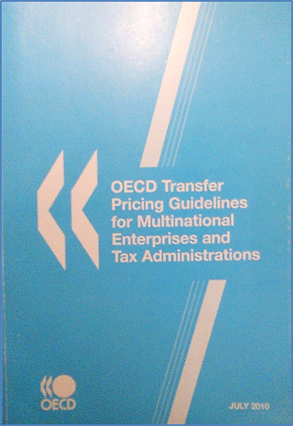
OECD Transfer Pricing Guidelines
Guidelines agreed by member countries; influential globally
‘Authoritative statement’ of the arm’s length principle = Associated Enterprises Article of OECD Model Tax Convention
Transfer pricing rules established by domestic law

Slide 7
Objectives of transfer pricing legislation
Generally based on the arm’s length principle
To enable countries to
Tax a an appropriate amount of profits on cross-border transactions
What would an independent enterprise have paid / received?
By reference to economic contributions
Minimise risk of double taxation, and hence encourage trade and investment

Slide 8
Arm’s length prices
Determine arm’s length pricing for transactions by reference to comparable, but independent, transactions
Transfer Pricing Methods
All aim to determine the arm’s length price of the transaction
OECD Guidelines require the ‘most appropriate’ method is used
Ideally, more direct methods are preferred. Most direct method compares prices (“CUP” method)
But, to be ‘comparable’, there must be no differences between the tested transaction and the independent transaction which would materially affect the price

Slide 9
Comparability
Finding truly comparable uncontrolled prices is rare
Lack of sufficiently comparable but independent transactions
Lack of available data
Other transfer pricing methods rely on a comparison of gross or net margins, or a split of profits
Reliable gross margin data from comparable but independent transactions is also uncommon
Transactional Net Margin Method (“TNMM”)
Commonly used in practice
Reliable net margin data from comparable, but independent transactions is more often available

Slide 10
TNMM
Aims to determine the arm’s length transfer price for the related party transaction (or an appropriate group of transactions by comparing net margins
All other elements are reliable (not influenced by the relationship)
Sales (for the importer); or Cost of goods sold (for the manufacturer)
Operating expenses (for both the manufacturer and the importer)
Profit and loss statement
Sales
less Cost of goods sold
Gross profit
less Operating expenses
Net profit

Slide 11
Applying TNMM
Transfer price = 70
Manufacturer (A)
Sales | 70
less Costs of production | -40
Gross profit | 30
less Operating expenses | -10
Net profit | 20
Importer(B)
Sales | 100
less Cost of goods sold | -70
Gross profit | 30
less Operating expenses | -29
Net profit | 1
Return on sales: 1%
TOTAL NET PROFIT (before tax) 20 + 1 = 21

Slide 12
Applying TNMM
If the arm’s length net margin from comparable, independent transactions = 4% return on sales for an importer,
Adjust the transfer price:
Manufacturer (A)
Sales
less Costs of production | -40
Gross profit | 30
less Operating expenses | -10
Net profit
Importer(B)
Sales | 100
less Cost of goods sold
Gross profit | 30
less Operating expenses | -29
Operating profit
-67
-67
17
4
Return on sales: 4%
Transfer price = 67
TOTAL NET PROFIT (before tax) 17 + 4 = 21

Slide 13
Thank you

