Slide 1
WHAT AUTHORS WANT Understanding Author Priorities in the Self-Publishing Era
Phil Sexton • Publisher, Writer’s Digest

Slide 2
Author Definitions
Aspiring: not yet published
Self-Published: self-published only
Traditional: traditionally published only
Hybrid: both self- and traditionally published
Profile: Typical author in the sample is a commercial fiction writer who might also write nonfiction and who had a project in the works that might soon be ready to publish.

Slide 3
Authors in the Survey
9,210 respondents (up from 5,000 in 2013)
88.4% fiction vs. 39.5% nonfiction
− 28.9% Fantasy − 21.8% General
− 26.1% Young Adult − 22.2% Romance
− 9.9% Bio/Autobio/Memoir − 8.0% Self-Help
30.2% writing New Adult
Hybrids 20−24 hours/week writing; all others 10−14
Hybrids 7−9 hours/week writing-related; Aspiring 34, SP+T 5−6
Median # published manuscripts: SP 1, T 2, H 2+2

Slide 4
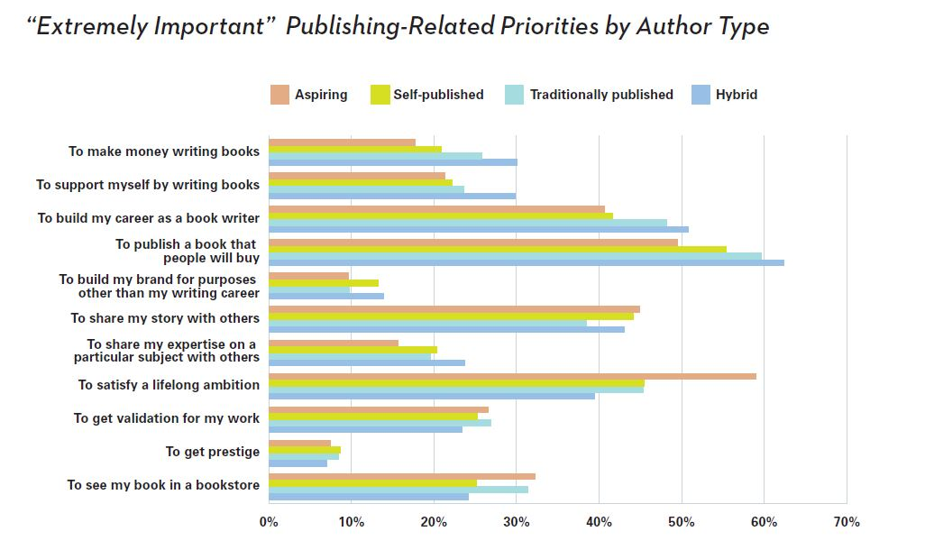
Why They Write

Slide 5
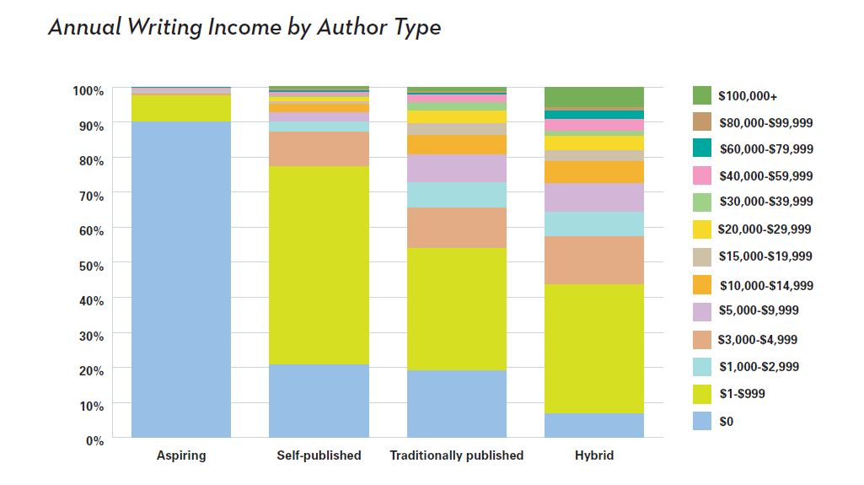
Annual Writing Income

Slide 6
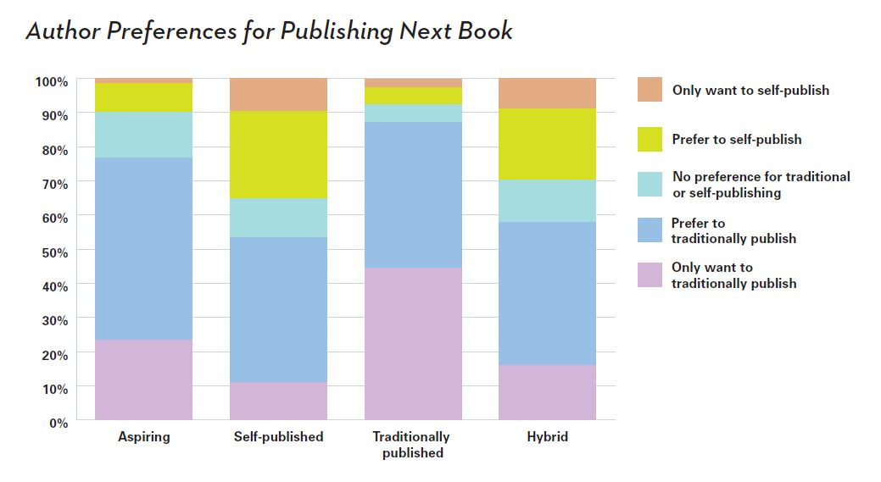
Publishing Preferences

Slide 7
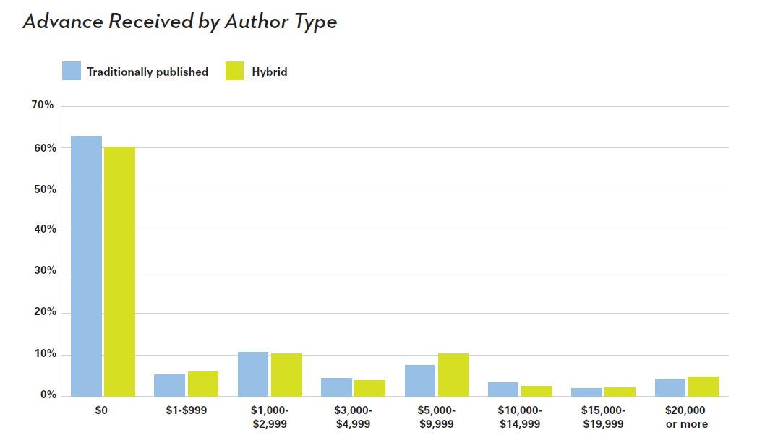
Advances

Slide 8
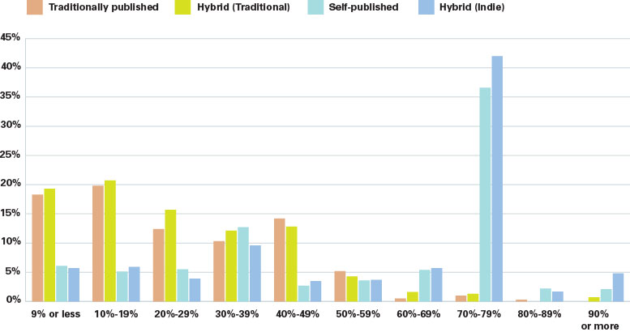
Royalties

Slide 9
Distribution and Marketing

Slide 10
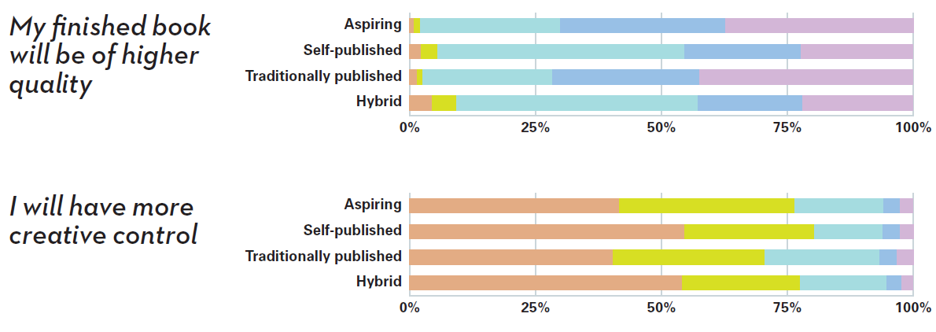
Production

Slide 11
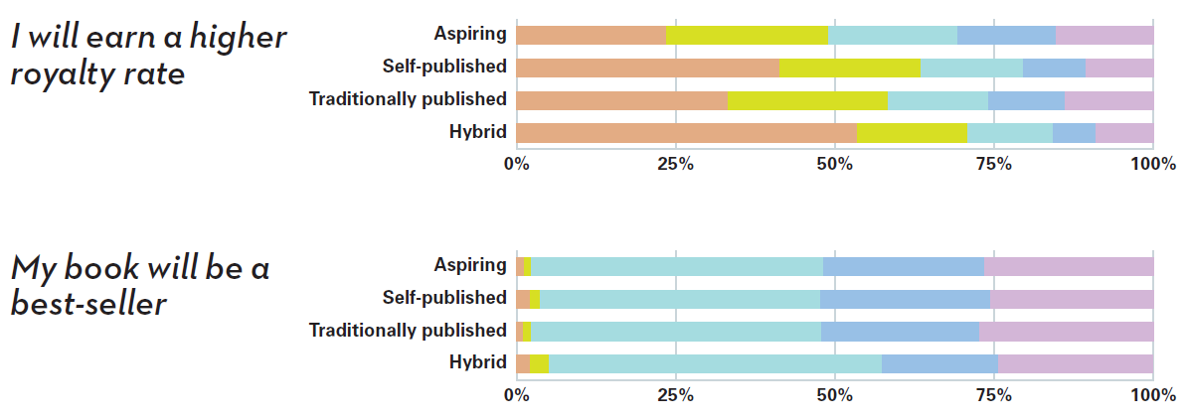
Sales and Earnings

Slide 12
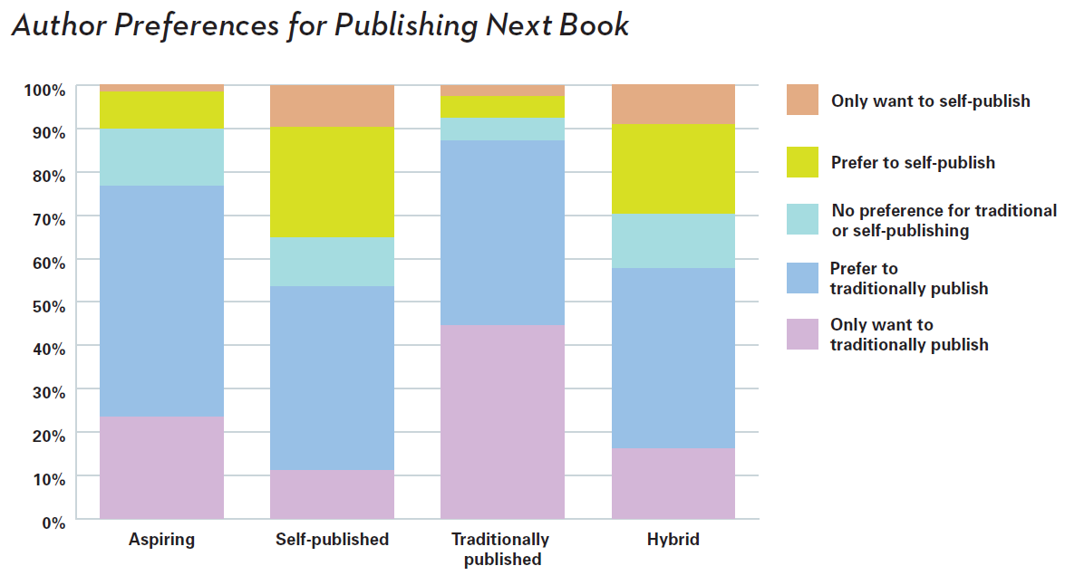
How Authors Want to Publish Their Next Book

Slide 13
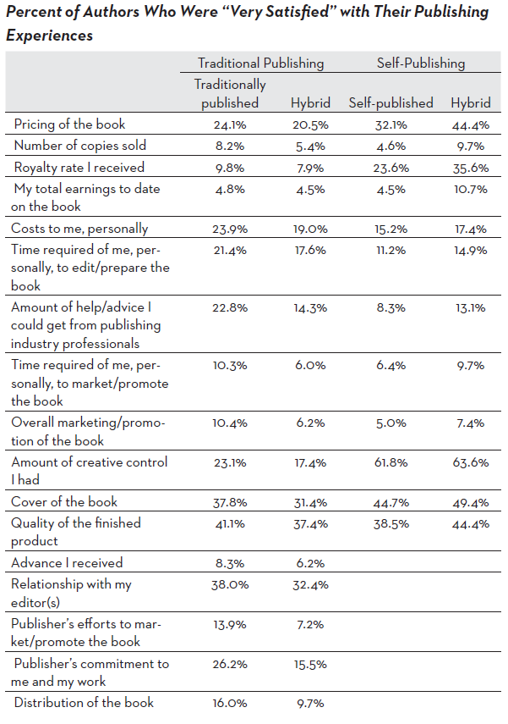
Author Satisfaction Results
• Cover: 31.4% HT−49.4% HSP
• Quality: 37.4% HT−44.4% HSP
• Pricing: 20.5% HT−44.4% HSP
• # Sold: 4.6% SP, 8.2% T, 9.7% HSP
• $ Sold: 4.5% SP, 4.8% T, 10.7% HSP
• Control: 17.4% HT−63.6% HSP

Slide 14
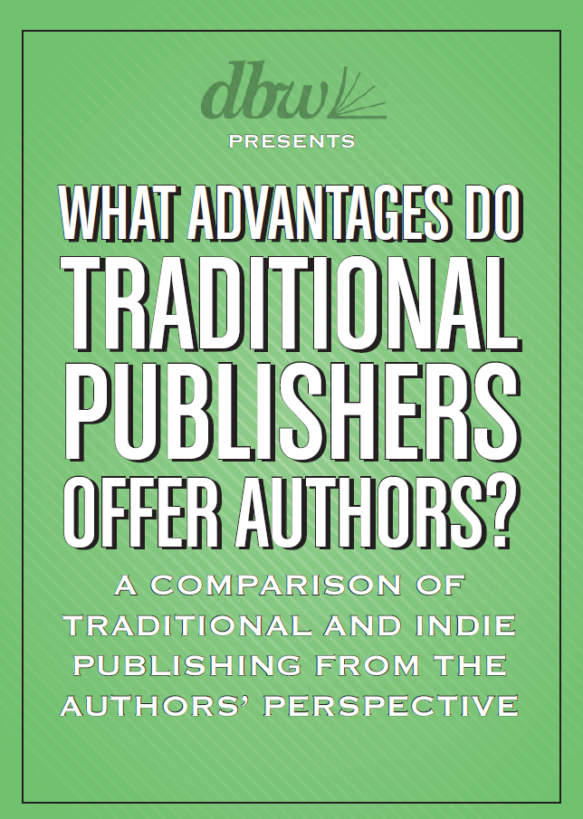
Conclusions
Full results and analysis available in the Digital Book World Store:
Store.DigitalBookWorld.com

