Slide 1
Network Connectivity Mapping
Comparison 2013 v. 2017

Slide 2
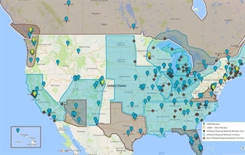
USDN’s REGIONAL NETWORKS

Slide 3
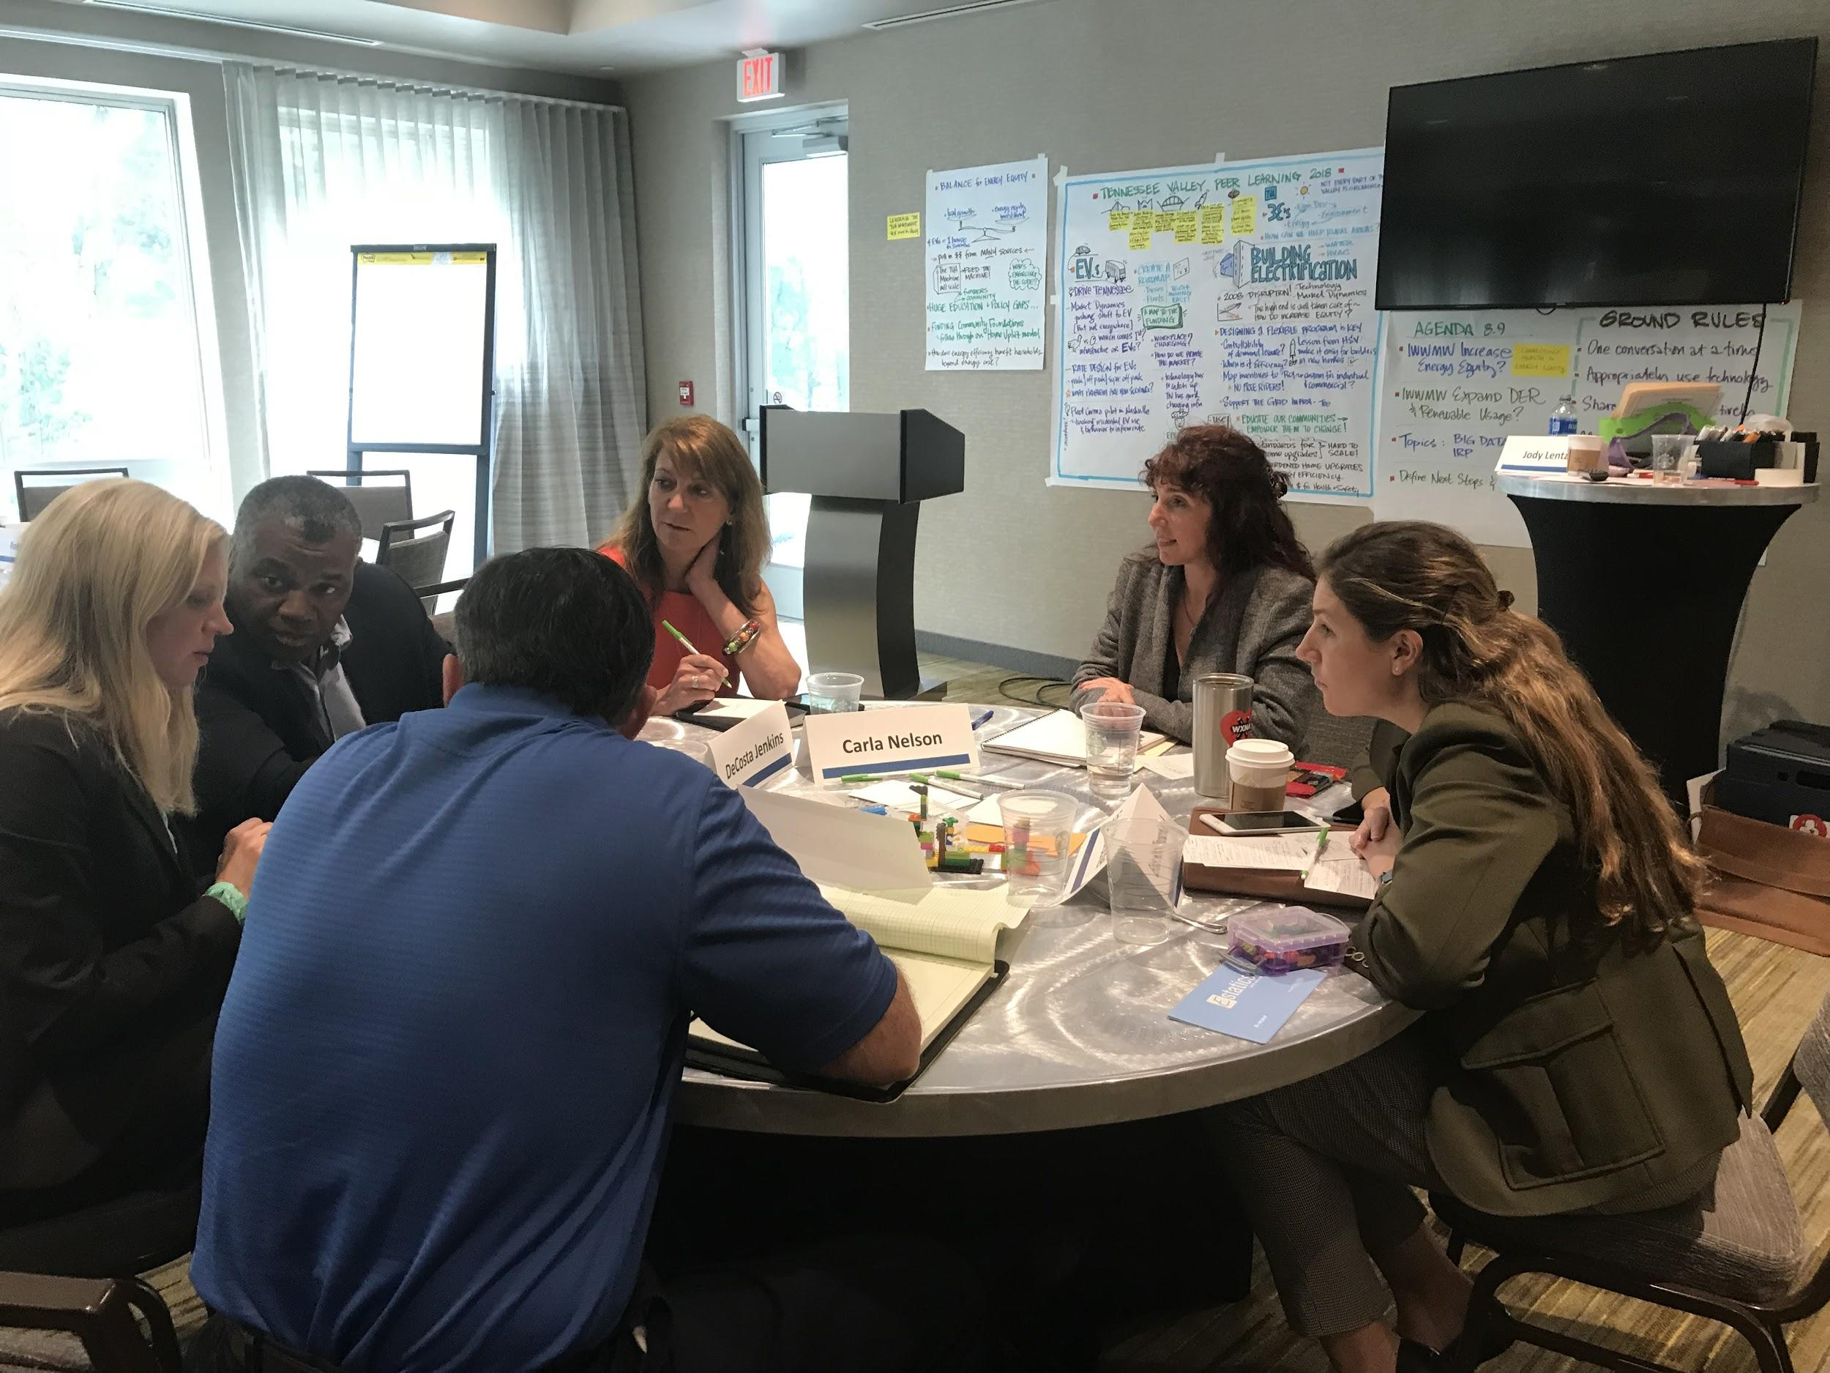
How to “Read” the Maps
Mapping software places the most connected “nodes” at the center of the map and the least connected at the periphery.
Arrows in the links between nodes show who acknowledged a connection to someone else.
Some people listed in the survey did not respond, so they appear in the maps, but only with arrows pointing at them, not going out from them)
Different colors in nodes are used to differentiate the nodes (see legend on map)
The first 2 map slides present the connections between members.

Slide 4
Metrics Definitions
Density – The total number of connections that exist out of the total possible (if everyone was connected to everyone else)
Path lengths – the average number of “hops” between any two people in the network
Ties Per Person – Average number of connections that each person has

Slide 5
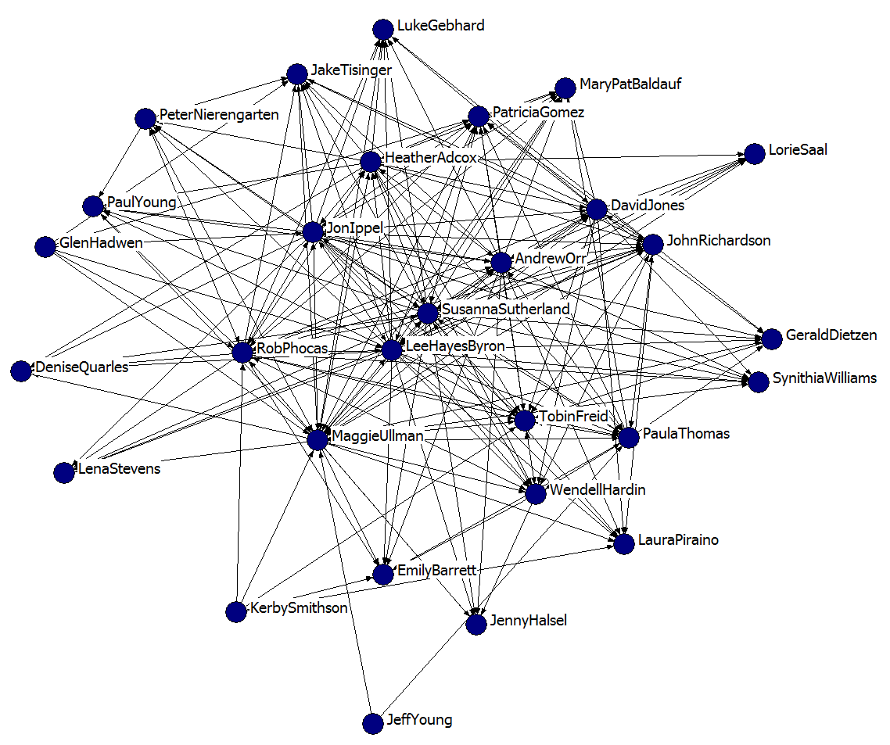
SSDN 2013 Overall Connectivity
1 = Introduced, infrequently info exchange
2 = Information exchange >1/month
3 = Exchange info, collaborate on projects
4 = Collaborate, rely on

Slide 6
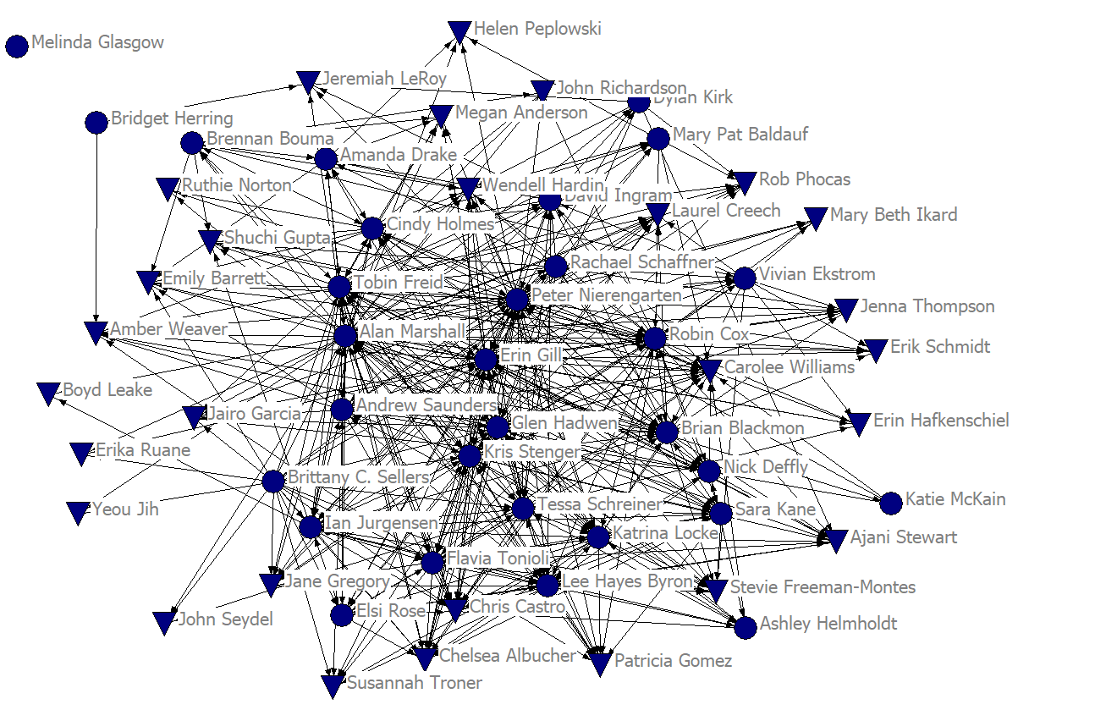
SSDN 2017
Overall Connectivity
1 = Introduction (no exchange)
2 = Introduced, infrequently info exchange
3 = Information exchange >1/month
4 = Exchange info, collaborate on projects
5 = Collaborate, rely on
Notes:
Nodes 12
Labels 18

Slide 7
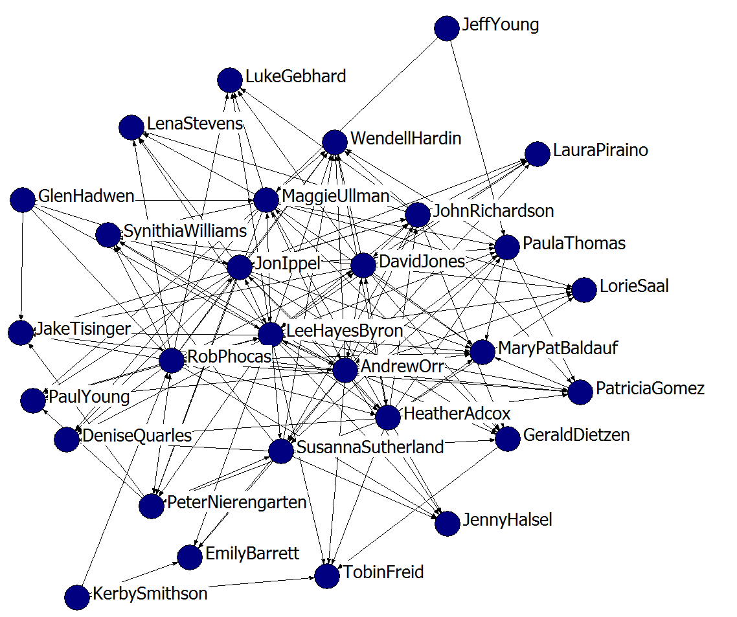
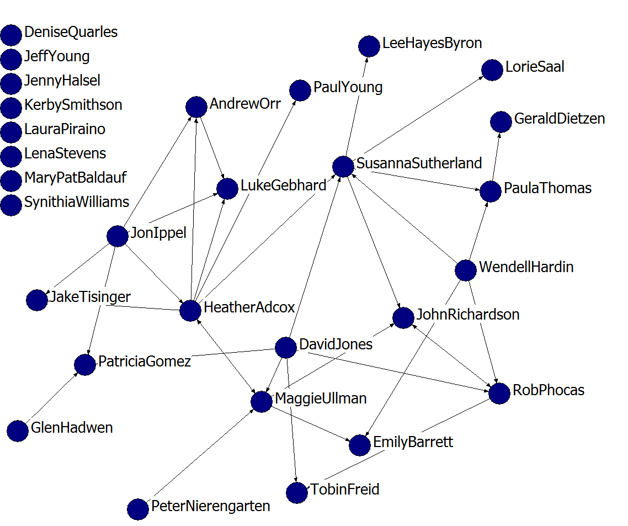
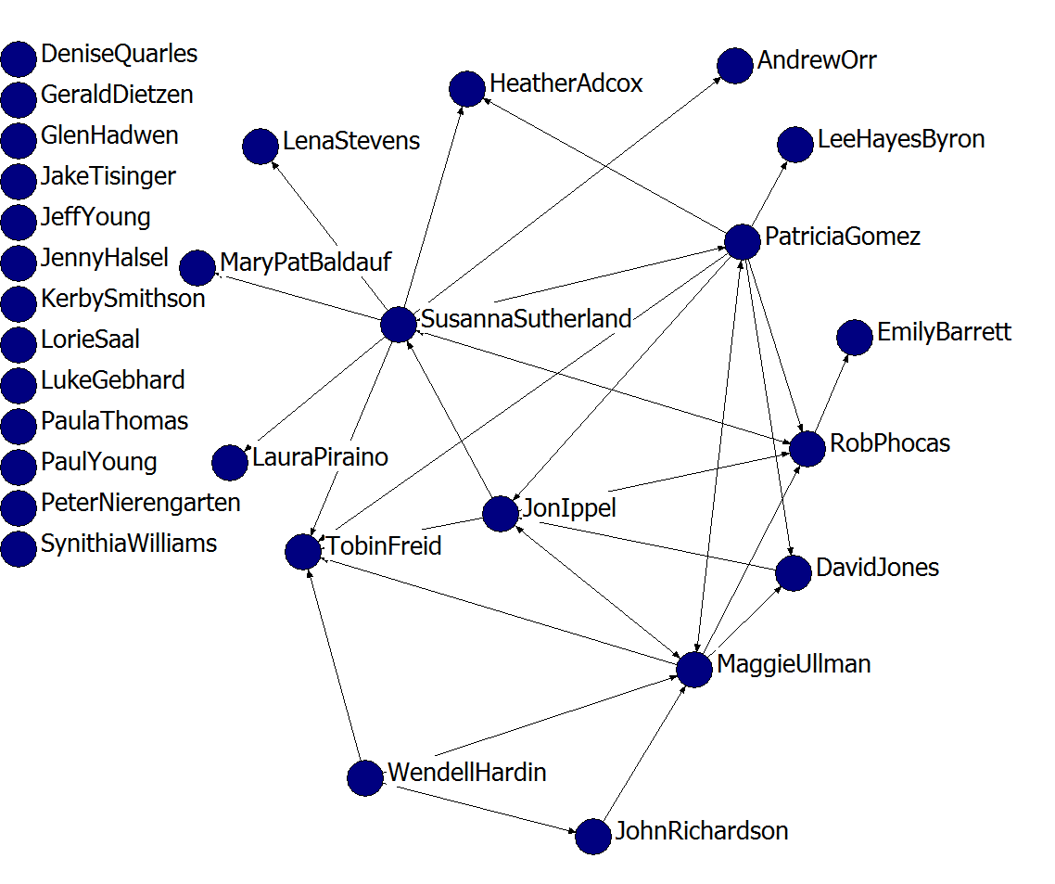
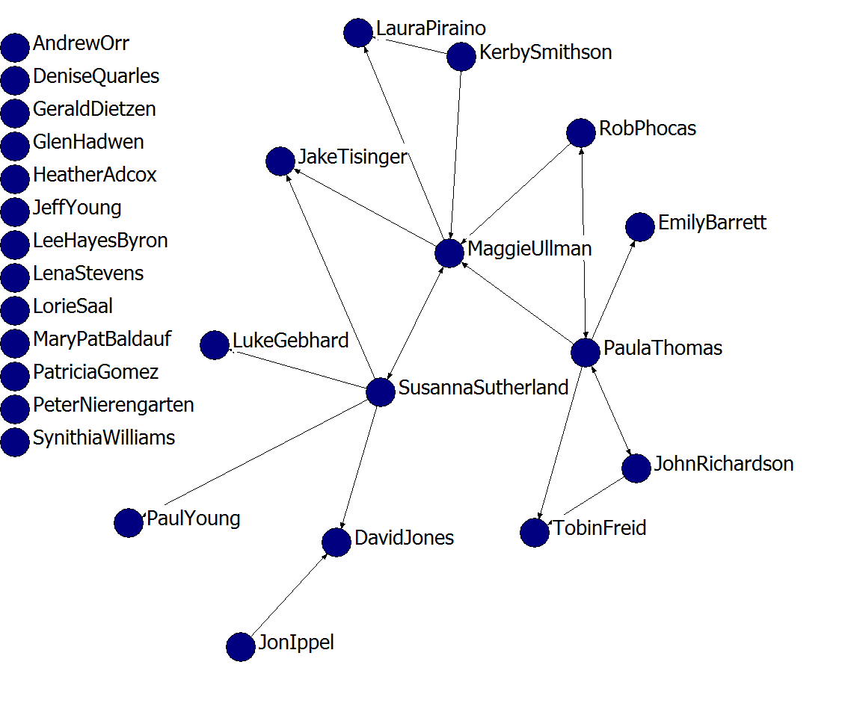
SSDN 2013 Each Level of Connectivity
1 = Introduced, infrequently info exchange
2 = Information exchange >1/month
3 = Exchange info, collaborate on projects
4 = Collaborate, rely on
Introduced (Level 1)
Information Exchange (Level 2)
Exchange and Collaborate (Level 3)
Collaborate, Rely On (Level 4)

Slide 8
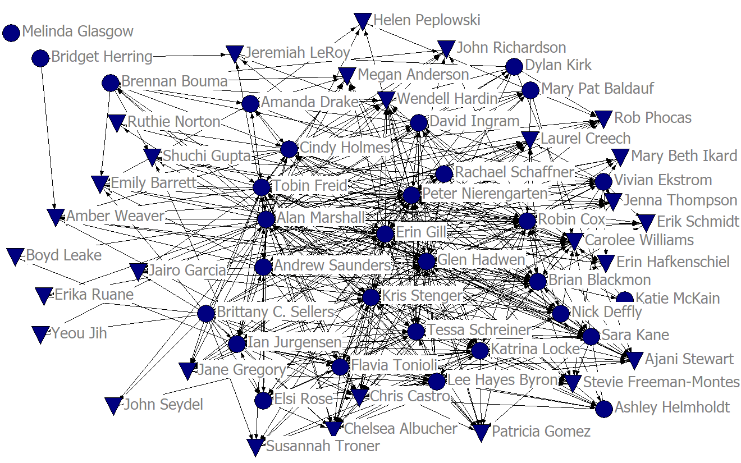
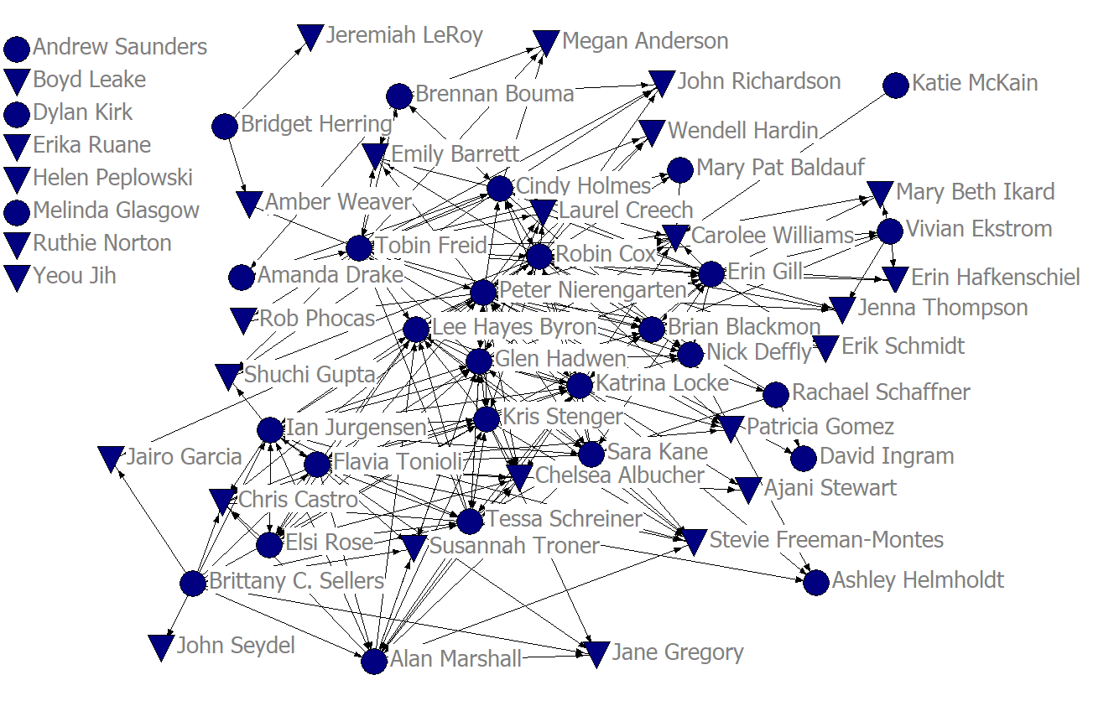
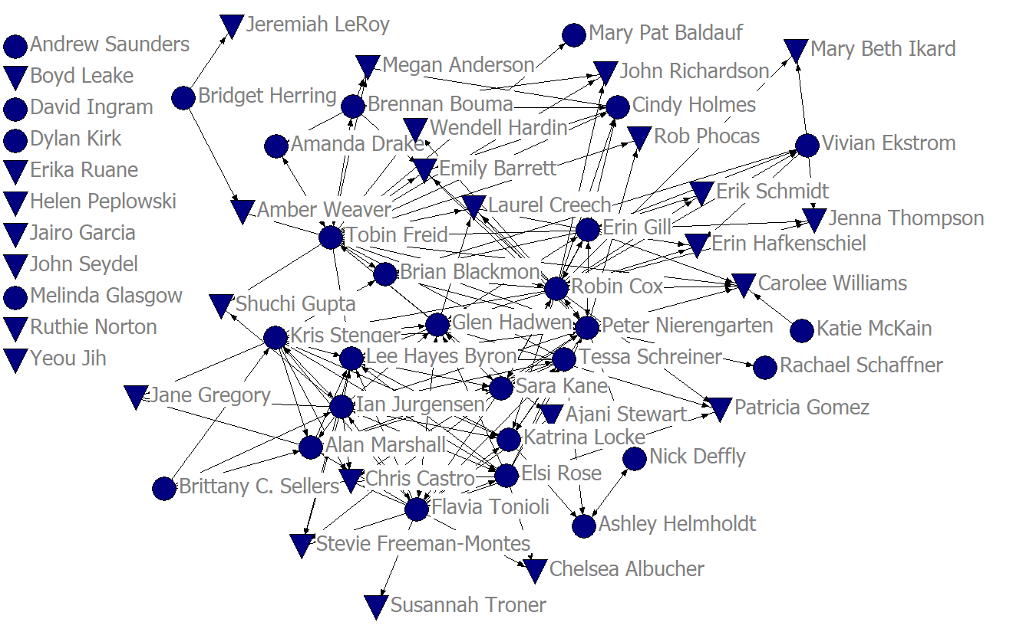
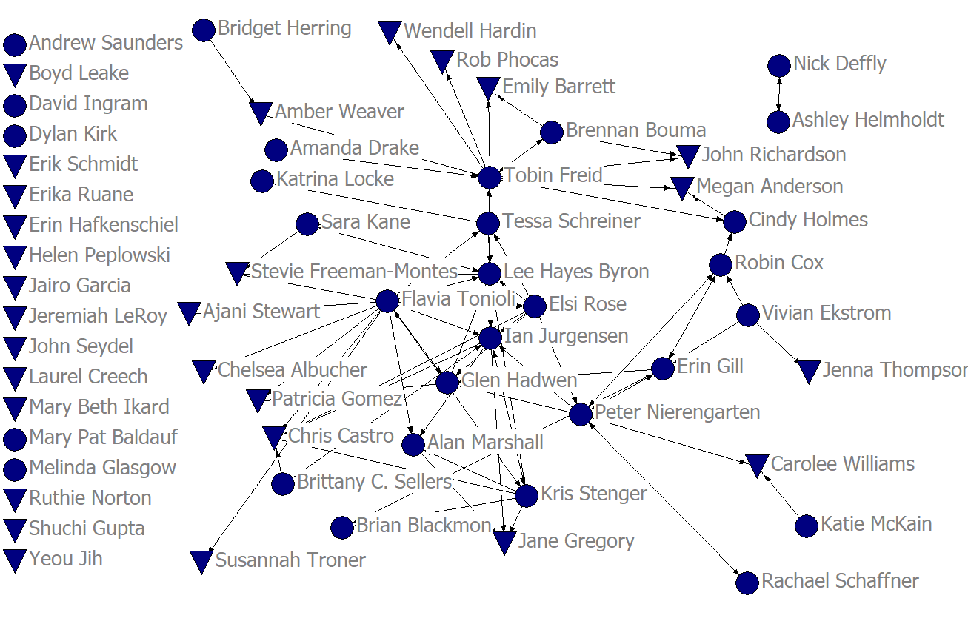
SSDN 2017
1 = Introduction (no exchange)
2 = Introduced, infrequently info exchange
3 = Information exchange >1/month
4 = Exchange info, collaborate on projects
5 = Collaborate, rely on
Connectivity+ (>=2)
Information Exchange+ (>=3)
Exchange and Collaborate+ (>=4)
Collaborate, Rely On (=5)
Notes:
Symbols size = 16
Labels size =20
Width = 4in

