Slide 1
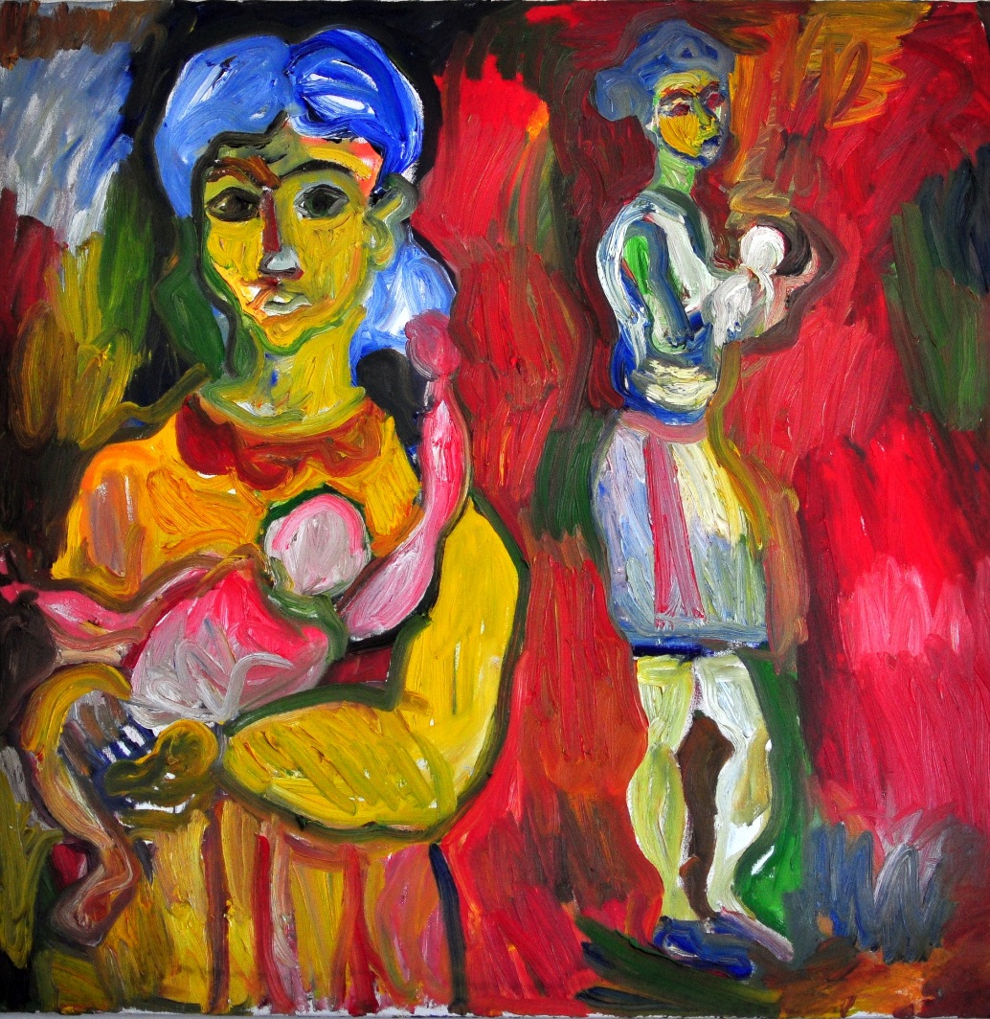

A new scientific humanism
Seven chapters on narrative medicine and precision medicine
Meyer Children’s Hospital
February 18-19, 2016
Giacomo Giacometti

Slide 2
Meyer Open Access
The meeting is targeted at the national and international scientific community and is available via streaming at: www.meyer.it

Slide 3
Foreword
Conference program
February 18, 2016
Opening remarks
  Alberto Zanobini
Why we are here: the emancipation of care
  Gianpaolo Donzelli

Slide 4
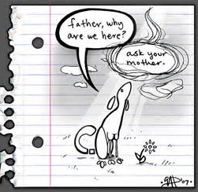

Slide 5
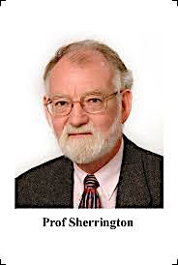
Sir Prof.
Charles Scott Sherrington
“The cultural journey never ends, it only has resting places, stopovers where the traveller can look around and collect his thoughts.”
1857 - 1952

Slide 6
Narrative medicine and precision medicine
Two schools of thoughts, two research laboratories, meet at this scientific event.
They are clinical and research areas – one that capitalizes on the fundamental aspects of human interaction, and the other that exploits innovative processes of the biomedical sciences – that are both expressions of a person’s communicative profiles, whether narrative or omics-based.

Slide 7
Emancipation
From the Latin emancipatio, which means:
  To obtain freedom by side-stepping hierarchies and dominant behavior
Why does medicine need to be emancipated?

Slide 8
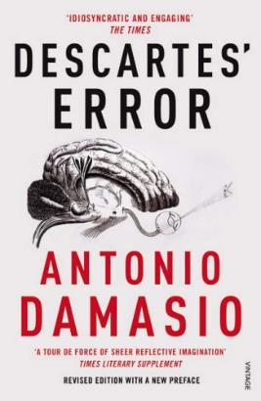
Medicine must free itself…
…from Descartes’ error
The dualist separation
  Mind and body
  Rationality and emotion
Descartes’ error is still overbearing in medical care

Slide 9
Medicine must free itself…
…from subordination to the biological paradigm
Considering the patient as merely the sum of circulatory, respiratory, and gastroenterological symptoms, a sort of brain-lung-heart preparation
And not in a holistic way as a harmonic system continuously interacting with himself and his environment

Slide 10
Medicine must free itself…
…from the confines of the healthcare system
Our work is organized to obtain objectives in the least amount of time according to an economic logic that does not take the value of the individual into account.
New healthcare scenarios could emerge to focus more on patient’s individual sensitivities, by doing away with the practice of stratifying patients according to the classification criteria of "sick organs and systems”, with all the serious limits they impose, and replacing this with an individualized medicine that is implemented in a substantial manner.

Slide 11
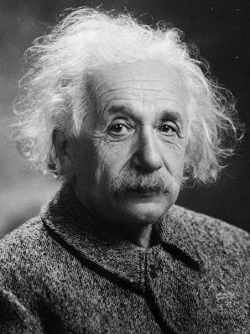
Medicine must free itself…
…from a passive subordination to technology
“It has become appallingly obvious that our technology has exceeded our humanity.”
- Albert Einstein
Notes:
Physicians who lock the care experience into an often excessively "silent" form of resorting to instrumental investigations and laboratory tests are most likely suffering from the "Ulysses syndrome”, due to the fact that just like the Homeric hero, they wander aimlessly amidst the islands of the Mediterranean before finally reaching Ithaca. But this is another story... and another long narration.

Slide 12
Medicine must free itself…
…from a “congenital” resistance to change
The change in medical care passes through freedom with respect to the biological paradigm, i.e. through a way of acting and thinking no longer of a Cartesian nature, but rather with a holistic vision of the patient.

Slide 13
Do we need a new paradigm?
…the question that arises at this point is the following: is it possible to overcome the critical issues represented by a “disease-centered medicine” versus a “person-centered medicine”?
Many healthcare and academic institutions are now recognizing narrative medicine, medical humanities and “democratic medicine” as a means to developing holistic and equitable individualized patient care, even though they are applied in professional development settings and less overtly employed with patient populations.

Slide 14

What’s in the news?
“When it comes to precision medicine, advances in technology, data science, and clinical research are already curing diseases that were once thought to be incurable. It’s entirely possible that a decade or two from now, treatments would be tailored not just to the disease, but also to the individual patient.”
- President Barack Obama
“President Barack Obama on how to win the future”, Popular Science, 9 February 2016

Slide 15
Chapter I – The paradigm
Conference program
February 18, 2016
Presented by: Monica Toraldo di Francia
A narrative future for medicine
  Brian Hurwitz
Health democracy and its ambiguities: an outsider’s reflection on narrative and medicine
  Carlo Ginzburg
Facing health inequalities: opportunities and challenges for promoting health, development and social justice
  Erio Ziglio

Slide 16
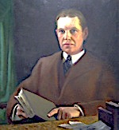
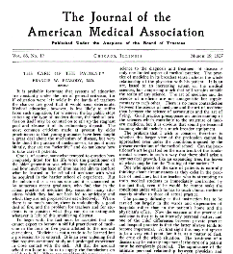
A new century, the same critical issue
A common criticism made at present is that young graduates have been taught a great deal about the mechanisms of disease, but very little about the practice of medicine - or to put it more bluntly, they are too “scientific” and do not know how to take care of patients.
From a talk given by Francis Peabody to the students at the Harvard Medical School on October 21, 1926.
Peabody F. The care of the patient. JAMA 1927; 88:877

Slide 17
How to approach training?
It is necessary to get to know “narrative medicine” and “medical humanities” without any preconceived ideas and to grant them the same dignity as other clinical and educational skills of medicine, considering them instruments of professional emancipation for the whole realm of medical sciences.
This is not “professional do-gooding” in the reductive sense of compassion, but a holistic perception by medicine of men and women in their complexity.

Slide 18
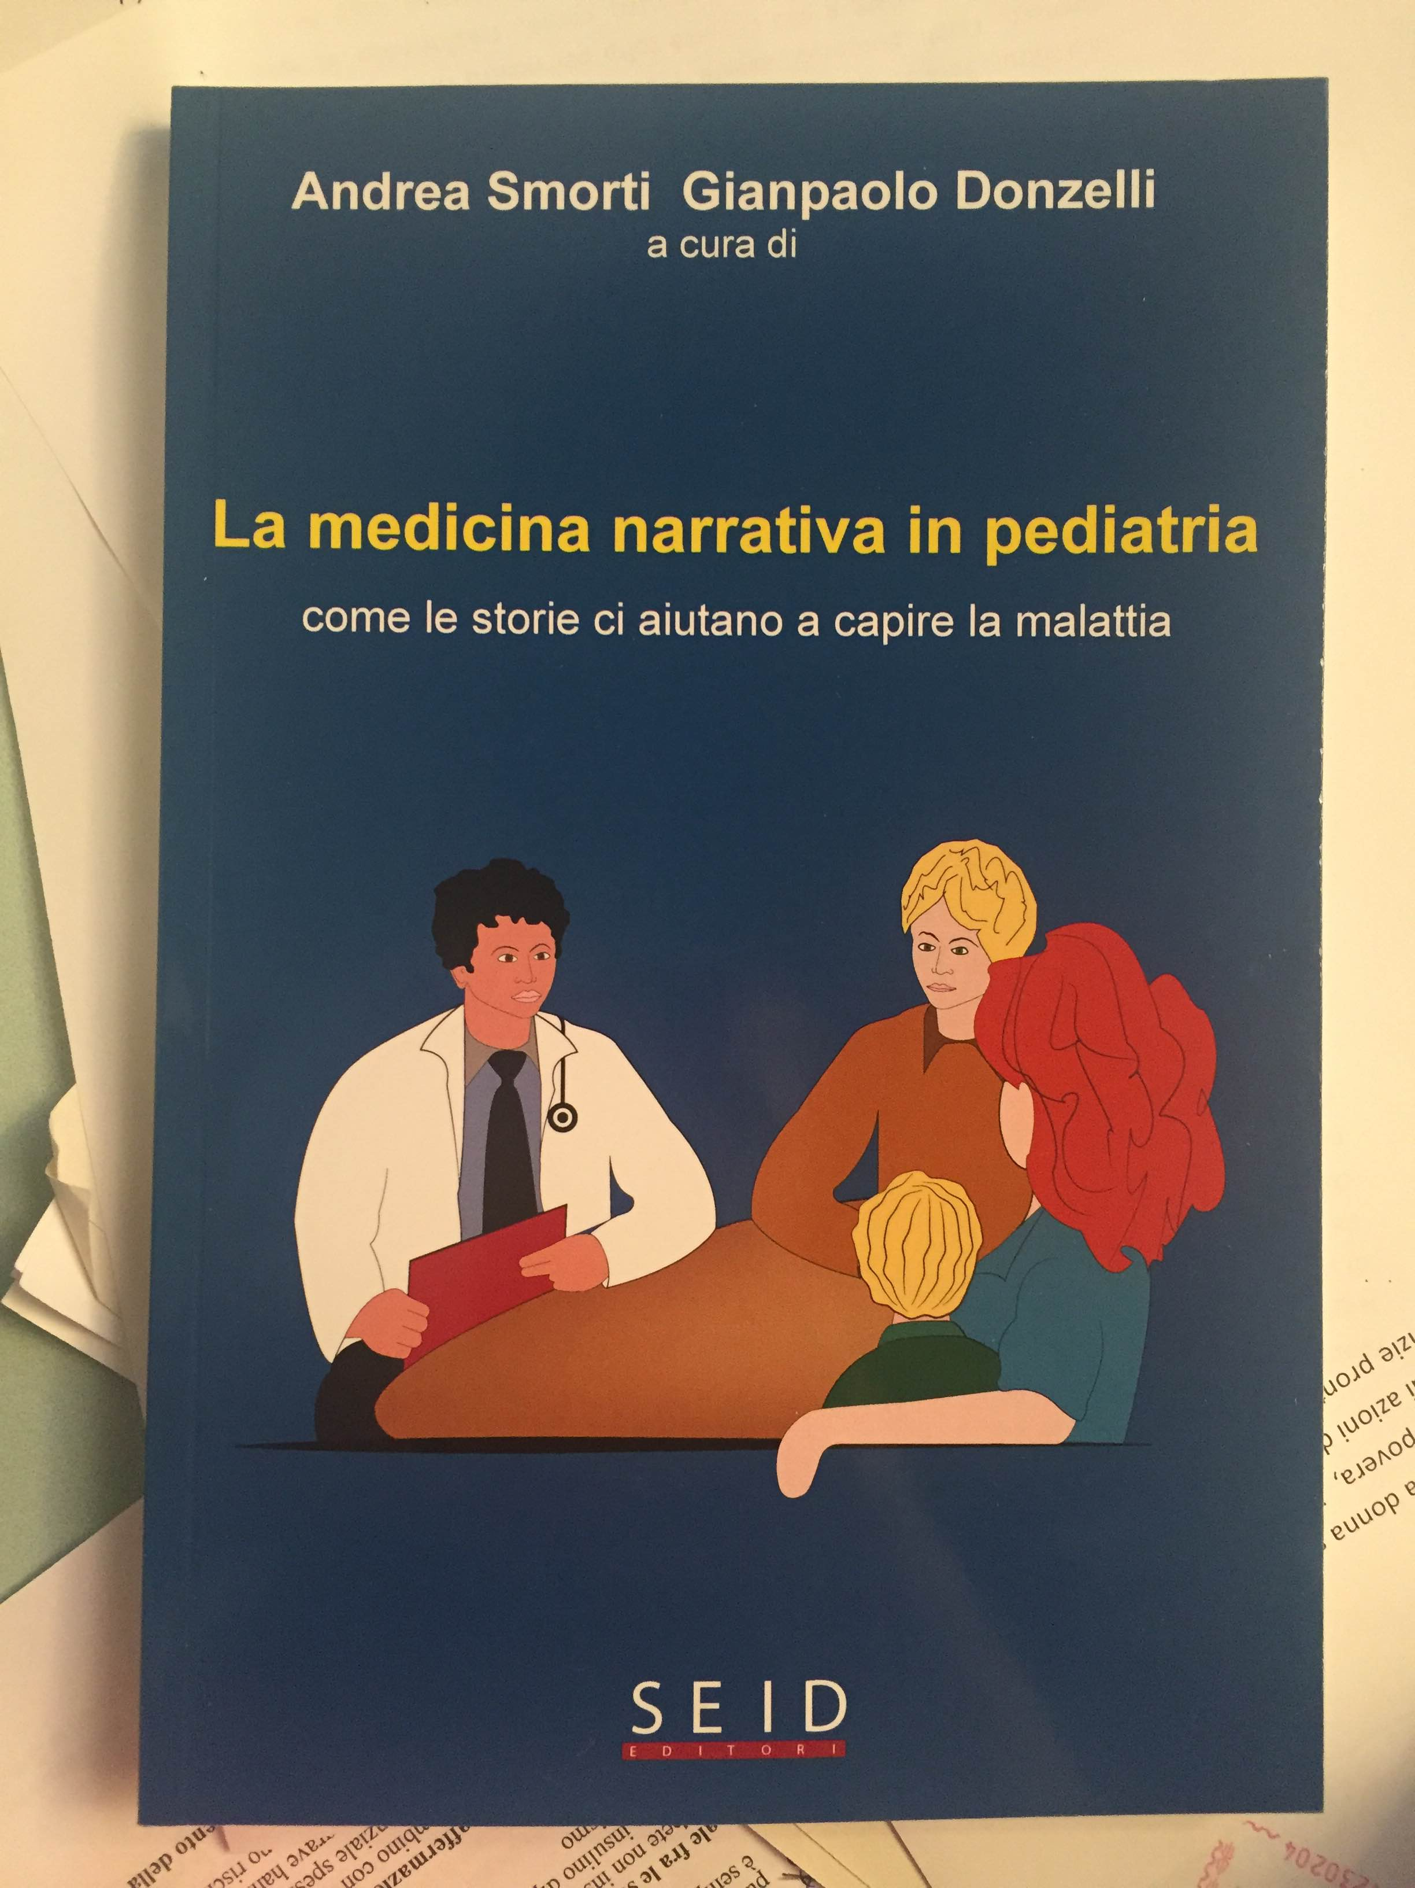

Slide 19
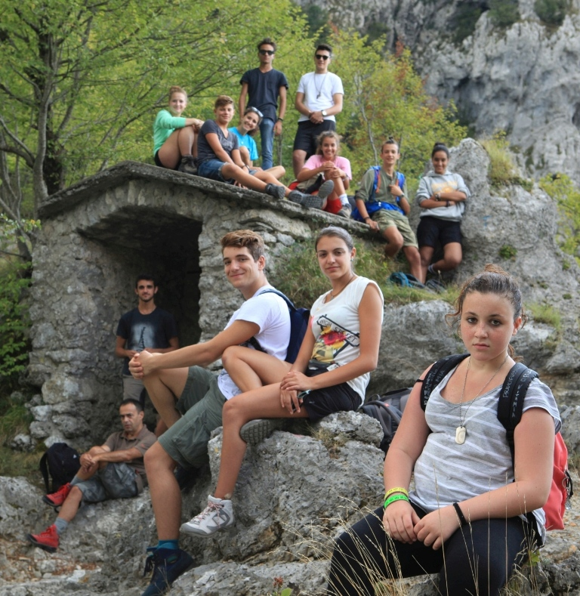
Settembre
Conference program
February 18, 2016
By: Duccio Charini

Slide 20
Chapter II – Training
Presented by: Maurizio de Martino
The use of narrative in medical education
  Stephen Ludwig
A Ph.D. in narrative medicine: how to promote the development of a relational mind
  Chiara Fioretti and Andrea Smorti
The use of literature to learn how to listen to the patient
  Donatella Lippi

Slide 21
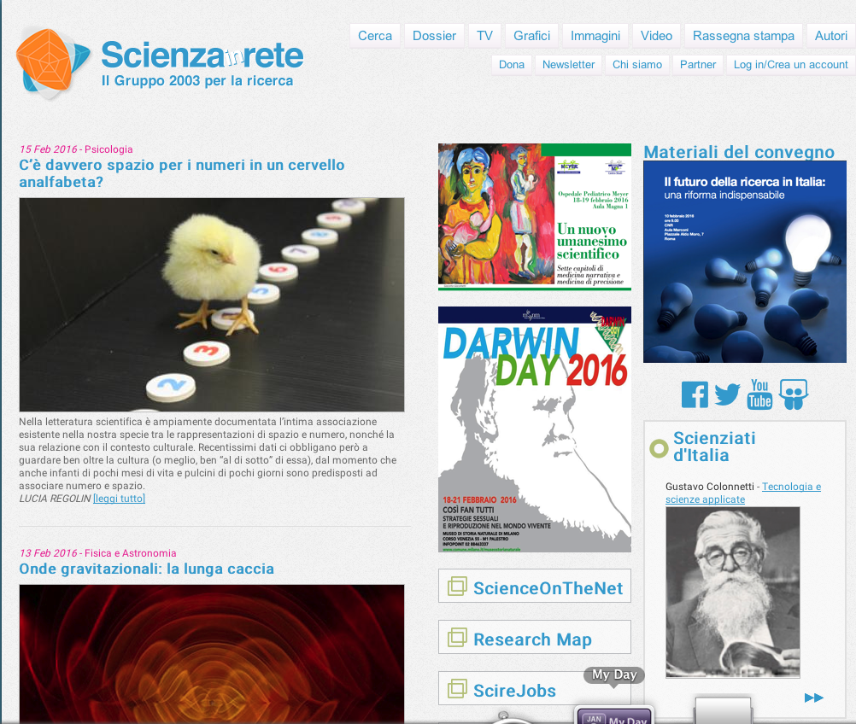
Scienzainrete www.scienzainrete.it

Slide 22
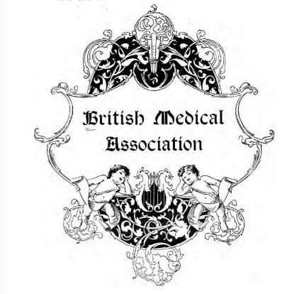
BMA
Founded in 1832
The BMA's stated aim is "to promote the medical and allied sciences, and to maintain the honour and interests of the medical profession".

Slide 23
Chapter III – The headlines
Science, medicine, profession
  A narration by Giuseppe Remuzzi, interviewed by Luca Carra

Slide 24
How to change?
In the medical world, every scientific practice is under the threat of refutation which gives rise to its evolutional dimensions. It therefore follows that change is one of the basic principles of the methodological and organizational healthcare sciences.
However, change is difficult as it gives rise to the questioning of certainties and habits, activating feelings and actions that are often antagonistic, which is why everything becomes exasperatingly long.

Slide 25
Chapter IV – The change
Presented by: Massimo Resti
Narrative medicine between art, science and philosophy
  Alberto Granese
Person-centered medicine
  Alfredo Zuppiroli
Individualized research and translational medicine
  Andrea Frosini
Narrative medicine and sustainable healthcare
  Maria Giulia Marini

Slide 26
Has the art of bedside medicine been lost?
It is not advisable for physicians to stray too far from the consolidated procedures or the methods established by protocols and guidelines. Even though these may not be infallible, they do offer comfort in the "certainty" of procedures which are at times complex and difficult - ranging from diagnosis to treatment - and which in their clinical practice consist of four fragile aspects.

Slide 27
Guidelines: light and shadows
They crystallize decisions so that they are not always able to adhere to the specific case;
by acting as guidelines, they tend to take the responsibility away from the professional;
they cloud over the physician-patient relationship, responding to needs that are often unrelated to the latter, but for the most part ascribable to defensive medicine;
they have a brief "half-life”.
Donzelli G. The change of paradigm in perinatal sciences: the role of Narrative Medicine and Medical Humanities Journal of Pediatric and Neonatal Individualized Medicine 3, 2 2014

Slide 28
Clinical decisions
So decisions are made on the basis of indications that are out of context with the situations of each individual patient and no heed is given to the change even when solicited by innovative references based on evident scientific findings.

Slide 29

Donzelli G. Medical humanities and narrative medicine in perinatal care. J Matern Fetal Neonatal Med. 2015 Jan;28(1):1-2.

Slide 30
Chapter V – The wards
Presented by: Carlo Dani
A new culture for birth: looking toward the past
  Gian Carlo Di Renzo
Giving a voice to newborns
  Mario De Curtis
Narrative medicine in neonatology
  Massimiliano Zonza
Guidelines for the use of narrative medicine in the clinical environment for rare and chronic degenerative diseases
  Amalia Egle Gentile
Narrative medicine in cardiology
  Stefania Polvani
The values shared by caregivers
  Giulia Bazzani

Slide 31
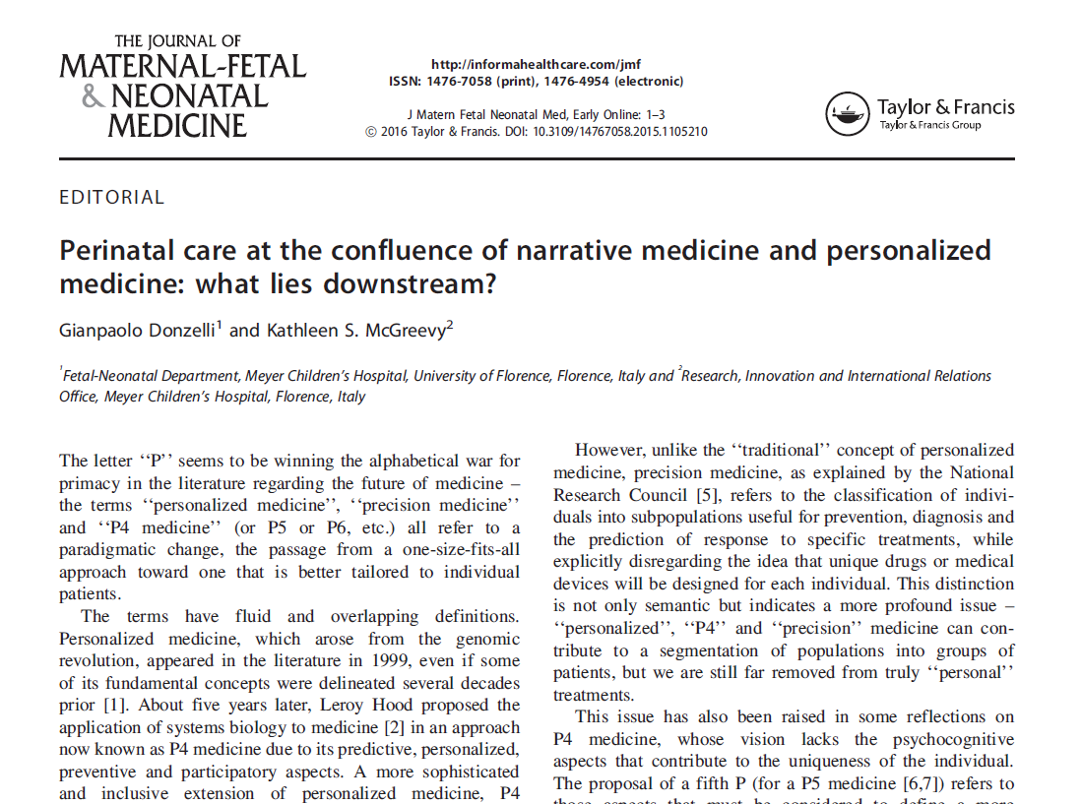
What happens when we combine narrative medicine and precision medicine?
Donzelli G, McGreevy KS, Perinatal care at the confluence of narrative medicine and personalized medicine: what lies downstream?, J Matern Fetal Neonatal Med, Early Online: 1–3, 2016.

Slide 32
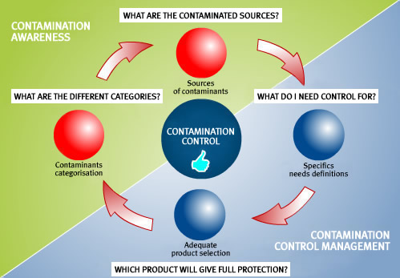
What do we mean by “contamination”?

Slide 33
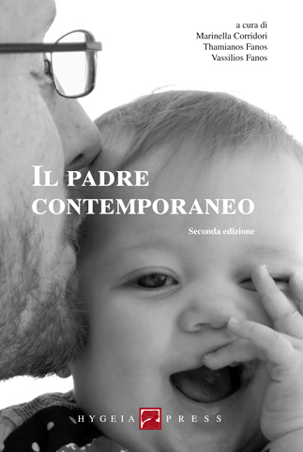
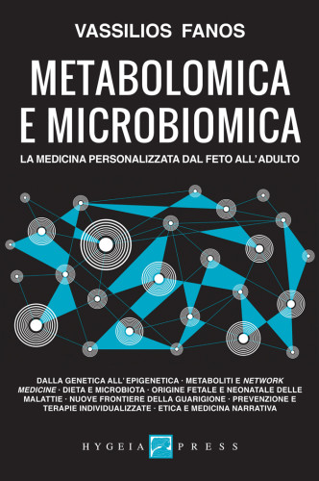

Slide 34
Chapter VI – Narrative medicine and precision medicine: a contamination
Conference program
February 19, 2016
Presented by: Elisabetta Cerbai
At the confluence of narrative medicine and precision medicine: what lies downstream?
  Kathleen McGreevy
Life narrated by the deciphering of the genetic code
  Orsetta Zuffardi
The use of stem cells in personalized medicine
  Paola Romagnani
“Narrative molecules” in the perinatal laboratory
  Vassilios Fanos
Point-of-care personalized management of infectious disease
  Chiara Azzari

Slide 35
What impact does the beginning have?
During early life (conception, pregnancy, infancy and childhood), how do the interplay between maternal and environmental factors program (induce physiological changes in) fetal and child growth and development that have long-term consequences on later health and disease risk?
The problems of medicine pose a surprising number of questions of an ethical and “political” nature. It is necessary for this issue to move out of the rooms of the people directly involved and become a topic of general discussion shared with the entire society, in particular with women.
The way in which these fundamental principles are dealt with not only produces effects on the individuals specifically involved (patients and health operators), but it can also have long-lasting effects on humanity as a whole”.
Donzelli GP. Manuale di Bioetica in Medicina Riproduttiva e Perinatale.
Centro Scientifico ed, Torino, 1999

Slide 36

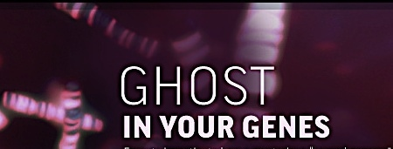
EPIGENETICS
Epi(επί = above)genetics
Nature, 2009
Notes:
THE THIRD ARTICLE ALWAYS PUBLISHED IN NATURE . IN AN EDITORIAL MUCH GUESSED TITLED “THE SECOND GENOME” PUBLISHED IN NATURE IL 2009 WERE REPORTED IN THE FOLLOWING WORDS: THERE IS A GHOST IN YOUR GENES. THIS CONSIDERS THE NEW SCIENCE OF EPIGENETICS WHICH REWRITES THE RULES OF DISEASE, HEREDITY, AND IDENTITY.

Slide 37
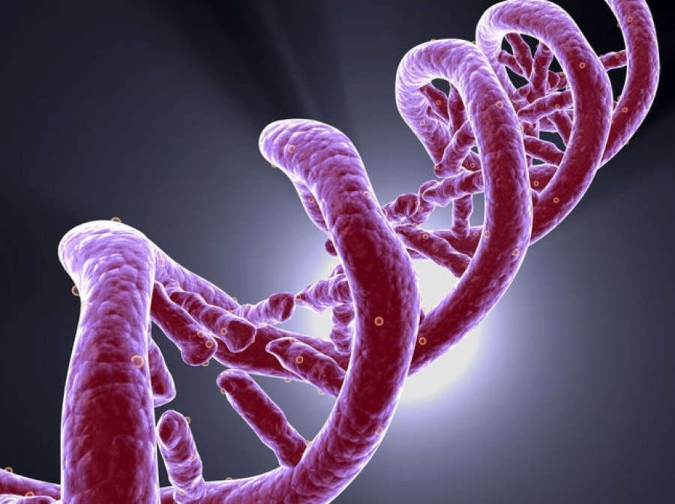
EPIGENETICS
“The new science: rewrites the rules of disease, heredity, and identity”
Nature 2009
Notes:
These changes were were represented by METILATION: addition of methyl groups to DNA cytosine bases;
ACETILATION : addition of acetyl groups to proteins (histones) around which DNA is wrapped
:
37

Slide 38
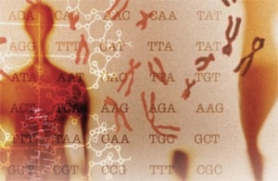

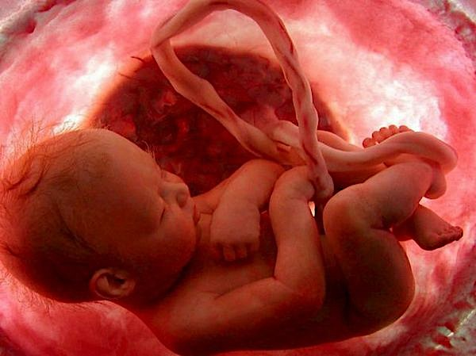
.
The nature (genes) nurture (the environment) debate by using the starting point of fetal life and birth as a lens to provide answers to clinical problems
NATURE, 2009
Notes:
EPIGENETICS HAS BECAME A PECULIAR SCENARIO FOR PERINATOLOGY. THE NATURE (FETAL GENES) – NURTURE (THE ENVIRONMENT) DEBATE BY USING THE STARTING POINT OF FETAL LIFE AND BIRTH AS A LENS TO PROVIDE ANSWERS TO CLINICAL PROBLEMS THAT WE MIGHT NEVER HAVE FACED IN SUCH A WAY.
38

Slide 39
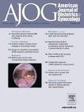
Low birthweight and small for gestational age at birth are risk factors for the adult onset of systemic sclerosis.
Donzelli G, et al. Fetal programming and systemic sclerosis. Am J Obstet Gynecol. 2015 Dec;213(6):839.e1-8. doi: 10.1016/j.ajog.2015.07.034. Epub 2015 Jul29. PubMed PMID: 26232509.

Slide 40
Chapter VII – Perinatal epigenetics
Conference program
February 19, 2016
Presented by: Nicoletta Berardi
270 days to write your future
  Irene Cetin
The developing brain
  Renzo Guerrini

Slide 41
What is the view of society in general?
A science, not the science, a certain scientific progress, not the scientific progress – often tied to the powerful logics of the economy, market, and ideology – have in themselves a substantial fragility that keeps them from “touch a person’s heart”

Slide 42
A new scientific humanism
Seven chapters on narrative medicine and precision medicine
Reciprocal thoughts
The vital core is not in their epistemological and lexical architecture. Their center of gravity lies, rather, in postulating a vision of medicine and healthcare activities that is truly and convincedly holistic.

Slide 43
Epilogue
Conference program
February 19, 2016
Presented by: Salvatore De Masi
After listening to the “seven chapters”
  Benedetta Fantugini

Slide 44
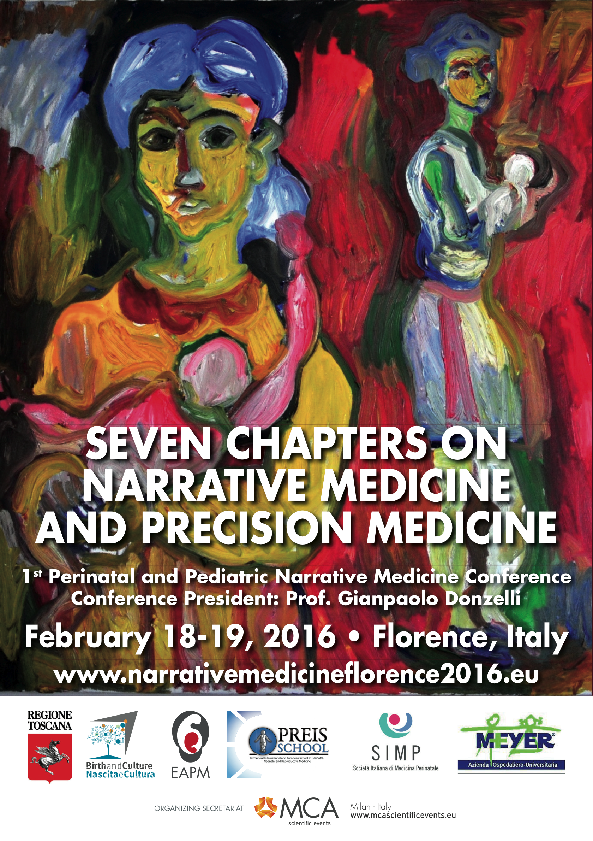
Giacomo Giacometti

