Slide 1
RECOMMENDATIONS
for the clinical implementation of
the Narrative Based Medicine
in the care of people with rare and chronic diseases
Amalia Egle GENTILE, Agata POLIZZI and Domenica TARUSCIO
National Centre for Rare Diseases, Istituto Superiore di Sanità, Rome
A NEW SCIENTIFIC HUMANISM
Seven chapters on narrative medicine and precision medicine
Conference Hall 1 - MEYER Children’s Hospital
Florence - February 18-19, 2016

Slide 2
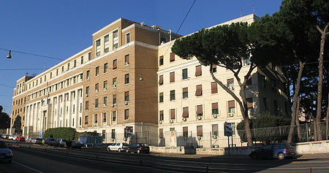
Counselling
Education
Research
Diseases prevention
and surveillance
Health promotion
HEALTH PROTECTION
Convegno medicina narrativa, 8 maggio 2015, Venezia

Slide 3
MISSION
To promote and develop
experimental research and public health actions
to provide technical expertise and information on
rare diseases and orphan drugs, for the prevention, treatment and
surveillance of these diseases.
G.U. n°157 del 7/7/2008

Slide 4
Low prevalence (≤ 5:10.000 in Europe)
Chronic, multisystem conditions often associated with
Severe disabling course
Reduced life expectancy
Multidisciplinary clinical pathways
High rates of hospital admissions
High medical expenses
Poor quality of life
Rare Diseases
Poor awareness among most health care professionals
Often inadequate levels of care expertise
Delayed diagnosis, misdiagnosis or even un-diagnosis
7-8,000 diseases
A new scientific humanism,. Florence_February 18-19, 2016

Slide 5
EVIDENCE BASED MEDICINE
Best scientific evidence
Clinical experience
Patient values & expectations
NARRATIVE
BASED MEDICINE
Evidence based medicine: what it is and what it isn't.
David Sackett et al, 1996
Convegno medicina narrativa, 8 maggio 2015, Venezia

Slide 6
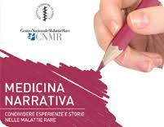
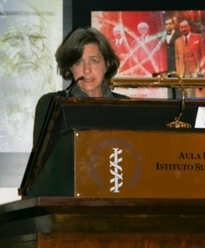
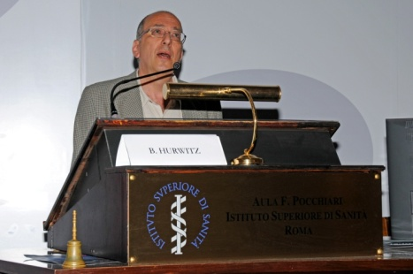
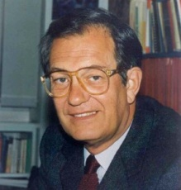
RESEARCH
EDUCATION
INFORMATION & COMMUNICATION
Survey on
General Practitioners and rare diseases:
knowledge, perceptions and needs
TRAINING COURSES
in collaboration with
Institutions, patient organizations, etc.
NATIONAL
& INTERNATIONAL MEETINGS
“Narrative medicine and rare diseases”
(2009, 2010, 2011 - 2012, 2014)
Convegno medicina narrativa, 8 maggio 2015, Venezia

Slide 7
Application lab
in Narrative Medicine
Convegno medicina narrativa, 8 maggio 2015, Venezia

Slide 8
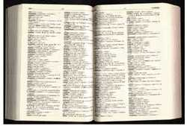
NARRATIVE BASED MEDICINE
Convegno medicina narrativa, 8 maggio 2015, Venezia

Slide 9
NARRATION in CLINICAL PRACTICE
Narration as traditional literary tool/means
Narration makes a pathological subject of conversation a lived experience
Narration as a constitutive element in the course of care comprising diagnosis, treatment and rehabilitation
Convegno medicina narrativa, 8 maggio 2015, Venezia

Slide 10
CONSENSUS CONFERENCE
Public meeting between an expert panel and a panel of concerned citizens - the lay panel.
Aim is to bridge the gap between the general public, experts and policy-makers assessing controversial on given suitalble issues
Experts
Jury panel
Promotor
Scientific Committee
Convegno medicina narrativa, 8 maggio 2015, Venezia

Slide 11
CONSENSUS CONFERENCE on RECOMMENDATIONS for the clinical implementation of the Narrative Based Medicine in the care of people with rare and chronic diseases
Convegno medicina narrativa, 8 maggio 2015, Venezia
Notes:
Scientific responsible
Promotor
Coordinators
Scientific Committee
Authors and speakers
Co-authors
Bibliographic support

Slide 12
CONSENSUS CONFERENCE on RECOMMENDATIONS for the clinical implementation of the Narrative Based Medicine in the care of people with rare and chronic diseases
Convegno medicina narrativa, 8 maggio 2015, Venezia
Notes:
President
Secretaries
Jury panel members
Scientific secretariat
Organisational secretariat

Slide 13
Consensus conference
1. What is the definition of Narrative medicine?
Convegno medicina narrativa, 8 maggio 2015, Venezia

Slide 14
Consensus conference
2. What are the methods and tools used in Narrative medicine?
Convegno medicina narrativa, 8 maggio 2015, Venezia

Slide 15
Consensus conference
3. What can be the benefit of Narrative medicine in clinical practice? In which areas can be used re the applications made to date?
Convegno medicina narrativa, 8 maggio 2015, Venezia

Slide 17
Consensus conference
NARRATION
constitutive element in the course of care comprising diagnosis, treatment and rehabilitation
Therapeutic
Phenomenological-hermeneutic
Socio-anthropological
Humanistic
TARGET
Professionals working in
medical, social and
health care areas
Istituto Superiore di Sanità, Roma.
11-13 giugno 2014
Convegno medicina narrativa, 8 maggio 2015, Venezia

Slide 18
NBM: definition (1/2)
The term Narrative based Medicine (NBM) refers to
methodology of intervention in clinical care
based on specific communicative competencies.
The narrative is the fundamental tool to capture, decipher and integrate the different points of view of those with a disease undergoing a care process.
The final goal is the construction of a shared pathway of personalized care (care history).
Istituto Superiore di Sanità, Roma.
11-13 giugno 2014
Convegno medicina narrativa, 8 maggio 2015, Venezia

Slide 19
NBM: definition (2/2)
NBM integrated with the Evidence-Based Medicine (EBM), takes into account the diversity of perspectives, making clinical care decisions more personalized, comprehensive, effective and appropriate.
The narrative of patients and their caregivers is an essential part of the contemporary medicine, based on the active participation of those people involved in making the choices.
Through their stories, individuals are protagonists of the process of care.
Istituto Superiore di Sanità, Roma.
11-13 giugno 2014
Convegno medicina narrativa, 8 maggio 2015, Venezia

Slide 20
NBM: methodologies and tools (1/2)
There are many tools proposed, in the scientific literature, re different contexts, aims and actors.
There is no evidence that one instrument is better than another
Some examples include:
interviews conducted with narrative competencies, semi-structured narrative interviews, parallel charts, Story Sharing Intervention (SSI), reflective writing
vicarious narrator, Time Slips, video interviews
Istituto Superiore di Sanità, Roma.
11-13 giugno 2014
Corso di formazione - Nocera Inferiore (SA), 20-21 aprile 2015

Slide 21
NBM: metodologie e strumenti (2/2)
Criteria for the choice of the most appropriate tool:
the importance of leaving the interviewed free to choose the narrative form that he is comfortable with.
the tool must contain factors resulting in a positive outcome for the care
Istituto Superiore di Sanità, Roma.
11-13 giugno 2014
Convegno medicina narrativa, 8 maggio 2015, Venezia

Slide 22
NBM: benefit, fields and context
Narrative Medicine places the patient at the center of a care process in the following areas:
prevention, diagnosis, treatment and rehabilitation
adherence to treatment
work of the care team
awareness of the role and values of professionals
prevention of the ‘burn-out’ of operators and caregivers
adoption and implementation of dedicated clinical pathways
optimization of financial resources
prevention of legal disputes and defensive medicine
LIMITATIONS
Young experience on this field gained to date
Absence of an established evaluation methodology based on experts opinion
Istituto Superiore di Sanità, Roma.
11-13 giugno 2014
Convegno medicina narrativa, 8 maggio 2015, Venezia

Slide 23
NBM: training
To introduce narrative competencies in all fields of potential applications including university educational programs, public health and social health activities
To implement multidisciplinary and inter-professional courses with the use of the following methods and tools:
a) collection of stories from patients, family members and caregivers
b) reflective writing
c) literature, films and other expressive arts
d) Web 2.0
Istituto Superiore di Sanità, Roma.
11-13 giugno 2014
Convegno medicina narrativa, 8 maggio 2015, Venezia

Slide 24
NBM: Research
Research activities are mainly addressed to public health issues fostering the integration between EBM and NBM through qualitative and quantitative methodologies
Istituto Superiore di Sanità, Roma.
11-13 giugno 2014
Convegno medicina narrativa, 8 maggio 2015, Venezia

Slide 25
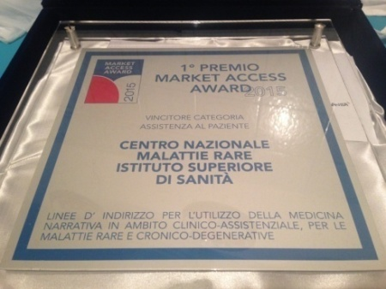
 www.iss.it/cnmr  medicina.narrativa@iss.it

Slide 26
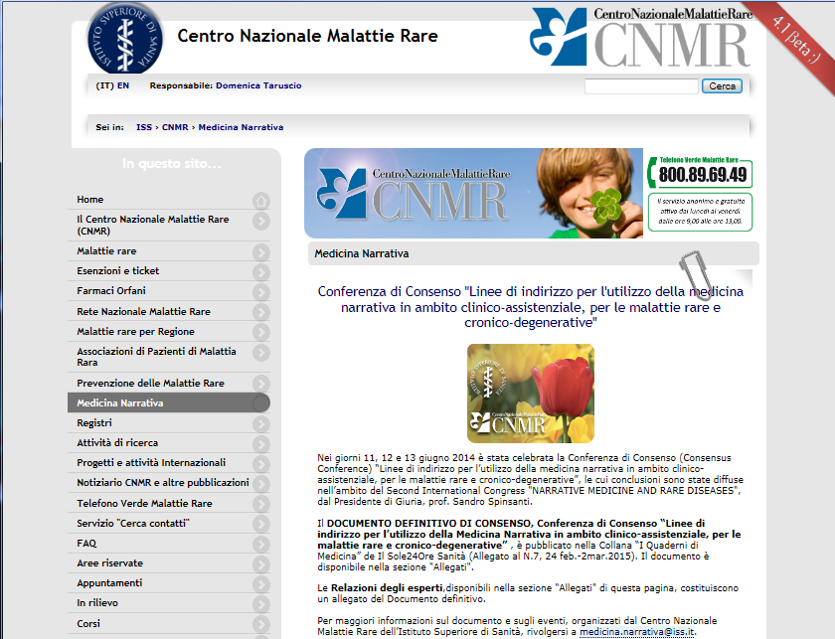
 www.iss.it/cnmr

Slide 27
Official rare diseases day 2016 video
Thank you
Convegno medicina narrativa, 8 maggio 2015, Venezia

