Slide 1



Produce Seguro
Innovating in El Salvador
with parametric insurance
Daysi Rosales-General Manager

Slide 2
Design and implementation process
2015
Project proposal in El Salvador
Selection of Seguros Futuro for development
Signing of Memorandums of Understanding between Seguros Futuro and MICRO
Selection of Banco de Fomento Agropecuario as initial aggregate
2016
Signing of the M.O.U between MICRO and BFA
Validation of the product with and adjustments to the product
Conversations and explanation about the product to SSF
Meetings with IADB
Product design and proceedings for the first installment of the insurance
2017
Presentation of the product to SSF
Approval of the first installment of PRODUCE SEGURO
Registration of BFA as mass seller
The SSF for the launching of the product
Validation (and adjustment) of parameters with MARN
First product and system audit in Seguros Futuro and BFA
2018
End of product and system Audit in Seguros Futuro and BFA
Product approval (v2) and registration of mass seller in BFA
Implementation of online product
Start of product plan
Management with new aggregates initiated
Average annual insurance recovery
Resulting protection gap

Slide 3
The solution is already available in El Salvador: Produce Seguro
This solution was adapted to El Salvador market by validation studies with customers of the Banco de Fomento Agropecuario.
Once the product was adjusted it was subject to exhaustive review by SSF and MARN, to make sure the product brings maximum value to the customers and aggregates.
The product was approved in 2018 and the mass trader was approved in June 2018, so there are insurance customers all over the country
Average annual insurance recovery
Resulting protection gap
The product registered before SSF may be traded in any financial entity that productive credits to the costumers

Slide 4
Insurable Interest: Produce Seguro
Produce Seguro protects against commercial disruptions that affect Productive Capacity in case of a severe event caused by excessive rain, earthquakes or drought.
The commercial interruption is an indirect damage and it causes:
Interruption in access roads
Income reduction as customers stop buying
Increase of raw materials costs
Lack of raw materials
Average annual insurance recovery
Resulting protection gap

Slide 5



Coverage: Produce Seguro
Indirect Damage to Productive Activity as a consequence of:
Earthquake
Drought
Excessive rainfall
Average annual insurance recovery
Resulting protection gap
In the place where the productive activity of the customer takes place

Slide 6
Does not cover: Produce Seguro
Risks that do not reach the force level preestablished int the tables
Other natural disasters that are not excessive rainfall drought, as a volcano eruption or flooding
Direct Damages that the crop or business of the insured may suffer
Average annual insurance recovery
Resulting protection gap
Remember that it covers catastrophic events it does not cover scary situations!)
There are disasters that do not have historical events data or that are nor relevant for everybody
Remember there are no inspection/adjustments

Slide 7




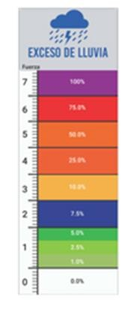
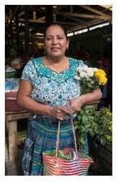
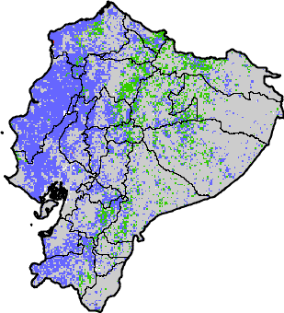


This is how it works: Produce Seguro
Disaster occurs
Customer is informed by SMS
Calculation platform
Detects and defines
Insurer identifies customer and pays
Remote monitoring

Slide 8
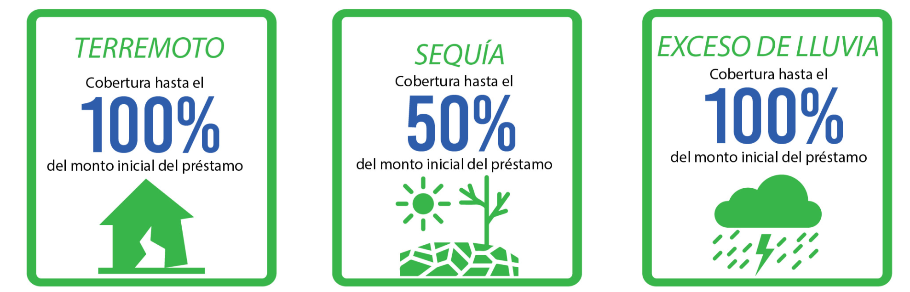
Amount insured: Produce Seguro
It is the initial amount of the credit granted by the financial institution for the Productive Activity
The Insured Amount has sub-limitations by Insured Risk as follows:
The maximum amount to be insured is $10,000.00

Slide 9
Compensation Parameters Table: Produce Seguro
What is MiCRO?
Average annual insurance recovery
Resulting protection gap

Slide 10
Main Features: Produce Seguro
What is MiCRO?
Insured | Seguros Futuro
Reinsurer | Swiss Re
Kind of insurance | Parametric
Risks covered | Drought, earthquakes, excessive rainfall
Insured amount | Initial amount of credit
Limits of insured amount | 50% for drought, 100% for earthquakes and excessive rainfall
Cost (Premium) | 5% (+ VAT) of the credit amount
Validity | Same one as the credit
Claims process | Automatic: the insured does not have to do anything
Payment of compensations | To the credit of the insured and his/her account if there is a surplus
Average annual insurance recovery
Resulting protection gap

Slide 11
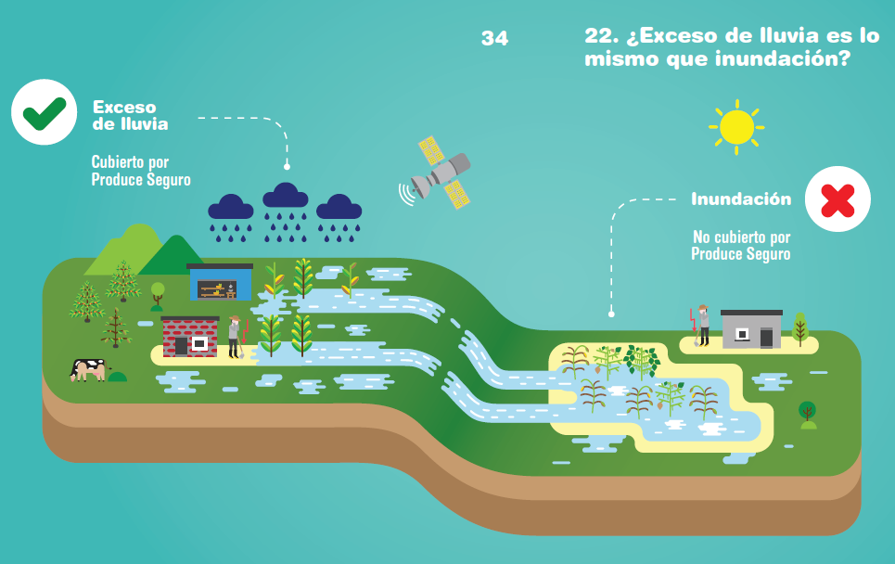
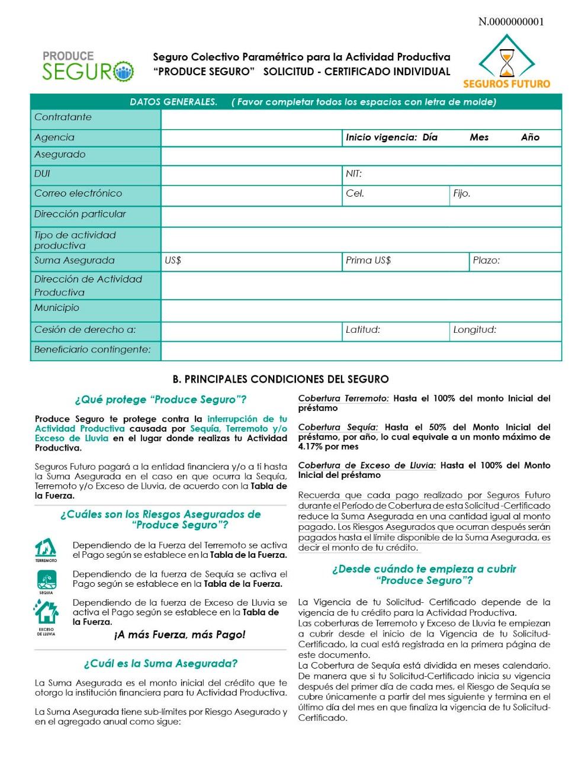
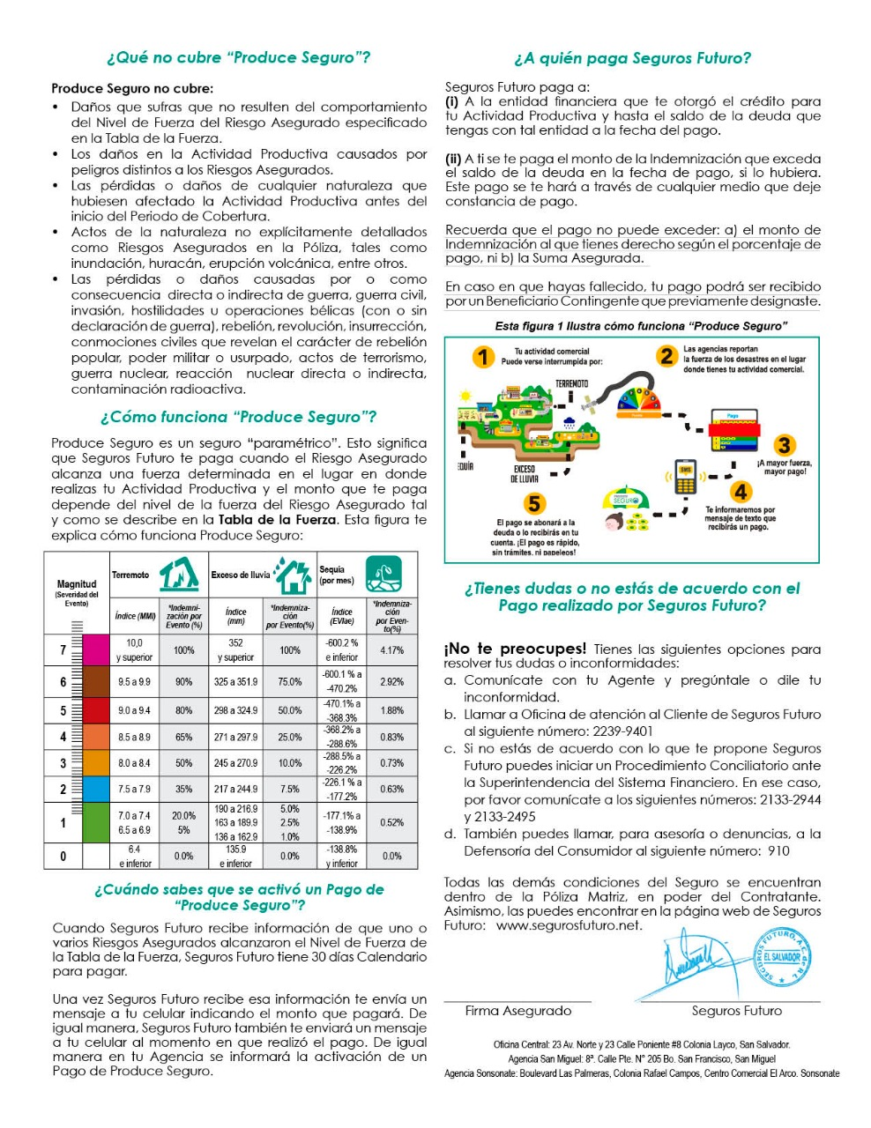
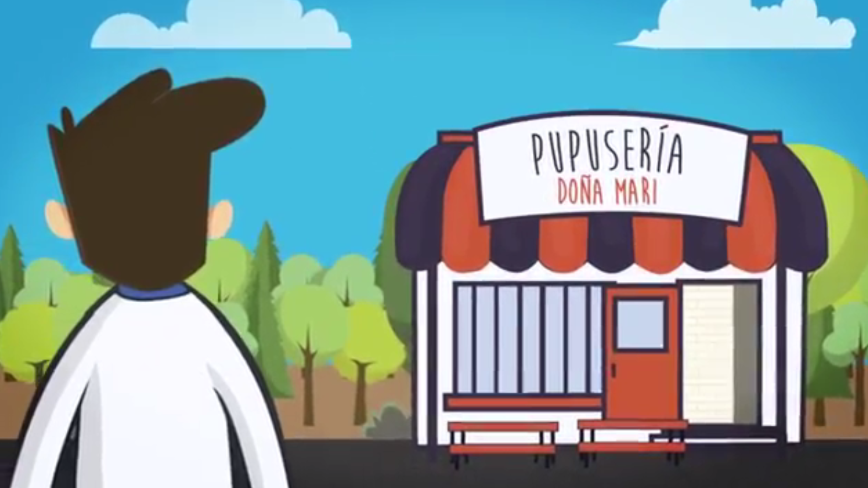
Empowering the customer is key
Even if the insurance works WITHOUT the insured having to do anything finacial education is important for a better impact
Special materials were designed so the customers could understand the insurance
Animated explanatory Video of the insurance
All the information required is delivered in a 2 page certificate

Slide 12
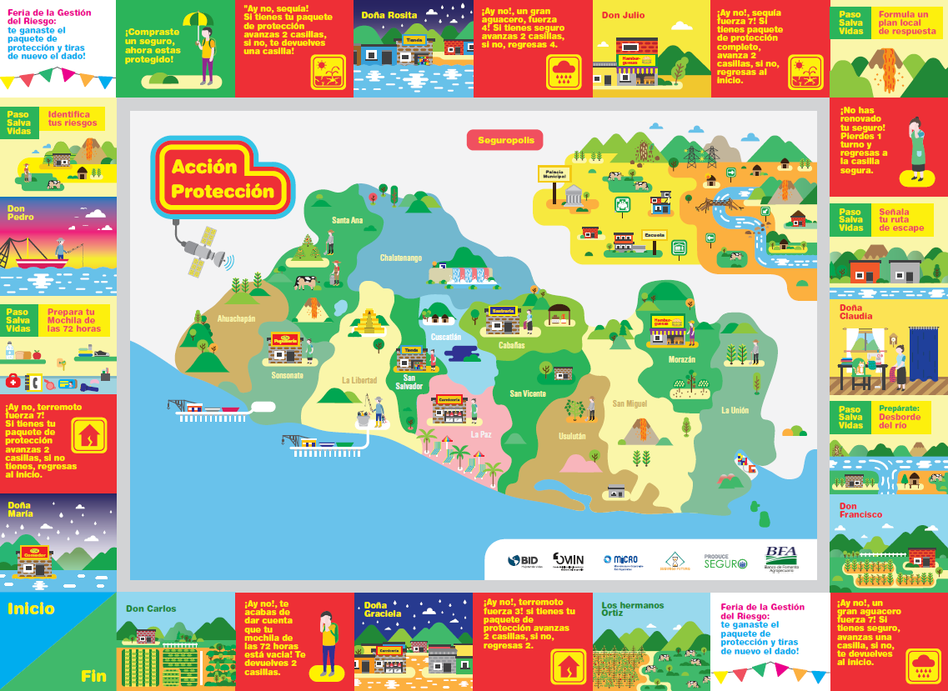
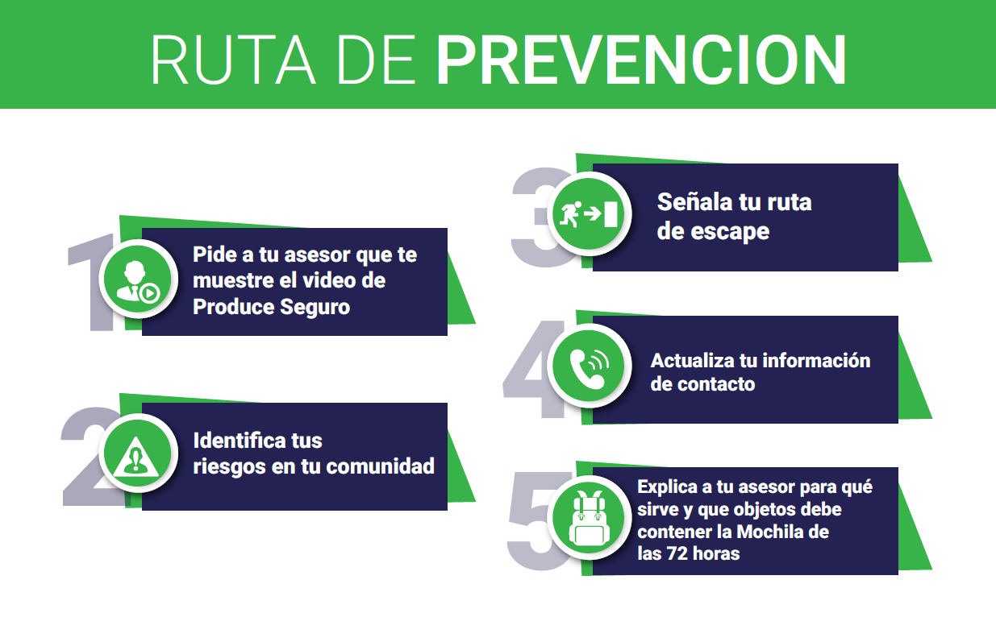


Added value program
The Value Added program offers a tangible component to the insurance product and helps clients to be more resilient when facing a disaster. This program includes risk management fairs, sending information via SMS, a board game and a 72 hours backpack.
A specific game was designed for customers to have fun while learning about nature disaster preparedness
The prevention route consists of 5 steps that encourage preparation

Slide 13
That is how it works
https://www.youtube.com/watch?v=LKgHIWcFd40&t=1s

Slide 14

Expanding the limits of insurability with technology
Carlos Boelsterli
Director of MiCRO

Slide 15


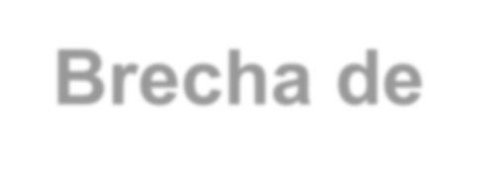

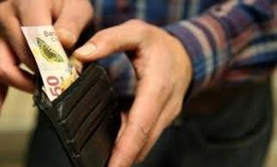



The issue
Multiple reasons:
Low income, high costs
Distribution in remote areas, scalability
Difficult subscription and adjustment of individual claims
“Risk culture”, product attractiveness
Little innovation, inadequate regulatory framework
Etc.
In Latin America, on average, only 12% of economic losses after a catastrophic event are insured
Swiss Re, Sigma, March 2015
Accessibility +
Protection Gap
-
$ Affordability $$$

Slide 16
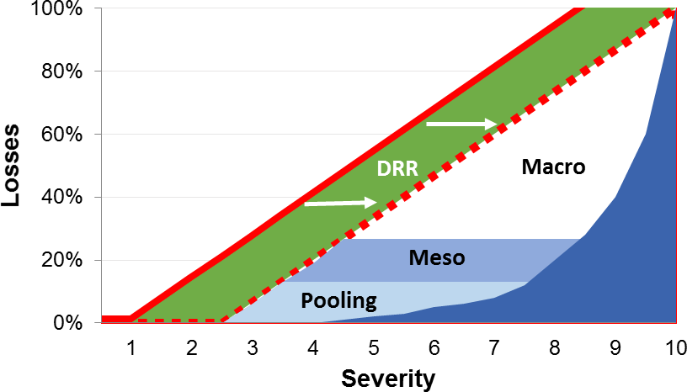
Closing the protection gap
Holistic strategy
Disaster Risk Reduction (DRR)
Adopt measures to strengthen resilience, increase competitiveness, ensure empowerment
Pooling
Luck community created with input from members
Participants
Micro
Individuals as direct beneficiaries of the coverage
Meso
Aggregator covering its own interests (portfolio) Macro
Government at the central, departmental or municipal level as a beneficiary of coverage

Slide 17

What does MiCRO do?
https://youtu.be/BMy3GTPBfqY

Slide 18




Diseño de productos paramétricos
Design of parametric products
1.
Prioritization of insurable risks that cause damage to the target population
2.
Selection of data sources to monitor the danger remotely
3.
Modeling of high correlation indexes with field losses
4.
Design of payment thresholds for each covered hazard and by location

Slide 19
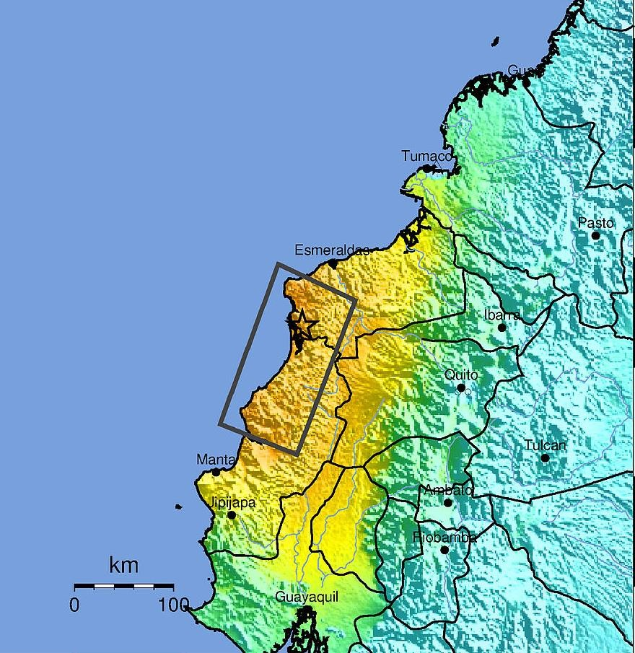
Ejemplo
Example: Earthquake
The calculation platform "reads" the ShakeMap, identifies the impacted locations and assigns them the compensation level based on pre-agreed terms.
All customers in the same location receive the same compensation percentage
Ecuador: April 16 earthquake
100%
75%
50%
25%
ÍIndex
USGS ShakeMap, M 7.8, Apr 16, 2016
Locations

Slide 20
Productos paramétricos
Parametric products
Advantages
Challenges
Requirements
Existence of insurable interest
Indexes that reliably record relevant and insurable phenomena
Adequate correlation between deviations
of the index and losses in the field
Affordability
Accessibility
Transparency
Fast payments
Base risk
Data access
Regulation
The case of MiCRO:
The continuity of the productive activity is the insurable interest (indirect damages)
Covers all types of productive activities
The sum insured is limited to the initial amount of the credit for the productive activity
The calculation platform allows payments to be very fast
Studies prove index correlation with field damage

Slide 21


Distribución
Distribution
Individuals
Farmers and microentrepreneurs
Main Aggregator
Microfinance, Institutions and Coop
Local Insurer Local insurance company
Reinsurance Risk Takers

Slide 22
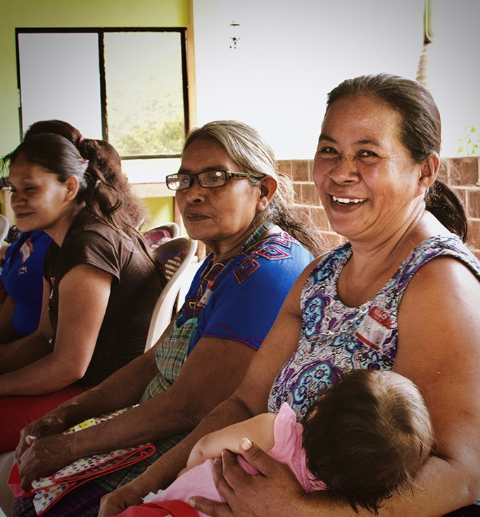
What MiCRO offers its local partners
Assistance in design and implementation of integral solutions:
  Parametric microinsurance product that protects commercial disruption caused by relevant natural disasters
  Added value program (AVP) that integrates preparation as social marketing.
  Financial Education program and marketing for the product.
  Calculation platform for product operation.
  Monitoring and evaluation of the microinsurance product.
  Assessment for the design and implementation of other risk transference strategies to increase protection.

Slide 23
Thank you!

