Slide 1
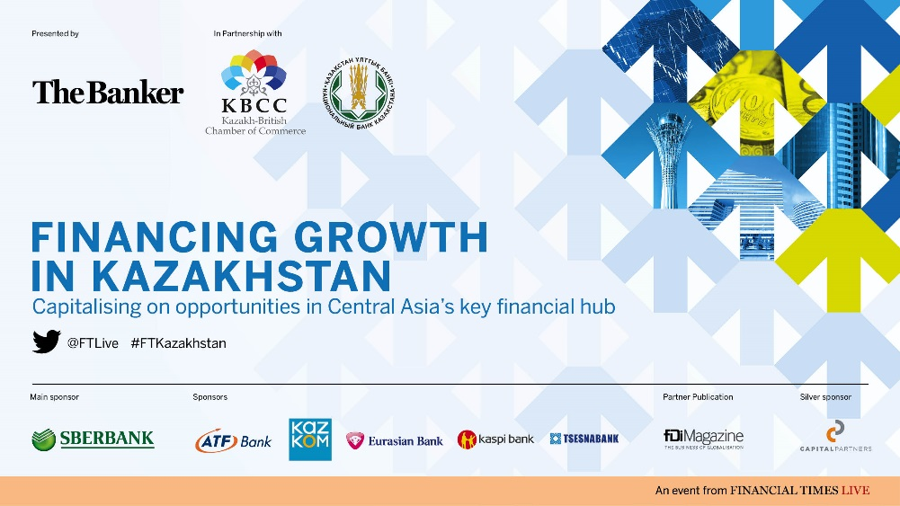

Slide 2
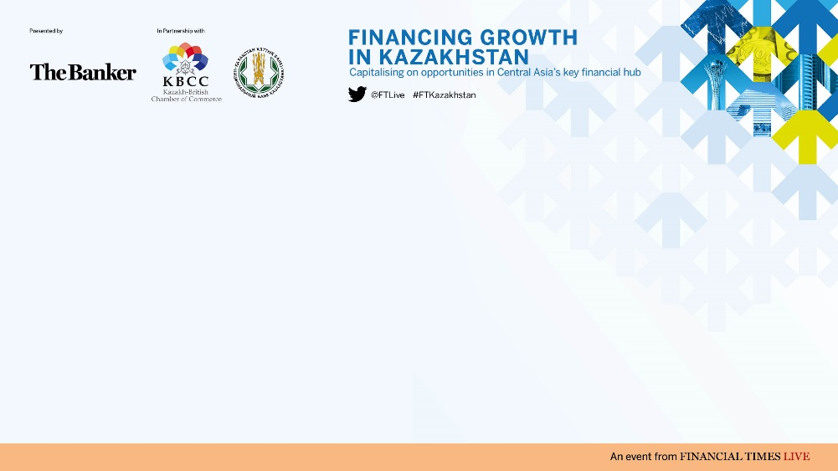
Welcome
Artur Krivov, President,
Kazakh-British Chamber of Commerce

Slide 3
Welcome remarks from the Chairman
Brian Caplen, Editor, The Banker

Slide 4

Keynote address: Kazakhstan as the financial hub of Central Asia
His Excellency Karim Massimov,
Prime Minister, Republic of Kazakhstan
Akhmetzhan Yesimov, Mayor of Almaty,
Republic of Kazakhstan

Slide 5
Address: Fostering and facilitating the
growing opportunities for trade and
investment between the UK and Kazakhstan
Professor Charles Hendry MP, UK Prime Minister’s Trade Envoy to Kazakhstan, Azerbaijan & Turkmenistan

Slide 6
The outlook for Kazakhstan and the role of financial sector and other policies
Jonathan Dunn, Deputy Division Chief,
Middle East and Central Asia Department, International Monetary Fund

Slide 7
The Economic Outlook for Kazakhstan and
The Role of Financial Sector and Other Macroeconomic and Structural Policies
Jonathan Dunn
Deputy Division Chief
Middle East and Central Asia Department
International Monetary Fund
November 2014

Slide 8
Outline
Economic developments, outlook, and risks
Financial sector developments and macro-financial linkages
Policies to promote long-term sustainable growth

Slide 9
Economic developments, outlook and risks

Slide 10
Economic developments
Solid growth over the past decade, supported by rising oil prices and output, helped Kazakhstan achieve upper middle-income country status…

Slide 11
Economic developments
However, output growth has decelerated in recent years and vulnerabilities remain.
Standard Deviation of Annual Real GDP Growth Rates (2003-13)
Kazakhstan | 2.985 | Brazil | 2.427
Russia | 4.594 | India | 2.191
China | 1.956 | South Africa | 2.052

Slide 12
Economic developments
Also economic growth is narrowly based.

Slide 13
Economic outlook
The near-term outlook has become less favorable, given a weaker global backdrop, while medium-term prospects are stronger…

Slide 14
Risks to the outlook
Risks to the near-term outlook are predominantly external and on the downside...
Slower-than- expected growth in emerging markets
Russia, China, global commodity demand
Exports and FDI
Renewed concerns about financial stability
Channel
Impact
Lack of progress on NPLs, further tenge devaluation
Risk
Geopolitical risks
(Russia-Ukraine, Middle East)
Transport disruptions, Russia growth, and ruble depreciation
Exports,
project financing, FDI, bank credit lines
Domestic confidence

Slide 15
Financial sector developments and macro-financial linkages

Slide 16
Financial sector developments and macro linkages
An unsustainable surge in external borrowing pre-crisis led to unsustainable growth in credit, the stock market, and housing prices…

Slide 17
Financial sector developments and macro linkages
This culminated in a sharp reversal in credit expansion, magnified by deleveraging, especially in the real estate sector…

Slide 18
Financial sector developments and macro linkages
Slow recovery in credit led to a marked deceleration in growth (notwithstanding a quick rebound from the crisis), exacerbating the rise in NPLs and limiting the recovery in banks’ capital…

Slide 19
Financial sector developments and macro linkages
The policy response to the financial crisis addressed two important concerns:
Bank recapitalization (mainly through state ownership)
Restructuring of banks’ external liabilities
However, the asset side of banks’ balance sheets was not sufficiently addressed, leading to persistently high NPLs

Slide 20
Financial sector developments and macro linkages
High NPLs are concentrated in large banks—in particular BTA—and originated mostly in non-tradable sectors of the economy (e.g. construction and services)

Slide 21
Financial sector developments and macro linkages
More recent aggressive efforts to tackle the NPL problem are noteworthy:
Ceilings on NPLs (10 percent by end-2016)
Substantially increasing the financing and flexibility of the Problem Loans Fund (PLF)
Amending the tax code to encourage write-offs
Removing legal obstacles to the transfer of NPLs into Special Purpose Vehicles (SPVs) or the PLF
Implementation is key

Slide 22
Policies to promote long-term sustainable economic growth

Slide 23
Policies to promote long-term sustainable growth
Long term prospects for Kazakhstan are good:
Country endowed with natural resources
Disciplined management of oil wealth
Enhancing the macroeconomic policy architecture and promoting a business environment unencumbered by the state remain key challenges to:
Becoming a dynamic emerging market economy
Ensuring durable and balanced long-term growth

Slide 24
Policies to promote long-term sustainable growth
I. Build a stronger financial system
Fully implement the NPL resolution framework
Bolster the financial safety net:
    Further strengthening macroprudential regulations
    Enhancing risk-based supervision
Address the high incidence of financial dollarization

Slide 25
Policies to promote long-term sustainable growth
II. Bolster monetary and fiscal policy frameworks
Monetary policy:
Strengthen the role of interest rate instruments
Allow for greater exchange rate flexibility
Enhance communications
Fiscal policy:
Consolidate the oil fund within the budget
Integrate the fiscal accounts within a broader macroeconomic framework
Improve revenue policies

Slide 26
Policies to promote long-term sustainable growth
III. Speed up implementation of structural reforms
Promote a diversified private-sector led growth strategy
Strengthen human capital and institutions
Collaborate closely with the multilateral development organizations

Slide 27
Conclusions
Oil wealth has helped Kazakhstan achieve middle income country status and boosted living standards
The near-term outlook has become less favorable, though assuming sound policies are pursued medium and long-term prospects are strong
In particular, building a robust financial system and strengthening macroeconomic policy frameworks are paramount to insulating the economy from shocks
Ultimately, promoting private-sector led growth is key to ensuring sustainable development and inclusive prosperity

Slide 28
THANK YOU

Slide 29
Perspectives: Taking the next steps to deliver growth and competitiveness in Kazakhstan banking sector
Magzhan Auezov, Managing Director,
Kazkommertsbank, Chief Executive Officer, BTA

Slide 30


Integration in progress…
Дальнейшие шаги по повышению конкурентоспособности
банковского сектора Казахстана
Магжан Ауэзов
Управляющий директор АО «Казкоммерцбанк»
Председатель Правления АО «БТА Банк»
Ноябрь 2014 г.

Slide 31













2014 год – поворотный для банковского сектора Казахстана
Выход Государства из капитала коммерческих банков
Расширение перечня инструментов фондирования в тенге
Размещение средств ЕНПФ в банках (долгосрочные облигации и депозиты)
100 млрд. тенге через ДАМУ в сектор МСБ через банки
Процентно-валютные свопы в тенге
Слияния и поглощения
Уменьшение доли иностранных банков

Slide 32
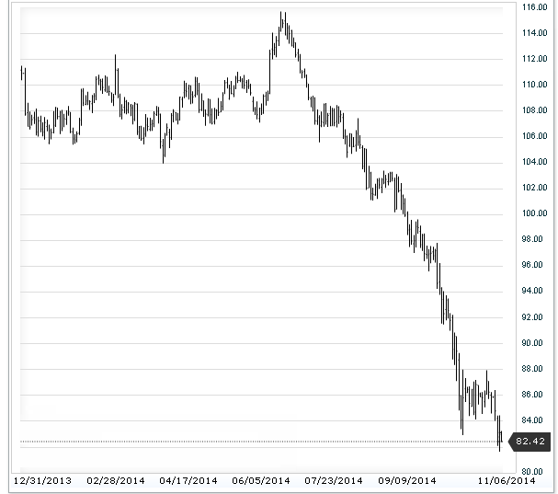
Макроэкономические вызовы (1/2)
Динамика цены на нефть марки Brent
Снижение цен на основные экспортные товары
Влияние девальвации рубля на тенге и усиление конкурентного давления на казахстанских производителей
Секторальные риски – сельское хозяйство, потребительское кредитование
Источник: www.Investing.com
Динамика курса RUR/$ – 44.4 рубля за $1 на 4.11.14
Источник: ЦБ РФ www.cbr.ru

Slide 33
Макроэкономические вызовы (2/2)
ВВП и инфляция
Международные резервы, млн долл.
Источник: www.nationalbank.kz
Тем не менее, базовые макроэкономические показатели остаются положительными.

Slide 34
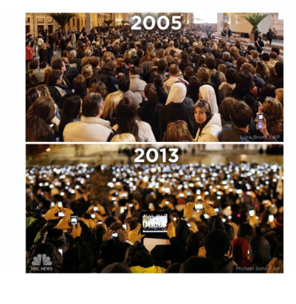
Площадь Св. Петра. Избрание Папы Римского

Slide 35

Внутренние вопросы и их решения
к
лиентоориентированность. Обновление продуктовой линейки в соответствии с быстроразвивающимися потребностями казахстанских клиентов, с учетом продуктового предложения на более развитых рынках
Высокая конкуренция за качественных заемщиков ведет к снижению маржи при высокой зависимости доходов банков от кредитования
Узкая продуктовая линейка, отстающая от реальных потребностей клиентов
Концентрация банков на внутренних вопросах
к
росс-продажи. Разработка и предложение соответствующей продуктовой линейки и организации кросс-продаж комиссионных продуктов для снижения зависимости от кредитования
к
онтроль над расходами путем оптимизации операционной модели банков и предложения инновационных решений

Slide 36
Ожидаемые Результаты 2016-2018 гг.
Нормализация уровня недействующих кредитов в результате инициатив НБ РК и Правительства
Расширение продуктовой линейки
Рост доходности банков с акцентом на непроцентные доходы
Синергия, реализованная в результате завершения объединения банков
Повышение рейтингов и возврат на международные рынки капитала

Slide 38
Address: Regulation and governance in the Kazakhstan financial sector
Kairat Kelimbetov, Governor, National Bank of Kazakhstan
Miklos Dietz, Managing Director, McKinsey & Company
Timur Suleimenov, Member of the Board, Minister of Economy & Financial Policy, Eurasian Economic Commission

Slide 39
KAIRAT SLIDES – INSERT HERE

Slide 40
Address: Regulation and governance in the Kazakhstan financial sector
Miklos Dietz, Managing Director, McKinsey & Company
Kairat Kelimbetov, Governor, National Bank of Kazakhstan
Timur Suleimenov, Member of the Board, Minister of Economy & Financial Policy, Eurasian Economic Commission

Slide 41
Consolidation in the banking sector
Nurlan Abdrakhmanov, Director of Department for Methodology of Control and Supervision, National Bank of Kazakhstan

Slide 42
Capitalising on consumer and business demand through the modernisation of banking systems
Matthieu de Heering, Head of Russia,
CIS and Mongolia, SWIFT

Slide 43
A perspective on SWIFT, Regulation and Standards
Matthieu de Heering
Head of Russia, CIS, and Mongolia - SWIFT
07Nov2014

Slide 44

SWIFT is the global provider of secure financial messaging services
212
10k+
5*9
Notes:
212 countries
10 000 + Institutions
99.999 availability
COOPERATIVE
THREE PILLARS:
COMMUNITY
STANDARDS
AND PLATFORM

Slide 45

Messaging
21 mio
FIN messages per day
6 billion
FIN
messages per year
6 trillion USD per day
25 mio
peak day messages

Slide 46





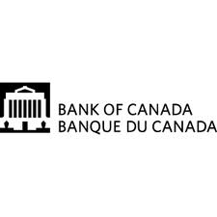





Oversight
Governance
Board
Board committees
National Member Groups
National User Groups
Notes:
Stress oversight from RIKS
Stress governance and the fact that SE board member chairs SSC and Norwegian ESA board member chairs BPC

Slide 47
SWIFT in Russia, CIS & Mongolia
1989: First customer, VEB
  in Kazakhstan: Kazakh Interbank Settlement Centre
2009: SWIFT Moscow office opened
  Kazakhstan is 2nd country by traffic
Today: 1000+ customers
  in Kazakhstan: 43
Traffic growth: 60% plus
Payments represent biggest business
  cross border and domestic

Slide 48
Agenda
SWIFT Community approach & cooperation with our members
  Market Infrastructures
  Participants
Focus on Financial Crime Compliance

Slide 49
Engagement for our communities

Slide 50
ISO 20022
How does it fit into the ISO structure?
ISO Technical Committee TC68
Financial Services
SC2
Security
SC4
Securities
SC7
Banking
ISO 20022
RMG
RMG members nominated by P-member countries and A-liaison organisations
TSG & SEG members nominated by all member countries and liaison organisations
TSG
RA
SEG
Securities
SEG
Trade Services
SEG
Payments
SEG
FX
SEG
Cards
Notes:
Where does the ISO 20022 platform fit in the ISO structure?
ISO is a federation of 164 national standards bodies, i.e., the ISO member countries. The standardisation work is spread over various ‘Technical Committees’ (TCs) to which the 164 ISO member countries can decide to participate. Technical Committee TC68 is in charge of ISO standards related to Financial Services (such as the BIC, the LEI, the IBAN, the ISIN, the CFI, the MIC, ISO 8583, ISO 15022 and many others, including ISO 20022).
The work of TC68 is further split among three ‘Sub-committees’ (SCs), each in charge of standards for a specific area. In total, 78 ISO member countries are involved in the work of TC68 and its Subcommittees, among which 31 are actively participating in the standardisation work (they are called the ‘P’-member countries). In addition, standards organisations, which because of their international nature, cannot access the ISO work through a specific country, can be authorized to establish a direct ‘Liaison’ with the TCs or SCs they are interested in. When they participate actively in a committee, these Liaison Organisations are called category ‘A’ liaison organisations. In total, TC68 and its sub-committees have accepted 16 liaison organisations, such as the ECB, EPC, ISDA/FpML, FIX Protocol Ltd (FPL), ISITC, IFX Forum, Mastercard, VISA, Euroclear, Clearstream and SWIFT.
ISO 20022, because it covers all financial messages, reports directly to TC68. Other standards generally report to the Subcommittees. As such, the ISO 20022 Registration Management Group reports to TC68 and the RMG members can be nominated by the P-member countries and the category ‘A’ liaison organisations. The RMG monitors the RA, the TSG and the SEGs. The RA is nominated by TC68 and has a specific contract with ISO. The TSG and SEG members can be nominated by any type of TC68 member countries or liaison organisations.

Slide 51
Legal Entity Identifier
Enable consistent and accurate identification of all legal entities that are parties to financial transactions to support systemic risk management.
More than 60,000 codes issues
Standards body - ISO17442
  Standard approved in May 2012; endorsed by FSB
  Non-intelligent alpha-numeric ID - unique, persistent and freely available

Slide 52
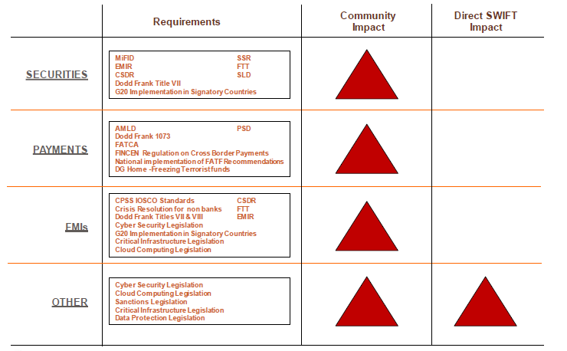
Regulatory Summary – SWIFT Community

Slide 53
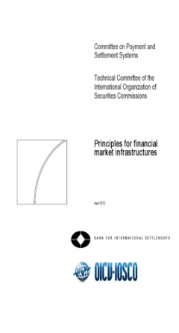
Principles for Financial
Market Infrastructures (PFMIs)
Foster financial stability
Limit systemic risk
Increase safety
Support greater efficiency
Published by CPSS-IOSCO
24 principles
Issued for consultation in 2011
Finalised in April 2012
To be applied December 2012 (*)
(*) “CPSS and IOSCO members will strive to adopt the new standards by the end of 2012 and put them into effect as soon as possible”
High Value Payment Systems
Low Value Payment Systems
Central Counterparties
Central Securities Depositories
Trade Repositories
Critical Service Providers

Slide 54
What are Critical Service Providers (CSPs)?
Annex F - Principles underlying the key role of CSPs
CSPs are 3rd party service providers delivering services that are critical to FMIs’ operations
FMIs depend on the continuous and adequate functioning of CSPs
FMIs need to assess the reliability of the CSPs they rely on
A strong CSP should
  Meet the FMI’s functional requirements
  Ensure full compliance with the oversight expectations for CSP in PFMI (Annex F)
  Commission verification of compliance (assurance process)

Slide 55
Expectations for robust, secure and resilient CSPs
Annex F : Oversight expectations applicable to CSPs
Risk identification management
Information security
Reliability and resilience
Technology planning
Communication with users

Slide 56
SWIFT’s role in the PFMIs
SWIFT is a Critical Service Provider
SWIFT has identified itself as a CSP for the services it provides to FMIs
Notes:
SWIFT is a critical service provider
SWIFT is not an FMI
SWIFT core products and services should not be considered outsources services

Slide 57
SWIFT complies with PFMI annex F
How do we demonstrate Compliance?
Today, SWIFT supports FMIs in their Compliance…
PFMI Annex F: Oversight expectations applicable to CSPs | ISAE 3402 and High Level Expectation Assurance report
Risk Identification management
Information Security
Reliability and resilience
Technology planning
Communication with users
√
√
√
√
√

Slide 58
T2S – where SWIFT fits in
T2S brings harmonised Delivery versus Payment securities settlement to the EU, with the aim of making cross border settlements as efficient as domestic settlements.
Closely aligned with the CSD-Regulation
Follow up of Giovannini assignment
23 participating CSDs
4 CSD migration waves for T2S
Messaging Standards – ISO 20022
SWIFT is one of the value-added network suppliers

Slide 59
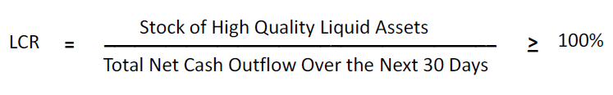
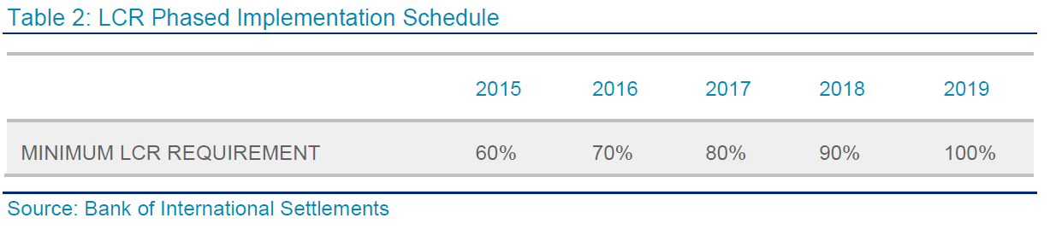
Basel III and Intraday Liquidity Reporting
Global
Content
Impact
Capital requirements
Liquidity requirements
Leverage ratio
Additional capital buffers
Improved monitoring of available liquidity

Slide 60
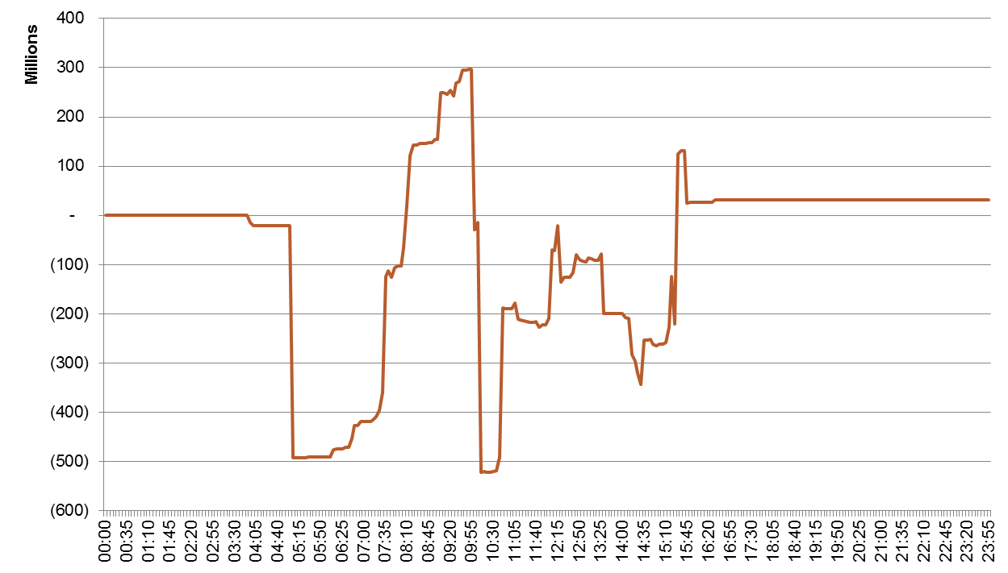
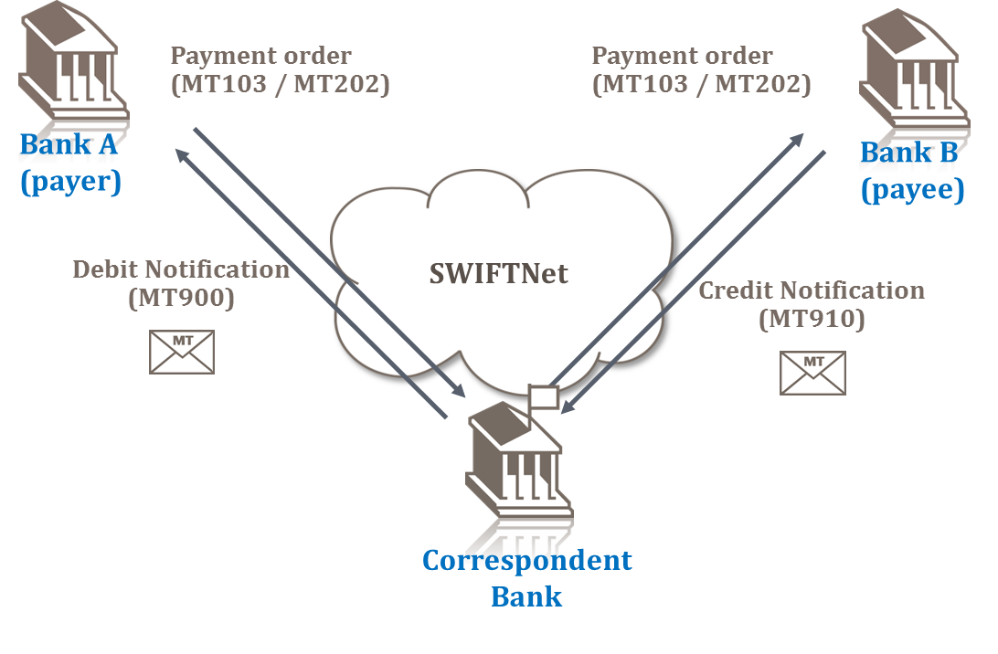
Liquidity reporting and management
Options
Intraday liquidity
  MT900
  MT910
Intraday reporting
  MT94x
End-of-day reporting
  MT950
Real-time full information
  FINInform
Business Intelligence

Slide 61
SEPA
Content
Impact
Borderless system for secure and efficient transfers within the EU
Deadline Eurozone – August 2014
Deadline remaining EU – 2016
Covers credit transfers and direct debits
Impacts banks and corporates
Increased ISO20022 adoption
Mandatory IBAN adoption
IBAN to BIC mapping required
Increased need for reference data

Slide 62
How SWIFT supports members in SEPA compliance
Effective
SEPA Compliance
Analysis
Messaging
Ref. Data
Training
- Impact Analysis
- BBAN to IBAN
conversion
- Standards
mapping
- Integration
FileAct
SEPA Plus
IBAN Plus
ISO20022
SWIFT
Notes:
62

Slide 63
Financial Crime Compliance

Slide 64
A community issue calling for a community solution …
Financial crime is top of the agenda for banks
All geographies / All types of players impacted
Significant costs
at stake….
... Yet no competitive advantage for banks
Lots of duplication…
… for universal challenges

Slide 65
Financial Crime Compliance Roadmap
Live
Development
Qualification
Standards
Sanctions list service
Exploration
Data repository
KYC registry
Traffic analysis
Business intelligence for Compliance
Processing services
Scree-ning
Testing
FATF 16
Quality
Traffic restriction (RMA)
AML testing & tuning
Sanctions
KYC
AML
Notes:
Two words one each:
Screening – in the cloud without banks needing to operate own infrastructure (small medium banks)
Larger ones have their own infra – Testing to make sure and be able to demonstrate that it works with empirical analysis
RMA – make sure you are doing business with the entities you wanna do business with
BI 4 compliance – using SWIFT stats to do better monitoring on AML (banks know what they are doing but not what the market is doing from a compliance perspective) Q2 next year
KYC registry – building a utility solution for bilaterally expensive problem, using information submitted to SWIFT upon joining of all 10k institutions. We provide data resp.ty is with banks
FATF 16 – how to ensure that regulatory required ordering and beneficiary of the payment properly identified in payment qualification = know we will do it, looking at how
Sanctions list service – harmonised list service
AML testing and tuning – similar to testing but for AML versus terrorism
CONCULSION – SWIFT community sees financial crime compliance as a transformational movement for SWIFT – high economies of scale and non competitive, and we are ideally positioned (as global provider of int’l xbd flows)

Slide 66
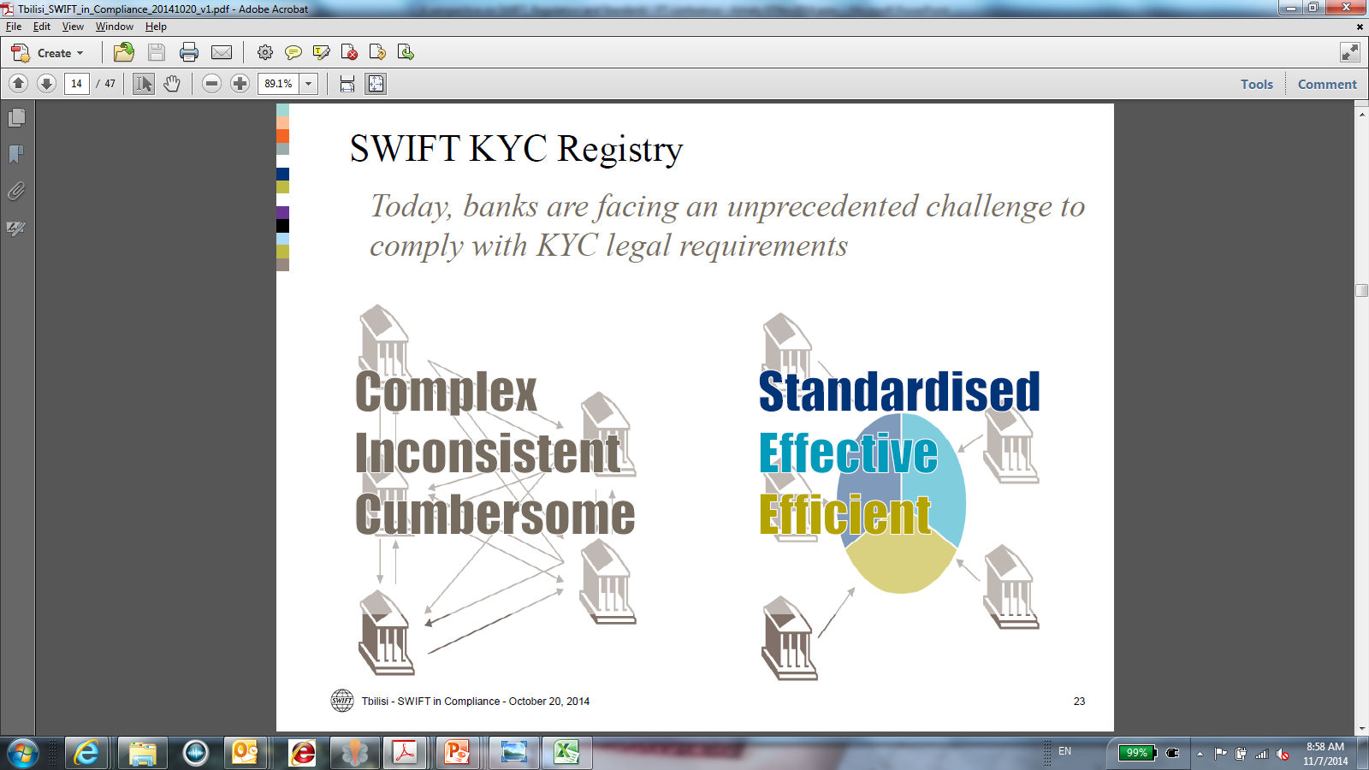

Slide 67
KYC Registry – Guiding principles
A SWIFT managed global KYC Registry
Leverage SWIFT membership process
Provide enrichment based on SWIFT traffic data
Operated and secured according to SWIFT standards
Focus on banks KYC (reach to more than 7000 banks)
Banks remain (1) owner and in control of their information and
(2) responsible for their KYC process, criteria and results.

Slide 68
Thank you
Matthieu de Heering
Геринг Матвей Филиппович
Head of Russia CIS Mongolia
Руководитель московского офиса SWIFT
Глава региона Россия, СНГ и Монголия
T
+7 495 228 5923
matthieu.deheering@swift.com
www.swift.com
E
W

Slide 69
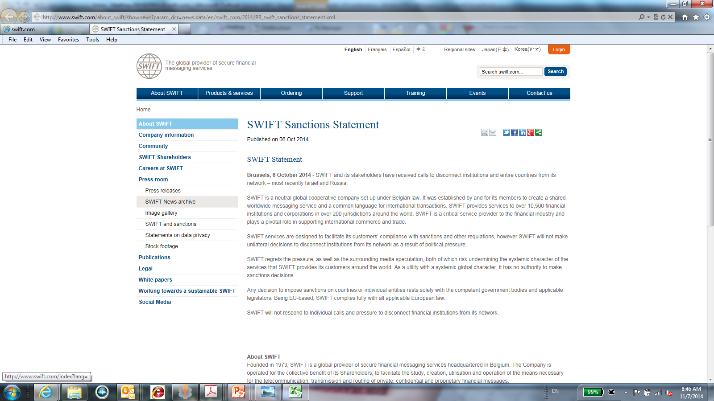
Sanctions Statement

Slide 70
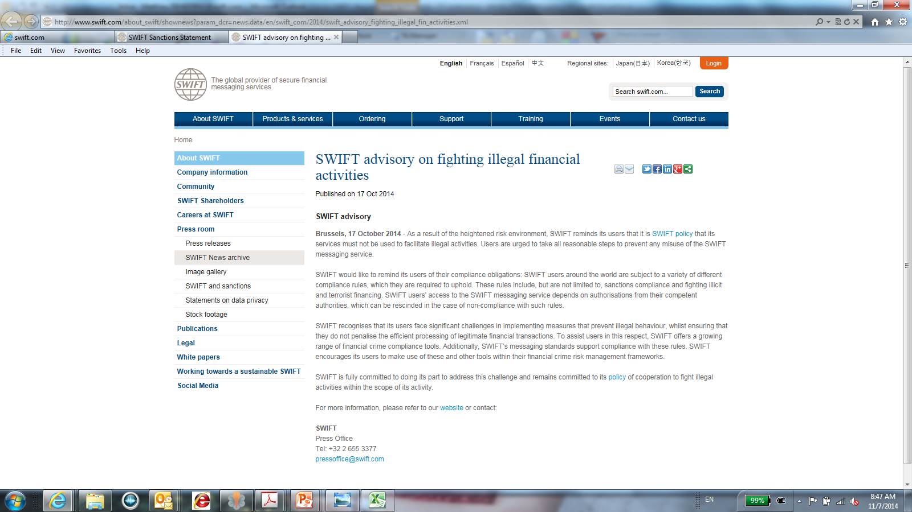
Advisory on fighting illegal activities

Slide 71
Towards effective management in capital and exchange rate markets
Livio Stracca,Head of International Policy Analysis, European Central Bank

Slide 72

Towards effective management in capital and exchange rate markets
Kristina Bluwstein and Livio Stracca*
European Central Bank
Financing Growth in Kazakhstan
Capitalising on opportunities in Central Asia’s key financial hub
7 November 2014, Almaty
* We thank Michael Sturm for very useful comments and suggestions. The views expressed are personal.
Notes:
Thank you for inviting me to this very interesting event. It is really a pleasure to be here in Almaty for the first time.
This is joint work with my colleague Kristina Bluwstein and benefited from important comments by Michael Sturm. An important disclaimer is that what I present today represents solely my views, and not the official views of the European Central Bank.

Slide 73
Common Challenges of Oil Exporters
1
Long term: Quality of institutions and coping with the Dutch Disease
2
Cyclical: How to deal with the volatility of oil revenues
3
What role for monetary policy
Notes:
Challenges to oil exporting countries can be divided into two categories, long term and short term.
In my presentation today, I will first deal with the long term questions, then move to the short term challenges – dealing with the volatility of oil revenues – and finish with the role of monetary policy and the management of capital flows.
I will try to provide an horizontal view and provide benchmarks, against which I will assess the particular situation of this country, Kazakhstan.

Slide 74
Overview of the Presentation
1
Long term: Quality of institutions and coping with the Dutch Disease
2
Cyclical: How to deal with the volatility of oil revenues
3
What role for monetary policy
Notes:
Let me therefore start with the long term challenges, which are often defined in terms of inter-generational equity, given that oil and other commodities are often non-renewable resources.

Slide 75
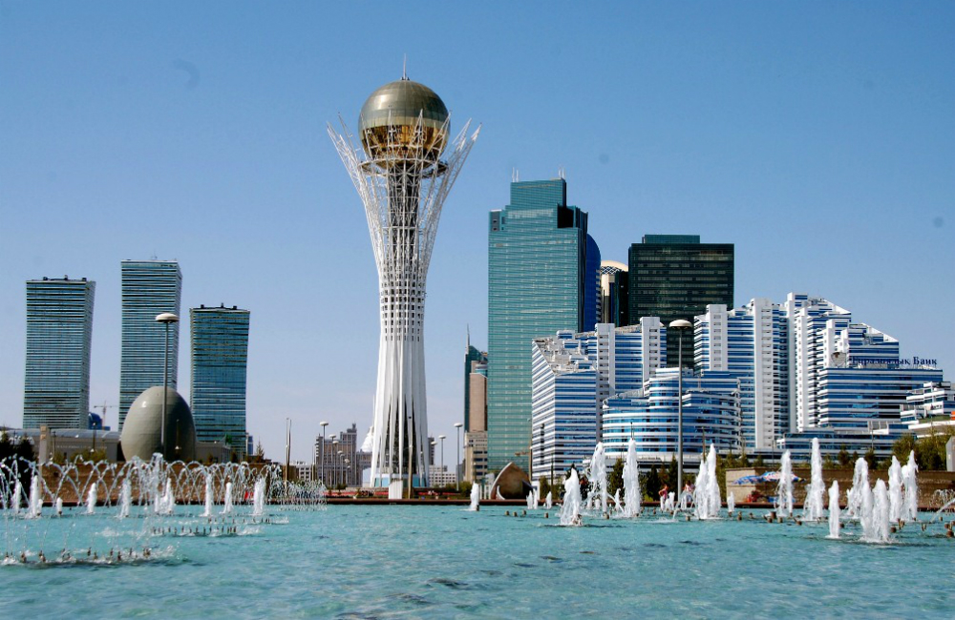
Oil windfall gains due to high oil prices
Natural resources are obviously an asset, but there are considerable challenges to deal with
Notes:
Obviously one cannot argue with the notion that natural resources, including oil, are a boon for the countries possessing it. But it is a blessing that requires some care!

Slide 76
Oil trade balance to GDP
Source: WDI , own calculation.
Notes:
As you can see, KZ is quite highly dependent on its oil exports, in line with the average for OPEC countries.

Slide 77
The long term challenges
Macro: the Dutch disease
Micro: the quality of institutions
More than half of resource dependent economies are low or middle income countries
Notes:
The long term challenges can be divided into two, related, categories. The so-called “macro” challenge is the dutch disease, namely the excessive appreciation of the exchange rate which prevents the development of other domestic industries and services. The “micro” challenge is that natural resources wealth may prevent the development of good institutions, leading to the “curse of natural resources” or “good economics, bad politics”. All this impinges on inter-generational equity, because natural resources are exhaustible.
It is perhaps not by chance that most resource rich economies are also relatively poor countries. There is indeed a long literature in economics on the “curse of natural resources”.

Slide 78
The Dutch Disease
Dutch Disease: Specialisation on natural resources can lead to a decline in domestic manufacturing and agricultural sector (e.g. Corden and Neary, 1982; Stijns, 2003)
Rising commodity prices can lead to
Appreciation (Chen and Rogoff, 2003)
Fall in competitiveness in non-oil sector (Spatafora and Warner, 1999)
Fall in non-oil output and further specialisation on natural resources
Little innovation and growth in non-oil sector in the long term (Sachs and Warner, 2001)

Slide 79
The possible solutions
Solution strategies:
  Quality of Institutions positively correlated with long term benefits of natural resources (Keikha, Keikha and Mehrara, 2012)
  More diversification could soften the blow of oil price shocks and increase competitiveness of non-oil manufacturing
  Oil fund to save current oil earnings for future generation and long-term growth projects

Slide 80
But is is not easy
Solution strategies:
  Quality of Institutions: How to change them exogenously?
  More diversification: how?
  Oil fund to save current oil earnings for future generation and long-term growth projects: Yes, but not clear what to do with the windfall gains
    With low quality of institutions, public investment may be inefficient
Notes:
The solutions proposed are certainly not easy to implement. The quality of institutions is of crucial importance, but it is not easy to change them in an exogenous way; often they are the result of historical evolution.

Slide 81
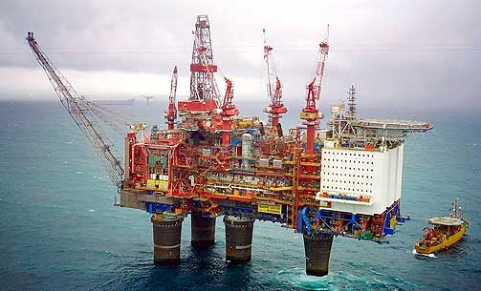
Norway
Notes:
An oil exporter with famously good institutions is Norway, which is an obvious benchmark for many oil exporting countries (and I will show more figures on Norway later). However, good institutions were developed in Norway long before oil was extracted in large quantities in the 1960s, so I am not sure how relevant Norway can be for other resource-rich countries.

Slide 82

Botswana
Notes:
A more interesting case could be Botswana, which does not export oil but diamonds.

Slide 83
Botswana
Botswana experienced remarkable growth
Good governance was a crucial determinant (IImi 2006; Acemoglu, Johnson and Robinson 2002)
  Voice and Accountability
  Government effectiveness
  Pro-business oriented policies
  Anticorruption laws
Once good institutions in place (Meija & Castel 2012)
Sustainable Fiscal Policy
Economic Diversification
Sustainable Growth in Botswana
Investment of Resource Wealth
Notes:
Botswana has achieved very high economic growth and has largely avoided the curse of natural resources. In part his reflects luck, such as a relatively homogenous population from an ethnic point of view and other historical reasons related to its colonial past, but also good choices by its leadership.

Slide 84
Quality of institutions
Source: Aljaž Kunčič (2014). Institutional quality dataset . Journal of Institutional Economics, 10(01), 135-161.
Notes:
The quality of institutions in KAZ is comparable to that of OPEC countries and still quite far away from Norway. Still, I note an improvement over time, though less so that the OPEC average.

Slide 85
Scope for more diversification in KAZ
Source: WDI , OPEC, own calculation.
Notes:
There is also scope for more diversification in KAZ, which remains highly dependent on fuel exports as I also mentioned before.

Slide 86
Common Challenges of Oil Exporters
1
Long term: Quality of institutions and coping with the Dutch Disease
2
Cyclical: How to deal with the volatility of oil revenues
3
What role for monetary policy
Notes:
Challenges to oil exporting countries can be divided into two categories, long term and short term.
In my presentation today, I will first deal with the long term questions, then move to the short term challenges – dealing with the volatility of oil revenues – and finish with the role of monetary policy and the management of capital flows.
I will try to provide an horizontal view and provide benchmarks, against which I will assess the particular situation of this country, Kazakhstan.

Slide 87
The cyclical challenge
Dependence on oil terms of trade (Kilian, 2009)
Oil terms of trade depends on US exchange rate
Current account could show high volatility to external shocks (Kilian, Rebucci and Spatafora, 2009)
Insulating the economy from oil price shocks is welfare improving (Pieschacon 2012)
Solutions
  Fiscal policy (Oil fund)
  Monetary policy
    Pegging to the USD not necessarily a good solution
Notes:
Speaking notes to be included (Livio)

Slide 88
Correlation between GDP growth and ..
 | Kazakhstan | Norway | OPEC Average
Terms of Trade Growth | 0.29 | 0.41 | 0.51
Oil Price Growth | 0.36 | 0.18 | 0.35
Source: WDI, own calculations based on annual data from 2000-2012.
Notes:
The correlation between GDP growth and oil prices is similar in KAZ as in other OPEC countries. It is lower in Norway. However, the correlation with the terms of trade is lower than both Norway and the OPEC average, which is good.

Slide 89
Terms of trade and oil price in USD
Source: WDI, own calculations.
Notes:
Terms of trade still depend a lot on the oil price in USD, in KAZ as well as comparator groups (OPEC and Norway).

Slide 90
Volatile terms of trade in KAZ
Source: Datastream, own calculations.
Notes:
As a result of volatile oil prices, terms of trade are volatile in KAZ.

Slide 91
KAZ current account volatile, but quite balanced
Source: WDI, own calculations.
Notes:
Although it is rather volatile, the current account is quite balanced in KAZ. It is as correlated with the oil price as for OPEC countries. For Norway (benchmark) the correlation appears to be lower.

Slide 92
But the effect on income growth is muted - good
Source: Datastream, own calculations.
Notes:
We find little evidence, however, that volatile terms of trade are translated into volatile real GDP growth. This is also the evidence we saw earlier in the correlation table.

Slide 93
Private consumption is however more volatile
Source: Datastream, own calculations.
Notes:
It is also interesting to look at private consumption.

Slide 94
GDP and terms of trade growth
Source: WDI, own calculations.
Notes:
Again, terms of trade growth and GDP growth are not too correlated in KAZ, which is a good sign.

Slide 95
Common Challenges of Oil Exporters
1
Long term: Quality of institutions and coping with the Dutch Disease
2
Cyclical: How to deal with the volatility of oil revenues
3
What role for monetary policy
Notes:
Challenges to oil exporting countries can be divided into two categories, long term and short term.
In my presentation today, I will first deal with the long term questions, then move to the short term challenges – dealing with the volatility of oil revenues – and finish with the role of monetary policy and the management of capital flows.
I will try to provide an horizontal view and provide benchmarks, against which I will assess the particular situation of this country, Kazakhstan.

Slide 96
Monetary policy goals
Stabilising oil revenues and income (together with fiscal policy)
Maintaining central bank credibility
There may be a trade-off between these two objectives
Notes:
Speaking notes to be included (Livio)

Slide 97
The trilemma for monetary policy
Trilemma
With tight exchange rate regime and free capital movement → monetary policy less effective
Independent Monetary Policy
Free Capital Flows
Fixed Exchange Rate
Notes:
Speaking notes to be included (Livio)

Slide 98
The position of KAZ
Source: Aizenman, Joshua, Menzie D. Chinn, and Hiro Ito (2008). Index based on 2011. KAZ Financia l Account Openness has not been updated since 1996 and is most likely a substantial underestimation for 2011.
Notes:
The “solution” chosen by KAZ appears to be low capital account openness, although it is difficult to judge since there is no recent data available, to our knowledge. KAZ has also opted for a high degree of exchange rate stability, although based on data up to 2008.

Slide 99
Low financial openness in KAZ
Source: Chinn, Menzie D. and Hiro Ito (2008). "A New Measure of Financial Openness". Journal of Comparative Policy Analysis,Volume 10, Issue 3, p. 309 – 322
Notes:
Again, data for KAZ might be outdated.

Slide 100
But current account broadly balanced
Source: WDI, own calculations.
Notes:
Speaking notes to be included (Livio)

Slide 101
The exchange rate regime in KAZ
Since 2013: peg to a basket of currencies (70% dollar, 20% euro, 10% Rouble)
Before 2009 and after 2011 peg to dollar/tenge corridor
From 2009-2011 managed floating regime
Source: WDI, own calculations.
Notes:
Speaking notes to be included (Livio)

Slide 102
The exchange rate regime in KAZ
Since 2013: peg to a basket of currencies (70% dollar, 20% euro, 10% Rouble)
Before 2009 and after 2011 peg to dollar/tenge corridor
From 2009-2011 managed floating regime
Source: WDI, own calculations.
Notes:
Speaking notes to be included (Livio)

Slide 103
Pegging to the dollar?
Getting paid in USD is not necessarily a good reason to peg to the USD (Setser 2007)
What oil exporters need is a currency regime that let their currencies appreciate when the oil price increases, and vice versa
Some form of inflation targeting is probably optimal, in particular when targeting producer prices (Catao and Chang 2013)
If a peg really is needed, better to a broad basket of currencies (Al-Abri 2014)

Slide 104
Pegging to the dollar?
However, pegging to the USD may also have advantages in practice (IMF 2008)
Inflation targeting may be difficult
Requires more financial openness that is politically difficult to achieve
“Pegging to the export price of oil (PEP) delivers automatic accommodation of terms of trade shocks, but could transmit significant volatility to other sectors of the economy” (IMF 2008)
Notes:
We would need a controlled experiment or at least empirical work, but we do not have enough observations available. Almost all oil exporters peg their currencies in a way or another.

Slide 105
Why the USD peg is not necessarily bad
No other way to establish credibility (inflation targeting too difficult)
Pegging as a way to run a de facto oil fund (Wills and can der Ploeg 2014) - if a proper oil fund cannot be optimally managed (e.g., if it can be raided)
During an oil price increase, the central bank accumulates foreign reserves, and indeed there is evidence for that (Bützer, Habib and Stracca 2014)
But the success of this policy depends on the openness of the capital account
  It only works under a relatively close capital account (which is typically the case for resource-rich countries) – only in this way can the central bank control net saving in the economy

Slide 106
Conclusions
A focus on the long term is crucial for resource rich countries. Key role of institutions; learn from leading examples (Norway, Botswana..). This is the key question
Fiscal policy, and notably the oil fund, plays a key role in the cyclical stabilisation. KAZ doing relatively well in this respect, it seems, but still highly dependent on oil prices and oil exports
The choice of the monetary policy regime is not obvious. Tension between theory and reality. No obvious way to improve KAZ’s current approach
Notes:
These are my main conclusions
Thank you very much for your attention and I look forward to actively participating to the rest of this interesting event.

Slide 107
Panel: The outlook for financial services in Kazakhstan
Michael Eggleton, Chief Executive Officer, Eurasian Bank JSC (Kazakhstan)
Anthony Espina, Chairman, Management Board, ATFBank JSC
Janet Heckman, Director, Kazakhstan, The European Bank for Reconstruction and
Development (EBRD)
Kairat Kelimbetov, Governor, National Bank of Kazakhstan
Mikheil Lomtadze, Chairman of the Management Board, Kaspi Bank
Antonio Riera, Senior Partner and Managing Director, The Boston Consulting Group
Moderator:
Brian Caplen, Editor, The Banker

Slide 109
Government Address: Restarting growth and competiveness in the Kazakhstan economy
Yerlan Sagadiyev, Vice Minister of Investment and Development, Republic of Kazakhstan

Slide 110
Address: Prospects for Kazakhstan as a
key Islamic Centre in Central Asia
Prasad Abraham, Chief Executive Officer,
Al Hilal Bank

Slide 111
Sector focus panel: Financing growth and investment in energy
Fatih Aydin, Emerging Markets, Investment Banking, Goldman Sachs
Andrey Kurilin, Chief Executive Officer, Citi Kazakhstan
Duncan van Bergen, Vice President and Country Chair, Kazakhstan, Shell
Moderator:
Jack Farchy, Moscow and Central Asia Correspondent, Financial Times

Slide 113
Panel: Infrastructure financing in Kazakhstan
Moazzam Mekan, Regional Manager, Central Asia, International Finance Corporation
Aaron Rubin, Chief Executive Officer, Macquarie Russia & CIS Infrastructure Fund
Askar Namazbayev, Principal Banker, Infrastructure Group, Central Asia & Russia, The European Bank for Reconstruction and
Development (EBRD)
Yerlan Sagadiyev, Vice Minister of Investment and Development, Republic of Kazakhstan
Moderator:
Jack Farchy, Moscow and Central Asia Correspondent, Financial Times

Slide 114
Panel: Financing and investment opportunities in Kazakhstan’s property
and real estate
Ogeday Sogut, Director, Capital Markets, Sales & Marketing, Scot Holland – CBRE
Kairat Kelimbetov, Governor, National Bank of Kazakhstan
Colin Breeze, Vice President Private Equity, Excel TriGlobal Property Fund
Umirzak Shukeyev, Chief Executive Officer, Samnuk Kazyna
Moderator:
Jack Farchy, Moscow and Central Asia Correspondent, Financial Times

Slide 115
Special Address
Umirzak Shukeyev, Chief Executive Officer, Samnuk Kazyna

Slide 116
Closing remarks and close of Conference
Kairat Kelimbetov, Governor, National Bank of Kazakhstan

