Slide 1

Change Management Creating A Learning Organization
@carolynpittis @welmandigital

Slide 2
Provoke (you to) #change
Notes:
Thank you to our conference organizers for inviting me to initiate the Change Management track.
A copy of my remarks are posted on the WelmanDigital blog for those of you notetakers or social media buffs.
These opening remarks are meant to do two things:
FRAME this afternoon's panel discussions around Organization, Process, and Technology.
PROVOKE your thinking.

Slide 3
1 What is Change?
^{改 变}
găi
change; transform. (v)
alter; revise. (v)
correct; rectify; put right. (v)
(followed by a verb) switch over to (doing something else).
biàn
to change;
to become different;
to transform;
to vary;
rebellion
Notes:
We all may have different connotations or emotional reactions to the word.
To the Chinese, the characters that say change can also mean "revolution." But we know that change can be evolutionary too.

Slide 4
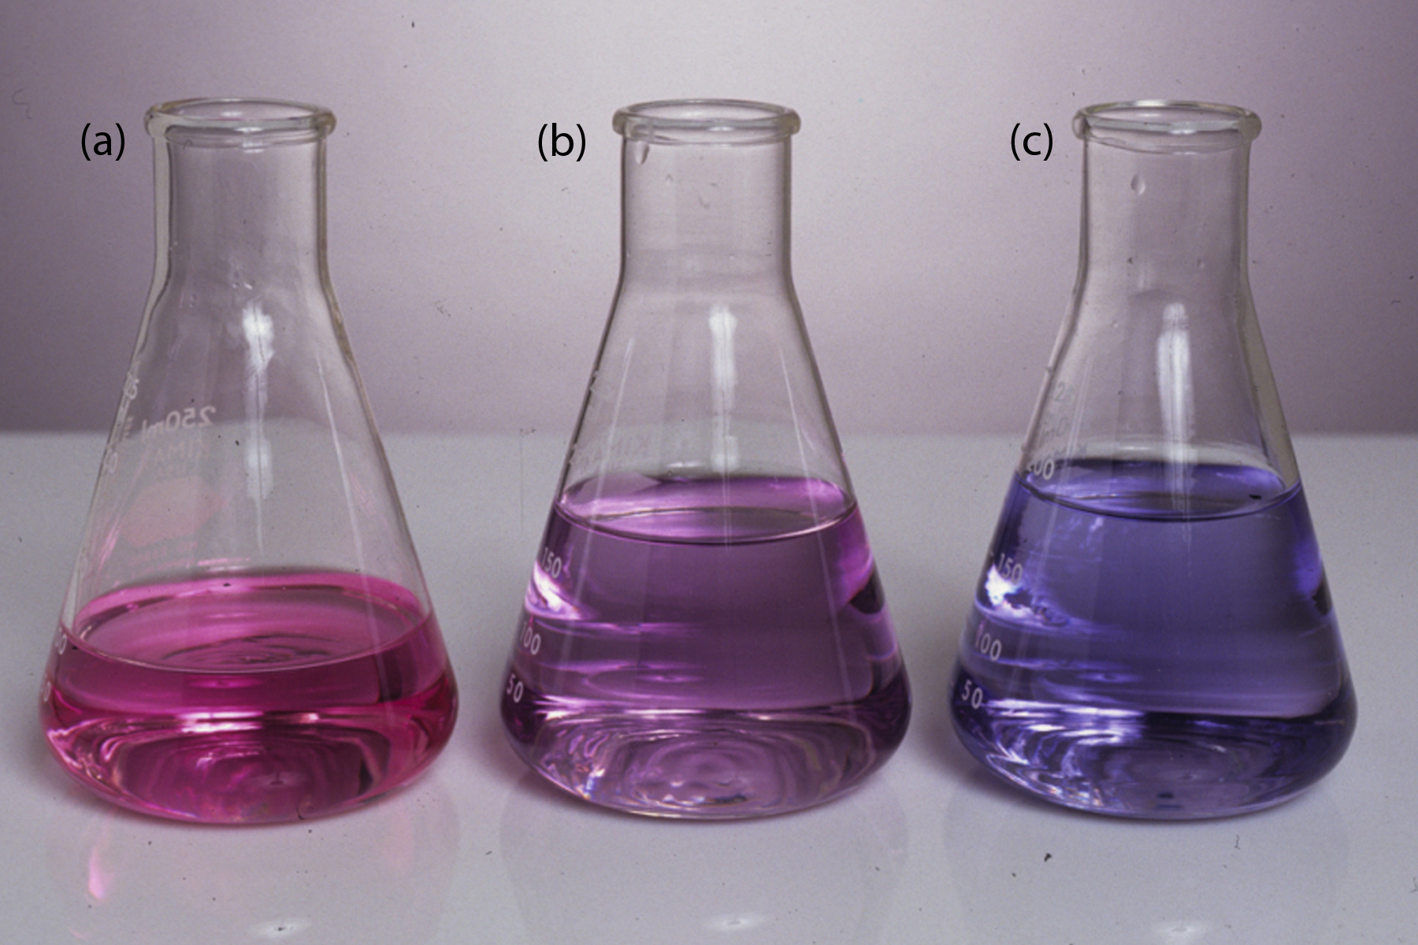
remember titration from Chemistry class?
1 What is Change?
Notes:
Implicit in our understanding of "change" is a measurable shift in state from one thing to another.

Slide 5
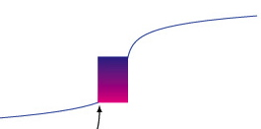
1 What is Change?
1 What is Change?
Is it still happening?
I don’t think anything’s happening?
Wait, I SEE IT HAPPENING!
Notes:
But rates of change are not always constant, the forces that move things may grow or decline over time. So too with people and change.
Change is hardest to support when we can't see whether it is happening - or at what rate.

Slide 6
1 What is Change?
1 What is Change?
Change that happens TO US
Change that happens BECAUSE OF US
Notes:
For our purposes today, there are two types:

Slide 7
1 What is Change?
1 What is Change?
Response Options
TO US
BECAUSE OF US
WORRY
CHANGE WHAT WE DO
COMPLAIN
CHANGE HOW WE DO IT
STRATEGIC
OPERATIONAL
Notes:
The change that has happened to us humans since the introduction of the personal computer is exponentially greater than anything that has happened in human history.
We find ourselves, as a result of this acceleration, at best only 50% fit for any job that we do.
There are two types of productive responses to where we find ourselves: changing what we do and changing how we do it.
Most of us are responsible for what you might call operational things - the "how to change” -- so that is my primary focus here.

Slide 8

2 What To Change?
Reader
Author
Reader
Reader
increase relevance for authors and readers at global scale
Author
Notes:
The Publishing Ecosystem – each of the players - exists to help connect writers with readers.
Our challenge, as ever, is to do this more efficiently, more effectively, and at higher levels personal relevance to both writer and reader
the twin customers of the publishing process -- both at global scale.
The job is both harder -- and easier -- than it used to be.
How we increase that relevance is what has shifted.

Slide 9
3 What is Change Management?
The process of mobilizing people from a lower to a higher set of measurable capabilities.
Creating a LEARNING ORGANIZATION.
Notes:
A pseudo-academic definition might be:
"The process of mobilizing PEOPLE from a lower to a higher set of MEASURABLE CAPABILITIES.”
Um, too much jargon. How about –
"Creating a LEARNING ORGANIZATION”
Everyone who ever struggled in math just relaxed a whole lot.

Slide 10
3 What is Change Management?
Acquires and applies new knowledge for the Organization’s benefit.
Enables bees to work for the health of the HIVE.
Notes:
A learning organization is one that:
"Acquires and applies new knowledge for the ORGANIZATION'S benefit."
Or:
"Enables bees to work for the health of the HIVE”
But, wait, bees do this naturally. It is innate. And so too with most humans. Humans are really good at norming their behavior to the needs of their peers. Social pressure is POWERFUL. GAMIFICATION is a trend that recognizes our need for peer status and uses that need to change both individual and group behavior. It turn out motivating people is not all about money!

Slide 11
3 What is Change Management?
Teams perform best when they work with individuals’ core strengths – and work around their allowable weaknesses.
Dr. Meredith Belbin
Notes:
A learning organization:
"works WITH the core strengths of individuals, and works AROUND what Dr. Meredith Belbin calls people's "allowable weaknesses”
the specific things that individual people don't do well.
Sometimes we need to get out of the way of innately good and curious behavior, and organize work to maximize fit of task, interest, and skill.

Slide 12
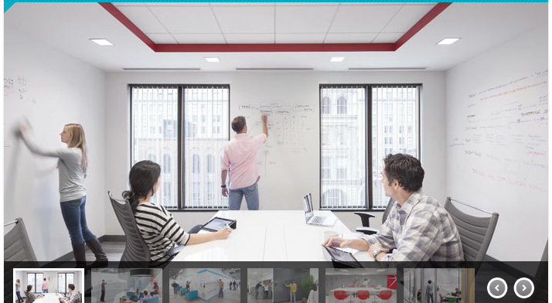
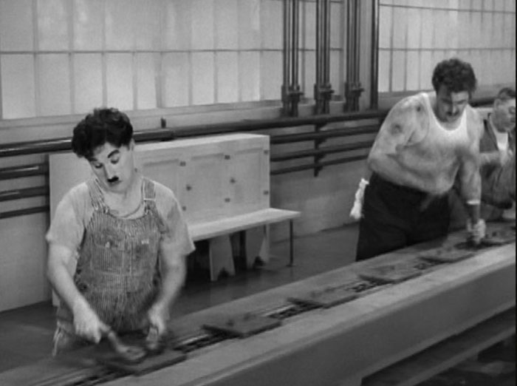
3 What is Change Management?
Notes:
The learning organization of our Modern Times is therefore the absolute reverse of the "habitual organization" designed for the First Industrial Age.

Slide 13

4 Whose Job Is Change?
Marketplace COMPLEXITY and
SPEED TRANSFERS
responsibility to the HIVE
Notes:
YOU, and the person sitting next to YOU.
The managerial ethos of a few all-knowing managers directing workers on assembly lines is antiquated.
If you are waiting for your CEO or Publisher to tell you what you should be doing differently, they are waiting for you to tell them.
What’s changed is that
The COMPLEXITY and SPEED of the global marketplace has TRANSFERRED responsibility FOR operational change to the hive.

Slide 14
4 Whose Job Is Change?
There's gotta be a better way . . .
But that’s not really my job . . .
Notes:
If you believe
"there's gotta be a better way”
Then, what simple changes could be made that would benefit the ecosystem, and how big would that benefit be?
How might you make that change or test its efficacy easily?
But the third rail here -- that electrocutes nearly every good idea -- is the expectation that implementing good ideas is someone else's job. That it is another DEPARTMENT'S JOB!

Slide 15
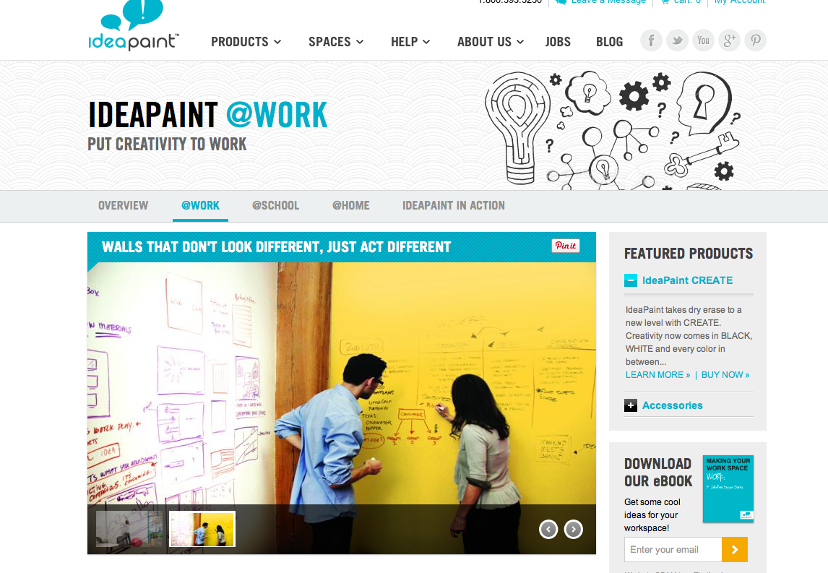
4 Whose Job Is Change?
Notes:
It is the job of Executives to have vision, and to be leaders.
Executives' jobs are to set strategic direction, but they may no longer be about setting specific mileposts along the way.
It is the job of most of us to figure out how to move along that path.
It is a LOT more responsibility.
It is no longer enough simply to row the boat.
You may need to rebuild the boat.

Slide 16
5 How Does Change Happen?
(M)otivation
(P)ermission
(K)nowledge
(M)easures
CTS
(Change That Sticks)
Notes:
The biggest myth is that "change is hard.”
Change can be complex and have many variables, which makes it look sometimes that it is hard.
But change is a simply a physics problem: are the forces of movement greater than the forces of statsis?
(Remember Objects in Motion Tend to Stay in Motion; Objects at Rest Tend to Stay at Rest?)
"Change is hard" is the laziness of the habitual brain.

Slide 17
5 How Does Change Happen?
(M)otivation
(P)ermission
(K)nowledge
(M)easures
CTS
(Change That Sticks)
Notes:
Motivation to learn comes from within for individuals.
Change fails to occur when humans don't feel emotionally connected to the REASONS for change.
People don't change what they don't care about changing.
Learning and applying knowledge can be materially encouraged by establishing new social norms.
Companies can do simple things - like painting walls with Idea Paint.

Slide 18
5 How Does Change Happen?
(M)otivation
(P)ermission
(K)nowledge
(M)easures
CTS
(Change That Sticks)
Notes:
A real reason people don't make change happen is that they don't feel they are allowed to act.
We almost always have more room for innovating than we think we have - than we give ourselves permission to have.
How many of our barriers are perceived rather than real?

Slide 19
5 How Does Change Happen?
(M)otivation
(P)ermission
(K)nowledge
(M)easures
CTS
(Change That Sticks)
Notes:
If we only have at best 50% of what we need to do a job, we may still need specific "how" tactics.
You may need to know how to do a simple process map, or build a simple business case, or write a list of requirements for how you need a new process to work.
The good news: there's free information on EVERYTHING, courtesy the MOOCs, and Khan Academies of the world.
This learning must not be theoretical - it must enable each of us to more efficiently, more effectively, more happily!

Slide 20
5 How Does Change Happen?
(M)otivation
(P)ermission
(K)nowledge
(M)easures
CTS
(Change That Sticks)
Notes:
We each have a choice - between seeing measurement as threatening, or as the most important tool to understanding where we each are individually and as work teams.
Knowing where you start from - our average time to market is 10 months, say - is the only way we will know where we need to go.
The first task is to establish your own key performance measures and learn from the results.
So the key OPERATIONAL differentiators today between companies that survive and thrive are:
" The amount of AGENCY and EXECUTION that INDIVIDUALS WORKING TOGETHER have, and accomplish."

Slide 21
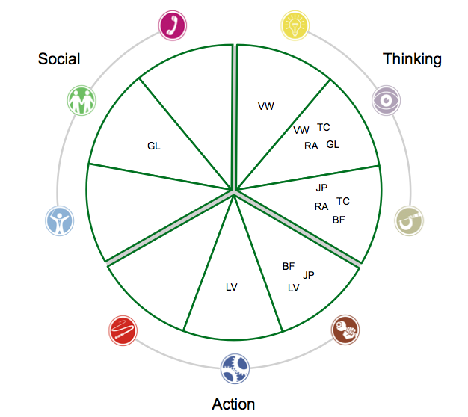
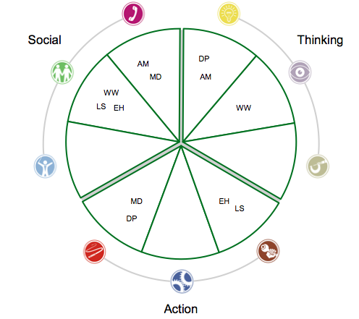
6 What Tools Help?
Notes:
The fastest way to get at people's core MOTIVATION -- what will move them to actively engage rather than watch -- is to know what roles they prefer to play in groups.
To do this, take the Belbin Test.
This 20-minutes assessment now includes two components, a self-assessment piece and a co-worker "adjective selection" piece that taken together, helps illustrate your likely best fit in working with others.
Over 20 years, it never fails to amaze me how accurate this simple inexpensive tool is in guiding the assembly of high-performing teams -- or in predicting how specific combinations of individuals might struggle to work together productively, regardless of their intelligence or skill.

Slide 22
6 What Tools Help?
Team with an
“Action” deficit
Notes:
For Belbin generally, and for us in publishing today, it matters a LOT LESS whether your primary tasks are related to what we call Marketing, Design, Production, or Editorial, Product Development, Data Analytics, or Finance.
Within our industry, these familiar department groupings are increasingly archaic and a root problem of why change doesn't happen faster.
These departments are specialized for scaling the print publishing business - not its present or future. Hard-wired functional role specialization -- versus content or knowledge or situational or interest based role specialization - decreases communication, increases redundant steps, and feeds politics or rivalries.
It prevents organizations from increasing flexibility and adaptability.
These are Belbin's Nine Team Roles, and most people, when working with others, prefers one to three of these roles - can play one to three others if required - but have either low aptitude or high antipathy for the others. Now you might work with people for years to find this out - or you can find it out in 20 mins. What is more efficient?
If you know your preferred roles, the preferred roles of your teammates, and take an active role in accelerating what you learn, how you learn, and make change happen faster.

Slide 23
7 What Measures Help?
But not everything we do is easily measured . . .
Revenues
Throughput
Create Consumer Awareness
Count of Pitches (To Outlets)
Count of Bookings (At Outlets)
Size of Audience Per Booking (Reach
SUCCESS MEASURE 2
Total Reach / Total Bookings ("Average Reach / Booking")
SUCCESS MEASURE 1
Bookings / Pitches
(”Booking Hit Rate")
Effectiveness
Efficiency
Notes:
Many of you may be thinking this.
Well, the PROCESS of seeking to define measures itself may actually be sufficient to dislodge unproductive habits or processes that have gone unquestioned.
Call it a type of Placebo effect.
Once you start asking questions of yourself, you might intuitively change behavior that you know is no longer relevant, but that you never really focused on.
But, let’s look at the Trade Publicity function. We all know that National Publicity, done well, sells books.
What, however, are the specific measures of the Publicity Function?
Ideally, Publicists are measuring maybe four things - 3 tied to their functional task, and one tied to the author experience of their work performance:
If higher amounts of Publicity have a direct relationship with Revenues, you can likely increase Revenues by optimizing how you work to increase your hit rate or your average reach / booking. But doing this optimization might require you to do a simple process map to see where you are losing efficiency!

Slide 24
7 What Measures Help?
Revenues
Throughput
Acquire Great Content
Count of Looks (Agent Submissions etc.)
Count of Bids (Offers to Authors)
Count of Wins (Contracts Signed)
SUCCESS MEASURE 2
Wins / Bids
("Hit Rate")
SUCCESS MEASURE 1
Bids / Looks
(Bid "Efficiency" Rate)
Effectiveness
Efficiency
Notes:
What about Editorial.
Well, everyone knows that Editorial work is HIGHLY creative and essentially unmeasurable, right.
And everyone knows that the Acquisition process is, well, just completely about relationships and advance levels and is essentially unanalyzeable and unscaleable, right?
Well, what if you could understand better how well your process is helping you get the looks, get the bids, and get the wins.
Is it really all about the Advance and Royalty Rate – authors tell me no.

Slide 25
Enabling the bees to do measurably good things for the hive.
#ChangeOrganization
#ChangeProcess
#ChangeTools
Notes:
So what's change management
Enabling the bees to do measurably good things for the hive.
If is about setting a clear vision for what we want to change why and by when.
We are responsible for focusing more on changing what we can and should and less on those forces beyond our control.
It is about letting go of Industrial Revolution MANAGEMENT methods but adopting its OPERATIONAL ones, even and especially in our most "creative" departments.
It is about facilitating the collaborative learning that will enable the hive to deliver better results -- which may involve creating more structured ways that groups can visualize solutions in collaborative ways.
Or it may be as simple as getting out of other people's way.
Change can be led by and participated in by ANYONE, but it likely works best when the whole hive agrees to become -- and behaves as -- a learning organization -- that it agrees on the likely financial benefits, short and long term, of becoming a SMARTER HIVE.
This afternoon we have three panels stocked with Change Leaders from across the industry with wide and deep experience making stuff happen. There are rock stars with decades of insights and practical and specific examples of what has worked for them.
Panel One is about our Organization and the Roles that we need today, with insights and stories from David Nussbaum, Laura Baldwin, and Martin Klopstock -- and moderated by Wendy Elman.
Panel Two is about Process Change - about how that happens well; with thoughts from Bill Bosak, Daryl Lubin and Kevin Sullivan -- and moderated by Julie Blattberg.
Panel Three is about Technology - its rightful and wrongful roles in enablng the hive, with experiences from matt Bennett, Donna Ketler, Don Seitz, and Steve Kasdin.
Thank you.

