Slide 1
21st Century Customs Solution
WCO 2015 Conference
May 08, 2015
Presented by:
Pulak Chakrabarti
President & CEO, CMCI

Slide 2
Agenda
Introduction
21st Century Customs Solution
Challenges
Integrated Customs Solution
Utility Block
Single Window
Future Vision
Benefits
Challenges
2

Slide 3
Introduction - CMCI
Founded in 2005
Headquartered in the Washington DC Metro Region
IT Management Consulting and Services
Trusted Partner of US Customs and Border Protection
CMCI’s Focus
Trade Facilitation
Border Security
Counterterrorism
3

Slide 4
Introduction – CMCI Expertise
Risk & Threat Management
Cargo and Passenger Processing
Trusted Traders & Travellers
Single Window
Device & Technology Integration
Screening & Scanning
Business Intelligence & Advanced Analytics
4

Slide 5
Challenges for Customs in the 21st Century
Globalization - Increased international trade volumes and complexities
Shifting Patterns
Technological advances and cooperation among economies
Just-in-time delivery and low inventory retention
Multimodal logistics services
Increased complexity of supply chain networks
Increased complexity of risks & threats – illicit trade, illegal passengers, fraud, drug & human trafficking
Admissibility & Revenue
5

Slide 6
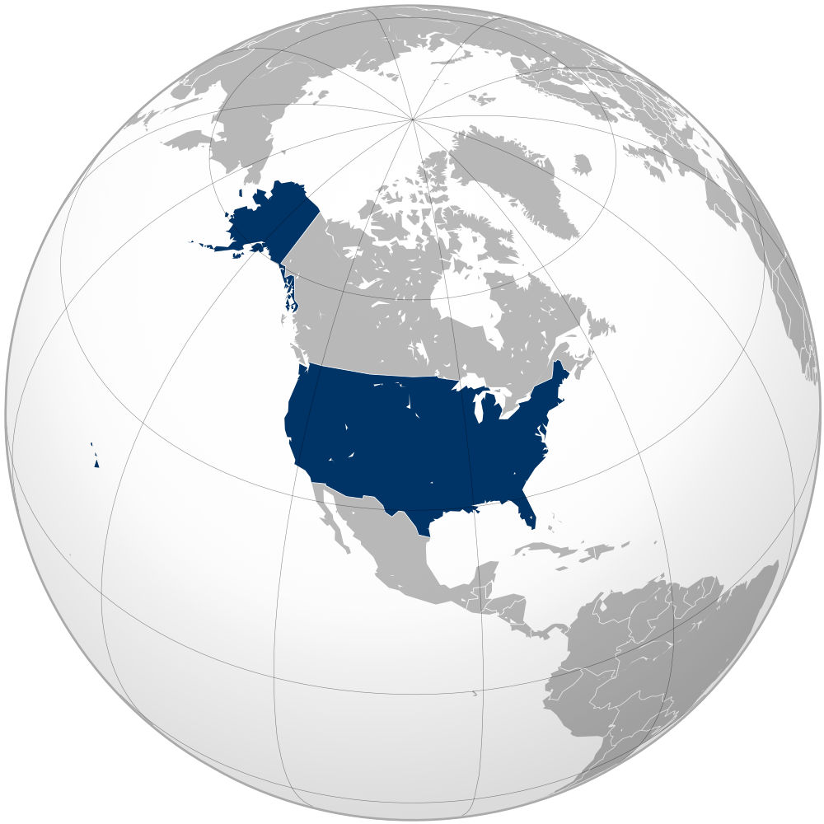
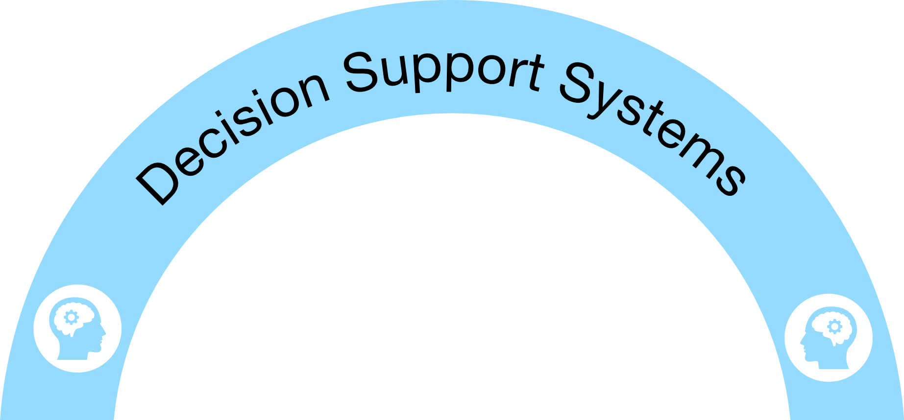
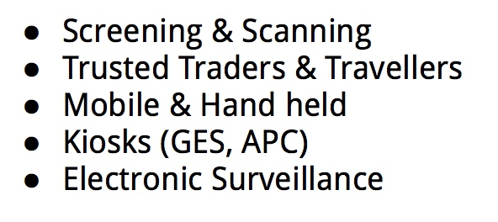
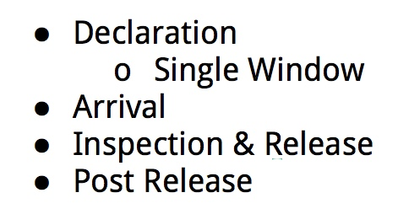
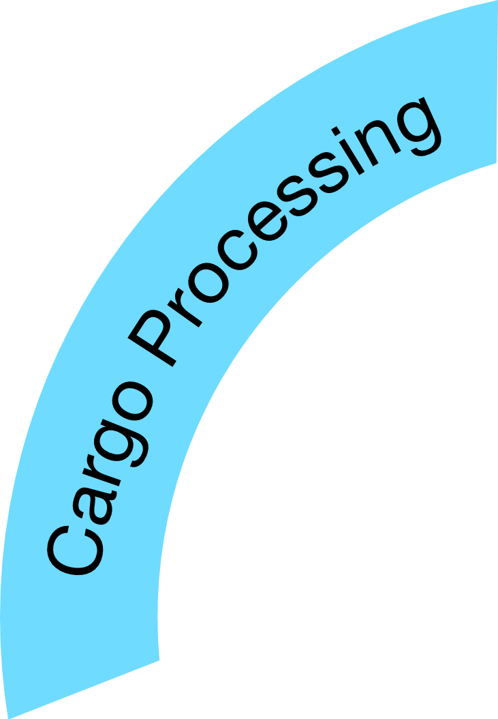
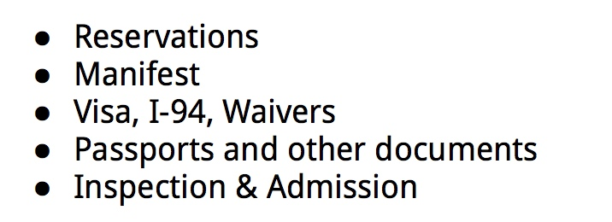
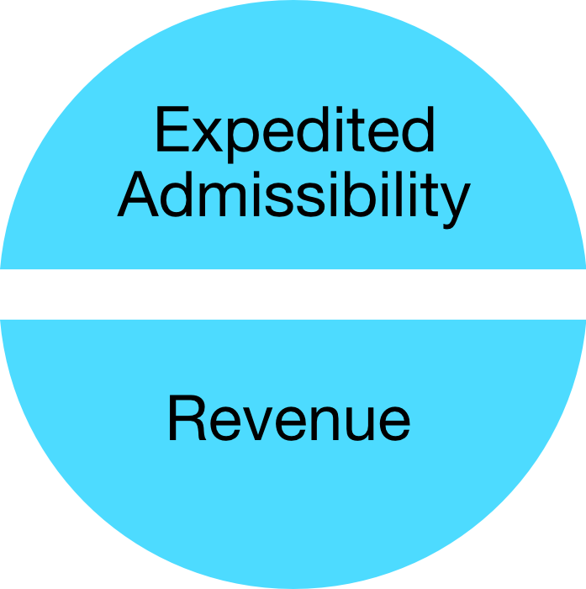
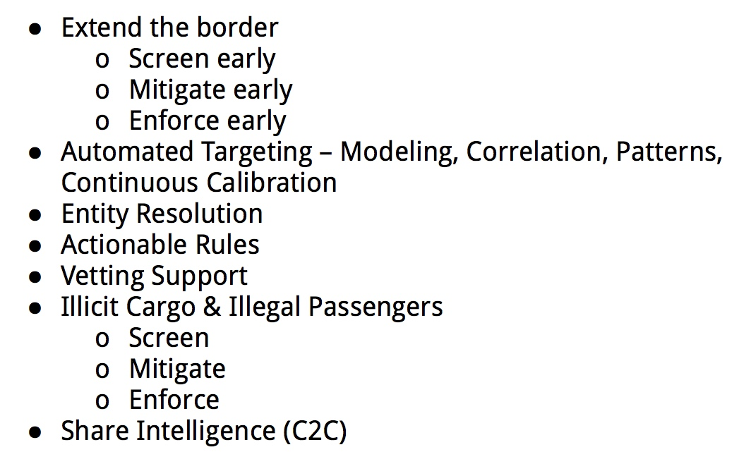
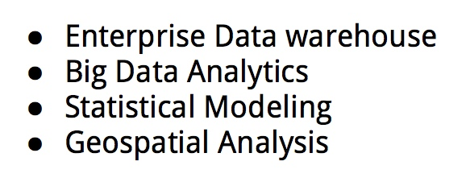
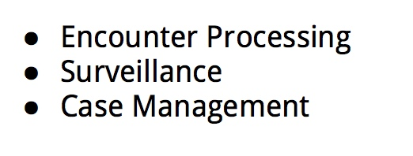
Integrated Customs Solution

Slide 7
Critical Drivers
Customs Capabilities – IT & Resources
Trade Capabilities – IT & Resources
Partnerships & Cooperation
Customs - Business
Business-Business
Customs - Customs
Customs – Other Participating agencies & entities
Simplification & Standardization
Information Sharing & Transparency
7

Slide 8
Capability - Trusted Traders
US-Customs and Trade Partnership Against Terrorism (C-TPAT)
EU-Authorized Economic Operators (AEO)
C-TPAT is a voluntary government-trade initiative
Establish co-operative relationships between Government & Trade
Enhance security through granting recognition to reliable partners
Strengthen & Improve International Supply Chain
Provide highest level of cargo security
Strengthen US Border Security
Enhance trade facilitation
Enhance security through granting recognition to reliable operators
Encourage best practices at all levels in the international supply chain
Strengthen & Improve International Supply Chain
Strengthen EU Territory
8

Slide 9
Mutual Recognition Agreement - US & EU
On May 4, 2012, US and EU signed an agreement on mutual recognition
Each party will accept or recognize results of conformity assessment procedures, produced by the other Party's conformity assessment bodies or authorities, in assessing conformity to the importing Party's requirements
9

Slide 10
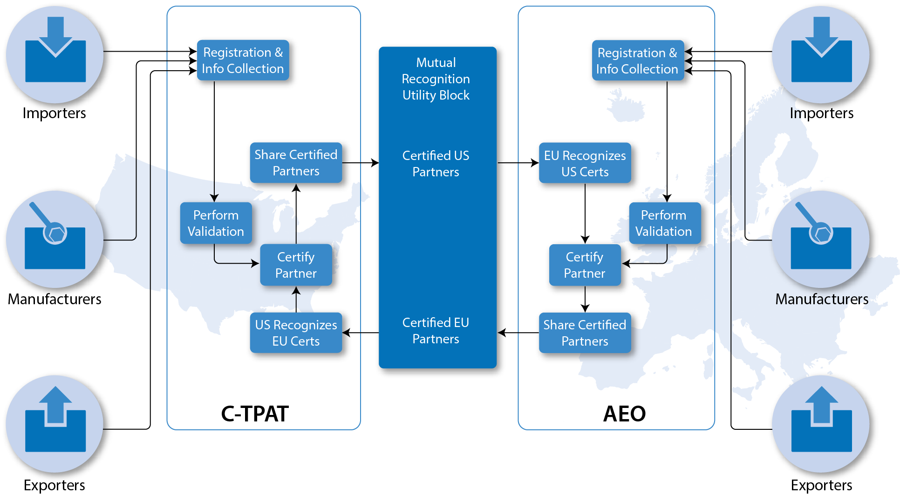
Utility Block – In Action
10

Slide 11
Memoranda of Understanding/Agreements
C-TPAT
AEO
New Zealand – June 2007
Canada – June 2008
Jordan – June 2007
Japan – June 2009
Korean – June 2010
EU – May 2012
Taiwan * – November 2012
Israel - June 2014
Mexico – October 2014
Singapore - December 2014
Switzerland – July 2009
Norway - July 2009
Andorra – January 2011
Japan – May 2011
USA – May 2012
China – May 2014
11

Slide 12
MR Utility Block - Benefits
This capability aligned with the Globally Networked Customs (GNC) Utility Block (UB) concept
Implemented as part of both C-TPAT and AEO initiatives
C-TPAT partners are mutually recognized between the US and EU
AEO partners are mutually recognized between EU and the US
Expedited admissibility
Better supply chain visibility for the governments
Elimination of redundant supply chain security evaluations
Reduced validation burden for the trade partners
Established implementation framework for the future Customs partners negotiating a bilateral agreement
Significant cost savings
12

Slide 13
Implementation Challenges
Establishment of collaborative legal and policy framework needed
Too many MOUs - slower adoption
Longer Implementation
Point to point integration
Data Standardization
ICDs are not harmonized
13

Slide 14
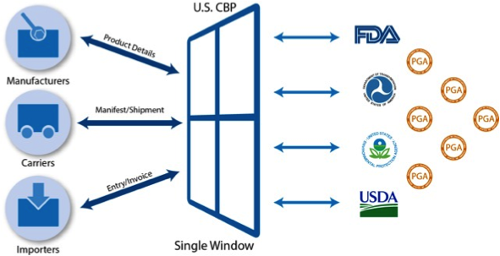
Single Window
Consolidated Information Sharing Capabilities:
Near Real-time information exchange
Improved supply chain visibility
Early determination & resolution of high-risk cargo
Agency Specific Message Set
Interoperability between agencies
14

Slide 15
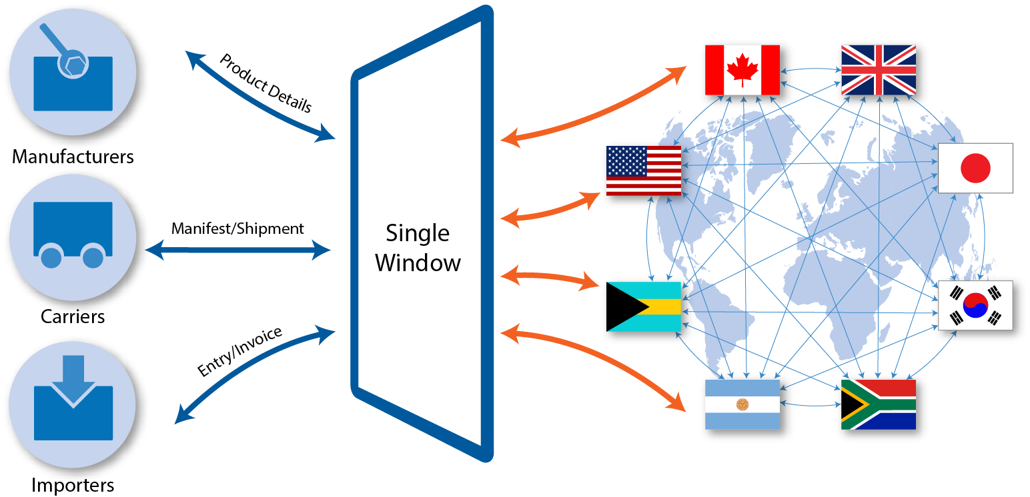
Future Vision of Single Window
15

Slide 16
Benefits
Significant reduction of the burden of compliance on trade
Maturity of Globally Networked Customs (GNC)
Improved & better Global Transparency between all entities
Meets the strategic goal of minimizing and streamlining data requirements
Near real-time information sharing between C2C
Near real-time information sharing between interested agencies & entities
Improved targeting and risk assessment
Expedited Admissibility
Streamlined Revenue Collection
16

Slide 17
Implementation Challenges
Establishment of collaborative legal and policy framework
Cooperation, Trust & Partnership
Customs - Business
Business-Business
Customs - Customs
Customs – Other Participating agencies & entities
Capabilities Maturity – Customs and Trade
Technologies
Resources
17

Slide 18
Technical Discussions and Q&A
CMCI
10300 Eaton Place Suite #250
Fairfax, VA 22030, USA
Toll Free: (866) 998-2624
Fax: (703)-278-0700
sales@c-mci.com
info@c-mci.com
www.c-mci.com
18

Slide 19
19

