Slide 1
CREWS developmental evaluation
Fred Boltz and Gareth Fowler
Atlanta | October 24, 2018

Slide 2
Developmental Evaluation (DE)
DE seeks to generate learning in order to help shape project implementation while it is happening
DE is about using data to inform innovation in progress
Whereas traditional evaluation approaches focus on measurement of performance and impact relative to anticipated (static) goals, DE is intended to support implementation and innovation within a (dynamic) context of uncertainty and change

Slide 3
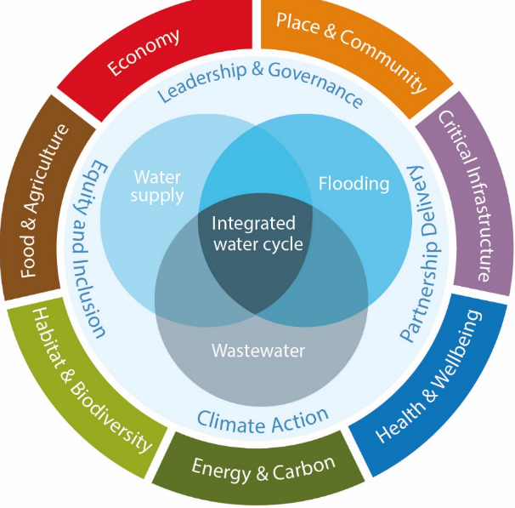
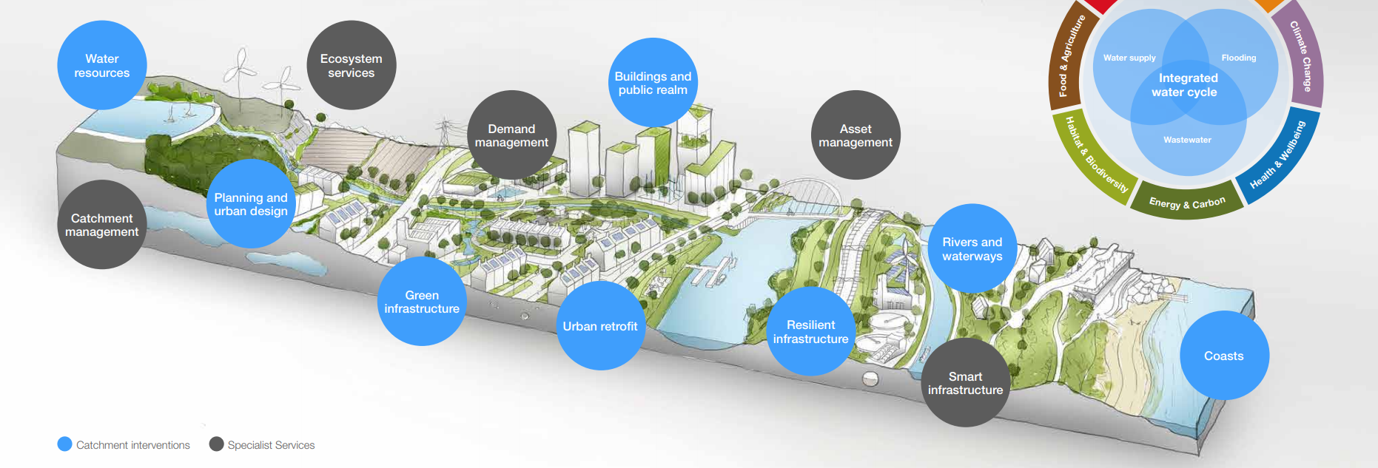
Systems Approach
Developmental evaluation considers how issues are embedded in broader systems and how systems can be part of the solution
Considering all relevant parts of the system, influences and inter-relationships
Understanding boundaries and what is within and outside of them

Slide 4
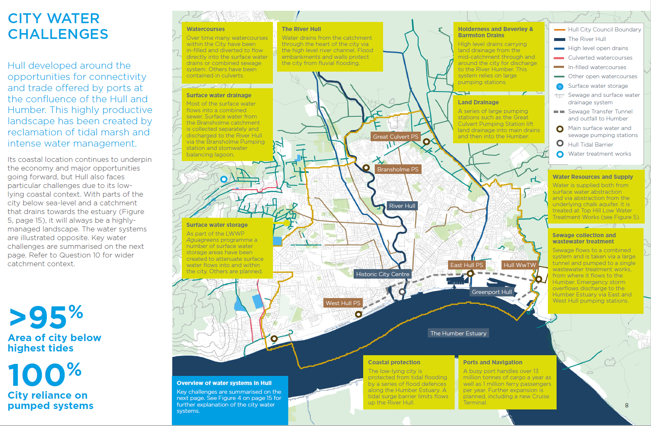
Complexity
DE is designed for systems with a high level of complexity:
Interplay between factors: social, political, economic, and environmental
Human context - shaped by social conditions and history, moral and legal systems, knowledge, language, and culture
Non-linear causality, with multiple influences from the broader environment
Surprise and uncertainty

Slide 5
A simple developmental evaluation considers 3 questions:
What is happening?
What is emerging as the project takes shape?
What are the indicators of change or stability?
What values, perspectives, and relationships are influencing the project?
So What does this mean?
What do initial results reveal about expected progress?
What insights can we draw about responses of the larger system/environment?
What effects are current changes likely to have on us, our network, and our field?
Now What?
What are our options?
What would strengthen our approach and impact?
When and how can we act, individually or collectively, to optimize opportunities?

Slide 6
CREWS developmental evaluation
We seek to generate learning about:
What successes and challenges reveal about designs, approaches, and expectations for performance and outcomes
How different values, perspectives, and relationships influence project effectiveness
Changes in complex environments that impact our work
The collective CREWS network -- how collaboration, exchange, and learning are informing innovation, adaptation, and progress
How the Kresge Foundation can most effectively support this group in its innovation and impact

Slide 7
How we’d like to involve you
Experts and informants
Guide development of the DE effort
Clients of learning
Learn about successes, challenges, and strategies across the CREWS network
Partners and beneficiaries
Inform, strengthen your work
Interviews, surveys to gain your expertise and perspective
Memos/briefs, Webinars/conference calls
Data, interpretation, individual & collective learning

Slide 8
What to expect
We will structure and derive learning to enable YOU to refine strategies and enhance impact
We will share what we learn along the way in multiple formats
We will collect and consider data in near-real time
Flexible
minimize burden on grantees
adjust our scope and process in response to opportunities and learning
Inclusive and equitable
include diverse, representative voices to deepen understanding
follow equitable evaluation principles

Slide 9
We follow equitable evaluation principles
Center for Evaluation Innovation, Dorothy A Johnson Center for Philanthropy, July 2017, www.equitableeval.org.

Slide 10
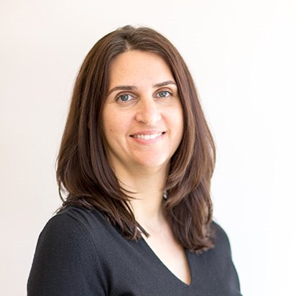
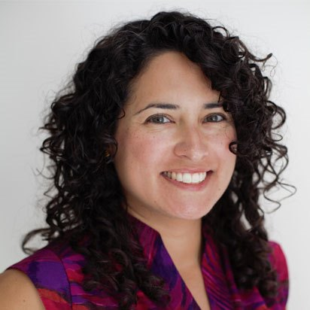
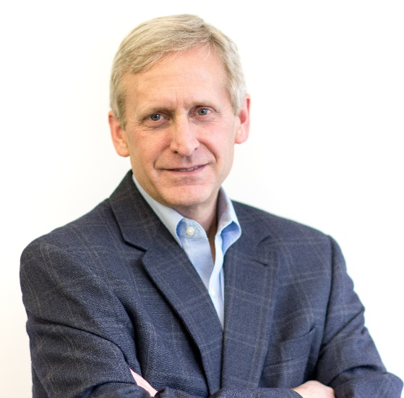
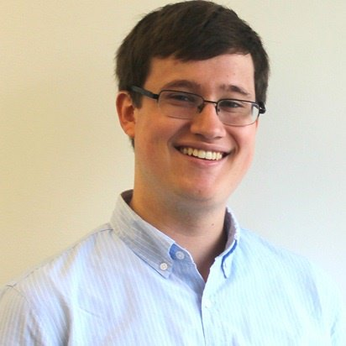
The Development Evaluation Team
Julie Slay
Senior Director Arabella Advisors
Marissa Guerrero
Director Arabella Advisors
Bruce Boyd Principal and Senior Managing Director Arabella Advisors
Gareth Fowler
Analyst Arabella Advisors
Fred Boltz
CEO Resolute Development Solutions

