Slide 1
What new, what next
In payment processing

Slide 2
EMV

Slide 3
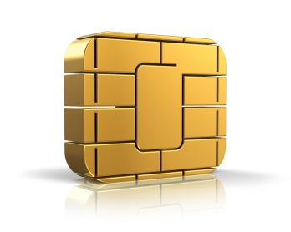
What is EMV?
An acronym created by Europay®, MasterCard® and Visa®
The global standard for the implementation of chip cards for the purpose of facilitating a more secure electronic payment transaction
A security framework that defines the payment interaction at the physical, electrical, data and application levels between chip cards and payment devices
EMV is also known as “chip and PIN” in the U.K.; domestically, EMV may be implemented as chip and PIN, chip and signature, or other variations.
Notes:
The first question most people ask is, “What is EMV?” [CLICK] Its acronym comes from EuroPay, MasterCard® and Visa® who launched EMV technology, that was later adopted by all major card brands for improved data security. [CLICK]
EMV’s embedded-chip technology is the global standard — currently in use or being implemented in more than 80 countries. [CLICK]
With its security framework, it is the best existing technology in use today to authenticate cards and cardholders. [CLICK]
EMV is also known as “chip and PIN” in the U.K.; domestically, EMV may be implemented as chip and PIN, chip and signature, or other variations.
Now let’s talk about “chip cards”…[CLICK]

Slide 4
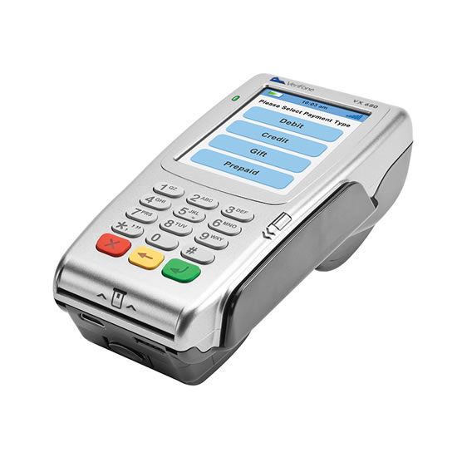
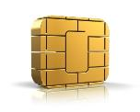
EMV – A New Way Of Doing Business
The primary intent of EMV is increased security to reduce counterfeit fraud.
To add an extra layer of security, we can also recommend solutions wherein cardholders never need to relinquish possession of their cards.
Note: ProcessNow® is not intended for restaurant environments.

Slide 5
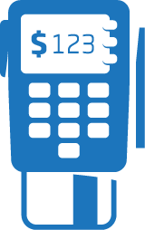
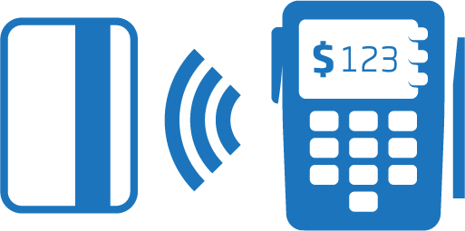
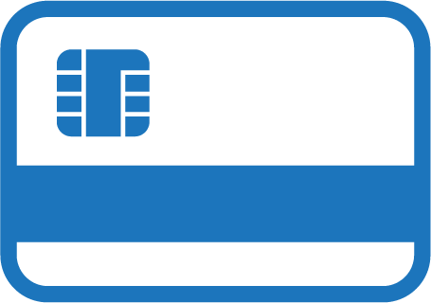
Secure Chip Card Technology
EMV-enabled cards — also known as chip cards or smart cards — have an embedded secure microprocessor chip that stores cardholder data and creates a unique value to make each processing transaction unique. This is known as dynamic authentication.
Smart Cards Can Be:
“Dual Interface”
“Contact”
“Contactless”
Notes:
{EMV-enabled cards — also known as chip cards or smart cards — have an embedded secure microprocessor chip that stores cardholder data and creates a unique value to make each processing transaction unique. This is known as dynamic authentication.}
Smart cards can be…[CLICK]
Contact: Contact cards get inserted into a card reader for transaction authentication.
[CLICK] Contactless: Contactless cards communicate via radio frequency (RF), also known as near field communication (NFC), to “tap-to-pay”. NFC uses a nearby contactless-capable reader for transaction authentication.
[CLICK] Or Dual Interface: Dual Interface cards combine both contact and contactless technologies and can communicate either way. Because EMV cards store payment information in a secure chip, unlike a magnetic stripe card, it is virtually impossible to create a counterfeit EMV card that could successfully conduct an EMV payment transaction. [CLICK]

Slide 6
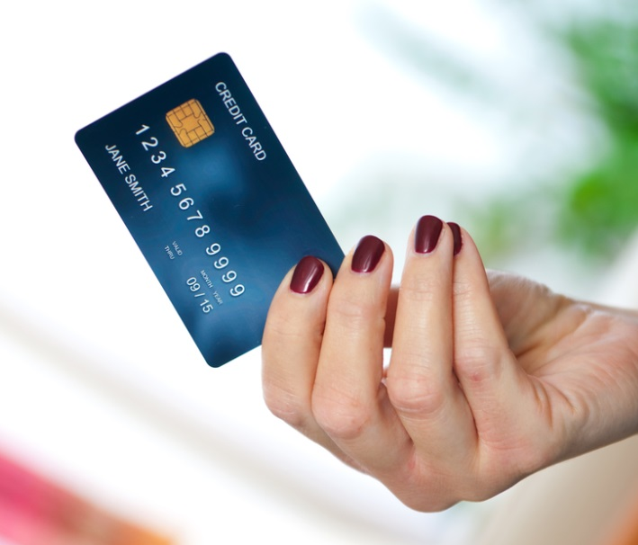
What EMV Will Require?
An upgrade to the systems used by issuers, acquirers and processors for payment processing (largely complete)
An upgrade of the merchant’s point-of-sale (POS) environment, including both hardware and software
A change in the traditional process consumers use to make a purchase edit or debit cards
Notes:
The EMV shift requires a system upgrade for issuers, acquirers and payment processors. [CLICK] It will also require both hardware and software upgrades of the POS environment. [CLICK] Finally, education is necessary. EMV requires training employees — and the public — on new payment methods. Many small merchants have little or no idea of what EMV is, let alone being prepared for it. Customers have to be trained too, for the “chip-and-dip” experience. [CLICK]

Slide 7
DATA BREACH

Slide 8
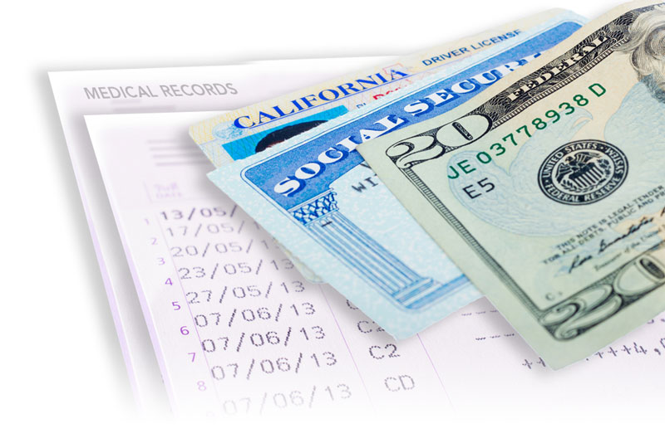
Data Breach Defined
Data breach is unauthorized access to a merchant’s network that results in stolen sensitive data, including:
Name
Social Security number
Driver’s license number
Medical records
Financial information
Notes:
Today, our topic is data breach and the importance of recognizing and preventing it to protect yourself, your business and your customers.
[CLICK] A data breach occurs when an unauthorized party accesses a merchant’s network and steals cardholder data. Targeted sensitive data includes:
[CLICK] name
[CLICK] Social Security number
[CLICK] driver’s license number
[CLICK] medical records
[CLICK] financial information
[CLICK]

Slide 9
Data Breach Statistics
● Million Americans’ personal information is compromised annually.
● Financial impact is estimated at more than $55 billion annually, impacting both businesses and consumers.
● 31 percent of data breaches were at organizations with 100 employees or less.
● The average cost of a data breach is $50,000, or about $200 per record compromised.
Source: Identity Theft Resource Center, http://www.idtheftcenter.org/index.php
Notes:
The latest data breach statistics drive home the seriousness of the situation:
[CLICK] The Identity Theft Resource Center (ITRC) reports 40 million Americans’ personal information is compromised annually.
[CLICK] The financial impact of this crime is estimated at more than $55 billion annually, impacting both businesses and consumers.
[CLICK] Recent statistics show that 31 percent of data breaches were at organizations with 100 employees or less.
[CLICK] The average cost of a data breach is $202 per record compromised.
Source: Identity Theft Resource Center, http://www.idtheftcenter.org/index.php
[CLICK]

Slide 10
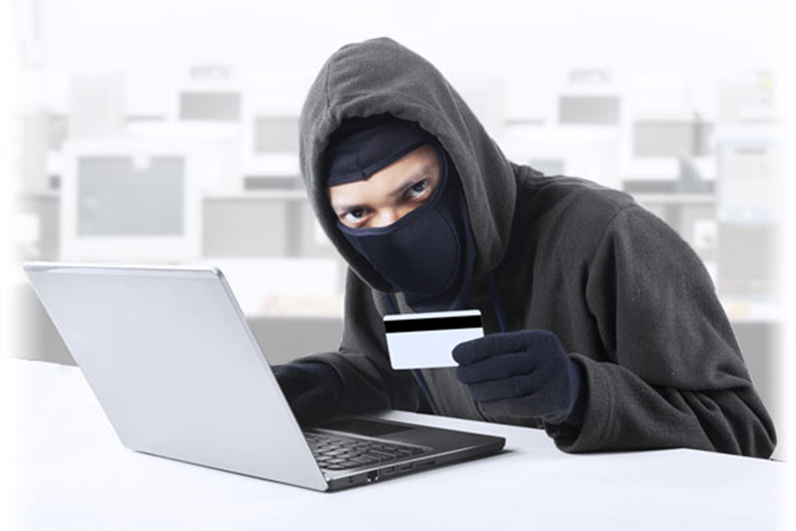
Data Breach Protection
Data breach is a serious threat to all businesses, so data breach protection is critical for all businesses.
Notes:
Given the serious threat posed by data breach to all businesses – regardless of size – data breach protection should be foremost in the minds of all businesses that accept payment cards. Recent statistics on the tremendous costs faced by merchants who experience a data breach underscore the fact that the stakes are just too high for breach protection to be relegated to your “to do” pile.
[CLICK]

Slide 11
Data Breach Security Program
A Data Breach Security Program:
Helps merchants meet expenses related to suspected or actual breach of payment card data.
Cost of data breach for small businesses (Level 4) can easily be $25,000 to $50,000 – potentially fatal to your business.
Notes:
That’s why TransFirst offers a unique Data Breach Security Program that’s specifically designed to help merchants meet the expenses resulting from a suspected or actual breach of payment card data. The cost of a data breach can easily be $25,000 to $50,000 for Level 4 merchants, more than enough to shut down a small business.
[CLICK]

Slide 12
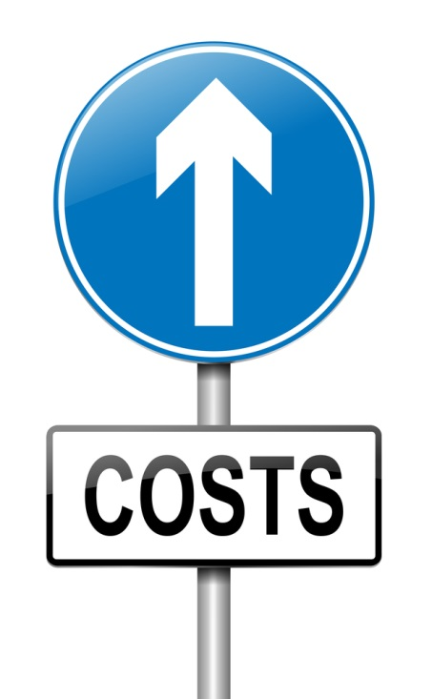
Data Breach-Related Costs
Additional costs may include:
Mandatory Forensics Audit = $8,000 to $20,000
Card Replacement Costs = $3 to $10 per card
Compliance Fines = $5,000 to $50,000+ depending on size of business and nature of offense leading to breach
Actual fines vary depending on the number of cards exposed.
Notes:
Additional breach-related costs may include:
[CLICK] Mandatory Forensics Audit = $8,000 to $20,000
[CLICK] Card Replacement Costs = $3 to $10 per card
[CLICK] Compliance Fines = $5,000 to $50,000+ depending on the size of the business and the nature of the offense that led to the breach
[CLICK] Actual fines vary depending on the number of cards exposed.
[CLICK]

Slide 13
Common Data Breach Misconceptions
Misconceptions lead to false sense of security:
● Only large retailers are subject to data breaches.
● PCI-compliant merchants cannot be breached.
Data breach does not affect business revenue.
Notes:
Unfortunately, there are some common misconceptions about data breach that lull some retailers into a false sense of security. For example:
[CLICK] Only large retailers are subject to breaches.
Large companies and retail chains may make headlines when they experience a breach, but most breaches involve smaller, Level 3 and Level 4 merchants.
[CLICK] PCI compliant merchants cannot be breached.
While PCI compliance is an ongoing process that’s measured at one point in time, a breach can occur at any time and without warning.
[CLICK] Data breach does not affect business revenue.
Just one data breach can cause a cascade of lost sales, cancelled accounts, destruction of business and community relationships, high-stakes lawsuits, insurance claims and expensive fines and sanctions by individual payment brands.
[CLICK]

Slide 14
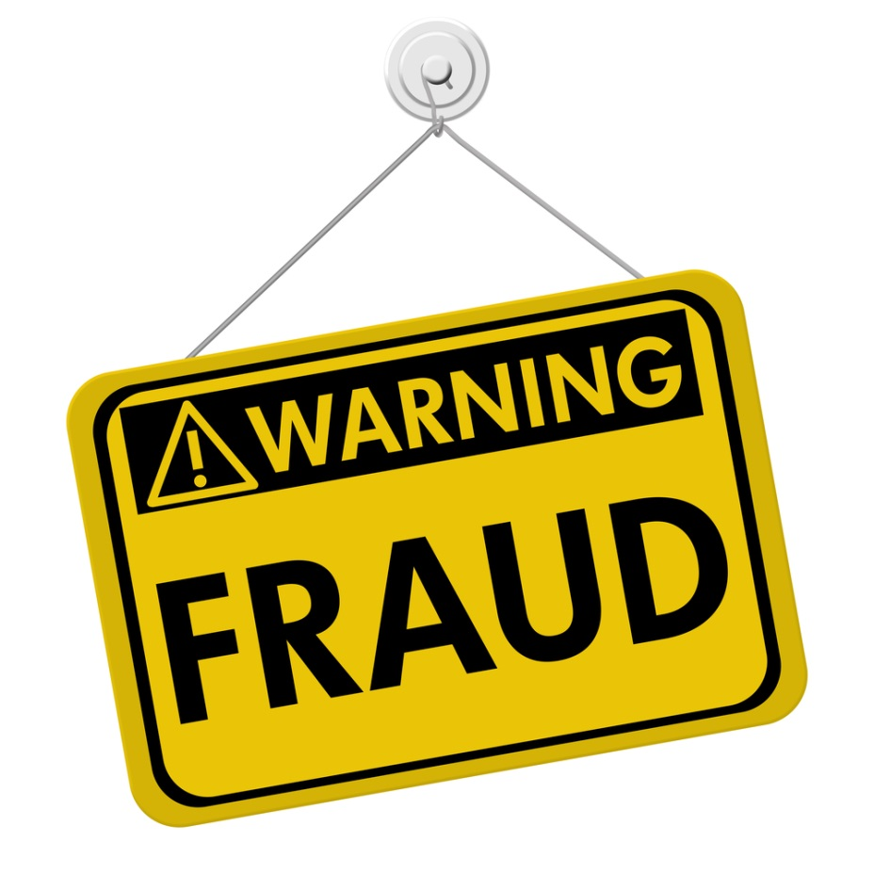
Fraudulent Transactions
Fraudulent card transactions are on the rise:
In 2013, more than two-thirds of all security breaches occurred in the United States.
Merchants must be proactive and protect themselves from huge financial losses associated with data breach.
Source: Experis Manpower Group 2013 Cost of a Data Breach Report
Notes:
Fraudulent payment card transactions are continually on the rise. It is estimated that in 2013 more than 66% of all security breaches happened in the United States, so it’s more critical than ever that merchants protect themselves from potentially huge financial losses associated with a data breach.
Source: Experis Manpower Group 2013 Cost of a Data Breach Report (https://www4.symantec.com/mktginfo/whitepaper/053013_GL_NA_WP_Ponemon- 2013-Cost-of-a-Data-Breach-Report_daiNA_cta72382.pdf)
[CLICK]

Slide 15
PCI Compliance

Slide 16
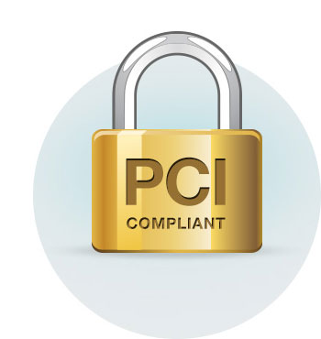
PCI DSS Requirements
Businesses that process, store and transmit the following are required to be PCI compliant:
Cardholder Data
cardholder name
account number
service code
expiration date
Sensitive Authentication Data
magnetic stripe/chip data
CVV
PINs
Notes:
Businesses that process, store and transmit the following are required to be PCI compliant:
[CLICK] cardholder data (cardholder name, account number, service code and expiration date) as well as
[CLICK] sensitive authentication data (magnetic stripe or chip data, CVV code and PINs) in compliance with these requirements so that it is kept private and secure.
[CLICK]

Slide 17
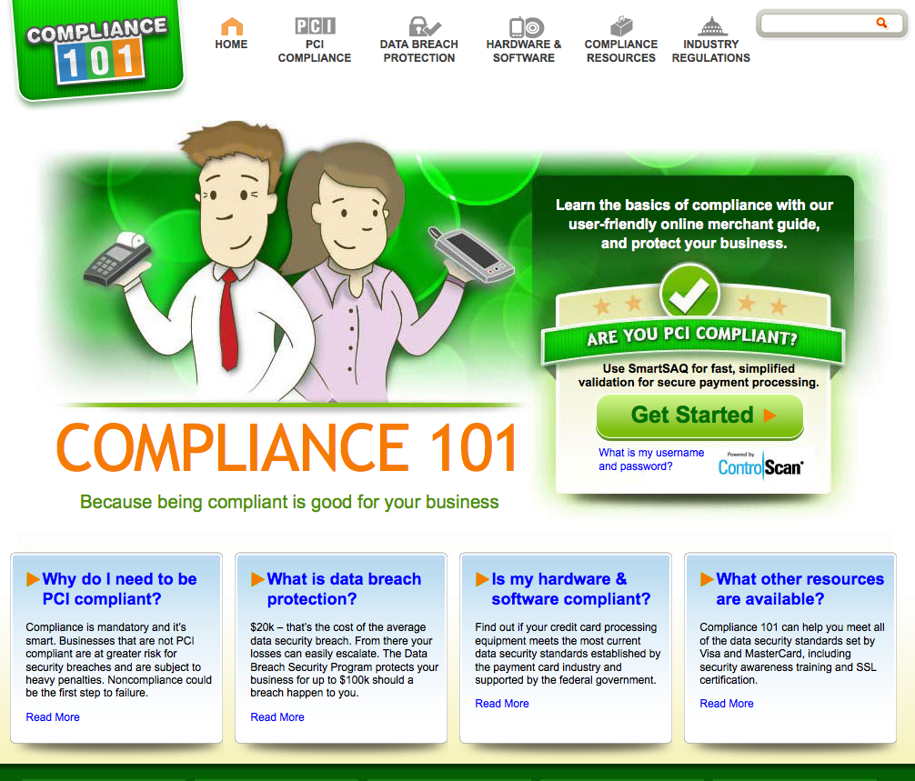
Compliance101.com
www.Compliance101.com
● Data Breach
● PCI Accreditation and Certification
● Terminal Compliance
● IRS Mandates
● Merchant Access Point
● W9 Validation
Notes:
For more information on PCI compliance and how to achieve and maintain compliance, please visit www.compliance101.com, a website that offers user-friendly, easy-to-understand information subject including:
[CLICK] Data breach
[CLICK] PCI accreditation and certification
[CLICK] Terminal compliance
[CLICK] IRS mandates
[CLICK] Merchant access point and
[CLICK] W9 validation
[CLICK]

Slide 18
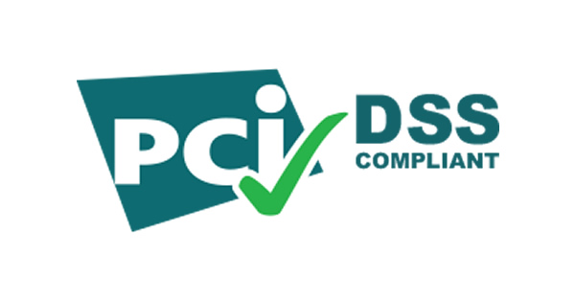
PCI DSS Requirements
PCI DSS (Payment Card Industry Data Security Standards) establishes requirements for:
● Data Security Management
● Policies and Procedures
● Network Architecture and Software Design
www.pcisecuritystandards.org
Notes:
Comprehensive operational and technical requirements outlined in the PCI DSS establish consistent measures for:
[CLICK] data security management
[CLICK] policies and procedures
[CLICK] network architecture and software design.
[CLICK]

Slide 19
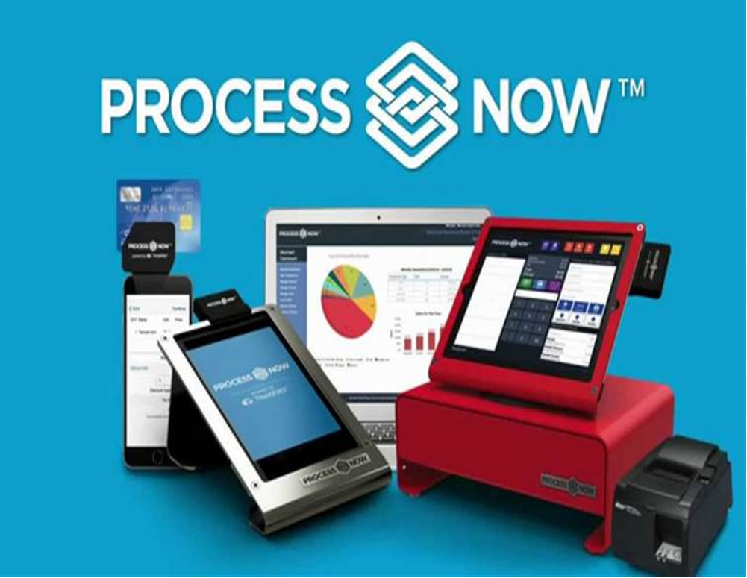
MOBILE PAYMENTS
Full Cash Register Solution
Mobile On-The-Go with iPhone and Android
In Store Cloud Based Terminal

Slide 20
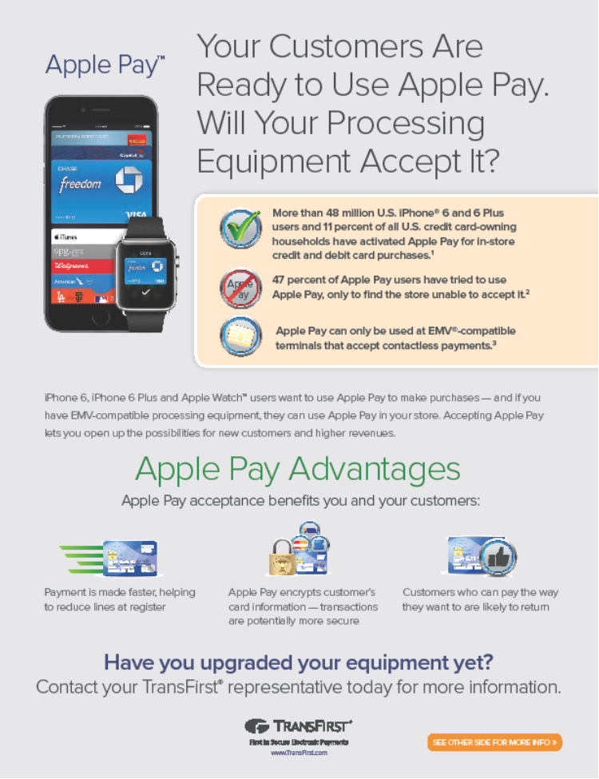
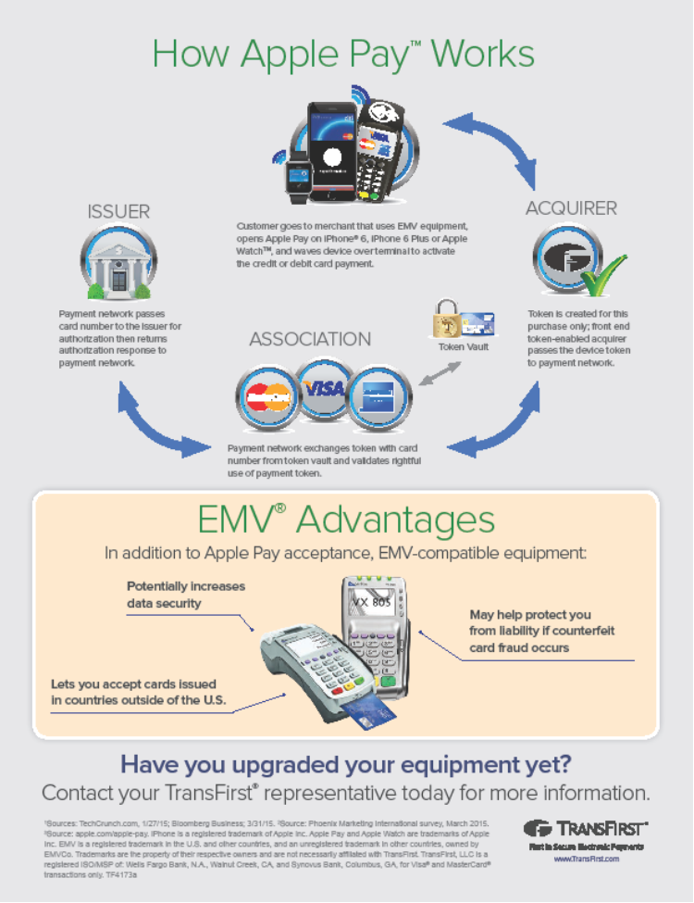
APPLE PAY

Slide 21
Questions
James Scott
JScott@Transfirst.com

