Slide 1

Reporting and Analyzing
Energy Bills
Lori Herrick BORDEN, mba, leed ap
City of Virginia beach
February 2019

Slide 2
Presentation Overview
Utility Bills Overview
Paper bills versus Electronic Data
Exciting Auditing Opportunities Using Technology

Slide 3
City of Virginia Beach Energy Payments
Vendor | FY16 | FY17 | FY18
Electric Providers | $14,287,557 | $14,295,545 | $14,541,842
Fuel Providers | $3,454,081 | $3,720,386 | $4,530,438
Natural Gas Providers | $875,648 | $830,546 | $786,543
Propane & Fuel Service | $22,129 | $26,180 | $33,487
TOTALS | $18,639,415 | $18,872,657 | $19,892,310

Slide 4
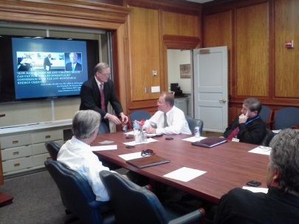
Energy Management for Municipal Operations
The Joint Energy Committee (JEC)
Created in the March of 2008 and is the governing body for energy management for municipal operations.
The JEC is chaired by a Deputy City Manager and includes staff from both the City and Schools.
The Energy Management Office
Located in the Department of Public Works, Facilities Management Group.
Daily administration of energy management for municipal operations
Notes:
Dave Hansen created the Joint Energy Committee (JEC) in the spring of 2007 in response to the City’s rising energy costs.
The JEC is now chaired by Deputy City Manager Tom Leahy meets once per month. Agendas include vendor presentations, study reports, consumption updates and energy technology.
The JEC includes representatives from both the City and Schools that have been identified to date as the largest energy consumers, as well as representatives from the Department of Management Services.
As the governing body for energy management for municipal operations, the JEC shall:
Establish and promulgate annual municipal energy goals and policies
Facilitate the presentation and discussion of alternative energy and energy reduction technologies and ideas;
Facilitate the discussion of municipal energy consumption; and,
Monitor progress against the published annual municipal energy goals.
The Energy Office: INTRODUCE MARK
Was created in FY2011:
Manages the Energy Capital Improvement Projects (CIP);
Provides administrative support to the Joint Energy Committee;
Trains City employees to be “Energy Champions”
Manages the City’s energy/utility payment software
Board member of the Virginia Energy Purchasing Governmental Association;
City Department Directors, or a designated Department representative;
Representative(s) from City of Virginia Beach Public Schools;
Representative(s) from Virginia Natural Gas; and
Representatives(s) from Dominion Virginia Power.
As the governing body for energy management for municipal operations, the JEC shall:
Convene meetings of the JEC a minimum of eight (8) times each year;

Slide 5
Energy Management by Commodity Usage
The City of Virginia Beach uses almost 800,000 MMBTU’s in electricity, natural gas, propane and fuel in the operation of municipal facilities, utility systems, vehicles and equipment.
Efficient management of energy enables the cost-effective delivery of City services to the public and helps to reduce environmental impacts.

Slide 6
Third Party Utility Bill Audit Summary
Refunds from Errors:
$13,762
Refunds from Mischarged Taxes:
$5,931
Refunds from Street Light Audit:
Approximately $10,000
Rate Schedule and Contracted Facility Charge Changes:
$53,300
$82,993.37 in savings and refunds –
(Relatively Small Amount)
Approximate Total Savings Over 10 Years: $749,600
Notes:
Approximately $83,000.00 in savings/refunds.
Learned a few things here from this audit
Can go back 36 months

Slide 7

Problems with the traditional way of paying
Utility Bills:
- Decentralized bill review model
- Paper process and vendor delays led to duplicate charges, late payments, and fees
- No auditing tools
- Overall utility costs were increasing

Slide 8

The New Way: The Plan
Bring all the utility bills belonging to the various departments into the energy software:
  Electronically for electric and natural gas
  Departments hand key the rest
Audit bills
Approve bills for payment
Export approved bills to accounts payable

Slide 9
Energy Software – Changing the Process
STEP 1
Bring all the utility bills into the software (electronically when possible):
STEP 2
Audit and approve the energy bills:
STEP 3
Supervisor approves and batch to Accounts Payable:
Interface to Accounts Payable –
Pays Vendor
Energy Software
Public Works
Convention & Visitors Bureau
Public Utilities
Notes:
This project is a partnership with the Energy Office, Department of Com IT, Public Works and Dept of Finance….
(DIAGRAM – first box )A little like herding cats….
Interface in
Interface out
AND we expect it to be a model for other Cities and counties….

Slide 10
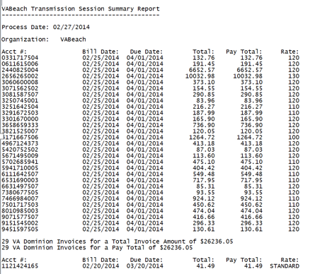
The New Way: Electronic Bill Summaries

Slide 11
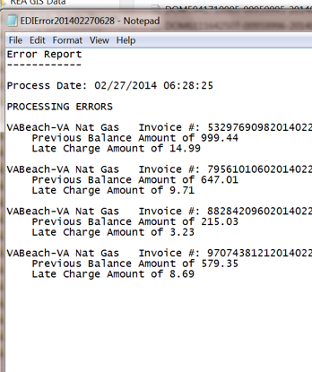
The New Way: Electronic Bill Error Reports

Slide 12
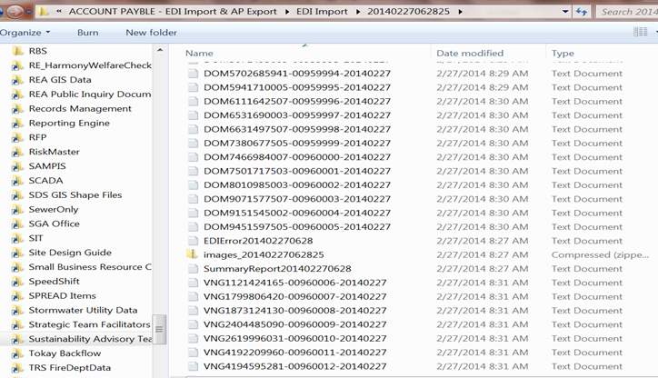
The New Way: Electronic Bill Imports

Slide 13
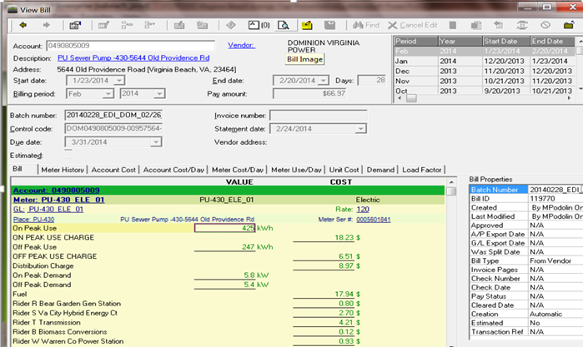
The New Way: Energy Software

Slide 14
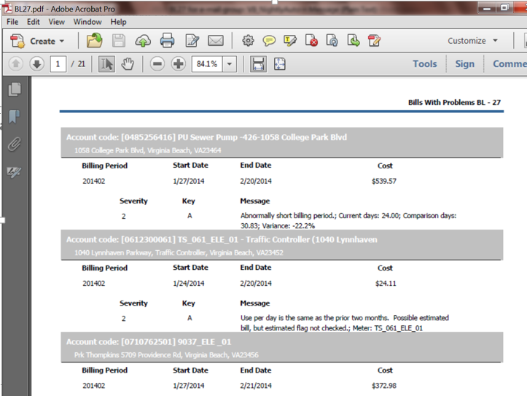
The New Way: Bill Audits &Comparisons
Notes:
Duplicate bills (re-bills)
Overlapping bills
Missing bills
Zero usage bills – turn off that meter!
The following month, meter still not turned off!
Increased usage – such as waterleaks

Slide 15
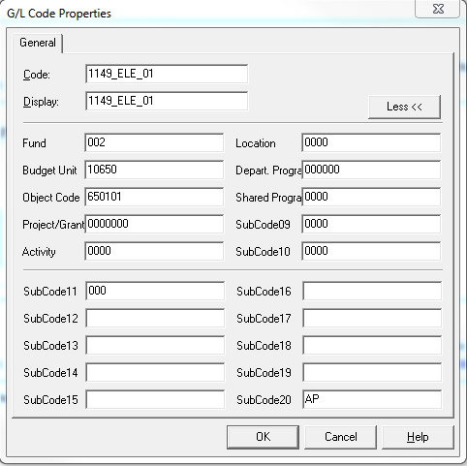
The New Way: Budget Code Storage

Slide 16

Benefits of New Process:
Eliminated thousands of paper invoices annually
EDI process is being explored with other vendors
Invoice processing time has been reduced by days/weeks (cash management)

Slide 17
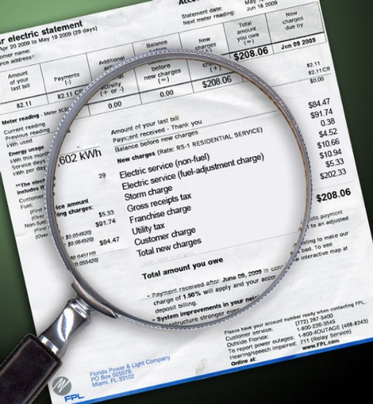
Benefits of New Process (cont’d):
Elimination of keying errors and charges to incorrect accounts
Credits are correctly applied and current (missing bill report)
Prevention of late fees due to mail delays or losses (or someone being on vacation!)

Slide 18
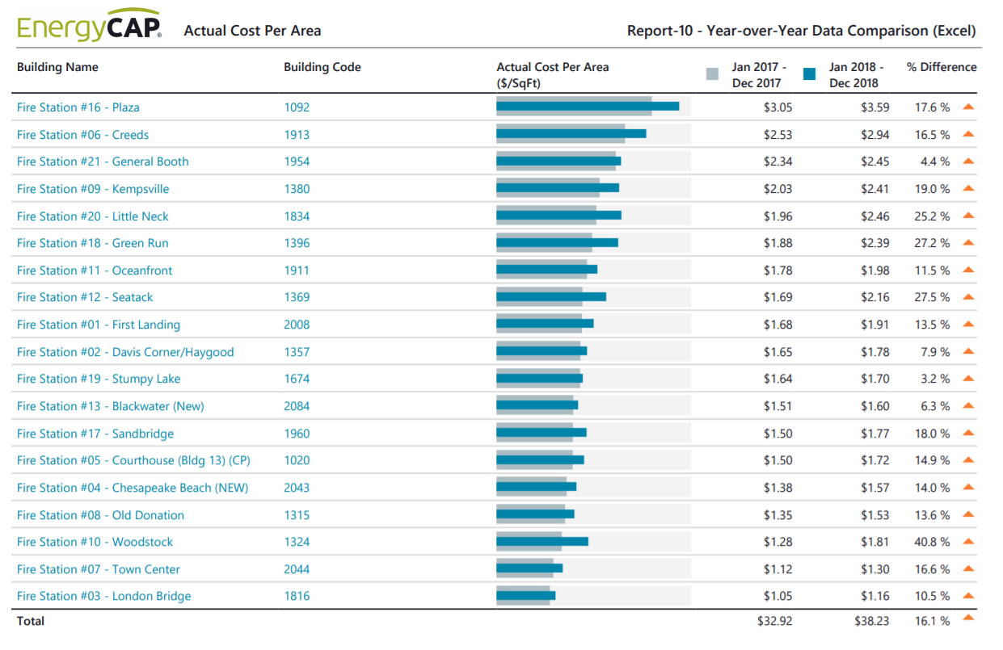
Benefits of New Process (cont’d):
More efficient bill validation and payment authorization
Made time and data to focus on analysis

Slide 19
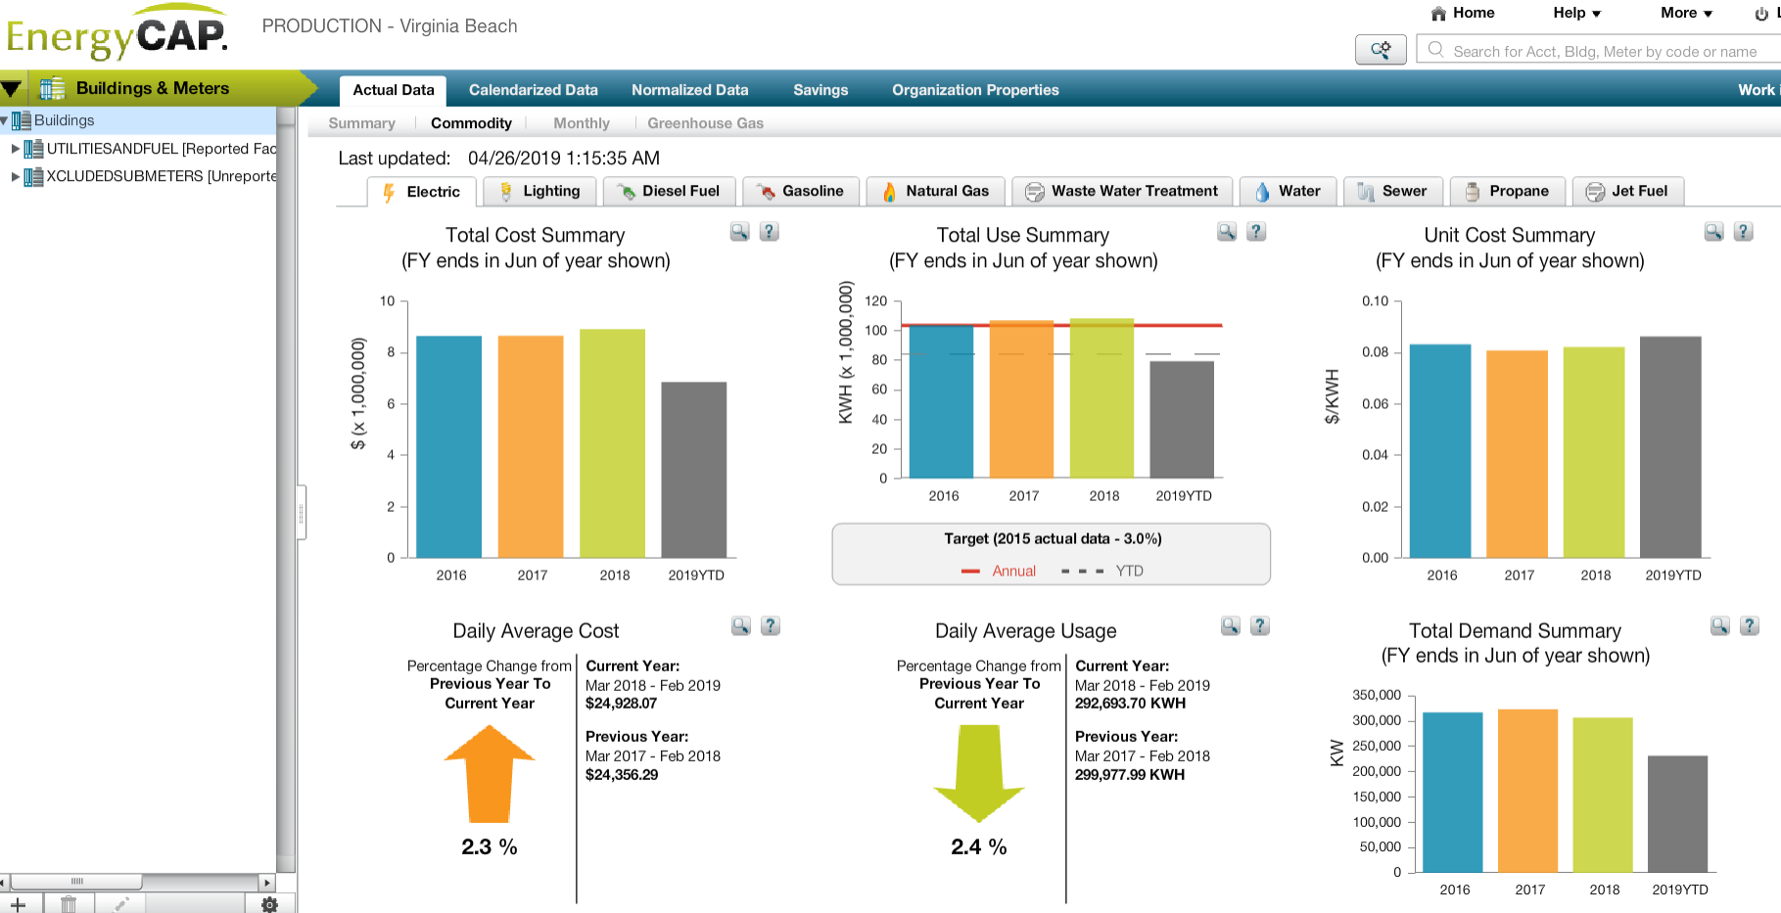
Energy Software Dashboards

Slide 20
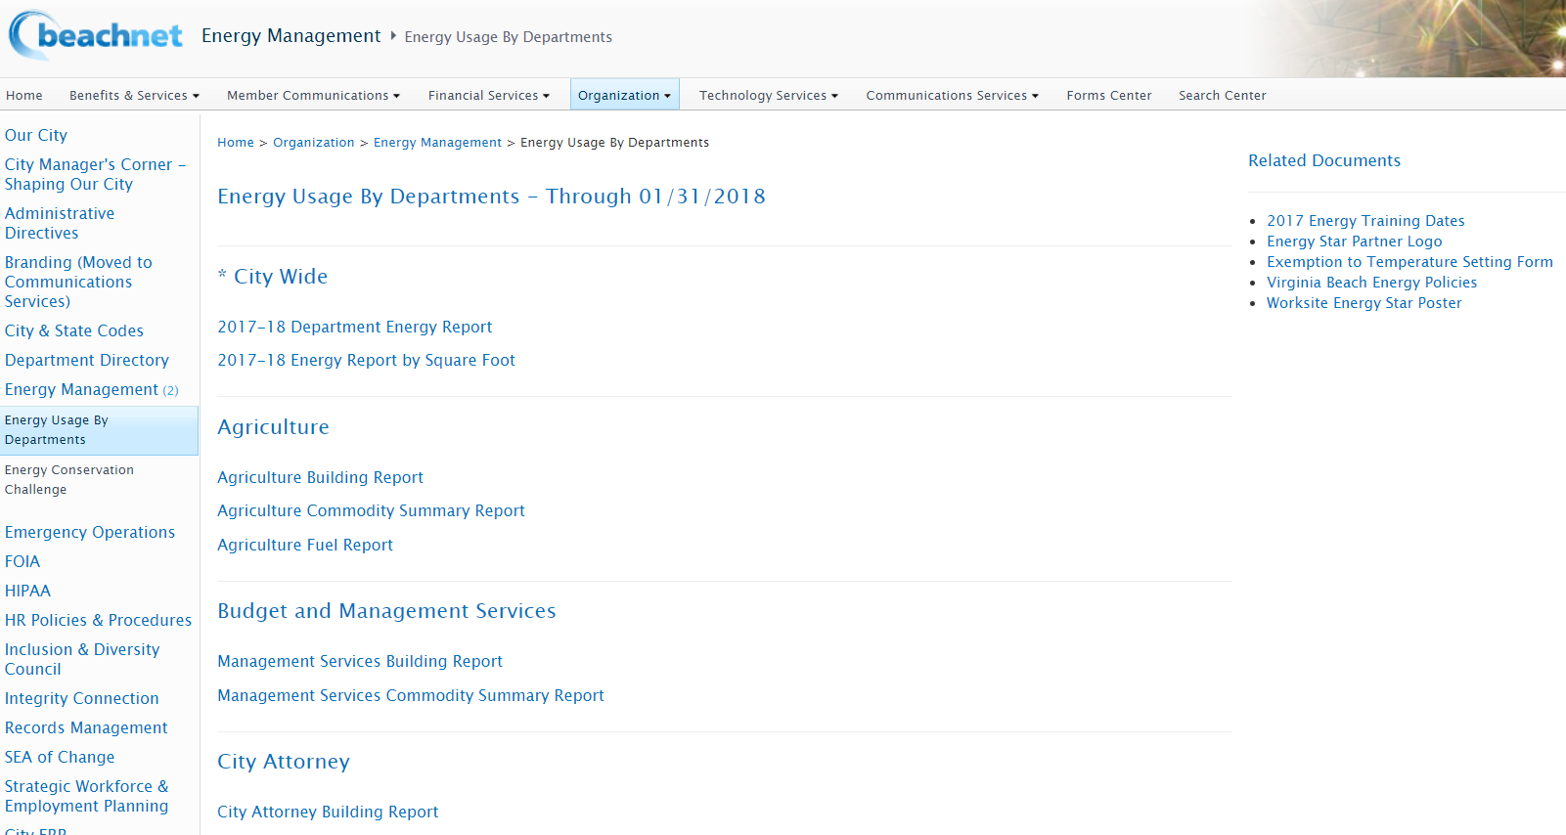
Energy Software Reports

Slide 21
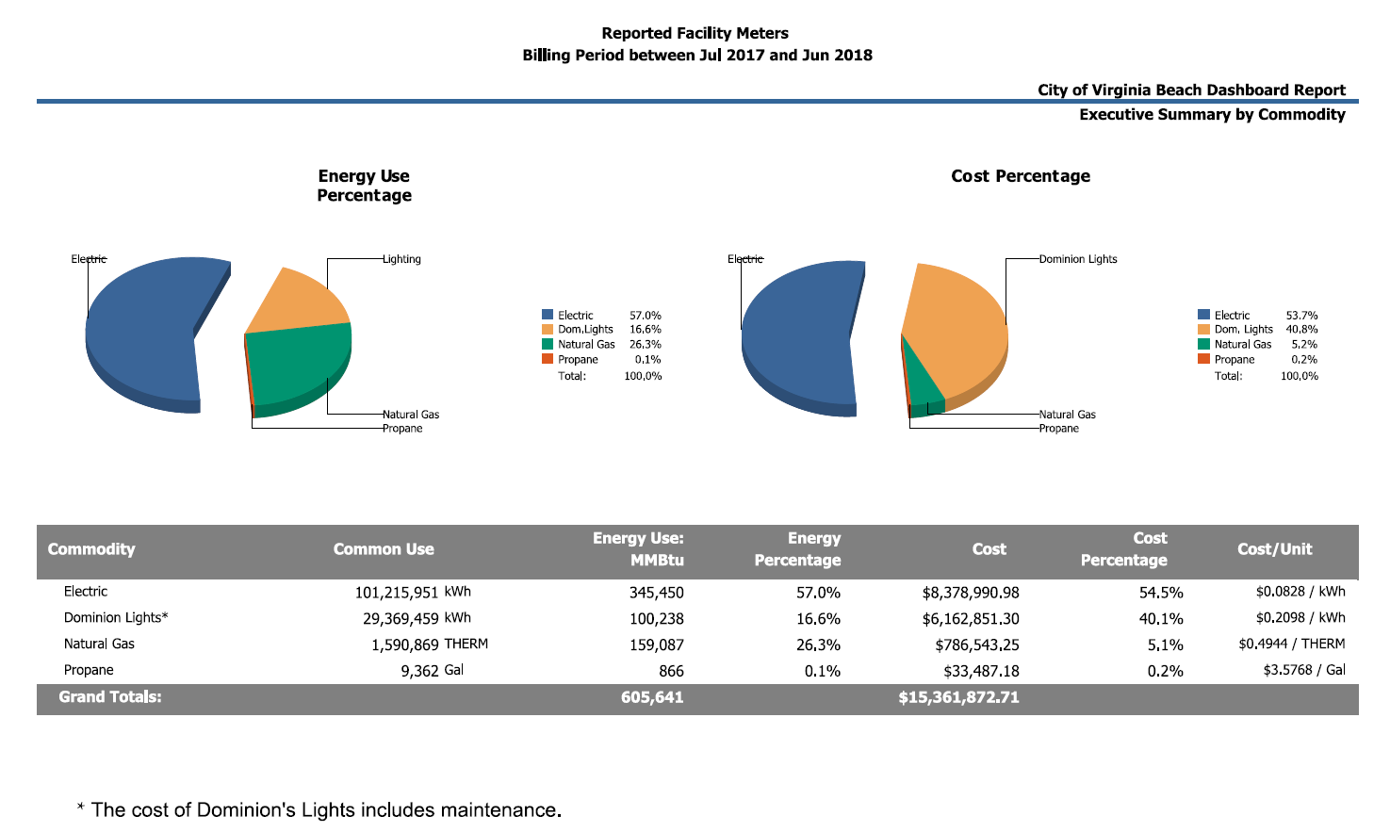
beachnet - Energy Reports (cont’d)

Slide 22

Vendor Bill Processing Issues Discovered
Faster payment processing
However…..
Still received late fees
Scheduled a meeting
Addressed the issue

Slide 23
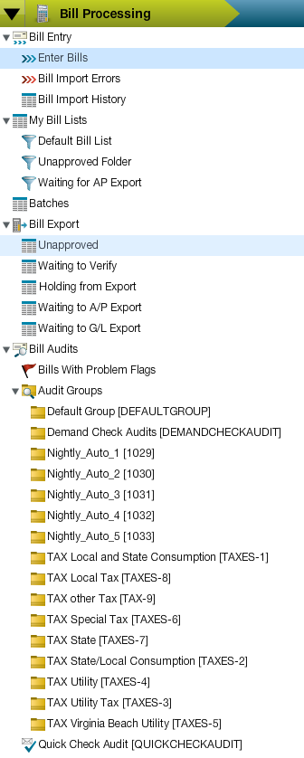
Tax Audits
Taxes we normally don’t pay are:
  State/Local Consumption Tax
  Utility Tax Federal Excise Tax
  E-911 Taxes
  Virginia Communication Sales Tax
  What else?
Two ways to audit:
1. Once every 24 - 30 months, physically review all of your bills (not just electric mind you).
2. For those who use EnergyCap, set up key word audits.
NOTE: Always request reimbursement going back as far as you can (currently 36 months)
Image: EnergyCap Software Example

Slide 24
Rate Schedule Audits
Reminder – the electric company does periodic rate schedule audits but does not evaluate every rate schedule. Examples:
The utility does not know your “all electric” building bills (Rate Schedule 110)
Outdoor lights, look at Rate Schedule 154 (this saved us about 1-2 cents per kWh)
Traffic management meters, look at Rate Schedule 102
Pump stations, look at Rate Schedule 120
Catch all the new meters!

Slide 25
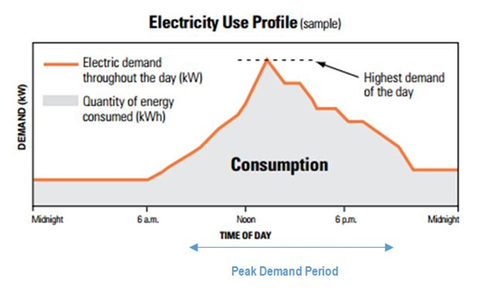
What is Peak Demand?
Notes:
Doing this things after 10 pm and before 10 am!
School example, pottery kiln same time as lunch
Aquarium, back wash and reheat at night.

Slide 26
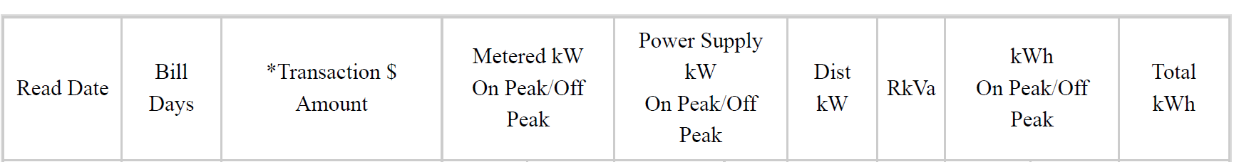
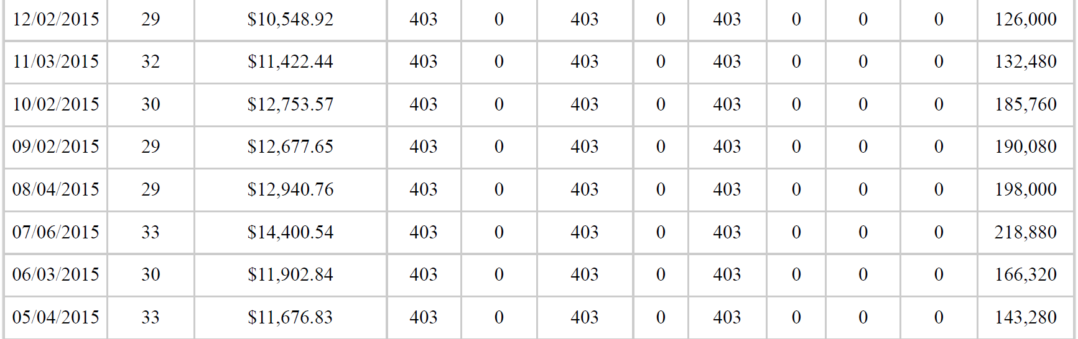
Suspicious Peak Demand

Slide 27
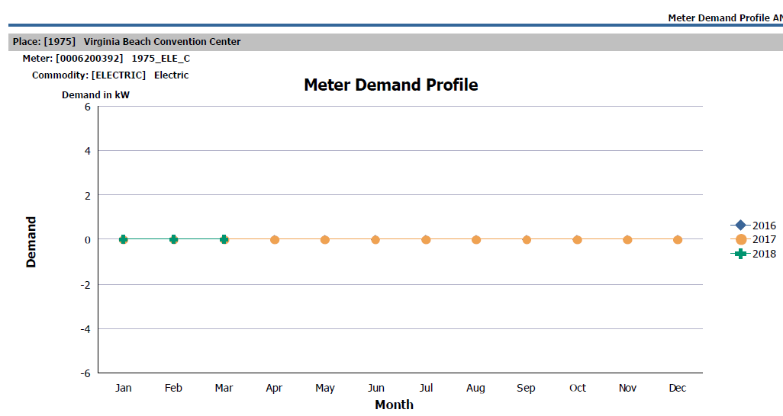
Suspicious Peak Demand
EnergyCap Report AN06
TIP - EnergyCap Report AN06

Slide 28
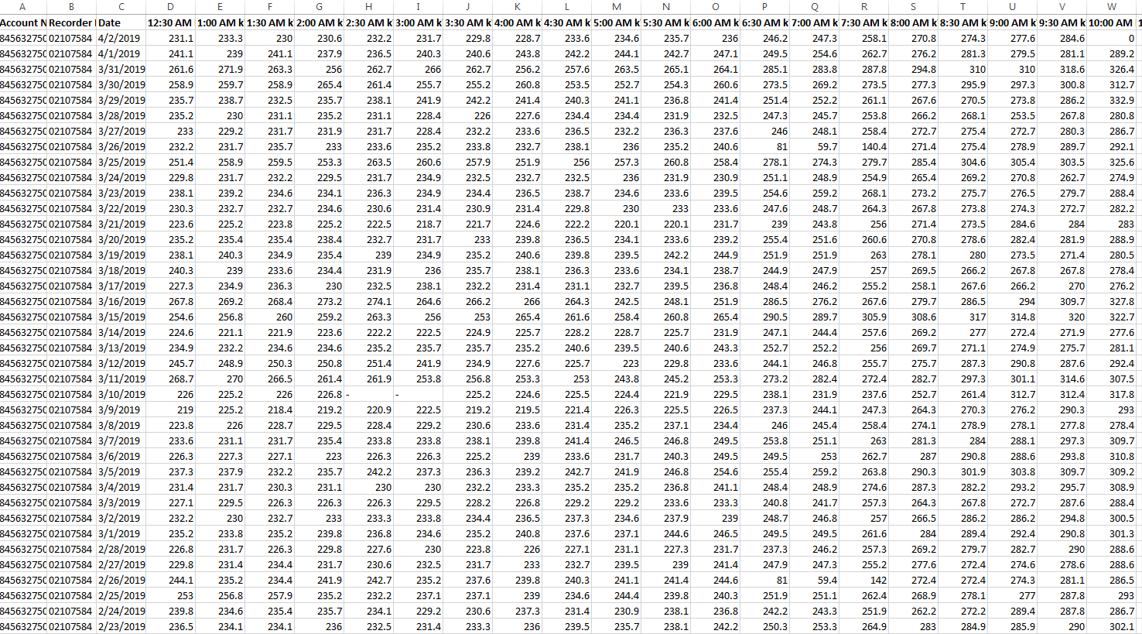
Electric Meters - Interval Data Recorders

Slide 29
Peak Demand Rate Schedule
 | 2016 | 2017 | 2018
Peak | 346 | 333.1 | 327.9
Date | 7/29/2016 | 8/18/2017 | 6/18/2018
Time | 4:00pm | 1:30pm | 4:00pm
Temp at Peak | 90° | 73° | 84°
High Temp of Day | 93° | 75° | 87°
Annual Electricity Cost | $118,459 | $117,534 | $110,709
Peak % of Bill | 22.6% | 24.9% | 23.3%

Slide 30
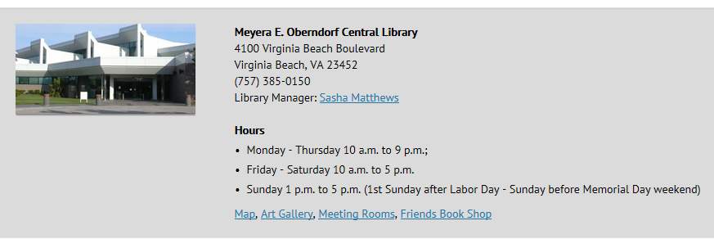
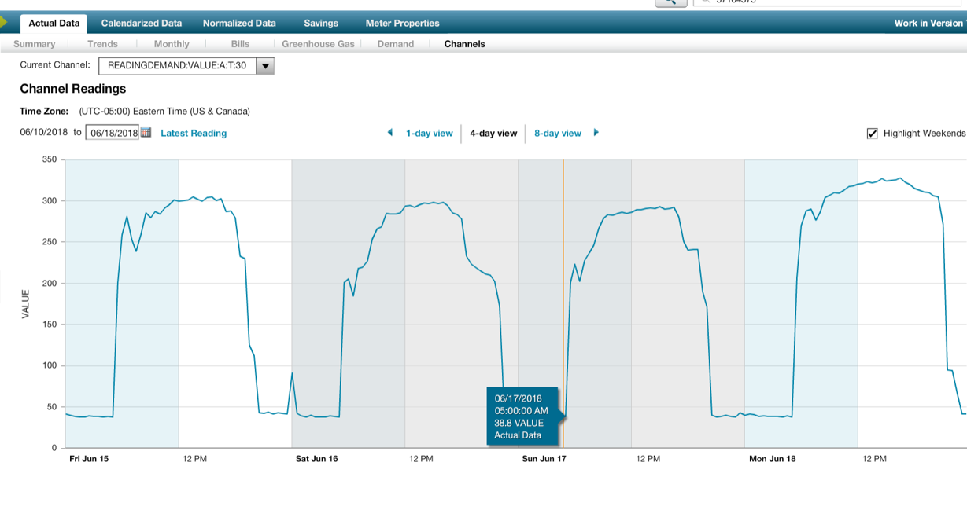
Central Library – IDR Data in EnergyCap

Slide 31

The New Way: Award Winning
As the result of this project, the City has reduced the keying of over 1000 paper bills to date and provides over 90 energy reports per month.
The City of Virginia Beach (CVB) received the Louisville Award for Innovation in Government from the Government Finance Officers Association (GFOA) for its new Energy Software Program.
The GFOA recognized this initiative as a contribution to the practice of government finance that exemplifies outstanding management.
Notes:
This software will allow us to bring in energy tracking and analysis into ONE PLACE in the City. A lot of this is being done currently by hand on spreadsheet or using access…
This reporting will allow Dept Directors to see their energy usage in much more detail on a monthly basis – and initiate corrective actions as needed
And we can see what building’s need retrofit work…

Slide 32
Other Audits

Slide 33
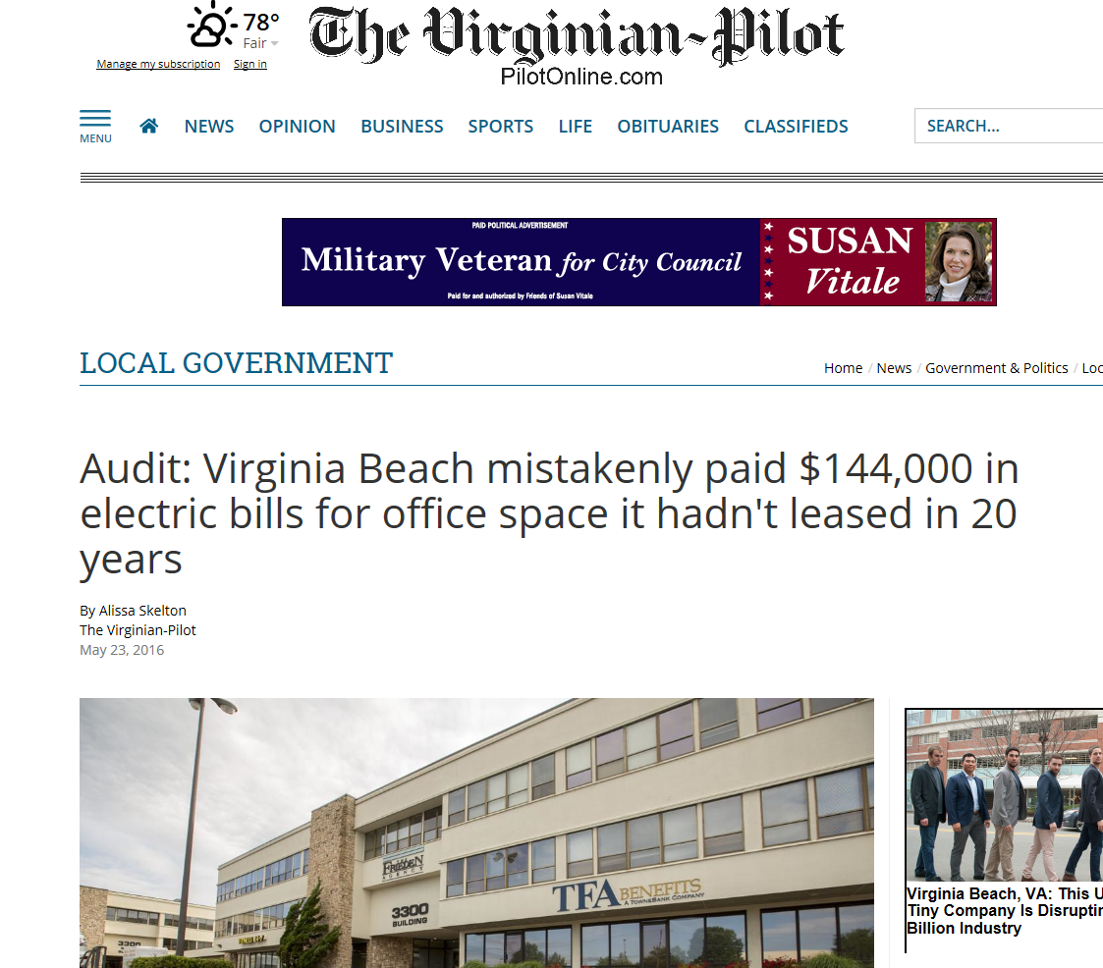
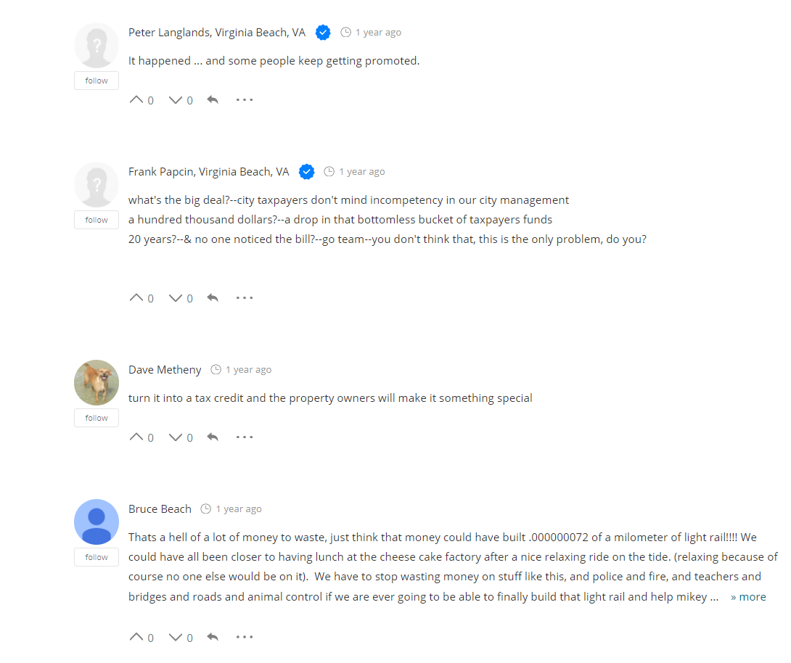
Meter Audits
Verify! Verify! Verify!
Paid $7,000 a year for 20+ years on a building we no longer leased.
We did recover $35,820.
Annual verification now required.
We also found lighted road signs that belonged to VDOT that we were getting billed for.
Notes:
(credit for $1,250, $400 a year savings going forward)

Slide 34
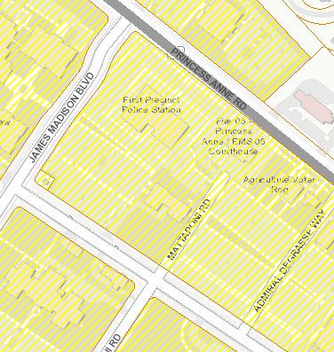
GIS Audits - Totalizing
Totalizing meters for billing purposes may save your locality money. For rate schedules like 130, the more you use, the less you pay per kWh. You can also “combine” peak demands if they are happening different times of the day.
Using your locality’s GIS map of your facilities, zoom in and locate all your contiguous property with facilities that have a decent amount of usage.
Once you identify the facilities, submit a letter to electric company requesting a review of the accounts for “totalization”.
We have the City properties as a GIS layer and we can use the map to evaluate our properties.
3. For billing purposes, totalized bills will come in as one bill.
Notes:
$60,000+ a year and counting

Slide 35
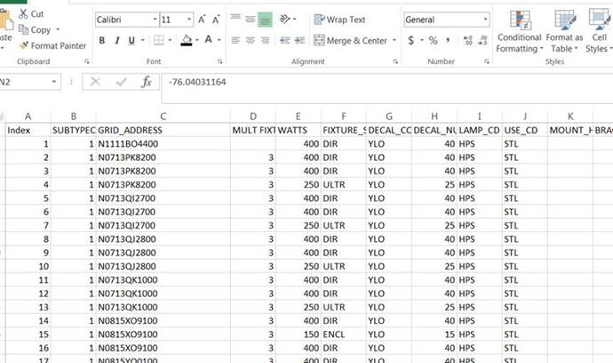
Auditing Poles - Using the Street Light Spreadsheet
Search for Duplicate Pole Numbers in the SOR/GIS:
Download all the street light data into an one excel spreadsheet (multiple contracts/bills)
Sort by the unique pole ID
There should only be one unique ID showing up on one bill (unless there are more than one light on a pole). Investigate possible duplicate billing for the same fixture.
Turn in letter and request a credit going back 36 months from the date of that letter.
Notes:
In 2016, we found 31 duplicate poles and received a credit of $3,700 and billing was cleaned up going forward.

Slide 36
Auditing Poles - Using the X/Y Coordinates (GIS)
Search for poles in the field that are just too close
Over the years, electric company physically removed poles and then installed new ones (an example would be for a knock down). We have found that sometimes these have not been removed from billing.
Using the spreadsheet, analyze with the X/Y coordinates are too close.
Turn in letter and request a credit going back 36 months from the date of that letter.

Slide 37
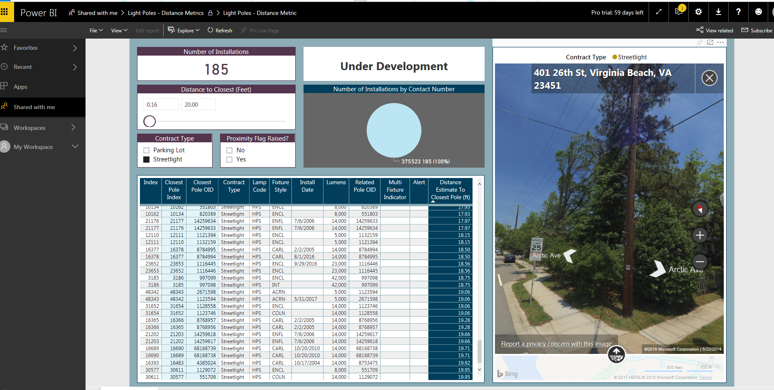
Auditing Poles using Business Analytics – Taking it a Step Further…
  Streetlights Scenarios – we assumed that two streetlight poles should not be within 15 ft. of each other.
  Parking Lot Lights Scenarios - we decided to review poles in parking lots that are within 10 ft. of each other or less.

Slide 38
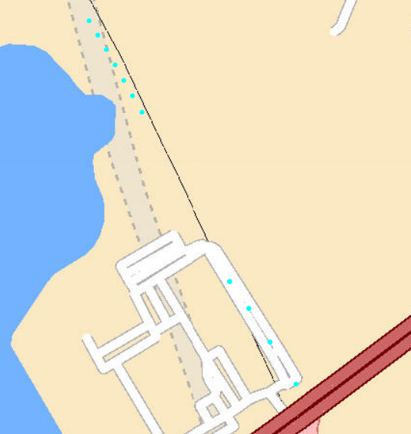
GIS Audits – Street lights
Search for lights that the City or that division should not be paying:
1. Working with your GIS team, upload the street lights into a map of your locality.
2. For electric company maintained parking lot lights, lay over City property. Looks for outliers. Review outliers for accuracy via google maps and site visits.
3. Review street lights on private roads.
4. Using your map, zoom in and go around the boundary of your locality (our GIS team also provides us with a report in excel that gives us the suspicious ones to review).

Slide 39
Auditing Poles that are no longer there – What?
Audit physically removed poles that still remain in the Dominion Billing:
Review your Dominion work orders/projects for poles that were physically removed from the field.
Locate their unique ID numbers and go into the SOR or your downloaded GIS data to see if they are still there.
Write a letter and request a credit back to the date of removal.
Notes:
So far, we have located 7 and received a credit for around $3,000. however, this audit is still underway.

Slide 40
Getting those Street Light Credits for Outages
Contract Language Regarding Credits
If the streetlight has not been repaired within the applicable time limit, below, electric company will automatically adjust the billing. The amount of any refund or credit for such lights shall be prorated for the days of outage following the first report to the Company.
a. For all installations not involving an underground cable failure, eleven calendar days.
b. For installations involving an underground cable repair, fifteen calendar days.
c. For installations involving an underground cable replacement, 45 calendar days.

Slide 41
Missing Street Light Outage Credits?
Here is an example:
POLE N0713TL4000:
7/3/2017 Was out for 58 days and then the work order was closed.
10/10/2017 Was out for 299 days and closed.
8/16/2018 Was out for 1 day and closed.
9/19/2018 Submitted again

Slide 42
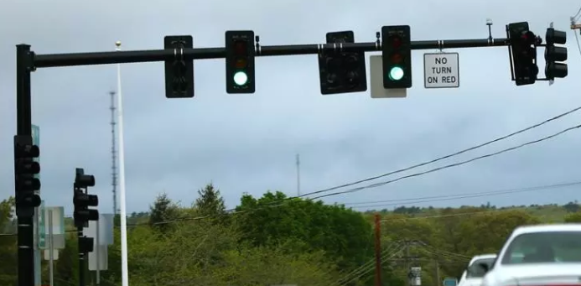
Traffic Signals Audit
Traffic Signal Audit – here is how our team did it:
Our traffic operations team had a list of intersections with traffic signal operations in the City.
The team added to their spreadsheet the meter and account number for each location (they also noted whether it was metered or unmetered service for future reference).
Then they went through all of the electric bills that they are paying for and checked off each intersection off of the bill. When they were done, they found that the same intersection was on multiple bills.
We turned in a letter and requested a credit going back 36 months (be sure to say from the date of that letter).
Notes:
Submittal of 18 duplicate signal meters to Dominion gave us a credit of $31,633 and an annual savings going forward of $11,000.

Slide 43
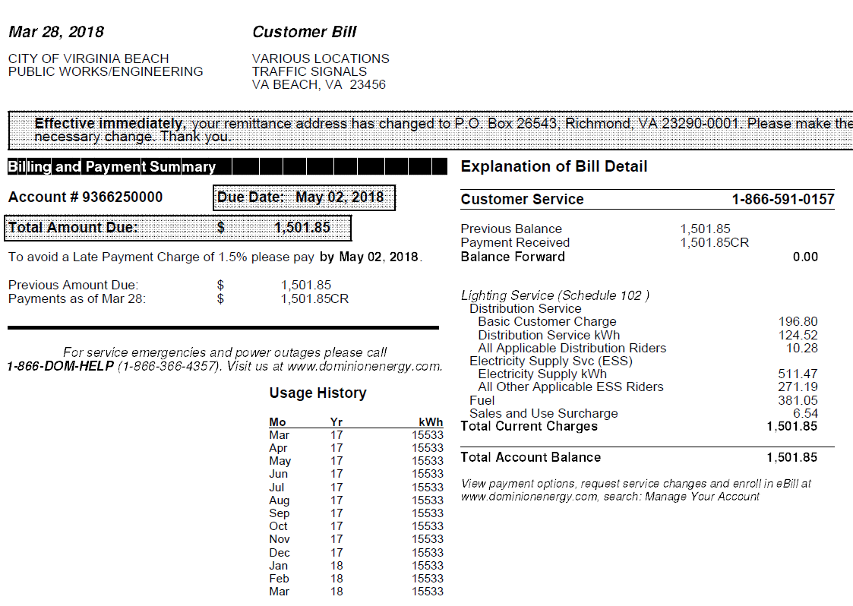
Unmetered - Dropped Usage due to LED’s
Review all unmetered billing compared to your recent LED projects.
Ensure you have not added a lot of additional items (video cameras etc.) to the meter.
Put in a formal request for a review if you reduced energy in the field (such as LED’s), you have to work with electric company to meter and document the reduction in order to see the savings on your bill.

Slide 44
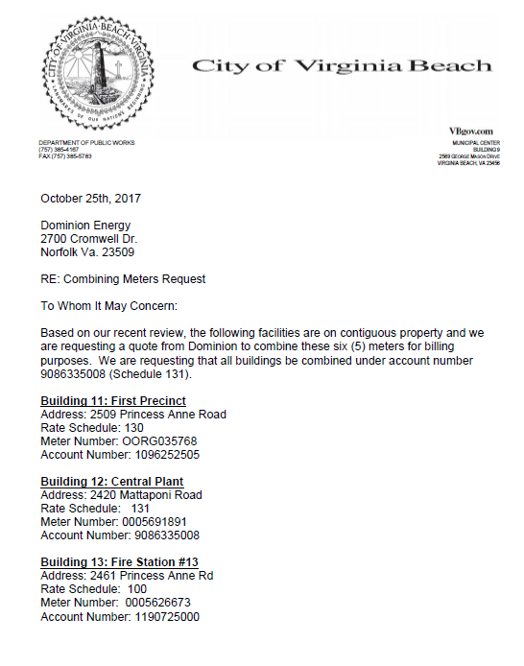
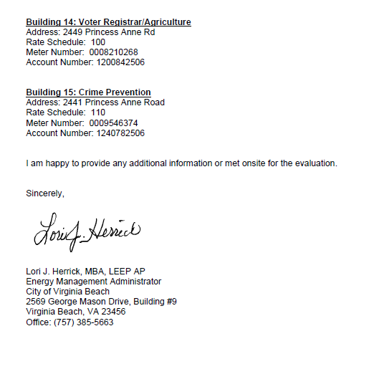
Make requests on Letterhead

Slide 45

Billing Errors
Peak Demand Issues - $163,921
Streetlights & Traffic Signal Overcharges - $40,509
Totalization Projects
Convention Center -
Judicial Center & Correctional Center - $23,142
Central Plant & 11-15 - $39,040
Rate Schedule Changes and Other Annual Savings
$29,210
Contract Demand Negotiations
Convention Center - $9,085
Billing Credits
Notes:
We currently have 12 issues outstanding with Dominion Energy and some go as far back as 2015.

Slide 46
Questions?
Lori Herrick Borden
lherrick@vbgov.com or (757)385-5663

