Slide 1
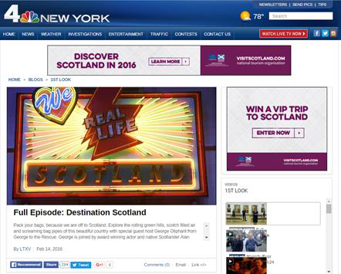
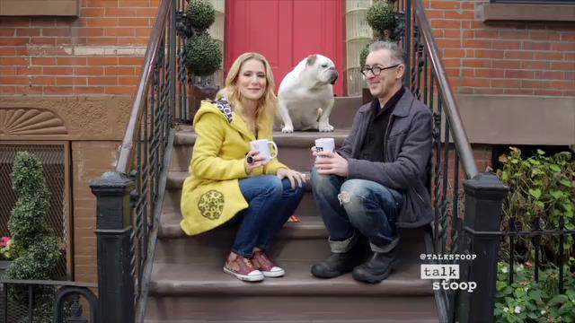
Wnbc
VS
½ hour show
30” vignettes
145 TV ad spots
Digital support
OOH taxis
Social amplification
Over 30 m impressions
Strategic partnerships to extend our reach
Notes:
WNBC campaign: £230K –largest campaign in terms of budget and workload. Our team became a fully functioning production team for a month putting together the filming schedule for two NBC programmes. We sourced a range of locations and activities that inspired US audience and found Scottish ambassadors to work with from Tom Lewis, the chef to kiltmaker Howie Nicholsby and even the First Minister of Scotland.
Broadcast £165K
1st Look Scotland special 30mins
Open House feature – Abbotsford House
NY Live
Talk Stoop – Alan Cumming promo
80x TV spots booked – 65 bonus spots delivered
6x 30’’ vignettes: golf, history, food&drink, Edinburgh, active, Alan Cumming
Digital £21.6K
Digital display inventory – desktop, table and mobile
OOH £15K
11K taxis featuring 60’’ Spirit brand ad and 60’’ NBC vignette
PR launch in NYC – wide media interest in the project.

Slide 2
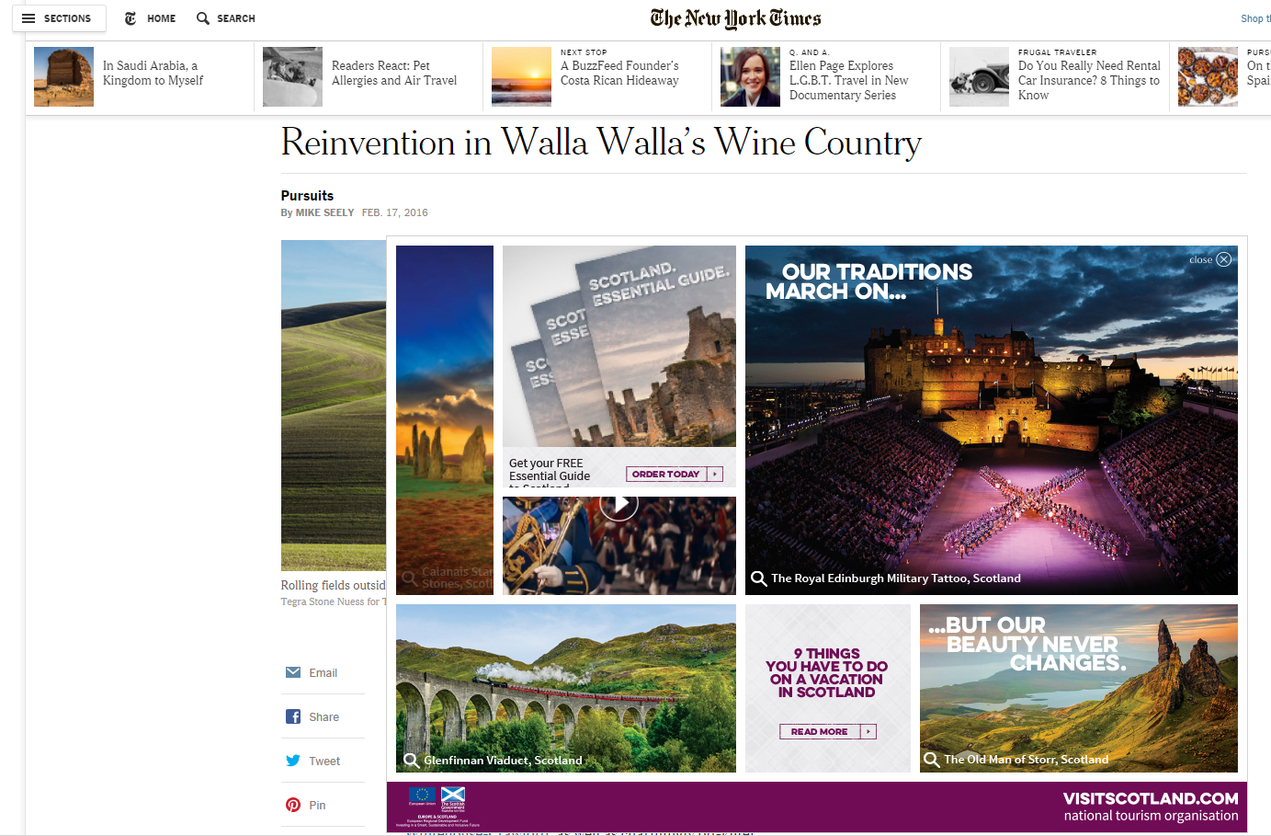
New York times
2.2 million impressions
19%
Interaction Benchmark
2.8%
53 sec
in-view time
Benchmark
25 sec
Click to interact
Telling our stories through others with greater reach
Notes:
New York Times bento box
Media budget: £71K includes production
Timings: 28 Feb – 31 Mar 2016
High engagement, low number of visits
2.2m impressions vs 2.2m target, 2.3K clicks vs 8k target, 0.11% CTR vs 0.38% target
*In-view time: the length of time an ad has been active and in-view.
*Interaction %: % of impressions where a user entered the frame of the ad and remained active for at least 0.5 seconds.
VS worked directly with NYT digital team to build the unit
Unit showed strong results against comparable units on NY Times
Most clicked: ‘Our traditions..’ ‘9 things you have to do..’
https://www.adfootprints.com/front/preview_Demo/a5cdd4aa0048b187f7182f1b9ce7a6a7

Slide 3
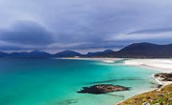
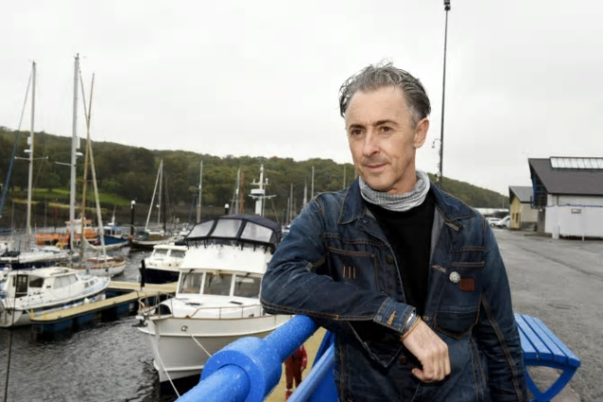
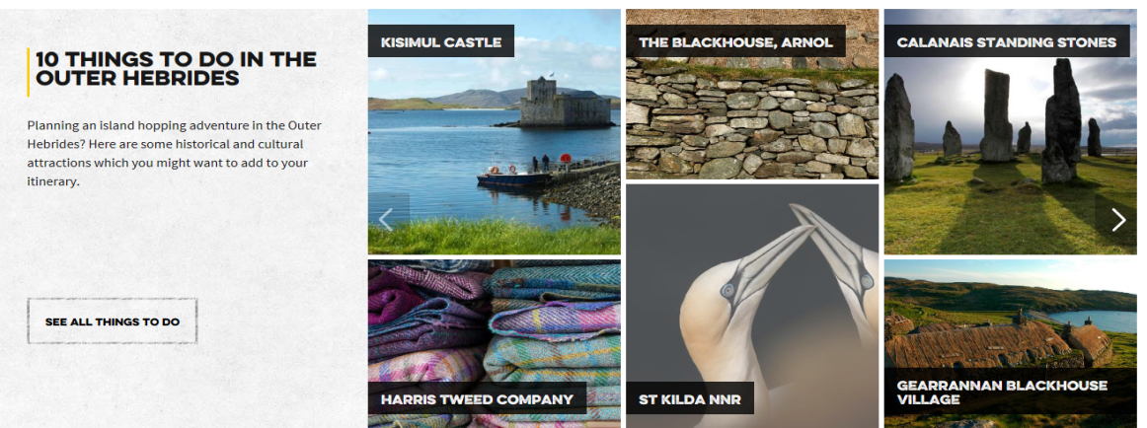
Stv / Alan Cumming’s edge of scotland
Hour long documentary (17 Feb) with repeats on main and city channels plus STV player
Pre promoted on air and to STV / VisitScotland email databases
TV ads running post show
Online retargeting of people who viewed show through Player
Social amplification through VisitScotland and STV channels
Telling our stories in new ways

Slide 4
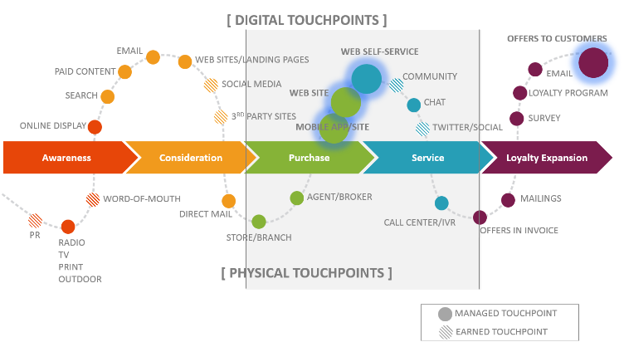
Always on digital
See
Think
Do
Care
ADVOCACY
*for illustration - not all touchpoints relevant to VS
We need to be ever present throughout the journey - 365 days a year

Slide 5
Loch morlich
Inspiring portrayal of modern scotland
EMPOWER AND ENABLE THE Businesses and Individuals
Harness networks of influence
‘DRIVING ADVOCACY’ IS OUR STRATEGY

Slide 6
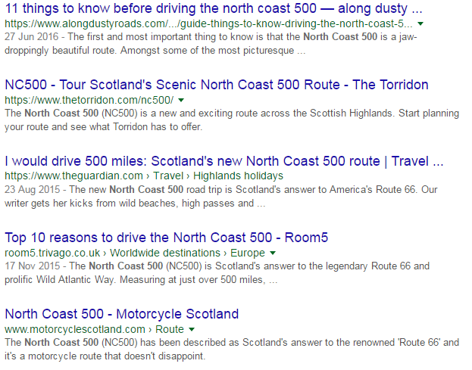
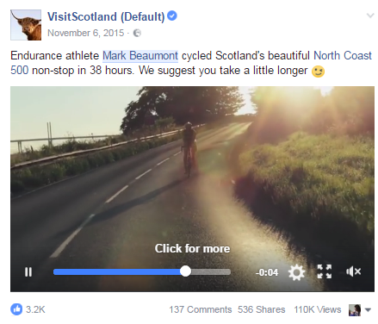
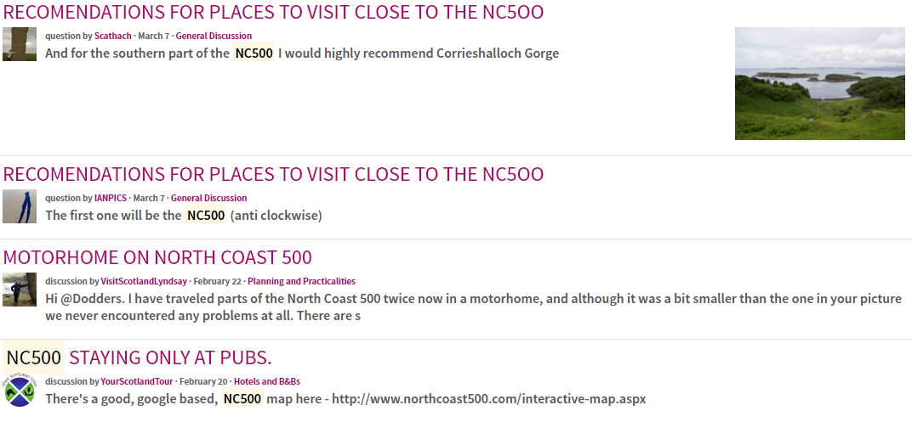
NC500
Google Search
Page views:
NC500 – 95k
Northern Lights – 117k
Outlander – 111k
VS Online Community
Top landing pages on vs.com:
NC500 – 95k
Northern Lights – 117k
Outlander – 111k
Creating experiences grows your share of voice
Notes:
Conversion (All Goals)
NC500 – 27%
Northern Lights – 19%
Outlander – 22%

Slide 7
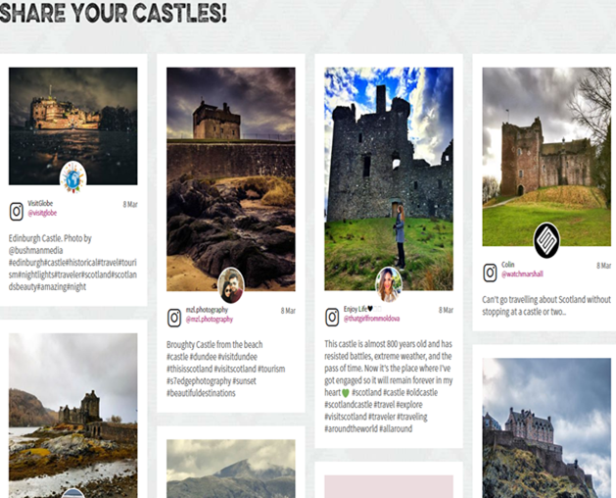
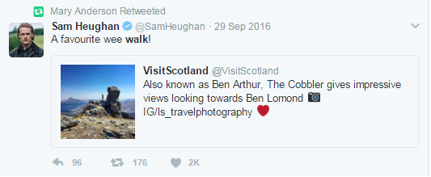
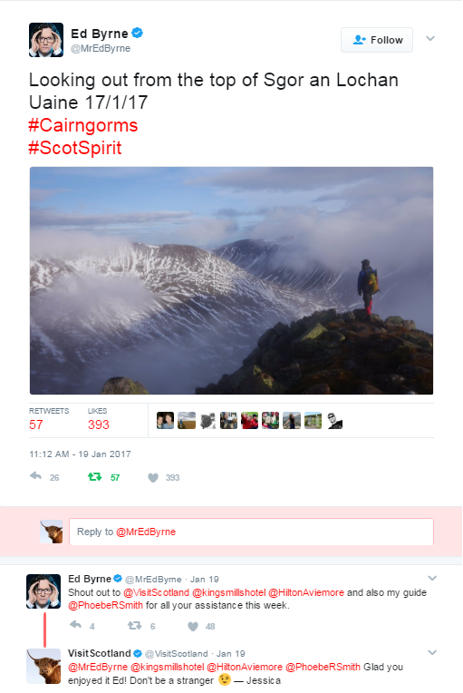
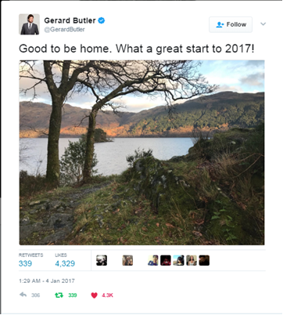
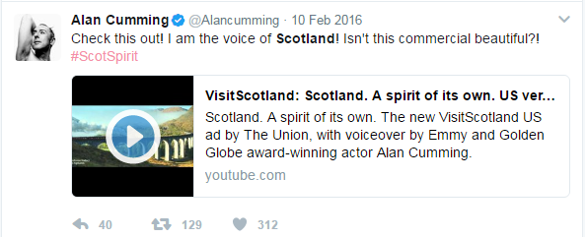
harnessing networks of influence – social followers work for us all

Slide 8
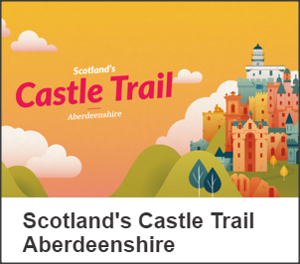
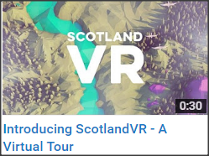
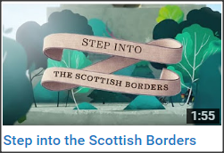
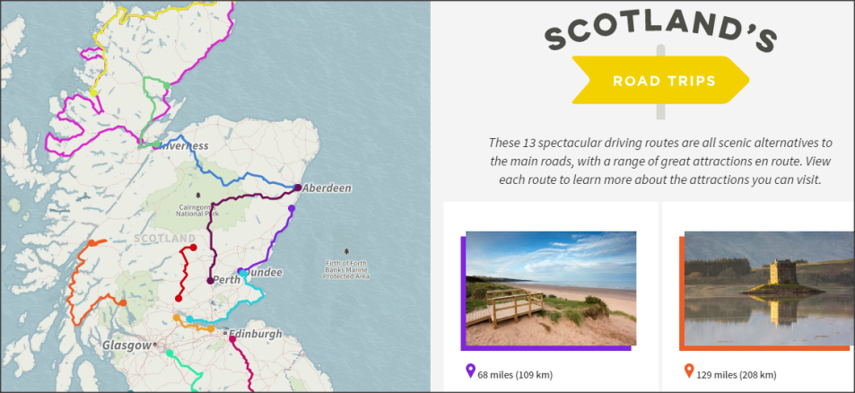
inspiring modern scotland
ScotlandVR – A Virtual Tour video
Scotland Castle Trail - Aberdeenshire eBook
National tourist routes microsite
Scottish Borders 39 Steps video
partnering to tell stories & create great content

Slide 9
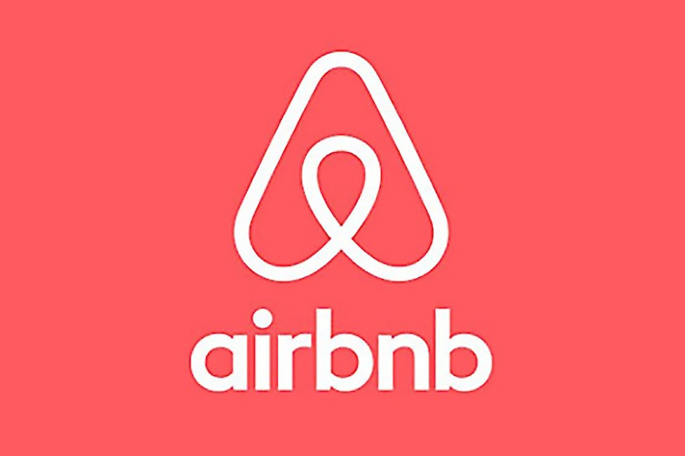
The Disruptors - Now

Slide 10
Trip Advisor Size of opportunity
Share of voice
Notes:
TA have analysed travel search behaviour for Scotland’s Top 25 target markets - to what volume are they searching for destinations outside of their home countries, and what % look at Scotland?
Opportunity for Scotland to grow it’s share of voice amongst target audiences when they are in-market to travel is massive
Chart shows 43m ‘lookers’ at Scotland content – from the Top 25 markets. Global audience looking ta Scotland circa. 70m (TBC by TA).
We are going to serve our content to those who look at countries that offer similar experiences – think Scandinavia

Slide 11
a new direction
Tell stories, sell experiences
Be a great partner
Look for opportunities such as Growth Fund
If its not measurable, don’t invest
A few rules that can work for us all
Notes:
Match fund grant award scheme for collaborative tourism marketing projects which focus on growth in the tourism sector and ensure that visitors experience the true Spirit of Scotland
Only constituted groups can apply for funding, not an individual business
Awards of £10,000 to £40,000
Applications must align with the national Tourism 2020 strategy, VisitScotland’s strategy and any relevant regional/sector strategies
Match funding of 50% is required – half of this match funding must come from private sector funds
Growth Fund Criteria & Conditions give further detail

Slide 12
Satisfaction with the overall visitor experience is high
9 or 10 scores (Top 2 Box) show genuine satisfaction and can foster loyalty. The challenge is to enhance the visitor experience for every visitor to encourage more to give the very highest scores on the satisfaction scale.
Top 2 box
Mean
70%
9.0
1
10
Note: post holiday reflection usually brings halo effect resulting in positive overall scores. New 1-10 scale helps understand more detail.
Q49 Overall, how would you rate your holiday / short break experience in Scotland? Base: S2 All (2999)
Overall Rating Of Holiday Experience

Slide 13
Thank you!

