Slide 1
Promoting Partnership and Collaboration in Serving Immigrant and Mixed Status Families in Child Welfare
Monica Montoya, LCSW
Maria Gurrola, PhD, MSW
Megan Finno-Velasquez, PhD

Slide 2
Learning Objectives
Discuss community and child welfare agency responses in border communities to meet the needs of children and families affected by immigration detention and deportation.
Learn about how other communities are responding to the current political environment as it relates to immigration policy enforcement and implications for the child welfare system
Share resources available to address the needs of immigrant children and families impacted by immigration enforcement and/or involved in the child welfare system
Identify how IV-E partnerships can promote advocacy and collaboration with social services that protect family unity and minimize harm to children in their communities

Slide 3
Agenda
Current Policy Context
Children Affected
Impact of Policy at Local Level
Local Community Responses to Immigrants
Impact on Child Welfare System
Child Welfare Practices to Address Needs of Immigrant Families
DIALOGUE
Resources

Slide 4
Policy Changes Increasing Risk of Family Separation
Executive Orders on Border and Interior Enforcement (Jan. 2017)
End of Deferred Action for Childhood Arrivals [DACA] (Sept. 2017)
End to Temporary Protected Status (TPS) for Nicaragua, Honduras, El Salvador, and Haiti (Nov 2017-Jan 2018)
Homeland security proposals to separate families at border (Dec. 2017)
Other congressional and administrative threats…
Notes:
These changes are resulting in:
Increase in number of people deported
Increased risk for family separation and/or intentional parent-child separation
We are also seeing
Parent-child separation without a plan in place
Increased deportations not allowing parents and children to do safety planning
Legitimate asylum claimants being detained
A slow down in processing of legitimate claims for protections such as Special Immigrant Juvenile Status

Slide 5
Current Threats to Children
Policy changes placing more people at risk for deportation and family separation.
Psychological and physical health issues in children as a result of immigration/deportation issues.
Risk of increased involvement with the child welfare system among children of immigrants.
Notes:
There are several threats to the well-being of immigrant children and children of immigrants in the U.S., that we can separate in to three areas

Slide 6
Who is at risk? | How many?
Children in mixed-status families with at least one unauthorized parent | 5 million + kids; 4.1 million U.S. citizen kids
Dreamers and DACAmented youth | < 1 million undocumented kids under 18; 800,000 with DACA
Unaccompanied children | Tens of thousands per year
Notes:
There are 18,413,000 children in immigrant families
-88% are US Citizens
-14% are foreign born
-40% non US Citizen parent
-6% are unauthorized
-21% have at least one unauthorized parent

Slide 7
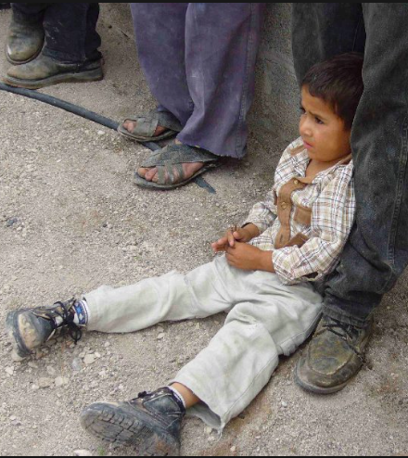
Immigration enforcement along the border
Raids and school support
More border patrol
School response to DACA
Border wall
National Guard

Slide 8
Community agency responses to immigration along the NM border
Collaborations
NM CAFe
America Civil Liberties Union (ACLU) Border Rights Office
Faith base institutions
Catholic Charities
Legal Services
Holy Cross Retreat Center (sheltering two immigrant families)
La Clinica de Familia (Inter-professional services)
Communities/Colonias along the border

Slide 9
Differing geographic perspectives on immigration enforcement
Las Cruces
"The work that you do -- that you have dedicated your lives to -- is essential. I believe it. The Department of Justice believes it, and President Trump believes it. You can be certain about this: we have your back and you have our thanks.”
"We cannot allow states, cities, or counties to violate federal law. Sanctuary policies hinder the work of federal law enforcement; they’re contrary to the rule of law, and they have serious consequences for the law-abiding people.” -AG Jeff Sessions
Dona Ana County
"My deputies, the office of the sheriff here in Doña Ana County, we're not enforcing immigration law. We're not immigration officers. We are out there in the desert doing search and rescue. It’s only being human out there because we do come across coyotes, getting paid and once they get paid the abandon folks coming from Central America from Mexico and we’re out there basically doing search and rescue.” - Doña Ana County Commissioner
Albuquerque
On the passage of city sanctuary law: "What our bill simply says is, 'We comply with the federal law that requires us to turn over information if we have it. We're just not going to have it.” - Council Member Pat Davis
Notes:
Proponents of the measure argue immigrants bolster the state's economy. A draft of the resolution cites studies showing immigrants' economic contributions, including Institute for Taxation and Economic Policy data showing unauthorized immigrants paid $101.5 million in state and local taxes in 2010 alone.
In 2016, immigrants made up more than 12 percent of the state's workforce, according to the Migration Policy Institute. Other institute numbers show 9 percent of New Mexico residents were born in another country. Roughly 120,000 immigrants — or 6 percent of state residents — were not U.S. citizens.

Slide 10
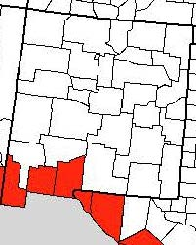
Child Welfare in New Mexico
New Mexico
Increase in child maltreatment reports, overall N=40,220
Slight increase in children and youth coming into care
Doña Ana
Increase of reports (N= 4,732)
No increase in CPS filing of cases/children coming into care
Border area intervention and intersection of Immigration
Approx. 2 unaccompanied minors with U.S. citizenship per quarter come in to care
More families with mixed status/undocumented status during investigations phase
Undocumented children are not coming into foster care
CPS cases impacted by immigration status come in waves
Currently seems to be more Central American immigrants
Sources: Children, Youth and Families, 2017, 360 Yearly, SFY17 Annual Report,
Salas, A., Gonzales, T., and Gutierrez, A., 2018, Personal Communication`
Notes:
Reports in 10/2016 = 4,658
Anecdoctal at best to try to dicipher how many immigrant/mixed status families are served in child welfare. There are no reliable data about the number of immigrant children and families in CPS (Annie E Casey, 2006).
Guatemala and Brazil
Word of mouth

Slide 11
Child Welfare System challenges
Lack of coordination between local ICE and child welfare agencies
Inability of parents to visit with child, meet child welfare case plan requirements, participate in family court proceedings
Barriers to receipt of needed services
Bias among child welfare staff & judges
Strict child welfare timelines that can result in termination of parental rights
Difficulty coordinating reunification at time of parent’s release, removal, or after removal
Notes:
This is a list of several documented challenges that CW agencies face when working with immigrant families.
-They don’t coordinate well with Immigration Center for Women and Children (ICWC) and have trouble finding immigrant detainees, who may be detained and sent anywhere around the country.
-They have trouble then creating meaningful connections between kids and parents while parents are detained.
-Child welfare cases have their own court timelines and hearings, which do not line up with immigration timelines. The most important timeline is the requirements for reunification, that give parents 15 months to complete everything required of them in a court mandated treatment plan before the child welfare agency will terminate their parental rights. How are parents in immigration detention for indetermined periods of time or have been deported to other countries supposed to do that?
-There are several barriers to immigrant parents receiving needed services.
-If parents or relatives are in other countries, there is often no official protocol or procedure for locating them, conducting home studies or getting children placed with them.

Slide 12
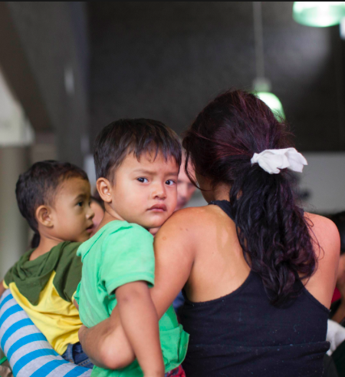
Local child welfare collaborative response
Collaborative cross-reporting mechanisms between law enforcement and CYFD
Collaborative cross-training of local law enforcement and CYFD
Multi-Disciplinary approach
Local strategies for working with immigrant families
Concept of obtaining permission or “Permiso”
Neutralize authority
Supportive and compassionate network
Pre-Initiation Staffing—mindful and purposeful
Source: Salas, A., Gonzales, T., and Gutierrez, A., 2018, Personal Communication
Notes:
Operate under a non-cooperation ordinance (local officials (including CPS do not inquire about a person’s immigration status, unless they are required to do so)

Slide 13
How CYFD is addressing Immigration barriers
Creativity in response to families (Micro and Mezzo)
Family Emergency Planning in investigation phase
Utilization of educational resources and support services
Voluntary placement and visitation with parents/guardians
Contracts with local community agencies to provide services (Macro)
Title IV-B grant programs
Programs that offer sliding scale fees
MOAs and building professional network and relationships with foreign Consulates (Macro)
Supporting CPS Caseworkers
Supervision and Consultation
Pre-Initiation Staffing—mindful and purposeful in consideration of immigration related issues
Notes:
Schools and CPS have developed collaborations to support immigrant children and families.
Establishing formal agreements with foreign consulates; family connections transcend country boundaries, to establish and/or maintain connections family are important resources for children in US.
Caseworkers express fear of jeopardizing the immigration status of the family by involving Law Enforcement (Las Cruces—city limits), and are hesitant to do so; not that they don’t take steps necessary in cases of child maltreatment; but is often an area of discussion during the pre-initiation and other staffing. Best practice: proxy questions (country of origin, language at home, length of time in US)

Slide 14
Child Welfare Best Practices
Child welfare agencies can…
Develop clear policies on sharing info with immigration authorities
Implement policies similar to SB 1064
Equip workers to screen for SIJS, U Visas, VAWA
Establish relationships with local immigration legal clinics
Encourage workers to support immigrant families in preparing for possible detention and deportation
Notes:
The good news is that several states and jurisdictions have models that have worked well in serving immigrant families. Many of those models and practices are on our website.
So… child welfare agencies can develop clear policies on sharing info with immigration authorities, or better yet, how to protect the confidentiality of immigrant families involved with child welfare system.
Develop policies similar to SB 1064, is a state policy

Slide 15
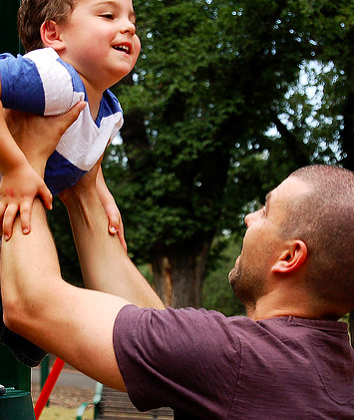
Interactive dialogue / Q & A
What emerging policies/issues/trends are you noticing specific to immigration and child welfare in your area?
What challenges or barriers specific to child welfare practice do you encounter when working with immigrant/mixed-status families?
What education, training and collaboration/capacity building efforts are needed to enhance service provision to meet the needs of immigrant families in child welfare system in your states?
Notes:
Trends/threats to overall child safety, well-being and permanence. Implications for child welfare service provision working with immigrant/mixed status families in child welfare.

Slide 16
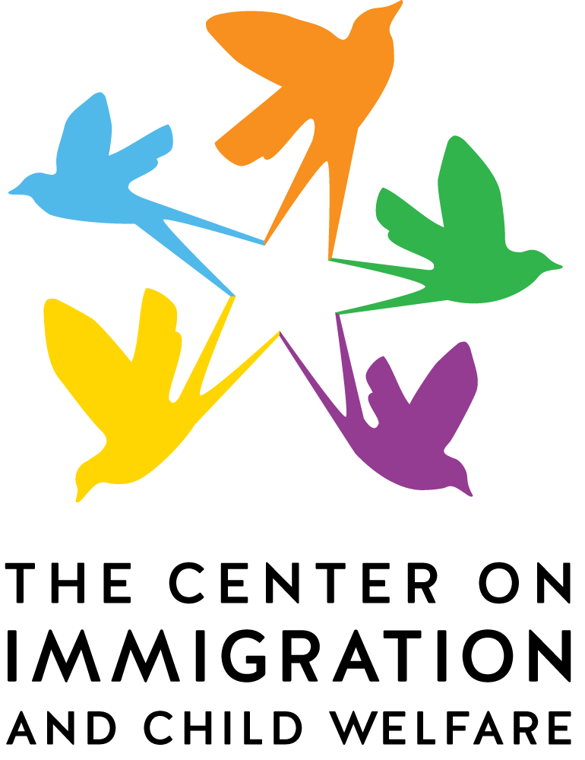
The Center on Immigration & Child Welfare
The Center on Immigration and Child Welfare (CICW) is a network of diverse organizations and individuals working around the country in law, in advocacy, and in direct child welfare practice.
The CICW builds the capacity of the U.S. child welfare system to respond to the unique needs of immigrant families and children through research, resource development, training and technical assistance, and national leadership.
Notes:
Currently, the CICW is housed at the New Mexico State University School of Social Work.
Prior to 2017, the center had been inactive for some time. Now that it is under new management, the center has been working to build upon what was already established by previous leaders, by taking steps forward in continuing our work.
Our primary activities at this time are to continue disseminating information and resources, provide training and technical assistance as requested, based on the current issues that have come about recently as a result of rapid policy changes, and the current political climate.

Slide 17
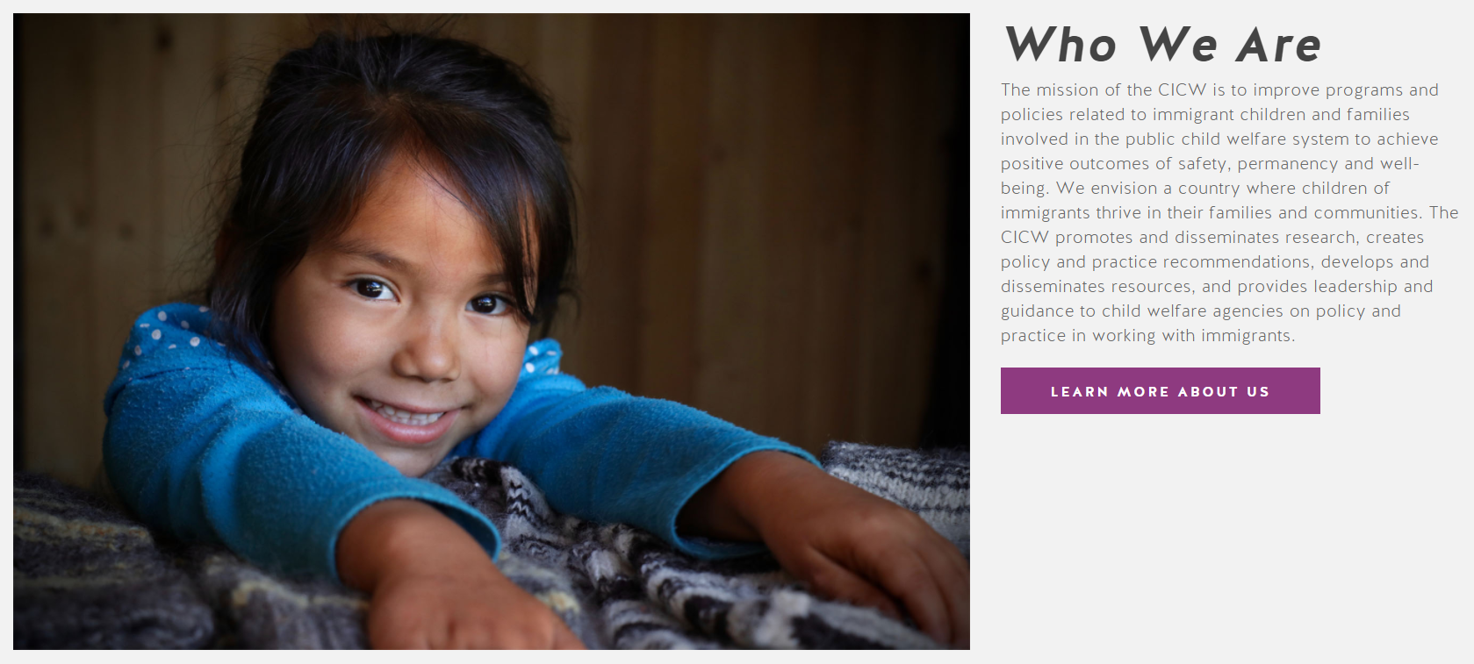
Resources and Technical Assistance
Notes:
The new CICW website features a variety of resources on practice, law & policy, and research as they relate to the intersection of immigration and child welfare.

Slide 18
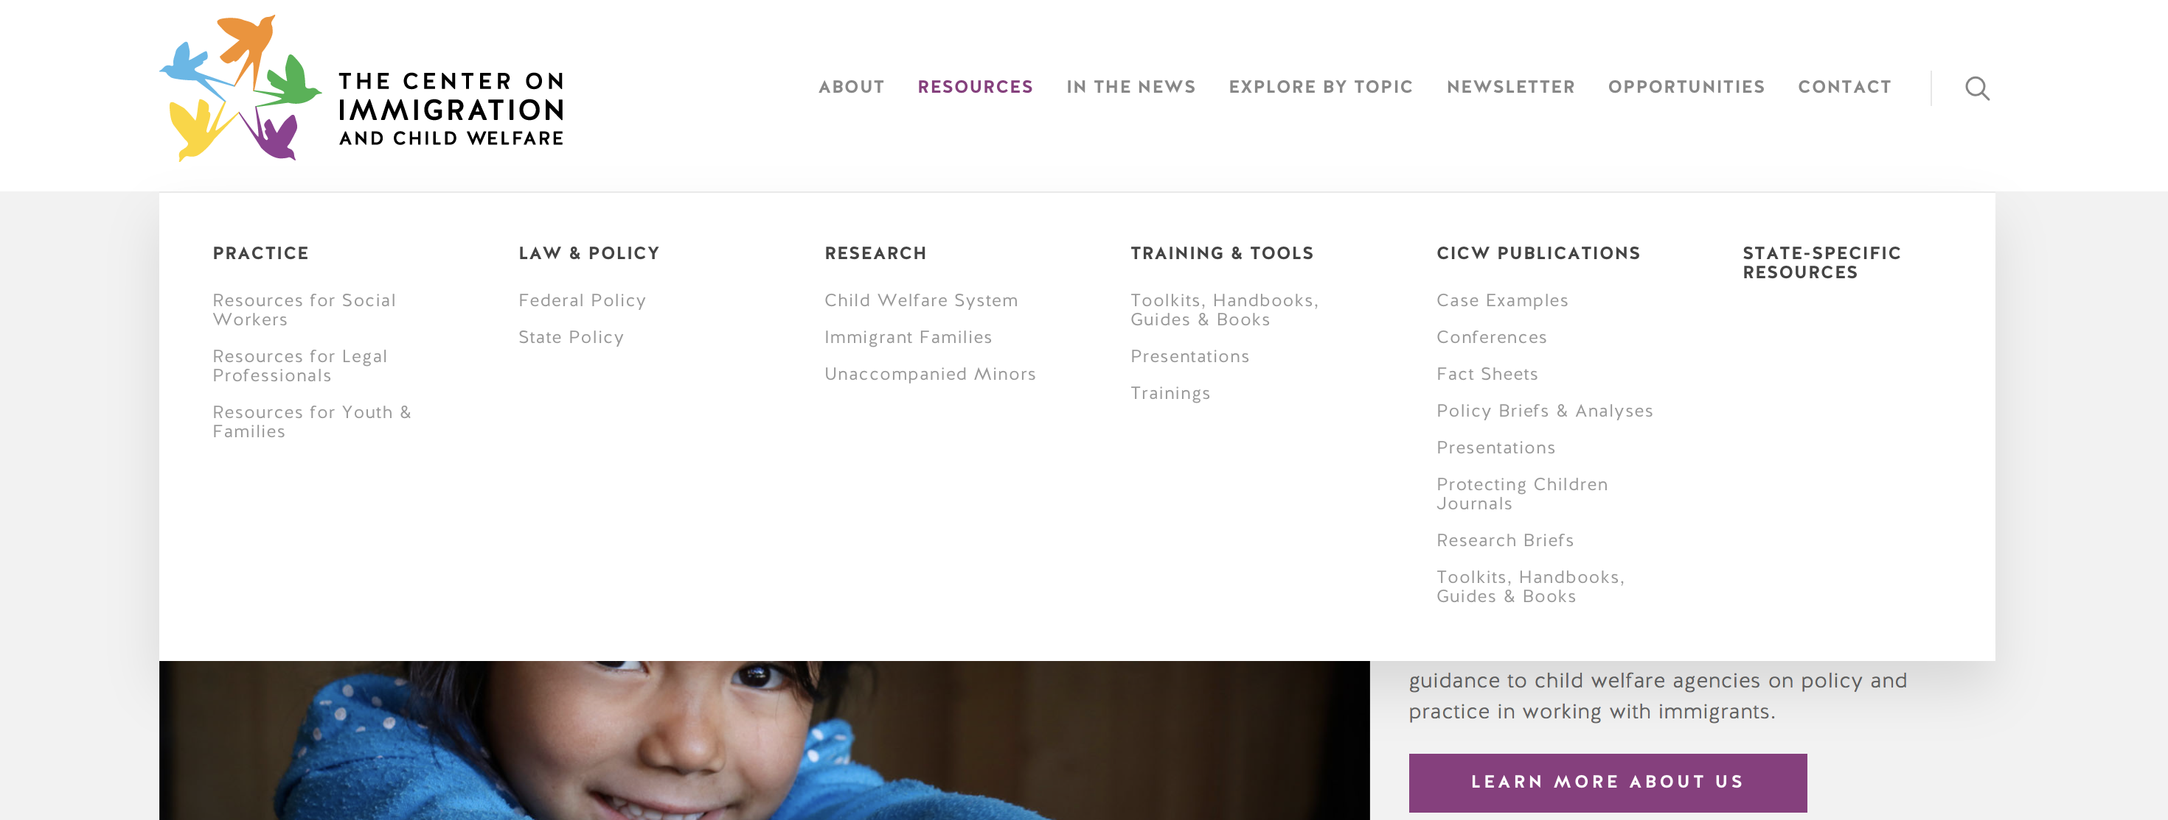
Resources
Notes:
There are practice resources for social workers, legal professionals, and youth and families.
There are federal and state policy updates and analyses as well as state-specific resources.
There are research briefs and articles about the child welfare system, immigrant families, and unaccompanied minors.
The website also houses a variety of trainings and tools, including toolkits, handbooks, and presentations.
Finally, there are a variety of CICW publications from throughout the years, including case example, conferences, fact sheets, presentations, briefs, and more.
There is also a section of the website that features the latest news and current events related to immigration and child welfare.

Slide 19
All resources are also all searchable by topic. Hover over “Explore by topic” to see.
Notes:
The aforementioned resources are also all searchable by topic. These topics include: Adoption, Child Abuse/Neglect Prevention, Child Maltreatment, Child Well-Being, Culture: Issues and Competencies, Deportation, Detention, etc.
For example To find a guide about working with immigrant families who may be facing deportation you can navigate to “Resources for Social Workers” under the Practice category
You can find the same resource about working with immigrant families who may be facing deportation by navigating to the “Deportation” topic under “Explore by topic”

Slide 21
How to Contact Presenters:
Monica Montoya, LCSW, 575-646-6342, monicamo@nmsu.edu
Maria Gurrola, PhD, 575-646-4803, gurrola@nmsu.edu
Megan Finno-Velasquez, PhD, LMSW, 575-646-0306, mfv@nmsu.edu
The Center for Immigration and Child Welfare website: http://cimmcw.org

