Slide 1
MenuCal
Grainne Gilson
16th July 2017
Notes:
Hello, I would like to say think you for the invite to come along and speak to you today.
As introduced my name is Grainne and I work for Food Standards Scotland within the Enforcement Delivery team and partly with the Nurtition Science and Poilcy team.
Unfortunately, the title of my session makes what I have to speak to you about sound very fancy. But really it is all about new tool that supports allergen and calorie labelling.

Slide 2
MenuCal, what is it?
MenuCal is a free to use web based allergen management and calorie labelling tool
MenuCal supports two areas of Food Standards Scotland (FSS) work in out of home catering settings:
mandatory provision of allergen information
voluntary energy (calorie) labelling
FSS purchased the licence for the MenuCal tool for Scotland from the Food Safety Authority of Ireland in March 2016.
The MenuCal license allows FSS to make amendments to the Scottish version of the MenuCal tool to make it applicable to Scottish Food Businesses.
MenuCal is currently being piloted in Partnership with Scottish Food Enforcement Liaison Committee (SFELC) Diet and Nutrition Working Group.
Notes:
And that tool is MenuCal
It is a free, online allergen management and calorie labelling tool
MenuCal supports two areas of FSS work – Provision of allergen information and voluntary energy (calorie labelling)
MenuCal was developed by the Food Safety Authority of Ireland, primarily for calorie labelling but when the legislation about allergens came into force it was adapted to include allergens.
The MenuCal licence was purchased by FSS in March 2016 for Scotland. This allows Scottish businesses access to the tool and the ability for FSS to modify the tool according to Scottish business needs.
The tool is live and available for use now, but we are currently piloting with a small group of food business before the official roll out.
Before I give you a run through of Menucal I just want to provide you with a little context to allergens and calorie labelling.

Slide 3
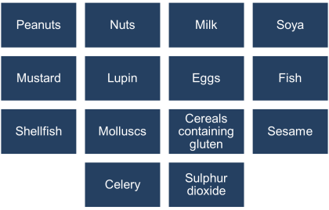
Allergens
December 2014 - mandatory provision of allergen information for non-prepacked food.
For example, food served in restaurants, cafes etc. and food sold loose from bakers, delicatessens and sandwich shops.
This applies to the 14 allergens identified as causing most concern across the EU, as listed in Annex II of the Food Information to Consumers Regulation Regulations.
Notes:
So ALergens
Since December 2014 it has been mandatory for all providers of non-prepacked food to be able to inform consumers about the presence of allergens in the food.
This includes food served in restaurants, cafes, food vans, and where selling food that is not in a packet.
There are currently 14 identified allergens.

Slide 4
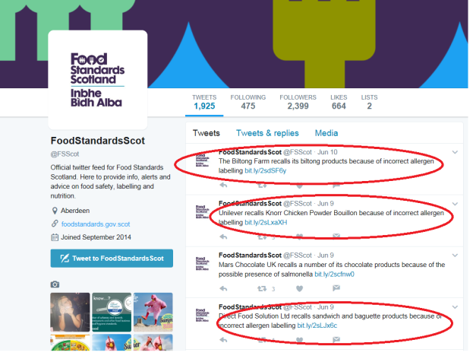
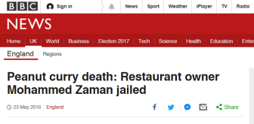
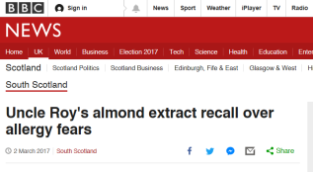
Allergy Alerts/Incidents
Notes:
The Number of allergy alerts are on the rise and you may recall there have been some very serious incidents in the press recently, some even resulting in a death and a restaurant owner getting a jail sentence.
I took the screen shot of our twitter feed on Monday when I was pulling my slides together, and 3 out of the last 4 were allergen related.
Allergens can be quiet a daunting topic for restaurant owners with some needing help to improve their information management.
You can sign up to allergy alerts on our website to keep informed.

Slide 5
Calorie Labelling
The March 2017 FSS Nutrition Board Paper ¹ highlighted that calorie labelling should be part of the overall approach to improving diet and health in Scotland.
Calorie labelling is easier for larger businesses who have the resource and specialist to support.
FSS recognises that calorie information is harder for small businesses and they will require support.
Calorie labelling has the potential to;
Support consumers to make informed choices
Motivate business to reformulate to reduce calories..
¹http://www.foodstandards.gov.scot/sites/default/files/Board%20meeting%20-%202017%20March%2008%20-%20%20Diet%20and%20Nutrition%20one%20year%20on_0.pdf
Notes:
Then there is Calorie Labelling-
In the march 2017 FSS Nutrition Board paper, caloire labelling was highlighted to be included in the approach to improving the diet in Scotland.
Larger businesses tend to find it easier to provide this information as the are more likely to have the resource and expert skills.
FSS recognises that the providing this information is harder for small businesses and they will require more support.
Supporting small businesses will enable them to compete in the market and support consumers to make healthier choices.

Slide 6
MenuCal
MenuCal is a free tool to support SME’s in the provision of calorie information.
Additionally it has the potential to encourage Food business to ;
Reformulate
Reduce portion size
Adopt healthier cooking methods
Develop new product range/ lighter choices
Notes:
That is where Menucal comes in.
It is freely available for Scottish food businesse to use.
And it also has the potential to encourage businesses to consider other options to support their customers to make healthier choices.
This includes- reformulating recipes, reducing portion size, using healthier cooking methods and developing new lower calorie options.

Slide 7
MenuCal, over to Ollie…
Notes:
Now I will take a little break from speaking and hand over to my lovely assistant Olly…
That is one of the many introductory/training videos that are on the MenuCal site.

Slide 8
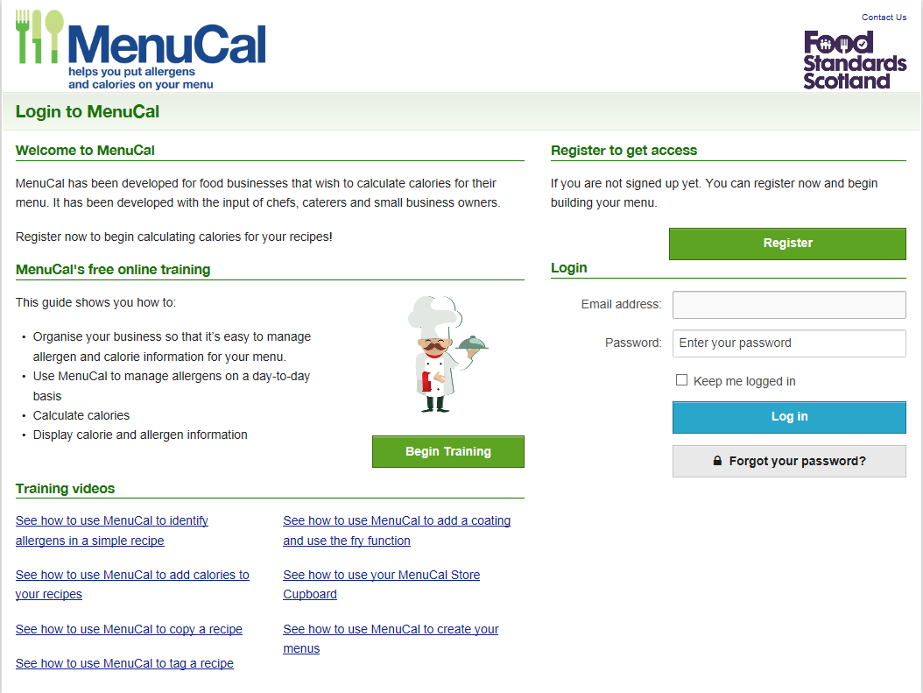
MenuCal, what it looks like…
Notes:
Now for a quick run through of the key functions of MenuCal.
When you go to the site the is the homepage
You can access the training videos, with logging in.

Slide 9
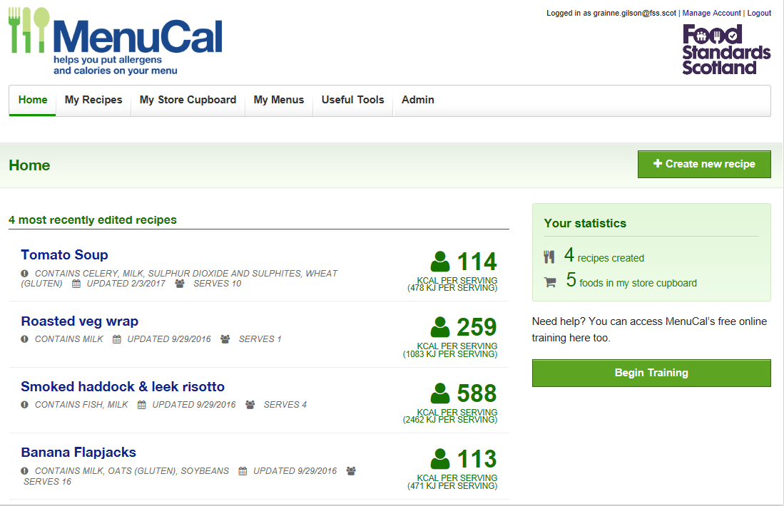
Once you have logged in…
Notes:
When you log into MenuCal your home screen will look like this, showing your most recent recipes.
For each recipe it provides the name of the recipe, the allergens, when it was last updated, the number of servings that the recipe provides and the number of kcals per serving.
It will also inform you of how many recipes you have created and the number of foods that you have in your store cupboard.
The training video is a great way to familiarise yourself with how to use MenuCal prior to getting started.

Slide 10
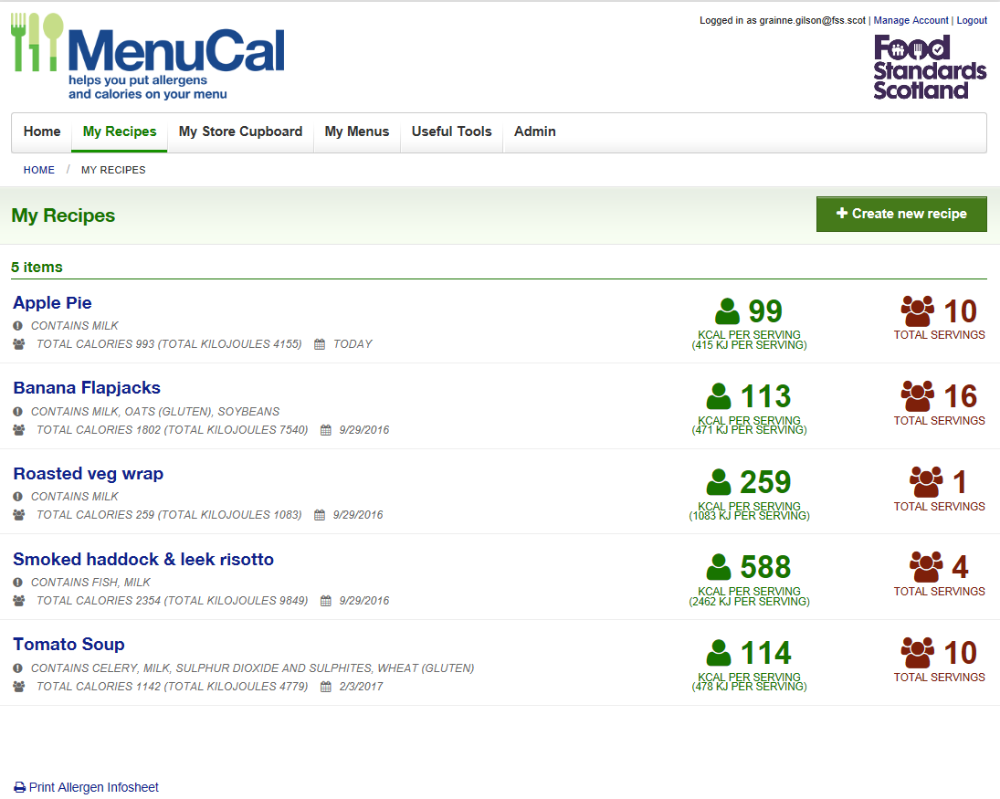
Recipes
Notes:
By selecting the ‘My Recipes’ tab along the top you will be taken to a page with all of your recipes. On this page there is a ‘print allergen infosheet’ which will print an allergen matrix with a list of your recipes with a tick next to any of the 14 allergens present in the recipe.

Slide 11
Allergen Matrix
Business can download as Pdf
Notes:
This is a small image of the pdf allergen Matrix that businesses can download and use within their establishments.

Slide 12
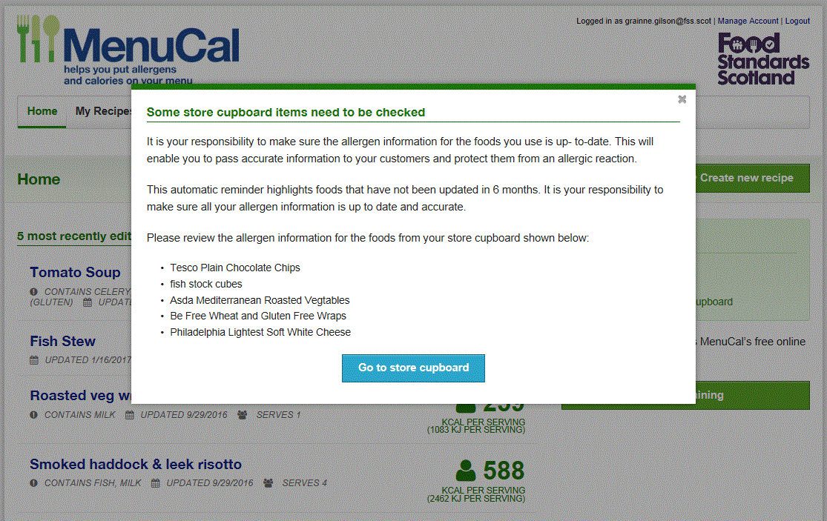
Allergen Reminder
Notes:
There are also reminders bulit into the site to remind users to review their allergen information, as you can see here I need to update some of my ingredients.

Slide 13
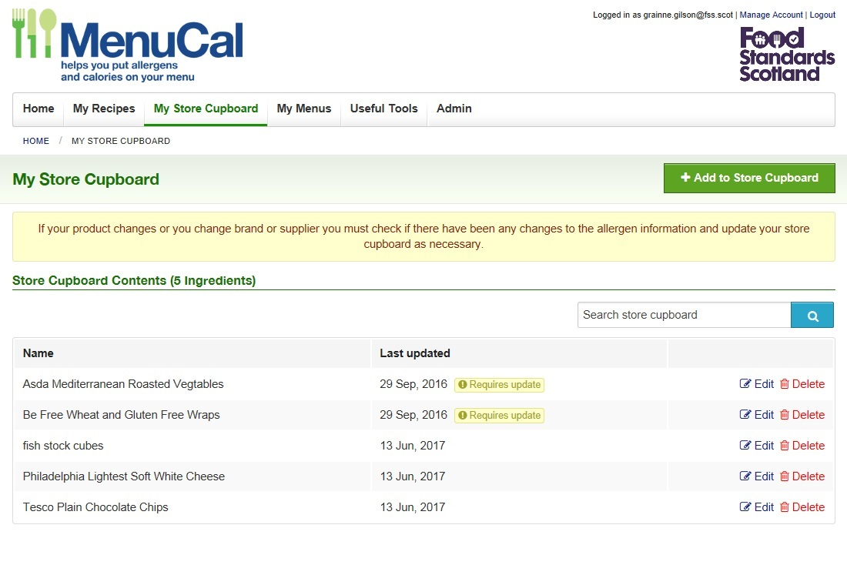
Foods not in the database…
Notes:
Foods which are purchased from suppliers should be added to the store cupboard.
It is important to update products in the store cupboard if suppliers change or the products themselves change.

Slide 14
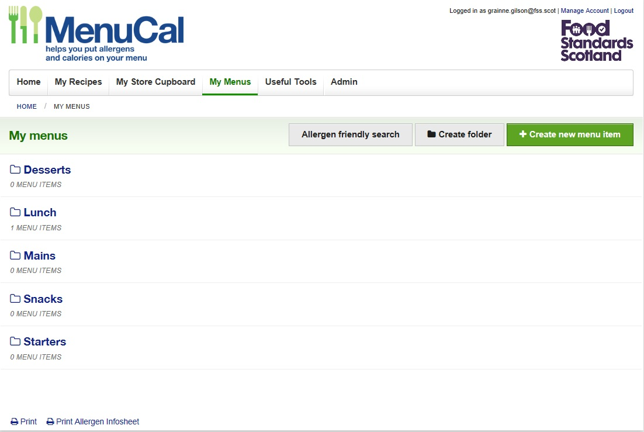
Create Menus or Menu Items
Notes:
‘My Menus’ is a place for you to keep all your menu items, as they would appear on your menu, in specific folders e.g. lunch.
Menu items can be a recipe, a combination of recipes, a store cupboard food or a combination of recipes and store cupboard foods. An example of a menu item would be a roasted vegetable wrap served with a side salad and homemade coleslaw which would go within the lunch folder.

Slide 15
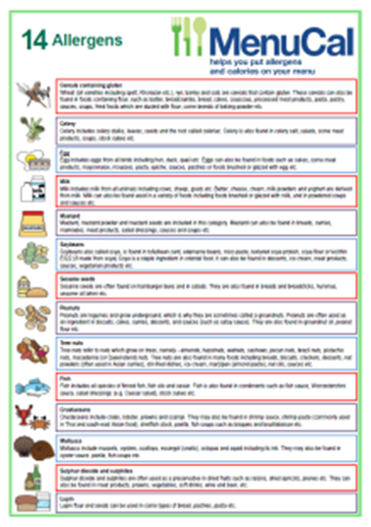
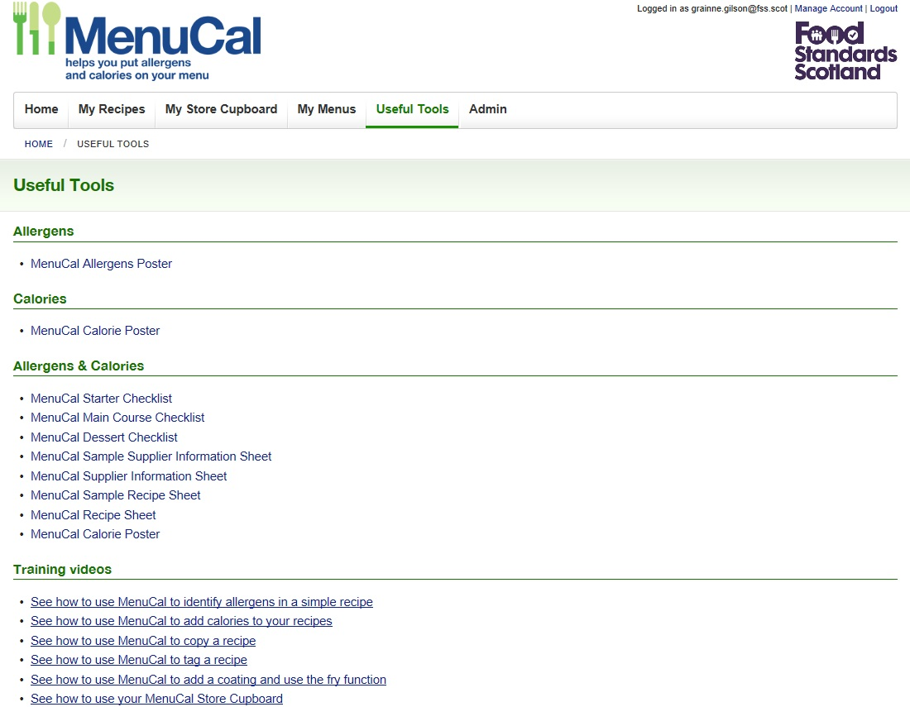
Useful Tools…
Resources and tools to support businesses with MenuCal
Quick link to training short videos
Notes:
There is also a tab which provide businesses with tools and resources to help them when they are using MenuCal.
There are Posters, allergen and calories information.
Checklists and forms to help get business get organised and using the information correctly
And again links to the training videos.

Slide 16
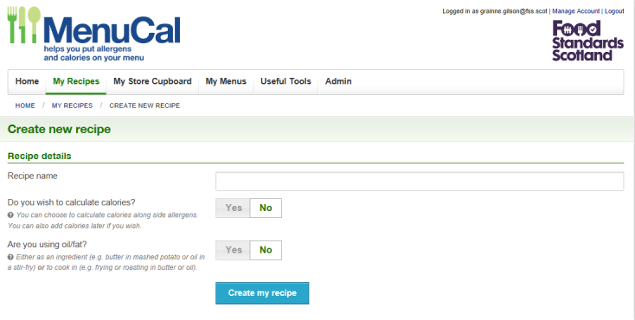
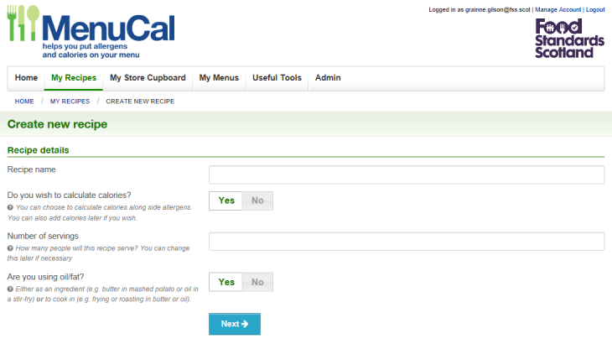
Creating a recipe…
Allergens only
Both allergens and Calories
Notes:
Businesses can use MenuCal to manage allergen information only or do both allergen and calorie information.

Slide 17
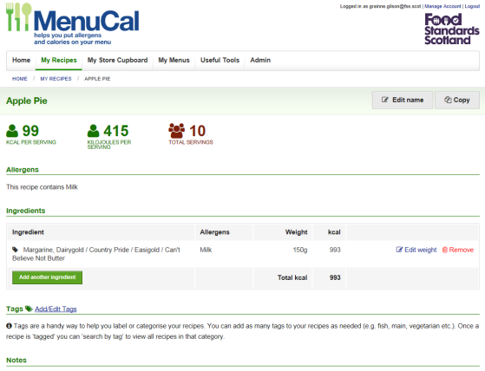
Creating a recipe…
Logical steps
1. Search ingredient or add to store cupboard
*oil/fat always first ingredient to be added- Type, how its used (as an ingredient, shallow fried/deep fried).
2. Prompts for allergen information for oil/fat used.
3. Prompt for Quantity
4. Repeat steps 1-3 for every ingredient
Notes:
After deciding what information you want from the system-
Creating a recipe on the system is a really logical step by step process.
You search for your ingredient, the fat and oil is always the first ingredient selected –the type, how much and how its used)
Then you are prompted for the allergen information
Prompted for quantities and then you repeat these steps for the rest of the ingredients..

Slide 18
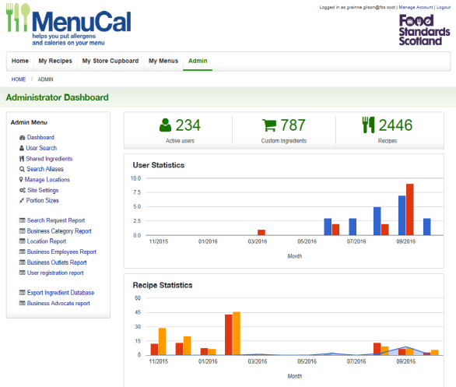
Admin Functions
Returning Users/
New Registrations
New Recipes/ Updated Recipes
Allergens/
Allergens and Calories
Recipe Type
Notes:
There is an admin side to the site too-
It provides topline Stats
Total users
Amount of custom ingredients and recipes
User Stats New/Returning
Recipe – New/Update and Allergen/allergen and calorie
And allows us to Maintain and montior the site.
Search for users by name – Lost User Names/password resets.
Update locations
Ability to update site internally
Items searched and what was selected.
Who is using MenuCal
Business user types
Regional users
Business Size (number of employees and outlets)
How they heard about MenuCal

Slide 19
Supporting Resources
FSS have developed two documents to support businesses, which are currently being reviewed as part of the MenuCal Pilot before they are made available;
The MenuCal User Guide - a pictorial step by step set of instructions for using the MenuCal tool.
Business guidance – Voluntary Calorie Labelling in Scotland. This guide outlines the principles and practices to be followed by the food businesses when they are using calorie labelling.
Notes:
We have also developed to supportingn documents to go with MenuCal
User guide
And
Business guidance to putting caloires on Menus.
I just want to add these are not available just yet as the under review as part of the pilot.

Slide 20
Principles for Calorie Labelling on Menus
1. Display calorie information at point of choice
2. Display calorie information for all standard food and drink
3. Display calories in terms of portions or meal
4. Display average calorie requirements
Notes:
The purpose of the business guidance is t support consistency in the way calories are displayed.
We have broken this down into 4 principles for businesses to follow
Displaying information at point of choice, near to the price.
Displaying calories for all standard items on their menus, we have taken a standard food item as an item that is on the menu for 30 days or more.
Displaying calories per portion or meal
And
4. Displaying the average calorie requirements somewhere near this information, to provide context.

Slide 21
MenuCal to date…
Food data update in July 2016 .
FSS version of MenuCal created, updated and rebranded. Now live on https://menucal.fss.scot/
MenuCal User Guide and Business Guidance have been developed.
Pilot – On-going
Collaboration with the SFELC Diet and Nutrition Working Group.
Pilot was initiated in November 2016 and due to finish June 2017.
Around 25 businesses across 7 LA’s.
Pilot outcomes will inform how we take MenuCal forward.
Notes:
Finally,
What has happened with MenuCal since FSS purchased it-
Data set was updated –(Data Sets MC&W, IUNA- Irish Food Portion Sizes Database & USDA)
The FSS version was created, updated and rebranded.
Supporting documents were developed
And there is the pilot was initiated in November last year, which is due to finish at the end of this month.
Aim of the pilot-
Test the usability of
Make sure it supports Scottish Food Businesses to provide allergen and calorie information
And
To look at the use of the Local Authority (LA) Environmental Health Departments to disseminate MenuCal information and support.
The outcomes from the Pilot will inform how FSS takes MenuCal Forward.

Slide 22
Thank You
Questions?
Email: grainne.gilson@fss.scot
Tel: 01224288391

