Slide 1
Predictive Analytics in
Customs Administration
Duncan Cleary
Fiscal Affairs Department –
Revenue Administration
International Monetary Fund
WCO IT Conference & Exhibition,
6-8 May 2015, Bahamas

Slide 2
Talk Outline
What are Predictive Analytics (PA)?
What are the performance benefits from applying PA in Customs Administration?
How to apply PA in Customs Administration
  People, Processes and Technology
RA-FIT: Revenue Administration’s Fiscal Information Tool – Customs Module
Notes:
What are Predictive Analytics (PA)?
What are the performance benefits from applying PA in Revenue Administration?
How to apply PA in Revenue Administration – People, Processes and Technology
How are predictive analytics currently being used in Revenue administrations?
What are Analytics?
What is the value of using analytics?
People, processes and technology
Methods – Anomaly detection, pattern recognition and predictive modeling
Evaluation and performance management
RA-FIT: Revenue Administration’s Fiscal Information Tool

Slide 3


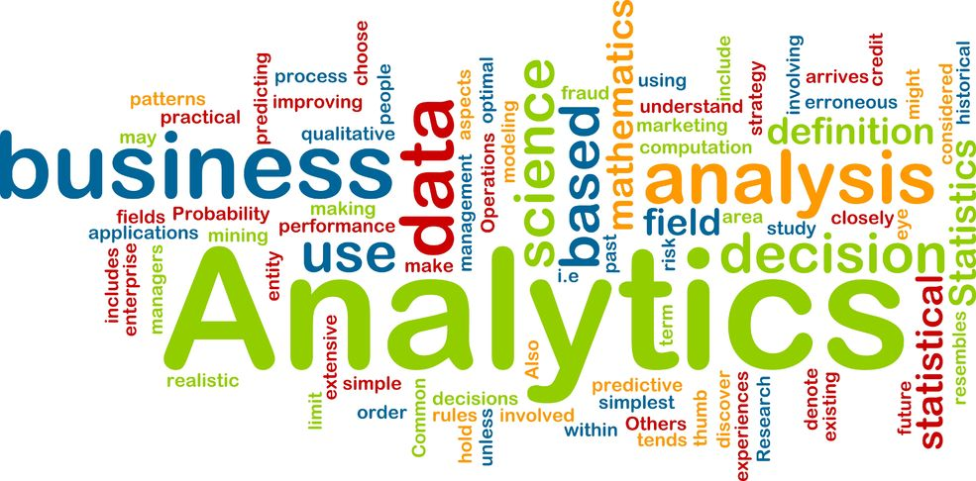

Who Uses Analytics…?

Slide 4
What are Predictive Analytics?
Predictive Analytics - A Definition:
The application of the Scientific Method to solve business problems.
  Analysis of current and historic data to make predictions of events of (future) interest;
    uses statistical techniques including data mining and machine learning;
    needs training data to create models and score new cases;
    leverages computing power now available.
Most important thing: The Target Definition!
http://en.wikipedia.org/wiki/Analytics
Notes:
From Wikipedia:
Analytics is the discovery and communication of meaningful patterns in data. Especially valuable in areas rich with recorded information, analytics rely on the simultaneous application of statistics, computer programming and operations research to quantify performance. Analytics often favors data visualization to communicate insight.
The most common application of analytics is the study of business data with an eye to predicting and improving business performance in the future.¹ Other fields within the area of analytics are enterprise decision management, retail analytics, marketing and web analytics, predictive science, credit risk analysis, and fraud analytics.
Analytics can require extensive computation (See Big Data) and thus the algorithms and software used for analytics harness the most current methods in computer science, statistics, and mathematics
http://en.wikipedia.org/wiki/Analytics
Data mining can be defined as the application of the scientific method, including statistical analyses, to large amounts of data to uncover valuable information from that data.
Predictive analytics encompasses a variety of statistical techniques from modeling, machine learning, data mining and game theory that analyze current and historical facts to make predictions about future events.¹²
In business, predictive models exploit patterns found in historical and transactional data to identify risks and opportunities. Models capture relationships among many factors to allow assessment of risk or potential associated with a particular set of conditions, guiding decision making for candidate transactions.
Predictive analytics is used in actuarial science,³ marketing,⁴ financial services,⁵ insurance, telecommunications,⁶ retail,⁷ travel,⁸ healthcare,⁹ pharmaceuticals¹⁰ and other fields.
One of the most well known applications is credit scoring,¹ which is used throughout financial services. Scoring models process a customer’s credit history, loan application, customer data, etc., in order to rank-order individuals by their likelihood of making future credit payments on time. A well-known example would be the FICO score.

Slide 5
What is the Value of Using Analytics?
Strategic
Goals
Outcomes
Tactical
Measures
Outputs
Operational
Specific
Targets
Data = Valuable Assets that should be leveraged
Data Driven Decisions – Objective & Scientific
Able to handle ‘Big Data’
‘Compete with Analytics’
Complements other risk management methods
Less false positives – leave the ‘good guys’ alone
Success is measurable
Robust and scalable
Data
Information
Knowledge
Standard Reports
Ad Hoc reports
Descriptive Analytics
Predictive Analytics

Slide 6

What is Needed to Apply Analytics?
Process
Technology
People
Models
Rules
Intel
Results
Notes:
Managers, Analysts, IT and Operations, Change Management, Culture
"CBP female officers going aboard a ship" by James Tourtellotte, U.S. Governement - http://www.cbp.gov/. Licensed under Public Domain via Wikimedia Commons - http://commons.wikimedia.org/wiki/File:CBP_female_officers_going_aboard_a_ship.jpg#/media/File:CBP_female_officers_going_aboard_a_ship.jpg

Slide 7
Applying Analytics – People & Processes
Business
(Operations)
Factory
(IT)
Laboratory
(Analysts)
Performance Management & Evaluation
Notes:
Managers, Analysts, IT and Operations, Change Management, Culture

Slide 8
Applying Analytics – Technology
Targets for Analytics in Customs
Data and Data Quality
Software & Hardware
Analytical Methodologies
Performance and Evaluation

Slide 9

Targets…
"Shipping containers at Clyde" by Steve Gibson from Airlie Beach, Australia - shipping containers. Licensed under CC BY 2.0 via Wikimedia Commons - http://commons.wikimedia.org/wiki/File:Shipping_containers_at_Clyde.jpg#/media/File:Shipping_containers_at_Clyde.jpg

Slide 10
Opportunities for using Analytics in Customs
Prevent:
Manifests, bills of lading, open source
ID theft, anomaly detection, importer risk, manifests, pattern recognition, GIS
Prevent/ Detect: Customs declarations/ profiles
Red-Yellow-Green:
Detect: Post clearance audit/ checks
Predictive models, segmentation/ sector based risk, re-audit programs
Predictive models with targets
Supplement to risk rules
Origin - Valuation - Misclassification
Notes:
A priori
Post hoc
Pre and post clearnace
Trade Revenue and Borders

Slide 11
Data and Data Quality
Some Data Management Issues
Governance and Accessibility
Structure/ or lack of
Matching records – data integration
Spreadsheets and unformatted records
Storage
Data entry errors – staff and customers
Misclassification – e.g. Goods, sectors
Completeness/ missing data
Versions/ Changes
Outliers/ anomaly detection
Fraud & intentional or unintentional error
Timeliness/ Real Time
Recording results
Notes:
WCO data model

Slide 12
Software and Hardware
Open Source or Off-the Shelf...?
Integrated Tax & Customs Systems
Data Integration – Common Identifier
Data Quality: both source and end product
Hardware: Cloud or Stand-alone?
Metadata – Boring but important
Data Warehouse – Accessibility
Analytics Platform – Supporting Analysts
Business Intelligence – free the data
Case Working and Feedback tools - NB

Slide 13
Analytical Methodologies
Standard Statistical Univariate/ Bivariate Exploratory Techniques
Unsupervised Techniques : without a target
  Principal Components Analysis
  Association Analysis
  Cluster Analysis/ Segmentation
Anomaly/ Outlier Detection, sector based approaches
Text Mining/ ‘Unstructured’ data analytics
Network Analysis, linkage analysis
GIS - Geographic Information Systems
Supervised Techniques: with a target
  Predictive Models
    Decision Trees
    Neural Networks
    Regression (Linear, Logistic, Stepwise etc.)
    Ensemble models (combination of those above and others)
Semi-supervised, rare target data, hybrid approach (more later)...
Many Others!

Slide 14
Applying Predictive Analytics – Process
Extract data from Source
Review, integrate, transform,
Load ABT in to modeling environment
Begin:
Identify
Problem
Gather
Data
Scoring and/ or Deploy
Model
Evaluate
Results
Predictive
Modeling
Assess
Models
Data
Quality
Review
Transform
and Filter
Make ABT
Sample
Explore
Modify
Model
Assess
Notes:
Work with Business Experts, create ABTs
Join data sources
Filter Rows
Filter columns
Derive new fields
Aggregate data sources

Slide 15
Sample
Explore
Modify
Model
Assess
Input Data
ABT
EXPLORE
Summary Stats
Visualization
Univariate
Bivariate
Scatterplots
Crosstabs
MODIFY
MODEL
ASSESS
SCORE
Transform
Select variables
Regression
Decision Trees
Neural Networks
Ensemble
Filter variables (Columns)
Filter cases (rows)
Compare models’ performance using validation and test data, lift charts, residuals/ error, misclassification ROC charts
Use selected model code to score full population ABT of cases with p score, decide on cut off for target cases.
Training data
Scoring data
Cross validation
Training/ Validation/ Test
Data partition:
SAMPLE
E. G. see Sarma, Kattamuri S., 2007. Predictive Modelling with SAS Enterprise Miner: Practical Solutions for Business Applications. Cary, NC: SAS Institute Inc.

Slide 16
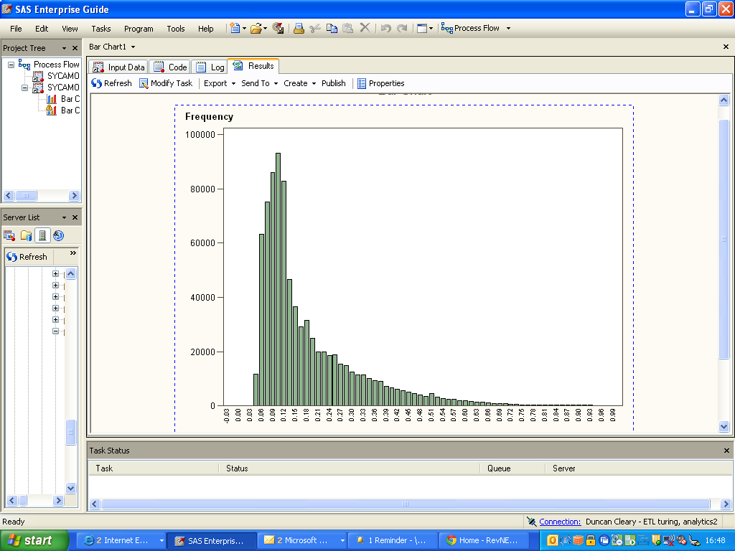
Scored population cases & cut-off points
Cases above cut-off are at least twice as risky.

Slide 17
Evaluation: Testing, Dashboards & Feedback
Within Modelling
Start small and test samples
Feedback of good quality
Back Validation
Notes:
Model Evaluation A: Within Modelling
Randomly split data into training and validation data sets, e.g. 60:40 split
Create model using training data
Evaluate how well the model performs with the validation data
If model is robust it will be almost as good at predictions with the validation data as with the training data.
Likely to perform well with new data
Can also use cross validation sampling and compare results
Model validation with a binary target: aim to have the maximum number and/ or percentage of hits in the upper probability ranges from the model.
Maximise true positives and minimise false positives, e.g. ‘nil yields’.
Can add decision costs (e.g. cost of audit) to penalise the model more for false positives.
Model Evaluation B: Test Samples
Samples can be selected from across the probability range for the target in the model
Partner with the business to test the cases in the sample, an indicative result is sufficient, as time can be a factor in successful deployment
Assess results and see if the proportions of ‘hits’ are higher in the higher probability ranges, decide if quality is good enough to go live
Decide on good cut-offs, monitor volumes and distribution stability
Model Evaluation C: Live Feedback
BI Dashboards can help assess model performance
Comparisons for hit rates above and below cut-offs can be made and monitored.
Assess results and see if the proportions of ‘hits’ are higher in the higher probability ranges, if not investigate and decide if model needs to be recalibrated or retired.
Decide on adjusting cut-offs and/ or sample rates for different risk types or regions, depending on performance
Monitor ROC and lift charts to see if model continues to perform over time
Monitor stability of underlying ABT variables by regularly examining variables used in model to identify any shifts in the population that could have an effect on how cases are scored. Create reports on this regularly, with traffic light indicators to flag any need for change. Seasonality and behavioural shifts can be identified in this way.
Model Evaluation D: Back Validation
After a certain period of time new results will come in for the target of the model, e.g. amount of audit yield. These new results can be used to ‘back validate’ the model
There should be a strong correlation between the model’s prediction and the average outcome since it was produced.
Do as an on-going test as data becomes available, as risk evolves over time.
Robust to data quality issues as the results were not known before the model was built
Eventually, build a challenger model with new training data and new variables, and replace any old model if required.

Slide 18
Interaction/ Benefits of Hybrid Methods
Existing
Business
Rules
Predictive
Models
Raw Data & Information
Network
Analysis
Intelligence
New Risk
Rules
Data + Results + New Data = Better Models and Rules
Notes:
18

Slide 19
From micro to macro…
Micro
Micro
Macro
Micro
Micro

Slide 20
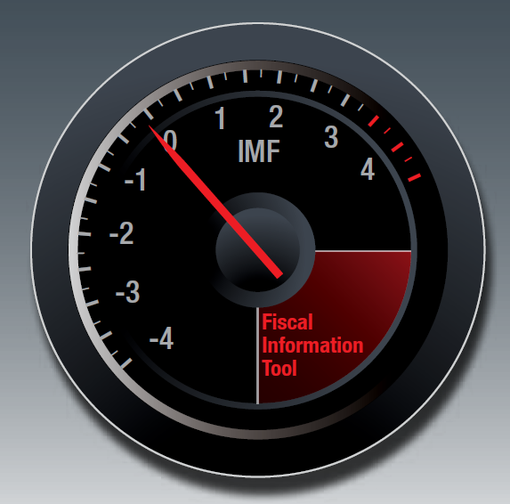
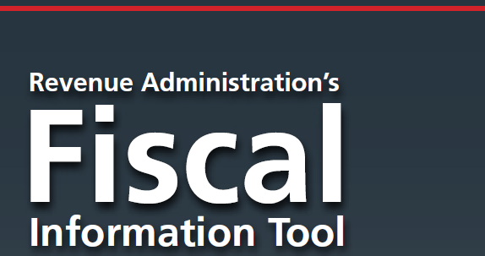
Revenue Administration’s Fiscal Information Tool
Purpose and Benefits
RA-FIT provides the platform for a single international revenue administration (tax and customs) data gathering tool
Encourages and supports performance measurement to developing countries
Used to establish key baselines and identifies key risk areas for revenue (tax and customs) administration
Makes aggregated data & analysis available to member countries
Improves the quality of Technical Assistance delivery
Customs Module 2015 now live

Slide 21
RA-FIT – Cost of Collections – Customs
 | Total Cost of Collection - 2010 | Operating Cost % - 2010 | Cap Ex Cost % - 2010
LOW INCOME COUNTRIES | 2.60% | 95% | 5%
LOWER MIDDLE INCOME COUNTRIES | 2.79% | 95% | 5%
UPPER MIDDLE INCOME COUNTRIES | 4.08% | 83% | 17%
HIGH INCOME COUNTRIES | 5.53% | 83% | 17%
48 respondents provided total annual expenditure information from the 63 countries completing customs operations

Slide 22
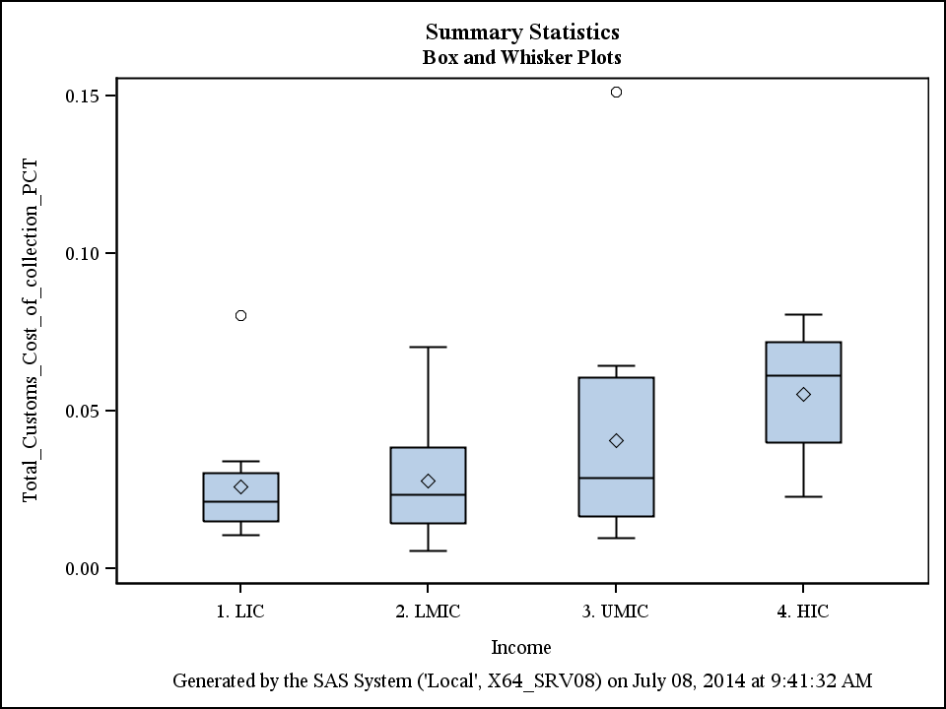
RA-FIT – Cost of Collections – Customs
Ratio of cost of collection and customs revenue
(17)
(17)
(17)
(17)

Slide 23
RA-FIT – Customs: Traffic by Channel

Slide 24
RA-FIT – Customs: Release Times on Imports

Slide 25
Full Circle: Potential for getting predictive…
Attributes of tax and customs administrations that have been captured in RA-FIT (‘00s dimensions) can be correlated with targets of interest…
A
B
1
A
B
0

Slide 26
Thanks for your attention!
Duncan Cleary
Fiscal Affairs Department - Revenue Administration 2
International Monetary Fund
1900 Pennsylvania Ave., N.W.| HQ2-06-778| Washington, DC 20431
T: +1.202.623.7097 | M: +1.202.531.4889
DCleary@imf.org | Skype: duncancleary | www.imf.org

