Slide 1
Digital Book World

Slide 2
World’s largest digital library
Massive audience to expand market for books
80M monthly readers globally
Site used in over 100 countries
Top 100 website globally in traffic
Platform - web scale
Reading on Web, Mobile Web, iOS and Android
Subscription, Retail and Excerpts
Hosting 40M books and documents
Content in over 80 languages
Market leading analytics

Slide 3
Subscribers choose what to read not what to buy
$8.99 per month
Free trial
Unlimited books
Personalized
Any device
Synchronized

Slide 4
DBW Panel
Bryan Batten
Founder

Slide 5
Bryan Batten Bio
Founded Entitle Books in 2011 (Formerly oEbra, then eReatah and now Entitle)
Third time is the charm right? ☺
Previously worked in business development within the pharmaceutical industry and left to found Entitle
Currently reading – Without Reservations and In the Plex

Slide 6
Tiered Subscription service
Offers 3 different plan types

Slide 7
About
Highlights
Works across iOS and Android (includes Kindle Fire)
Can be saved to computer and read on most eInk Devices
Plans start @ $14.99 for 2 books per month
Users have permanent access to books

Slide 8
Content
What we carry and who we work with
Publishers of all size
From some of largest in the industry to small independent publishers
Distributors
Deals with several distributors to expand the depth of titles we offer

Slide 9
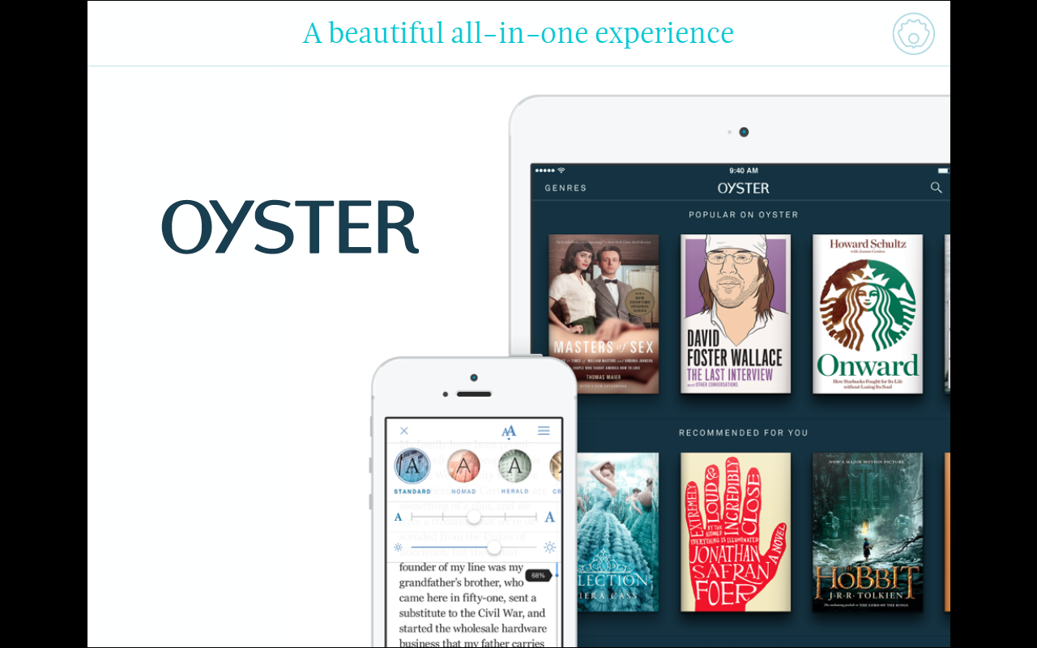

Slide 10
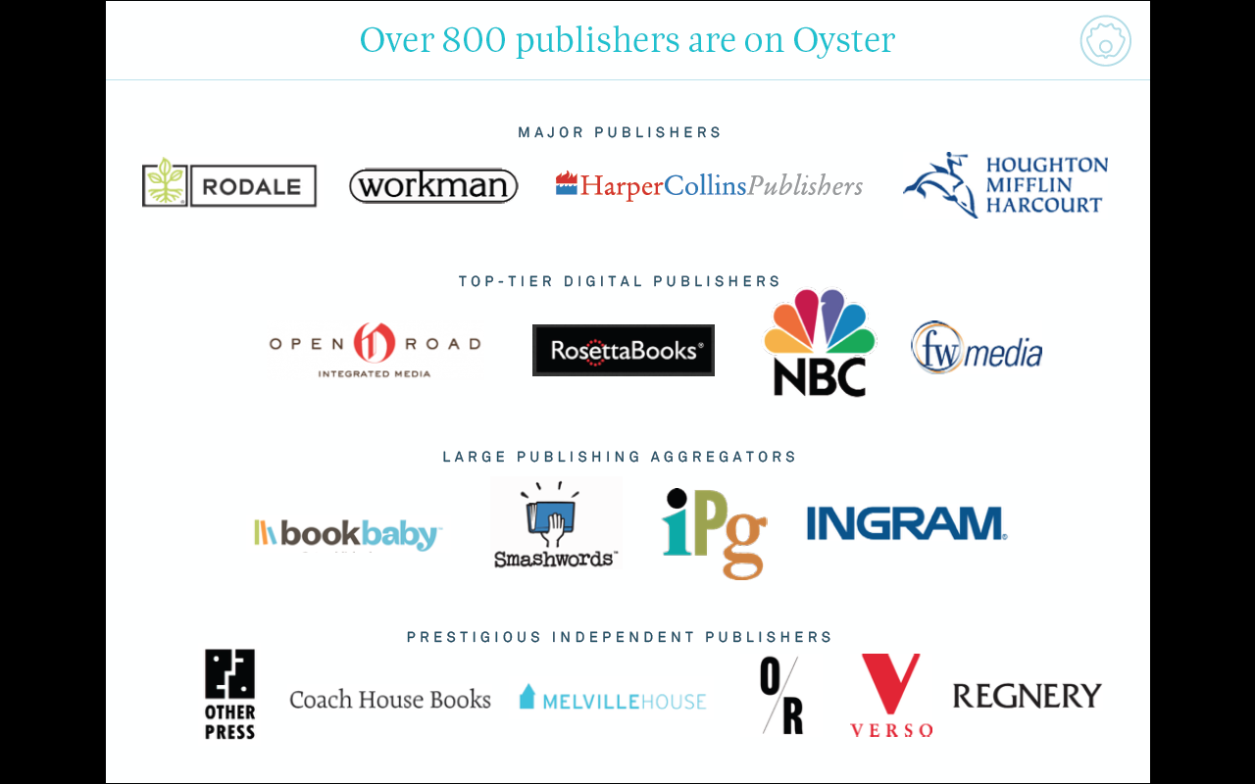

Slide 13
ACCESS A WORLD OF BOOKS

Slide 14
MOBILE CARRIERS
24SYMBOLS.COM
CLUB
FREEMIUM
PAY PER BOOK TO PUBLISHERS
PAY PER PAGE TO PUBLISHERS

Slide 15
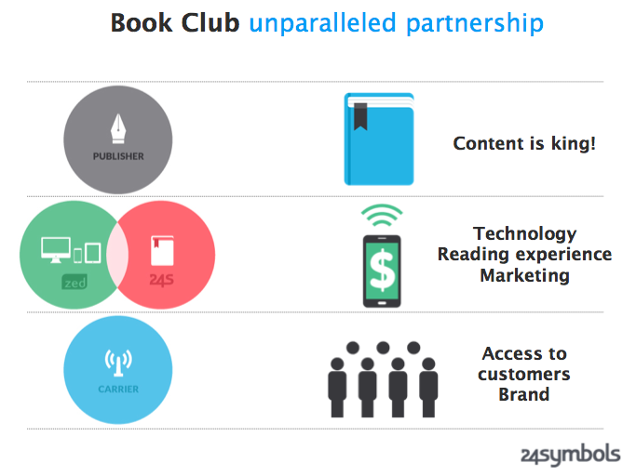

Slide 16
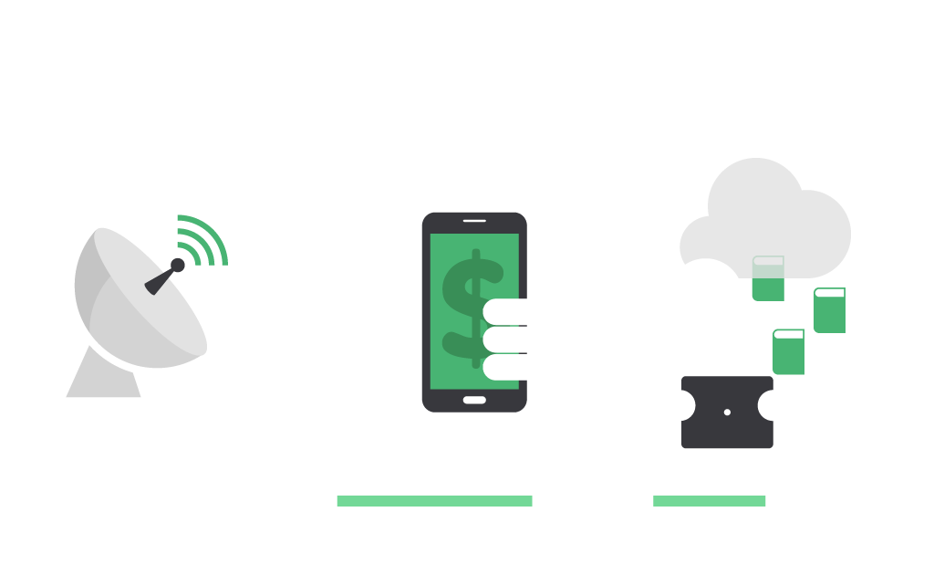
BOOK CLUB FOR MOBILE USERS
1
2
3
CREDITS
CREDITS
COMMUNICATION
SUBSCRIPTION
READING
SUBSCRIPTION OFFERED TO MILLIONS OF CARRIER USERS
USERS ACCEPTS SUBSCRIPTION AND GETS CREDITS TO BORROW BOOKS AT THE BOOK CLUB
USER CAN BORROW BOOKS USING CREDITS AND READ ON THE CLOUD OR OFFLINE

Slide 17
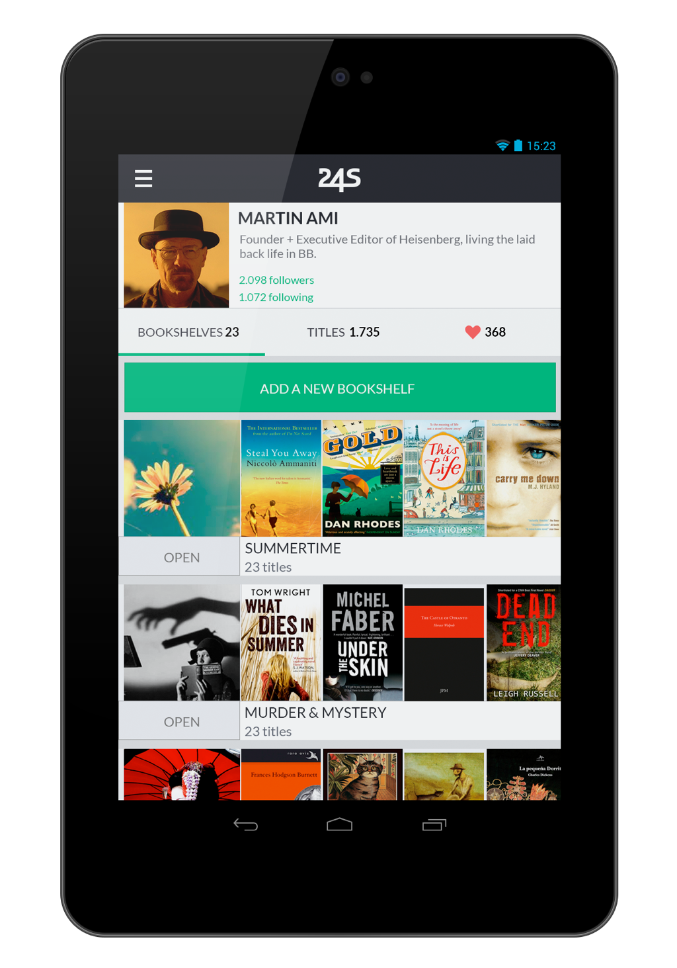
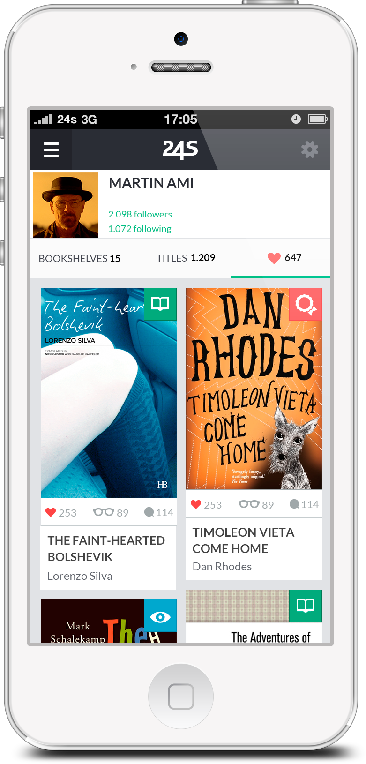
APPS

Slide 19
THANK YOU
Justo Hidalgo: Co-founder, Chief Product Officer
jhidalgo@24symbols.com
@justohidalgo
www.24symbols.com

