Slide 1
Lessons Learned
Paul Luther
Relay Technician Puget Sound Energy

Slide 2
Outline
Terms and Vocabulary
Tools
Electromechanical Relay Testing Concerns
Microprocessor Relay Testing
Results (Anticipated and Unanticipated)
Root Cause Analysis
Events and Observations

Slide 3
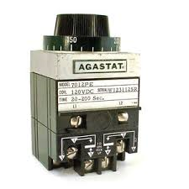
“Old Timer” Advice
Relay work is complicated and stressful
Math is involved
You will make mistakes
Electromechanical relays are very delicate
Microprocessor relays do exactly as programmed
9.75 times out of 10, you connected/shorted/programmed something wrong, the relay is not broken or “messing” with you

Slide 4
Terms and Vocabulary
Spurious Torque
Directionally Controlled
Polarizing Units
Maximum Torque Angle
Shunt Screws
MHO Circles
Polarity
Manual Relay Testing

Slide 5
Tools

Slide 6
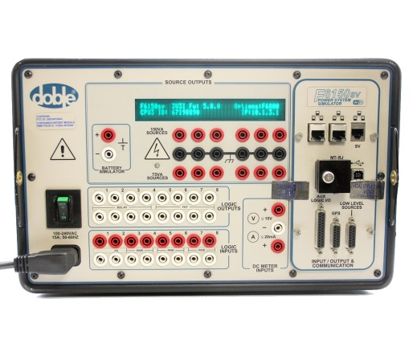
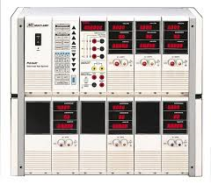
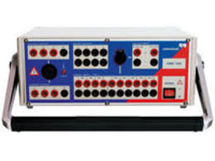
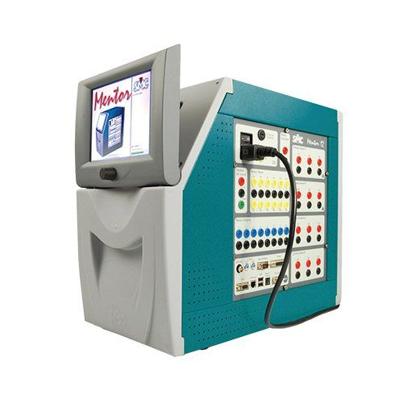
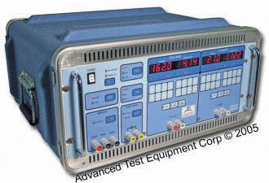
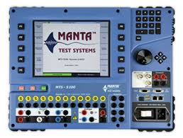
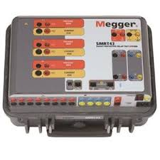
Tools
System Simulator Test Set
Proper use and care of test set
Calibration
Limitations
Repair

Slide 7
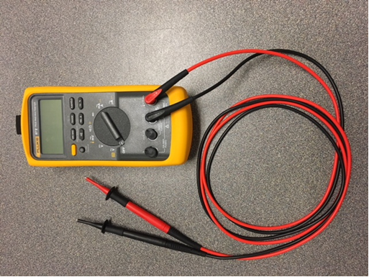
Tools
Multi-meter
Proper use and care
Understand Operation of all functions
Understand Limitations and Ratings
Blown fuse replacement

Slide 8
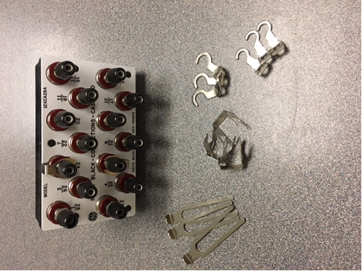
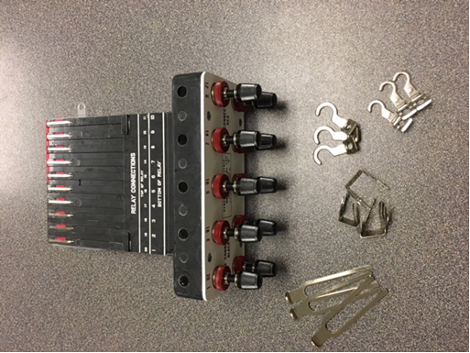
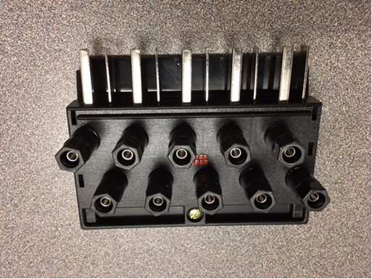
Tools
Test Blocks
Understand how to properly set up and use test blocks on energized relays

Slide 9
Tools
Computer
Security Updates
Application Updates
Hardware Updates
Physical Security
Peripheral Devices

Slide 10
Tools
Your Brain
Leave your comfort zone
Learn new techniques
Exposure to complex concepts
Learn new technologies
Know when to ask for help

Slide 11
Electromechanical Relay Testing Concerns

Slide 12
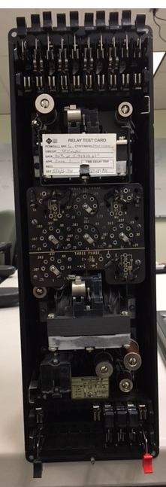
Electromechanical Relay Testing Concerns
Removing in service relays from the case
Cover
CT shorting
ABB shorting switch
GE shorting bars/paddle
Voltage restraint
Test switch sequence

Slide 13
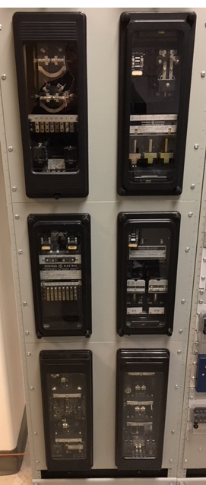
Electromechanical Relay Testing Concerns
Removing in service relays from the case
Adjacent relays
Vibration concerns

Slide 14
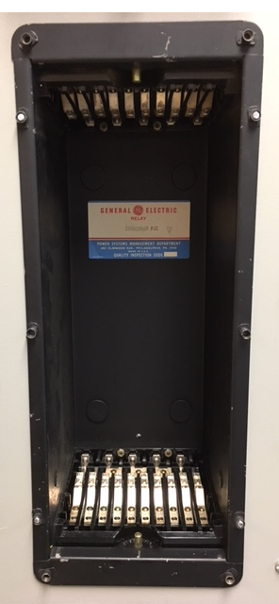
Electromechanical Relay Testing Concerns
Removing in service relays from the case
Compromised protection
Temporary replacement relay

Slide 15
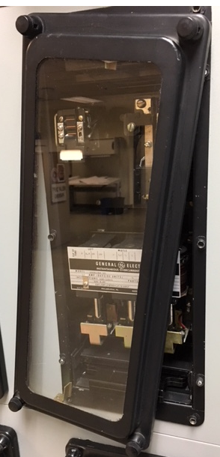
Electromechanical Relay Testing Concerns
Removing in service relays from the case
Target reset mechanisms
Removed from cover
Requires qualified person to reset targets

Slide 16
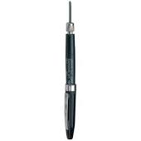
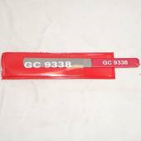
Electromechanical Relay Testing Concerns
Cleaning the relay
Canned air
Keep can upright
Soft bristle brush
Keep clean
Burnishing tools
No Solvents!

Slide 17
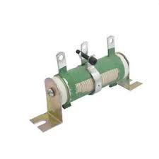
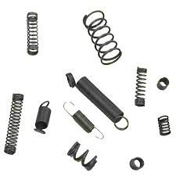
Electromechanical Relay Testing Concerns
Adjustments and repair
Use of proper/improper tools
Fine wire resistors
Springs
Parts replacement
Capacitors
Stripped threads
Soldered connections
ICS/Target repair
IL parts list

Slide 18
Electromechanical Relay Testing
Relay replacement
Pretested replacement
Change out bad relay for an even worse relay?
Thoroughly inspect replacement relay
Easier to repair than replace

Slide 19
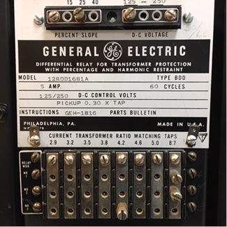
Electromechanical Relay Testing Concerns
Relay replacement
Sometimes exact model must be used
Specific characteristic
Model numbers are different for a reason!

Slide 20
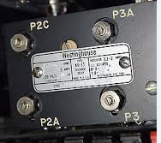
Electromechanical Relay Testing Concerns
Relay replacement
Sometimes a slightly different model relay can be adjusted to work
Beware of relay components at the very end of operational spectrum

Slide 21
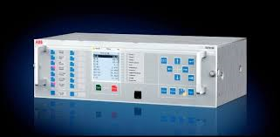
Microprocessor Relay Testing

Slide 22
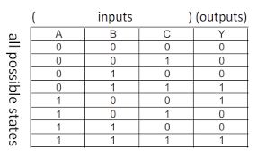
Microprocessor Relay Testing
Logic and element testing
Handmade logic diagrams/truth table
Yellow line completed paths
Investigate confusing results

Slide 23
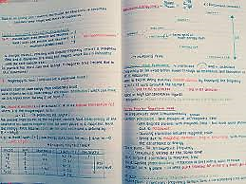
Microprocessor Relay Testing
Logic and element testing
Personal notes that can be deciphered in the future
Write testing procedures for future use

Slide 24
Microprocessor Relay Testing
Logic and element testing
Scrutinize all test results
Double check math/formulas
Document test results

Slide 25
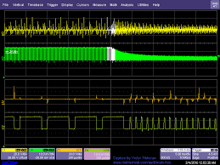
Microprocessor Relay Testing
Logic and element testing
Fault simulation for trip checks and reclose testing
Fault simulation for communication assisted trip schemes

Slide 26
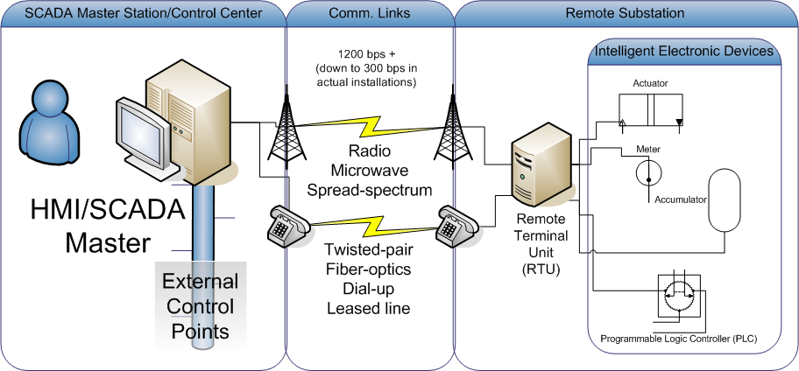
Microprocessor Relay Testing
Logic and element testing
Operations Center to Substation Communication testing
Relay to Relay Communication testing

Slide 27
Results

Slide 28
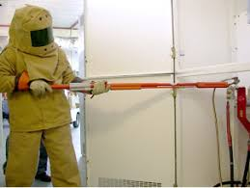
Anticipated Results
Anticipated
Testing (ATV)
Relays
Voltage/Current Circuits
Trip Testing
Switching
High Voltage
Metering
Proper values

Slide 29
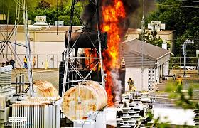
Unanticipated Results
Unanticipated
Causes
Proper procedure?
Safety issue?
Lack of focus?
Clean up
Physical and Professional
Stress

Slide 30
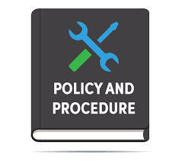
Root Cause Analysis
How/Why did this happen?
Underlying causes
Observing a symptom or a cause?
Unfavorable results of RCA
Discipline
Procedure changes
How is easy
Why is not so easy

Slide 31
I swear it was there….

Slide 32
Obrien Substation
230Kv-115Kv
2-325 MVA transformers
2-230Kv circuits
12-115Kv circuits
115Kv Bus is split 2 times
Mixture of Oil breakers and Gas breakers
Mixture of electromechanical relays and microprocessor relays

Slide 33
Obrien Substation

Slide 34
Obrien Substation

Slide 35
Obrien Substation

Slide 36
Obrien Substation
PDN 0942
Oil breaker
25 Years old
Operating almost every morning and every night for three months for line project across Vashon Island in Puget Sound
Operated properly in the morning, but breaker failed in the evening when switching back in
PSE breaker fail initiates for all trips, including supervisory

Slide 37
Obrien Substation
115Kv South Bus section cleared properly via the South Bus differential lock out relay
Breaker fail at PSE is set to 10 cycles
PDN 0942 opened in about 13 cycles
Breaker fail appears to have worked properly, with the exception of PDN 0164 did not open
No fault

Slide 38
Obrien Substation

Slide 39
Obrien Substation
What could have caused PDN 0164 to not open when the bus lock out relay clearly tripped?

Slide 40
Obrien Substation
What could have caused PDN 0164 to not open when the lock out relay clearly tripped?
It turns out the wires from the lock out relay to the trip circuit for PDN 0164 were never installed!

Slide 41
Obrien Substation

Slide 42
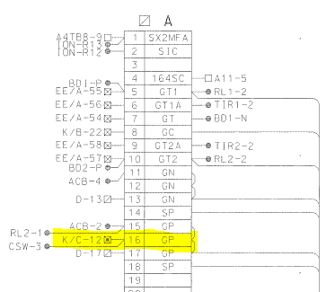
Obrien Substation

Slide 43
Obrien Substation
What could have caused PDN 0164 to not open when the lock out relay clearly tripped?
It turns out the wires from the lock out relay to the trip circuit for PDN 0164 were never installed!
Which also means they were never tested!

Slide 44
Obrien Substation
New wires were ran and tested
PDN 0942 was ready to be changed out as it obviously is not working properly, is old…
Trip checks proved the continuity of the trip circuit
Breaker fail was isolated during trip checks
One last look from the maintenance crews discovered a gummy trip latch
A little TLC and good as new

Slide 45
Obrien Substation
Lessons Learned
Properly commission all aspects of the job
Bus was split years ago, and obviously no trip checks were ever done properly
Drill down to the actual cause of a failure
Don’t assume anything
This led to PSE redesigning the breaker fail logic to include breaker fail initiate from lock out relay trips and remove it from supervisory and control handle trips

Slide 46
Our job is tough enough already….

Slide 47
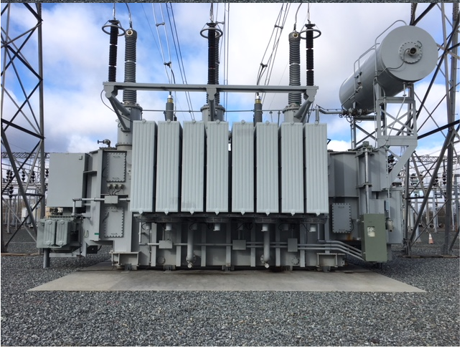
LTC Fun
Two identical transformers
Same rating (325MVA)
Same Transformer Manufacturer
Same LTC Manufacturer
One built in 1998 the other 2007
They are even the same color!

Slide 48
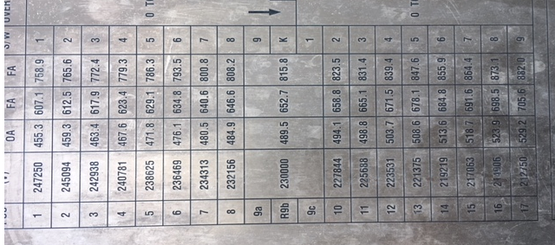
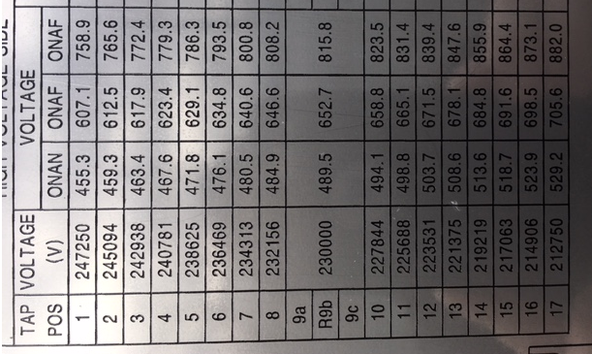
LTC Fun
Bank #1 Nameplate
Bank #2 Nameplate

Slide 49
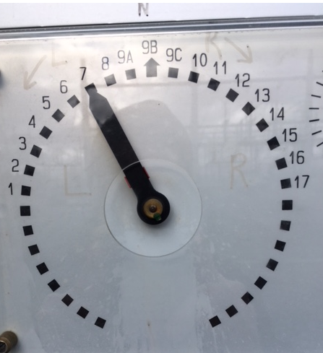
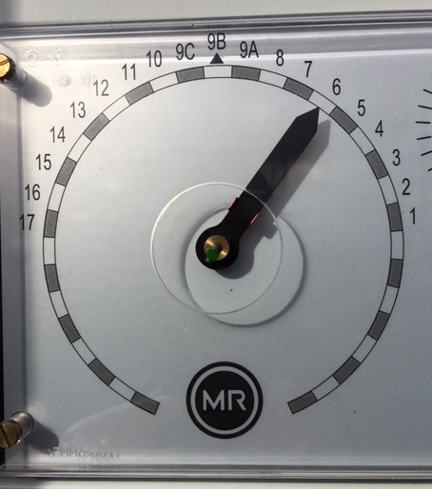
LTC Fun
Bank #1 LTC Tap position indicator
Bank #2 LTC Tap position indicator

Slide 50
Fredonia Generator Station

Slide 51
Fredonia Generating Station
4-50 MW gas turbine generators
2-16Kv to 115KV GSU
2-16Kv to 230Kv GSU
115Kv switch yard
230Kv switch yard
Located near Anacortes, Washington

Slide 52
Fredonia Generating Station
Unit 4 down for maintenance
Unit’s 1, 2 ,3 all offline, but available
Around 8 pm unit 4 GSU trips
Substation and Generation personnel dispatched

Slide 53
Fredonia Generating Station
One responder from Substation group
New wireman…been with PSE for 3 months
Two relay technicians working at substation 100 miles away are called to help, no response locally
Over the phone diagnosis provides no information
No targets on any relays was reported
Relay technicians will complete their work…get a few hours of sleep, and head towards FGS

Slide 54
Fredonia Generating Station
Arrive at FGS
Meet with Substation and now Generation personnel
AHHH! It gets worse now…in the six hours it took the relay technicians to sleep for a bit and drive to FGS…the batteries have gone completely flat!
Unit 4 provides it’s own station service
All relays and RTU are completely dead
Do see lock out relay rolled….

Slide 55
Fredonia Generating Station
Troubleshooting
Ask Generator folks to please back feed some station service from anywhere to get the batteries back up….
Inexperienced Generation staff…not sure how to go about getting us station service
I will not be deterred…Use small generator to power my test set, and use test set to power relays…HA!

Slide 56
Fredonia Generating Station
Troubleshooting
All microprocessor relays show no events
AH HA! 59N Bus Neutral overvoltage relay has a target
Now that it is daylight…dead crow on ground just below GSU low side switch
Two things don’t belong in this substation….59N target and dead crow

Slide 57
Fredonia Generating Station
Troubleshooting
Diagnosis
Crow flew onto GSU low side bus
When the bird attempted to fly away, it went A phase to ground
This caused A phase voltage to collapse, in turn causing both B and C phase voltages to rise
The open Delta connection of the low side PT’s creates enough voltage to trigger relay
Relay trips properly

Slide 58
Fredonia Generating Station
Problem solved…
Not quite
Generation personnel are unable to restore station service to unit 4
Decision was made to energize unit 4 GSU with dead relays! Are you kidding me!
We got lucky…bank energized with no issues and battery charger nearly jumped off the wall with all the current it was drawing

Slide 59
Fredonia Generating Station
Conclusions
Inexperienced personnel will pose challenges
An alternate station service needs to be available
The battery bank was woefully undersized for the application…replace batteries
The dead crow was not visible until daylight hours
All targets from all relays should be noted

Slide 60
Lessons Learned

Slide 61
Obrien Substation
230Kv-115Kv substation
2-325 MVA transformers
Multiple 115Kv lines
Multiple 230Kv lines
Newly commissioned relay packages for both transformers
Transformer #1 energized for about a week

Slide 62
Obrien Substation
Beautiful summer day, easy Friday
LOR for transformer #1 rolls
Transformer #1 trips offline
Overcurrent target on Primary relay
Possible settings issue?
Overloaded transformer?
200MW was recorded just before transformer tripped

Slide 63
Obrien Substation
Review settings in Primary relay
51P element was responsible for the trip
Set for 2.5 amp pick up with 6.0 time dial
CT ratio 200:1 PT ratio 2000:1
The math for pick up calculation:
2.5 P.U. X 200 = 500 amps x 132794 L-N = 66397000w
66397000/1,000,000 = 66.397 MW X 3 = 199.191 MW
199.191 MW = TRIP (we recorded just over 200MW)

Slide 64
Obrien Substation
We hit 200MW and tripped
Bank is rated for 325 MW with an 8 hour 10% overload
We discovered that the settings were transposed
Relay was set 2.5 P.U. with 6.0 time dial
Should have been set 6.0 P.U. with 2.5 time dial
The math: 6.0 X 200 = 1200 amps X 132794 = 159352800 watts
159352800/1,000,000 = 159.353 MW X 3 = 478.058 MW

Slide 65
Obrien Substation
Transformer was restored to service about 10 minutes after tripping with new settings installed
Technician was asked if he checked the settings in the secondary relay and he replied “yes”
10 minutes later the transformer tripped again!

Slide 66
Obrien Substation
It was discovered that the Technician actually didn’t change the settings in the secondary relay
Settings were changed and the transformer was returned to service
The first trip was on System Protection Engineering…the second trip was on the Relay Technician

Slide 67
Obrien Substation
Conclusions
Pay very close attention to the settings provided by engineering
Don’t hesitate to “recalculate” the engineer’s settings
Stay calm in situations…the technician was a bit stunned at the first trip and didn’t fully understand the question asked of him
Stay focused…solve the problem…learn

Slide 68
Last Thoughts
This week will be challenging
Ask questions
Meet new people
Try something new
It should also be fun!

Slide 69
Thank You

