Slide 1
Welcome

Slide 2
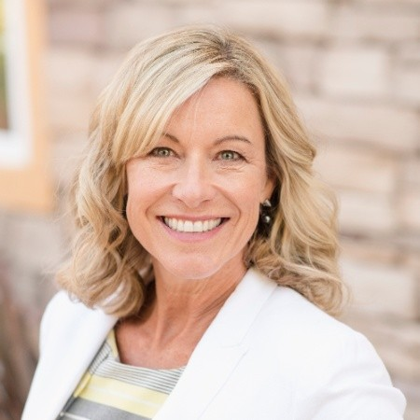
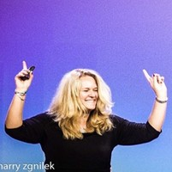
Opening Remarks
Lisa MacKenzie
Partner & EVP
The Channel Company
Julie Simpson
CEO
ResourceiT

Slide 3
Thank You to Our Global Sponsors!

Slide 4
Thank You to Our Sponsors!
Premier
Diamond
Executive
Event

Slide 5
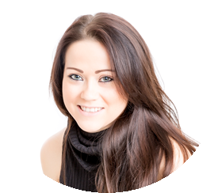
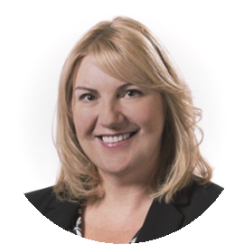
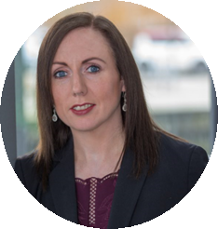
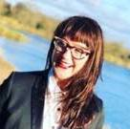
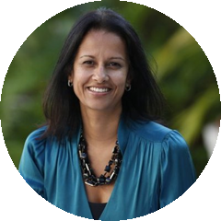
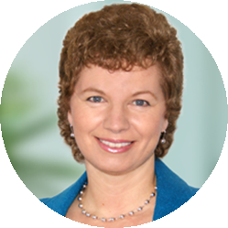
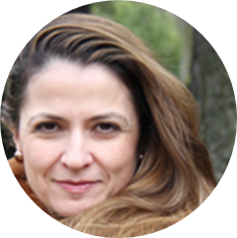
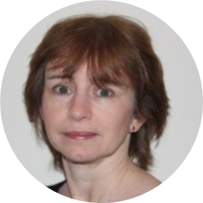
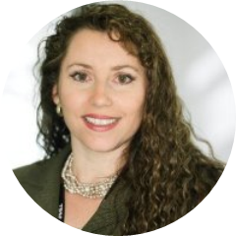
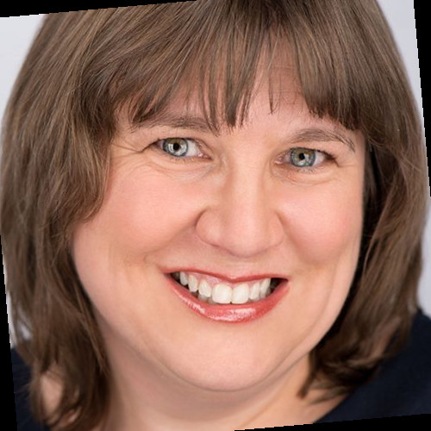
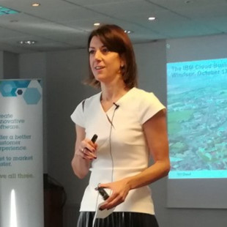
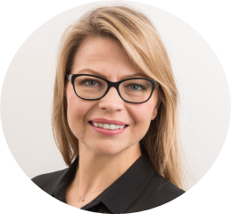
Thank You to Our Advisory Board!
Sophie Atherton Adatis
Julie Baldwin
Red Hat
Andrea Carter Sophos
Bethany Hedger
VMware
Kavita May GTDC
Sarah Munro
Intel
Maribel Ortiz
Viavi Solutions
Diane Paternoster
Red Hat
Penny Philpot
Microsoft
Carol Rosati OBE
v2 Coaching
Alison Say
IBM
Violetta Senda
UBS

Slide 6
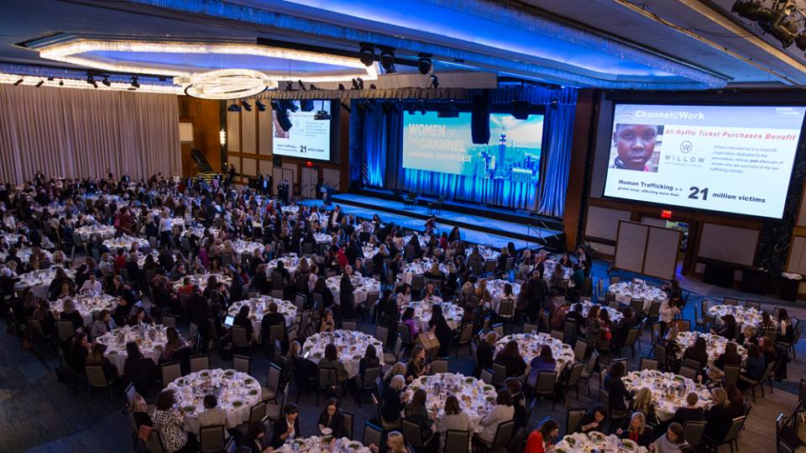
Thanks to You –
Women of the Channel Continues to Grow!

Slide 7
From Coast to Coast and Sea to Sea…
Tampa
Seattle
Austin
Denver
SEPT. 10, 2019
Singapore
www.WomenoftheChannel.com

Slide 8
This Photo by Unknown Author is licensed under CC BY-NC

Slide 9
Gathering as Women vs. Tackling Diversity
Social Connection and Community
Role Models
Time for reflection and realistic personal assessment
Future plan and positive momentum
Worth and value in the market
Personal and professional strategies for managing it all
Find or become a mentor

Slide 10
Your Outcomes According to HBR:
You will be twice as likely to receive a promotion in the next year
You will be 3x more likely to ask for and receive a pay increase
Likely to walk out more Optimistic about your future
You will have a better sense of Community and Connection increasing your overall Happiness factor

Slide 11
Event App
Access Right at Your Fingertips:
Agenda
All Social Media
Attendee Profiles
Speaker Information
SLIDO Code #5480
Add Your Headshot and Update Your Profile!
Search to download to device:
The Channel Company Events
Notes:
Debbi.

Slide 12
Morning Agenda
09:15 – 09:45 Keynote: State Of Female Tech Talent In Europe
Margaret Adam, Senior Program Director, IDC
09:45 – 10:15 Executive Keynote: The Workforce Of The Future
Claire Vyvyan, SVP & GM, Commerical Business, UK & Ireland
10:15 – 10:45 Keynote: Authenticity In The Workplace
Kate Wood, Culture Director, Chess
10:45 – 11:15 Networking Break & Tabletops
Reading & Writing Room / River Room

