Slide 1
WEDC Food & beverage sector support
WEDC IFT15 Initiative: International Food & Technology (IFT) Exhibition
The 75th IFT Annual Meeting & Food Expo
July 11-14, 2015
McCormick Place in Chicago, Illinois, USA
http://www.am-fe.ift.org/cms

Slide 2
Agenda June 2
Company Introductions Cate Rahmlow
Support for Partners Sarah Bownds
InWisconsin Exhibit Overview
Website for Delegation
Company Directory
Media Plan Elizabeth Geib
Social Media Tools & Support Shauna Breneman
Export Assistance Opportunities Lisa Stout
International Buyers Ron Hagemann
Schedules Sarah Bownds
Action Items & Critical Dates
June 5 – Deadline for company directory information and graphics
June 26 – final update meeting prior to Expo.

Slide 3
IFT 15 Messaging
5 Priorities
Encourage attendee engagement with booth staff
Raise awareness of sector strength
Business growth
Business attraction
Talent attraction / recruitment
13 total panels
8 distinct Food & Beverage (FaB) industry panels
5 statewide strength panels

Slide 4
8 Industry Panels
Ingredients & Additives
Organic, Non GMO, Grass-Fed, or Gluten Free
Supply Chain & Food Safety Services
Fruit & Vegetable Processing or Co-packing
Farm, Factory, Fork & Export
Dairy Industry Showcase
Meat Industry Showcase
Academic Partners for R&D, Product & Talent Development

Slide 5
5 State Strength panels
Welcome/ Intake panel (Innovation messaging)
Participating companies
Quality of life
Water Resources & Water Sector Strength
Entrepreneurial Spirit

Slide 6
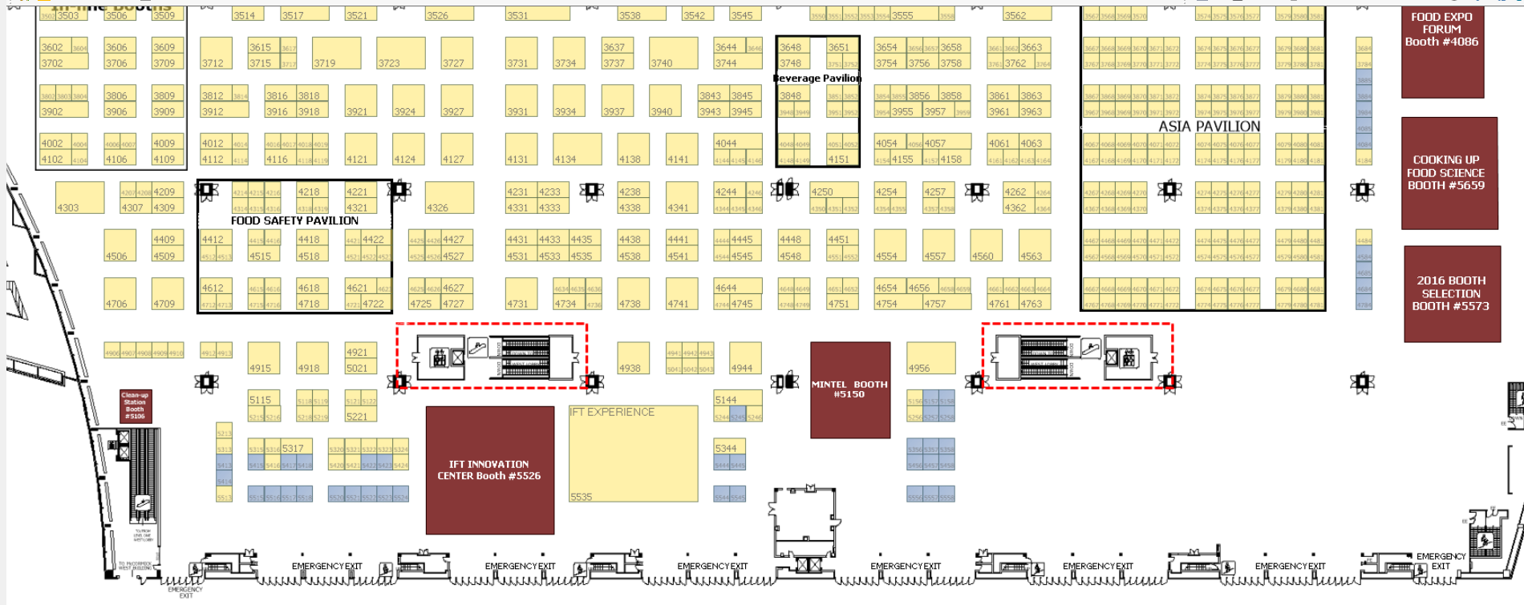
30x20 Exhibit
Booth # 4956

Slide 7
Exhibit Layout

Slide 8
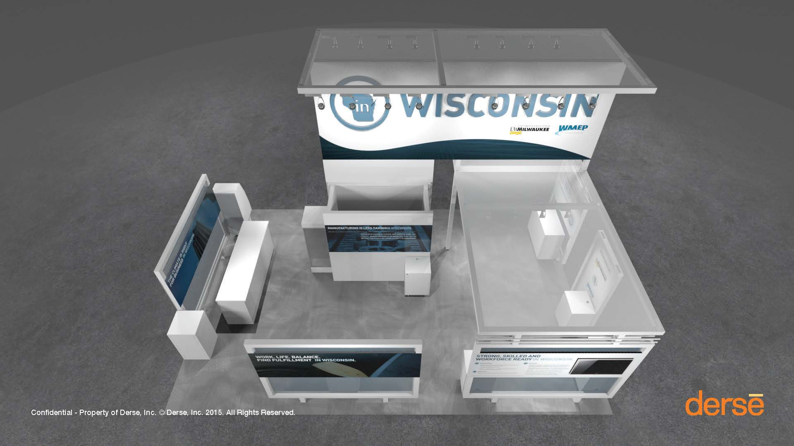

Slide 9
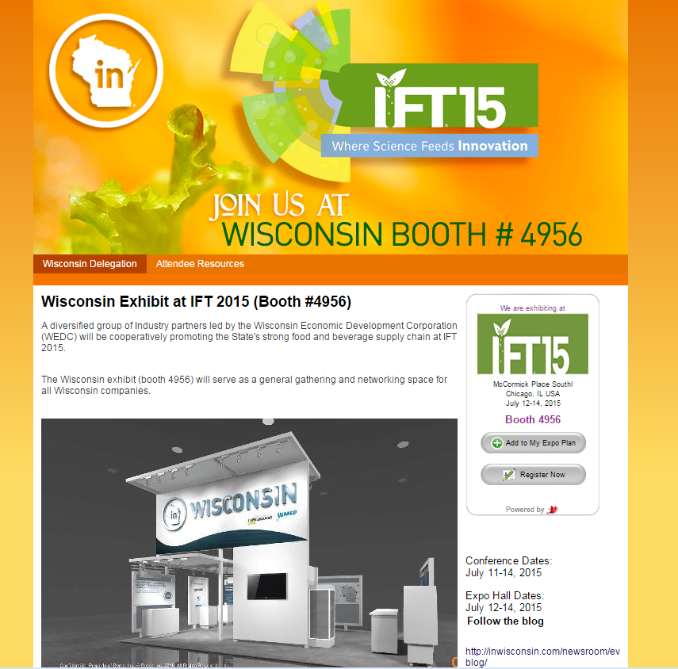
Web Site
http://join.inwisconsin.com/ift
Web Site

Slide 10
Booth Company Directory
Resource for booth staff
Deadline for entry – June 5
events@wedc.org

Slide 11
WEDC EVENT MARKETING PLAN COMPONENTS
Blog
Press releases
Story pitches to local and national media
Syndicated content to partners
Social media

Slide 12
Export Services of WI Department of Agriculture, Trade and Consumer Protection
Lisa Stout, Division of Agricultural Development

Slide 13
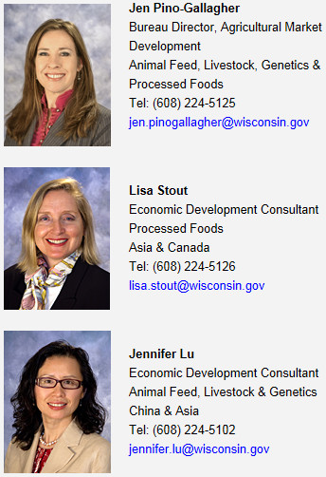
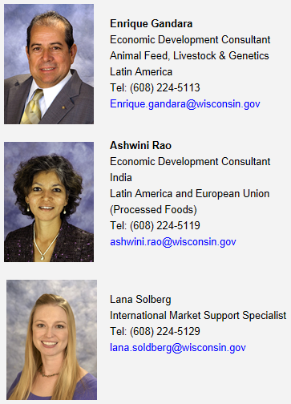
Staff at the International Agri-Business Center,
WI Department of Agriculture, Trade and Consumer Protection

Slide 14
Export Services
One-on-one consultations,
Export seminars, specifically for food and agricultural products,
Market research,
Food Export Helpline,
Export documentation and certificates,
Buyers’ missions, trade missions, etc.
Website: http://datcp.wi.gov/Business/Exports/index.aspx

Slide 15
MEETING PREPARATION
Food Export webinars: http://www.foodexport.org,
How to Prepare for Meetings with Foreign Buyers *updated April 2015
How to Follow Up on Foreign Buyer Leads *updated August 2014

Slide 16
MEETING PREPARATION
Research countries of interest:
http://www.fas.usda.gov- FAS GAIN reports;
http://www.foodexport.org - Country profiles,
http://www.Export.gov -- Country Commercial Guides

Slide 17
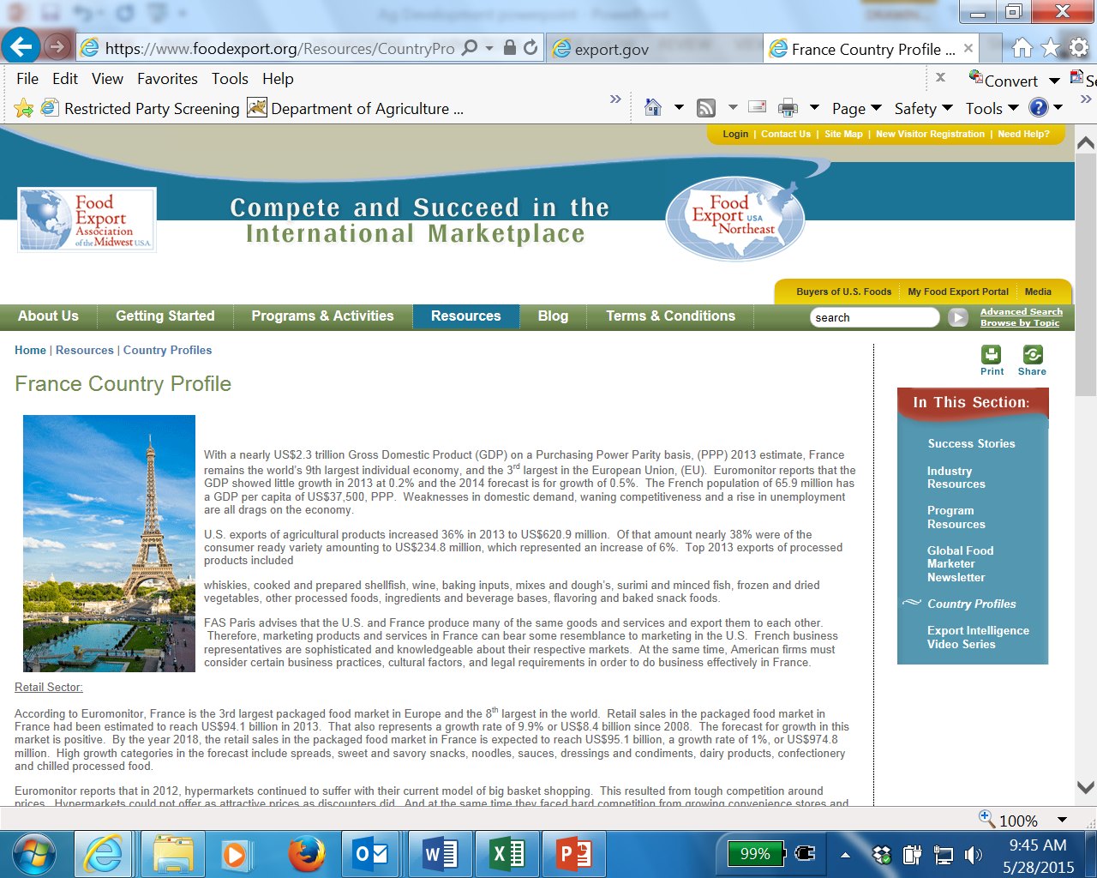

Slide 18
MEETING PREPARATION
Know your HS code and Schedule B, http://www.foodexport.org, Food Export Helpline
Labeling requirements, if applicable
Understand standard shipping costs to major ports
Trade leads -
Use a trade lead form
Staple business cards in a notebook

Slide 19
THANK YOU!
Lisa Stout, Economic Development Consultant
Wisconsin Dept. of Agriculture, Trade and Consumer Protection
Phone: (608) 224-5126
Email: lisa.stout@wi.gov

Slide 20
International Buyers
Ron Hagemann

Slide 21
WEDC Contacts
Project Manager:
Cate Rahmlow, Sector Manager 608- 210- 6845 cate.rahmlow@wedc.org
Exhibit & Logistics:
Sarah Bownds, Events Manager
608- 210- 6769 sarah.bownds@wedc.org
Regional EDO & Company Activities:
Mary Gage, Regional Account Manager
608-210-6750 mary.gage@wedc.org
Jennifer Kuderer, Regional Account Manager
608-210-6820 jennifer.kuderer@wedc.org

