Slide 1
How it all comes together. The vital volunteers
Neil Macleod
Notes:
Brief intro and welcome to the college.

Slide 2
Volunteer Management Experience
Notes:
Some more background information on my own experience and the events that I have been involved in.

Slide 4
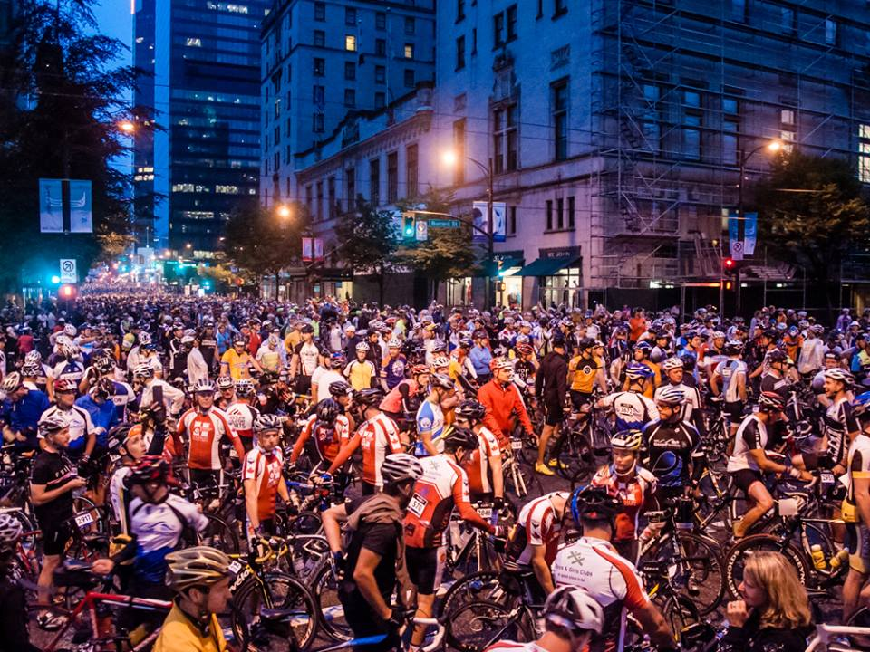

Slide 5
2014 Glasgow Commonwealth Games

Slide 7
THE STORY SO FAR
Sir Tom Hunter stepped in last year to underwrite the Kiltwalk charity after identifying it as a powerful platform for fundraising in Scotland.
The event model has been designed to turbocharge fundraising with 110% going back to the Kiltwalker’s choice of charity.
NEW FOR 2017
Due to high demand, the Kiltwalk has decided to open its doors to all Charities, widening the impact of the Kiltwalk events. Scotland’s children remain at the heart of why we walk with all ‘Kiltwalk’ charity fundraising distributed through STV Children’s Appeal.
“Now my ask is simple; be a hero and help us make Kiltwalk the biggest mass participation fundraising event in Scotland” — Sir Tom Hunter, Scottish Philanthropist

Slide 8
140% now going to all Scottish charities!

Slide 10
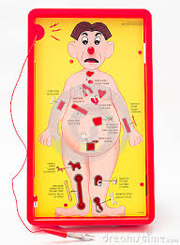
Planning – Two Clear Areas of Focus

Slide 11
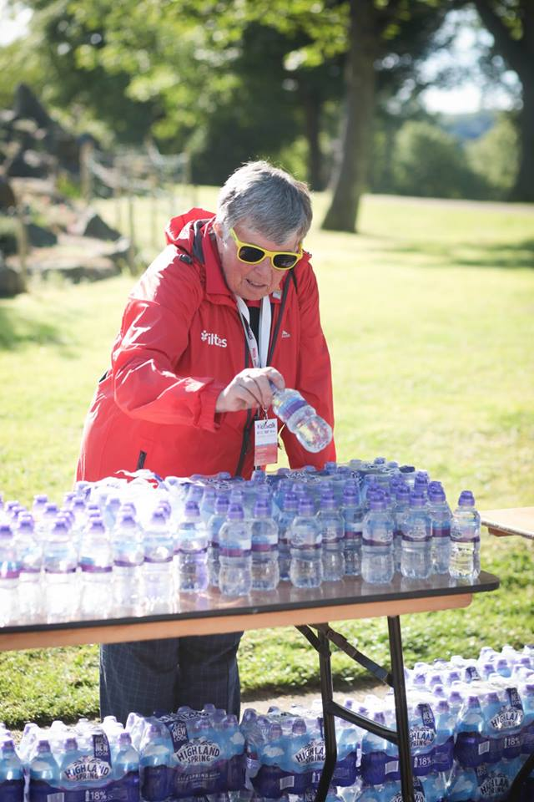
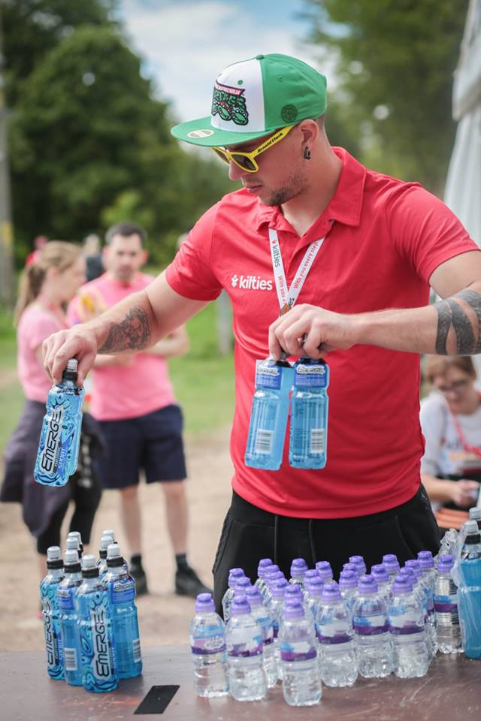
Marketing – Who are the Kilties?

Slide 12
Key Messages - 2017 Kilties
Kilties are a powerful enabling force whose sole mission is to encourage and support all Kiltwalk participants to succeed
Kilties echo the Kiltwalk pledge and display 110% commitment
The Kilties program is a platform for personal and social development

Slide 13
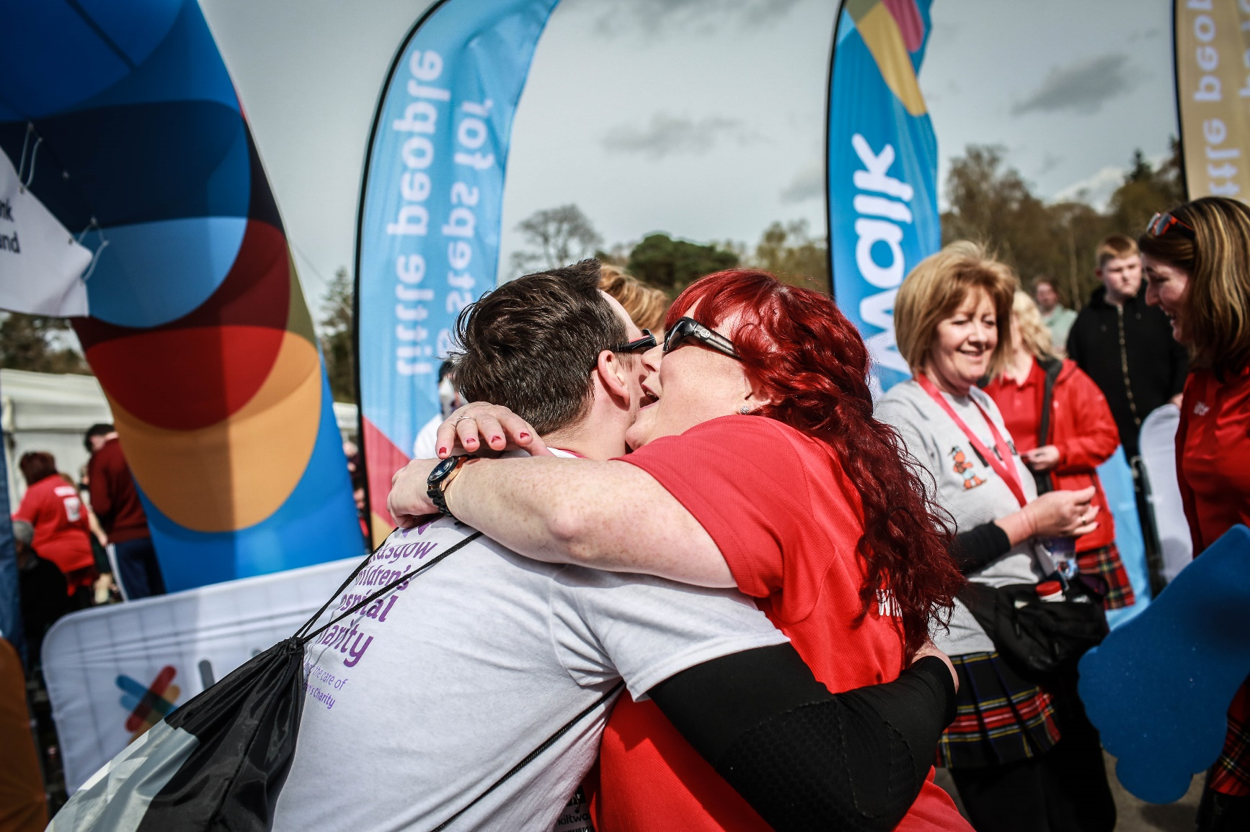
New Reward & Recognition
Kiltie Charity Boost Program

Slide 14
Key Operational Documents
Full Course Timings
Dot Plans
Deployment Plan
Shift Plan
Briefing Schedule
Redeployment Plan

Slide 15
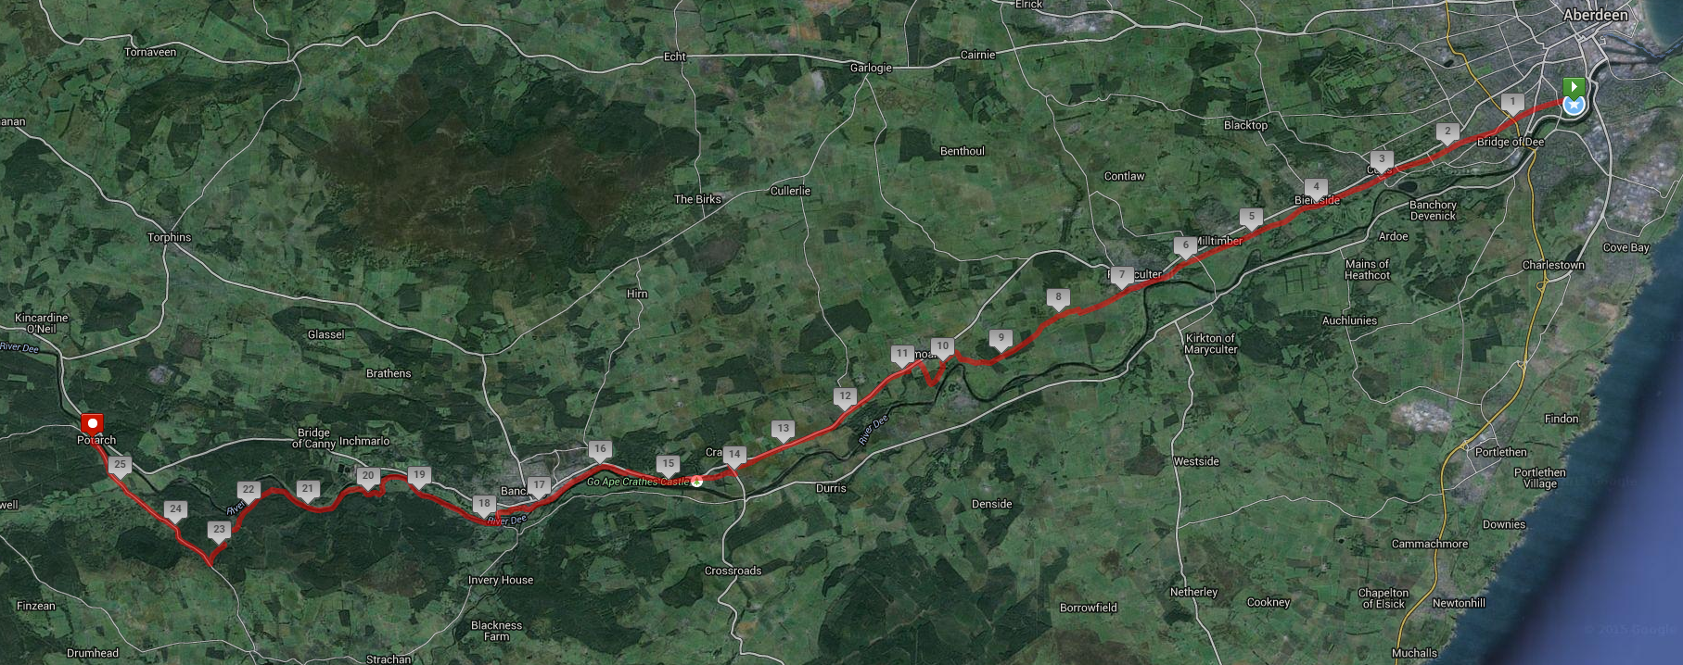
Full Course
Duthie Park
Pit Stop 1
Pit Stop 2
Potarch Green
Pit Stop 4
Pit Stop 3 Big Stroll Start
Pit Stop 5 Wee Wander Start
Pit Stop 6

Slide 16
Full Course Timings

Slide 17
DOT PLANS

Slide 18
DOT PLANS
Kiltwalk Aberdeen – Banchory to Potarch

Slide 19
Deployment Plans

Slide 20
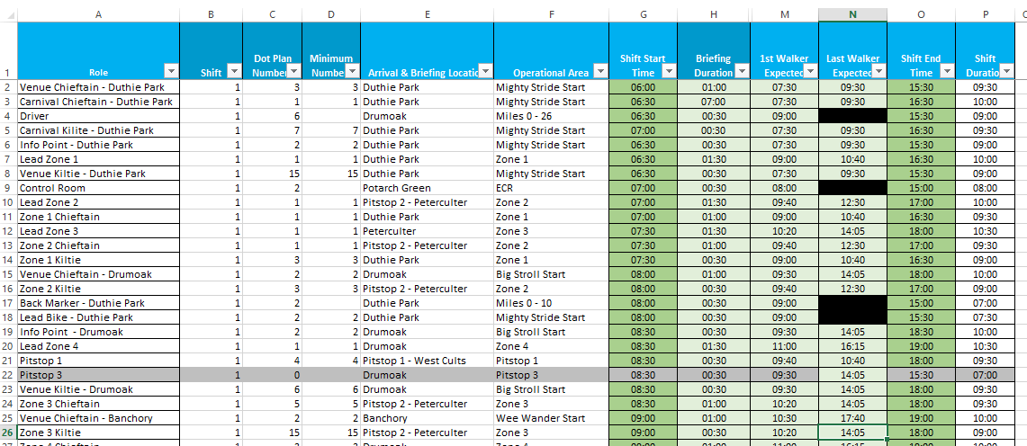
Volunteer Shift Plan

Slide 21
Systems

Slide 22
Briefing Schedule

Slide 23
Redeployment Plan

Slide 24
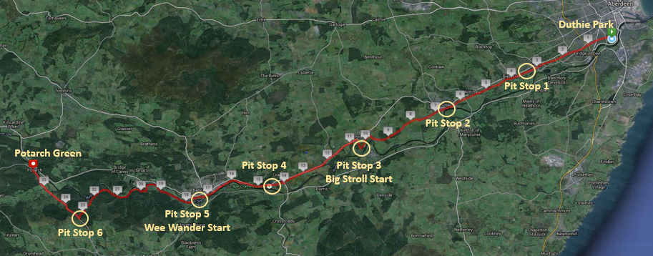
Redeployment – Scheduled & Unscheduled
168 Planned Positions Needing Covered
75 Volunteers Recruited
121 Positions Covered Through Redeployment
Notes:
Rosie

Slide 25
Kilties Process

Slide 26
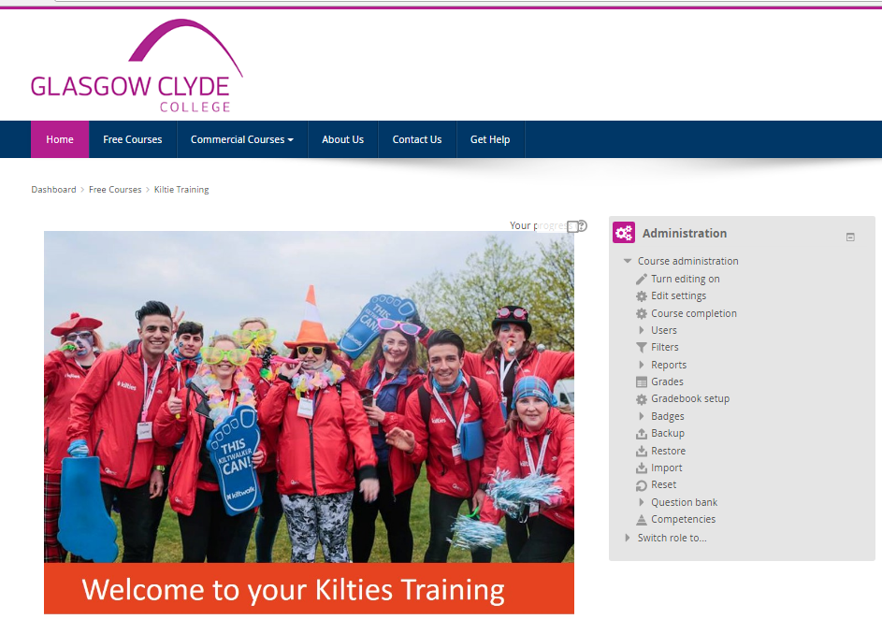
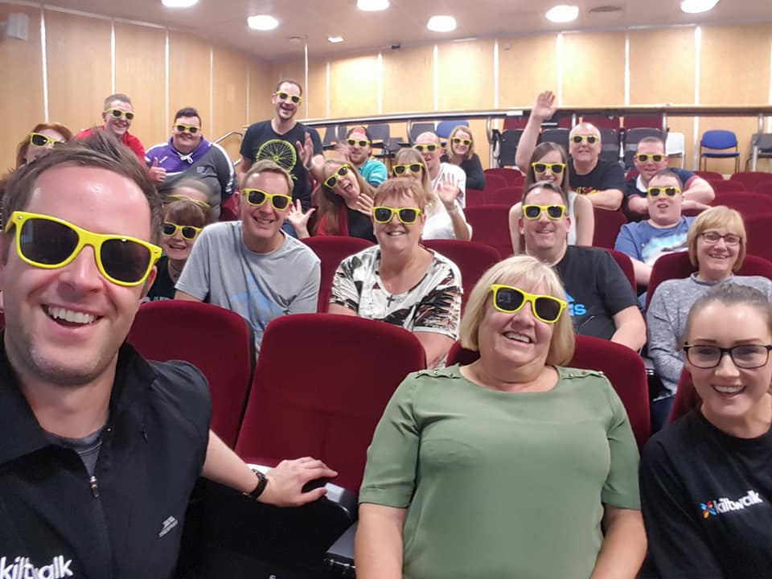
Training
Face to Face
Introductory E-Learning Module
Full E-Learning Module

Slide 27
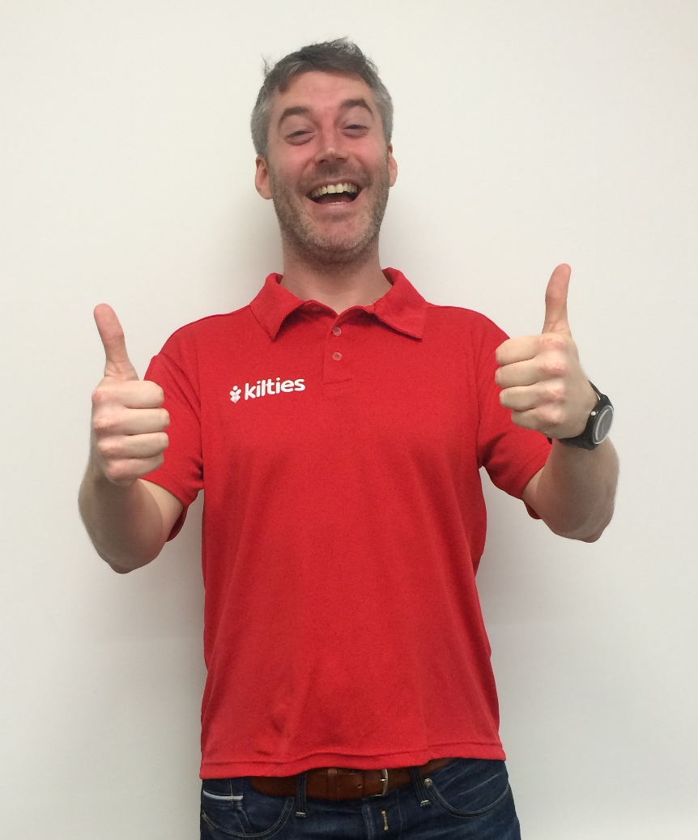
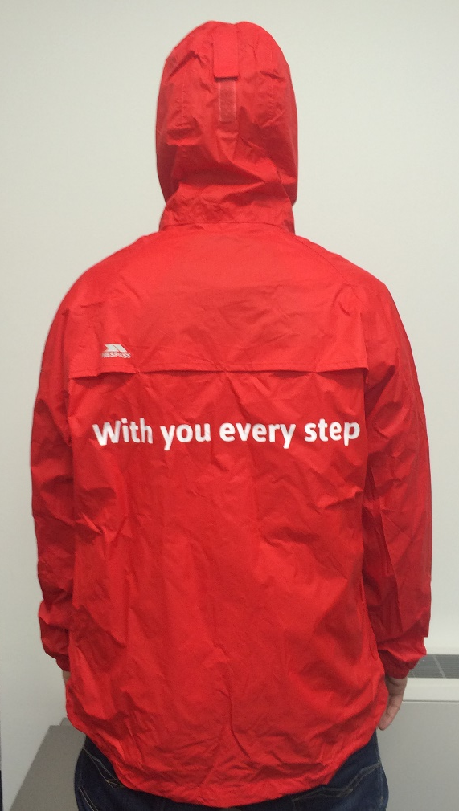
Uniform

Slide 28
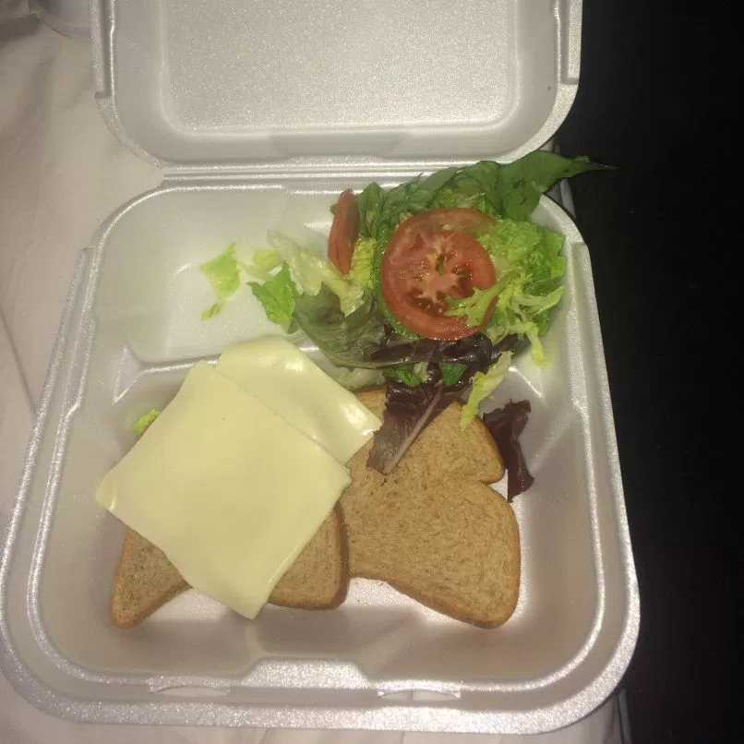
Food

Slide 29
The Kiltwalk Event Day Org Chart
Event Director
Route Manager
H&S Manager
ECR Manager
Lead Bike Kiltie
Back Marker Kiltie
Control Room Kiltie
Half Venue External Coordinator
Registration Manager
Event Manager
Start Venue Manager
Traffic Management
Stewarding
Security
Medical
Start Coordinator
Emergency Services
Venue Chieftain
Volunteer / Staffing Manager
End Venue Manager
Half Venue Manager
Venue Chieftain
Registration Manager
Venue Chieftain
Venue Kiltie
Info Point Kiltie
Transport and Logistics Manager
Transport and Logistics Coordinator
Pit Stop Coordinator
Pit Stop Kiltie
Kilties coordinator
Route Coordinator
Registration Manager
Start Venue External Coordinator
Start Venue Internal Coordinator
Driver Kiltie
Lead Zone Chieftain
Course Zone Chieftain
Course Zone Kiltie
Entertainment Coordinator
Chivas Team
Police
Fire
Media and PR Manager
Registration Assistant
Registration Assistant
Registration Assistant
End Venue External Coordinator
Core Team
Contractors
Kilties
Freelancers

Slide 30
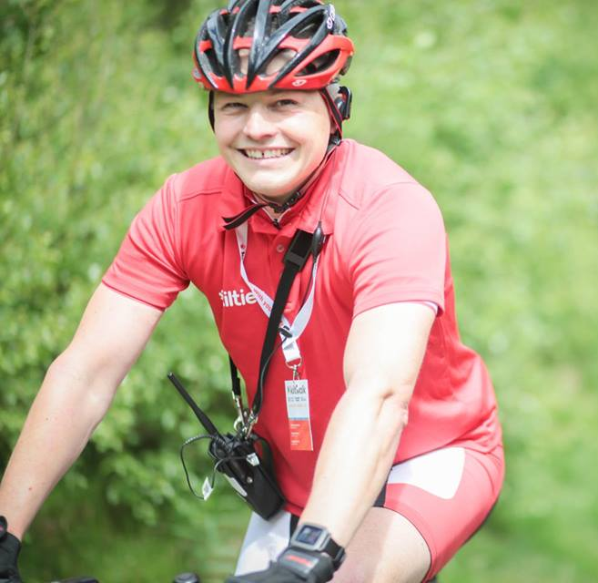
What does success look like?

Slide 31
Student Apprentice Project

Slide 32
Program Outline
Specifically tailored information & training sessions
Observation opportunities at planning meetings & site visits
Option to apply for paid contracts specifically targeted at those enrolled in the program
Event day mentoring opportunity
Opportunity to receive a certificate of achievement award from The Hunter Foundation

Slide 33
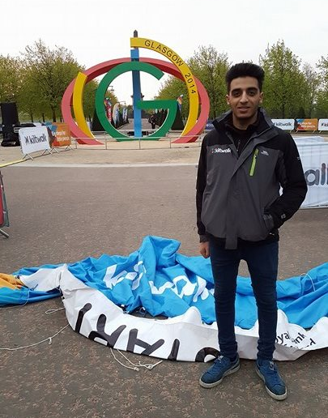
Paid Roles - Registration Assistant

Slide 34
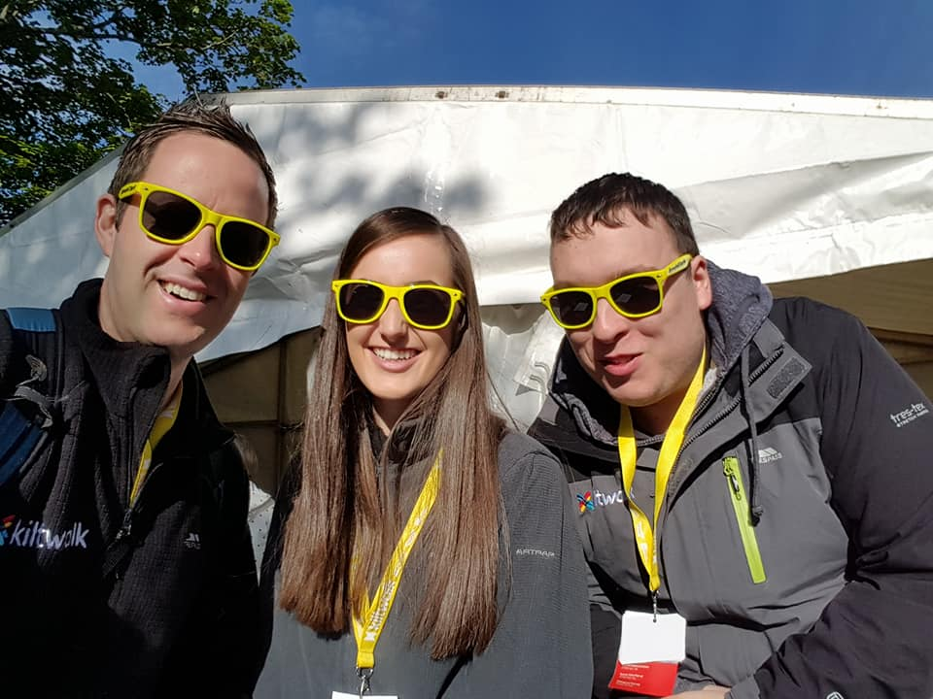
Paid Roles - Registration Assistant

Slide 35
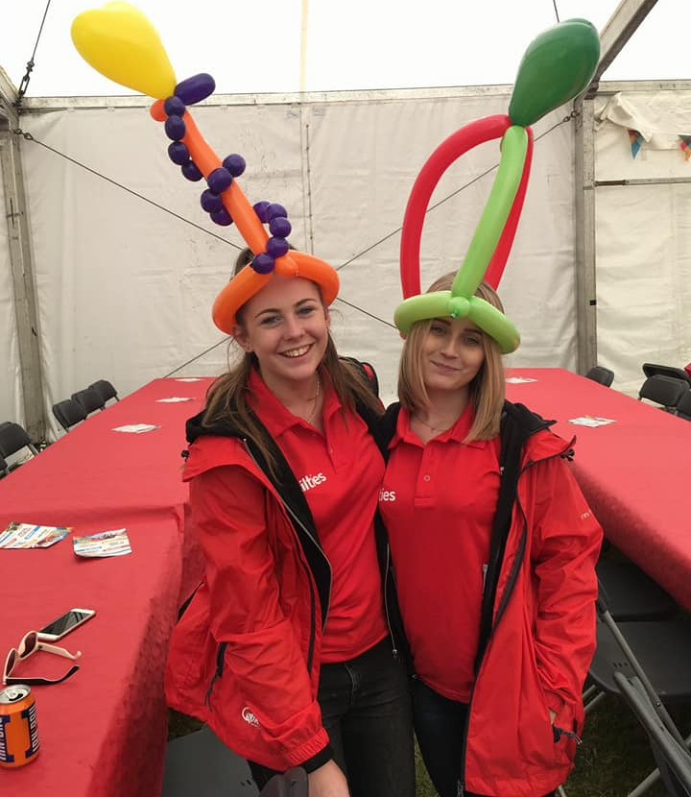
Long Term Volunteers – Entertainment Coordinators

Slide 36
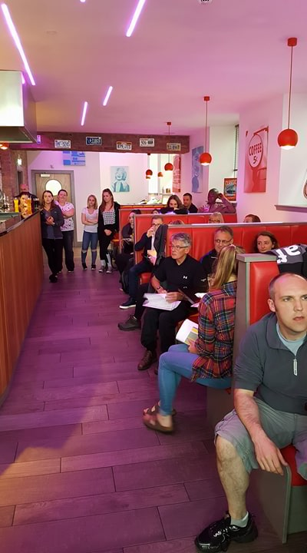
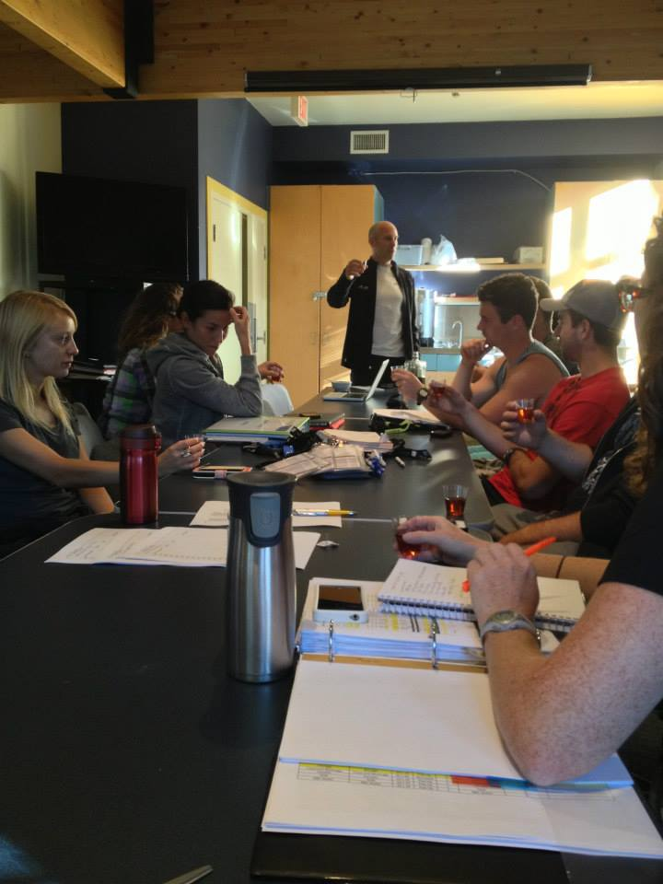
Exposure to Behind the Scenes

Slide 37
Observation Sessions/ Site Visits

Slide 38
Invest in Your Future – Start Now

Slide 39
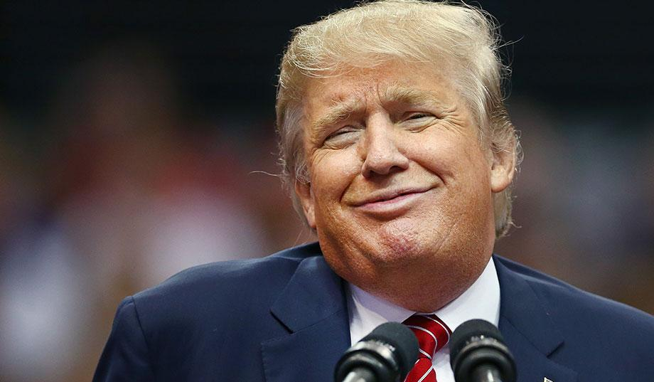
Questions?

