Slide 1
Continuing importance of Customs data for official international trade statistics
Ronald Jansen
Chief of the Trade Statistics Branch
United Nations Statistics Division / DESA
E-mail: Jansen1@un.org or
BigData@un.org

Slide 2
Purposes of Trade Statistics
Development of national, regional and international trade policy, including trade negotiations, monitoring trade agreements and settling trade disputes;
Establishing general economic policy, including policies on sustainable development, fiscal, monetary, structural and sectoral matters, as well as addressing issues relating to environmental and health concerns;
Market analysis to find supply sources or foreign markets and, in combination with structural business statistics, to determine economic characteristics of traders;
Infrastructure planning (harbours, airports, roads, etc.);

Slide 4
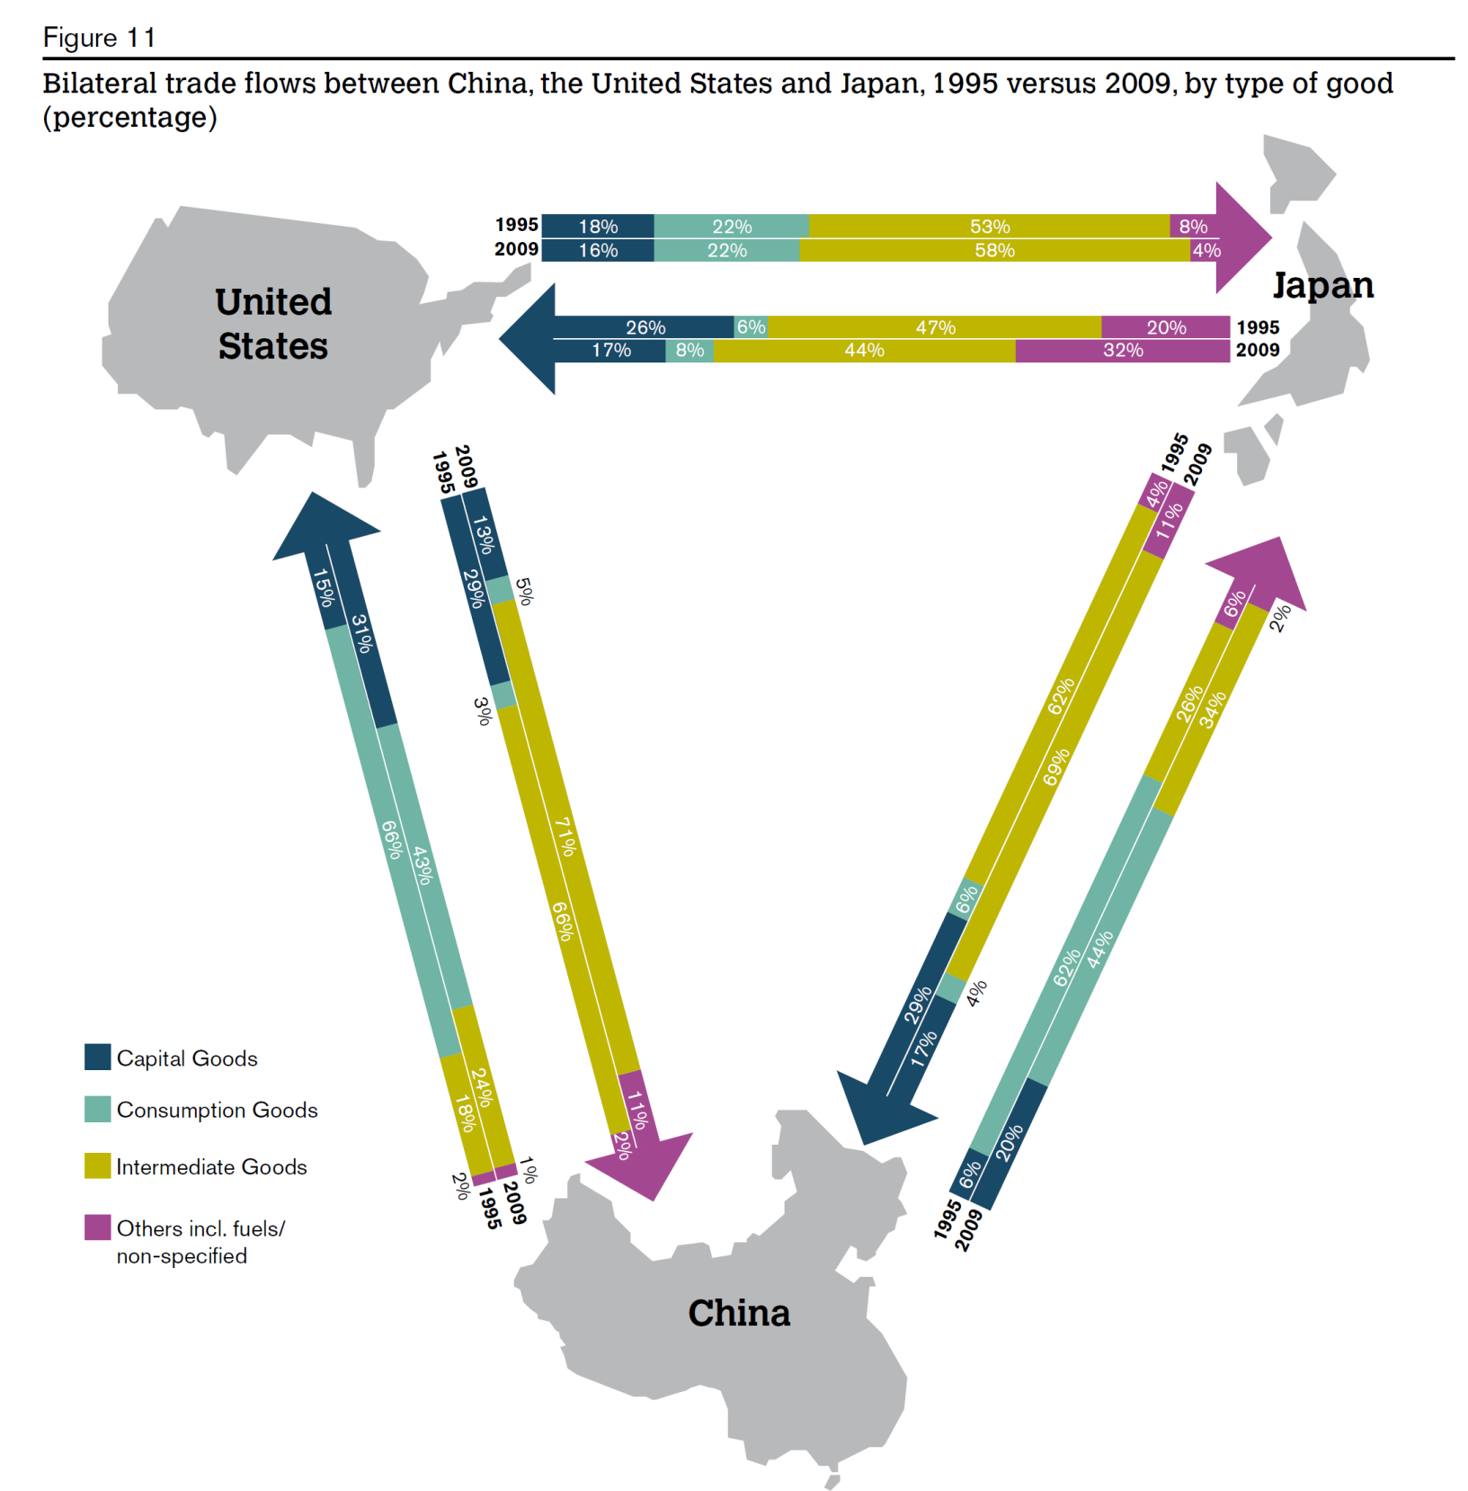

Slide 5
Global Value Chains

Slide 6
Costa Rica’s Position in the Medical Devices GVC

Slide 7
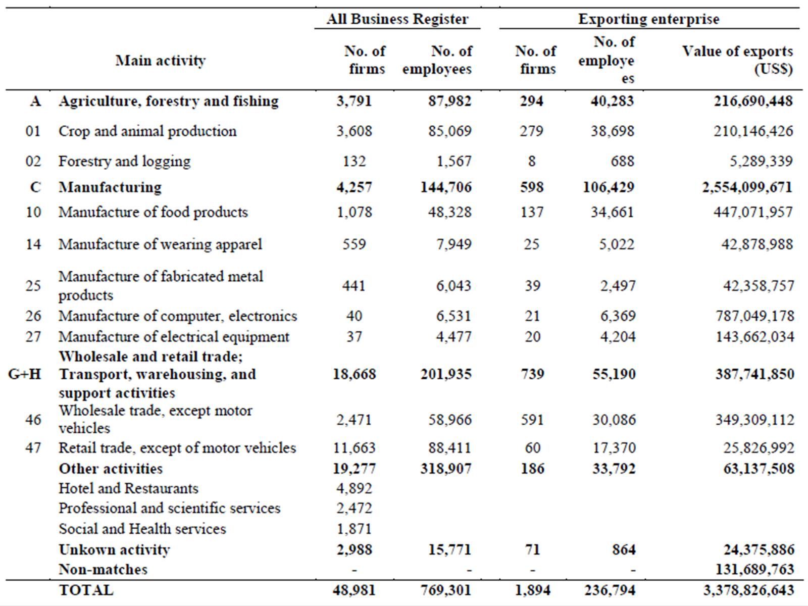
Costa Rica: Trade by Enterprise Statistics

Slide 8
Costa Rica: Trade by Enterprise Statistics

Slide 9
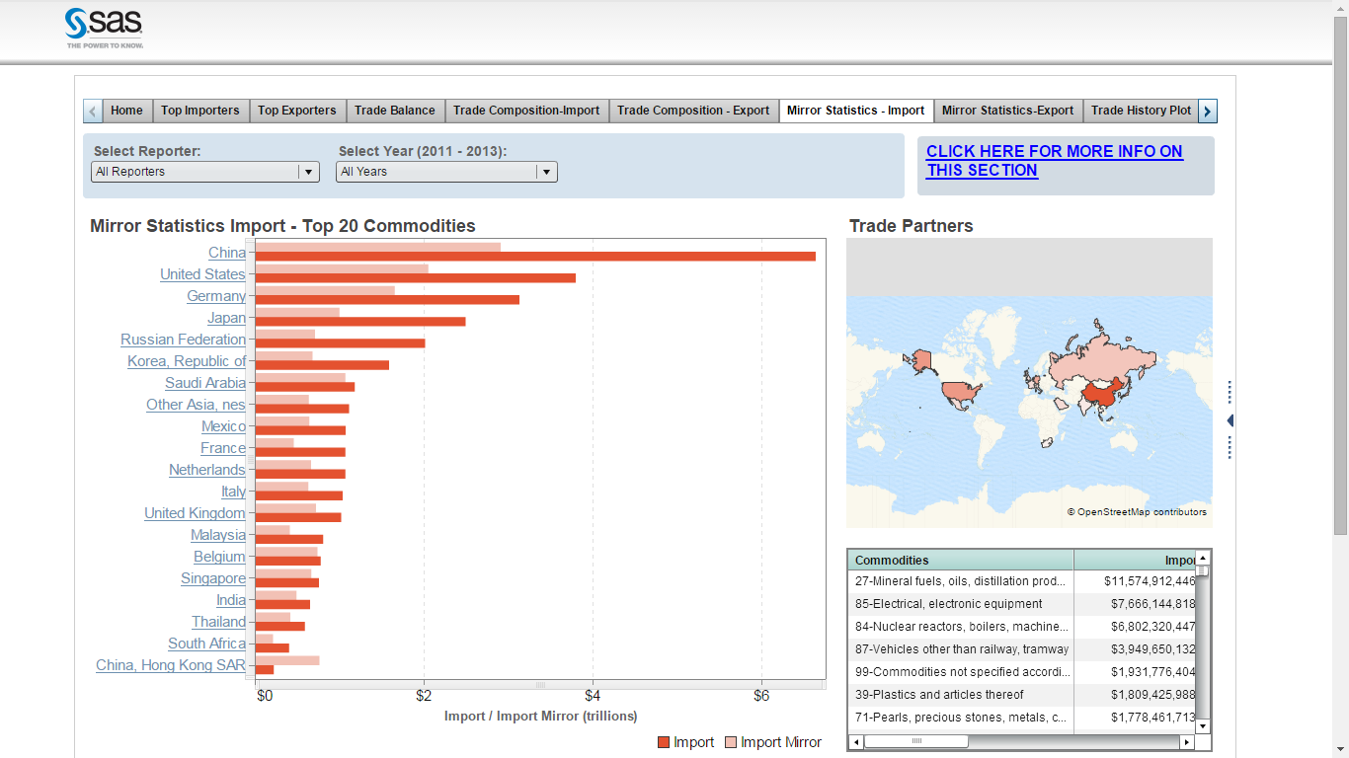
Matching Imports and Exports Data

Slide 10
Customs – Statistics Cooperation
Mandatory elements of Customs declarations (while not adding administrative or financial burden to Customs and traders – e.g. through ASYCUDA)
Quantity information
Country of consignment
Enterprise identification (Economic owner)
Statistical requirements in a memorandum of understanding between Customs and the national statistical office
Access to information such as shipping manifests and other additional electronic information

Slide 11
Thank you
Ronald Jansen
Chief of the Trade Statistics Branch
United Nations Statistics Division / DESA
E-mail: Jansen1@un.org or
BigData@un.org

