Slide 1
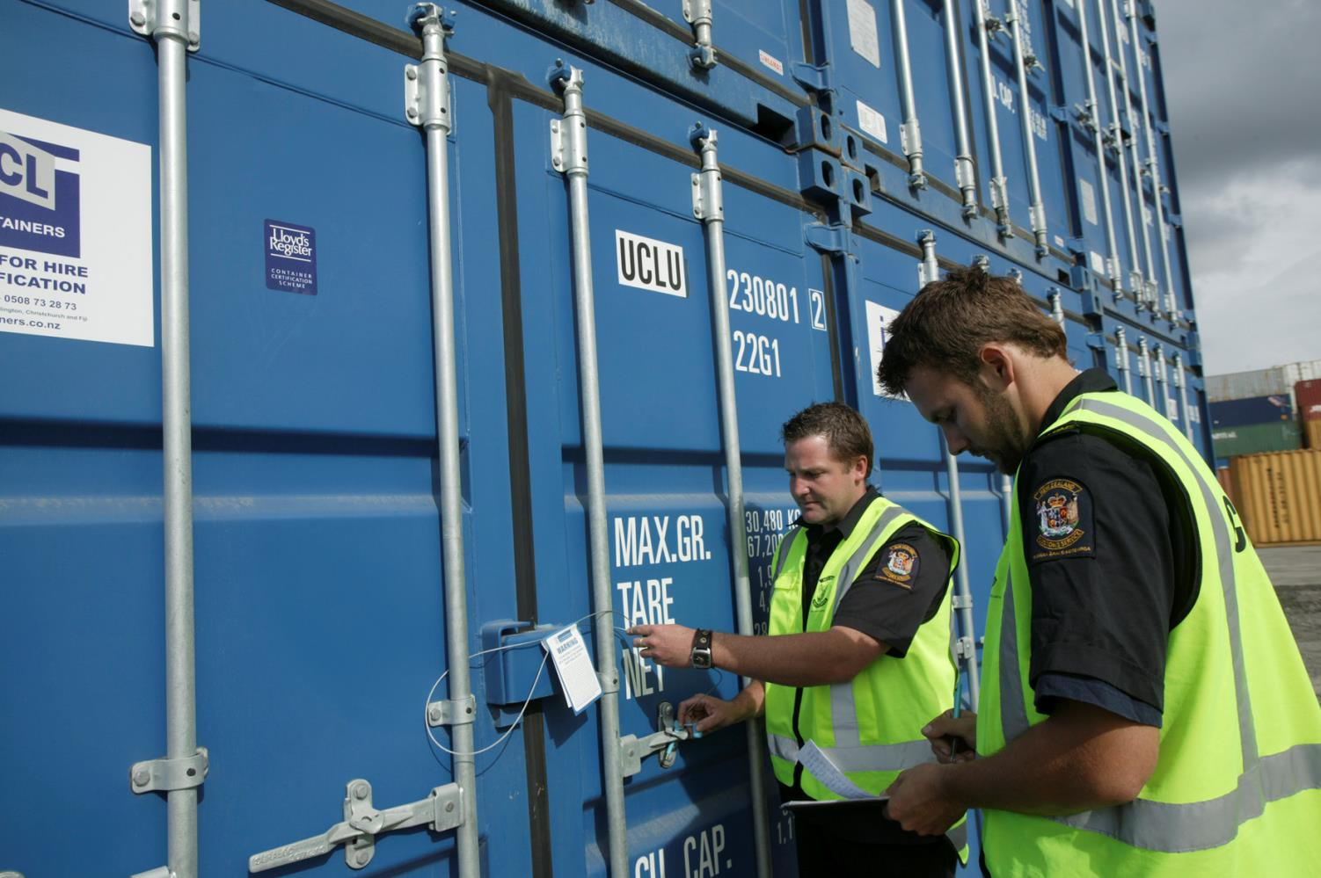
IPM:
The World Customs Organization’s tool against Counterfeiting
Knowledge Academy
Brussels, 03/07/2014

Slide 2
Agenda
What is IPM?
IPM Key figures
IPM in practice
IPM Mobile
Authentication and Traceability

Slide 3
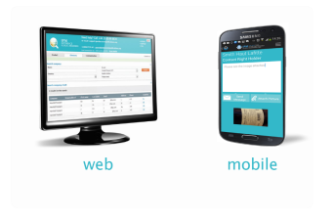
A communication tool bringing together Customs and Right Holders
Customs Officers
Right Holders

Slide 4
What is IPM?
A Detection tool to facilitate the distinction between GENUINE and COUNTERFEIT

Slide 5
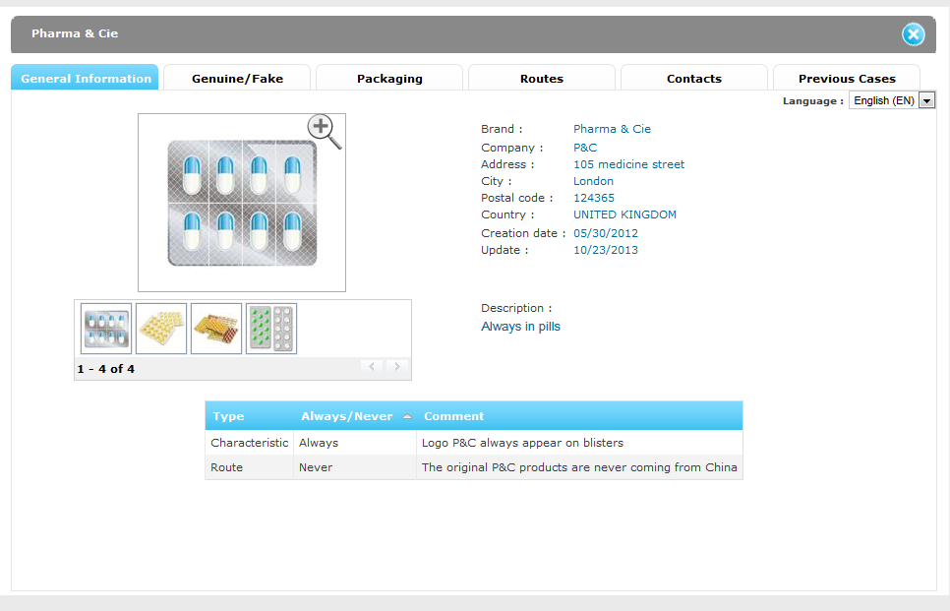
IPM Database: General Information

Slide 6
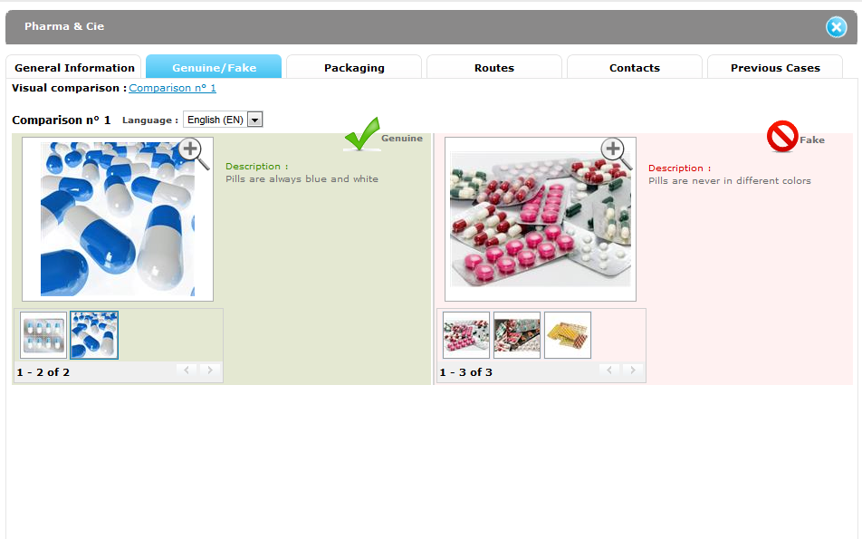
Genuine/Fake

Slide 7
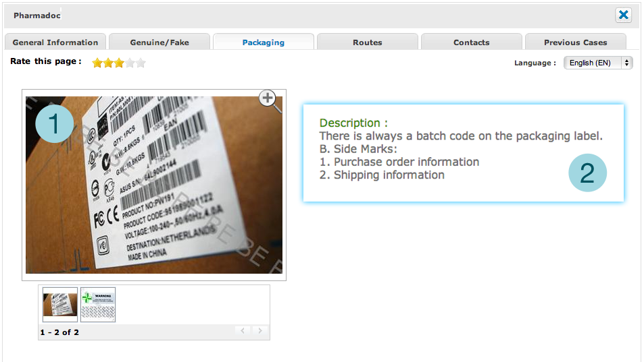
Packaging

Slide 8
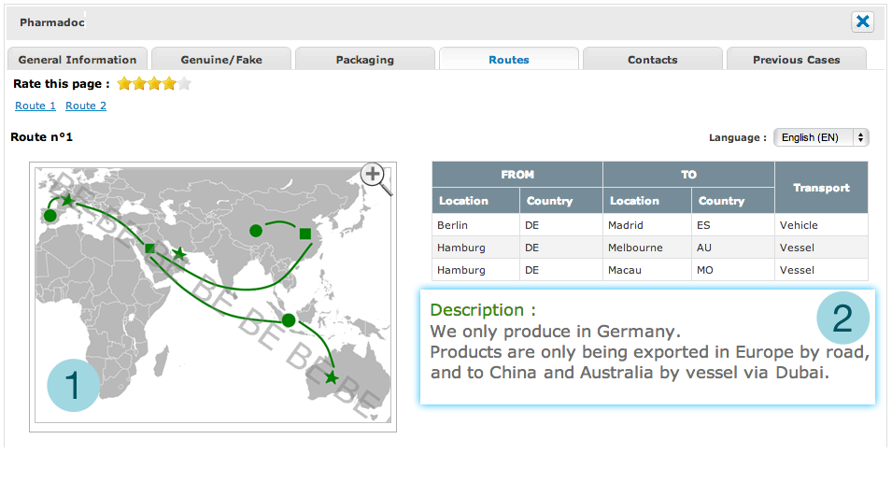
Routes

Slide 9
Contacts and Previous cases
Contacts
Previous cases

Slide 10
IPM Key Figures: Countries
76 Member Countries

Slide 11
IPM Countries
Americas and Caribbean: 13
Argentina
Mexico
Bahamas
Chile
Dominican Republic
Costa Rica
Guatemala
Jamaica
Panama
Peru
Ecuador
Uruguay
United States
North Africa, Near &
Middle East: 5
Egypt
Israel
Morocco
Tunisia
UAE
Europe: 19
Albania
Armenia
Azerbaijan
Belgium
France
Georgia
Hungary
Iceland
Ireland
Kazakhstan
Montenegro
Netherlands
Serbia
Turkey
The Former Yugoslav Republic of Macedonia
Russia
Ukraine
United Kingdom
West & Central Africa: 10
Benin
Cameroon
Cape Verde
Central African Republic
Democratic Republic of the Congo
Guinea
Liberia
Senegal
Togo
AP Region: 13
Cambodia
Hong Kong
Japan
Korea (Republic of)
Macau, China
Malaysia
Mongolia
Philippines
Samoa
Seychelles
Thailand
Tonga
Vietnam
East & Southern Africa: 9
Angola
Djibouti
Kenya
Madagascar
Mauritius
Mozambique
South Africa
Tanzania
Uganda

Slide 12
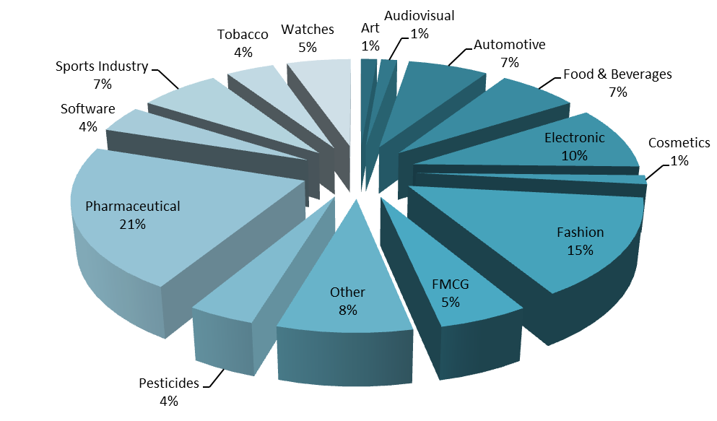
IPM Key Figures: Over 650 Intellectual Property Rights

Slide 13
IPM in Practice: Operation Biyela 2013 (Togo)
Counterfeit Product
Genuine Product (IPM)

Slide 14
General Information in IPM

Slide 15
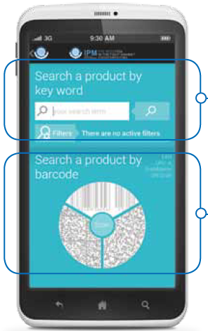
IPM - New version for smartphones
GS1 Barcode standards help Customs Officers to access data seamlessly
The product can be searched by entering keywords manually...
... or can be searched by scanning GS1 barcode to benefit from :
A universal pointer to access product data thanks to GTIN (Global Trade Item Number)
Company related information available to 2 million registered businesses in 150 countries thanks to GEPIR (Global Electronic Party Information Registry)

Slide 16
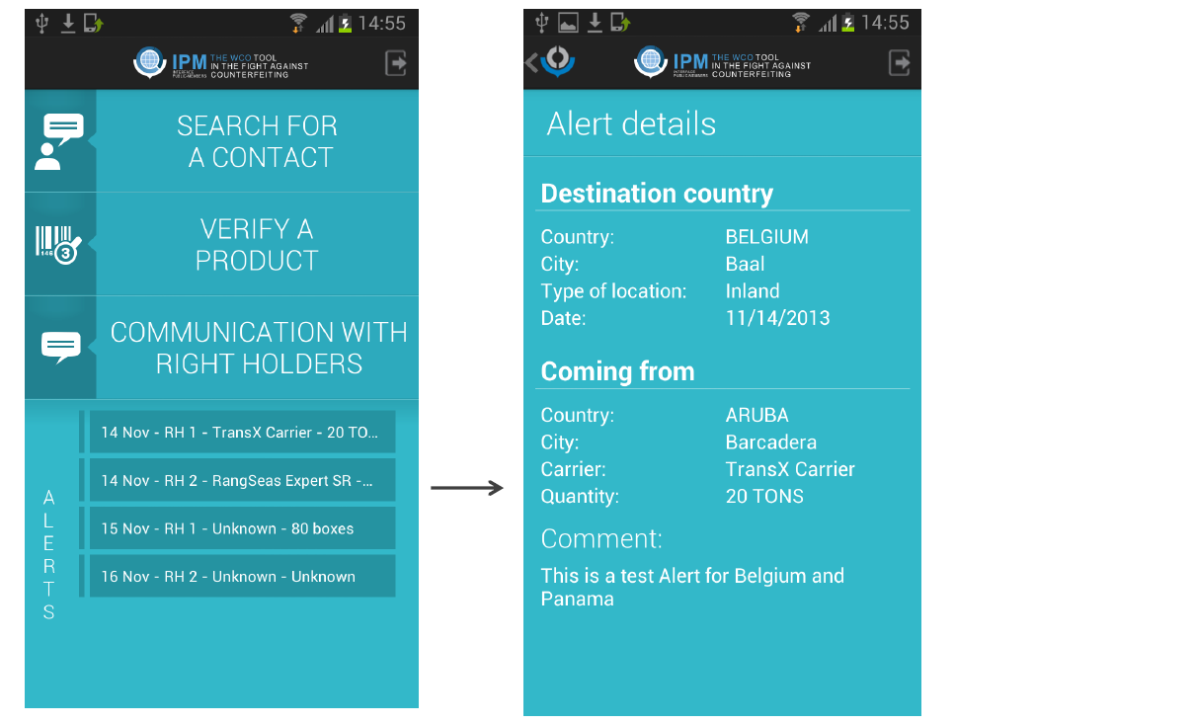
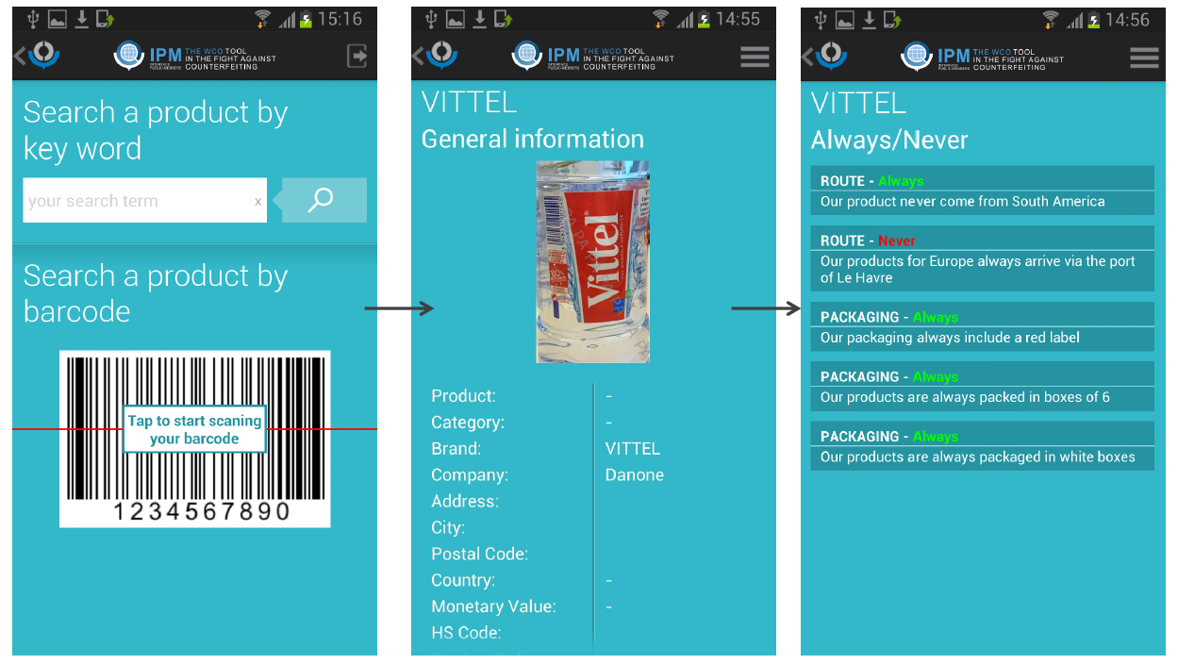
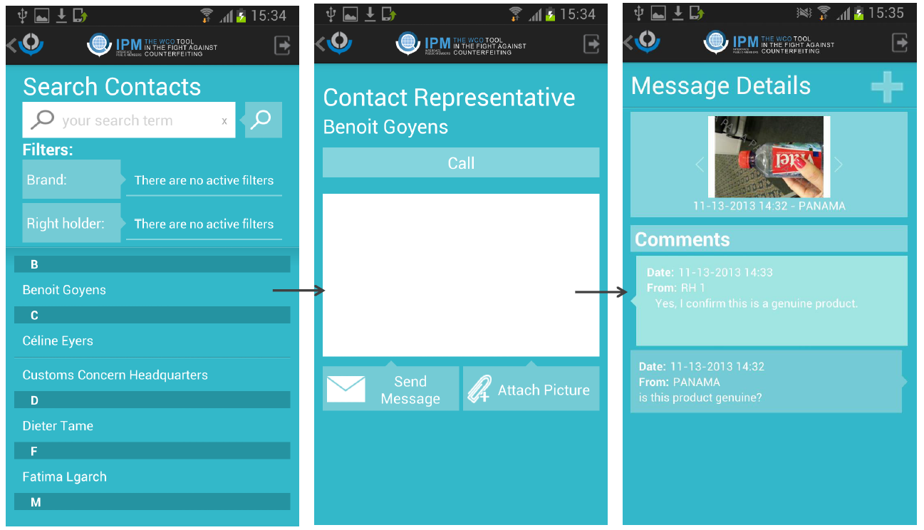
IPM - New version for smartphones

Slide 17
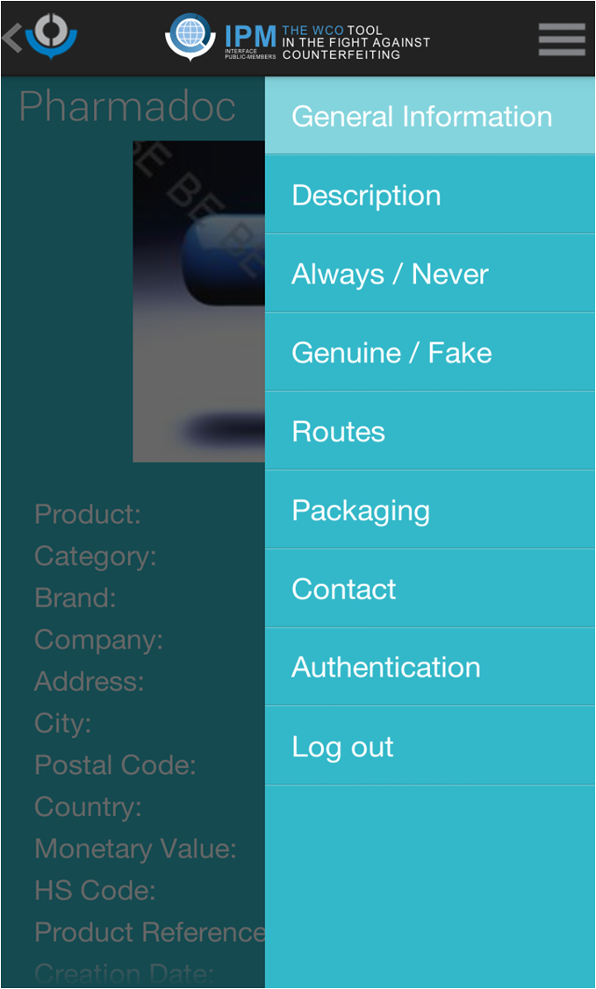
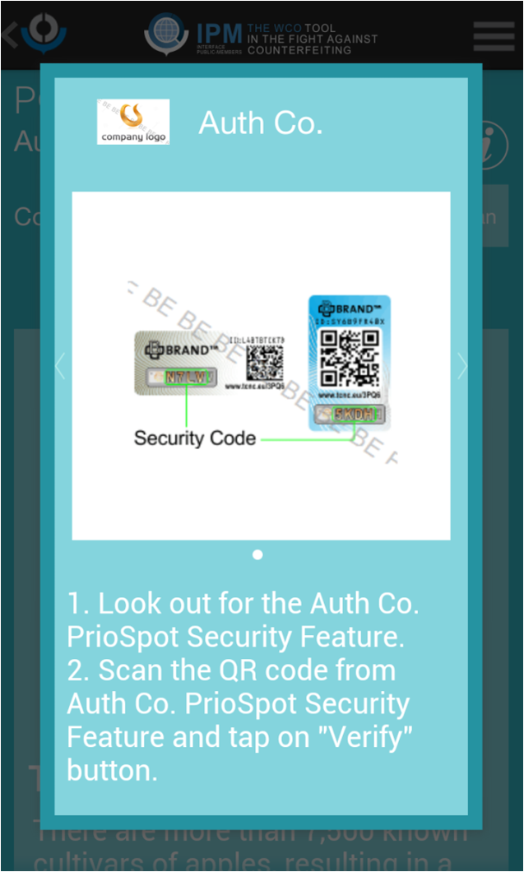
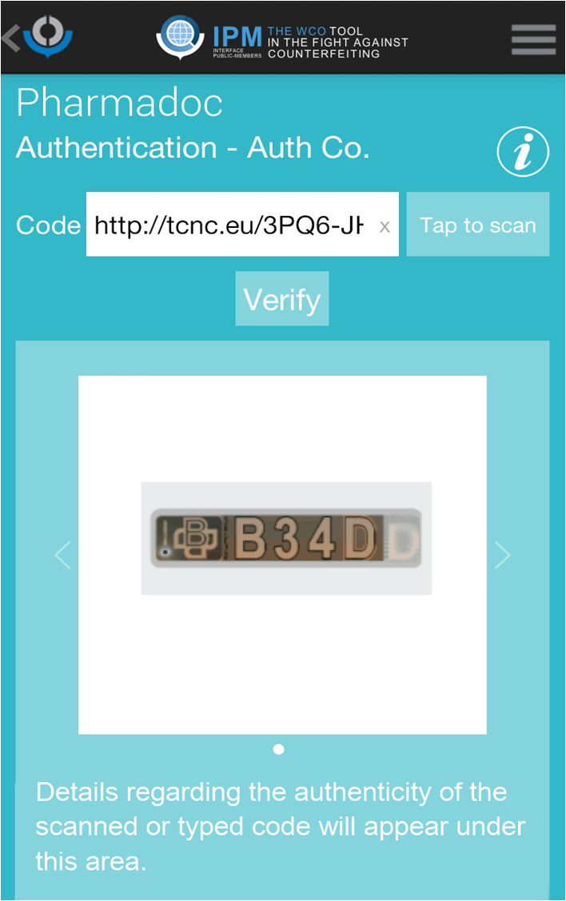
IPM - Authentication and traceability

Slide 18
IPM Mobile
UAE Pilot (4th week statistics)
150 Users Total
WEB
+/- 11600 Products consulted
Mobile
+/- 4700 Products consulted
+/- 1100 Contacts searched
180 Scans
120 Communications through IPM

Slide 19
Thank you!
For more information, please visit www.wcoipm.org
Contact: Elena.Trefas@wcoomd.org
Copyright © 2014

