Slide 1
Basic Math Review for Relay Techs
Bill Unbehaun
Tacoma Power

Slide 2
Triangle Basics
Pythagorean Theorem
C²
100⁰
B²
180⁰
45⁰
35⁰
A²
60⁰
30⁰
3.7
3.7
10
10
60⁰
60⁰
75⁰
75⁰
3.7
Equilateral
Isosceles

Slide 3
30-60-90 Right Triangle
Basic Trigonometry:
SOH – Sine = Opposite over hypotenuse
CAH – Cosine = Adjacent over hypotenuse
TOA – Tangent = Opposite over adjacent
60
60⁰
1
0.5
30
30⁰
90⁰
0.866

Slide 4
120⁰ and √3
120
60
60
60
1
1
30
90
0.866
0.866
1.732

Slide 5
Circles
Circumference is distance around the circle
Radius is distance from center to circumference
Diameter is longest chord and it goes through center
Thales Theorem – angle inside semi-circle is right
The circumference is equal to the diameter times π.
C = πd = 2πr
π = 3.1416
Diameter
Thales
Radius

Slide 6
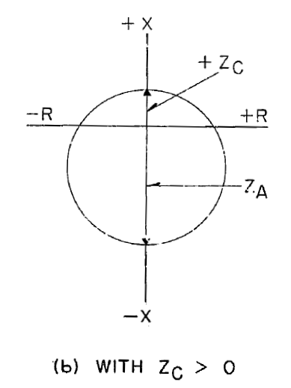
Loss of field characteristic

Slide 7
Loss of field characteristic

Slide 8
Loss of field characteristic

Slide 9
Loss of field characteristic

Slide 10
Cartesian Planes
Y
X

Slide 11
Cartesian Planes
Y
₊
-
₊
X
-

Slide 12
Cartesian Planes
Y
X

Slide 13
Cartesian Planes
Y
90⁰
180⁰
0⁰
X
270⁰
Or -90⁰

Slide 14
Cartesian Planes
Y
90⁰
Vc
Va
180⁰
0⁰
Ia
X
Vb
270⁰
Or -90⁰

Slide 15
Power Plane
Q
Watts flowing out
P
Inductive VARs
(unless at a generator)

Slide 16
Power Plane
Q
Watts flowing out
P
Inductive VARs
(unless at a generator)
VA

Slide 17
Power Plane
Inductive VARs
(at a generator)
Q
VA
Watts flowing out
P

Slide 18
Impedance Plane
X
Reactance
Resistance
R

Slide 19
Impedance Plane
Reactance
X
Impedance – i.e. line impedance
Resistance
R

Slide 20
Impedance Plane with Mho Characteristic
X
R

Slide 21
Getting to the Impedance Plane
R = V/I
Z = V</I<
Z = 100v<0 / 10a < -20
Polar division: divide magnitudes and subtract angles
Z = (100/10) < 0 – (-20)
Z = 10 < 20
Y
90⁰
Z
Va
180⁰
0⁰
X
Ia
270⁰
Or -90⁰

Slide 22
Getting to the Impedance Plane
R = V/I
Z = V</I<
Z = 100v<0 / 10a < -20
Polar division: divide magnitudes and subtract angles
Z = (100/10) < 0 – (-20)
Z = 10 < 20

Slide 23
Getting to the Impedance Plane
R = V/I
Z = V</I<
Z = 100v<0 / 10a < -20
Polar division:
divide magnitudes and subtract angles
Z = 100/10 < 0 – (-20)
Z = 10 < 20
X
90⁰
Z
Va
180⁰
0⁰
R
Ia
270⁰
Or -90⁰

Slide 24
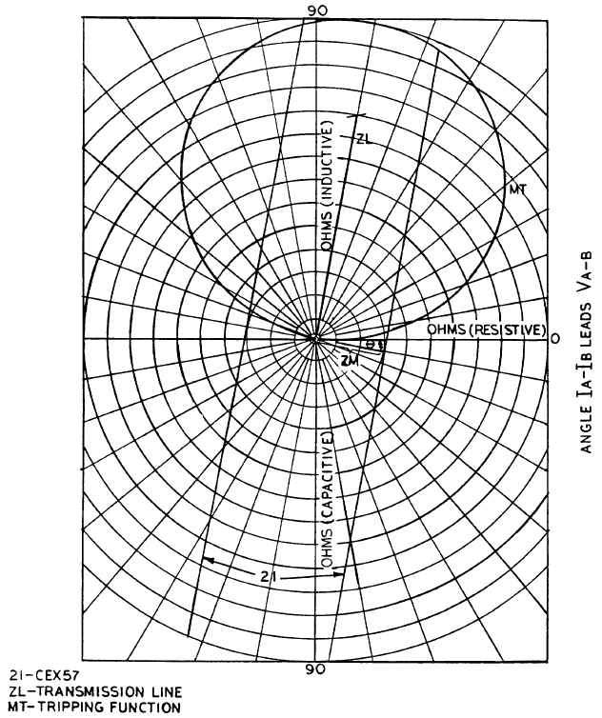
Polar Diagram of an Impedance Unit

Slide 25
Ratios
Ratios are used to compare two quantities
They can be expressed as comparisons - 2:3 or as fractions - 2/3
We see them in transformers – 115kV/12.47kV
The full description of transformer parameters is:
a (turns ration) = N₁ / N₂ = V₁ / V₂ = I₂ / I₁
Can be simplified by dividing 115/12.47 = 9.2/1
Also CTs 2000/5 = 400/1
And PTs 115,000/115 = 1000/1

Slide 26
Per Unit
11 men who play soccer together can be referred to as a team
11 players 1 team
11 1 per unit

Slide 27
Per Unit
This makes discussion of leagues much easier
Instead of listing all 11 players every time that group is mentioned, we refer to the team name

Slide 28
Per Unit
Per unit means putting the base at one
Like percentage without the factor of 100
50% is the same as 0.5 per unit
A relay value called tap is a base – 2 x tap =
2 per unit
Used in some relay settings – differential minimum op and unrestrained are often per unit settings, also directional power in some generator relays

Slide 29
Per Unit Example
40MVA transformer, 115 kV / 12.47kV
Rated current would be
40,000,000va/115,000 v/ √3 = 200.8 a
If you apply 100 kV, this would be 0.87 per unit voltage; if you applied 230 kV it would be 2 per unit
If you measure 100.4 a, this would be 0.5 per unit
If you run it at 110 kV and 50 a, you would see 110 x 50 x √3 = 9.53 MVA or about 0.24 per unit MVA

Slide 30
Decimals
In the examples above, there were quantities of several orders of magnitude: amps, kV, MVA
You must keep your decimals in order!
If you use kV and MVA to avoid writing out 0’s, be sure you know what the current designation will be
Same with milli’s and micro’s

Slide 31
Significant Digits
My calculator tells me √3 = 1.732050808
It calculates that 120 v / √3 = 69.2820323
My test set will differentiate at millivolt level but not micro- or nanovolts
Think about how many decimal places you realistically need – usually 69.3 or 69.28 volts is close enough and round off – 0.0-0.4 goes down,0.5-0.9 goes up

Slide 32
Algebra
Basic identities: If A = B and B = C, then A = C
Properties:
Distributive: a(b+c) = ab+ac
Associative: a+(b+c) = (a+b)+c and a(bc) = (ab)c
Commutative: a+b = b+a and ab = ba

Slide 33
Order of Operations
Please Excuse My Dear Aunt Sally
Parentheses – complete operations within any parentheses
Exponents – resolve any squares or square roots, etc.
Multiplication – complete any multiplication
Division – same as above
Addition – combine anything
Subtraction – subtract anything

Slide 34
Examples
A² + B² = C², where A = 3 and B = 4
No parentheses, so exponents: A² = 9, B² = 16
No multiplication or division, so addition: 9 + 16 = 25 = C²
No subtraction, so find the square root of 25 to get C = 5
a((5 - 3)² ) + a(5 + 3) = 24
Parentheses: 5-3=2; 5+3 = 8 a(2²) + 8a = 24
Exponents: 2² = 4 4a + 8a = 24
Addition: 12a = 24
a = 2

Slide 35
Factoring
18 = 1x18 = 2x9 = 3x6
1,2,3,6,9, and 18 are the factors of 18
You can use them in equations and expressions to simplify
a/18 = b/3; since 3 is a factor of 18 you can multiply both sides by 3 to simplify
a/6 = b/1 or a/6 = b
We use multiples of 10 as factors a lot

Slide 36
Equations
Solving equations: do the same thing to both sides
a+2 = 5
subtract 2 from both: a+2-2=5-2, a = 3
3a = 6
divide both sides by 3, 3a/3 = 6/3, a = 2
The same applies to addition and multiplication

Slide 37
Examples
V=IR Ohm’s Law
I=V/R
R = V/I
A² + B² = C² Pythagorean Theorem
A² = C² – B²
B² = C² – A²
Cosine = Adjacent / Hypotenuse Trig
Adjacent = Cosine x Hypotenuse
Hypotenuse = Adjacent / Cosine

Slide 38
Calculator Tips

Slide 39
Example Problems

Slide 40
Double Check
Does the answer make sense?
If you work backwards from your answer, do you get your original values: if solving for impedance, work back with the impedance and voltage – do you get the original current?

Slide 41
Questions?
Resources
The Relay Testing Handbook Chris Werstiuk
Protective Relaying Quick Reference Power Engineers
Several pocket references for power calculations, etc.
Lots of sites on the Internet
Prepared by Bill Unbehaun of Tacoma Power for The Hands On Relay School.

