Slide 1
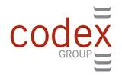
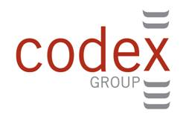
The Author Brand Opportunity
Peter Hildick-Smith
Codex-Group LLC
16 W. 16th St.
NY, NY 10011
212-255-0405
hildick-smith@codexgroup.net
Digital Book World
January 14, 2014

Slide 2
Three Pillars of Initial New Book Sales
2
Is the Book Idea Interesting Enough to Buy?
Conversion
1
Do I Know
the Book Exists?
Discovery
Availability
Buyer
Target
3
Is the Book Available to Buy Whenever, However I Want It?
Discovery + Conversion + Availability = New Book Sales
2

Slide 3
Three Pillars of Initial New Book Sales
2
Is the Book Idea Interesting Enough to Buy?
Conversion
Author “Brand”
Topic/Message
Discovery
Availability
Reader
Target
Book Conversion Driven Most by Author “Brand” and Book Topic/Message.
3

Slide 4
“Brand Author” Defined
Adult Frequent
Book Buyers
500,000 Fans
1% of Frequent Book Buyers
50,000,000
A “Brand Author” = 500,000 Fans or More.

Slide 5
Why Author Brands Matter

Slide 6
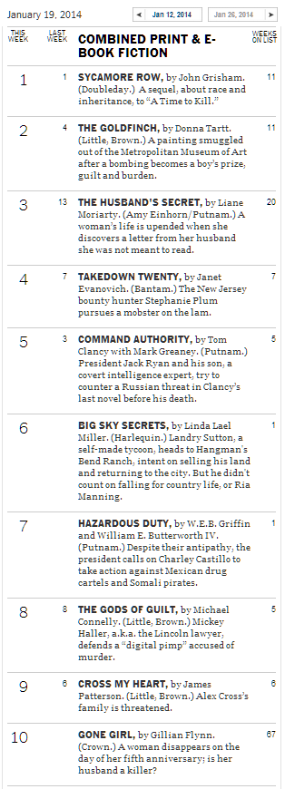
Brand Author Bestseller Placement – 1/19/2014
Brand
Brand
Brand
Brand
Brand
Brand
Brand
Brand
Brand
Brand
Brand
Brand
Brand
Bestseller List Dominated by “Brand” Authors.

Slide 7
New Book Purchase Decision Factor Share: Last Book Bought – 11/2013
When browsing for new books, which of the following factors influenced your decision most when choosing [your last book bought]? (pick one)
Most Influential Purchase Decision Factor: Last Book Bought
Book
Bought Last
Favorite Author/Series
Book Topic/Message
Personal
Recommendations
“Favorite Author or Series” Single Biggest Book Purchase Decision Factor.

Slide 8
New Book Purchase Decision Factor Share: Last Book Bought – 11/2013
When browsing for new books, which of the following factors influenced your decision most when choosing [your last book bought]? (pick one)
Most Influential Purchase Decision Factor: Last Book Bought
Genre
Fiction
Literary
Fiction
Narrative
Nonfiction
Utility
Nonfiction
Favorite
Author/Series
Topic/
Message
Recommend
“Favorite Author or Series” Dominant Factor in Fiction,
Major Potential Force in Narrative Nonfiction.

Slide 9
Book Buyer’s Author Opinion BEFORE Discovery – 11/2013
BEFORE you first discovered [the book you bought last] -- what was your overall opinion of its author or series?
Author Rating BEFORE Book Discovery
Genre
Fiction
Literary
Fiction
Narrative
Nonfiction
Utility
Nonfiction
Very Good/
Favorite Author
Not Familiar
Author
“Brand” Authors Most Purchased in Fiction – Unknowns Often Avoided.
9

Slide 10
Author Equity Brand Impact on Book Sales – Purchase Propensity – Fiction
15X
Author
“Fan”
Not Familiar
With Author
Author Brand Equity is Book Sales Multiplier!

Slide 11
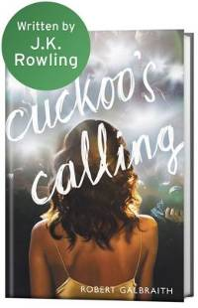
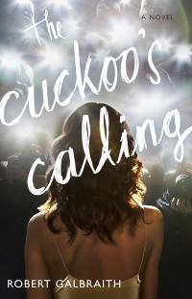
Author Equity Brand Impact on Book Sales – Initial 8 Week Print Unit Sales
April 30
2013
July 14
2013
500X
Author Brand Equity is Book Sales Multiplier!

Slide 12
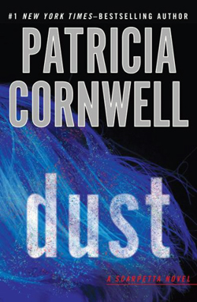
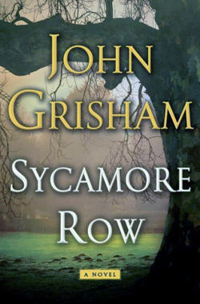
Author Fan Sales Contribution: % Book Purchase Demand From Author Fans
Celebrity
Biography
Y
Fan Contribution: Major Authors Depend on Fans for 50-80% of Sales.

Slide 13
Retail Price Expectation: Impact of Author Brand Strength – 6/2013
How much do you normally expect to pay for a new or recently released book by (the author of the book you bought last) -- in each of the following formats?
BEFORE you first discovered [the book you bought last] -- what was your overall opinion of that author?
+37%
Thriller Authors
Hardcover
“Brand” Author
Unknown Author
+66%
eBook
Book Buyers Expect to Pay Significant Premium for Their Brand Authors.

Slide 14
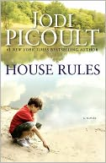
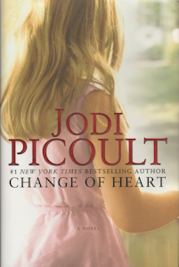
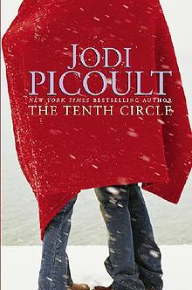
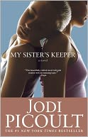
Author Fan Base vs. Initial 8 Week Unit Sales – Jodi Picoult
Author
Equity
Initial 8
Week Units
The Bigger The Fan Base – The Greater The Sales Potential.

Slide 15
Making Author Brands Work

Slide 16
Name Recognition Measurement – U.S. Past Month Book Buyers – 11/2013
Recognize
Name
Celebrity
Biography
Y
A Famous Name Is Not Enough.

Slide 17
Author Equity Brand Measurement – U.S. Past Month Book Buyers – 11/2013
Recognize
Name
% Book
Buyer Fans
Author Equity is Measurable – Fan Loyalty is The Key.

Slide 18
Author Equity Matrix: Book Buyer Audience Strength
Acquire/Grow
Manage
Fan
Loyalty
Fix
Avoid
Platform Size
Invest in Author Brand Development.

Slide 19
Author Fan Fulfillment: % of Author Fans Who Own/Plan to Buy Book
Over Half of Fans Want Book
Less Than Half of Fans Want Book
Average: 45%
Self-Help
P
Self-Help
L
Fan Fulfillment – Does the Book Connect with its Author’s Fans?

Slide 20
“Brand Author” Fan Fulfillment Impact – Initial 8 Week Unit Sales
Prior
Self-Help
Title
- 467,000
units
Self-Help
P
Prior
Self-Help
Title
15% Fan
Fulfillment
Self-Help
L
16% Fan
Fulfillment
- 130,000
units
Miss Your Fans – Miss Your Sales.
*Source: BookScan initial 8 week unit sales

Slide 21
Author Brand Sales Impact
Greatest Impact
Author Acquisition
Fan Fulfillment – Topic & Message
Relative Sales
Impact
Price Premium
Category Expansion
Marketing
Moderate Impact
Multiple Author Brand Sales Growth Avenues.

Slide 22
Author Brand Growth Opportunity

Slide 23
Author Brand Growth Opportunity
FAN LOYALTY DRIVE SALES: Primary Sales Source
SALES MULTIPLIER: #1 Conversion-to-Sales Factor
PRICE PREMIUM: Loyal Fans Value Their Authors
CONSISTENT BOOK-to-BOOK GROWTH: Fan Fulfillment
PARTNER CHALLENGE: Author, Fan, Agent, Editor, Publisher

