Slide 1
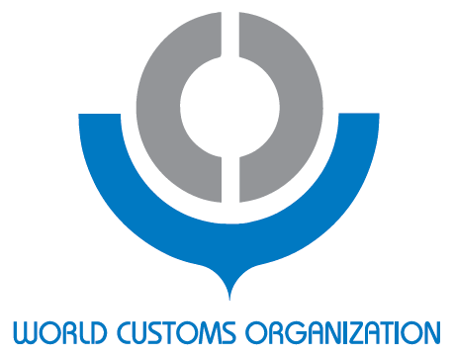
Post Clearance Audit (PCA) Data Analysis for Selection and Execution of Audits
Knowledge Academy Compliance And Facilitation Track
19-23 June 2017

Slide 2

Objective of this Session
Participants understand:
Background
WCO PCA Concepts
PCA Selection Strategies
Targeting Methods
Audit Approaches
Types of Audits
WCO PCA Tools and Instruments
Notes:
Now, this is what I will explain this morning. There are 3 points.
First, I introduce you the PCA in the world.
I invite you for the journey of variety of concepts and operations around the world. I said PCA is new but some administration has conducted it for more than 40 years. Experienced administrations has somehow common concepts, but newly born PCA sections have different ones. I do not deny these concepts because each Admin has different situation and problems. Moreover, the WTO has no definition on PCA.
Second, the WCO’s PCA
And its tools.

Slide 3
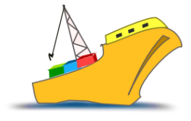
1. Background
Ever-growing Trade
Trade Volume has grown 35% worldwide since 2005.
Data arranged from WTO Statistics
“Volume of world merchandise exports and gross domestic product”

Slide 4

What does Customs do, to tackle the influx of cargo
while the Customs resources are limited?
Notes:
Then, what Customs are required to do? When the number of Customs personnel remains the same?

Slide 5

Risk based approach
  Revised Kyoto Convention
    6.4. Standard
    The Customs shall use risk analysis to determine … which goods … should be examined ...
  WTO Trade Facilitation Agreement
    4.4. Each Member shall base risk management on an assessment of risk through appropriate selectivity criteria.
    7.5 Each member shall adopt or maintain post – clearance audit
…because
      It is impossible to check all the cargo
      It is impossible to correct all the irregularities.
      Of course, we try to minimize irregularities.
Notes:
Risk based approach.

Slide 6
Establish PCA
What is written in the article
With a view to expediting the release of goods,
each Member shall adopt or maintain
to ensure compliance with customs and other related laws and regulations.
post-clearance audit
Article 7.5.1
Notes:
So, this is what’s written in the article 7.5.1
It says: Members, establish PCA.
SO, first, you establish PCA, and…

Slide 7
Using Risk Management
What is written in the article
Each Member shall select a person or a consignment for post-clearance audit in a risk-based manner,
which may include appropriate selectivity criteria.
Article 7.5.2
Members shall, wherever practicable, use the result of post-clearance audit in applying risk management.
Article 7.5.4
Notes:
Using risk management.
You should select a person in a risk-based manner, and use the result in applying risk management.

Slide 8
In a transparent manner
What is written in the article
Each Member shall conduct post- clearance audits in a transparent manner.
Where the person is involved in the audit process and conclusive results have been achieved the Member shall, without delay, notify the person whose record is audited of the results, the person's rights and obligations, and the reasons for the results.
Article 7.5.2
(cont.)
Notes:
In a transparent manner.
You need to notify the results to the auditee that their rights and obligations, plus the reasons.

Slide 9


For future actions.
What is written in the article
The information obtained in post-clearance audit may be used in further administrative or judicial proceedings.
Article 7.5.3
Notes:
For future use.

Slide 10
What is the characteristic of importers in your country?
You might say …
They don’t like Customs!
They are usually good and honest.
How can you accept the risk?
Notes:
Let me answer that questions by asking you this: What is the characteristics of the importers in your country?
^^^^^^^
But you should think about this: Some are not trustworthy but some traders might be different.

Slide 11
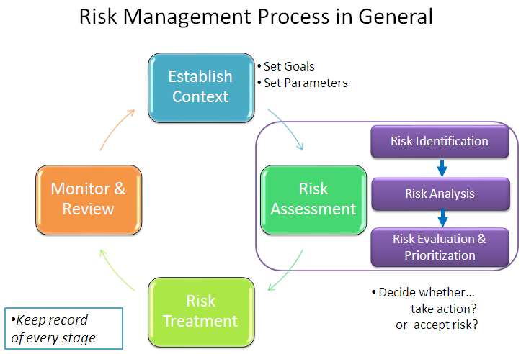

Slide 12
Strategic Planning for PCA
(a) PCA Policy
PCA in overall Customs policy
Scope and procedure
(b) Audit Plan
Framework of targeting
Quality management
(c) Operational Risk Management
Selection of auditees
Execution of audit and feedback
Annual/monthly Audit Plan
Maintaining Importer Profiles
Resource management
Notes:
- There are several things to consider when you develop or reconstruct PCA.
- PCA Guidelines divide what you need to think into 3 levels.
First 1 is the foundation of PCA
Second level is the management of PCA
Third one is daily operation
- Let’s look at each of them

Slide 13
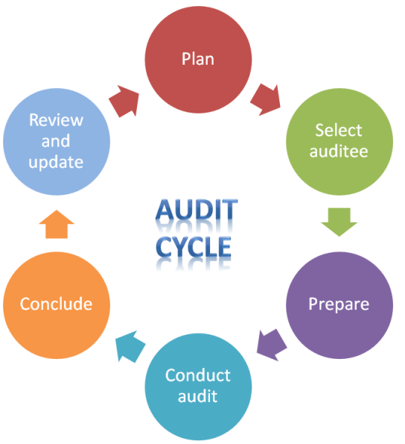
Operational Risk Management
PCA Guidelines Vol .1 (page 7)
Notes:
- This is the last part. This is what auditors are supposed to do as daily work.
After drafting audit plan, auditors select an auditee. (Sometimes it is done by RM section.)
Preparation is very important. Our co-facilitator will demonstrate how he usually does.
Then conduct audit. The success depends on the auditor’s technique to find it and ability to persuade the auditee.
Conclude the audit with audit reports. What you feed back is one of the most important source of info for the future audits.
(what do you usually record for the future?)
- The compliance level of the importer can be scaled as
- Cooperation Level : willing to disclose info?
- Management check: ask certain documents and see whether they can easily submit them. If the management is good, it comes quick.
Ask questions to operational managers other than accountants. They may reveal the truth which was hidden by accountants.

Slide 14


2. What is WCO’s concept on PCA?
“A means to measure and improve compliance”
WCO PCA Guidelines (2012)
The PCA process is the structured examination of a business' relevant commercial systems, financial records etc.
Notes:
In the WCO PCA Guidelines, PCA is defined as “a means to measure and improve compliance” of companies involved in trade. By ~~
and as a result of auditing, Customs recover unpaid duty and taxes.
“measure the compliance” and “improve it.”

Slide 15

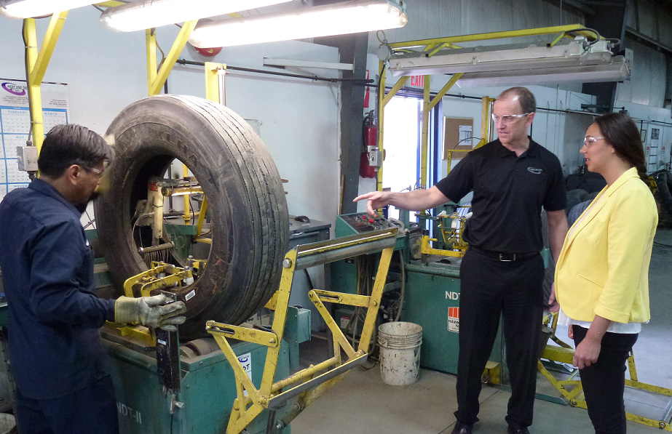
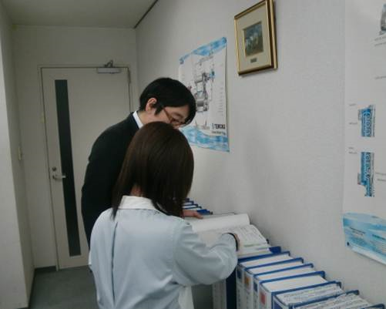
WCO’s concept on PCA
Measure the compliance
Trustworthy?
(signs, appearance)
Corresponds to
import goods?
Understand the manufacturing process
Properly kept records?
Notes:
First, measure the compliance.
Therefore, auditors should visit companies that is regarded as high compliance to check if they really are.
You observe the building; is this auditee the real importer?
<Raw material imported to this ordinary building?>
If they are a manufacturer, observe their manufacturing process to know their business.
<whether their products or materials used in the process correspond to the imported / exported goods>
Ask questions on how they properly lodge the declarations or keep accounting books. Cross-check them with their documents.
By these activities, auditors assess overall compliance level of the traders. Unless you measure their compliance level, you cannot take appropriate measures to that particular trader.
Second, improve their compliance.

Slide 16
WCO’s concept on PCA
Improve the compliance
PCA provides a perfect system to lead the traders to be more compliant by:
Trader Profiling
Target Auditee
Conduct Audit
Audit Results
Feed back the results to risk management cycle
More compliant =
Less border control
and/or audit
Notes:
As provided for in the TFA 7.5.2 and 7.5.4, Customs should use risk management.
Customs is now able to select an auditee with selectivity criteria based on the result of the audit.
The WCO concepts goes even beyond that. You can tell the auditee, or you can publicly announce that if you are more compliant, you get less intervention from Customs. It motivates the traders to be more compliant.
In this sense, PCA and border control should be closely linked for better synergy.
So, this is how you ensure compliance by audit. Measure the compliance level and lead the traders to be more compliant. It is more effective than opening every package at the border.
[7.5.2] Each Member shall select a person or a consignment for post-clearance audit in a risk-based manner, which may include appropriate selectivity criteria.
[7.5.4] Members shall, wherever practicable, use the result of post-clearance audit in applying risk management.

Slide 17
Individual approaches - example
3. Selection Strategies
Targeting Framework
How can you select auditees?
  Customs clearance system?
  Particular Intelligence?
  Past record of irregularity?
  Import Volume?
Notes:
- I’ll explain two major targeting methods.
- How do you usually decide?
- I’ll introduce you several operational models according to the concept and targeting methods.

Slide 18
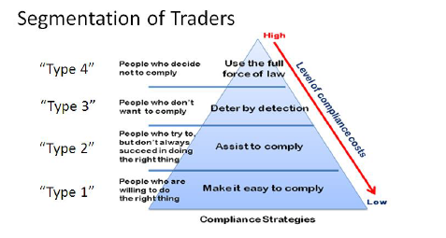
(a) Customs clearance system based on risk analysis / compliance
1. Selection Strategy
Implementation Guidance on PCA
Notes:
Trader Management
The PCA Policy may include how to manage traders (with what data elements) and
also how to categorize them (with what kind of criteria). This will correlate to targeting for
more effective audit, and the Policy should indicate what risks can be tolerated in order to
achieve bigger objectives.
The Guidelines define PCA as a compliance management tool. For an administration
which accepts this definition, it is more appropriate to focus on the importers’ compliance
level and measure whether their current “Type” categorization remains applicable. A change
in the business environment or in the social conditions surrounding a company will always
affect its activities, which means that companies are always seeking better business
partners. In addition, the person in charge may change as part of personnel rotation.
Therefore, a trader’s compliance level is not stable, and administration that take this
approach are encouraged to measure traders’ compliance levels at least every few years for
this purpose.
When auditors reevaluate a trader and assign it to a different risk level, it is suggested
that the reason for the change be noted on the trader’s profile. A precise risk description
concerning the trader is beneficial for effective targeting.

Slide 19

Example: PCA by ASYCUDA
Red Channel
Physical examination
Declaration
Yellow Channel
Documentary examination
Green Channel
Clearance without interception
Blue Channel
Clearance without interception, but documentary checks on the revenue purpose, after the release.
How? - Member’s example
Selectivity Criteria are encouraged to be defined by PCA team
by comparing with value database to see if the value need to be further examined
by checking already submitted documents or request additional docs
Invoice
HS 1609
$400 /pc
HS 1609
$450 ~ $ 600
Notes:
Good example is PCA through ASYCUDA system. I won’t take much time on how ASYCUDA works, but there’s a Channel called Blue.
Usually cargo will not get inspected at the time of clearance if it goes through Blue channel. Instead, declarations are sent to PCA section where they get examined, usually with valuation database to compare the value between the invoice and the database.
This way, you are starting to shift the enforcement from the border to post-clearance stage. It is very simple and easy to start, and an ideal revenue enforcement method if you still have enough resources. In the WCO PCA Guidelines, it is called “Transaction Based Control.”

Slide 20


Trade Facilitation
Physical Inspection
Questioning
HS
Origin
Valuation
At Border Customs
Post Clearance Audit
Security / social Risk
Informal Trader
Revenue Risk
Ease the congestion at the border
Notes:
Usually Customs administrations start with this objective. They used to check 100％ at the border but since there were too many cargo, simply moved the control to later stage. In this case, PCA is taken as purely a trade facilitation tool.

Slide 21


Compliance Programme
Physical Inspection
Questioning
HS
Origin
(Valuation)
At Border Customs
Post Clearance “Control”
Green Channel
The Rest
Notes:
- This is a popular model for admin which just started / starting PCA.
Usually traders promise to be compliant and get accreditation for the green channel, in return to the acceptance of PCA.
- Therefore, targeting is simple. Only for the traders with this privilege. We call it a Compliance Programme.
- Do you see the advantage? - Do you also see the disadvantage?
(Ad) if the

Slide 22




2. Selection Strategy
b) with specific intelligence
1. Info comes from the border or business rivals
This company does not declare the correct value
Doubtful declaration!
2. Post Clearance Control
try to look for evidence for further actions
Notes:
- This is another operational model. This admin target companies based on info provided.
- Info comes from either inside Customs or outside. Once auditors obtained the info, auditors verify the information by consulting the import/export data. If auditors found any problem, it goes to the company to look for evidence.
- Usually the goal is to fight against fraud, recover revenue and impose penalty.
- WCO has a good training for these investigators: COPES programme.
- Do you see the advantage? And also the disadvantage?
(Ad) Initiating PCA with intelligence is rather quick and the hit rate is relatively high.
(Dis-ad) There is a loophole when and where information is difficult to get. No audit without info?

Slide 23
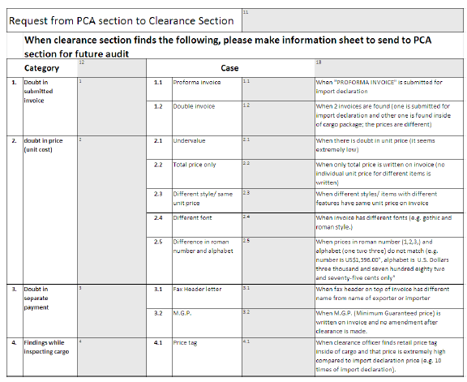
Requirements – flow of information
Implementation Guidance on PCA

Slide 24
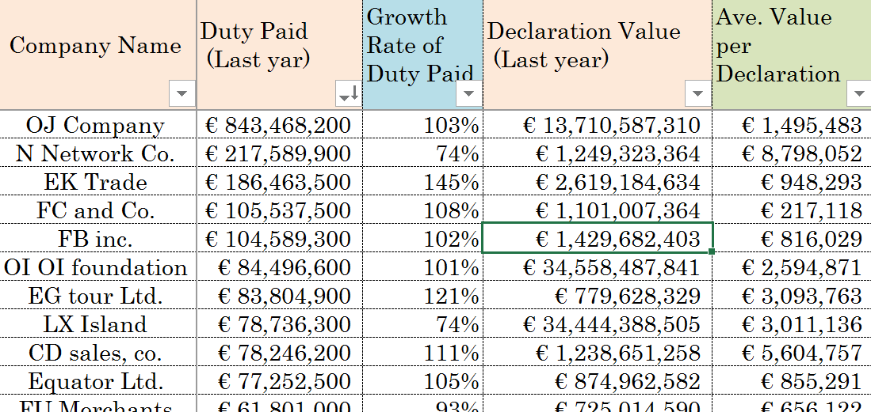

Targeting Strategy
c) analysis of high risk declarations
Analyse data & Target auditee
Notes:
- This is the last operational model. This can be observed from admins with long audit experiences.
- It can be more efficient because it is operated by the concept of risk management cycle.
- The auditee are always targeted by referring to previous records.
- Targeting are refined by the cycle.
- It fits to the concept of the WCO’s PCA. Auditors look for high risk importers but the auditors are not really sure if auditees really have anything wrong; so what they do is to measure the compliance level and try to improve it, according to its compliance level.
- The results are fed back to the database for future analysis. If the compliance level is high, the trader is less likely to be audited soon.
(Adv) No loopholes on business sectors by the absence of intelligence.
(dis-ad ?) hit rate is usually 60-70%. -- admin usually welcome if the number goes lower.
So, this model is what we are going to introduce. How you analyze the data.

Slide 25
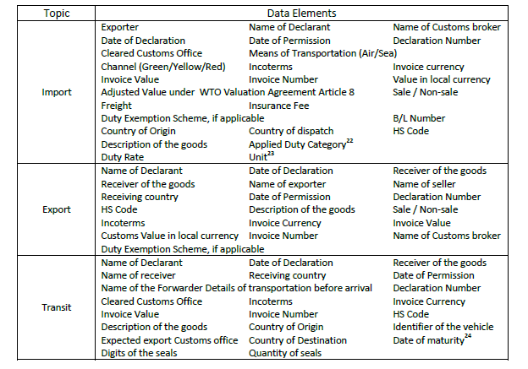
Requirements – data + analysis tools
Implementation Guidance on PCA

Slide 26
Targeting Strategies
Best Practice Strategy–
individual mixture of a), b), c)
Multiple factors or audit reasons
Profiles of the trader
PCA risk assessment, flow on information and evaluation
Data Analysis
Trader-focused and issue focused strategy
→ Profound, traceable system

Slide 27
Two major targeting methods
4. Targeting Methods
1. What could be the risk in this country?
2. Who has the most risk on that issue?
1. Who is the risk?
2. What is the risk within this auditee?
Issue Focused Targeting
Trader Focused Targeting
Notes:
Two major methods in this operational model.
- One is focus first on the company. Then they analyse the data to find the issues within the auditee
- The other method focuses first on issues. Then they analyse the data to find who to audit.
I’ll explain the issue focused targeting method.
It looks easier to begin with, and is more adoptive to desk audit.

Slide 28
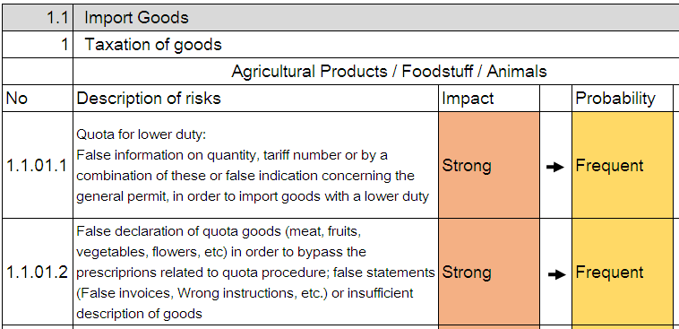
Member’s example (1) ~ issue focused method
Targeting Methods (Issue Focus)
1. What could be the risk?
Risk Identification
Risk Analysis
Notes:
- First, you identify the risk.
- Usually risks factors are collected from frontlines, then HQ or intelligence unit analyse it.
- What is the risk in your admin? (industry: textile, shoes / procedure: drawback, quota)
- See the slide. Actual example of an admin: very precise. This Risk Assessment Meeting is done at HQ every year.
- After identification, they analyse the impact level and probability.

Slide 29
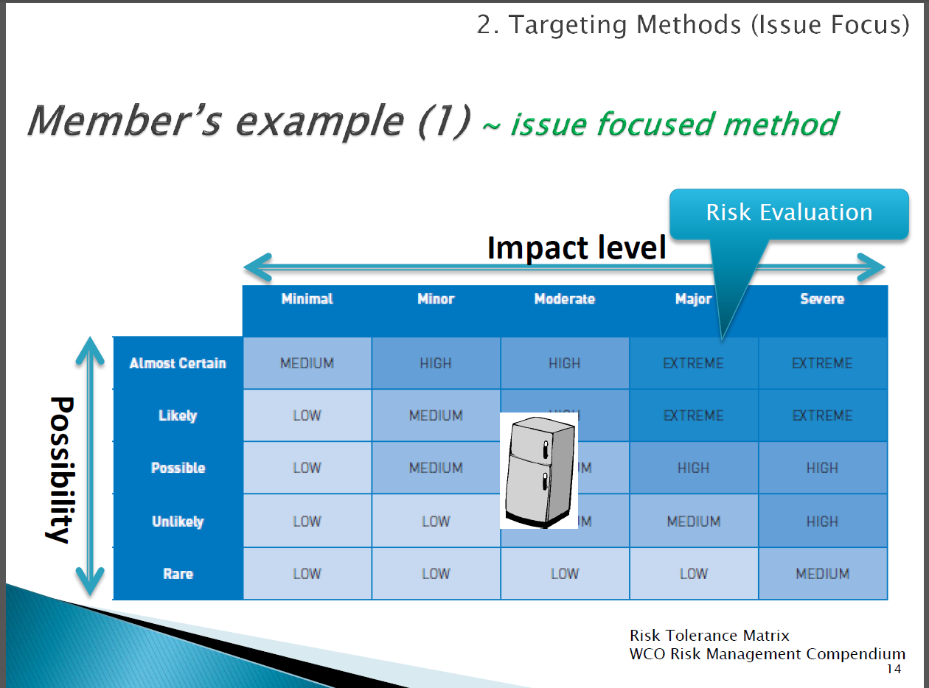

Slide 30
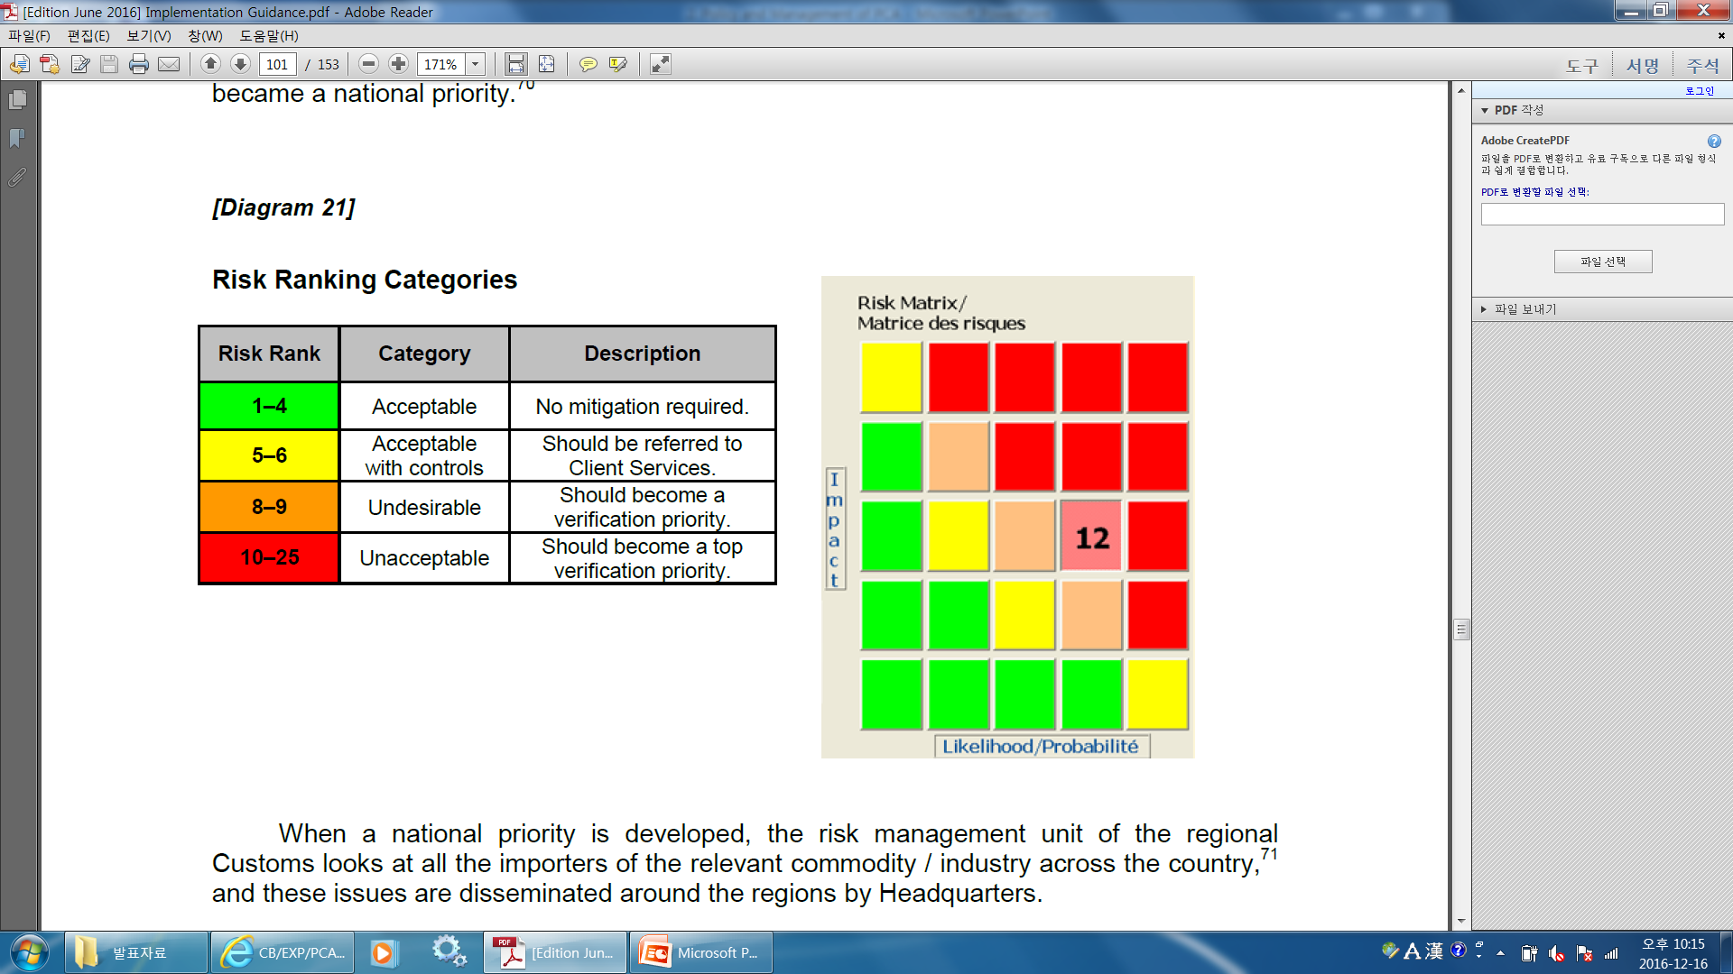
It is important to have national guideline on tolerable risk

Slide 31
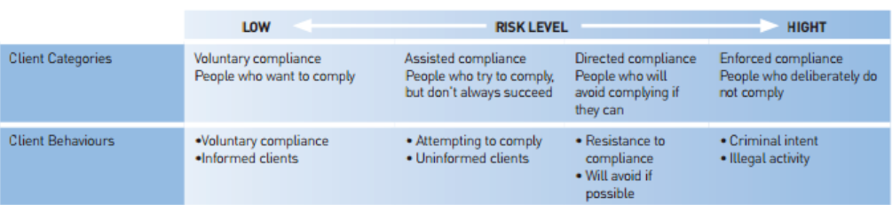
Targeting Methods (Trader Focus)
Client Rating ~ Trader Focused Method
Different approaches – depending on data available
Compliance level
.
.
.
In this approach, auditors analyse Importers’ profiles first, to decide which company poses higher risk.
Notes:
- In order to use this targeting method, you need to have database of importers.
- Most of the data elements can be taken from your import data but you need to have more info for better analysis.
- The expert will show you how to analyse the data later.
このデータベースをどう使うかと言うと、リスクの高いCriteriaに対してソートを欠け、高い順番で並べる。それを他のCriteriaも順番にソートをかけて順番に並べ、原則的に上から順番にAuditしていくという方法。

Slide 32
Targeting Methods (Trader Focus)
Member’s example (2) ~ Trader Focused Method
Risk Indicators
Risk Criteria | Risk (High ⇔ Low)
Total Value of Imports | Large Small
Errors found at clearance stage | Many Few
Duty of major commodity of Imports | High Low
Irregularities found at Past audits | Many Few
Level of intelligence received | Important None
Notes:
- There are many risk indicators.
- You need to prioritize which indicators have more impact to your admin.
- Let’s imagine you want to audit one company.
1. One company has more minor errors at the border but import volume is smaller.
2. The other company has bigger import volume but less errors.
Which would you audit? Of course it depends on the number of errors / import volume but generally speaking you need to have this idea.

Slide 33
Targeting Methods (Trader Focus)
Member’s example (2) ~ Trader focused method
Regional Customs decide which company to audit
 | Capital | Imp. Value (HS20.01) | Amount of duty paid | Origin of import products | Past Audit records
BRU and co. | 200,000 | 3,500,000 | 200,000 | Country A | + 850 (2011)
Rogier Ltd. | 15,000 | 1,580,000 | 8,000 | Country B | + 3,000 (2013)
Manneken Co. | 100,000 | 900,000 | 70,000 | Country C | +2,000 (2012)
Notes:
- Local auditors analyse the trade data, and consider who would pose the higher risk on that particular issue.
- Which company if you can choose to audit first?

Slide 34

5. Audit Approaches
Comprehensive Audits
Looking at entire business
control environment
  Systems Based Audit
Focused Audits
Concentrating one area of customs
  Transaction Based Audit
  Systems Based Audit
Notes:
What is systems-based audit?
This methodology is commonly referred to as a “top- down” approach. The audit starts with an evaluation of the high-level company structure and its business objectives, usually involving a dialogue with a senior company representative. This is followed by an assessment of the company’s systems and accounting records. Poor systems and weak audit trails often indicate low levels of compliance. An examination of individual transactions then follows as the next stage to test the systems and determine the level of compliance. The strength of the systems determines the level of substantive testing and, consequentially, the audit approach.
Comprehensive audits
This approach looks at the entire business control environment and the impact this might have on Customs compliance. Analytical procedures are used heavily and substantive testing reduced where control environment and corporate governance systems are good. This kind of audit takes place at the premises of the auditee. The amount of information to be examined by auditors is potentially large although it depends on frequency of PCA for one auditee. A complete picture of the business can be captured by the field audit, including its business systems, trading methods and partners
Focused audits
This approach only concentrates one area of Customs e.g. valuation. Tests on related systems and controls and substantive tests may also be carried out.
Criteria will be necessary to decide which type of audit is appropriate in each case, based on the most effective use of resources and the desired objectives.

Slide 35

6. Types of Audits/Verifications
Post-Importation Transaction Verification
Office/ Desk Audit or Verification
Field / On-Site Audit
Notes:
{I} Post-Importation transaction verification {two methods}
Referrals from the border port
Targeting Team
{II} Office/desk audit or verification
{III} Field/On-Site audit
Example: Mule or horse („Enemy“ has horses (Accounts, records, etc., no chance with a mule to follow). We need horses (PCA field audit). But this does not mean, if we have a stable with 10 boxes, to buy 10 horses. Better buy at least one mule, because there are tasks (carrying of goods) also a mule is needed and it´s better to use it than to waste a horse for that. So Field audit is undoubtable needed. But to have other types in addition (e.g. 80 % field audit, 20% transaction /desk audit) can be OK.

Slide 36
Audit Procedure –
Standardized Procedure
particularly for
Quality management
Anti-corruption reasons
Notes:
• Standardized PCA procedures/techniques: To ensure that audits are carried out effectively and consistently, Customs should prepare standardized procedures, which may include the audit procedure. Benefits are again transparency and trust (politics, citizens and economy), also equal treatment and equal (high) quality.
The detailed procedures and techniques of PCA may vary from one Customs administration to another,
depending on the scope of PCA. It is also recommended that the procedures are set out in written guidelines and made available to Customs audit staff.

Slide 37

7. WCO’s Tools and Instruments
PCA Guidelines
Diagnostic Tools
Implementation Guidelines
Audit Typology – How to Audit

Slide 38
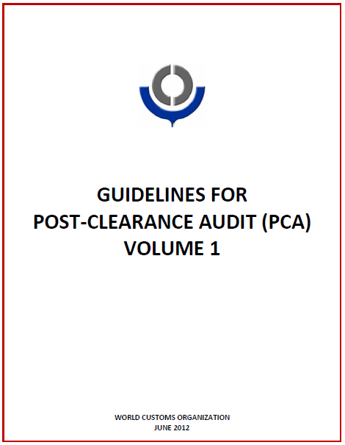
PCA Guidelines
(Endorsed by the Council in 2012)
Theoretical background of PCA
  Volume 1 :
  Benefits,
  Strategic development and Implementation of PCA
  Volume 2 (restricted):
  Operational guidance on conducting on-site audits

Slide 39
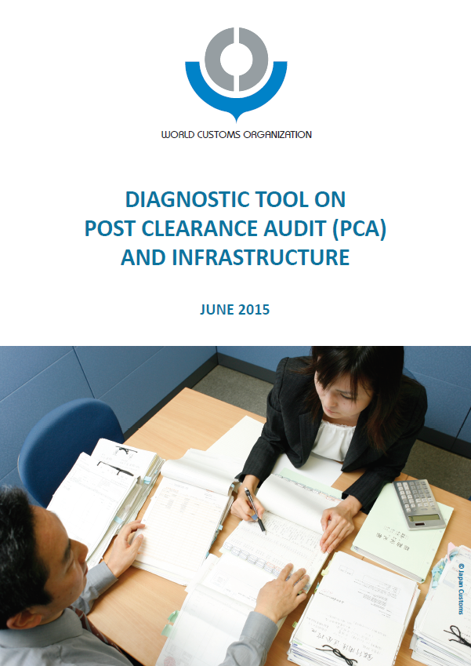
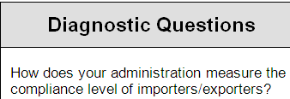
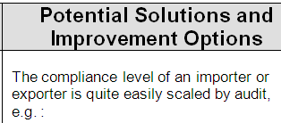
Diagnostic Tool on PCA
(Endorsed by the Council in 2015)
  Gap Analysis
  against PCA Guidelines
Notes:
But Members expressed a need to self-asess their situation to plan the way forward.
In order to do that, this Diagnostic tool is now presented to this Committee.
The structure is the same as other Diagnostic Tools: Helps you analysis the gap between your administration and PCA Guidelines,
and find potential solutions and improvement options.
I listen to your comments after my presentation. I value your comments and reflect your input before presenting this to the Policy Commission.

Slide 40
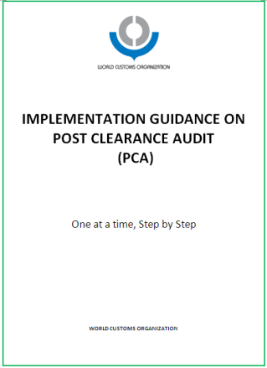
Implementation Guidance
This Guidance material will provide step-by-step direction towards the WCO standard.
Step 1: Setting-up a PCA Unit
Step 2: from “Desk” to the “Field”
Step 3: for More Targeted Audit
With practical exercises

Slide 41
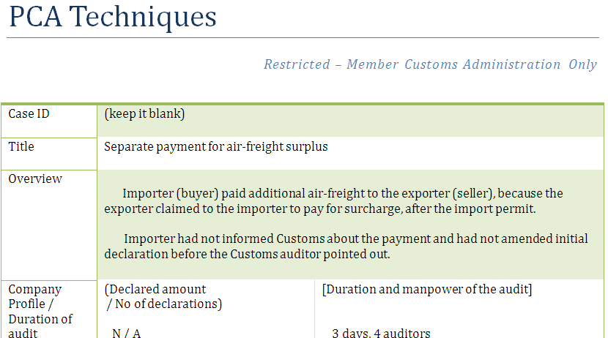

“How to audit” Typology
PCA Unit has been established.
Now what?
PCA now on track.
Need more case studies for better techniques.
Notes:
I have introduced WCO Tools and instruments but they are all for the management level, to encourage upgrading PCA operation as a whole.
But there are fundamental problems remains.
^^^^^^
There are case studies in the PCA Guidelines Vol.2 and it is truly interesting to read.
However, it does not answer the questions, as to how we can find these irregularities.

Slide 42
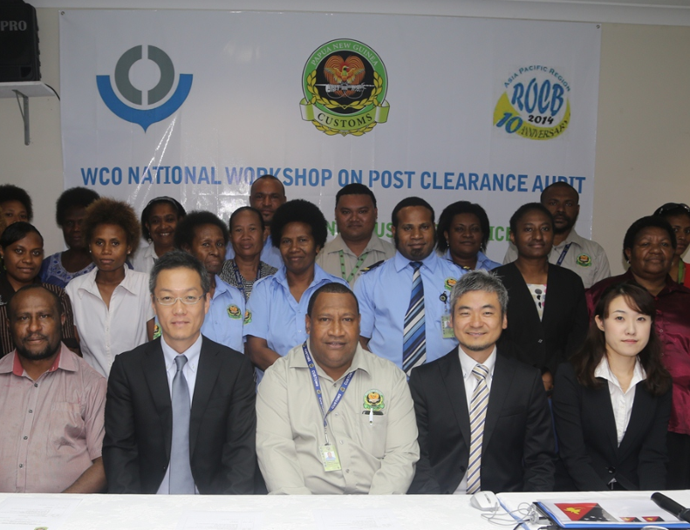
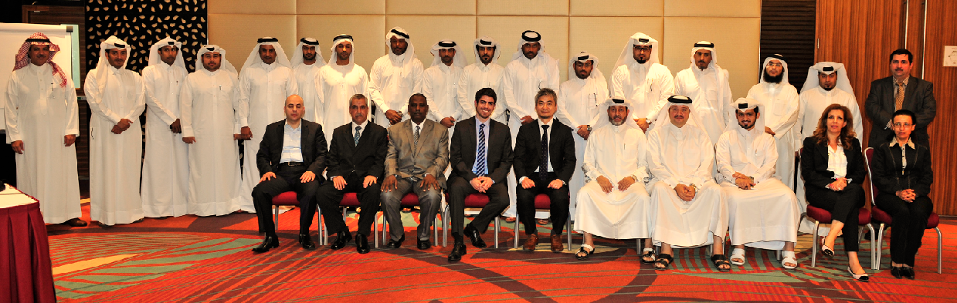

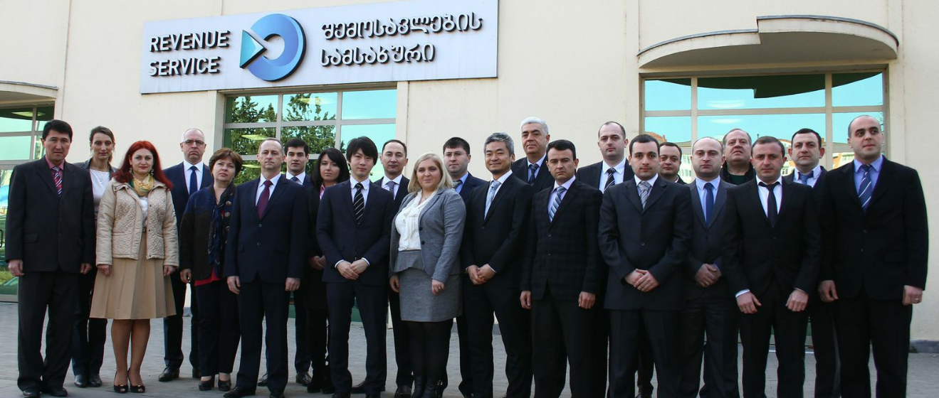
Technical Assistance
The WCO has conducted 19 PCA missions in 2016/17.
Please contact ROCB for your needs.

Slide 43
What is PCA?
Again!
“A means to measure and
improve compliance”
WCO PCA Guidelines (2012)
Try to educate traders, if you worry about the leakage of revenue!
Notes:
Again, PCA is a means to measure and improve compliance.
It is the most cost-effective ways to improve revenue compliance, and valuation control.

Slide 44

Thank you for your attention!

