Slide 1
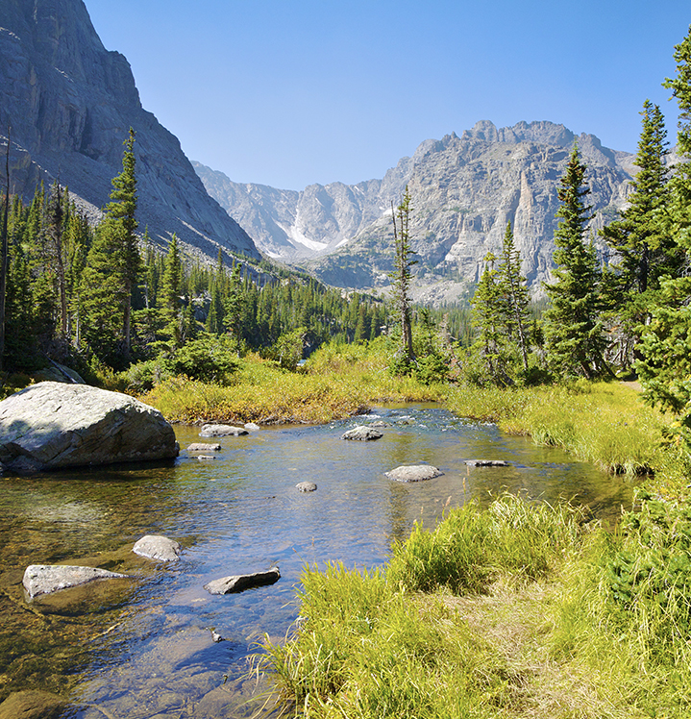
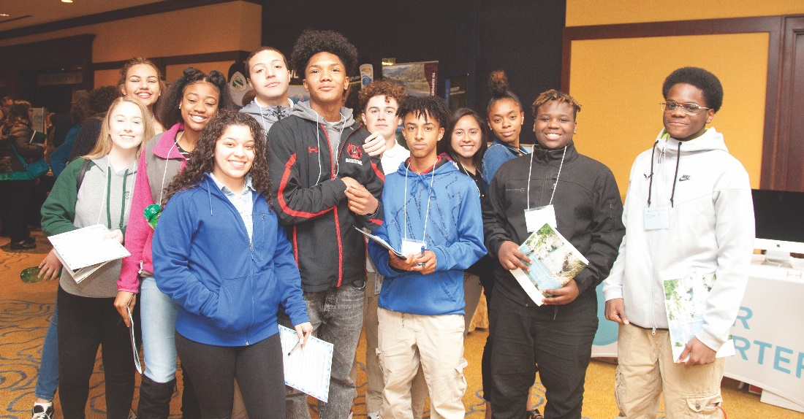
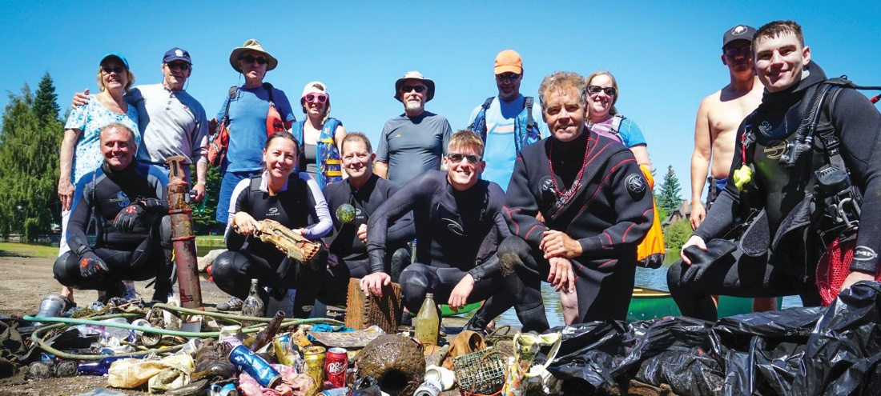
Our story: Building Will and Alignment on Equity at River Network
CREWS Convening - October 23-25, 2018 Nicole Silk, President/CEO

Slide 2
Notes:
I grew up

Slide 3
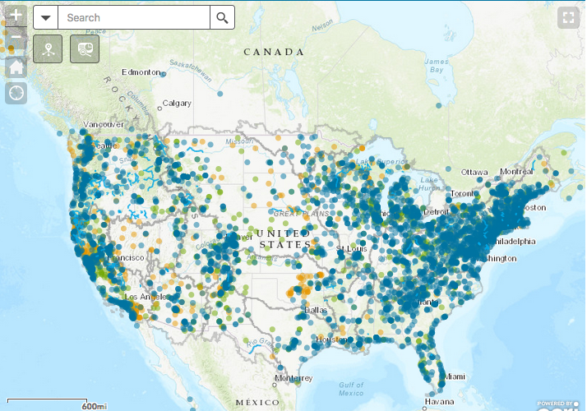
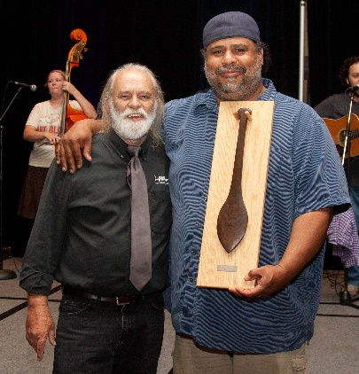
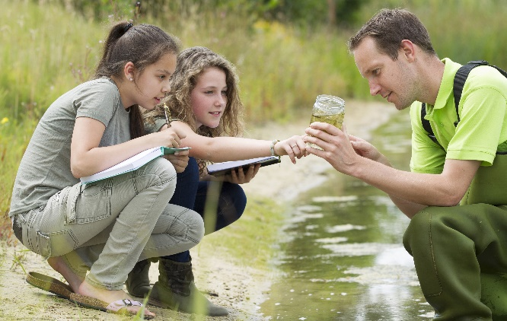
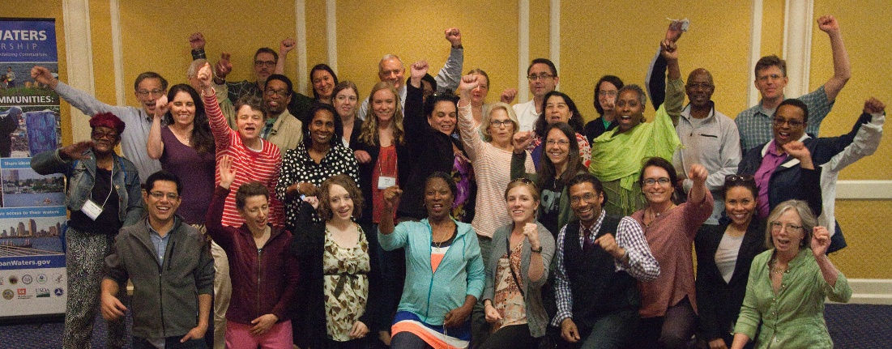
ABOUT RIVER NETWORK
River Network connects and empowers over 6,000 local nonprofits working for clean water and healthier rivers across the U.S.
We envision a future of clean and ample water for people and nature, where local caretakers are well-equipped, effective, and courageous champions for our rivers.
Meet our network and search the Water Protectors Map on our website rivernetwork.org.
Notes:
For 30 years, River Network has filled a unique niche in the environmental community by focusing primarily on groups that work that work at the local level to support healthy rivers and clean water.
We provide our community, and anyone with curiosity, access to proven solutions and approaches for making a difference through our website, annual conference (River Rally), publications, access to a network of both peers and experts who can help, and access to resources that help individuals, groups and coalitions become more effective champions for our waters. We also deliver direct consultation to coalitions, groups and leaders to help them become effective, courageous, and sustainable. Our team includes a special set of people who understand the challenges of those on the ground working to take care of their waters, the importance of science to making sound decisions, and how to use policy and advocacy to creating lasting change.
River Network is the foremost nonprofit connecting and empowering over 6,000 working for clean water and healthy rivers across the U.S.

Slide 4
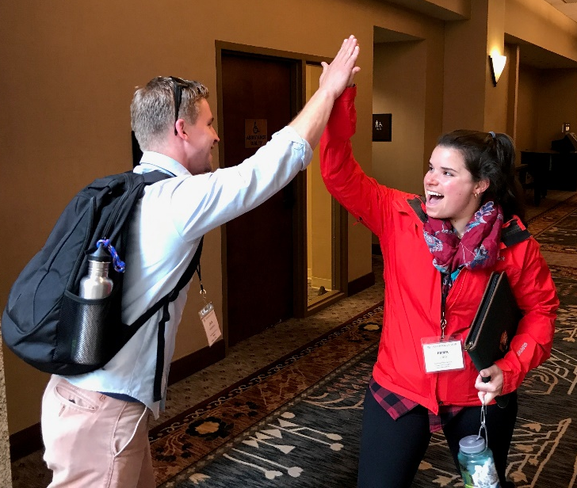
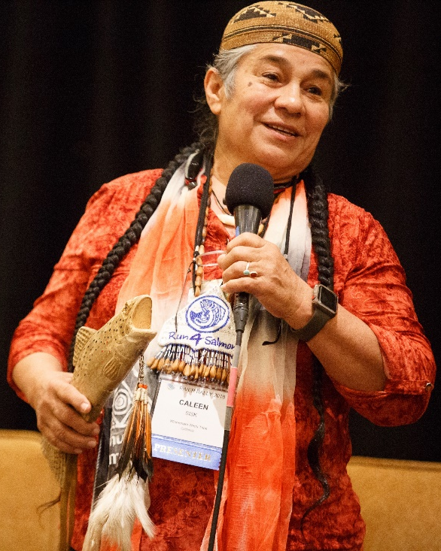
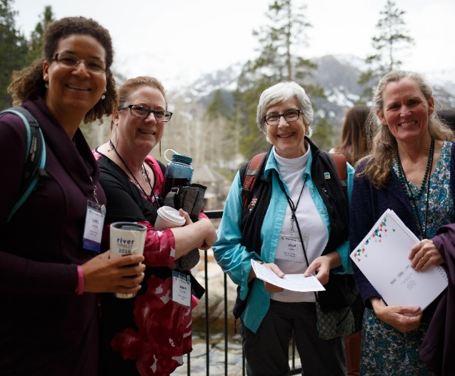
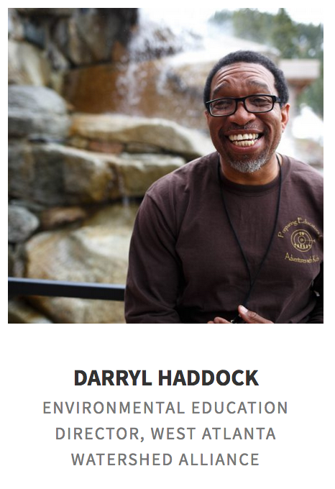
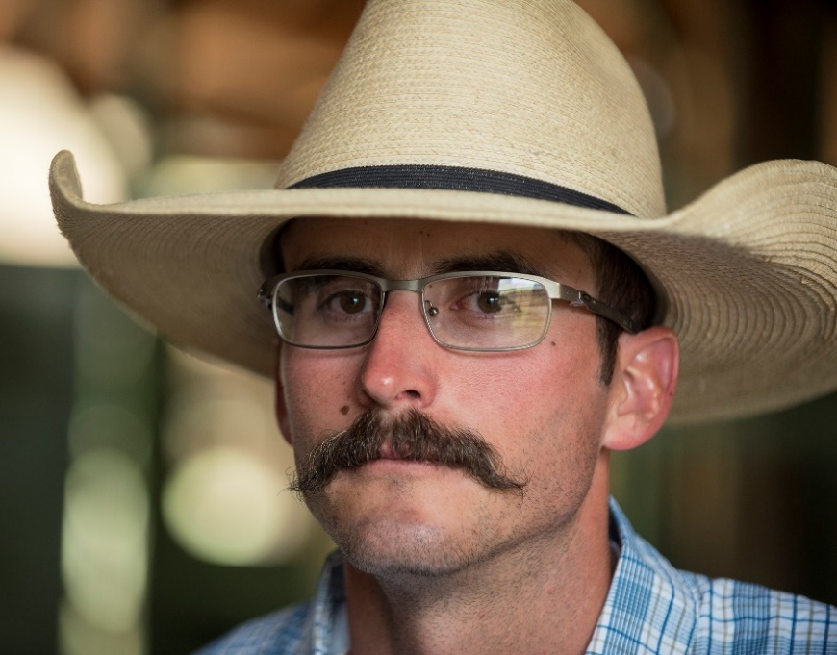
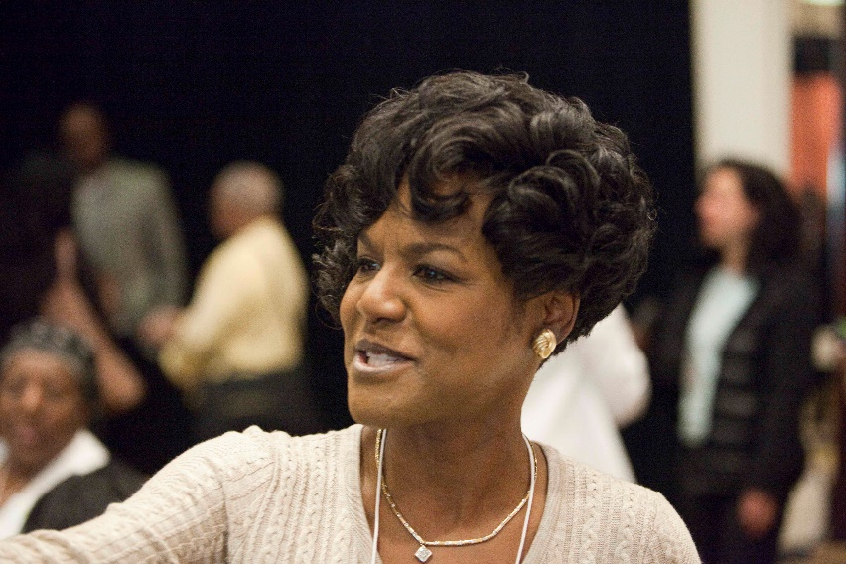
OUR TAG LINE
Notes:
River Network was founded thirty years ago to strengthen local efforts to protect rivers. Over three decades our focus has remained remarkably consistent: We connect people to save rivers. That simple tagline belies a tremendous amount of action to protect and restore waters across the country, particularly at the local level.
River Network began by helping river and watershed organizations expand protections for pristine rivers and encourage regulatory compliance. Since then our ambitions, leadership, and programs have evolved to align with our understanding of what rivers need to remain healthy, the challenges of a dynamic climate, and significant shifts in the social, political, and economic context of water.
While remaining committed to helping grassroots efforts and local groups thrive, we now play an active role in building coalitions across sectors - uniting NGOs, tribal nations, government agencies, and businesses - to actualize bigger impacts.

Slide 5
OUR EVOLUTION
Foundational
EDI goals, commitment, intentions and approaches via these 3 documents: our statement of commitment, our case statement, and our EDI principles
Equity tool for internal programmatic decisions (available for others to use as well)
Metrics - to gauge progress across our EDI work (evaluated annually)
External
River Rally - 30-40% workshops address equity & inclusion, 100% of plenary panels include POC, inclusive social aspects (POC social hr., open mic), Emerging Leader Award.
Imagery - Reflect diversity within our network. See www.rivernetwork.org.
Vulnerable – My story, our story, and River Rally 2018 apology (very public and heartfelt apology by board chair, acknowledging our blind spots and welcoming ideas).
Drinking water and resilient communities work – Diverse (and urban) by design with $.
Webinars – Aparna Group and others for our entire community (available free to anyone)
Internal
Hiring practices and board recruitment goals and practices
EDI training for all staff and board
Utilization of equity tool in programmatic decisions
Notes:
Today, nearly 40% of our population in the United States is people of color, according to the U.S. Census Bureau. And by the mid-2014s, predictions suggest that non-whites and people of mixed-race will be a majority of our population. To remain socially relevant, our organizations and our movement should reflect the diversity of society as a whole.

Slide 6
KEY ISSUES and CORE STRATEGIES
KEY ISSUES
Safe, clean, affordable drinking water
Resilient cities and communities
Healthy rivers in agricultural landscapes
Robust & effective water laws + policies
CORE STRATEGIES
BUILD STRONG CHAMPIONS
STRENGTHEN OUR NETWORK
GROW OUR NETWORK
LEVERAGE OUR VOICES
ORGANIZATIONAL EXCELLENCE
WHAT
ABOUT
EQUITY?
Notes:
Numerous issues call for urgent collective action, but four have risen to the top based on our network-wide engagement for this strategic plan; the timeliness of the issue; alignment with our existing work; opportunity to engage a wider audience and to make a difference; intersection with issues of equity, diversity, and inclusion; and potential for attracting new sources of funding.
To move beyond crisis, we must work together across all sectors (agriculture, municipal, industry, energy, recreation, and conservation) to define a new path forward.

Slide 7
Core Strategies – YTD FY18 Indicators*
Build Strong Champions
Strengthen Our Network
Grow Our Network
Leverage Our Voices
38: Number of customized consultations or other support (500+ hrs)
$580,333: Amount of direct financial support provided to 191 groups
4,146: Number of individuals educated through our webinars, workshops, presentations, peer calls, etc. (including River Rally)
6,397 (400 members): Number of groups in our network
9,887 / 10,734: Number of email subscribers/social media followers
141: Number of quarterly social media posts
165,881: Number of website page views
53,545: Number of unique website visitors
22: Number of original articles/blogs published YTD
13,327: Number of people attending RN supported clean-up events (WED only)
Organizational Excellence
81%: Percent of BOD engaged in River Network fundraising activities
100%: Percent of BOD support River Network personally
$30,670: Amount of revenue from BOD directly (pers. donations)
$210,211: Amount of revenue from BOD directly and indirectly
* Not all indicators are reported quarterly, e.g., EDI, satisfaction, % POC, etc.

Slide 8
Equity, Diversity & Inclusion – YTD FY18 Indicators*
BECOMING MORE INCLUSIVE
DIVERSIFYING PARTICIPATION
Board: 21% (4 board members / 1 recruited in FY18)**
Staff: 15% (2 staff)**
Finalists for staff vacancies: 10% (1/10 finalists)**
Finalists for board vacancies: 43% (3/7 finalists)**
14%: Number/percentage of individuals we train and support through in-person trainings that identify as non-white. (n=131)
30%: Percentage of trainings and consultations that incorporate aspects of diversity, inclusion and equity into them. (18 of 60)
44%: Percentage of articles, blog posts, River Voices and other digital storytelling pieces published and/or promoted that focus on issues related to EDI
River Rally specific:
Engaged “Inclusion at Rally” committee of volunteers and implemented all their recommendations
Hosted “People of Color – We’re in the Movement” social hour – 44 attendees, very well-received, requests to continue hosting
“Come Kick it With Us” Open Mic social – high marks for having a large, more diverse attendance, welcoming & inclusive event
“White Allies” breakfast discussion table
25%: Workshops related to EDI (19/77)
44%: POC as keynote and plenary speakers (4/9)
Launched “Emerging Leaders Award” for FY19
EXPLORING INEQUITY AND INEQUALITY
DATA NOT YET AVAILABLE: Extent to which RN programs are inclusive and integrate equity considerations (qualitative measure)
100%: Percentage of staff that have received training related to power, privilege & racism in previous 2 years or are scheduled to receive it by the end of the fiscal year
* EDI indicators are reported on annually
** Indicators reflect numbers as of Sept. 2018

Slide 9
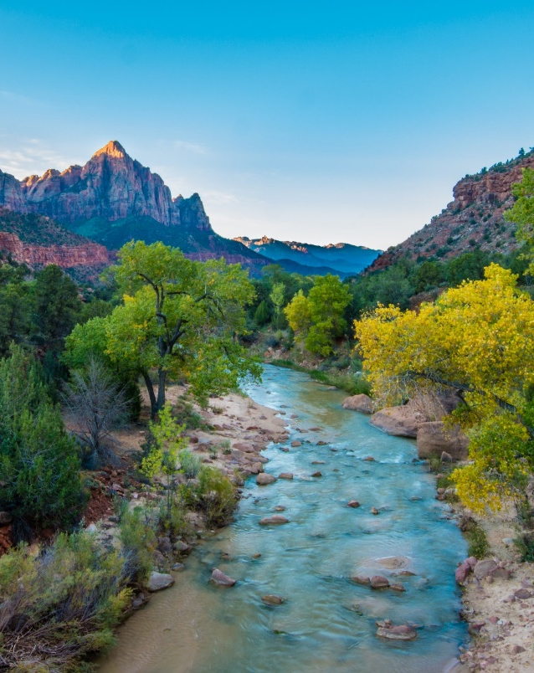
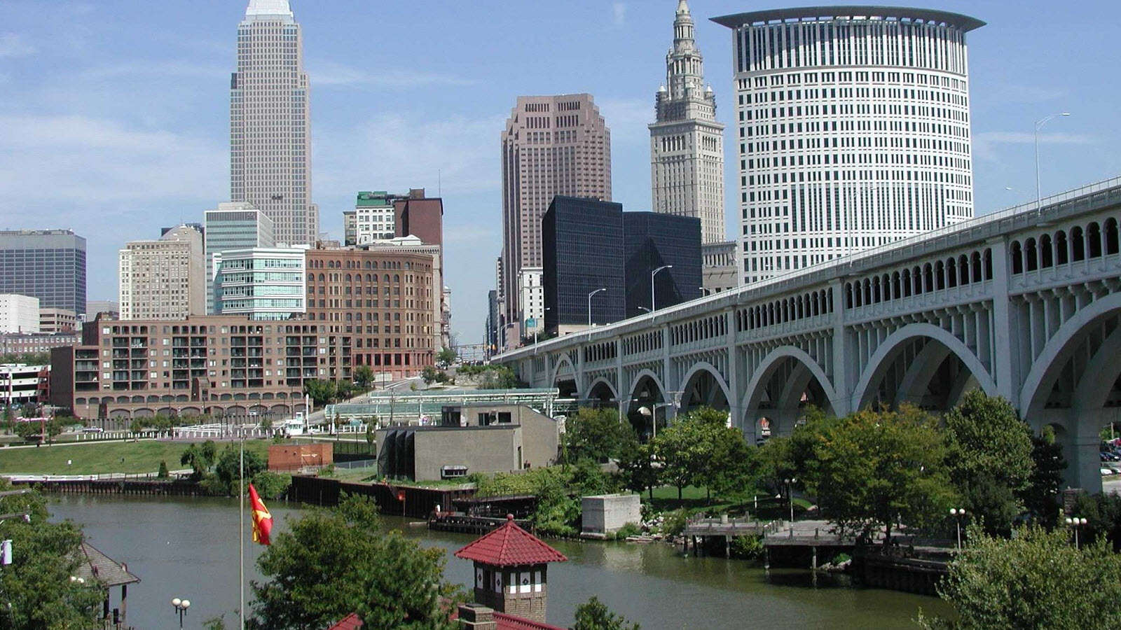
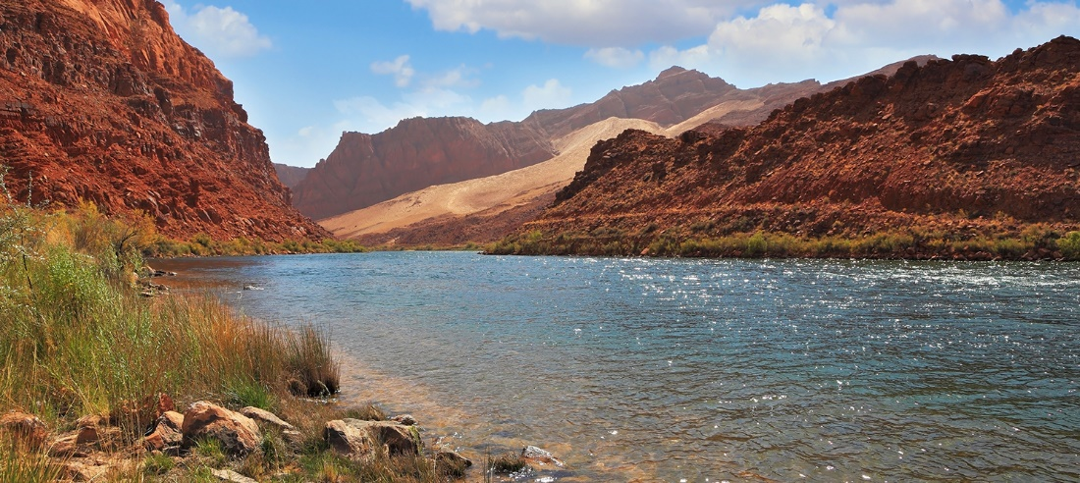
LESSONS
Leadership matters – board and staff
Be curious, courageous, and courteous – listen
Visually portray the future you seek – images matter
Establish indicators/benchmarks/practices and track progress
Be vulnerable, recognize unintentional harm, and celebrate progress

Slide 10
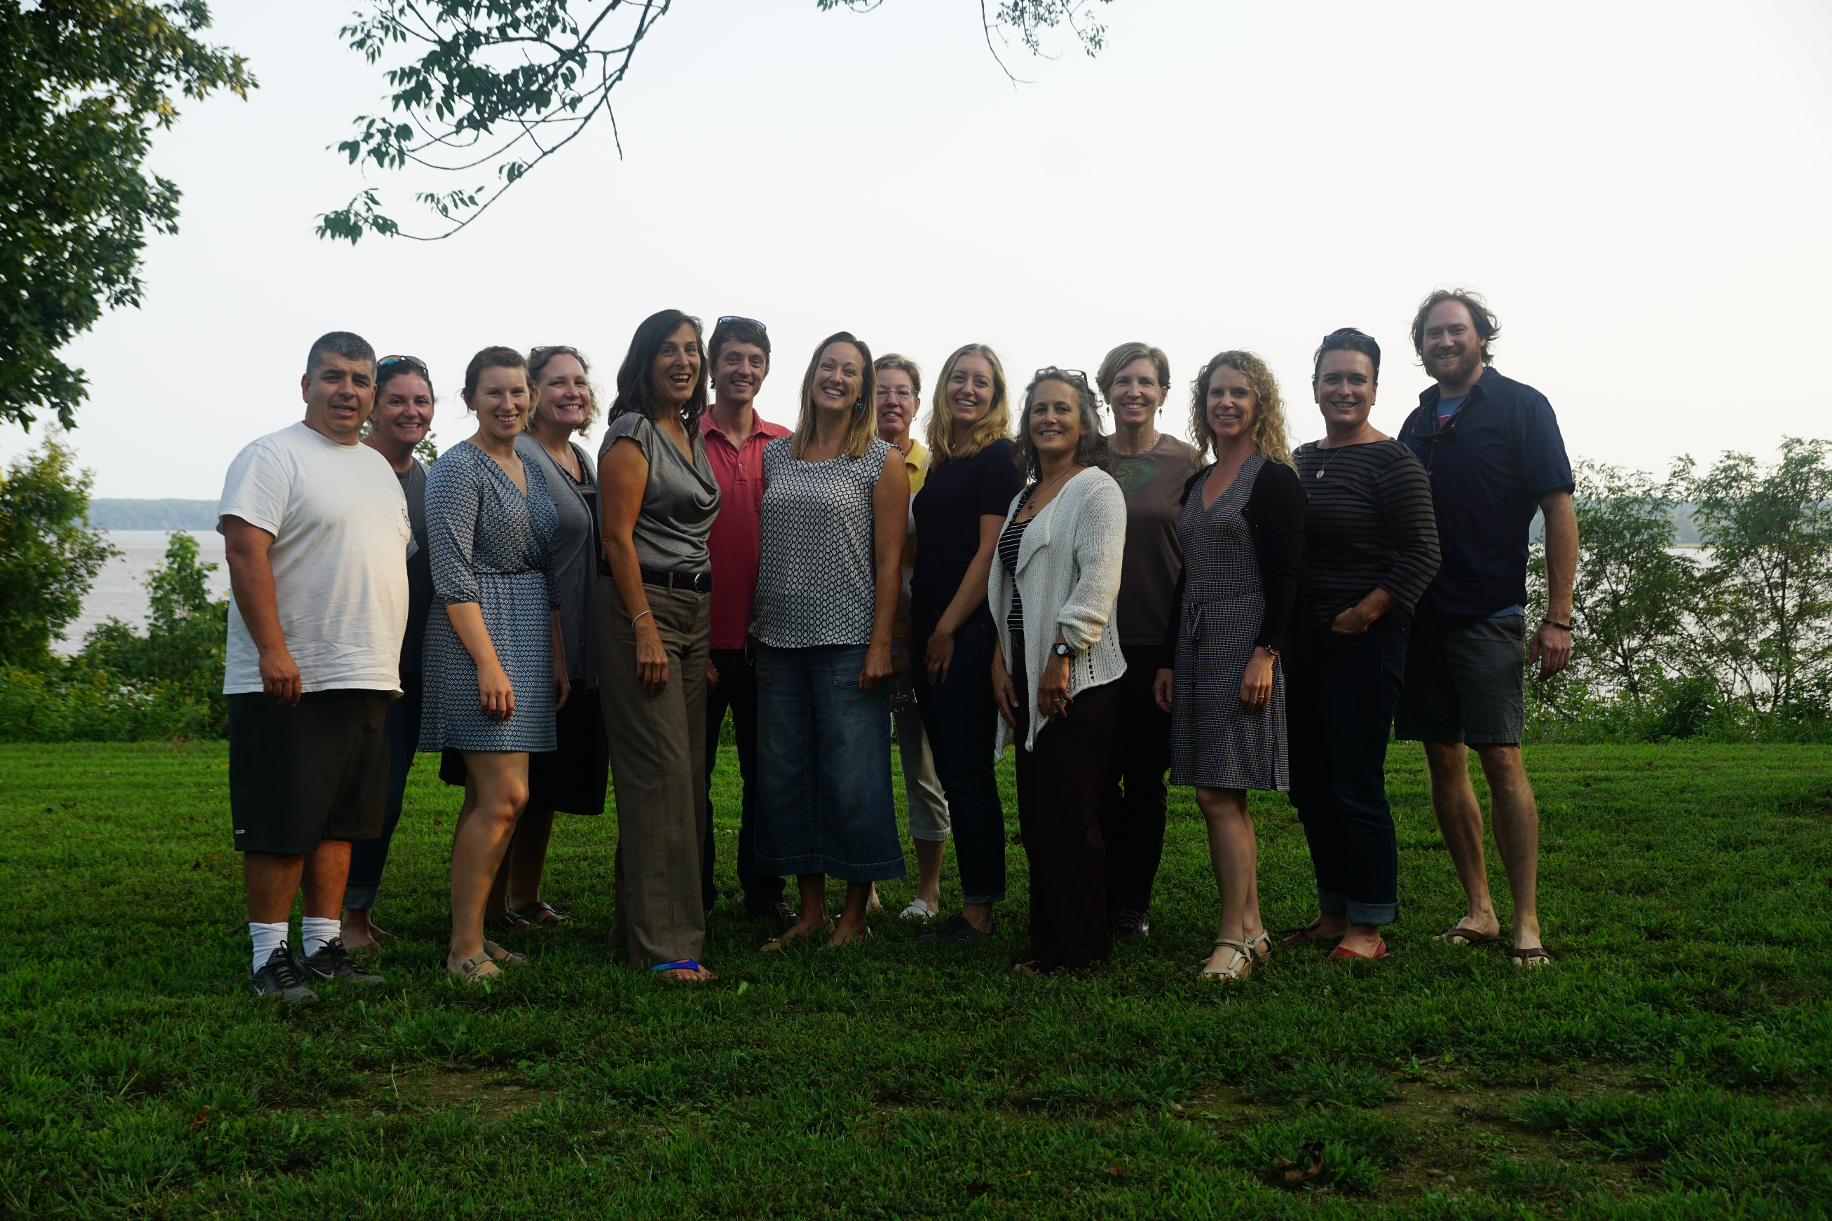
Thank you!

