Slide 1
The Evolution of Mobile Apps for Events
Josh Dry Marketing Executive ShowGizmo

Slide 2
Something big has happened!

Slide 3
Smartphone Evolution is still early…

Slide 4
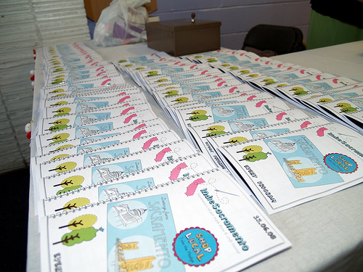
The creation of the Mobile App..
iPhone App Store... the revolution
Mobile Apps 1.0 = Web 1.0
Passive viewing
Difficult to truly engage attendees
Long development cycle
Early mobile event apps were just “show guides”

Slide 5
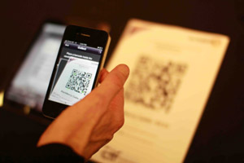
Evolution of Mobile Apps 2.0
Then there was Web 2.0 and Apps 2.0 soon followed…
Information sharing
User generated content
Video & multimedia
Improved simplicity & usability

Slide 6
iOS and Android Platforms Rule...

Slide 7
Penetration of Mobile Event Apps
A key finding of the 2011 Meeting Technology Trends Survey was that 64% of meetings are already using a mobile app, or intend to add one this year. Another 16% intend to add one within three years.
Corbin Ball “If you don’t have an event app within the next year, your customers will be asking why not”…

Slide 8
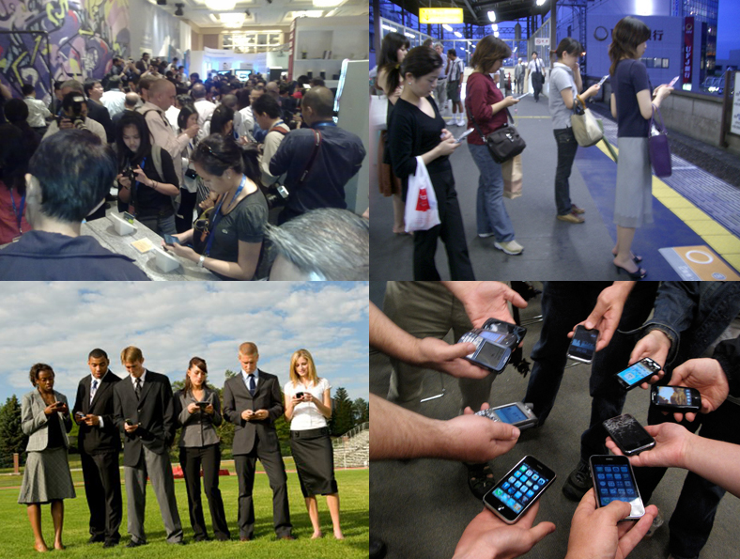
The truth about “Up-take”...
Percentage downloads vary – average 30%
Factors that affect uptake:
Smartphone penetration
Event Type
Marketing
Features of the app (least impact)
Beware the App Company “Spin Doctors”

Slide 9
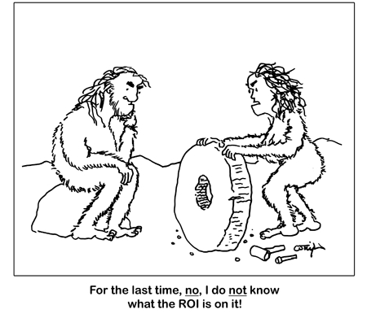
The Elusive ‘ROI’ - #ECME12 case study
Print costs
Relevance to your community
Carbon Footprint
Competitive edge
Extend the life of the event
Increase in Sponsorship $

Slide 10
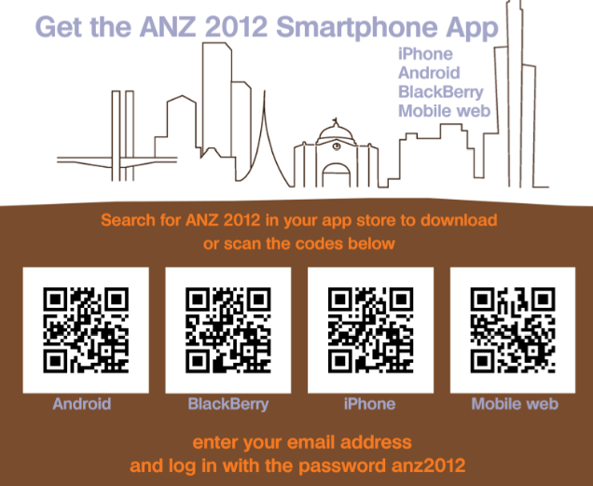
Top tips for getting an Event App…
Good UI
Don’t offer too many options
Less is more
Native or Mobile Web?

Slide 11
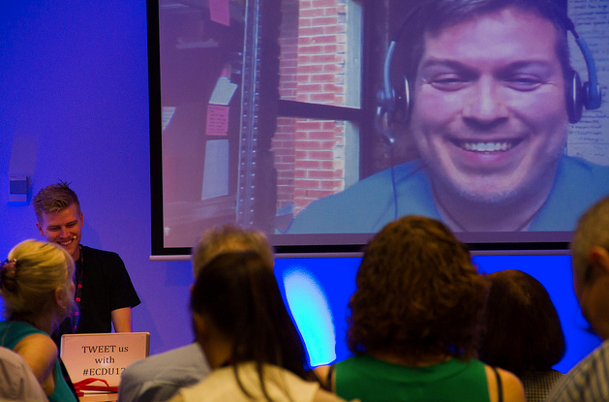
Top tips continued…
Focus on Objectives
Keep updating your App
Bandwidth
Compliments face-to-face
Reporting

Slide 12
Getting the right deployment…
Define your objectives
Understand who your attendees & exhibitors are and where they are
Choose a development partner
Spend time to plan

Slide 13
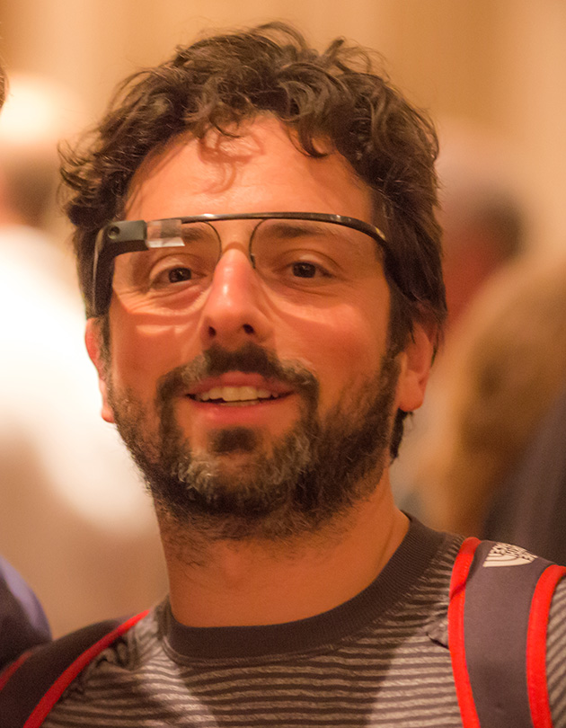
What’s next?
IPS
NFC
“Gamification”
HUD

Slide 14
Thank You!
Jo-Anne Kelleway – Info Salons Group
Joanne.Kelleway@infosalons.com.au

