Slide 1
Two Sides
The Myths and Facts About Print & Paper
TAPPI / PIMA Student Summit
Raleigh, NC
January 19, 2013
Notes:
Thanks to TAPPI for the invitation…really nice to be here

Slide 2
What is Two Sides?
An initiative by companies from the Graphic Communications Value Chain, with now over 1,000 members.
Non-profit launched in 2008 in the UK and present in 3 continents and over 12 countries.
Two Sides U.S., Inc. began operating in January 2012.
Notes:
Rapidly becoming an industry authority on the sustainability of print and paper
Two Sides is the only recognized global campaign focused on this topic.
Our members include: Forestry, Pulp and paper, printing, converting, publishing, ink and chemical manufacturing, equipment, retail,

Slide 3
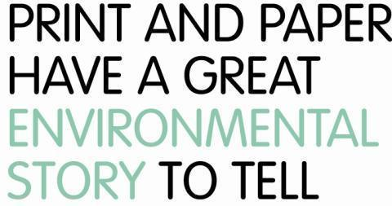
Notes:
‘

Slide 4
Our Mission

Slide 5
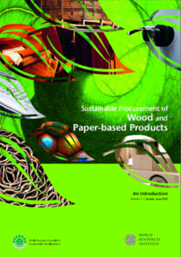
1. Promote the responsible production and use of print and paper.
Reduce impacts over the life cycle
Sustainable forest management / certification
Environmental performance at manufacturing facilities (emissions to air, water, solid waste)
Renewable energy at facilities / grid
Best practices for responsible paper use (ex: promote paper recovery)
Responsible procurement
Reduce carbon & water footprint
Several tools, guidance documents and paper scorecards available at www.twosides.us

Slide 6
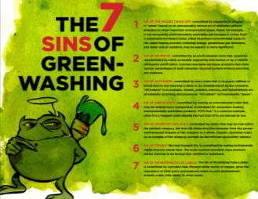
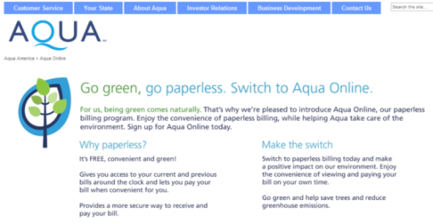
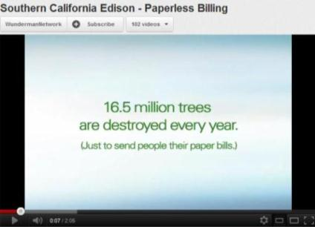
2. Dispel common environmental misconceptions

Slide 7
Two Sides sends open letter to Mr. Eric Schmidt, Chairman and CEO of Google in response to the newly announced ‘Go Paperless in 2013’ campaign

Slide 8
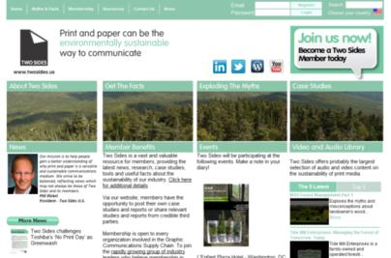
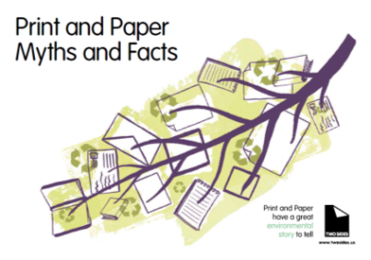
3. Provide verifiable information on why print and paper can be a sustainable way to communicate
www.twosides.us is a repository of science-based information and news
Reports, articles, facts, videos
Tools
Upcoming events
Searchable database by topic
Customizable brochure on the Myths & Facts of Print and Paper
Print advertising
Conferences, webinars

Slide 9
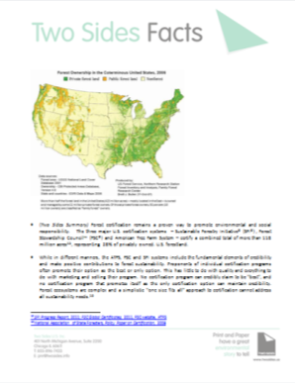
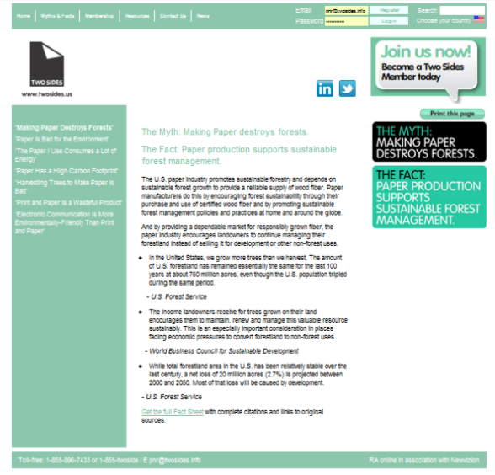
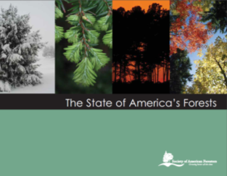
Myths and Facts - www.twosides.us

Slide 10
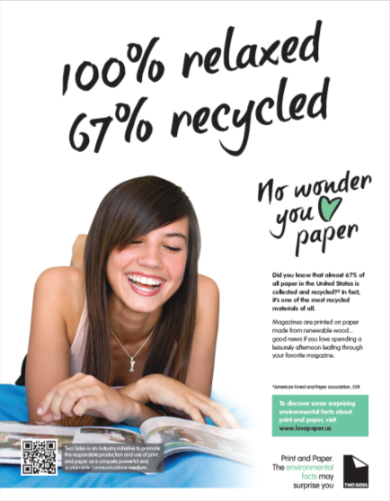
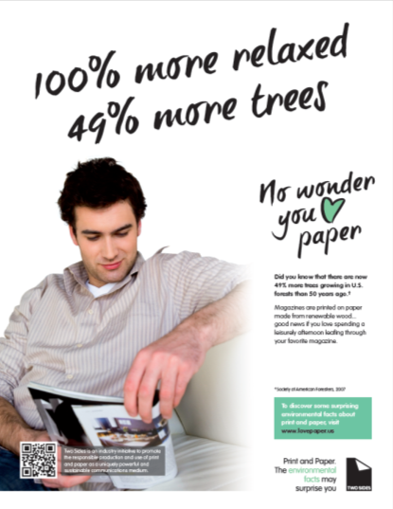

Slide 11
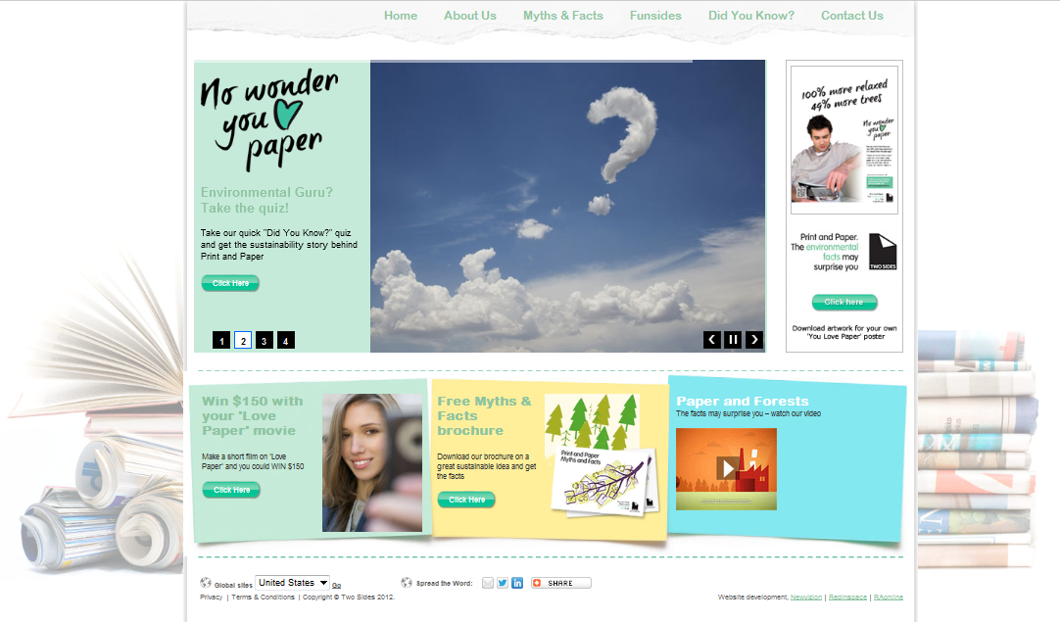
Supporting website - www.youlovepaper.info/US
Notes:
Contest 250
Quiz

Slide 12
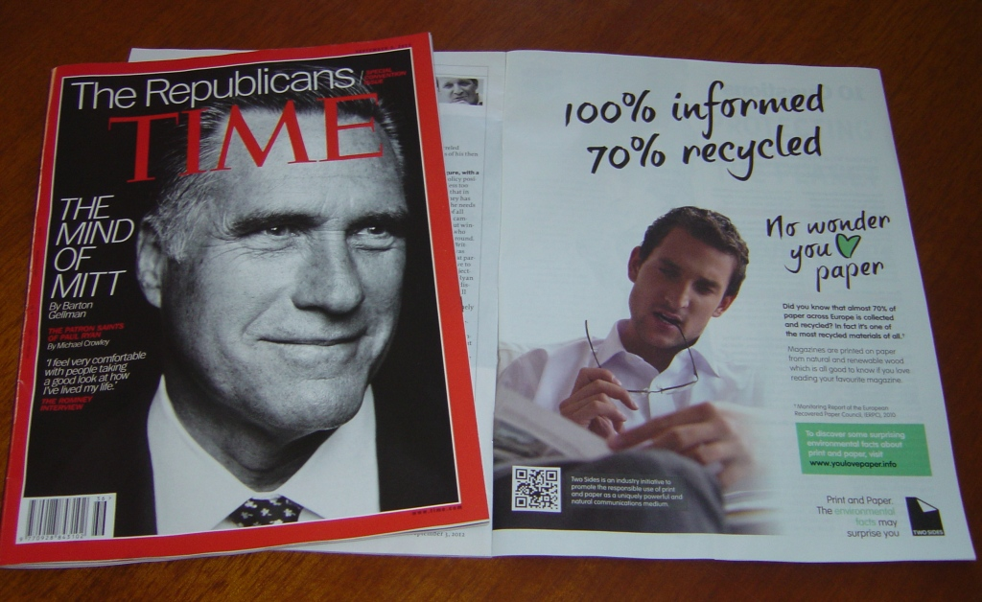
Business focussed magazines

Slide 13
Over 70 US Organizations Have Joined Two Sides
Commercial Members
Allied organizations
Notes:
Full member list on our website.

Slide 14
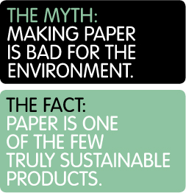
Why Two Sides?
Need to promote the sustainable features of paper and print
Negative and misleading news often prevails re: environmental impacts of paper
Lack of a strong and common forest products industry voice
Notes:
Environmental groups and the media have painted the picture for us
There is also a sort of urban society's disconnect with nature and the concept of sust. forest management which makes people susceptible to media message.
Emotional connection with forests and lack of education on sustainable forestry….Logging is seen as deforestation.
The life cycle of sustainable forests is not understood. People see forests as finite.
Electronic media claiming it is "greener“
Switch to e-billing. Go paperless…out of control
Do not print – email trailer

Slide 15
Results of 10-country Consumer Environmental Perception Survey (2010)
Paper is the preferred information medium for reading and storage of documents – all ages, incl. 18-24 year olds
~70% of respondents,
Paper not seen as environmentally preferable way to read.
70% link paper to tropical deforestation & concerns about forests
Actual: US forest area has remained stable for the past 100 years, and growing volume has increased by 49% (USDA, 2010)
~80% of 18-24 yr.o. chose electronic as the most environmentally-friendly way
Books 56%, Newspapers 64%
For a summary of survey results click here
Notes:
10 country survey – USA, UK, France, Germany, Italy, Finland, Austria, Portugal, The Netherlands and Spain
5,000 online interviews using the IPSOS Consumer Panel
These results are for the US only

Slide 16
Two Sides Messaging Framework
Print and paper has a sustainable life cycle from raw material to recovery and reuse
Print and paper have unique sustainability (environmental, social) features
Responsible use of resources is key
Industry environmental performance is continuously improving
Promote responsible use of print and paper over the life cycle (purchasing / best practices)
Based on a renewable resource Sustainable forest management Forest certification Biodiversity Ecosystem services Benefits of a working forest | A great carbon story Minimizing carbon footprint Use of renewable energy and carbon neutral biomass Carbon benefits of managed forests and forest products
Recyclable Increased recycling Eventual elimination of print and paper waste in landfills Smart use of recycled fiber | Effective communications medium Social benefits of print and paper Co-existence and synergies with e-media

Slide 17
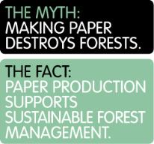
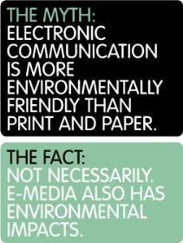
Two Sides Key “Facts”
Paper production supports sustainable forest management
Paper is one of the most recycled products in the world
Most of the energy used to make paper is renewable
The carbon footprint of paper is not as high as you think
E-media also has environmental impacts that need to be considered
Paper has inherent sustainable features

Slide 18
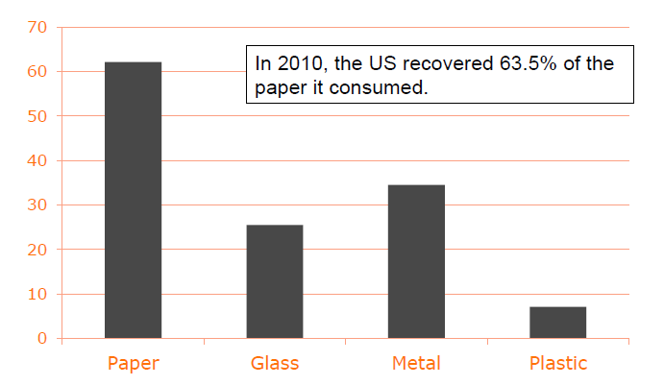
In 2011, the US recovered 67% of the paper it consumed.
2x as high as glass & metal, and ~9x higher than plastic
In 2009, 25% of electronics were recycled.
Source: US EPA

Slide 19
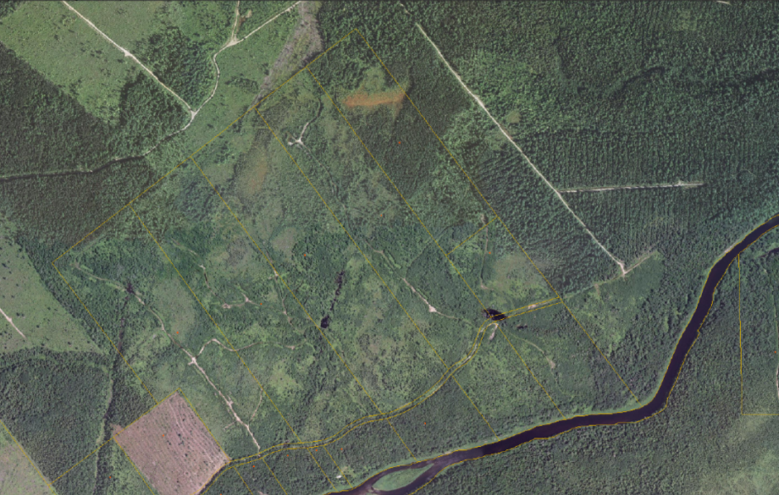
Connecting paper with responsibly-managed forests…here for the long term
Notes:
We own 200 acres
Land has produced forest products for many yrs, lumber and pulp
We have a management plan that spells out how we will manage the land long term

Slide 20
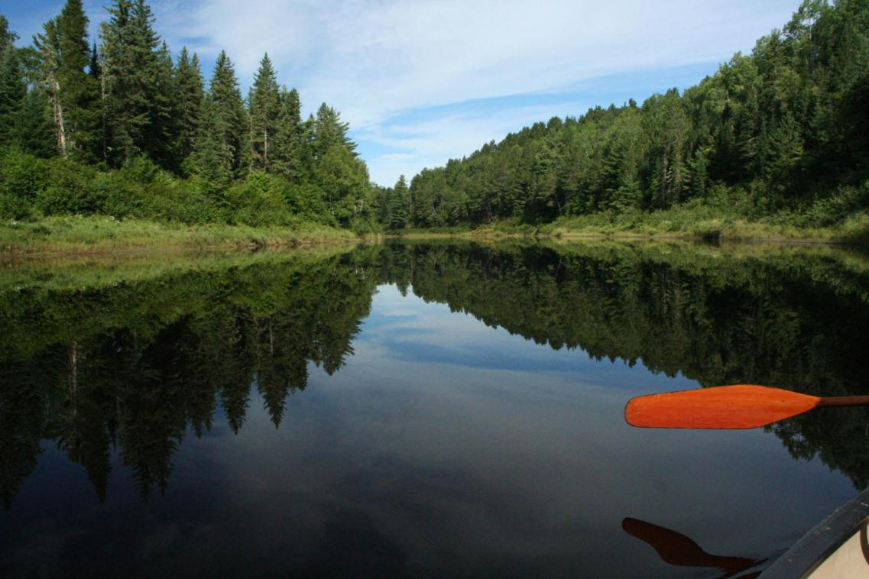
Notes:
It is truly a beautiful place
The trout and atlantic salmon fishing is great….salmon migrate up this river every yr in spring anf fall

Slide 21
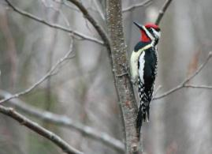
Notes:
The is tons of wildlife…moose, deer, bobcat, otters, bald eagles, ospreys, owls, well over 50 species of birds in the summer
This is just my example….there are thousands of other forest owners throughout North America who could say the same

Slide 22
Source: WRI / WBCSD, 2009.
Notes:
Land with trees provides society with numerous benefits including ecosystem services such as filtration of rainwater, habitat for wildlife and pollinating insects, and scenic beauty. When forests become fragmented, neglected, or are converted to other land uses the level of ecosystem services, as well as wood and non-wood forest products, often declines.
- Dovetail Partners

Slide 23
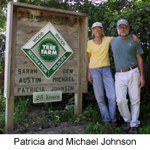
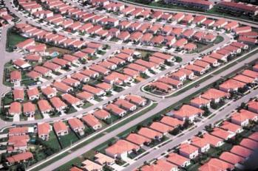
Sustainable forestry is an important form of conservation
Of the wood used to make U.S. paper, about 60% comes from family-owned forests.
The demand for sustainable paper products provides a strong financial incentive for landowners to manage their land responsibly rather than sell it off for development –the primary cause of U.S. forest loss.
56% of U.S. forestland (420 million acres) is privately owned.
~10 million family forest owners in US – pivotal for the protection and sustainable management of our forests
Sources: SFI; WBCSD & NCASI, US Forest Service

Slide 24
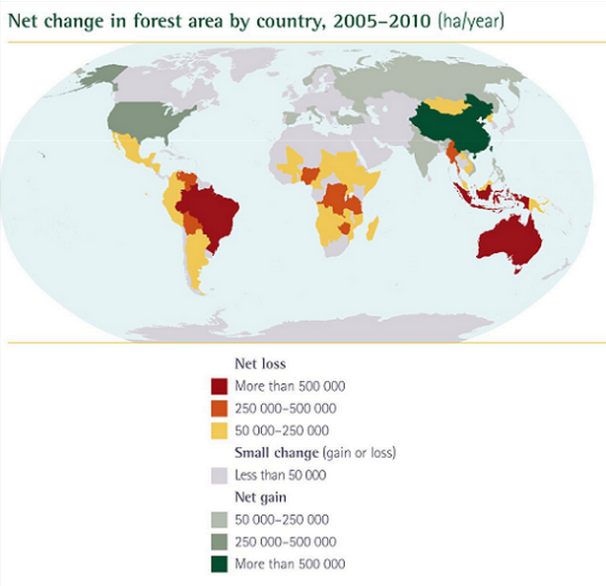
U.S. papermaking does not cause deforestation.
US forest area has remained stable for the past 100 years, and growing volume has increased by 49% in last 50 yrs.
Net loss of 20 million acres (2.7%) is projected between 2000 and 2050. Most of that loss will be caused by development.
U.S. Forest Service
Source: FAO Global Forest Resources Assessment 2010 :
Notes:
Explain colors

Slide 25
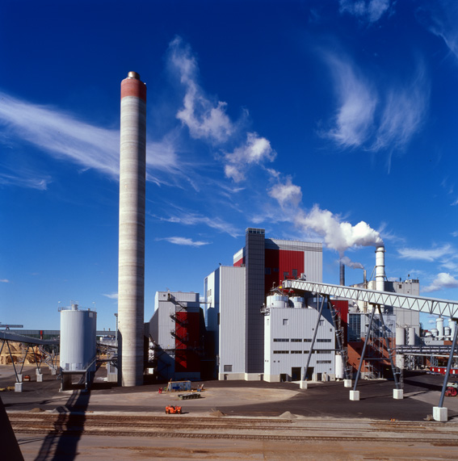
~65% of the energy used to manufacture U.S. paper comes from renewable, carbon-neutral biomass (AF&PA)
Because forest products [including paper] can require little or no fossil fuels for production and store carbon throughout their useful life, they can have inherent climate change advantages over all other materials with which they compete, provided they are produced in a sustainable manner.
World Resources Institute

Slide 26
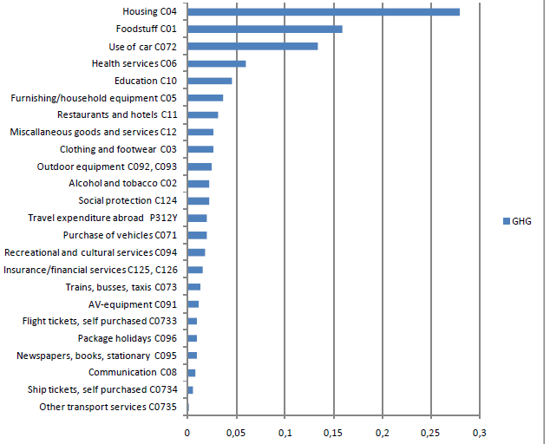
The Carbon Footprint of Paper: in perspective
Paper use accounts for 1% or less of the carbon footprint of the average family. 57% comes from housing (28%), food (16%), driving a car (13%)
VTT
The print and paper industry contributes 1.1% to world greenhouse gas emissions (2006)
WRI
Notes:
January 19, 2013
26
The production & running of the ICT sector equates to 2% of global GHG emissions, similar to the airline industry (expected to double by 2020)

Slide 27
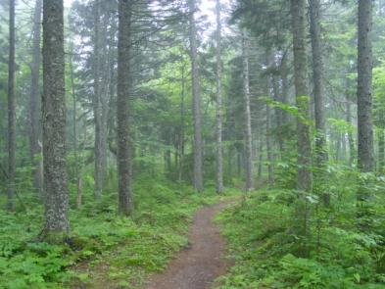
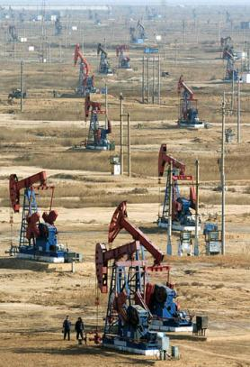
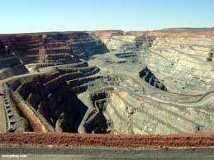
Forest Products Can Provide Solutions to:
More environmental benefits and biodiversity.
Climate Change:
Generally require low amounts of fossil fuels for production and store carbon throughout their useful life
Biodiversity:
Forests provide shelter and habitat for numerous species
Land Use:
Forests provide more environmental and social benefits than other raw materials
Conservation:
Forest management can be a critical and cost-effective conservation tool
Renewable / sustainably managed forests
Increased use of non-renewables (plastic, metals, fossil fuels & derivatives)
More intrusive. More habitat loss and environmental impacts

Slide 28
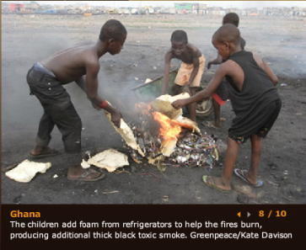
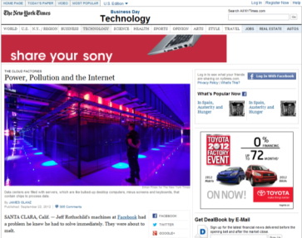
The impact of switching from paper-based communication to e-media must be properly considered
Direct impact of ICT replacing paper is far from negligible, and the trade‐off between the two “technologies” depends on conditions such as use frequency, source of energy, end‐of‐life management of the products .
With a reading time of 30 min/day, the environmental impact of a web based newspaper was in general in the same range as the printed newspaper environmental impact.
E-media impacts:
Non-renewable natural resources
Energy use
E-waste: the fastest growing waste stream
Sources: www.greenpeace.org; Arnfalk, P. 2010; Moberg, A. et al. 2007.; http://www.gartner.com/it/page.jsp?id=503867

Slide 29
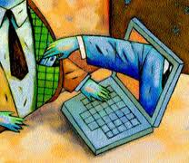
Print and paper have proven benefits for learning, literacy and record-keeping
Tactilely richer experience than clicking and scrolling through a digital text
Many people learn better from print than they do using a screen
Advantages in supporting annotation, quick navigation
Flexibility of spatial layout
Allows readers to deepen understanding of the text
Online = a more superficial processing of information
Internet / online fraud is an issue.
In July, the Treasury Inspector General for Tax Administration reported that the direct deposit and debit card policy has resulted in $5.2 billion in refunds sent to thieves (conservative).
Estimated $21 billion over the next 5 yrs
Sources: O’Hara, K. and Sellen, A., 1997; A.Mangen, 2008; J. Neilsen, 2009; Consumer for Paper Options, 2012

Slide 30
Print and paper can be critical for some…
Kinesthetic learners (tactile learning)
Active, do-ers, good at sports, acting, good hand-eye coordination, multi-taskers
Need physical, tangible, tactile interaction
50% of US high school students
…visual learners
Reader/ observer
Benefits from diagrams, pictures, films, written directions
Values to-do lists, written notes
Visualize things when thinking, enjoys drawing
40% of US high school students
…and seniors
45% of U.S. seniors do not own a computer
Many with Internet access are not technologically savvy enough for online transactions
Sources: Wikipedia; Livestrong.com; Consumer for Paper Options, 2012

Slide 31
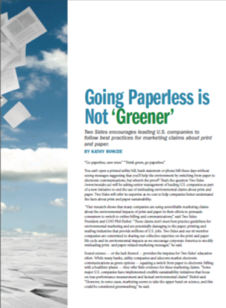
Two Sides educational campaign to correct “go green – go paperless” messages
Out of 94 leading U.S. banks, telecoms and utilities, 50% are using unsubstantiated environmental claims to encourage consumers to switch to lower-cost e-billing
Goal is 80% success (change or stop their environmental claims used to support e-billing).
>40 letters sent, discussions underway with 15 companies, 2 companies have removed their claims

Slide 32
Key Talking Points
The “go green – go paperless” message is damaging to the print, paper and mail value chain…and 8.7 million jobs rely on this value chain ($1.1 trillion in revenues).
Print on paper has unique environmental features that many other products and materials do not.
The “saving trees” message creates a false impression that forests and trees are a finite resource that is being lost instead of a renewable resource being replenished based on sustainable forest management practices.
Corporations must follow best practices for environmental marketing. Claims should be based on sound and peer-reviewed scientific evidence (US FTC Green Guides and ISO14021)
The full impact of switching to e-media are often not properly considered and sometimes ignored.
The life-cycle of e-statements is not paperless

Slide 33
What can you do?
Write to the companies
Use our template letter at:
http://www.twosidesus.wordpress.com/2012/02/15/a-response-to-paperless-environmental-claims/
Register on our website to get more tools in the near future
Contact me directly

Slide 34
?
Low environmental footprint over the life cycle
Top performance of pulp and paper mills (air, effluent, solid waste, use of B-A-T)
Environmental Journey towards sustainability
Low water footprint
Environmental Performance of Paper
Credibility of Environmental Communications
?
Negative pressures and challenges (environment, energy, legal, financial)
Low carbon footprint
Sustainable use of fiber (recycled, wood, other)
?
Unique environmental features of paper
Environmental Features of Paper
Notes:
Illegal logging
Loss of primary forest and biodiversity
Limited to fossil fuels as key energy source
Older mill facilities / poor performance
Regional differences in regulations
Available capital for investment

Slide 35
Key Messages
All products need to be produced, used and disposed of responsibly to minimize environmental impacts.
The alternatives to print and paper are not without impact.
Print, paper and e-media complement each other and can co-exist.
It is not a question of paper or electronic, but rather which combination of the two has the least impact on the environment while meeting social and economic needs.
Paper has a head start over many other products that surround us today - it has unique environmental and social features and its manufacture has the potential to be a self-sufficient and renewable industrial system.

Slide 36
Thank you!
Phil Riebel, President and COO
Two Sides U.S., Inc.
pnr@twosides.info
Toll-free: 1-855-TWOSIDE
www.twosides.us

