Slide 1
State of the Art -Sjogren’s Syndrome
BSR Autumn 2015
Elizabeth Price

Slide 2
Declaration of Interest
I have nothing to declare

Slide 3
Background
Chronic autoimmune disease characterised by inflammatory infiltrates into salivary and lachrymal glands
Aetiology unknown
First descriptions in literature 1892 (Mikulicz) & 1925 (Gougerot)
Henrik Sjogren published his doctoral thesis 1933

Slide 4
History
Distinction between primary & secondary Sjogren’s described in 1960’s
Chisholm & Mason 1960’s
Anti-Ro (SS-A) and anti-La (SS-B) 1969

Slide 5
Prevalence
Primary SS - 0.1 – 0.4% dependant on index population & criteria
Secondary SS - 10-20% of patients with longstanding RA
Presentation often non-specific
Often ‘grittiness’ rather than dry eye
Oral symptoms may require prompting

Slide 6
Making the Diagnosis!
Ocular symptoms
Oral symptoms
Ocular signs
Oral signs
Histopathology
Anti-Ro/La antibodies
American-European consensus group (AECG) criteria
Ann Rheum Dis, 2002; 61: 554-8

Slide 7
Autoantibodies
Ro (SSA) – 52 or 60kD, bound to cytoplasmic RNAs
La (SSB) – 48kD, nuclear, bound to RNA polymerase III transcripts (transcription termination factor)
ANA & RF often positive but non-specific

Slide 8
Minor Salivary Gland Biopsy
Daniels et al (1984) described currently used technique
Inside of the lower lip between midline and commissure
Incision through normal looking mucosa followed by blunt dissection, identifying and avoiding sensory nerves
1% sensory loss

Slide 9
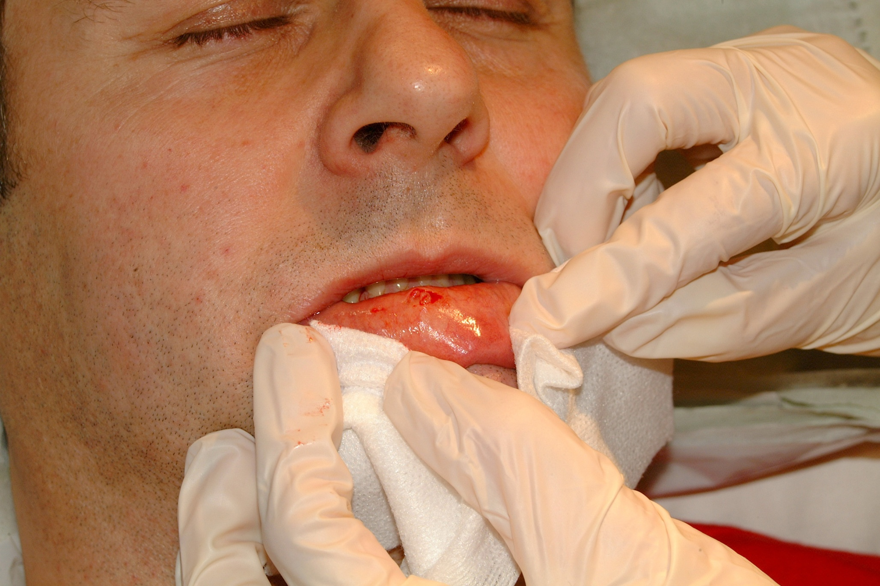

Slide 10
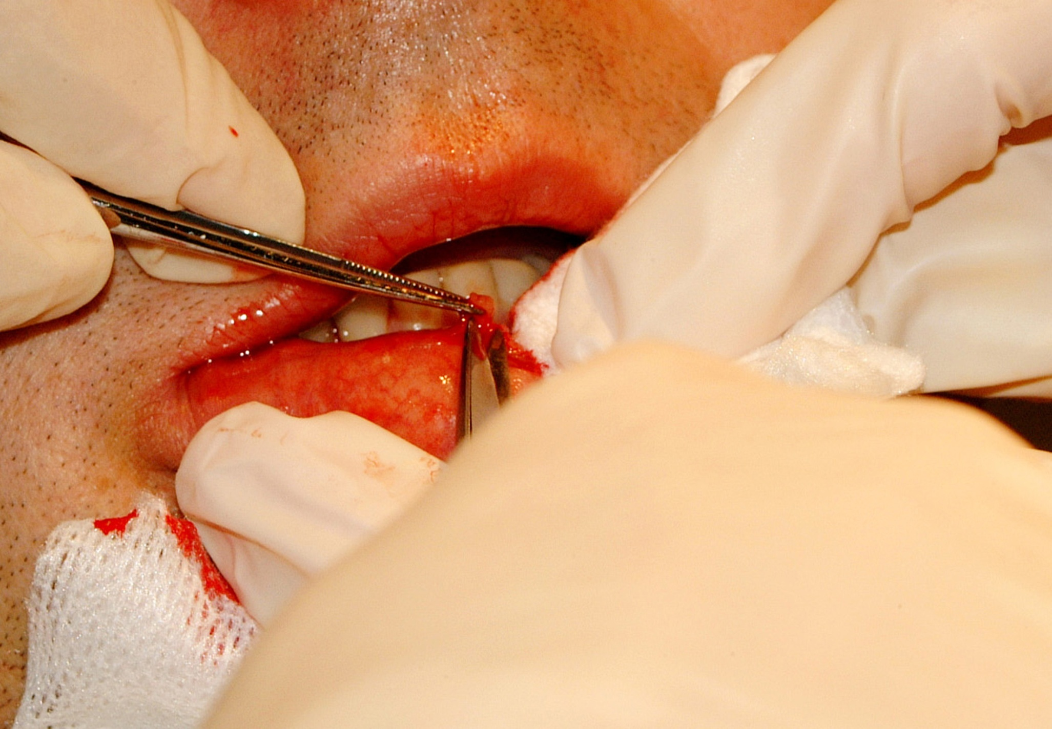

Slide 11
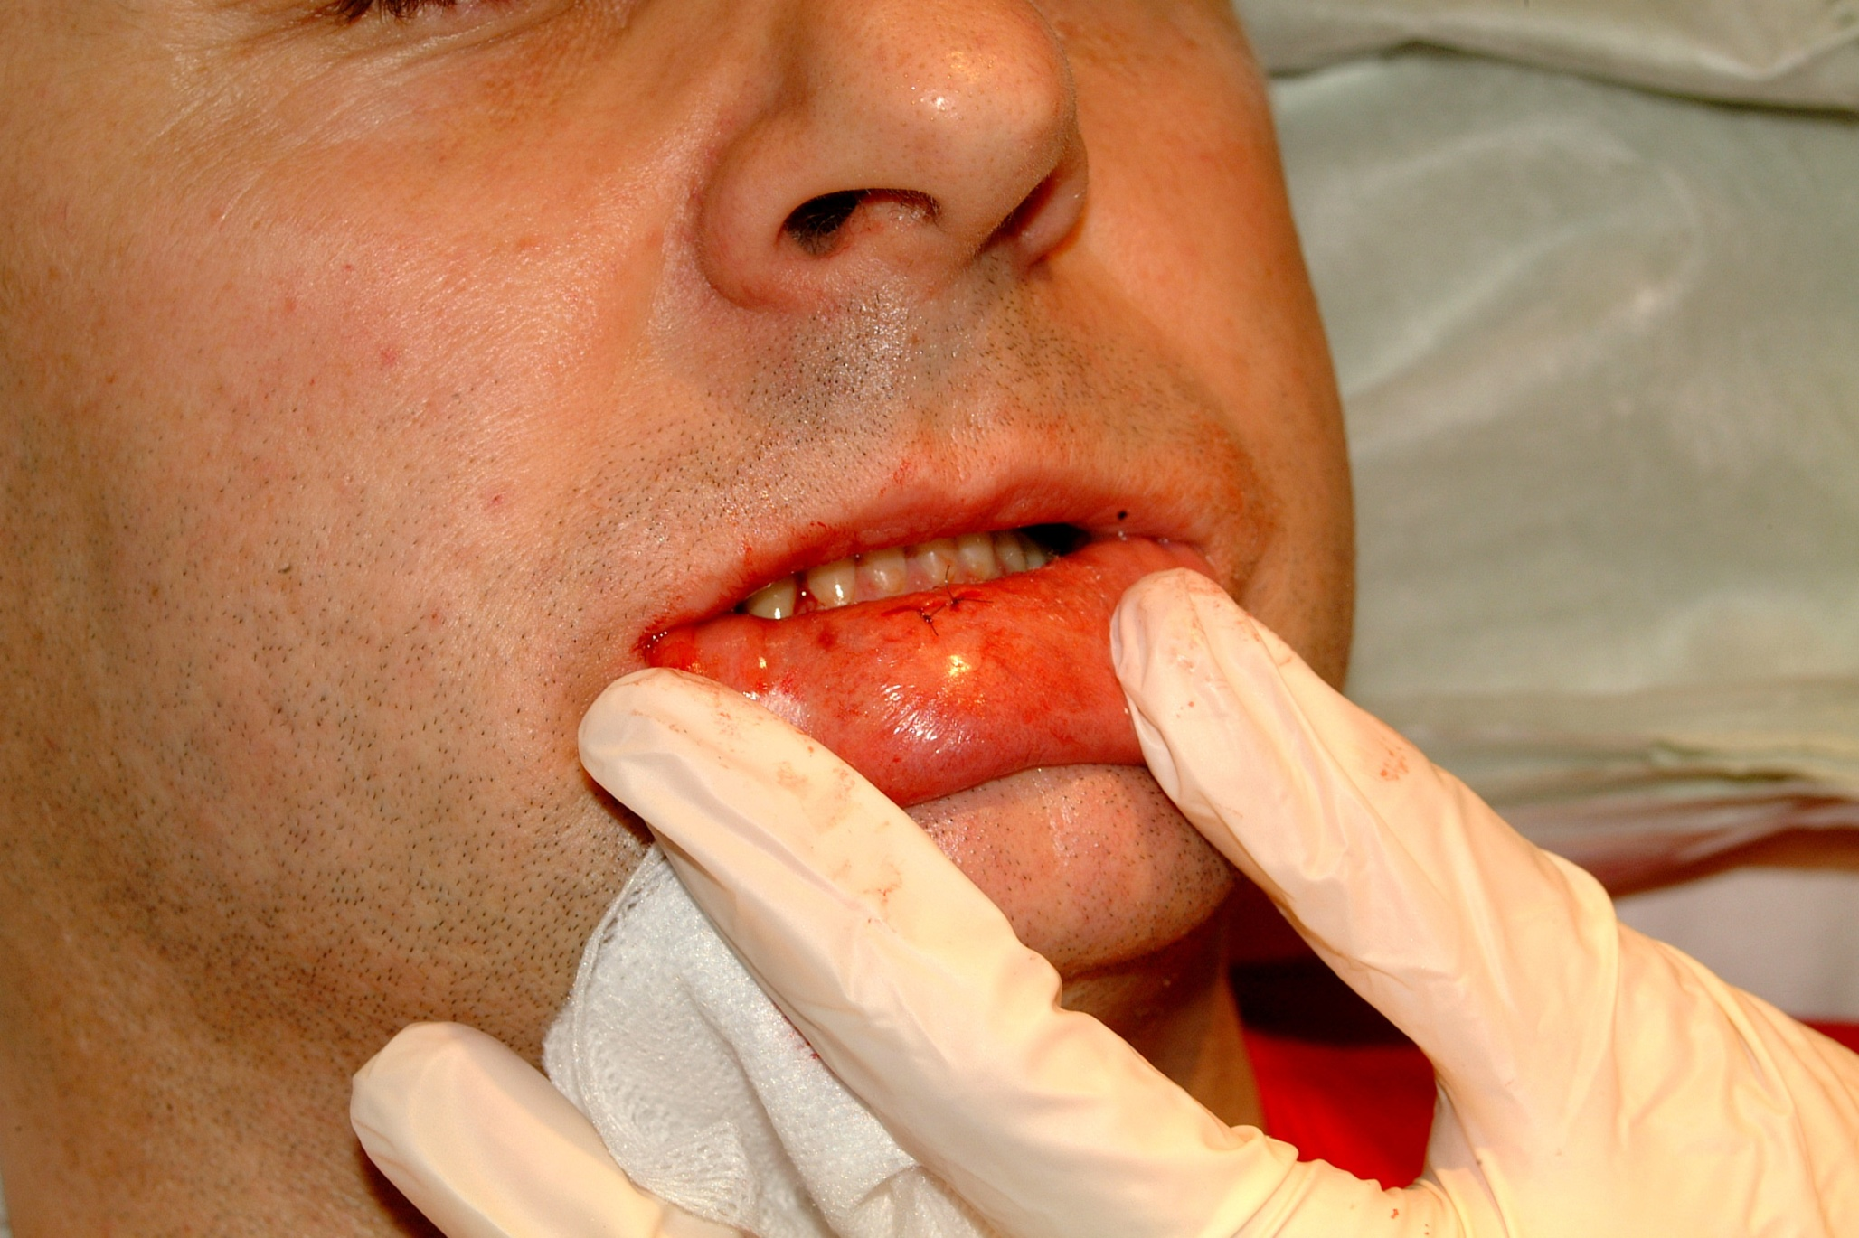

Slide 12
Histology

Slide 13
Glandular features
Changes in amount & composition of
secretions resulting in :
Dry eyes
Dry mouth
Dry skin
Dry vagina
Dry cough

Slide 14
General advice
Avoid dry atmospheres
Humidify rooms
Chew sugarless chewing gum
Shower rather than bath & avoid soap
Wear glasses (with side arms)
Avoid too much PC use (reduces blink rate) & laser surgery!

Slide 15
Dry eyes
Burning, grittiness
Fatigue, blurring
Watery eyes – due to increased reflex tearing in early stages
Hypoanaesthetic eye surface in later disease
Marginal tear film (norm ~2mm) reduced
Break up time reduced (norm >10secs)

Slide 16
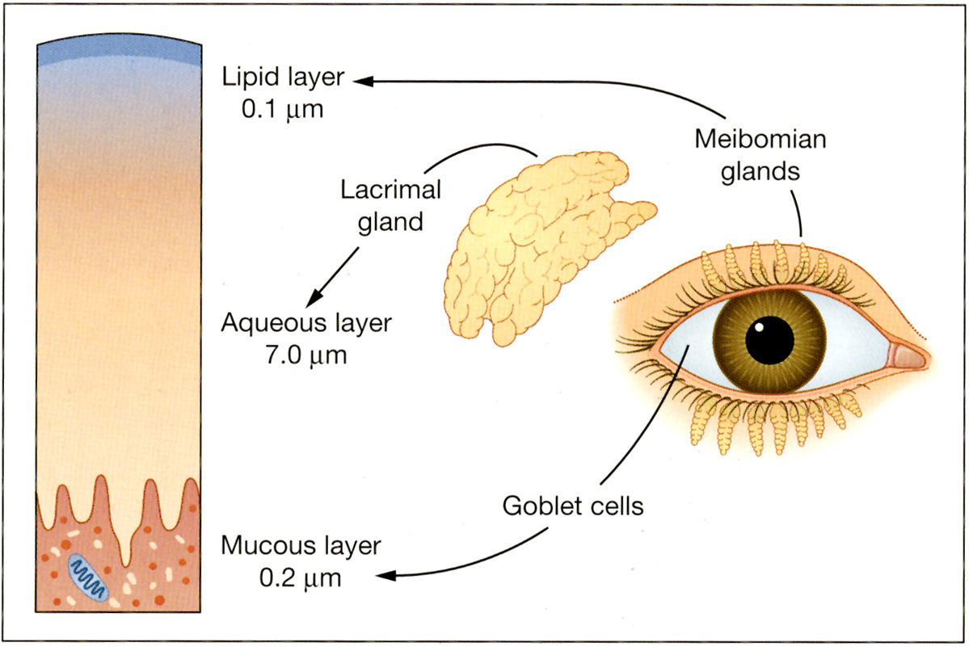
Tear Film

Slide 17
Topical treatment of dry eye
Start with simple lubricants
Hypromellose 0.3%
Carbomer gel e.g. Clinitas 0.2% gel
Carmellose e.g. Optive 0.5% (Biodegradable preservative)
Switch to preservative free if eye drop use > 4x daily

Slide 18
Topical treatment of dry eye
Use longer acting agents next
Carbomer eg clinitas gel 0.2%
Carmellose e.g celluvisc 0.5% SDU
Sodium hylauronate e.g Hylo-Tear 0.1% or Hylo-Forte 0.2%
VitA-Pos eye ointment at night
If mucus stranding use mucolytics e.g. acetylcysteine eye drops

Slide 19
Treatment of dry eye
Consider punctal occlusion (temporary first)
Stimulate meibomian gland secretions
Treat blepharitis (warm compresses, baby shampoo, topical antibiotics, oral doxycycline, omega 3 supplements)

Slide 20
Treatment of dry eye
Autologous serum ‘tears’
Cyclosporin eye drops and ointment
Steroid eye drops

Slide 21
Dry mouth
Increased caries & tooth decay (cervical & incisal)
Oral candida
Halitosis
Dysphagia

Slide 22
Topical treatment of dry mouth
Water
Avoid sugared & fizzy drinks
Chew sugarless chewing gum
Biotene Oralbalance salivary gel, BioXtra, Saliva-orthana & Luborant all contain fluoride
Glandosane fluoride free
Lozenges/pastilles no good if very dry

Slide 23
Topical treatment of dry mouth
Toothpastes (eg Duraphat) and mouthwashes
Home made mouthwash (1tsp salt & 1tsp baking powder in 1 litre water)
Olive oil, yoghurt
Treat candida if present (fluconazole 50mg orally or nystatin liquid or amphotericin lozenges for max 10/7 then break)

Slide 24
Vaginal dryness
Simple lubricants e.g. KY jelly
Non-hormonal moisturisers e.g. Replens, Sylk, Repadina (Hyaluron based capsules)
Oestrogen creams eg vagifem
HRT

Slide 25
Pilocarpine (salagen)
Muscarinic acetylcholine receptor agonists
May be more beneficial early rather than late
Start with low dose e.g. 5mg per day or consider drops (4% pilocarpine eye drops, 1 drop ~ 2mg)
Increase dose slowly to facilitate development of tolerance to side effects
Persevere with treatment to see effects

Slide 26
Systemic Disease
>80% of patients have extraglandular features at some point
Ro/La +ve have highest prevalence of systemic features
Overlaps with other autoimmune disease are common
Ramos-Casals 2008 & 2014
Asbrol et al 2014

Slide 27
Constitutional symptoms
Associated with disease ‘flares’
Lymphadenopathy 10 - 30%
Low grade fever and/or Weight loss ~ 10%
Davidson et al 1999
Voulgarelis 1999
Ramos-Casalas 2014

Slide 28
Fatigue
Physical & mental fatigue affects at least 75% of patients with Sjogren’s
Significantly higher levels of fatigue than healthy controls
Similar levels of mental & physical fatigue to patients with SLE
Bowman et al 2004
Theander et al 2010

Slide 29
Fatigue
Fatigue most disabling symptom for many
May correlate with sleep disturbance & anxiety
Influenced by pre-morbid personality
Encourage exercise
Improve sleep quality
Don’t forget other causes (eg anaemia, hypothyroid, depression, stress)

Slide 30
Mental Health
Sjogren’s patients have high levels of ‘psychological distress’ compared to Healthy controls
Personality features associated with SjS include negativity, preoccupation with detail, perfectionism & anxiety
Karaiskos et al Rheumatology 2010

Slide 31
Arthralgia/arthritis
Joint symptoms affect 30-50%
Outlook generally good
Peripheral, symmetrical, non-erosive
Mild synovitis (sub-clinical) can be detected on USS
Affects MCP, PIP & wrists most commonly
Hydroxychloroquine may help
Pease et al 1993
Fauchais et al 2010
Iagnocco et al 2010
Ramos-Casals 2014

Slide 32
Thyroid disease
Common in normal population – 11% of females >60years
Thyroid disease commonly accompanies primary SjS 15 - 20%
Thyroid antibodies in 20-30% of Primary SjS
Davidson et al Rheumatology 1998
Kang et al 2010
Abrol et al 2014

Slide 33
Thyroid disease
High prevalence of anti-thyroid ab in patients with sicca (59%)
37% of patients with autoimmune thyroid disease have objective dry mouth
23% of patients with autoimmune thyroid disease have objective dry eyes
J Rheumatol 2009;36(8):1626-1630
Coll et al J Rheumatol. 1997

Slide 34
Skin
Skin dryness affects >50%
Photosensitive rashes common in Ro+
Sub- acute cutaneous lupus in Ro+ve
Ensure UVA and UVB protection (look for high protection factors and star rating)
Davidson et al 1999

Slide 35
Skin
Hypergammaglobulinaemic purpura (~9%) helped by Hydroxychloroquine (& azathioprine or mycophenolate)
Annular erythema
Granulomatous panniculitis
Cutaneous lymphoma
Katayama et al 2010
Tait et al 2000
Vougarelis et al 1999

Slide 36
Raynauds
Raynauds 33 - 80%
Precedes sicca symptoms in 42%
Manage as for primary Raynauds
Davidson et al 1999
Skopouli 1990

Slide 37
Lung disease
Chronic dry cough due to dryness is common
Abnormalities on X-Ray in 14% (fine reticular basal changes)
Abnormalities on CT scanning in 34% (parenchymal linear opacities & bronchiolar abnormalities)
Only 26% symptoms & poor correlation with radiology
Franquet et al, AJR 1997

Slide 38
Autoimmune lung disease
Interstitial lung disease in ~ 7%
Disease may be subclinical for some years before symptoms occur
Constantopoulos et al 1985
Abrol et al 2014

Slide 39
Lymphocytic Intersitital Pneumonitis
Lymphocytic Intersitital Pneumonitis (LIP)
Fever, cough, dyspnoea
Bibasal infiltrates (lymphocytes & plasma cells on BAL)
Responds to corticosteroids
Dalvi et al 2007

Slide 40
Pulmonary Hypertension
Anecdotal reports and small case series suggesting rare but can be severe
Of 107 patients undergoing full prospective evaluation 15% had PAH on echo (mild in 13, moderte in 3 , none severe)
Moyssakis et al 2010
Launay et al 2007

Slide 41
Urinary symptoms
Mild symptoms of urinary dysfunction in 61% of patients with SS (cf 27% controls)
Severe symptoms 14% SS (cf 7% controls)
27% of SS patients report urinary frequency & 36% complain of suprapubic pain
Haarala et al 2000

Slide 42
Urinary Tract Infection
Probable increased frequency of UTI
Freq of UTI 6% in RA alone, 30% in RA/SS
Tischler et al 1992

Slide 43
Renal
Usually sub-clinical
Higher prevalence reported in historical series
Mild proteinuria (<1.5g/24hours) 44%
Distal RTA 33% (assoc with longer disease duration, high BP, raised creatinine)
Pertovaara et al 1999
RTA 3.9% and Glomerulonephritis 2.6%
Abrol et al 2014

Slide 44
Interstitial Cystitis
Chronic inflammatory bladder disease
90% females
Chronic inflammation of bladder wall
No evidence of infection
Cause unknown
Associated with underlying CTD
23% of patients with IC may have Sjogren’s
Van der Merwe et al 2003

Slide 45
Haematological Disease
Normocytic, normochromic anaemia 11%
Thrombocytopaenia 5 – 15%
Neutropaenia & Lymphopaenia (14 – 42%)
Autoimmune Haemolytic Anaemia rare
Mostly mild and asymptomatic
Asmussen et al 1996
Markusse et al 1992
Ramakrishna et al 1992
Kikawada et al 2005

Slide 46
Neurological involvement
Diffuse sensorimotor neuropathy (small fibre, n/conduction often normal) 8 -25%
Autonomic neuropathy (0-70%)
Trigeminal neuralgia 5%
Mononeuritis 3%
Dorsal Root Ganglionitis (rare)
Sjogrens myelopathy – may mimic MS, matched oligoclonal bands, treat with steroids (<3%)
Sene et al 2011, Abrol et al 2014, Fox et al 1996, Andonopoulos et al 1990, Griffin et al 1990,
Kovacs et al 2003, Vincent et al 2004

Slide 47
Dysphagia
Mechanical factors – dryness & poor dentition
Oesophageal dysmotility may contribute
Oesophageal webs in up to 10%
Candida detected in up to 75% of patients
Candida levels fall following treatment with pilocarpine

Slide 48
Autoimmune Liver disease
Reported prevalence varies from 6-27%
Liver function abnormalities in ~7%
Anti-mitochondrial ab 5-7%
Smooth muscle antibodies up to 30%
Clinically significant disease generally rare with non-specific changes on biopsy
Skopouli et al 1994
Ostuni et al 1996

Slide 49
Primary Biliary Cirrhosis
PBC may be present in 4-6%
SS found in 17% of patients with PBC
Ursodeoxycholic acid helped PBC but didn’t influence other autoimmune features such as sicca
Abrol et al 2014
Skopouli et al 1994
Parik-Patel et al 2001
Zukowsi et al 1998

Slide 50
Coeliac disease
Prevalence of biopsy proven coeliac disease 10 times higher than controls (4.5 per 100 vs 4.5-5.5 per 1000)
Ab to tissue transglutaminase found in 12% of SS patients v 4% of controls
Luft et al 2003
Szodary et al 2004

Slide 51
Gastritis
Prevalence of Helicobacter pylori in dyspeptic subjects with SS is similar to controls (57% v 62%)
SS patients demonstrated persistent symptoms despite H pylori eradication (75% v 13%)
Sorrentino et al 2004

Slide 52
Irritable Bowel Syndrome
Bloating, diarrhoea, abdominal colic
Affects 20% of normal population
Prevalence in Sjogren’s unknown but anecdotally common
‘Slow motility’ often observed

Slide 53
Lymphoma
40 fold relative risk
Risk rises with disease duration
3% in first 5 years to ~10% at 10 - 15 years in Ro/La+ve group
Median age of onset mid-50’s
Predictive factors for later development include lymphadenopathy, low C4
Lazarus et al 2006, Baimpa et al 2009,
Solans-Laque 2011, Abrol et al 2014

Slide 54
Lymphoma
Primarily B-cell (MALT) lymphomas
Commonest site of presentation parotid & other SGs, then orbits, stomach, thyroid, lung
90% respond to treatment, 5 year disease free survival >75%
Tsang et al 2001

Slide 55
Lymphoma
Median age of onset mid-50’s, Sjogren’s diagnosis pre-dates by ~ 7 years
Predictive factors for later development include lymphadenopathy, low C4
Lazarus et al 2006
Baimpa et al 2009

Slide 56
Fertility & pregnancy
Fertility normal
Small inc risk of m/c in Ro/La patients
Neonatal lupus rash in 5%
Rash appears at 6/52 of age & lasts ~17 weeks
Slightly commoner in female children
Few children have permanent areas of depigmentation or telangiectsasia

Slide 57
Congenital Heart Block
CHB <2% (but 17% for subsequent pregnancies)
CHB more strongly associated with Ro52 than Ro60
Risk increased if Ro and La both present
9 fold increased risk if coexistant hypothyroidism

Slide 58
Congenital Heart Block
Detected by USS from ~16 weeks gestation
May be 1st, 2nd or 3rd degree (latter not reversible)
Monozygotic twins may be discordant
70% survive & almost all require pacing
Priori et al

Slide 59
Hydroxychloroquine
ESR & Ig decreased, Hb increased
No change tear/saliva flow
Fatigue not assessed
Fox et al, Kruize et al
JOQUER study
No significant improvement in measurements of disease activity at 6 months
Some evidence of improvement at 48 weeks
Gottenberg et al, JAMA 2014; 312(3):249-258

Slide 60
Azathioprine
Azathioprine (low dose, 1mg/kg/day) – no improvement in fatigue, salivary flow, Ig levels, ESR etc

Slide 61
Cyclosporin
No improvement in salivary flow, fatigue, ESR
Reductions in Joint swelling and tenderness
Improvements in physical and mental health domains of the SF36

Slide 62
Methotrexate
Methotrexate – single open label study – 0.2mg/kg/week
No improvement in dryness
No change in Ig or ESR
Significant side effects in 41%
Skopouli et al, Clin Exp Rheumatol. 1996 Sep-Oct;14(5):555-8

Slide 63
Leflunomide
Phase II open label pilot study
15 patients
Severe adverse events observed
Efficacy modest
Woerkom et al (Ann Rheum Dis 2007; 66:1026-32)

Slide 64
Mycophenolate
Single center, open-label pilot trial.
Subjective improvement of ocular dryness and reduction in artificial tear use
No significant change in objective parameters of dryness of eyes and mouth
Significant reduction in Ig’s & RF
Increase in complements and WCC.
Willeke et al (Arthritis Research & Therapy 2007, R115)

Slide 65
Biologics
B-cell targeted therapies eg rituximab
T-cell targeted therapies eg abatacept
Anti-TNF targeted therapies
Anti-IL6 and anti-IFN targeted therapies
Others

Slide 66
Rituximab
Pilot studies, case reports and small RCTs suggest improvement in salivary flow rates and fatigue
TEARS study failed to reach primary end point
TRACTISS study yet to report
Being used for lymphoma and some systemic complications (thrombocytopaenia)
Good safety profile

Slide 67
Other B cell agents……….
Belimumab
Epratuzumab (anti-CD22) – early trials in SLE & lymphoma promising
Atacicept (soluble, fully human, recombinant fusion protein that inhibits B cell-stimulating factors APRIL (a proliferation-inducing ligand) and BLyS (B-lymphocyte stimulator) – decline in IgG & studies terminated early

Slide 68
Anti T cell agents
Abatacept – 2 small studies, increased saliva
Efalizumab – withdrawn due to safety issues

Slide 69
Anti TNF
Pilot study looked promising but subsequent RCTs x3 showed negative results

Slide 70
Potential Future agents..........
Tociluzimab (Anti-IL6) – one case report
INF-alpha – some evidence
Small molecules eg PI3K inhibitors

Slide 71
Non-pharmacological management
Evidence supporting graded exercise programmes and psychological interventions from other autoimmune diseases
Current study underway in Sjogren’s

Slide 72
Take Home Message
Sjögrens syndrome is a multi-system connective tissue disorder
Serious complications are rare but must not be forgotten
It may respond to immunosuppression and new treatments are on the horizon
Some interesting cases to follow & stimulate debate…………….

