Slide 1
Digital Book World
January 15, 2013

Slide 2
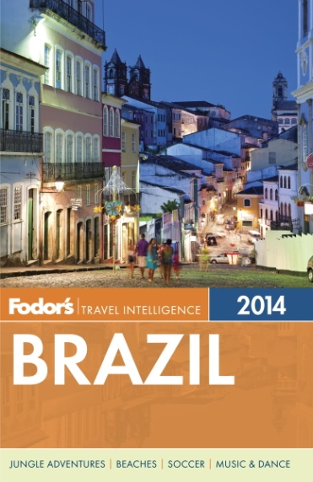
Guidebooks Since 1936

Slide 3
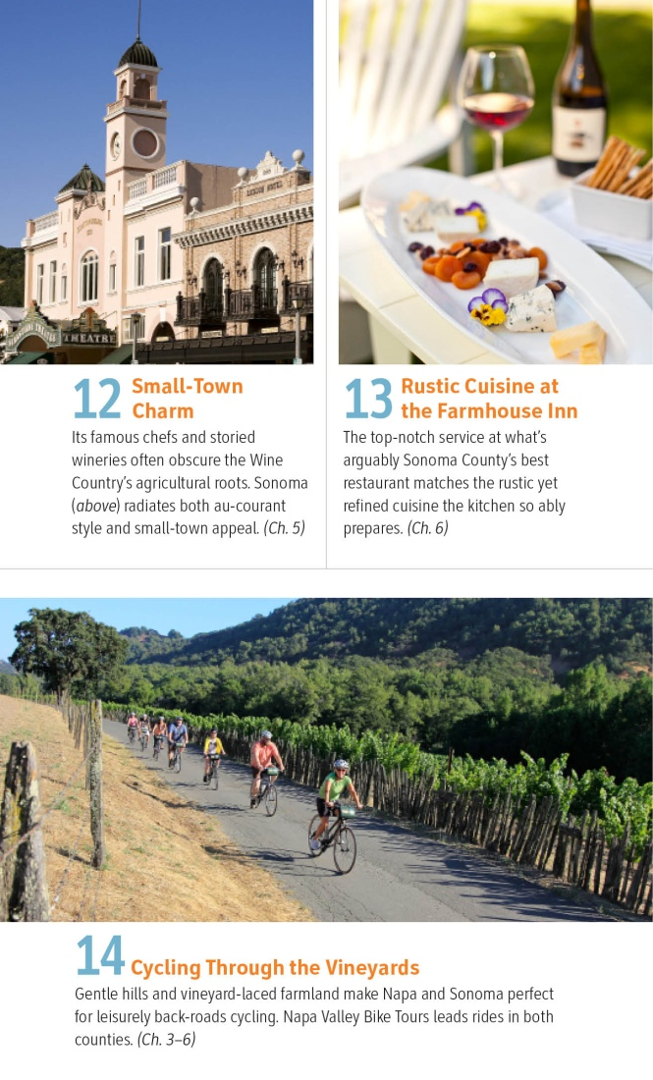

Slide 4
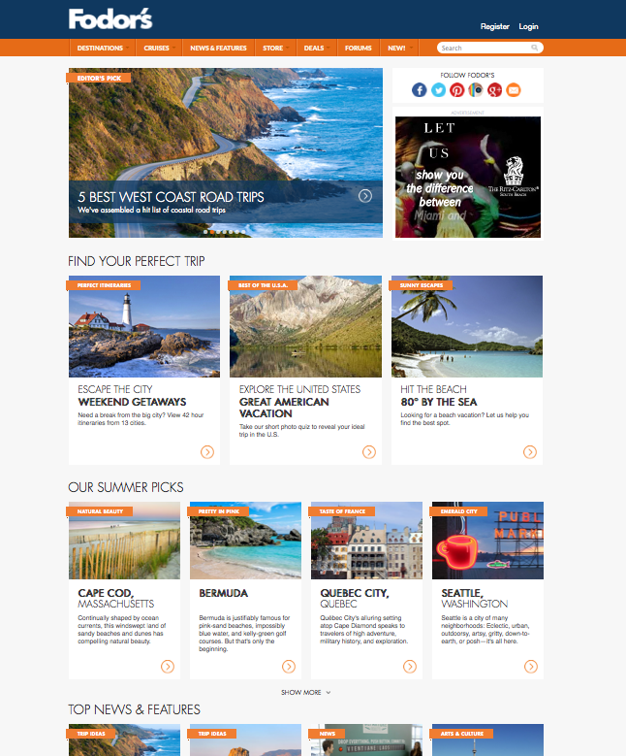
Redesigned Homepage
Fodors.com
5-6 million monthly unique visits
Destination Pages
Special Features
The Go List
Fodor’s 100 Hotels
80 Degrees
Blog—over 1M page views monthly
Responsive design for tablet, desktop, and smartphones

Slide 5
Fodors.com

Slide 6
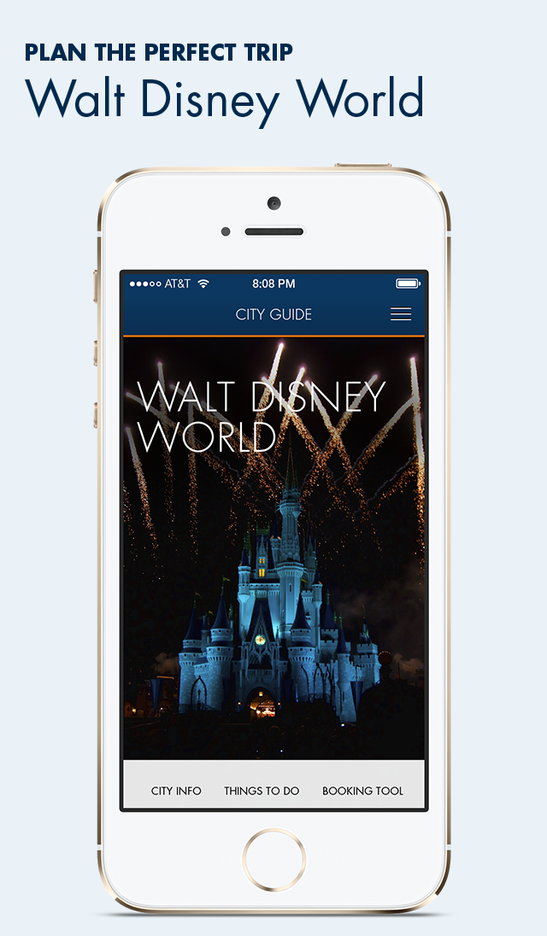
21 Cities As of July
City Guides Apps Cover 22 Destinations
Most Popular Cities:
1. New York City
2. Paris
3. London
4. Rome
5. San Francisco
6. Barcelona
7. Amsterdam
8. Chicago
9. Las Vegas
10. Boston

Slide 7
Social Growth
Social Media Reaches 660, 000 Followers

Slide 8
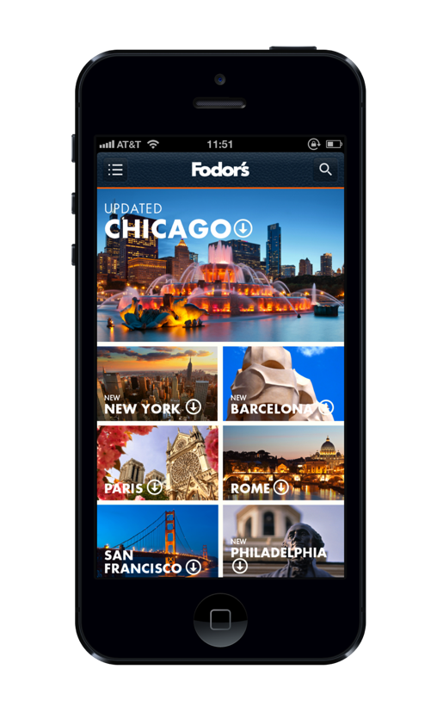
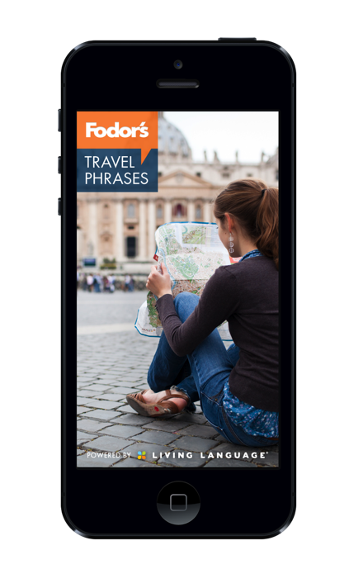
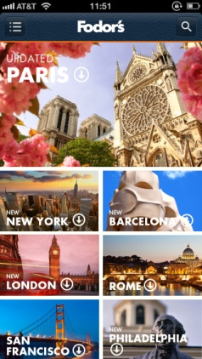
KEY PRIORITY: Create Once, Publish Everywhere

