Slide 1
Smart Beds Revolutionize Health Care
MIKE PICCIN
BAM Labs

Slide 2
What we do
Reduce Wounds
Reduce Falls
Customize care plans

Slide 3
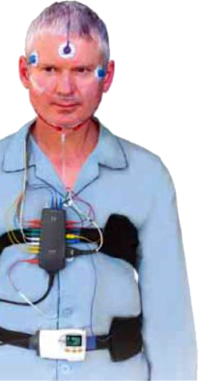
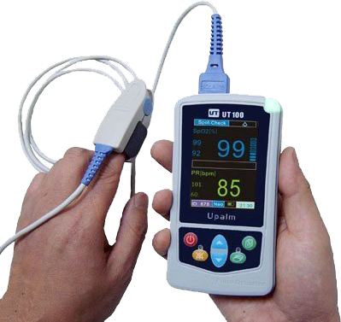
Without having to do this.

Slide 4
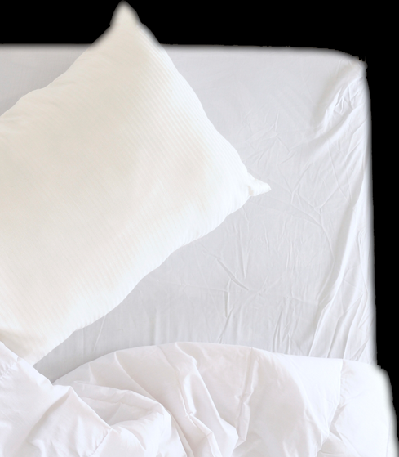
We use this.

Slide 5
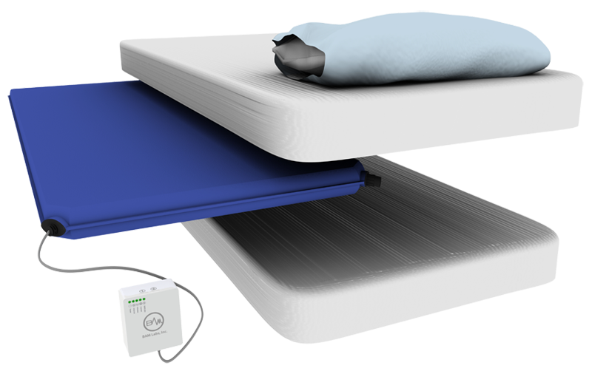
The BAM Labs Solution is under the mattress.

Slide 6
Works under
ANY
mattress.

Slide 7
This device is
Touch-free.

Slide 8
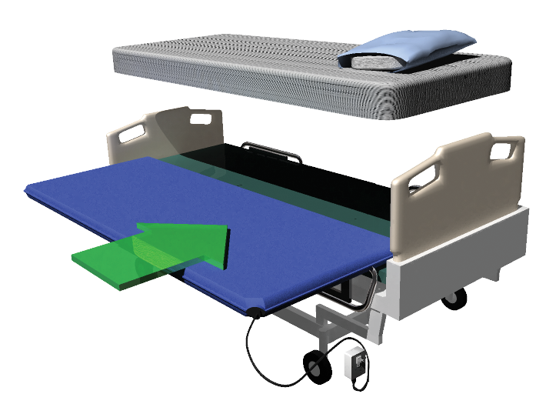
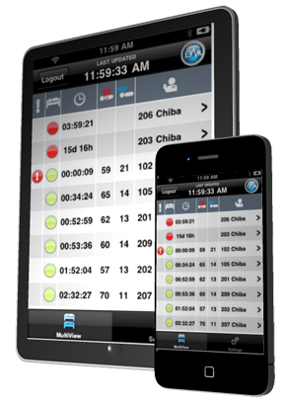
Sensor, Cloud, Applications
Sensor mat placed under any mattress
Bed Exit and Position Change data sent to PC, iPad or Mobile Device

Slide 9
Turns Prevent Pressure Ulcers
What BAM Labs Solution does that nobody else can do:
Schedules Turns
Records
Turns
Verifies
Turns
All patients are on different schedules.
Caregiver presses one simple button to record.
Biometric reading confirms turn for compliance and best practice.
The BAM Labs Closed Loop
Regular repositioning is a proven intervention for prevention of pressure ulcers and reduction in healing time.
Notes:
Closed loop solution for turns. Easy documentation, no clock watching, automatic validation of turns and reporting
More time focused on care and less on documentation

Slide 10
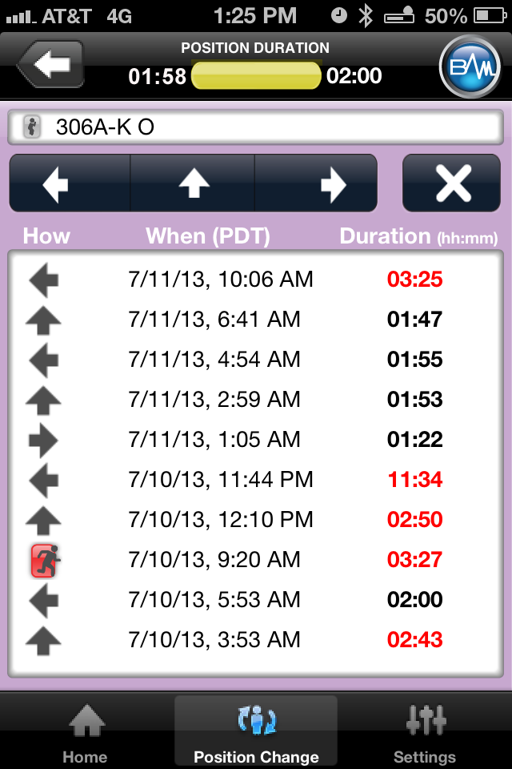
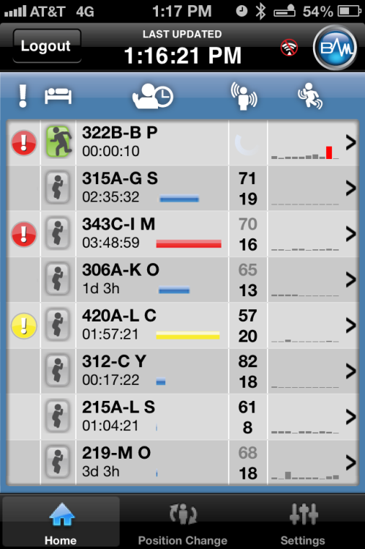
Easily Record Position Change
Select
Record
Notes:
Position change overview provides documented turns, validated turn motion and refused turns.
The only solution on the market that will automatically validate the movement of your turns. Biometric validation = the motion coincides with the documented turn
Customize your own thresholds by bed/patient to capture the validation of movement.

Slide 11
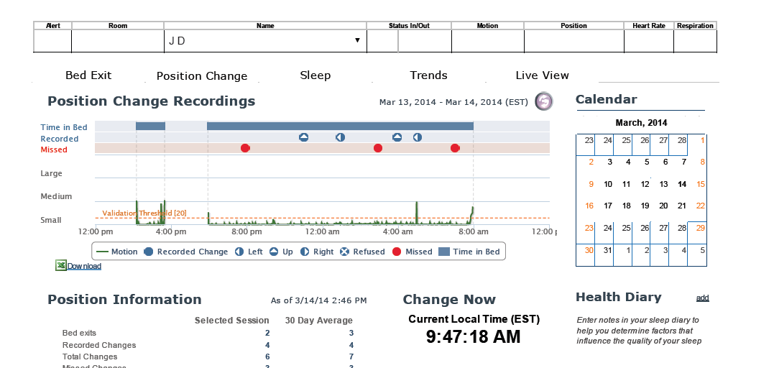

Slide 12
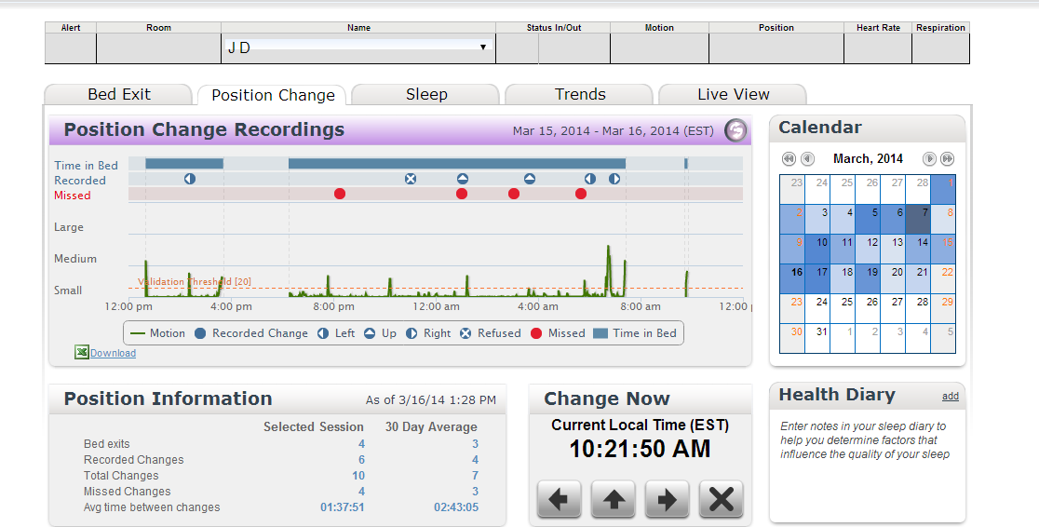

Slide 13
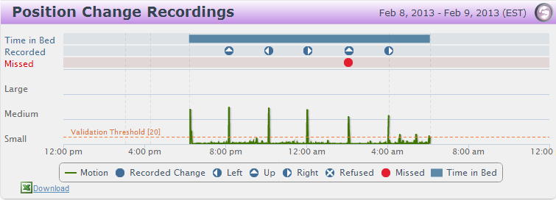
Position Change Validation Report
Verify
Notes:
Position change overview provides documented turns, validated turn motion and refused turns.
The only solution on the market that will automatically validate the movement of your turns. Biometric validation = the motion coincides with the documented turn
Customize your own thresholds by bed/patient to capture the validation of movement.

Slide 14
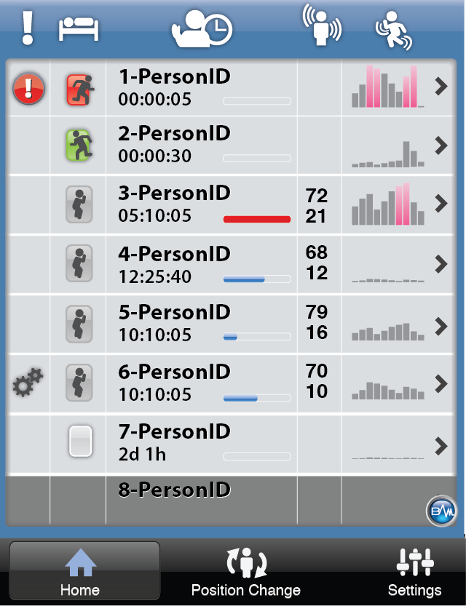
40%
Reduction in Falls
Caregivers receive an alert message on their mobile device when a patient gets in or out of bed to help reduce falls.
Notes:
Target market: 31.63% Moderate – High Risk for wounds = 506,000 LTC beds nationwide.

Slide 15
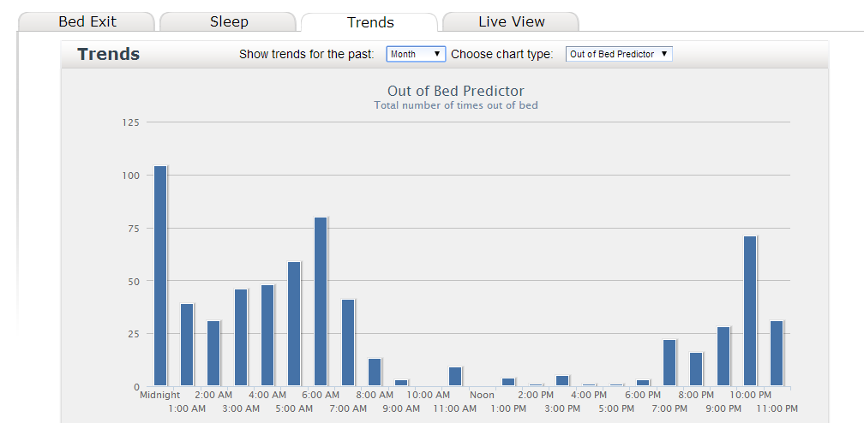

Slide 16
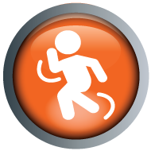
The BAM Labs cloud platform.

Slide 17
Conclusion
Reduce falls
Reduce pressure ulcer development
Validate best practice
Reduce risk factors based on evidence based factual data
Customize care plans for new residents
Increase quality of care

Slide 18
THANK YOU!!!!!

