Slide 1
Welcome

Slide 3
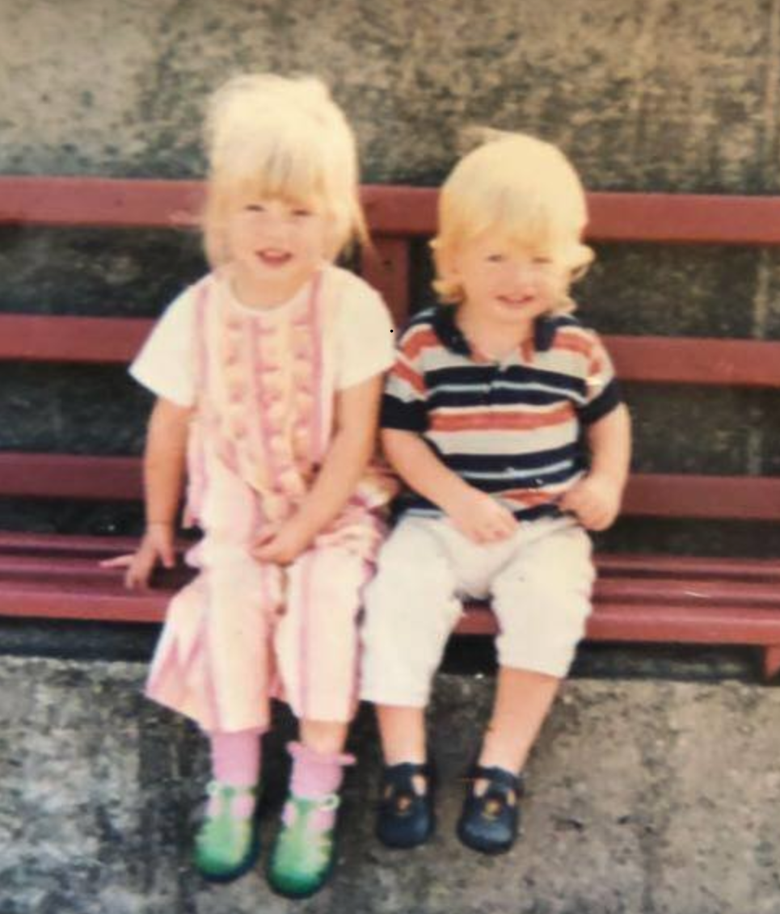

Slide 4
13% of employees are actively engaged
26% of employees are disengaged

Slide 7
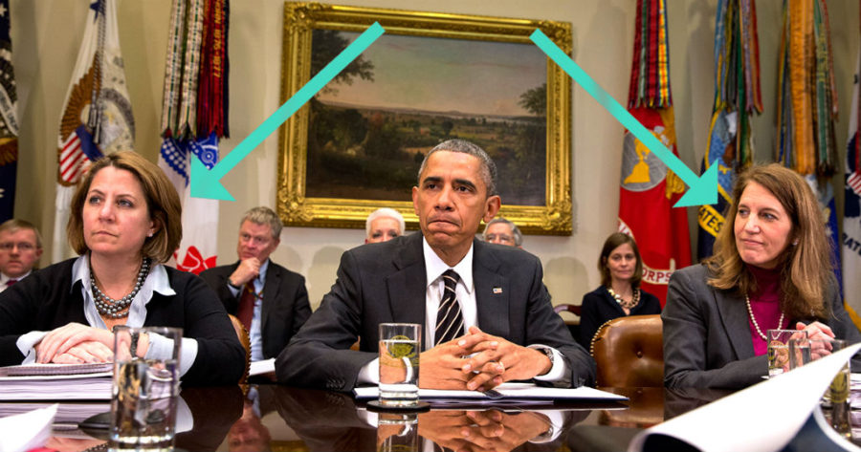

Slide 8
