Slide 1
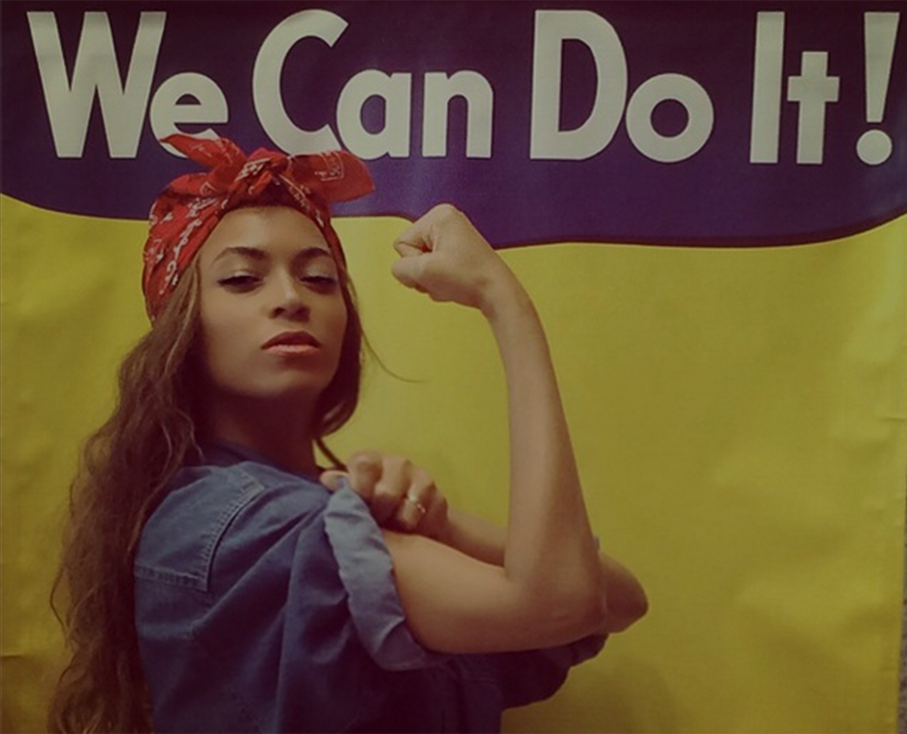
Me,
Myself, Yourself,
& I. We.
Inspiring & Promoting the next Generation
15 Nov 2018
Dr Anne-Marie Imafidon MBE
@aimafidon
Notes:
Almost “If you want my future, forget my past” - wannabe

Slide 2
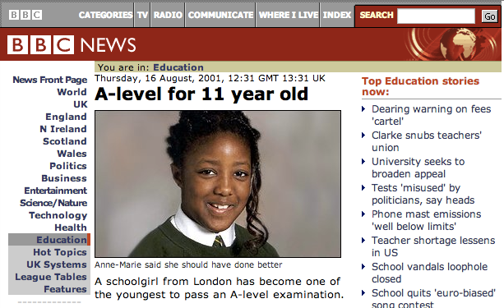
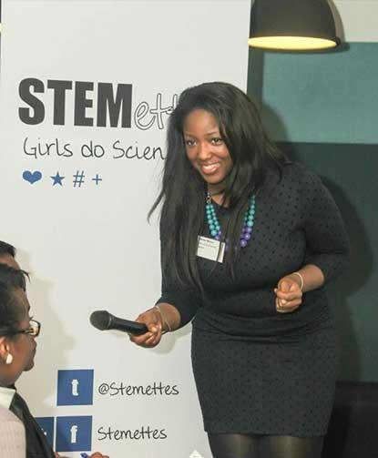
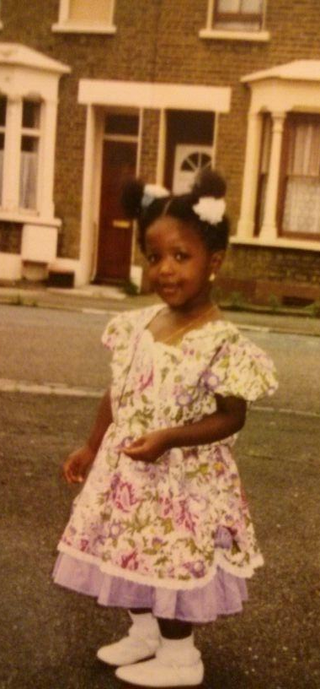

Slide 4
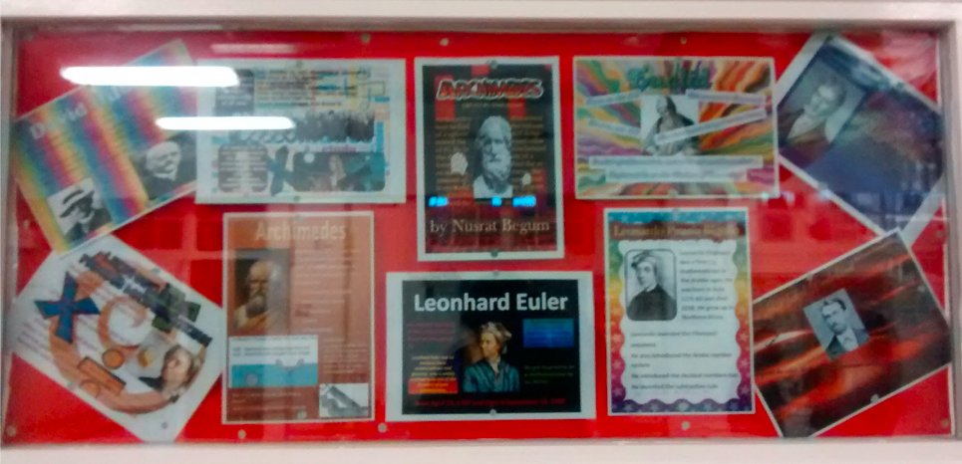
Notes:
5mins - learn future from the past
Past of STEM is a whole field of study. Its been about discoveries of new things and using old knowledge in new ones.
Stories told abound. Collectively there are huge parts they miss. These parts are the key to the future.

Slide 5
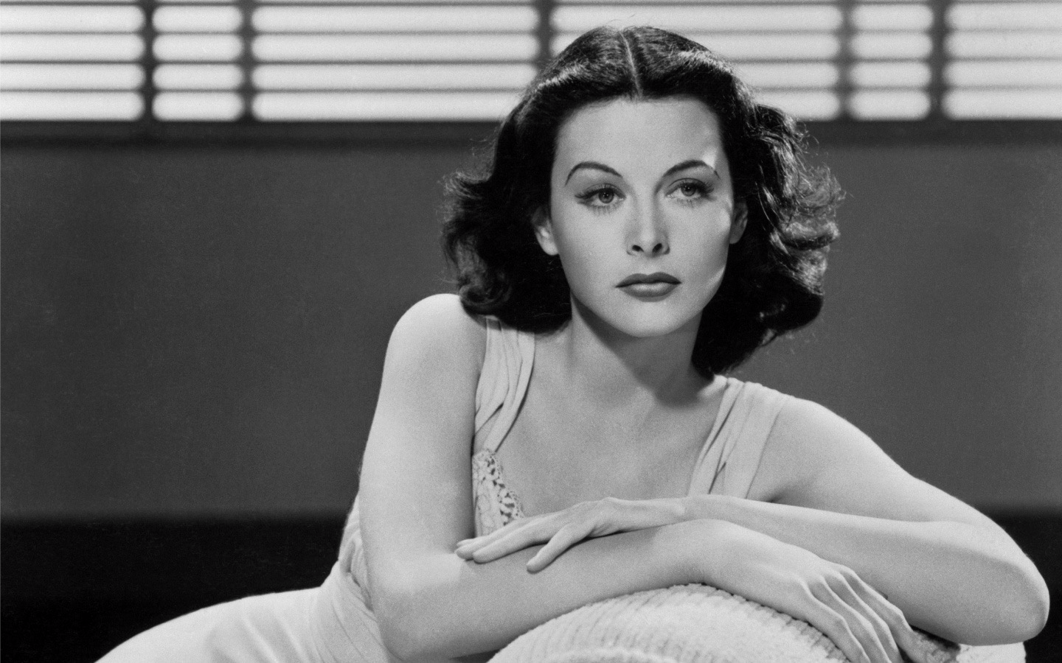
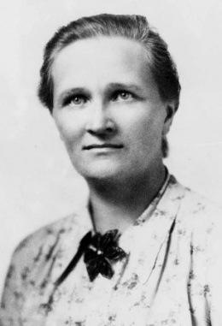
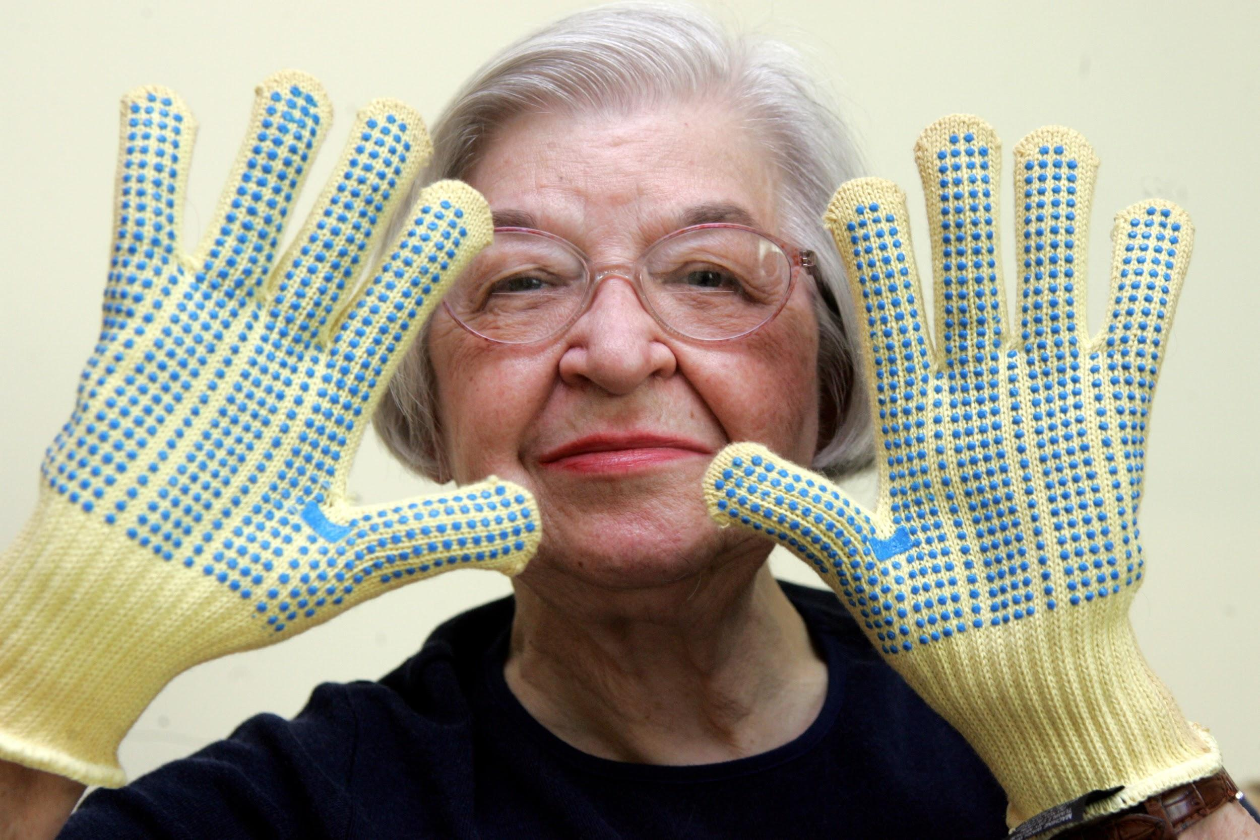
Notes:
History: Hedy Lamarr. Kwolek, Nesmith Graham, sophie marie germain, cctv lady

Slide 6
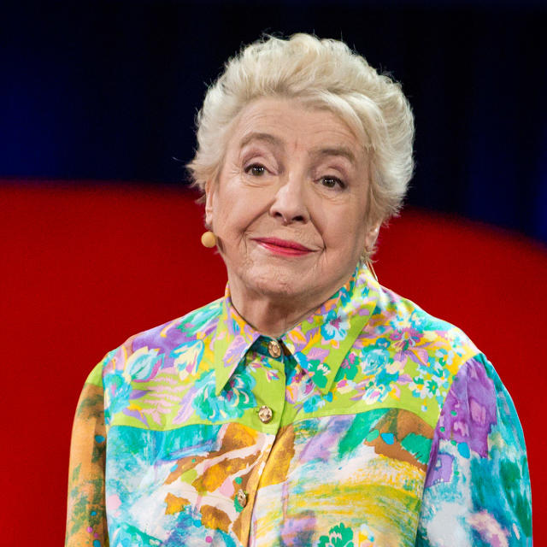
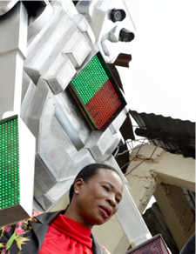
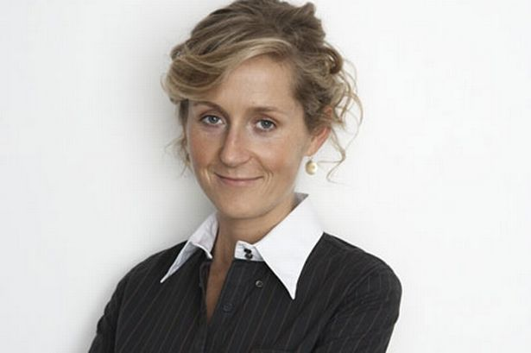
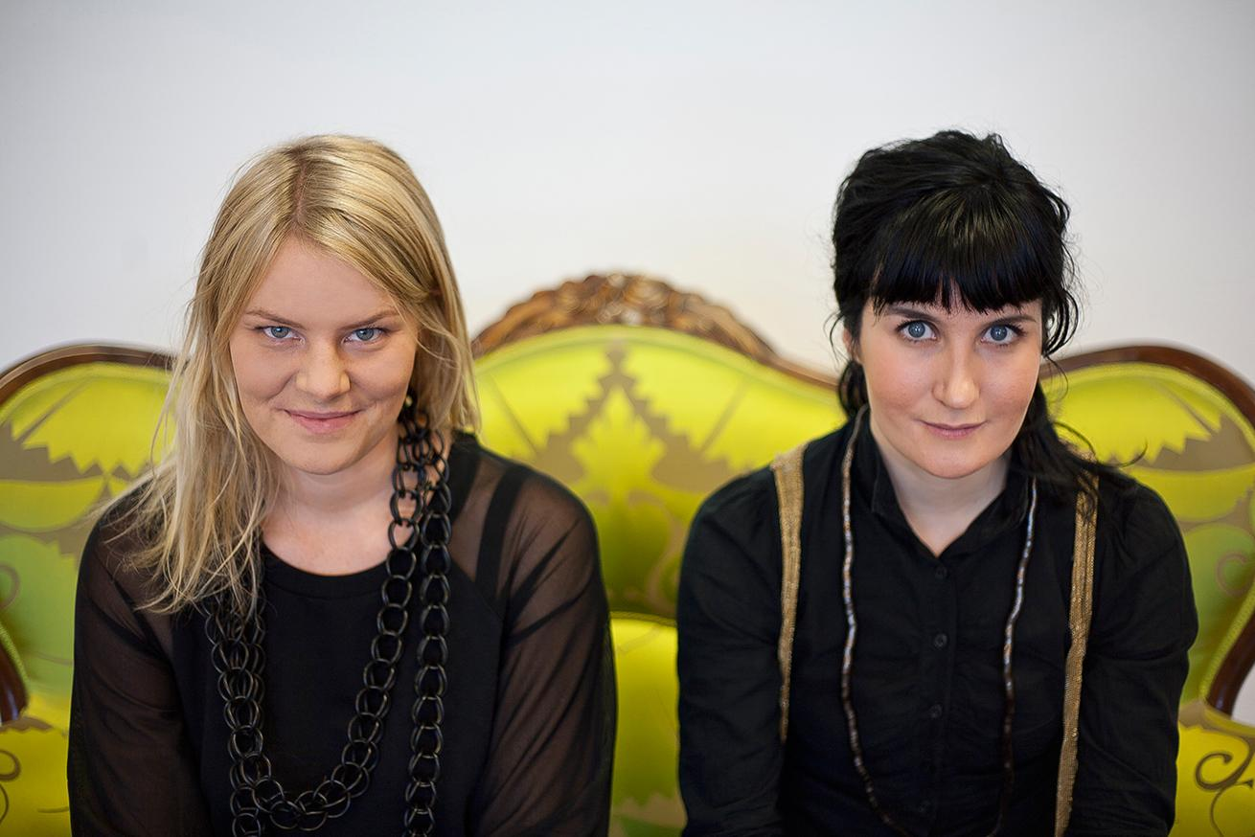
Notes:
Still alive: hovdig, lastminute, steve shirley.

Slide 7
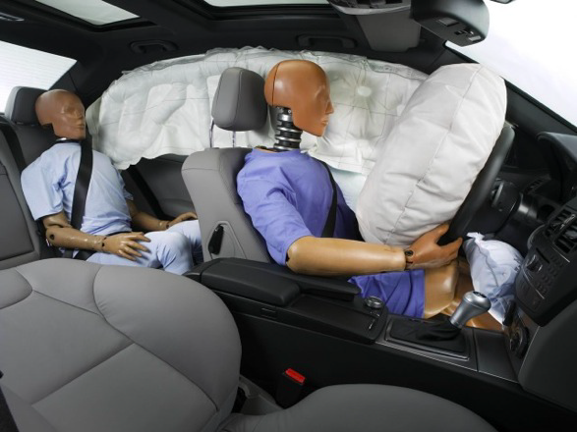
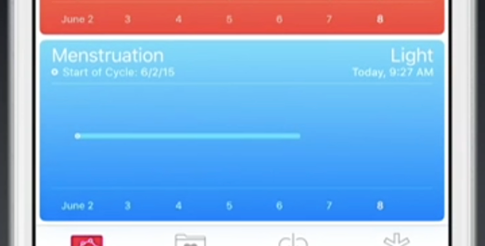
Notes:
Discoveries also, shaped by perspective.
seat belts, voice recognition, ios health. siri scottish accent.

Slide 8
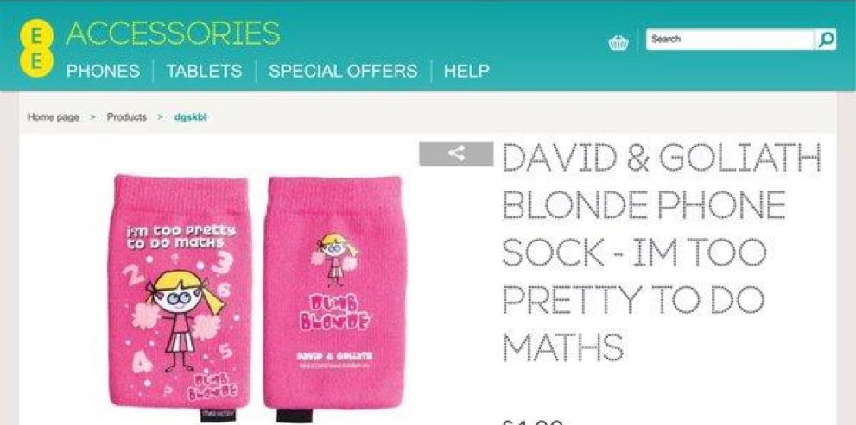
Notes:
Discoveries also, shaped by perspective.
seat belts, voice recognition, ios health. siri scottish accent.

Slide 9
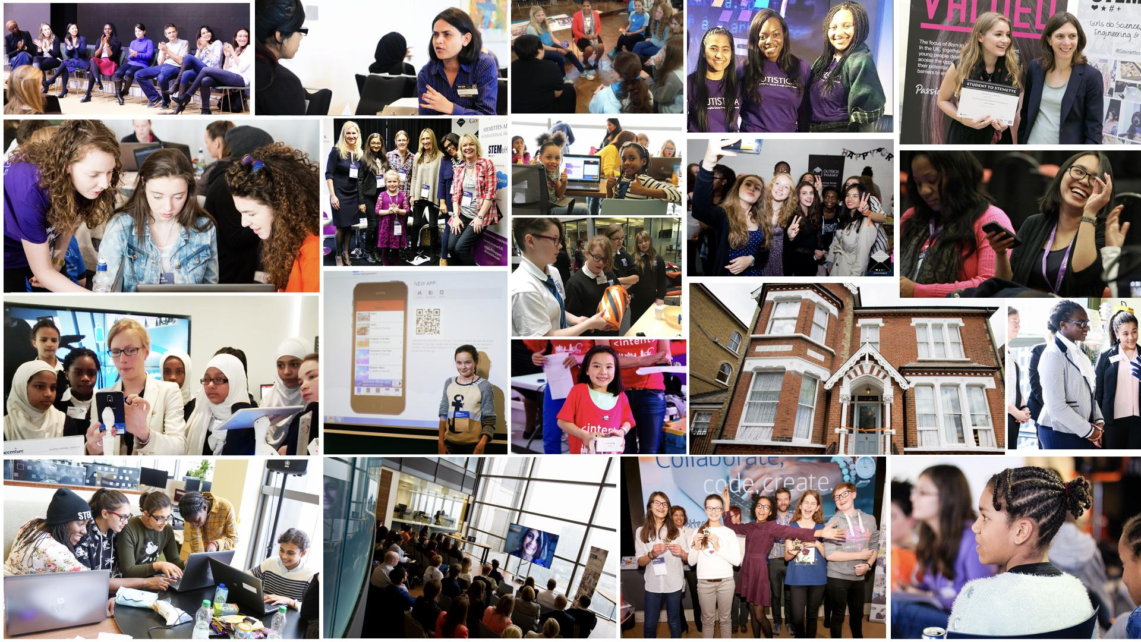
Notes:
Discoveries also, shaped by perspective.
seat belts, voice recognition, ios health. siri scottish accent.

Slide 10
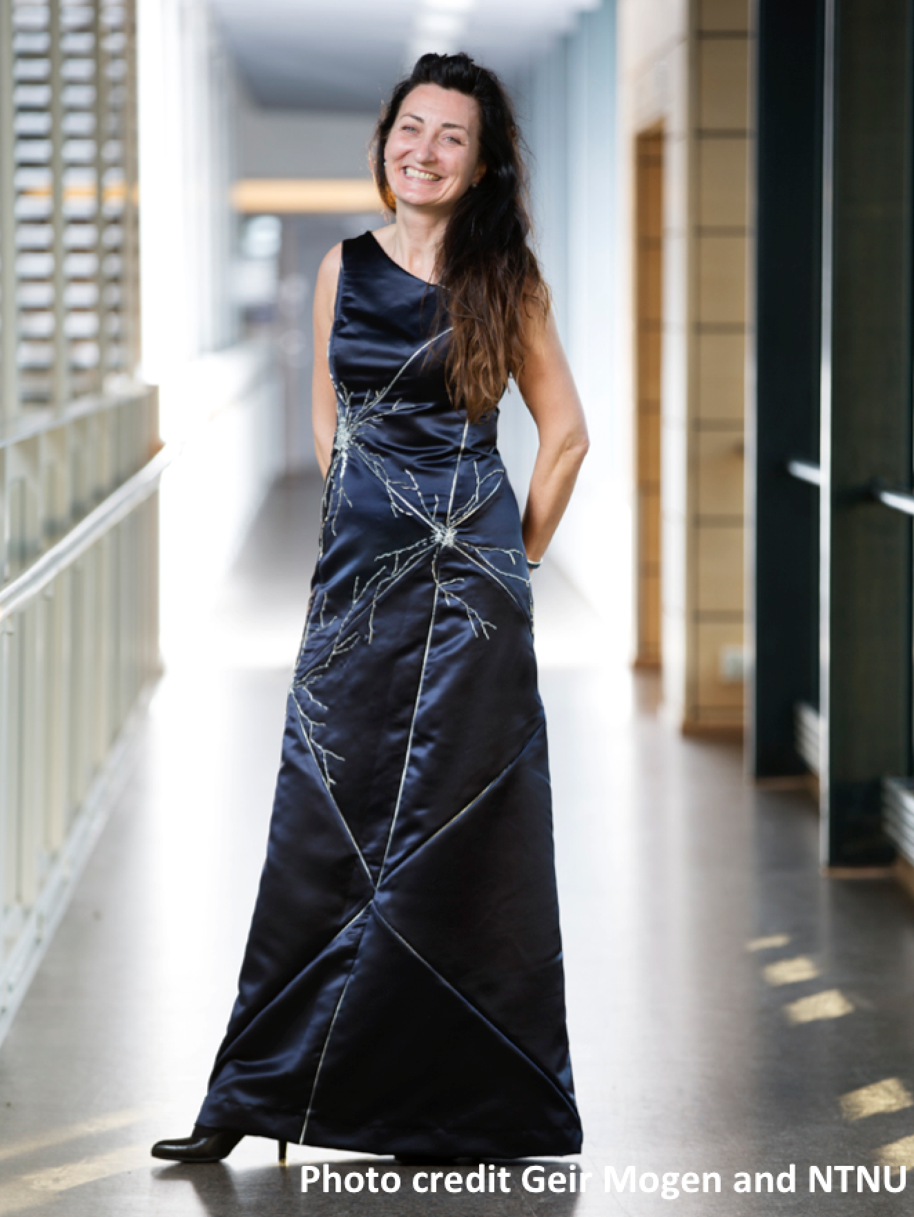
Notes:
Discoveries also, shaped by perspective.
seat belts, voice recognition, ios health. siri scottish accent.

Slide 11
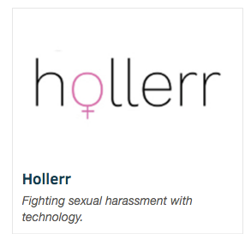
Notes:
Discoveries also, shaped by perspective.
seat belts, voice recognition, ios health. siri scottish accent.

Slide 12
Then those around you:
Your sphere of influence.
Dr Anne-Marie Imafidon MBE
@aimafidon
Notes:
Almost “If you want my future, forget my past” - wannabe

Slide 13
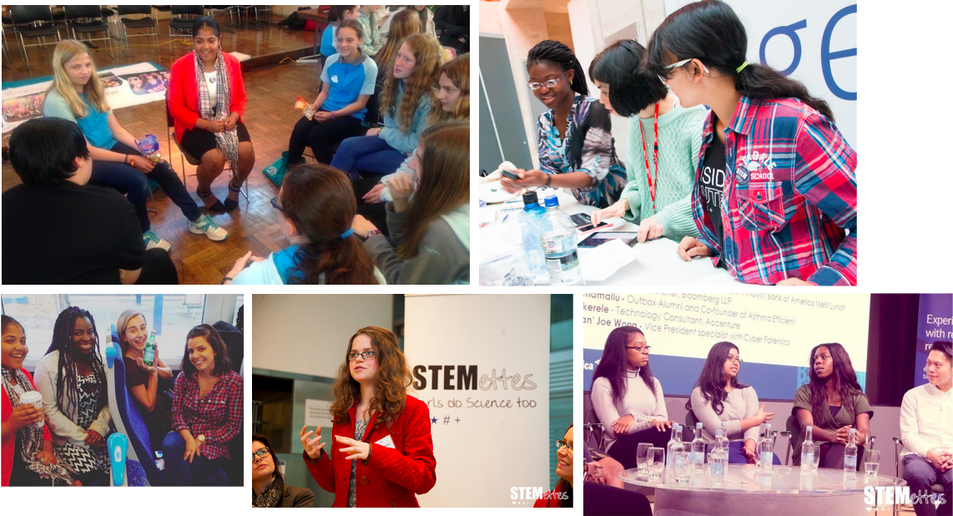
Notes:
Thirdly, the future is more inclusive. Definitely seeing more young women especially step forward to include, learn from and inspire others to create the future.

Slide 14
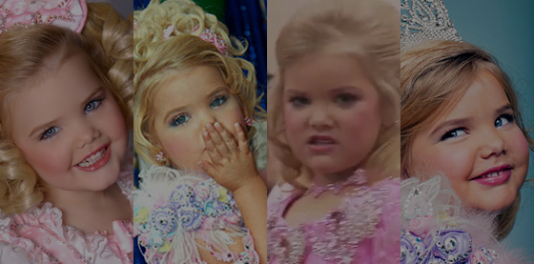
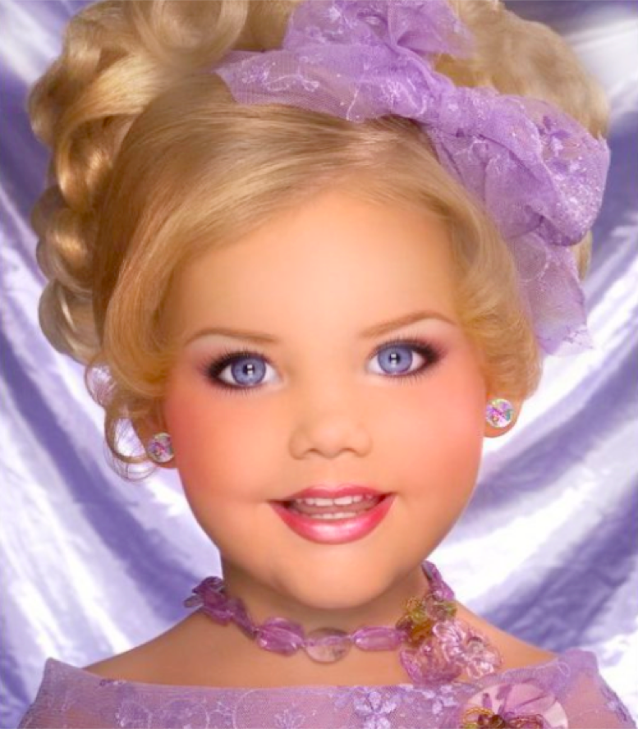
#4
Mentoring vs Sponsoring

Slide 15
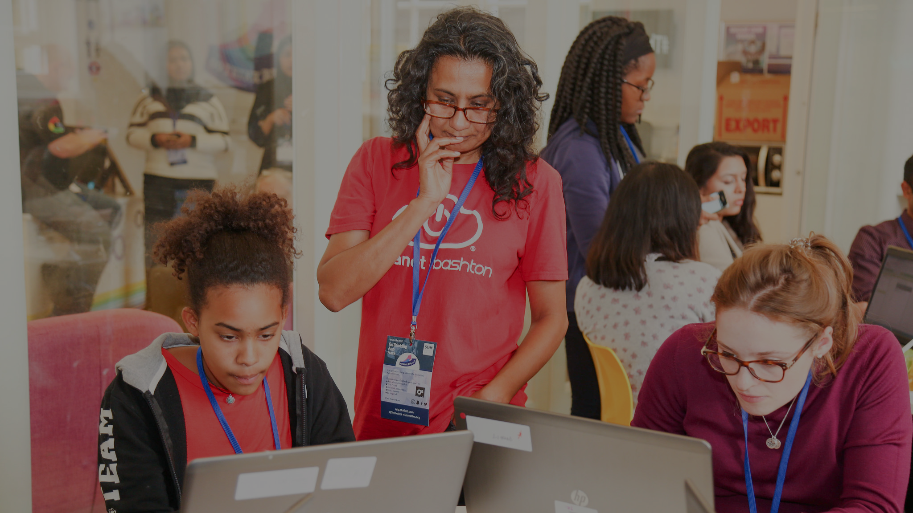
#5
Always promote learning; a tribe helps

Slide 16
#6
Embrace failure. Be open to new scary opportunities.

Slide 17
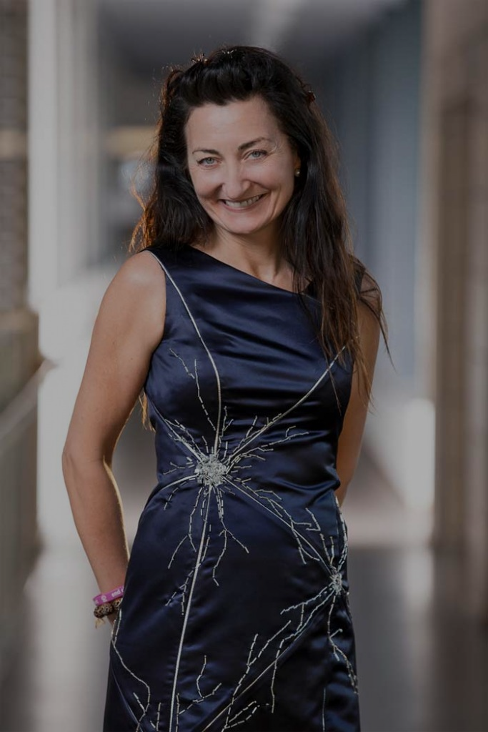
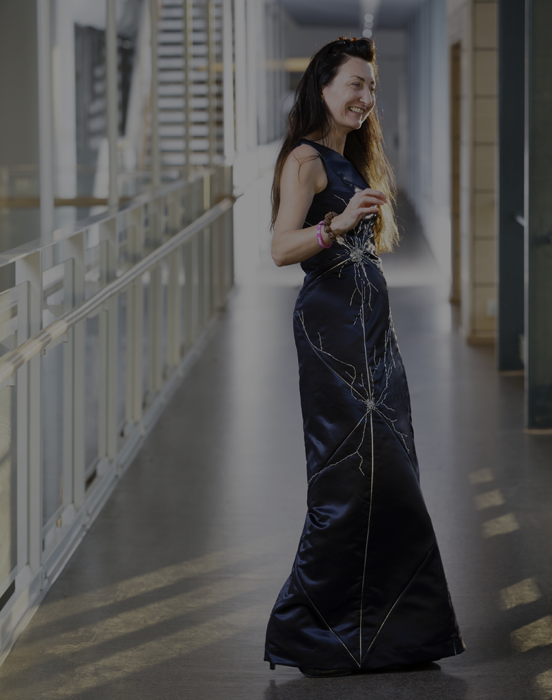
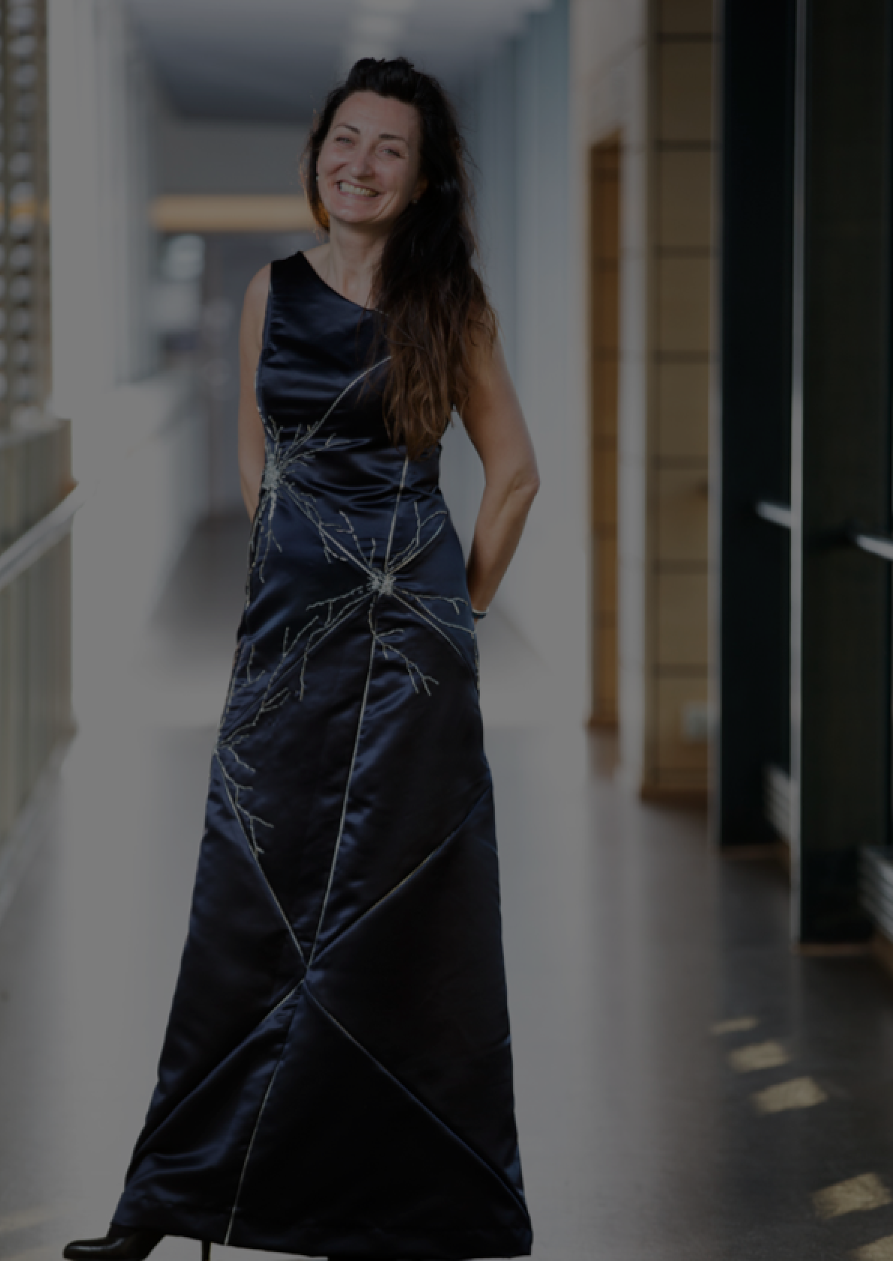
#7
Bring your whole self to work.

Slide 18
We, the organisation:
UnIntentionally exinclude.
Dr Anne-Marie Imafidon MBE
@aimafidon
Notes:
Almost “If you want my future, forget my past” - wannabe

Slide 19
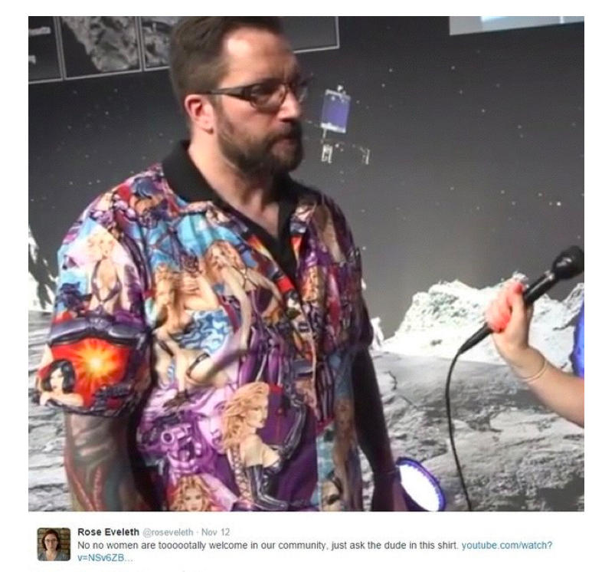
Notes:
Discoveries also, shaped by perspective.
seat belts, voice recognition, ios health. siri scottish accent.

Slide 20
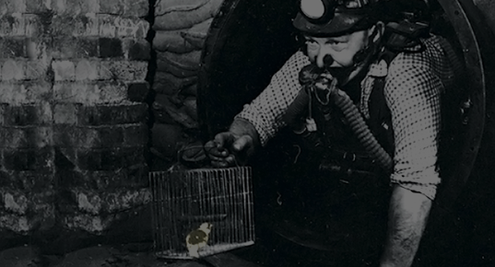
#8
Canary in a coal mine?

Slide 21
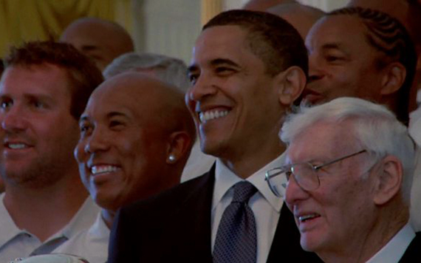
#9
Balanced recruitment for a balanced team.

Slide 22
#10
Culture is all of us.

Slide 23
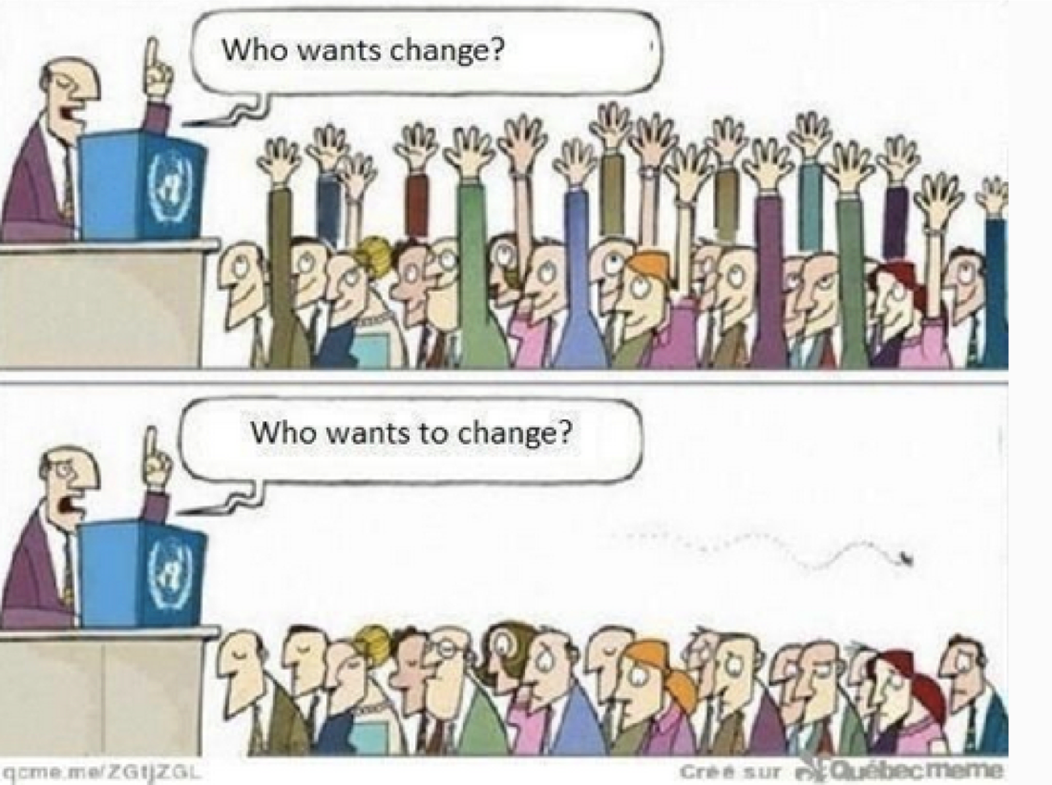
Notes:
Discoveries also, shaped by perspective.
seat belts, voice recognition, ios health. siri scottish accent.

Slide 24
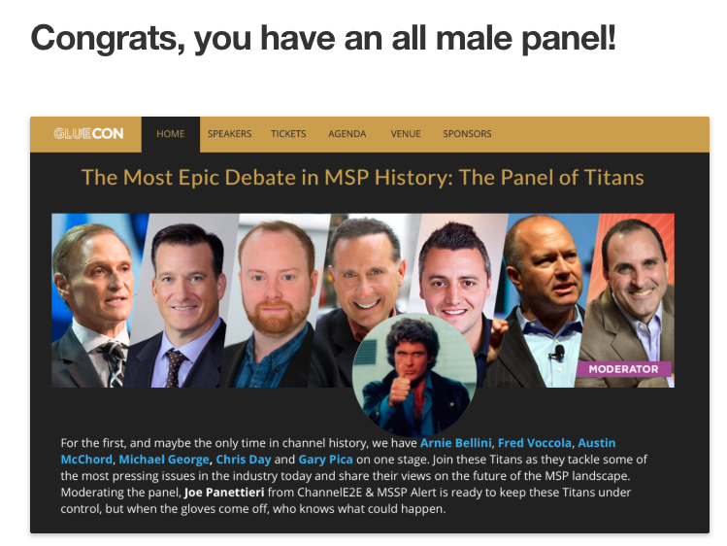
Notes:
Discoveries also, shaped by perspective.
seat belts, voice recognition, ios health. siri scottish accent.

Slide 25
Me,
Myself, Yourself,
& I. We.
22 Jan 2018
Dr Anne-Marie Imafidon MBE
@aimafidon
Notes:
Almost “If you want my future, forget my past” - wannabe

