Slide 1
Resilience : a business asset

Slide 2
AGENDA
Introduction : Lizzie Cohen- Laloum VP sales Fortinet
Why RESILIENCE
What do people say about resilience
Definition
What is the value for the business
How to develop resilience
take away

Slide 3
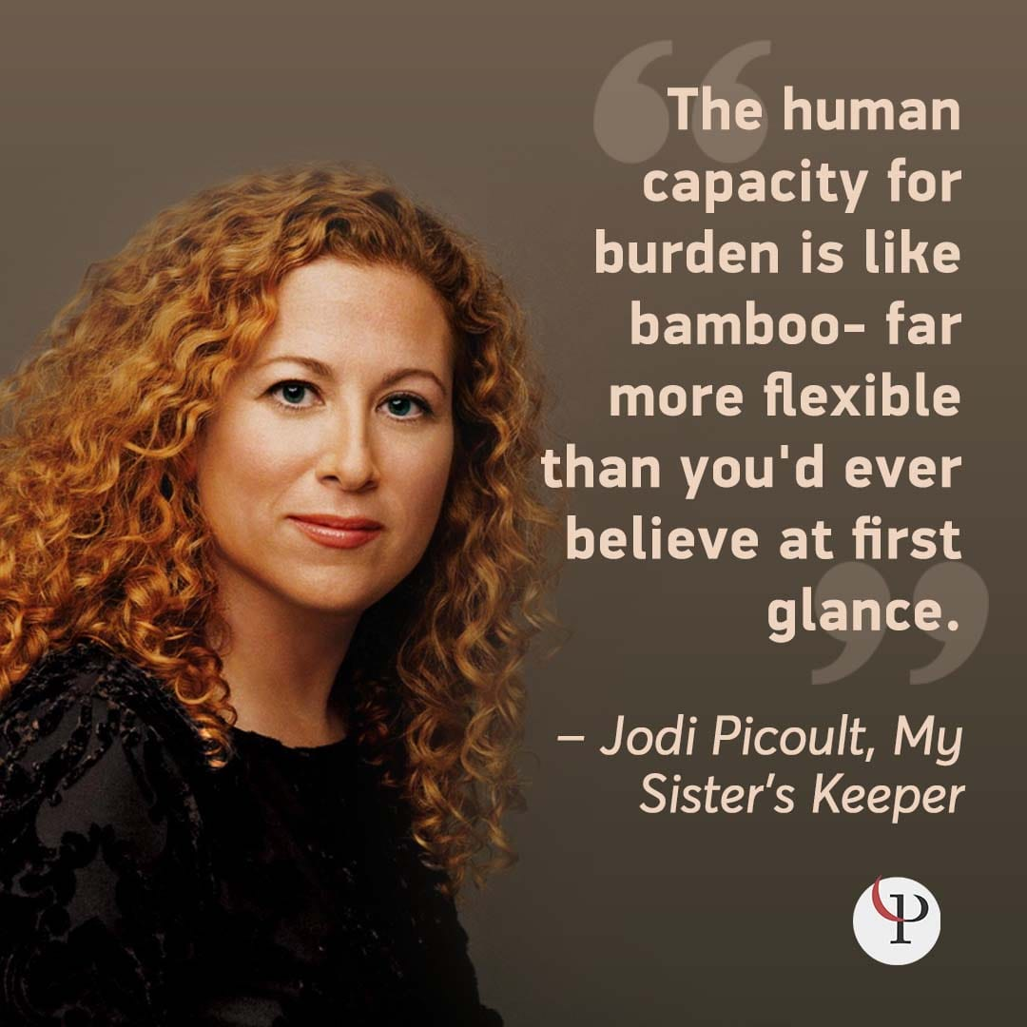

Slide 4
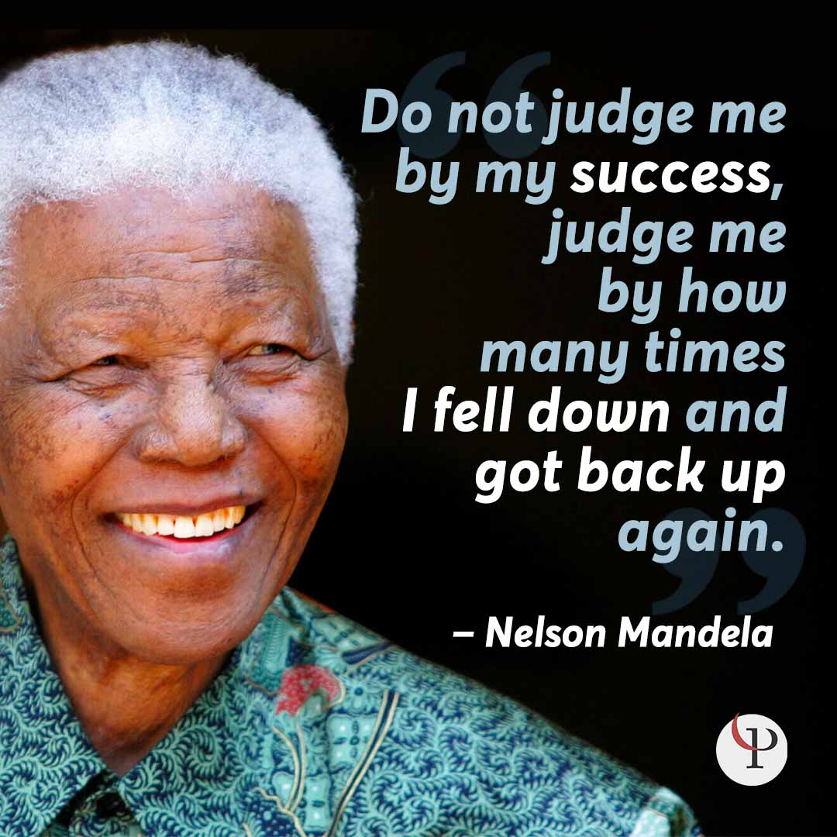
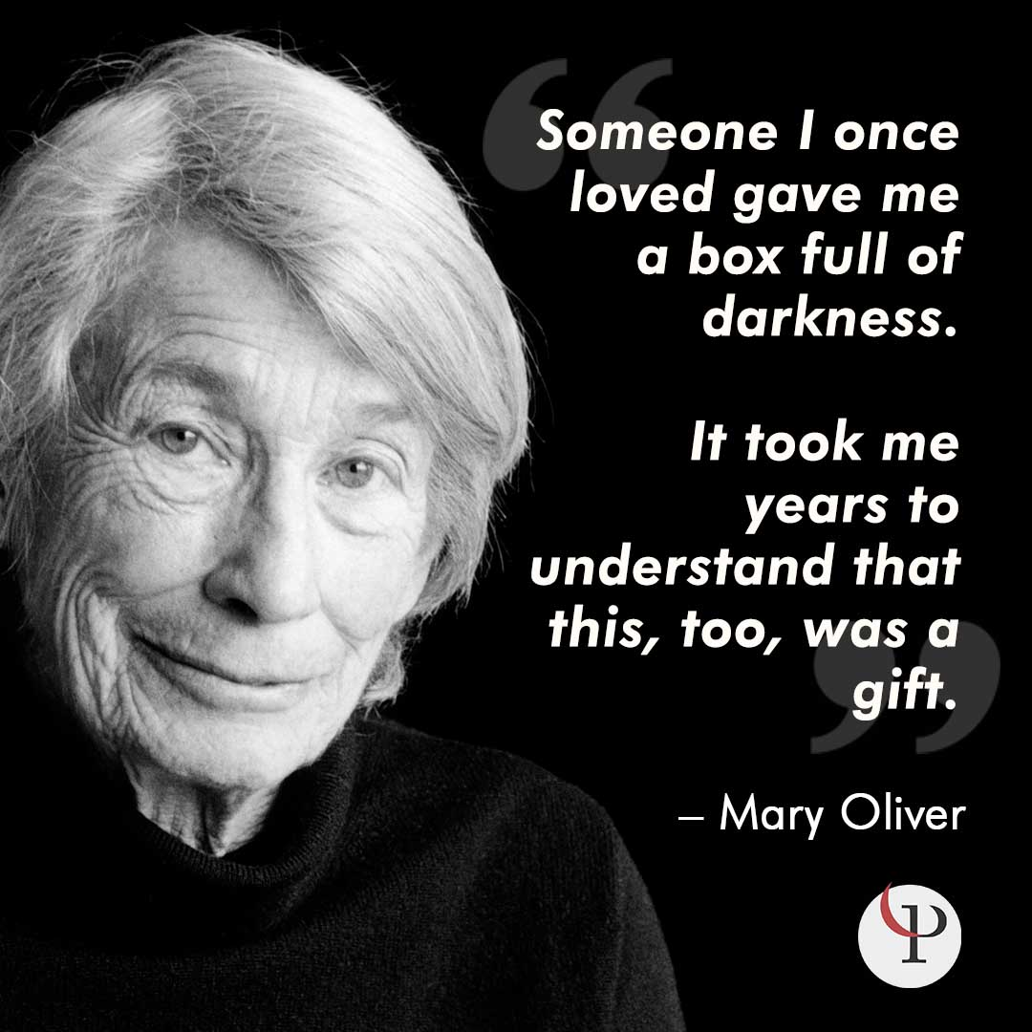

Slide 5
RESILIENCE : definition
Resilience is a scientific term that applies to materials that have the capacity to return to their original shape after being bent or stretched. Over time, however, we have come to apply the term to people as well. People who have the ability to recover readily from illness, depression, defeat, or other kinds of adversity.
It can be built and developed over time.
The U.S. Department of Health and Human Services (2015) defines individual resilience as the ability to withstand, adapt to, and recover from adversity and stress. In other words, resilience can manifest as maintaining or returning to one’s original state of mental health or well-being or reaching a more mature and well-developed state of mental health or well-being through the use of effective coping strategies.

Slide 6
There is no single accepted set of components of resilience:
Optimism – those who are optimistic tend to be more resilient as well since they are more likely to stay positive about the future even when faced with seemingly insurmountable obstacles.
Altruism– the most resilient among us often turn to help others when they need to relieve stress and boost their self-efficacy.
Moral Compass – people with a strong moral compass or steadfast set of beliefs about right and wrong generally have an easier time bouncing back.
Faith and Spirituality – while not a required factor for resilience, people often find their faith helpful in surviving challenges and coming through stronger and wiser on the other side.
Humor – people who have a healthy sense of humor and are able to laugh at their own misfortune are at an advantage when it comes to bouncing back, for obvious reasons!
Having a Role Model – this is also not a requirement for resilience, but those who have a role model in mind can draw strength from their desire to emulate this person.
Social Supports – unsurprisingly, social support is important when it comes to resilience; those with strong social support networks are better equipped to bounce back from loss or disappointment.
Facing Fear – this is not so much a characteristic as an action or tendency to act, but people who are willing to leave their comfort zone and confront their fears are more likely to overcome their challenges and grow as a person.
Meaning or Purpose in Life – it shouldn’t be surprising that those who feel they have a specific purpose in life or find a tremendous amount of meaning in their lives are more likely to recover from failure or disappointment; when you fervently believe you have a purpose, you are less likely to give up when faced with tragedy or loss.

Slide 7
RESILIENCE CAN BE MEASURED
using 8 different scales depending on the purpose (you can test and measure your own resilience)
For instance Connor Davidson scale to measure post traumatic stress disorder (war veterans, trauma..)
RSA scale for Health and clinical psychology
SPF scale of protective factor to measure how children have survived trauma
Develop your own resilience : use tactics to identify your inner strength and dilute stress.
RESISTANCE AT WORK : WHY
Work environment is not always positive critical feedback, failure at work, stress, resilience is the way to bounce back, increase productivity and well being at work
Even facing positive changes, increased responsibility, forward progress, can all result in the need for adaptation and recovery.

Slide 8
“As a leader, apologize for making mistakes. Don’t apologize for making decisions.”

Slide 9
Good reasons for organizations to train employees to be resilient :
-General employee well being
-career development : coaching on facing adverse work situation and not diminishing selfconfidence
-encouraging learning curve and innovation
-improving team dynamics
Highly resilient employees :
Develop high-quality connections
Manage stress effectively and avoid burnout
Act authentically and in accordance with their strengths and values
Develop Grit (the passion and perseverance to pursue long-term goals)
Stay inspired and find meaning
Stay flexible and mentally tough
Actively manage change and setbacks

Slide 10
THE GOOD NEWS IS RESILIENCE CAN BE BUILT
Different methods available and documented :
ABCDE (Adversity, Belief, Consequence, Disputation, energization)
The 3 musketeers of resilience
The 7 pillars of resilience
All methods can be used at individual level to build own resilience or at corporate level to build resilient workforce.
How do I strengthen my resilience :
Personal coaching available.
10 points method

Slide 11
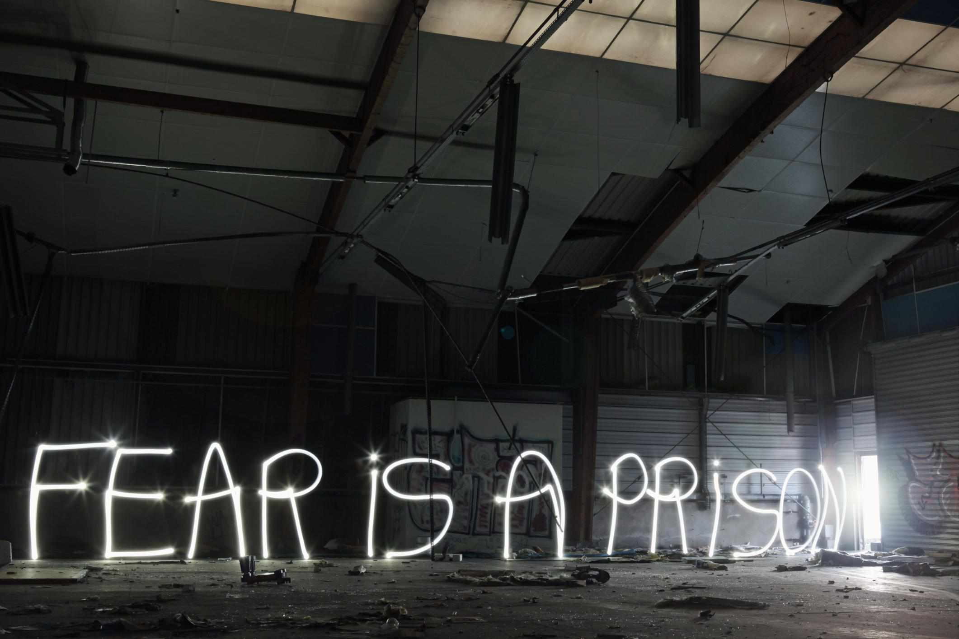
Build Positive Beliefs in Your Abilities
Find a Sense of Purpose in Your Life

Slide 12
Develop a Strong Social Network
Embrace Change
Be Optimistic
Nurture Yourself
Nurture Yourself
Nurture Yourself
Nurture Yourself
Nurture Yourself

Slide 13
Develop Your Problem-Solving Skills
Establish Goals
Take Action to Solve Problems
Keep Working on Your Skills

Slide 14
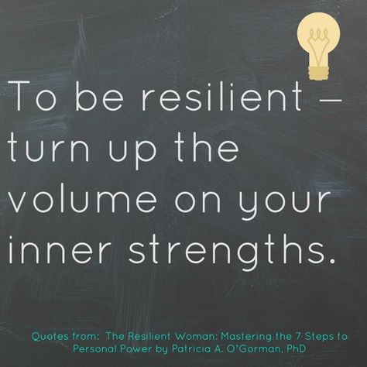

Slide 15
The development of resilience can be enhanced by organizations through:
Leading by example and building resilience at the executive level and in the management team
Fostering a sense of purpose and helping employees find meaning in their work
Promoting a sense of control and self-confidence in employees
Managing change effectively and responsibly to ensure that change is seen as an opportunity rather than a roadblock
Encouraging employee connections, whether formal or informal, through mentorship and company-recognized employee interest groups
Addressing stress levels, both in the organization as a whole and in individual employees
Nurturing a healthy sense of humor in the workplace (the appropriate level will depend on the organization and the industry)
Fostering grit and mental toughness in employees
Providing as many opportunities as possible for learning and professional development
Staying optimistic and using positive messaging
Encouraging flexibility and adaptability in employees, workgroups, and the organization as a whole
Building problem-solving skills at all levels of the company
Promoting good habits for physical and mental health

Slide 16
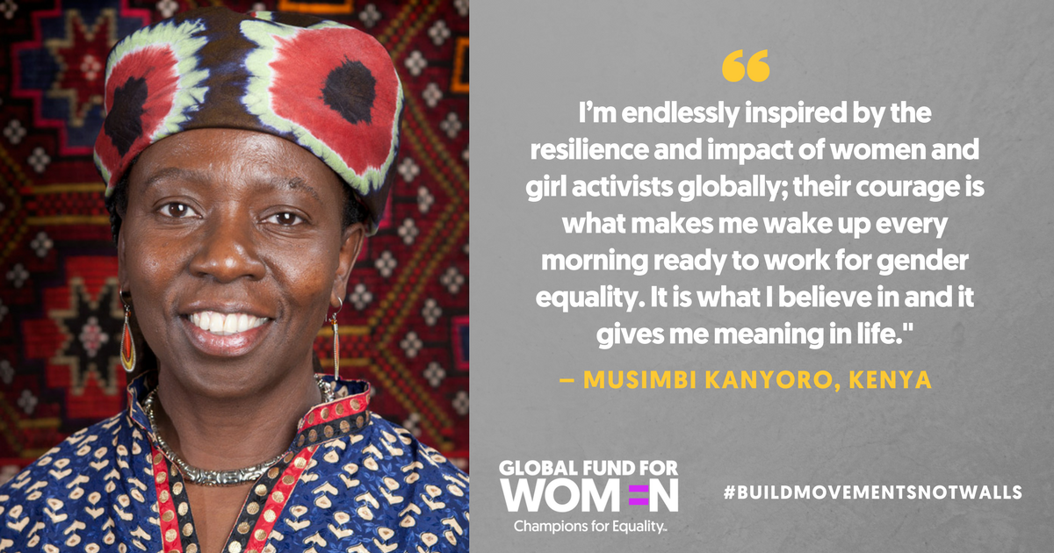

Slide 17
One ask from each of you :
Identify your resilience score and take one or two action items where you feel you can improve
For companies HR people in the room
Is your company aware of resilience and promoting this through the teams?
THANK YOU FOR YOUR TIME

