Slide 1
Digital Mammography Quality Improvement April 14, 2018
Trisha Kim, M.D.
Kaiser Permanente
South Bay Medical Center
Department of Diagnostic Imaging

Slide 2
Disclosure
Today’s faculty: Trisha Kim, M.D. does not have any relevant financial relationships with commercial interests or affiliations to disclose.

Slide 3
Overview - Objectives
ACR Guidelines in Image Quality and Positioning
To evaluate screening mammogram image quality.
To understand the components of a properly positioned screening mammogram.
To provide high quality screening mammograms which promote early detection of breast specific disease.
Pitfalls and Artifacts
To recognize hardware and patient related artifacts specific to digital mammography and how to correct them in order to provide optimal image quality.
Interesting Cases
To understand how certain non-breast related physical conditions can manifest on a mammogram image.
To recognize normal variants and interesting anatomy.

Slide 4
ACR Guidelines in Image Quality and Positioning
CC view:
At least one image from each breast should demonstrate nipple in profile.
The distance between the nipple and the posterior edge of the image should be no more than approx. 1 cm less than that on the MLO view.
Pectoralis muscle seen in 20-30% of cases.
Show as much medial tissue as possible: the portion of the breast that might be incompletely shown on the MLO view.

Slide 5
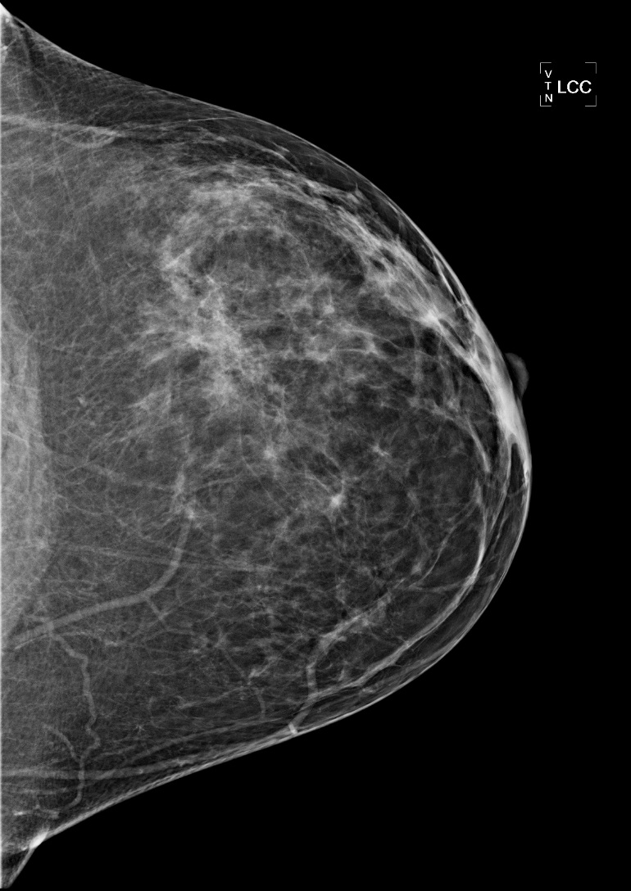
ACR Guidelines in Image Quality and Positioning

Slide 6
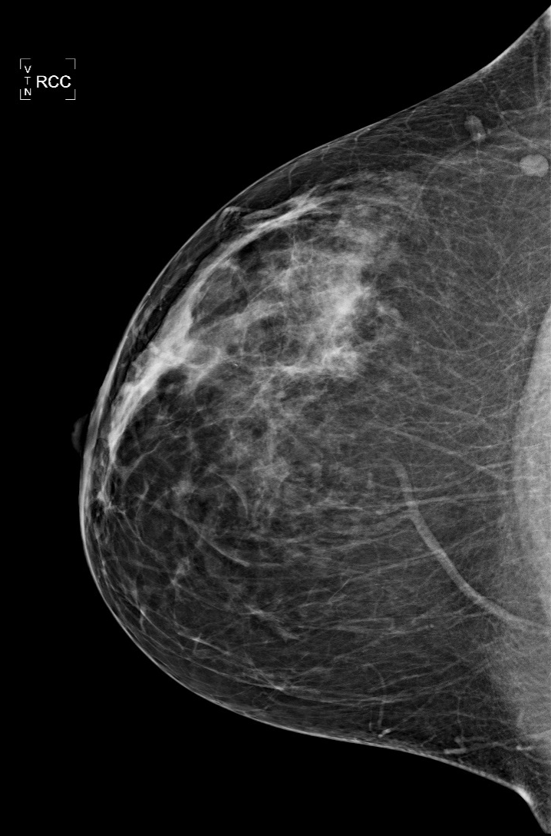
ACR Guidelines in Image Quality and Positioning
The distance between the nipple and the posterior edge of the image should be no more than 1 cm less than the distance between the nipple and pectoralis muscle on the MLO view
No less than 9 cm
10 cm

Slide 7
ACR Guidelines in Image Quality and Positioning
MLO view:
At least one image from each breast should demonstrate nipple in profile.
The anterior edge of the pectoralis muscle on the MLO view should be convex.
Pectoralis muscle should extend to at least the level of the nipple.
Inframammary fold will be open and its posterior extent visualized.

Slide 8
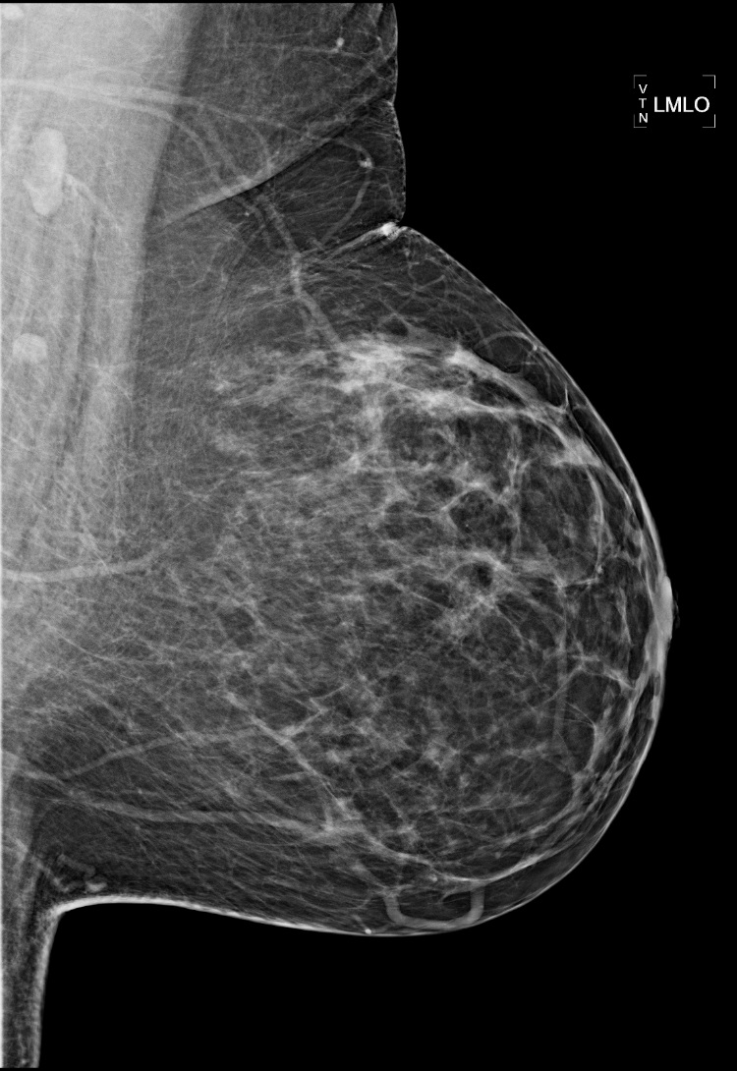
ACR Guidelines in Image Quality and Positioning

Slide 9
ACR Mammography Accreditation Clinical Image Quality
Top 10 Reasons for Image Submission Failures
Deficiency | Approx. Frequency
Inadequate pectoralis muscle on the MLO | 22%
Sagging of the breast on the MLO | 14%
Poor visualization of posterior tissue on MLO | 14%
Skin folds overlying breast tissue | 12%
Poor visualization of posterior tissue on CC | 11%
PNL on CC not within 1 cm of MLO | 10%
Excessive lateral or medial exaggeration on the CC | 6%
Breast too high on receptor | 4%
Portion of breast cut off | 3%
Other | < 5%

Slide 10
Interesting Cases
Importance of a properly positioned mammogram

Slide 11
Case 1
May 2013
March 2014

Slide 12
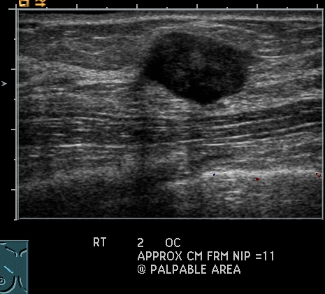
Case 1
Path: 1.6 cm Infiltrating Ductal Carcinoma + DCIS
March 2014

Slide 13
Case 2
April 2011
February 2013

Slide 14
Case 2
Path: 2.1 cm Invasive Lobular Ca Invading into chest wall, LCIS
February 2013

Slide 15
Case 3
Nipple NOT in Profile

Slide 16
Case 3
Path: 1.8 cm Pseudoangiomatous Stromal Hyperplasia

Slide 17
Case 4
MLO Sagging Downward
Nipple pointing down
“Camel-Nose”
Poor IMF
Inadequate breast compression

Slide 18
Case 4

Slide 19
Case 4

Slide 20
Case 4
Path: Benign

Slide 21
Pitfalls and Artifacts
Hardware Related Artifacts
Dust/Dirt Artifact
Gridlines
Patient Related Artifacts
Motion, blur
Deodorant, Lotions
Hair, chin, earrings

Slide 22
Hardware Related Artifacts
Dust or Dirt on Compression Paddle
May mimic calcifications or masses. Look for an artifact that is seen on at least two different images but in the same area of the detector (flipped and rotated)
Thorough cleaning of the compression paddles will prevent this type of artifact
Dead pixels may have a similar appearance but persist even after thorough cleaning of the compression paddles

Slide 23
Dust/Dirt on the Compression Paddle

Slide 24
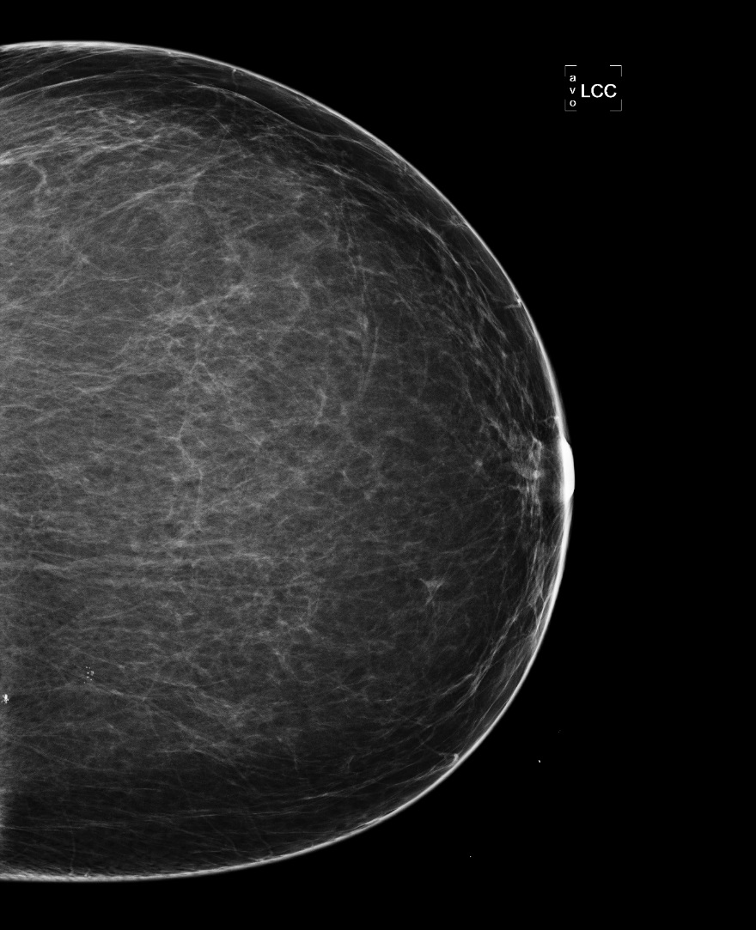
Dust/Dirt on the Compression Paddle

Slide 25
Dust/Dirt on the Compression Paddle
Artifact resolved after thorough cleaning of the compression paddle

Slide 26
Gridlines
Caused by stopping or slowing down of grid oscillation in the receptor causing gridlines to be superimposed upon the image
Seen as alternating thin band lines oriented at 45 degree angle
Repeat exposure and if the artifact persists, call for servicing

Slide 27
Gridlines

Slide 28
Gridlines
Artifact Resolved after Repeat Exposure

Slide 29
Deodorant/Lotion Artifacts
Deodorant
Can mimic calcifications
Most commonly aluminum and zinc containing products

Slide 30
Deodorant/Lotion Artifacts
Deodorant
Can mimic calcifications
Artifact resolved on repeat image after patient thoroughly cleaned the axillary regions

Slide 31
Patient Related Artifacts
Hair Artifact

Slide 32
Patient Related Artifacts
Repeat Image
Hair tied back, Extended face shield

Slide 33
Patient Related Artifacts
Jewelry removed, Extended face shield

Slide 34
Patient Related Artifacts
Pacemaker

Slide 35
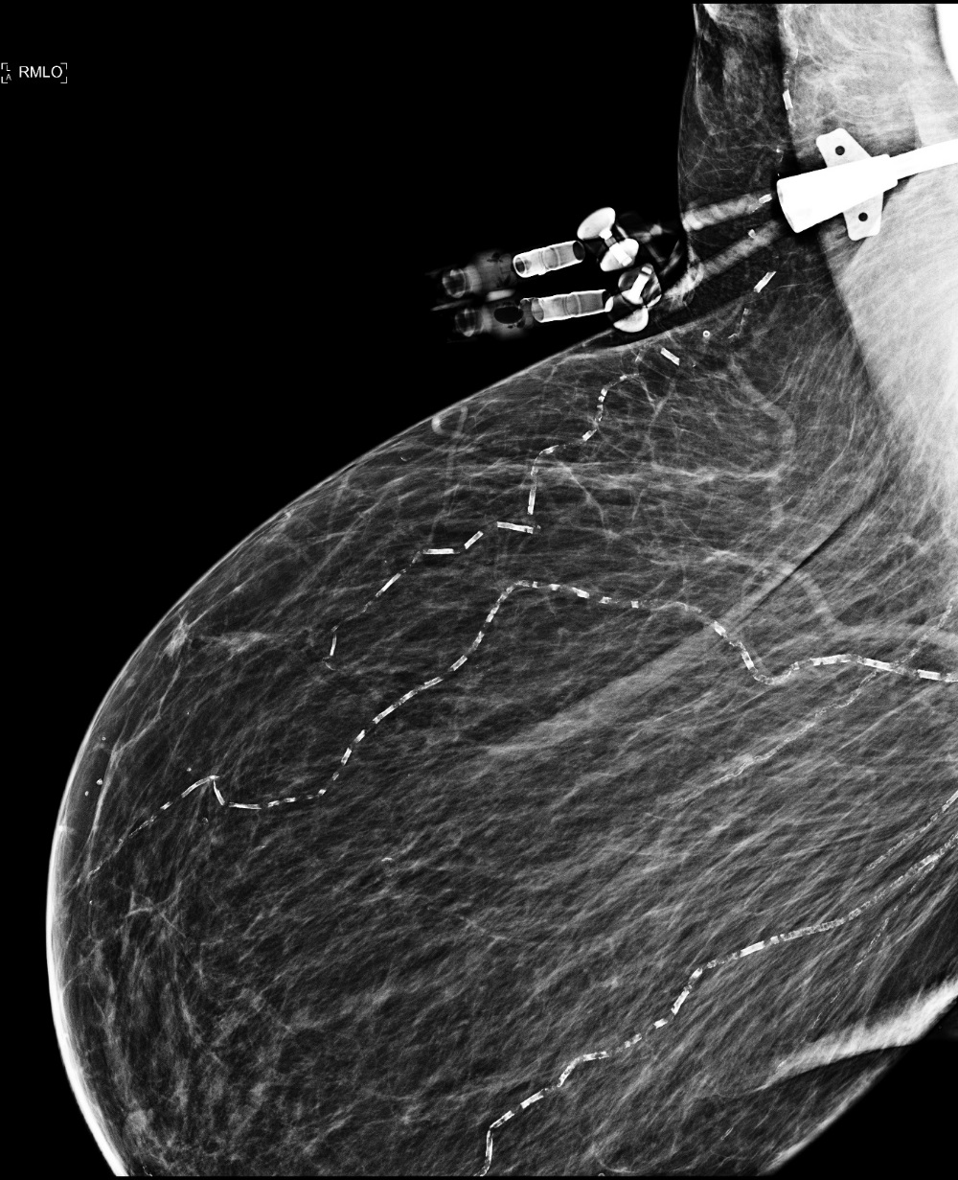
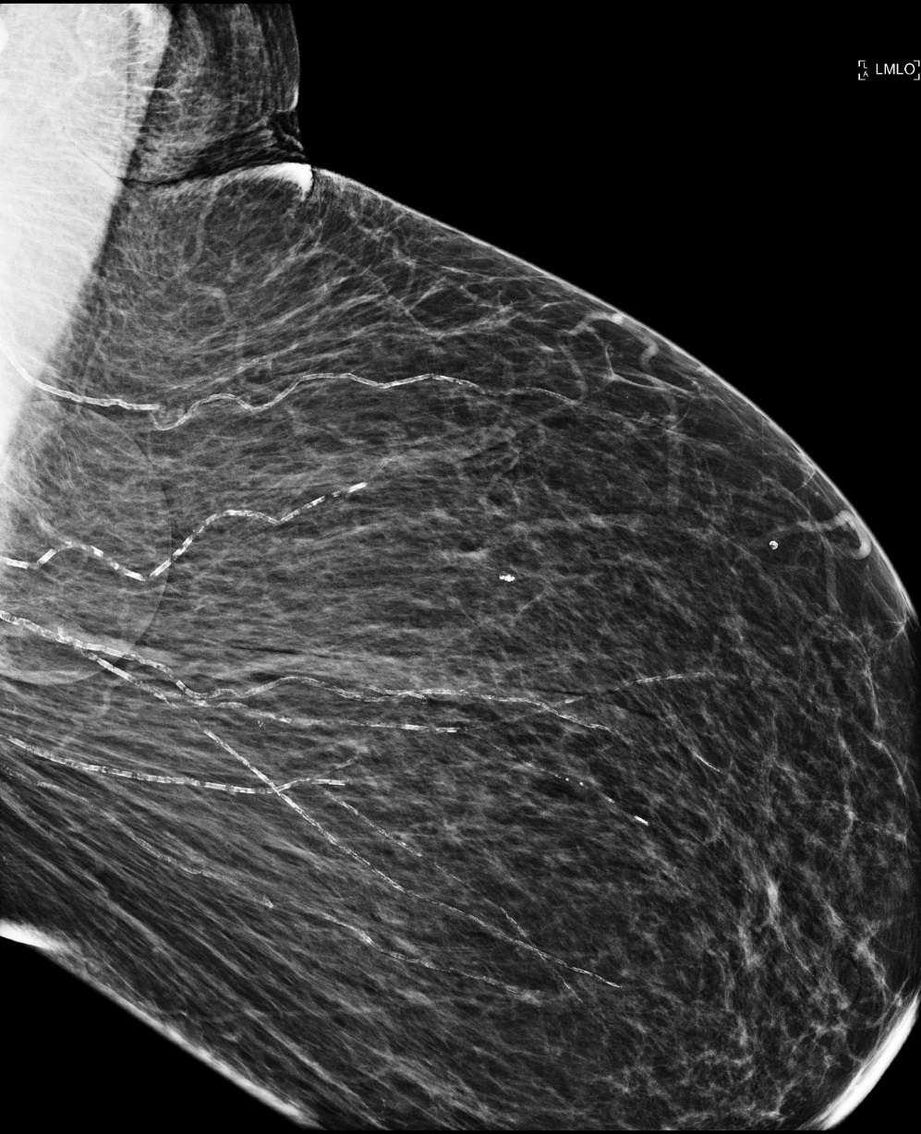
Patient Related Artifacts

Slide 36
Clinical History
History:
Age, weight changes
Menstrual:
Age of first onset
LMP
Age of menopause
Parity: Pregnancy history
Nulliparity: Never born child
Multiparity: Multiple births
Age of first pregnancy

Slide 37
Clinical History
Medications:
Estrogen, Progesterone, BCPs
Prolactin, Steroids
Thyroid, Diabetes medications
Surgical:
Mastectomy, lumpectomy, excisional biopsy
Breast augmentation, reduction
Hysterectomy, oophorectomy
Procedural
Prior breast biopsies
Family History

Slide 38
Clinical History
Visual Inspection:
Moles, sebaceous cysts, pimples
Scarring
Bruising, trauma
Tattoos
Appropriate markers placed and/or documented if applicable

Slide 39
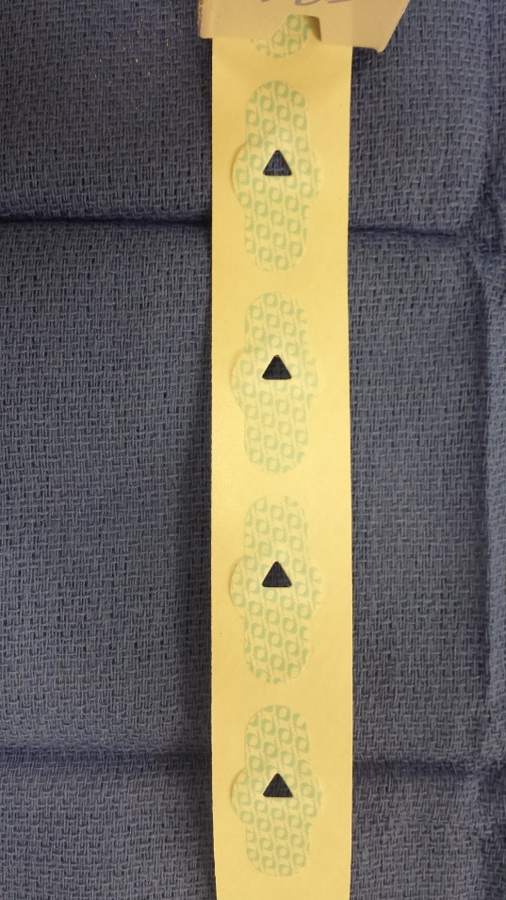
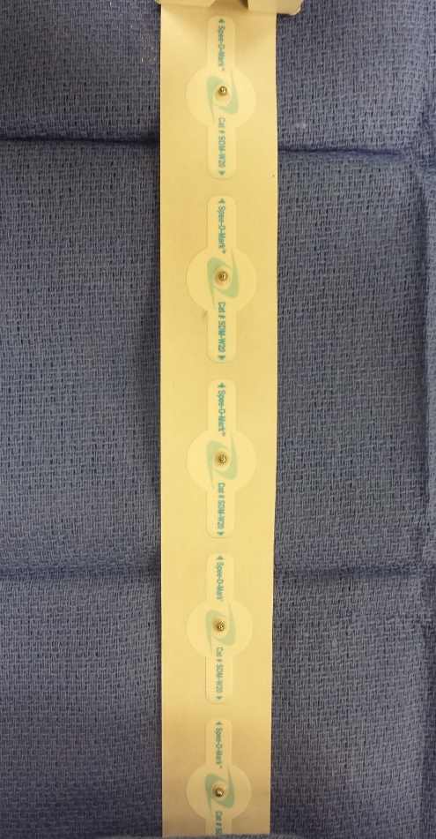
Skin Markers Adapted at SBMC
Lump Mole
Nipple, Tangentials Scar

Slide 40
Fun Miscellaneous Cases

Slide 41
Case #1
October 2013

Slide 42
Case #1
October 2013

Slide 43
Case #1
Path: Benign lymph node with extensive
black pigmentation consistent with tattoo
pigment.
October 2013

Slide 44
Case #1

Slide 45
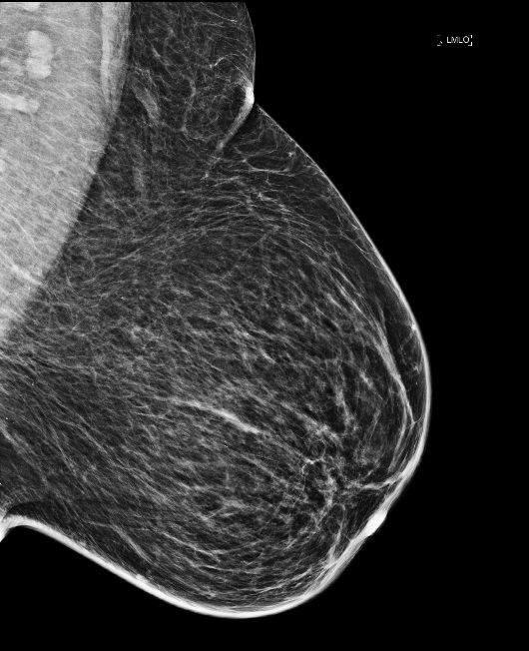
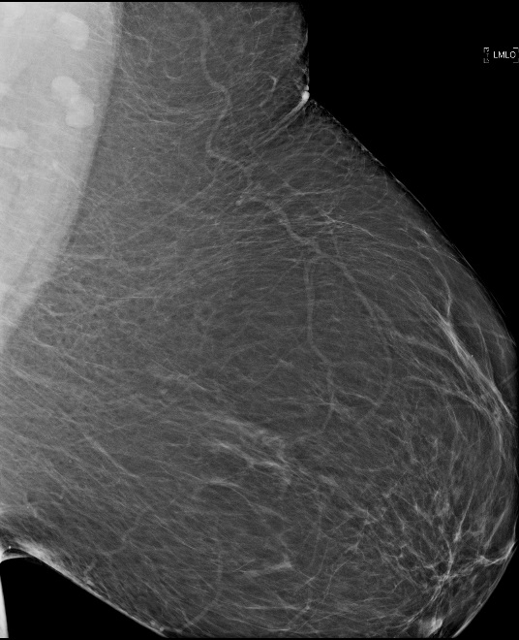
Case #2
April 2013
June 2014
June 2014
April 2013
What questions would you ask the patient?

Slide 46
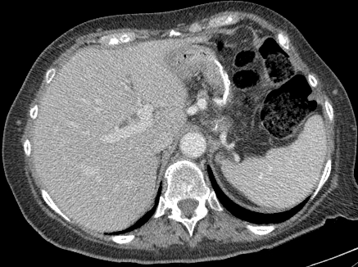
Case #2
June 2014
April 2013
What questions would you ask the patient?
Patient had a sleeve gastrectomy and lost >100 lbs

Slide 47
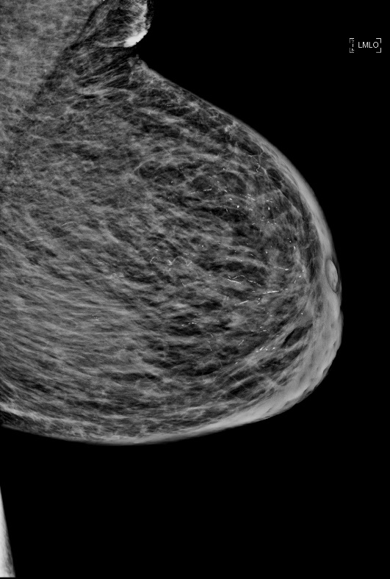
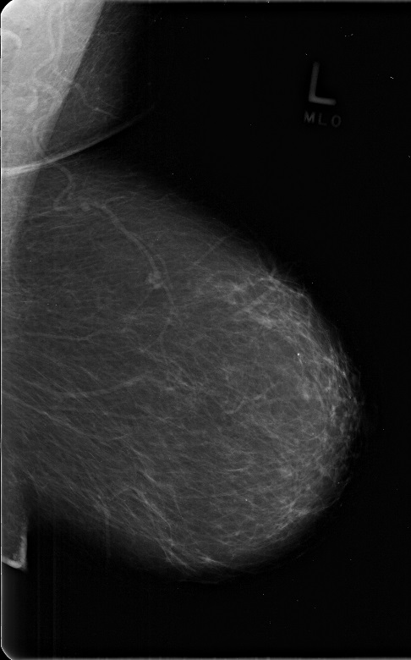
Case #3
2009
2013
2013
2009
Patient denies any significant weight changes
What can explain the findings?

Slide 48
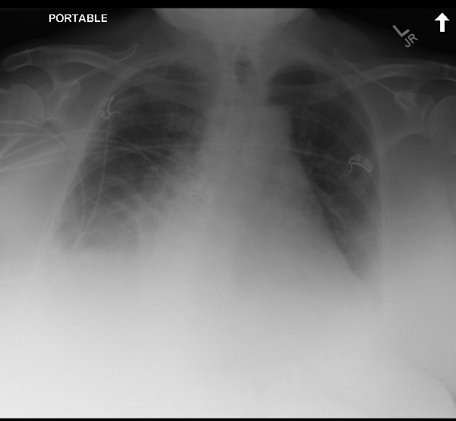
Case #3
CXR 2010
CXR 2015
2013
2009
Patient denies any significant weight changes
What can explain the findings?
Edema Secondary to Congestive Heart Failure

Slide 49
Case #4
Jan 2017
March 2018
Jan 2017
March 2018
Lactation Changes of the Breasts

Slide 50
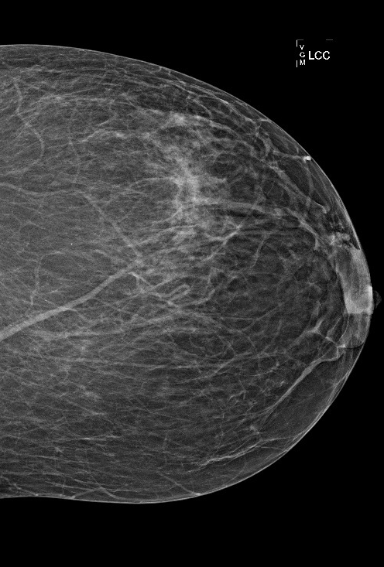
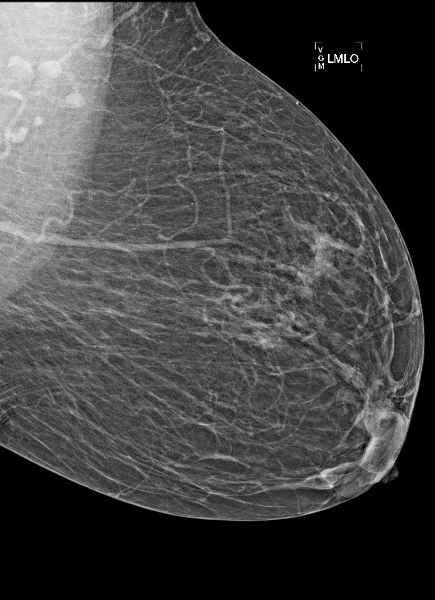
Case #5
March 2016
Feb 2018
March 2016
Feb 2018

Slide 51
Case #5
March 2016
Feb 2018
March 2016
Feb 2018
- Dialysis patient with a left upper extremity AVF.
- Extensive left chest wall dilated veins, venous collaterals, secondary to central venous stenosis, left subclavian vein

Slide 52
Case #6
June 2011
May 2014

Slide 53
Case #6
Reduction Mammoplasty
May 2014

Slide 54
Case #7
What is this structure?
Is this normal or abnormal?

Slide 55
Case #7
Sternalis Muscle
Uncommon anatomic variant of the chest wall musculature.
It may be visible as a rounded or irregular density on the craniocaudal mammogram along the sternal medial edge of the film.
With improved mammographic positioning it will be seen more frequently.
Variety of appearances.
Avoid confusion with a malignant lesion.

Slide 56
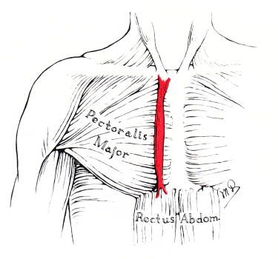
Case #7
Sternalis Muscle

Slide 57
Case #8
*
What is this structure (*)?
Is this positioning ideal? Why?

Slide 58
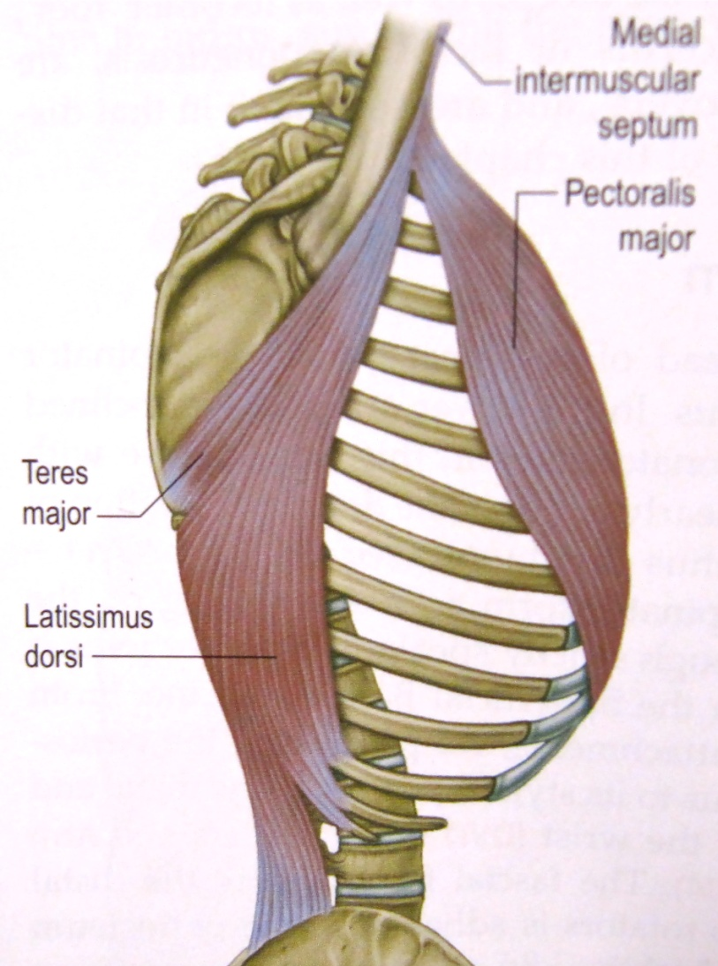
Case #8
Latissimus Dorsi
*

Slide 59
Case #9

Slide 60
Case #9
Absent Pectoralis Muscle- Poland Syndrome
Rare congenital disorder
M > F
Unilateral absence or hypoplasia of the pectoralis major and/or minor muscles
Asymmetry of the chest
Associations: rib or hand abnormalities, syndactyly

Slide 61
Overview
Strive for optimal positioning and compression in 4 views
ALARA (As Low As Reasonably Achievable)
Make every reasonable effort to limit unnecessary exposures to ionizing radiation while striving to achieve optimal image quality.
Optimal image quality = less recalls (patient exposures)
MAGNIFY each image before accepting it to avoid (and correct if possible) hardware and patient related artifacts
Understand unique physical/medical conditions and variant anatomies

Slide 62
References
Literature:
Ayyala, RS, ChorltonMA, Behrman RH, Kornguth PF, Slanetz PJ. Digital Mammographic Artifacts on Full-Field Systems: What Are They and How Do I Fix Them? RadioGraphics 2008; 28: 1999- 2008.
Bassett LW. Breast Imaging Philidelphia, PA: Elsevier, 2011; 110-145.
Farria DM, Bassett LW, Kimme-Smith C, DeBruhl N. Mammographic quality assurance from A to Z. RadioGraphics 1994; 14:371-385.
Hogge JP, Palmer CH, Muller CC, Little ST, Smith DC, Fatouros PP, de Paredes ES. Quality Assurance in Mammography: Artifact Analysis. RadioGraphics 1999; 19: 503-522.
Honegger MM, Hesseltine SM, Gross JD, Singer C, Cohen JM. Tattoo Pigment Mimicking Axillary Lymph Node Calcifications on Mammography. American Journal of Roentgenology 2004: 183: 831-832.
Websites:
ACR Mammography Accreditation. https://www.acraccreditation.org/modalities/mammography
Mammography Acquisition: Screen-Film and Digital Mammography, the Mammography Quality Standards Act, and Computer-Aided Detection. https://clinicalgate.com/mammography-acquisition-screen-film-and-digital-mammography-the-mammography-quality-standards-act-and-computer-aided-detection
Mammography Physics and Technology. http://www.sprawls.org/resources/MAMMO/module.htm
Poland Syndrome. https://emedicine.medscape.com/article/1273664-overview

