Slide 1
WCO CEN APPLICATIONS
Bridging the gap through technology

Slide 2
WCO CEN Applications
External Organizations
Customs Administrations
CEN Website
Customs Administrations
CEN Applications
Customs Administrations
External Organizations
Information can only be transferred between applications manually by the owner of the information

Slide 3
Differences
CEN database is a global system managed by the WCO Secretariat
It contains non nominal information
nCEN is designed to be installed on national servers and managed at the national level
It contains nominal/personal data

Slide 5
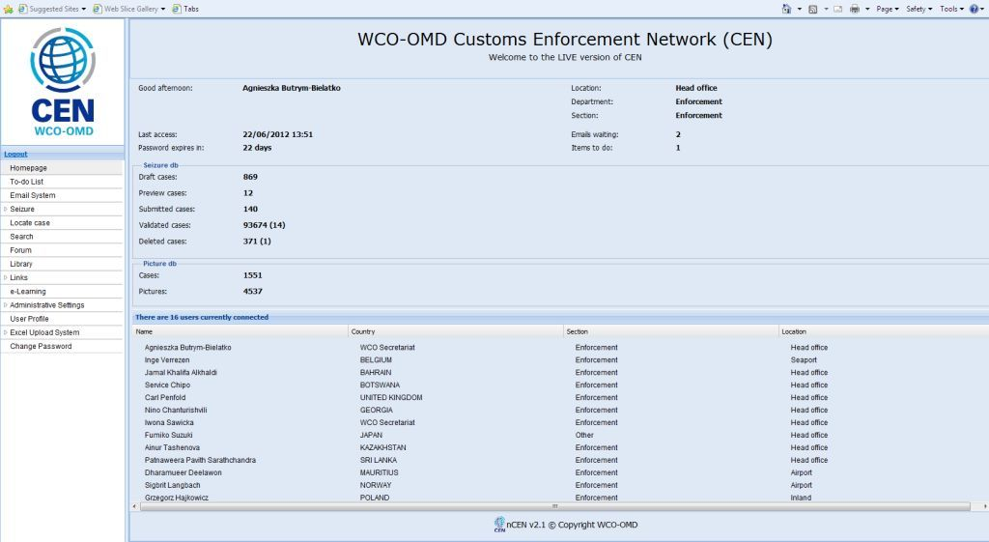

Slide 6
CEN Database Previous version
Access to data from 2000 to 2010
More than 425 700 cases collected
3 130 cases with pictures
Almost 2 000 Customs users
Access only for Customs officers
at the global level

Slide 7
CEN Database New and improved version!
Access to data from January 2011
More than 390000 cases
8462 cases with 23703 pictures
2004 Customs users
Access only for Customs officers
at the global level

Slide 8
CEN Database
Global Database of Customs seizures and offences
Non-nominal information
Divided into 13 commodities
Excel spreadsheets for all the commodities
Predefined structure to facilitate data input
Minimal mandatory data to ensure the quality of analysis

Slide 9
CEN Database
Concealment Picture Database
Search function for seizures and images
Available in English, French and Spanish
Secured mailing system for CEN users
Link to the WCO’s E-learning platform
Library, Statistical Data etc.

Slide 10
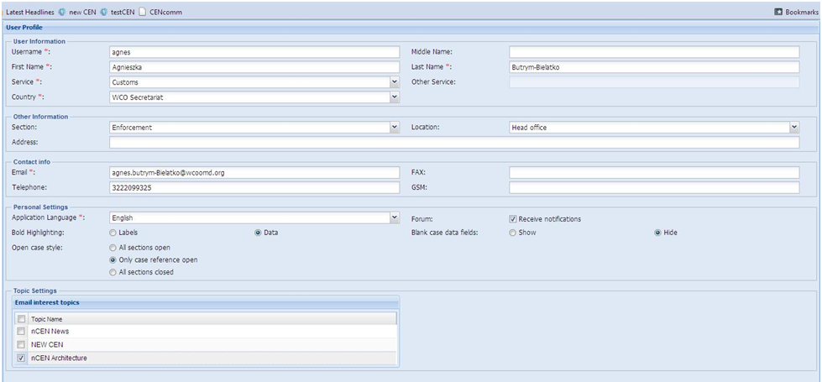
CEN Database
Layout of the screen
Bold Highlighting for: Labels or Data
Open case style: All section open
Only case reference open
All section closed
Blank case data fields: Show or Hide

Slide 11
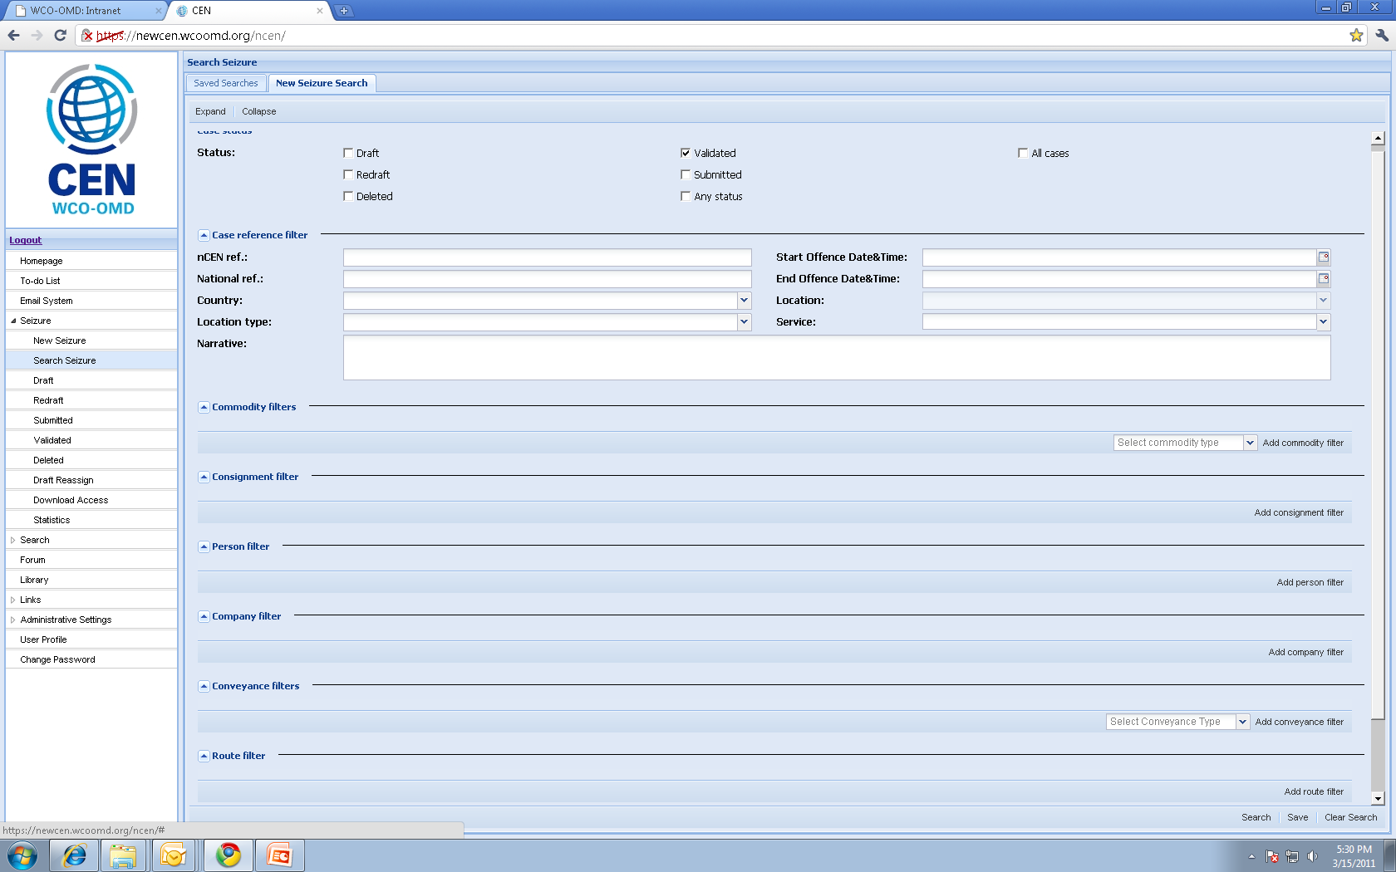
Powerful seizure search function
Notes:
Thank you very much for your attention.

Slide 12
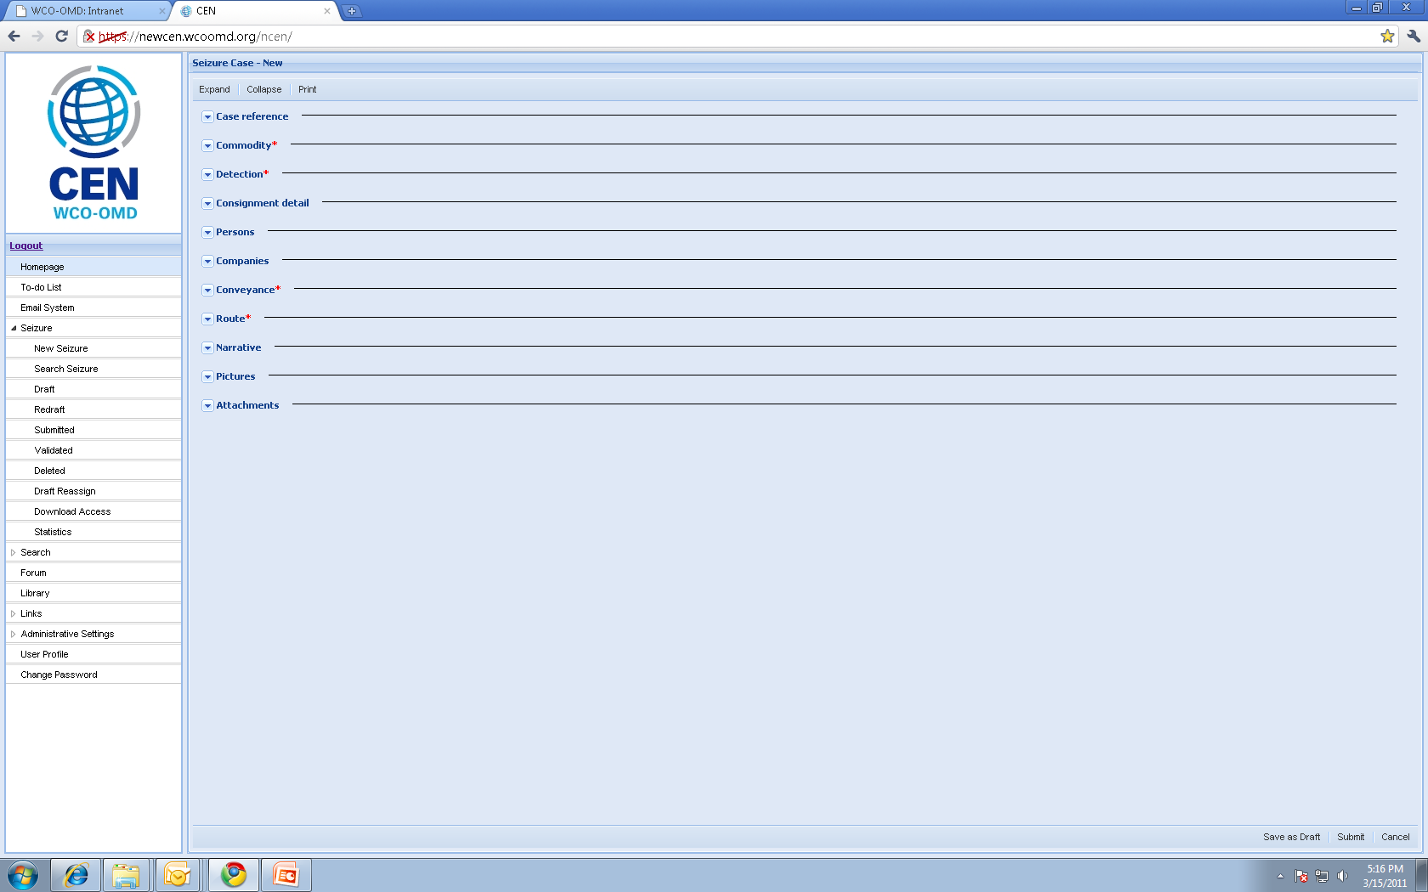
User-friendly input of data
ALL IN ONE SCREEN
Similar to CENcomm seizure template

Slide 13
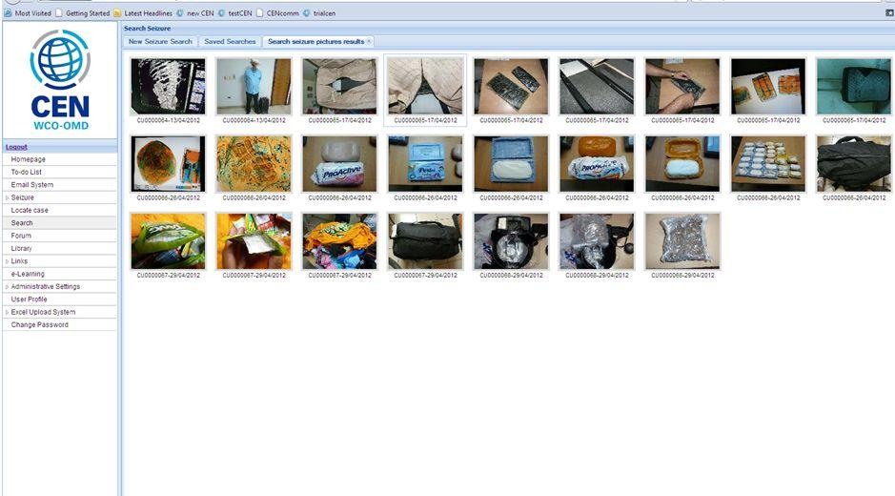
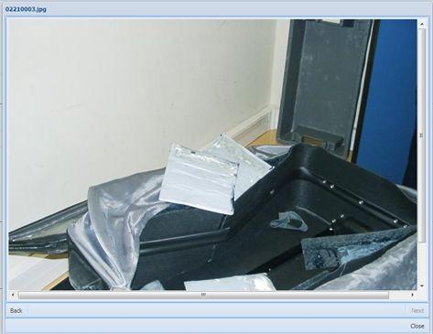
A picture is worth a 1000 words
Excellent training tool (e.g. search of X-Ray images)
Possibility to enlarge and download photos

Slide 14
CEN Database
Web Browsers
For security purposes, it is always recommended to use the latest version of any browser

Slide 15
CEN Database
Excel Upload
Excel spreadsheets exist for all of the commodities
More than 57 000 Drug, Tobacco and IPR cases for 2014 have been automatically uploaded to CEN
That’s around 60% of the total cases entered in 2014
22 countries actively use the excel upload function

Slide 16
CEN Website
Alert messages and Situation Sheets divided into the main commodities
WCO Global Reports
RILOs’ updates, alerts and publications
Links to websites of external organizations
Customs media releases etc.
International Organizations can have access to the CEN Website

Slide 17
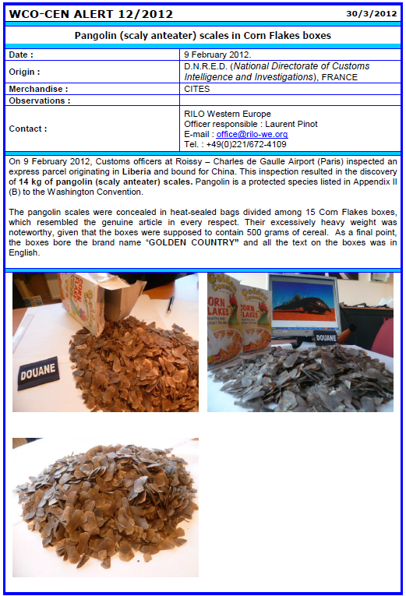
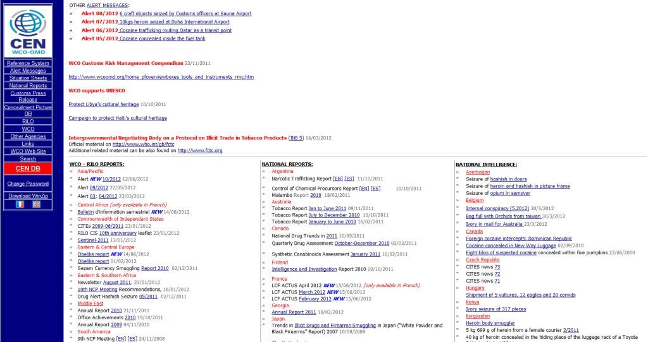

Slide 19
nCEN Database
A database of nominal Customs seizures and offences, suspected persons, means of concealment and offending business entities
A Concealment Picture Database
An Information Communication Interface (Icomm) for data exchange between nCEN systems and for transmission of non-nominal information to the CEN database

Slide 20
nCEN Database
Pilot Project in Mauritius and Kenya
Roll out of nCEN will be prepared by the WCO based on the information provided by Members
Road Map will be sent to all WCO Members in 2012
nCEN package will contain the Icomm tool
Start of implementation in ESA Region in 2013
nCEN software is free
Access only for Customs officers
national level

Slide 21
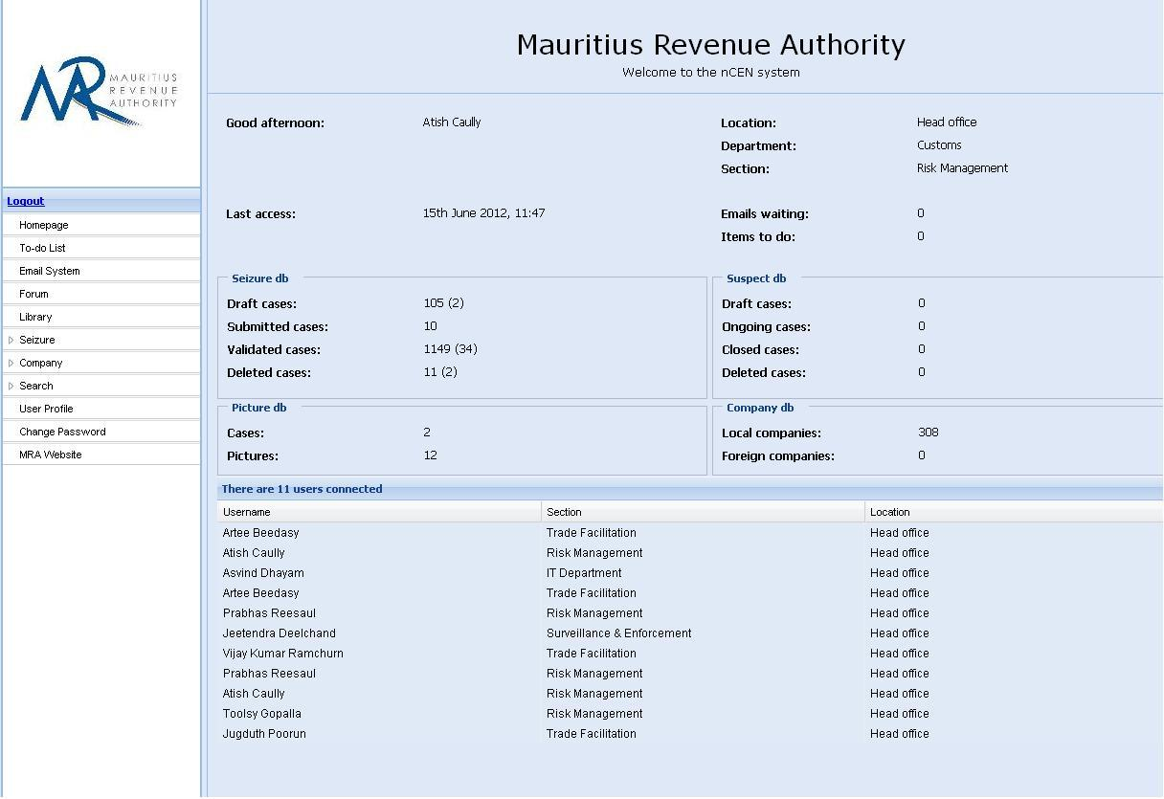

Slide 22
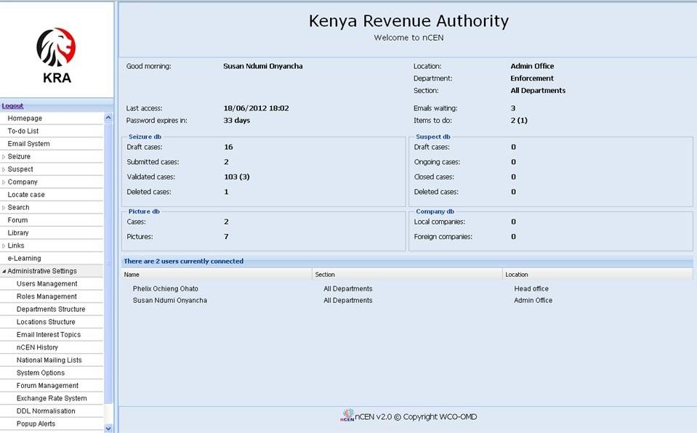

Slide 23
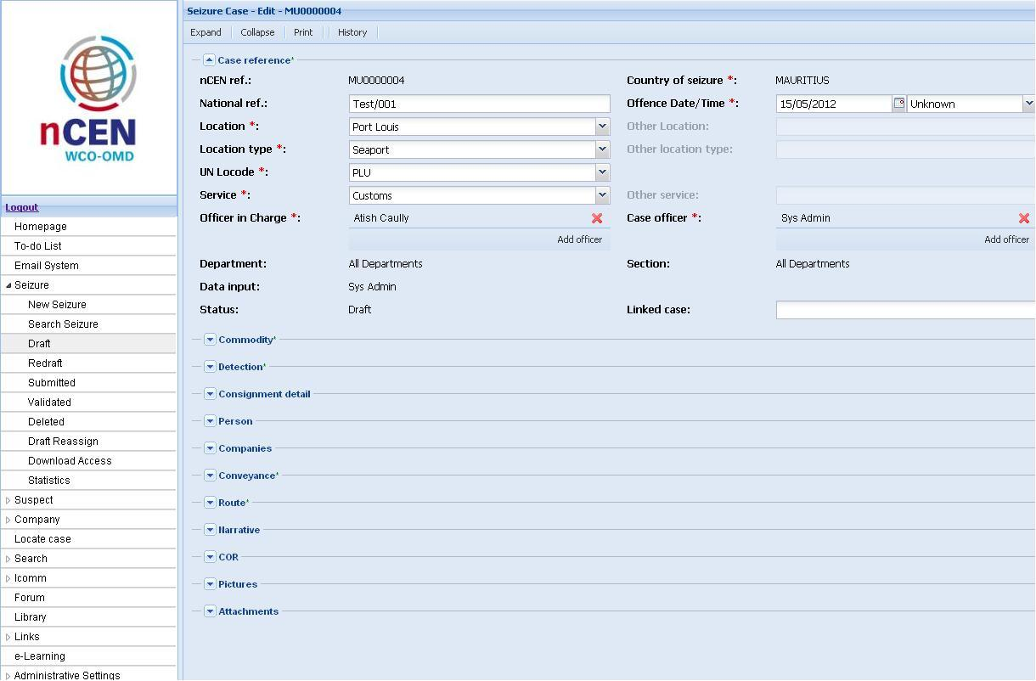
A case created in nCEN in Mauritius

Slide 24
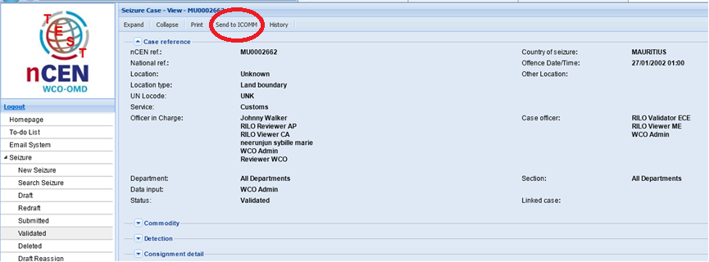
can be shared using Icomm

Slide 25
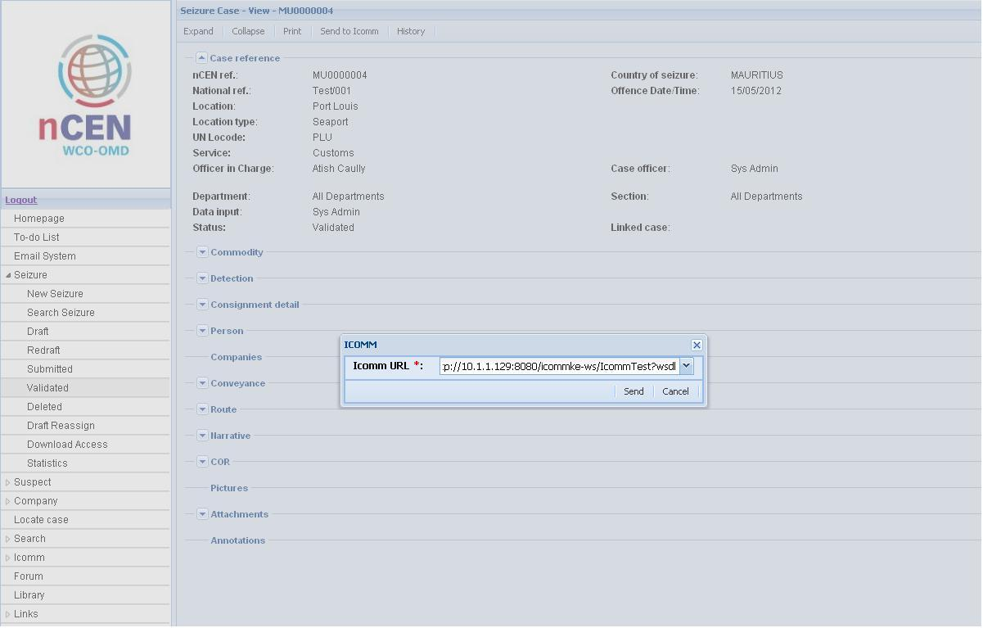
with another nCEN system in Kenya!

Slide 26
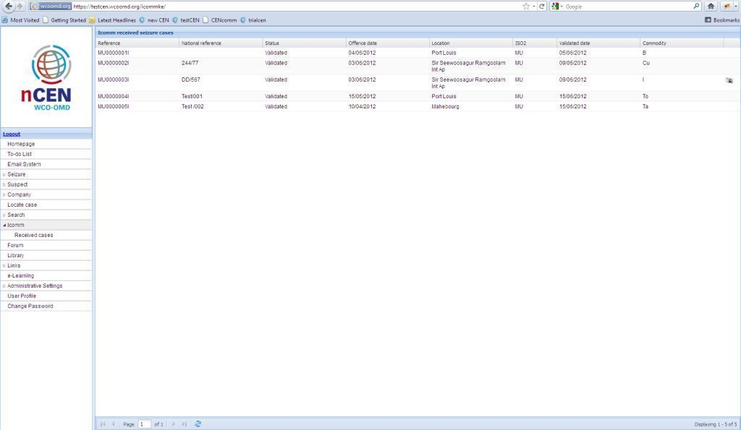
A list of cases received through Icomm in Kenya
Mauritius successfully exchanged test cases which are now visible in Kenya’s nCEN

Slide 27
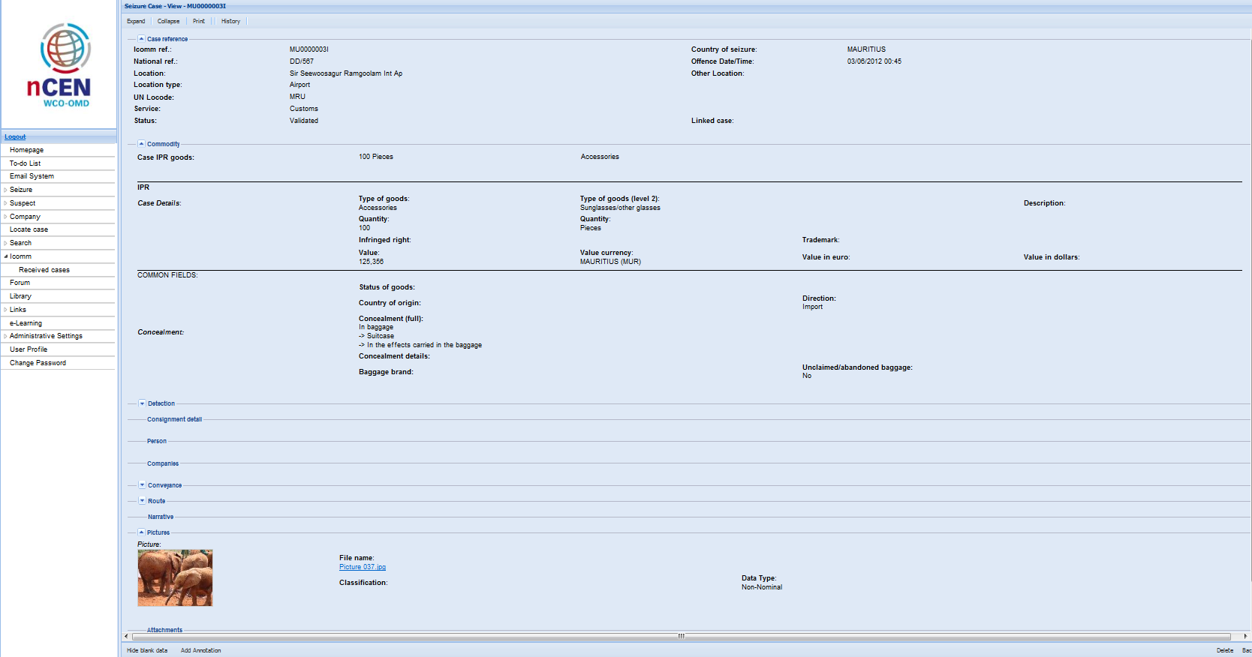
Example of exchanged information

Slide 28
nCEN Database
Meets international security standards
First nCEN security audit has been carried out and recommendations are currently being implemented
Second security audit for Icomm will take place before the roll-out in 2013
nCEN package will be delivered with mandatory Information Security Guidelines

Slide 29
nCEN Database
nCEN DEMO
Letter to DGs sent 27.04.2011
14 WCO Members asked for access to the DEMO version
No feedback/comments from Members so far
Updated DEMO version launched in March 2012

Slide 30
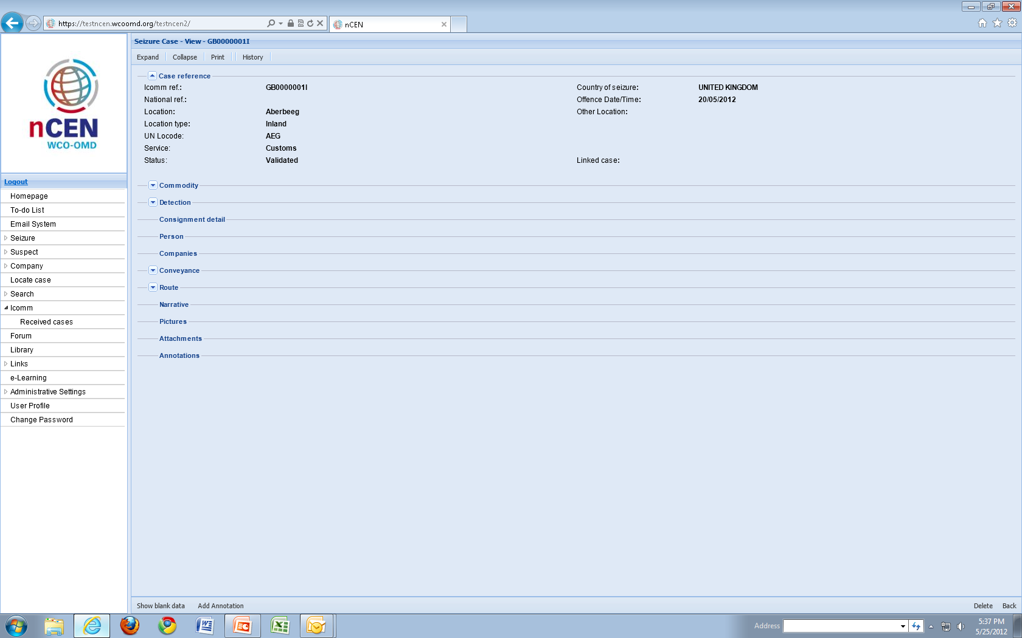
nCEN DEMO

Slide 31
nCEN Database
WCO deliverables
Project plan will be established based on info from Members
Hardware procurement (e.g. server, backup disks) is the responsibility of the national Customs Administration
A basic installation manual will be prepared by the WCO
The installation package will be fully automated

Slide 33
Differences
secured communication tool for operational purposes
system containing a database (non-nominal) and other enforcement tools
No link between the two applications
Information can only be transferred between the applications manually by the owner of the information

Slide 34
CENcomm
Projects
Operations
Communication Platform
Customs
Administrations
Other Law
Enforcement
Agencies
Private Sector
Exchange of nominal information
Possible upload of non nominal part of information to the CEN database
Organizer of the Operation/Project decides who participates
Different level of access granted
Library / MS Access Database / Operational Statistics
Notes:
6/19/2015
34

Slide 35
CENcomm
Secured communication system - personal login and password
Encrypted data storage on the WCO server
Accessible only to closed user groups for the duration of their active operation/project
Operational Coordination Unit (OCU) can be setup anywhere in the world. The only user requirement is an Internet connection
Available in English, French, Spanish, Portuguese, Russian and soon in German and Arabic

Slide 36
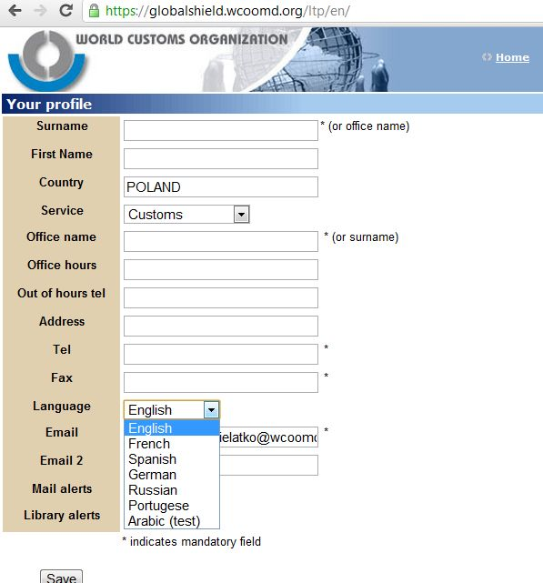
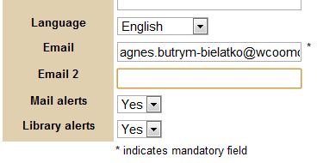
CENcomm
Automatic email to the user’s personal email account to inform them that there is a new message or a new document in the library
Possibility to choose the language in which the application/templates will be displayed!

Slide 37
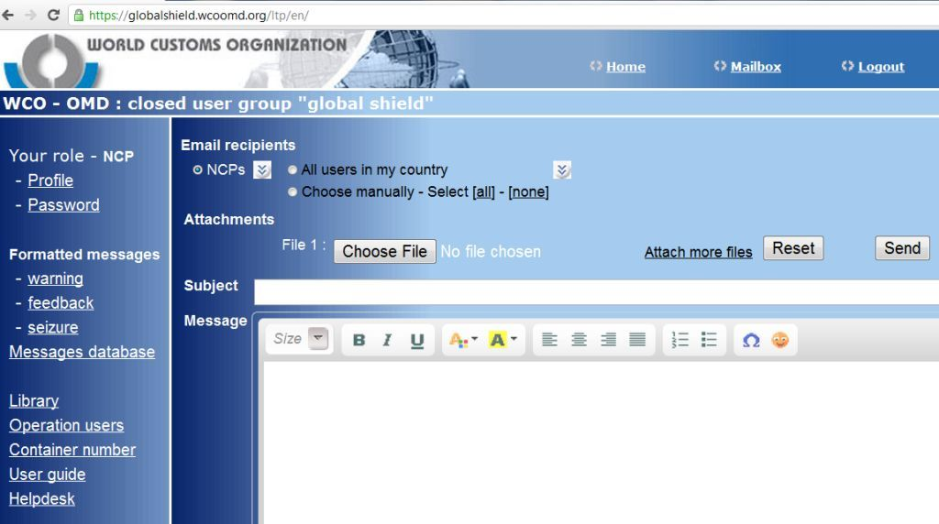
CENcomm
Different users ‘roles’ - OCU+, OCU, NCP, PU
Formatted templates
Messages database
Operation users
Library, manuals

Slide 38
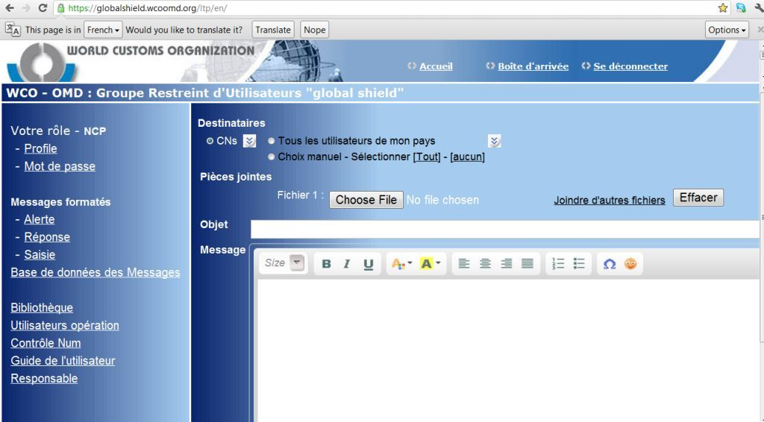
CENcomm
‘Rôles’ des différents utilisateurs - UCO+, UCO, CN, SU
Modèles formatés
Base de données des messages
Utilisateurs de l’opération
Bibliothèque, manuels

Slide 39
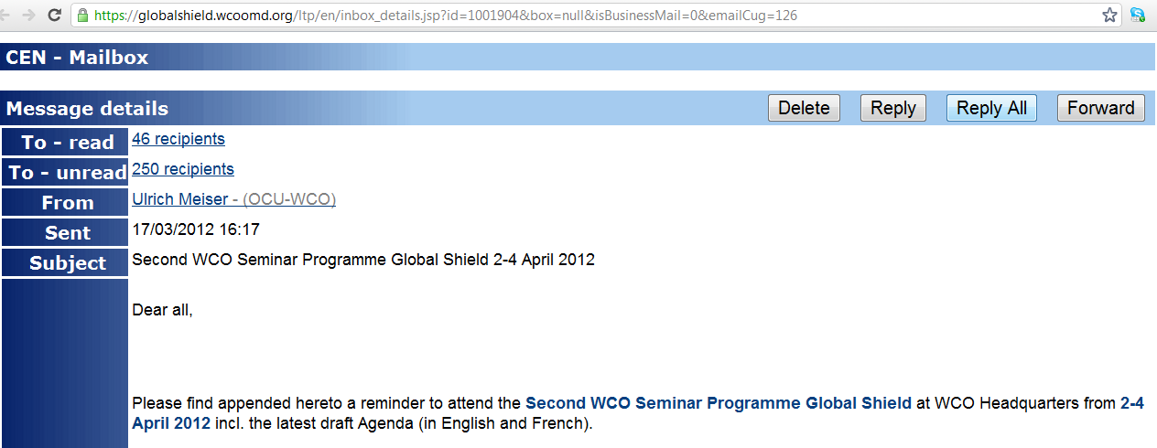
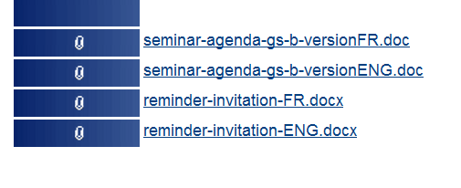
CENcomm mailbox
Enables to send multiple attachments of up to 10 MB(all type of files)
Enables to see if your message was already read by the recipients

Slide 40
CENcomm mailbox
To create folders e.g. for feedback, seizure or warning messages
To reply to warning message with the feedback or a seizure message

Slide 41
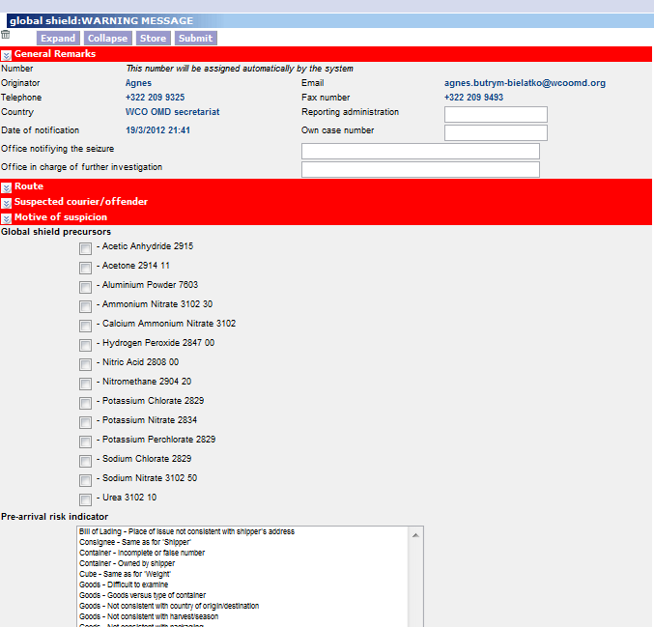
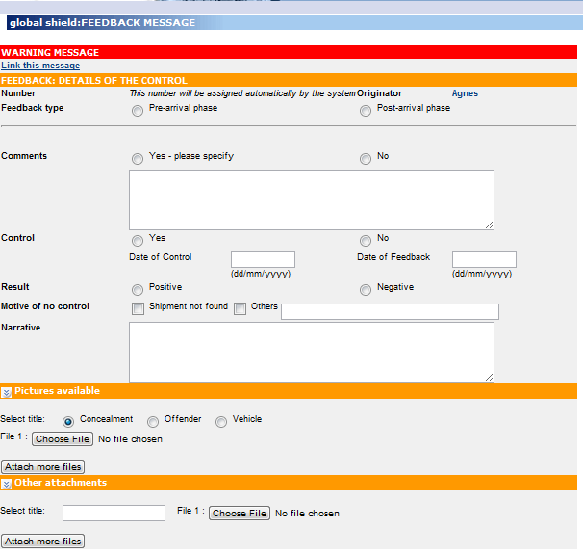
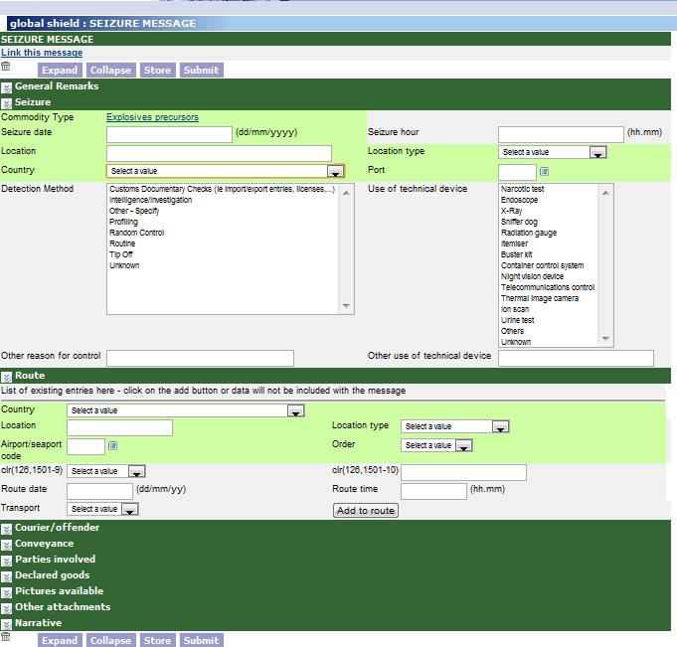
CENcomm Templates
WARNING
FEEDBACK
SEIZURE

Slide 42
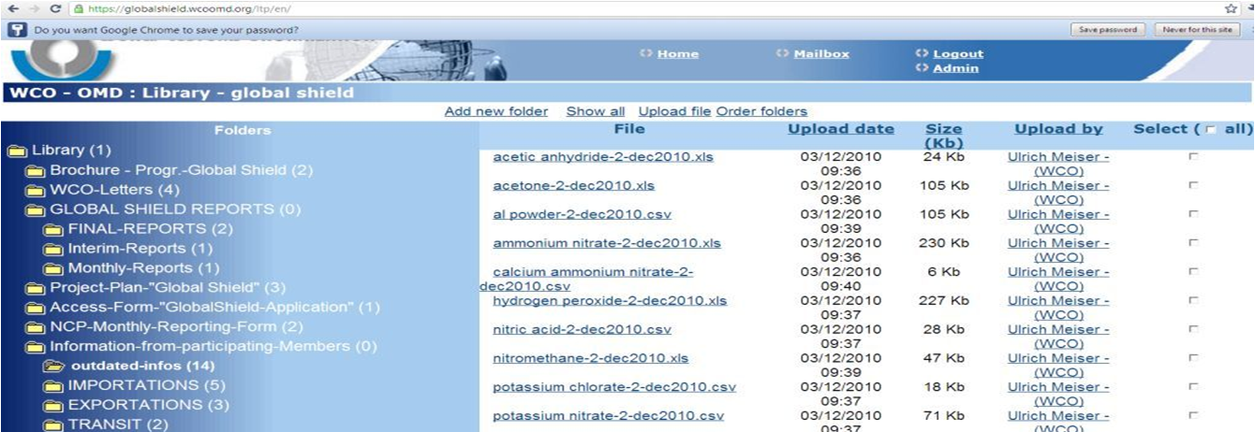
CENcomm Library
Possibility to create folders for newsletters, messages etc.
Upload of up to 10 MB (all types of files)

Slide 43
71 Projects/Operations/Communication Platforms were operational in 2014, 69 ongoing / planned in 2015
Project Global SHIELD (WCO/UNODC/INTERPOL) – preventing the illicit diversion and trafficking of precursor chemicals which may be used by terrorist and other criminal organizations to manufacture explosive devices
ENVIRONET- Global real-time communication tool for information exchange and cooperation in daily environmental enforcement
G8 INFO_IPR – exchange of nominal information on IPR seizures
CARICC – Central Asian Regional Information Co-ordination Centre – permanent communication platform
AIRCOP Project (UNODC/WCO/INTERPOL/EC) – Operational communication between Airports
WCO CENcomm Training Platform
Notes:
6/19/2015
43

Slide 44
Program Training
The CEN Team is preparing:
A set of training material and manuals tailored to each of the different CEN applications
Information and material on how to analyze CEN data
Training for Trainers
Interactive Training Programs
CEN Help Desk
Notes:
6/19/2015
44

Slide 45
The WCO will continue to work to improve and expand the capabilities of all CEN Applications
WCO is a voluntary Membership organization. We can design applications, devise measures and make them known to the Members, but we cannot mandate their use.
The CEN Applications are only as useful as Members make them. The more you contribute and participate the more valuable these tools become.

