Slide 1
FAIR AND EFFICIENT REVENUE COLLECTION Royal Malaysian Customs Experience
BY
NOR HAZIAH ABD. WAHAB
DEPUTY DIRECTOR OF CUSTOMS
ROYAL MALAYSIAN CUSTOMS DEPARTMENT

Slide 2
PRESENTATION OUTLINE
Overview
Revenue Collection Statistics
Challenges In Revenue Collection
Strategies To Increase Revenue Collection
Conclusion

Slide 3
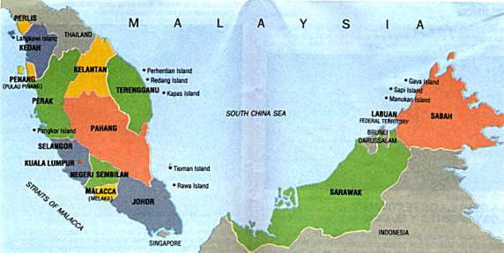
Overview
MALAYSIA – GENERAL INFORMATION

Slide 4
RMC ‘s Mission Statement
Overview
TO SPUR ECONOMIC GROWTH , PRESERVE NATIONAL SECURITY AND SOCIETY’S WELL BEING THROUGH REVENUE COLLECTION, TRADE AND INDUSTRIAL FACILITATIONSAND TO ENSURE EFFECTIVE AND EFFICIENT LEGISLATIVE COMPLIANCE

Slide 5
FEDERAL GOVERNMENT REVENUE STATISTICS - INDIRECT TAX
STATISTICS
2011 | 2012 | 2013
MYR | MYR | MYR
30.38 billion | 32.318 billion | 33.126 billion

Slide 6
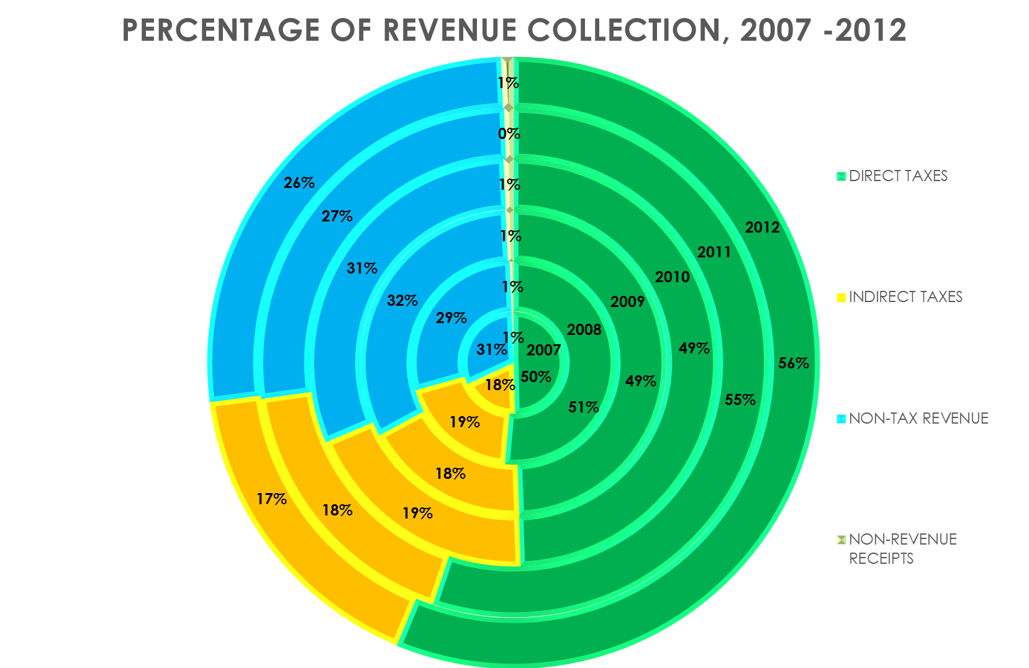
STATISTICS

Slide 7
CHALLENGES IN REVENUE COLLECTION
LOW COMPLIANCE
FAST-CHANGING TRADE AND BUSINESS ENVIRONMENT
COMMERCIAL FRAUD
SMUGGLING
INFORMAL TRADE

Slide 8
Discussion paper by the Tax Faculty of the Institute of Chartered Accountants of England and Wales (ICAEW) 1999 summarises 10 principles required for an efficient tax system:
• Statutory –
• Certainty –
• Simplicity –
• Easy to collect and calculate

Slide 9
Properly Targeted
Constant –
Consultation –
Regular review –
Fair and reasonable –
Competitive –

Slide 10
RMCD’S Strategies Towards An Efficient and Fair Revenue Collection
Automation – The development of a new Customs Information System known as U-customs
Statutory- A comprehensive review of Customs Acts and its regulations
Capacity Building- Increasing Awareness on Customs activities, regulations and procedures

Slide 11
RMCD’S Initiative Towards An Efficient and Fair Revenue Collection
Human Resource –Recruitment criteria, placement policies, Integrity matters
Customs Business Partnership- Regulated, Scheduled, ad hoc when needed
Customs-OGA Partnership – MOUs
Customs- Customs Partnership- CMAA’s

Slide 12
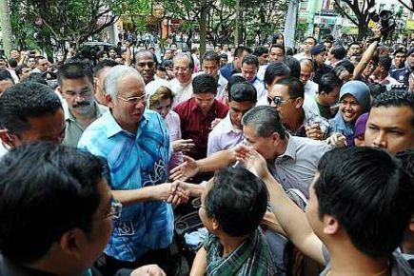
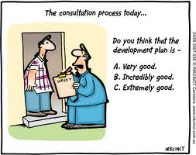
CONSULTATION / ENGAGEMENT
The days when Government knows best is OVER
LISTEN to our customers
Regular CONSULTATION
Make it a HABIT

Slide 13
COMPLAINT IS A GIFT
Complaints are valuable feedbacks for further improvements

Slide 14
CONCLUSION
RMCD will continue to implement its core function of collecting indirect taxes more efficiently and effectively
RMCD is committed to assist in economic competitiveness through trade facilitation by ensuring efficient customs procedures
RMCD is determined to preserve safety and security of society by detecting and preventing smuggling activities

Slide 15
Thank You For Your Attention

