Slide 1
Session Title Speaker Names, Companies

Slide 2
Thank you for presenting at the
WERC 2019 Annual Conference!
Please use the next slide as the template for your own slides.
Included in this template are seven research-backed design principles.
Studies show good design is important to learning and credibility.
Aesthetics can evoke positive emotion.
Good design can enhance your presentation by avoiding negative emotions!

Slide 3
Template
Enter Text Here
To be effective in the large conference meeting rooms, all text must be greater than 18 point.

Slide 4
1. Less is More!
One Thought Per Slide
&
Less Than 15 Words Per Slide
Communicates a Message FAST
Catches the Eye of an Often Distracted Audience
Becomes Memorable

Slide 5
2. Limit Color 2-4 Colors (at Most)
Choose Two Contrasting Neutral Colors
Choose One Complementary Accent Color
+

Slide 6
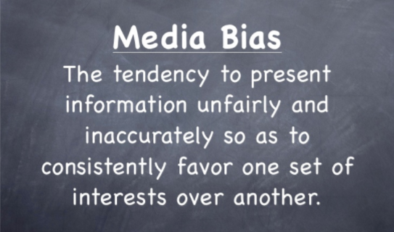
3. Choose Fonts (1-2 Fonts)
(carefully)
Some GREAT PowerPoint Fonts:
Century Gothic
Corbel
Ebrima
Franklin Gothic
Microsoft Sans
Trebuchet
The WERC template uses:
Montserrat ExtraBold
& Century Gothic
Avoid “Decorative” Fonts…
…That Don’t Convey Credibility!
Comic Sans Papyrus
Curlz
Jokerman
Brush Script
Chiller

Slide 7
4. Composition
Vary your slide compositions. Content in different places keeps eyes guessing and keep minds engaged.
White space in a design improves readability and increases comprehension. It helps avoid cognitive overload and processes the message faster.
The rule of thirds says that what is most pleasing to our eye is a composition that breaks down the image vertically and horizontally in thirds, placing the subject of that image on one of the intersecting points.

Slide 8
5. Emphasize!
Emphasize with
SIZE
Emphasize with
Color
Emphasize with
Style
Emphasize with
Contrast

Slide 9
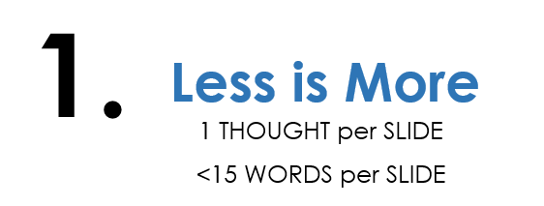
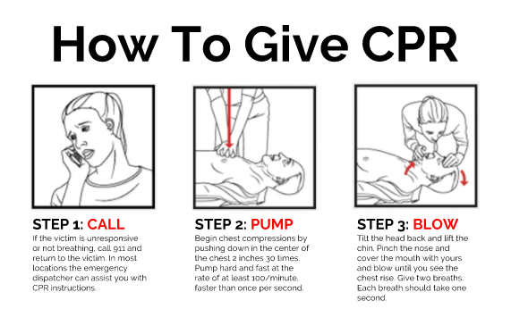
6. Create Relationships
Repetition:
Alignment:
Proximity:
(I’m Related!)
(I’m all alone.)

Slide 10
7. Use Images (That are Relevant)
Relevance is key:
+
minimal text
=
AWESOME

Slide 11
Thank You!

