Slide 1
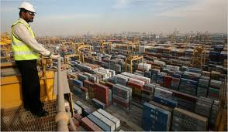
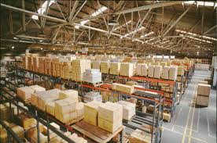
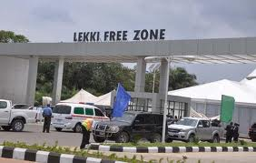
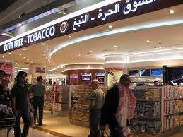
OPERATION GRYPHON

Slide 2
First Global Customs Operation to Combat
Illicit trade in Tobacco

Slide 3
The Threat
The illicit tobacco trade is a global phenomenon that contributes to the growth of transnational organized crime, adversely impacts fair and efficient revenue collection and undermines public health and safety objectives.

Slide 4
The Approach
To address this threat and to highlight the role of Customs in end to end supply chain security, the delegates of the 32nd Session of the WCO Enforcement Committee endorsed Operation GRYPHON, the first global Customs-centric operation tackling illicit trade in tobacco.
The methodology of Operation GRYPHON was highly influenced by Project CROCODILE, a long running, highly successful regional tobacco operation developed and led by the Regional Intelligence Liaison Office (RILO) Asia Pacific

Slide 5
Timely Initiatives
The Protocol to Eliminate the Illicit Trade in Tobacco products of the World Health Organization (Framework Convention on Tobacco Control) emphasizes that effective actions to prevent and combat tobacco smuggling require a comprehensive international approach and close cooperation among Countries.

Slide 6
Role of Customs
Customs administrations for decades have confronted the complexity of illicit trade in tobacco as a core business, especially when considering the staggering loss to nation states of excise taxes and duties as a result of illegal trade in tobacco.
Customs will undoubtedly play a key role in the implementation of the WHO protocol. Operation GRYPHON is a key project in support of Customs and Health objectives.

Slide 7
Duration of Operation
The operation had a duration of 6 months
(from October 2013 to March 2014).

Slide 8
Objectives
Phase I
October/November 2013
Phase II
December 2013/ January 2014
Phase III
February 2014/
March 2014
Identify diversion of equipment, chemicals, papers and other stores involved with the illicit production of tobacco products.
Investigate abuses of Duty free diversion;
Controls in ships stores (e.g. ships/aircraft/trucks/private vessels);
Controls on transactions of tobacco products in free zones.
Identify the smuggling of tobacco products via the Internet, the mail and the express consignments.
monitoring trans-boundary shipments of tobacco products;
notification of exported shipments posing a high risk of being illegal or being diverted;
feedback against information received from other parties
Reporting all the seizures of tobacco products

Slide 9
Participants
All WCO Member Customs administrations were invited to participate.
Coordination
Within their respective geographical region, the Regional Intelligence and Liaison Offices (RILOs) assumed the role of the Operation Coordination Unit (OCU).

Slide 10
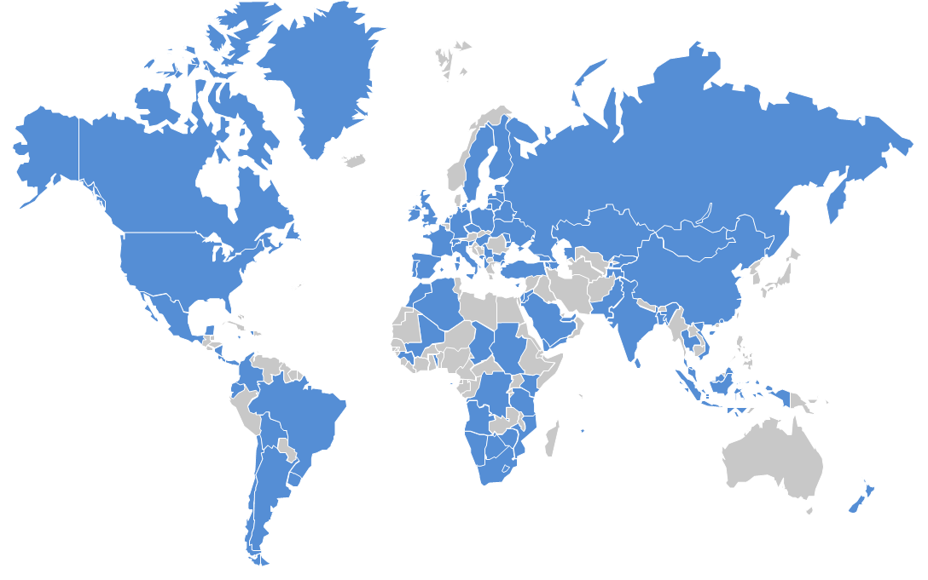
Participating Member States
93 participants

Slide 11
Results
Warning messages: 125
Feedback messages: 61
Seizure messages: 1967

Slide 12
Results (seizures)
Latvia
Mali
Malta
Mauritius
Moldova
Montenegro
Morocco
Mozambique
Nicaragua
New Zealand
Panama
Serbia
Slovenia
Spain
Sweden
Switzerland
United Kingdom
Uruguay
Uzbekistan
Zimbabwe
Algeria
Argentina
Bulgaria
Brazil
Botswana Chad
China
Canada
Czech Republic
Democratic Republic of the Congo
Estonia
Finland
France
Georgia
Hungary
Ireland
Italy
Jamaica
Jordan
Lithuania

Slide 13
Results
Very significant seizures have taken place particularly in Zimbabwe, Spain, Chile, Uruguay, Jordan, Belgium (not part of the operation), Mozambique, Thailand (under the project Crocodile) and South Africa.

Slide 14
Results
Trans-regional diversion has been identified as a method of smuggling tobacco products. This information was determined in large part by the significant seizures made by Belgium Customs pursuant to information passed on by RILO AP;
Misclassification of tobacco products has also been reported in addition to trans-regional diversion;
For the aforementioned practices of misclassification and trans-regional diversion, the primary region of origin was Asia. Particularly Singapore was identified as the port of departure in many of the reported cases.

Slide 15
Results
The operation has resulted in many seizures of relatively small quantities of tobacco products smuggled using schemes of minimal complexity (bootlegging) mostly from the Eastern European region with the intended destination of Western Europe.

Slide 16
Results
The operation pointed out some sensitive and atypical routing:
Shipments of cigarettes from Asia to Ivory Coast, then transshipped to Malaysia;
Cigarettes exported from China and re-integrated into China via Vietnam;
Shipments of cigarettes to conflict areas (Syria).

Slide 17
Results
Area I:
Warning messages concerning machinery parts, raw tobacco, and tobacco flavor were sent by Cyprus, Slovenia and Ireland. Information regarding their follow-up investigations is not yet available;
Area II:
Free Zone Subic Bay (Philippines) was identified as a suspect area for transshipments in furtherance of illicit trade in tobacco. Other Free Zones (such as Colon in Panama) are also suspected of being exploited for illegal trade in tobacco products;
Area III:
The Operation thus far has shown that smuggling via postal and express carrier channels is common. Canada has reported a large number of cases in this domain.

Slide 18
Preliminary conclusions
Operation GRYPHON has highlighted the global threat of illicit trade in tobacco to overall supply chain security, public health & safety, and revenue collection and has exposed the leadership role Customs administrations around the world take in combating the illicit trade in tobacco and tobacco products.

Slide 19
Preliminary conclusions (cont)
Operation GRYPHON has achieved many of its objectives; current results are encouraging when considering this is the first iteration of an organized global tobacco operation.
It serves as a prime example of international Customs cooperation and national level cooperation with other competent authorities.

Slide 20
Preliminary conclusions (cont)
Operation GRYPHON also displays the important role of the RILOs as:
the regional focal point for collecting and sharing of information and intelligence;
a functioning “hub” for initiating Customs cooperation across continents;
an essential component in Customs’ connectivity.

Slide 21
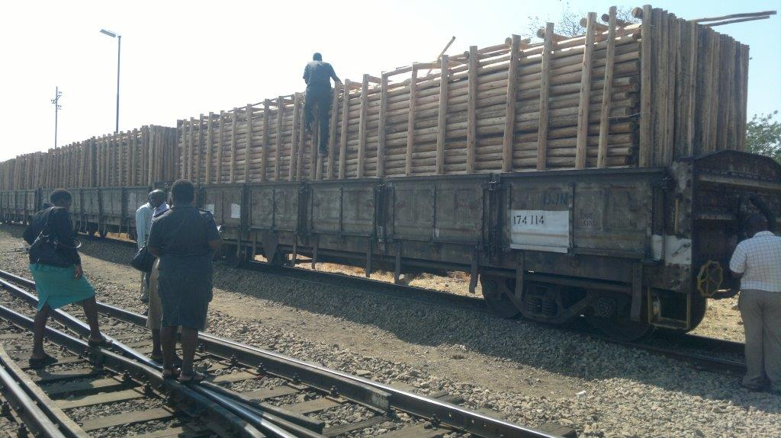
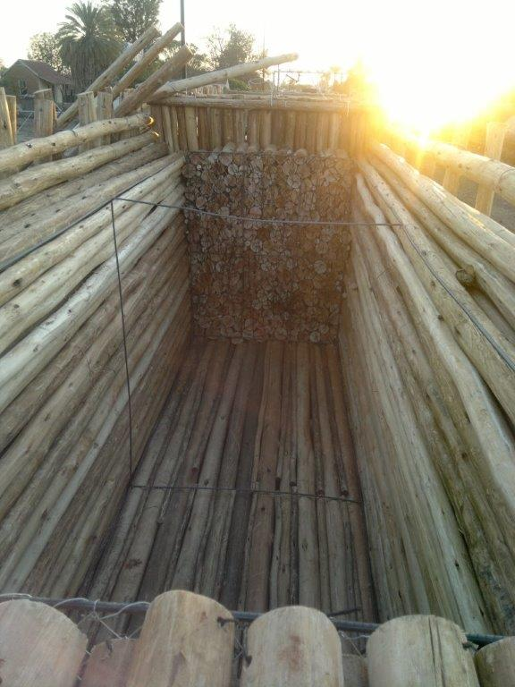
Seizures
ZIMBABWE
Seizure of: 15 930 000 Cigarettes (4 Train wagons full)
Coverload: Timber, Eucalyptus Gum Poles

Slide 22
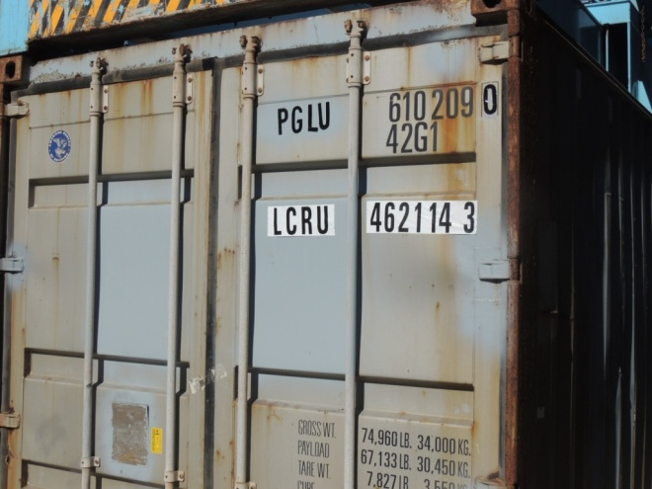
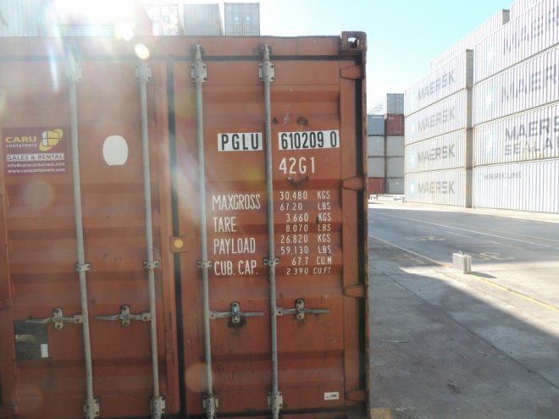
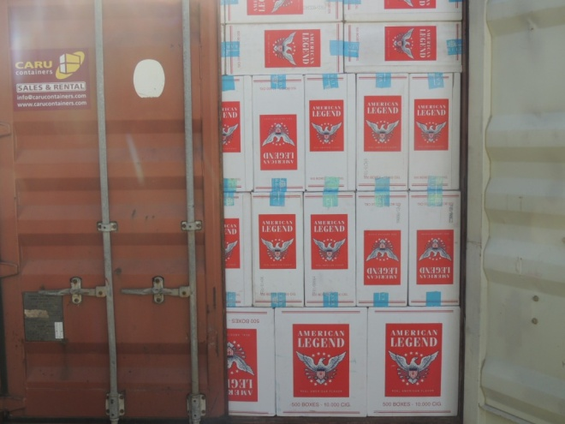
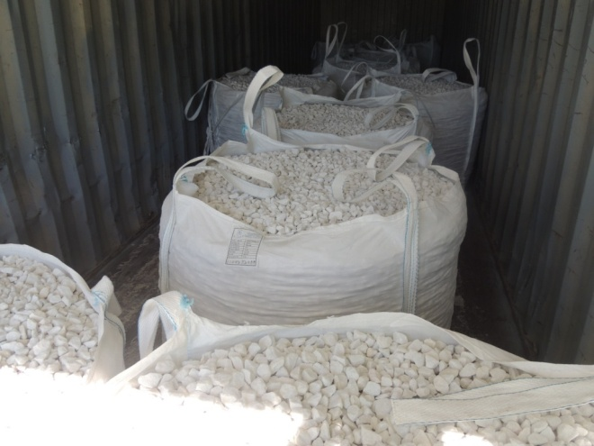
Seizures
SPAIN
Seizure of: 9.180.000 Cigarettes
The container number was duplicated (using stickers). One container was filled with stones; the other container was packed with cigarettes

Slide 23
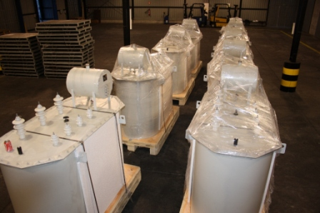
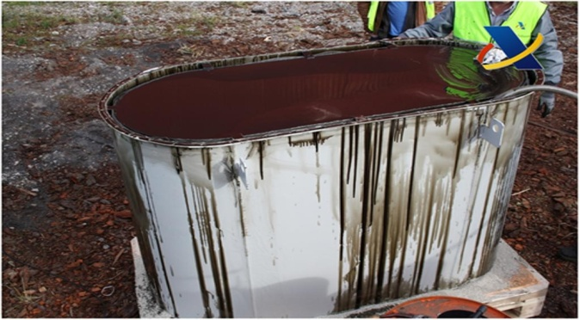
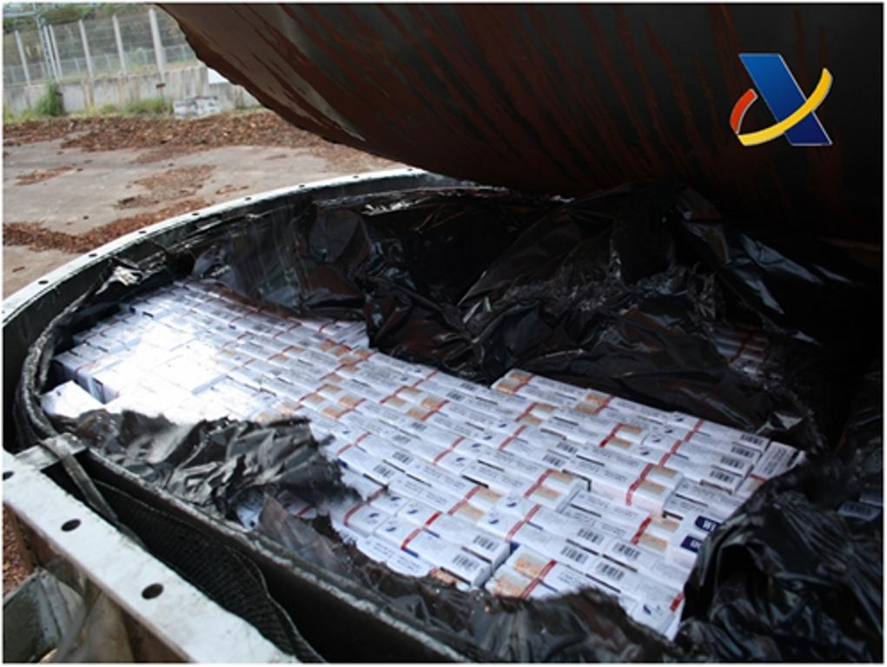
Seizures
SPAIN
Seizure of: 2.517.480 Cigarettes;
The cigarettes were concealed inside machineries full of oil;

Slide 24
Seizures
SOUTH AFRICA
Seizure of: 3.700.000 Cigarettes;
The cigarettes have been found in a compartment hidden in a consignment of maize;
Hidden compartment

Slide 25
Thank you for your attention!

