Slide 1


State of the Art in Rheumatology: What’s next in RA and AS?
Professor Peter C. Taylor MA, PhD, FRCP
Peter C. Taylor MA. PhD, FRCP
Norman Collisson Professor of Musculoskeletal Sciences
Director of clinical Sciences, Botnar Research Centre and
Kennedy Institute of Rheumatology, Nuffield Department of Orthopaedics, Rheumatology and Musculoskeletal Sciences, University of Oxford
Fellow of St. Peter’s College ,Oxford
British Society for Rheumatology Autumn Conference
15-16 October 2015

Slide 2
Disclosures
Research grants, consultation, and/or speaking
    UCB, Celgene, BMS, Lilly, Merck, Roche, Pfizer, Janssen, Fujifilm biologics, AbbVie, Baxalta, Epirus, GSK, Celltrion, Galapagos.

Slide 3
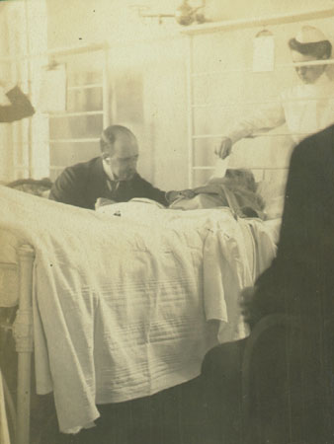

Sir William Osler (b12.07.1849)- on the art of medicine
“The good physician treats the disease; the great physician treats the patient who has the disease”
Notes:
State of the art for arthritis late 1880’s

Slide 4
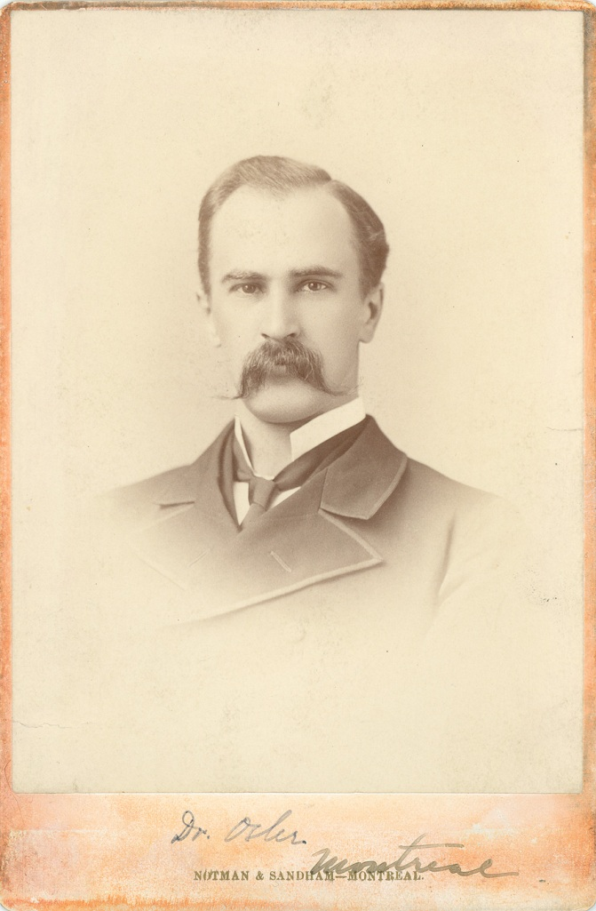
Sir William Osler
“…head out the back door whenever an arthritis patient comes through the front door”
Notes:
State of the art for arthritis late 1880’s

Slide 5
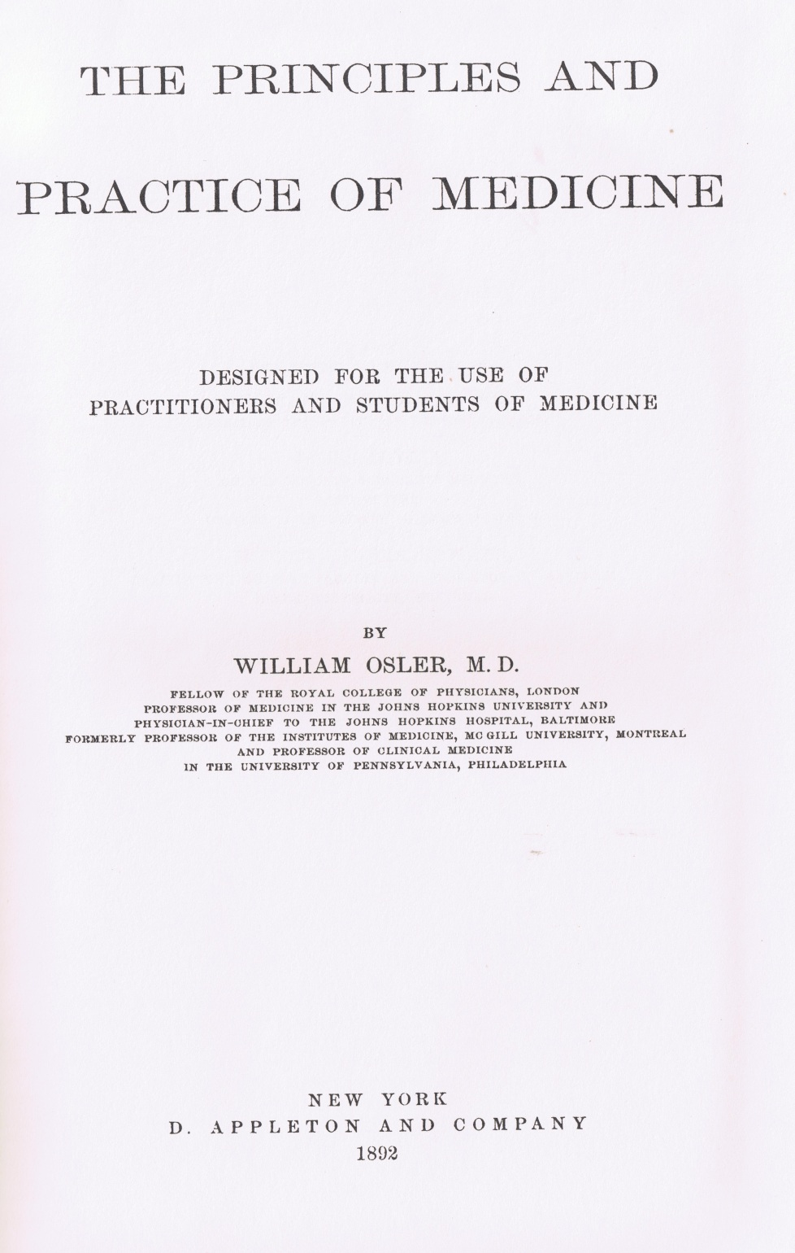
The problem
“Arthritis deformans is an incurable disease. …… Too often it invades successively all the articulations and in ten, fifteen or twenty years the crippling becomes general and permanent.”

Slide 6
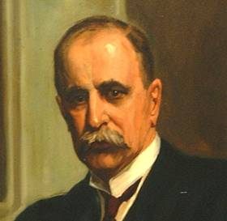
7th Edition 1909
The principles and practice of medicine
“No single remedy is of special value. Arsenic in full doses is helpful in some.. Syrup of iodide of iron… Fresh air and personal hygiene Eat all the good food they can digest.. Hydrotherapy Massage, hot air, systematic exercises..” | “It is useless to saturate the patient with iodide of potassium, salicylates or quinine. Arsenic seems to do good as a general tonic…. Hydrotherapy, with carefully performed massage, is best for the alleviation of the pain… When good results, it is largely from change of scene and climate and careful regulation of diet…”
Notes:
The change from 1892. The seventh edition was the last one Osler wrote completely himself.

Slide 7
Do we really need new therapies for RA?

Slide 8
RA treatment strategy
Diagnosis early
Use synthetic DMARDs early
(MTX)
Identify a treatment target
(remission)
Monitor (tight control) and adjust DMARD therapy according to the target
Add biological DMARD if target is not achieved
Continue to monitor and adjust therapy as long as the target is not achieved

Slide 9
ACR50 response at wk 24/30 of biologic agents plus MTX for MTX-IR patients
NOT HEAD TO HEAD
ACR50
(Secondary Endpoint)
PBO + MTX
TNFi + MTX
Non-TNFi + MTX
60:40:20¹
Patients (%)
25mg twice weekly Etanercept²
Week 24
3mg/kg
every 8 wks
Infliximab³
Week 30
IV
40mg every other wk Adalimumab ⁴
Week 24
200mg every
2 weeks Certolizumab⁵
Week 24
50mg every
4 wks
Golimumab⁶
Week 24
100mg/day
Anakinra⁷
Week 24
1000mg
day 1 & day 15
Rituximab⁸
Week 24
IV
10mg/kg once monthly
Abatacept⁹
Week 24
IV
8mg/kg every
4 wks
Tocilizumab¹⁰
Week 24
IV
ACR, American College of Rheumatology; IR, inadequate responder; PBO, placebo; TNFi, tumour necrosis factor inhibitor.
*p<0.001; †p<0.01; ‡p=0.005; §p<0.0001.
1. Burmester GR et al. Rheumatology. 2013;10(2):77-88. 2. Weinblatt ME et al. N Engl J Med. 1999;340(4):253-259. 3. Maini R et al. Lancet. 1999;354(9194):1932-1939. 4. Keystone EC et al. Arthritis Rheum. 2004;50(5);1400-1411. 5. Keystone E et al. Arthritis Rheum. 2008;58(11):3319-3329. 6. Keystone EC et al. Ann Rheum Dis. 2009;68(6):789-796. 7. Cohen S et al. Ann Rheum Dis. 2004;63(9):1062-1068. 8. Edwards JCW et al. N Engl J Med. 2004;350(25):2572-2581. 9. Kremer JM et al. Ann Intern Med. 2006;144(12):865-876. 10. Smolen JS et al. Lancet. 2008;371(9617):987-997.
Notes:
Certolizumab data changed to 37.1% because the licensed maintenance dose for RA is 200mg every 2 weeks not 400mg every 2 weeks (39.9% is for 400mg dose)
2/Weinblatt/
NJEM/1999/p255/Table2;
3/Maini/Lancet/1999/p1937/
Table3;
4/Keystone/Arthritis& Rheumatism/
2004/p1406/
Table2;
5/Keystone/Arthritis& Rheumatism/
2008/p3323/
Figure1A
6/Keystone/
Ann Rheum Dis/2009/p792/Table2
7/Cohen/Ann Rheum Dis/2004/p1063/col2/para3/
ln4-6/p1064/
Figure1A;
8/Edwards/NEJM/2004/p2577/Figure2A-B;
9/Kremer/Ann Intern Med/2006/
p869/col2/para3/ln5/p870/
col1/para1/ln1-2;
10/Smolen/Lancet/2008/p990/
Table2
1/Burmester/
Rheumatology/2013/p78/col1/para2/ln6-11

Slide 10
ACR50 response at wk 24 for anti-TNFs + MTX in
MTX-naïve patients
NOT HEAD TO HEAD
PBO + MTX
TNFi + MTX
Patients (%)
GO-BEFORE¹
(Golimumab)
ERA^{2a}
(Etanercept)
TEMPO^{3b}
(Etanercept)
ASPIRE^{4,c}
(Infliximab)
PREMIER^{5,d}
(Adalimumab)
ªEtanercept was taken in combination with PBO; ^{b}The TEMPO study investigated combination therapy with MTX+etanercept vs MTX+placebo in patients who were not MTX-naïve.^{c}Week;54 ^{d}Week 52
*p=0.042; †p<0.01; ‡p≤0.001.
1. Emery P et al. Arthritis Rheum. 2009;60(8):2272-2283. 2. Bathon JM et al. N Eng J Med. 2000;343(22):1586-1593. 3. Enbrel US Prescribing Information. New York, NY: Pfizer Inc; 2013. 4. Remicade US Prescribing Information. Horsham, PA: Janssen Biotech, Inc; 2013. 5. Keystone EC et al. J Rheumatol. 2014;41(2):235-243.
Notes:
GO-BEFORE:
1/Emery/Arth Rheum/2009/p2278/Table2
ERA:
2/Enbrel_PI/p19/para6/ln1-9/p19/Table6 (study III)
PREMIER:
5/Keystone/2014/p237/Figure 1A
TEMPO:
3/ENBREL_PI_PhysicianPackageInsert/2003/p4/Table1 (study II)
ASPIRE:
4/REMICADE USPI/2013/p12/Col2/Table7

Slide 11
Limited persistence, even on TNF inhibitors
TNFi switching status | Persistence Rate
 | 12 months (95%CI) | 24 months (95%CI)
First TNFi | 72% (70%-75%) | 57% (54%-60%)
Second TNFi | 60% (55%-64%) | 42% (37%-47%)
Third TNFi | 63% (54%-70%) | 42% (33%-51%)
Greenberg JD et al. Ann Rheum Dis. 2012;71(7):1134-1142
Notes:
Greenberg/Ann Rheum Dis/2012/p1140/Table5

Slide 12
Radiographic progression (mTSS) at wk 52/54 with biologics and MTX in MTX-IR and DMARD-IR patients with RA
NOT HEAD TO HEAD
ªModified Total Sharp/van der Heijde score.
^{b}DMARD-IR patients.
^{c}Genant-modified Sharp Score.
PBO + MTX
TNFi + MTX
Non-TNFi + MTX
mTSS/SHS, modified Total Sharp/van der Heijde score.
*p<0.0001; † p<0.001; ‡p=0.01.
Mean Change From Baseline
Etanercept^{1,a,b}
Week 52
Infliximab²
Week 54
Adalimumab³
Week 52
Certolizumab⁴
Week 52
Golimumab⁵
Week 52
Anakinra⁶
Week 52
Abatacept⁷
Week 52
Tocilizumab^{8,c}
Week 52
1. Klareskog L et al. Lancet. 2004; 263(9410):675-681. 2. Remicade Prescribing Information. Horsham, PA: Janssen Biotech; 2013. 3. Humira Prescribing Information. North Chicago, IL: AbbVie; 2013. 4. Keystone E et al. Arthritis Rheum. 2008;58(11):3319-3329. 5. Emery P et al. Arthritis Rheum. 2011;63(5):1200-1210. 6. Kineret Prescribing Information. Stockholm, Sweden: Swedish Orphan Biovitrum AB; 2012. 7. Kremer JM et al. Ann Intern Med. 2006;144(5):865-876. 8. Kremer JM et al. Arthritis Rheum. 2011;63(3):609-621
Notes:
1/Klareskog, Klareskog/p677/Table2/p678/Figure3
2/Infliximab:
Remicade PI/2013/p13/Table9;
3/Adalimumab:
Adalimumab PI/p32/Table5;
4/Certolizumab:
Keystone/Arth&Rheum/2008/p3320;Figure2A;
5/Golimumab:
Emery/Arth&Rheum/2011/p1204/
Table2
6/Anakinra:
Anakinra PI/2012/p7/Table5;
7/Abatacept:
Kremer/Ann Int Med/2006/p872/col1/para1/ln17-20
8/Tociluzumab:
Kremer/Arth&Rheum/2011/p613/
Figure1C

Slide 13
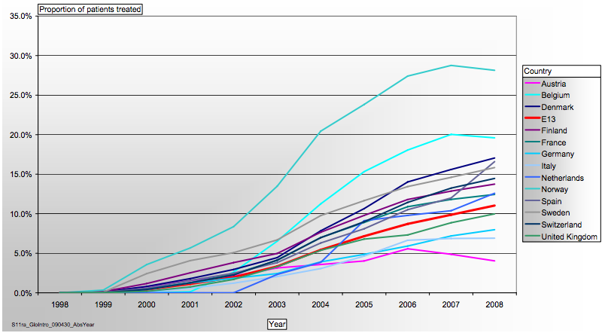
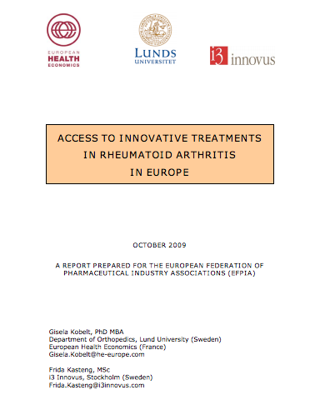
Access to innovative biologic treatments for RA in Europe: 1998-2008 LIMITED BY COST!
A decade after their introduction
Only 11% of EU patients could access biologics by 2008
Etanercept Infliximab Adalimumab Anakinra Rituximab Abatacept
1. Kobelt G, Kasteng F. http://www.efpia.eu/../ACCESS TO RA TREATMENTS - Rheumatoid Arthritis in Europe October 2009.pdf
[Accessed June 2015]

Slide 14
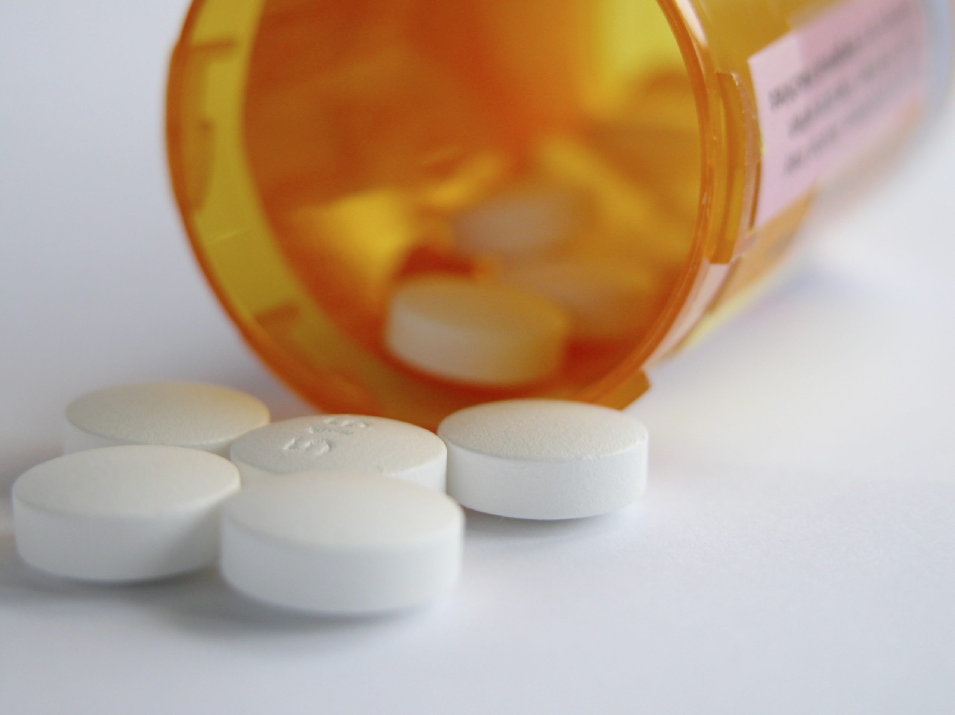
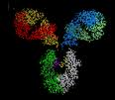

Biosimilars: The solution? But they are not generics
Follow-on products of traditional chemical pharmaceuticals are exact chemical copies
  These are true generics
Follow-on products of innovator biological pharmaceuticals are only similar ‘copies’
  There are no ‘biogenerics’
  There are only similar products,
  i.e. ‘biosimilars’
Figure 1
Figure 1. Clark (2003) Antibody engineering IgG effector mechanisms. Available at: http://www.path.cam.ac.uk/~mrc7/igs/mikeimages.html. Accessed November 2014

Slide 15
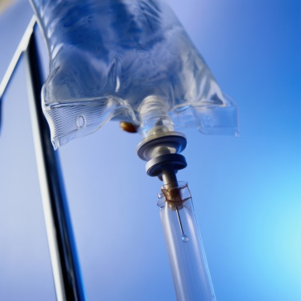
Manufacturing of biologics is complex¹,²
VL
VH
1
Tumor necrosis factor
(TNF)
3
Ck
CH1
2
CH2
CH3
Anti-TNF genes/DNA
Production
cell line
5
6
4
Perfusion
bioreactor
DNA
Protein
9
Y
Y
mRNA
Y
Y
Y
8
Y
Y
Y
Y
Monoclonal antibody
7
Y
Y
Y
Y
Y
Purification
Due to the manufacturing process and molecular complexity, it is extremely difficult to make an exact copy of a biologic, especially a monoclonal antibody³
1. Kuhlmann M et al. Nephrol Dial Transplant. 2006;21(Suppl 5):v4–v8. 2. Misra M. Indian J Pharmacol. 2012;44:12–14. 3. European Commission. 2013. What you Need to Know about Biosimilar Medicinal Products. Available at: http://ec.europa.eu/enterprise/sectors/healthcare/files/docs/biosimilars_report_en.pdf. Accessed 23 October 2014

Slide 16
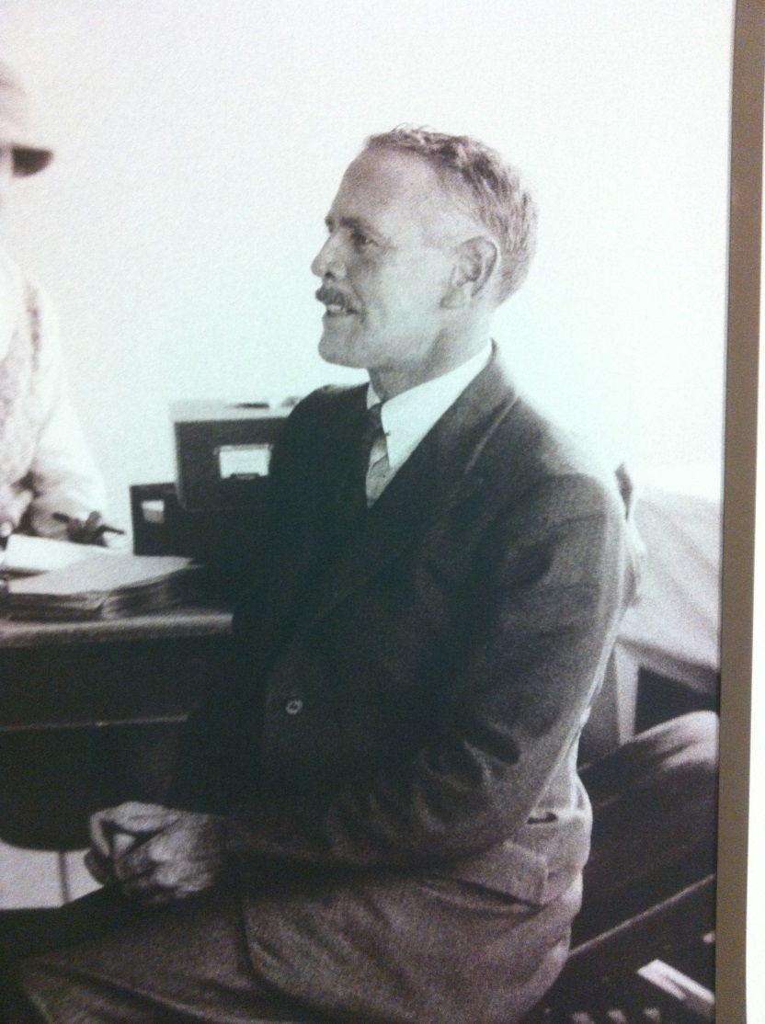
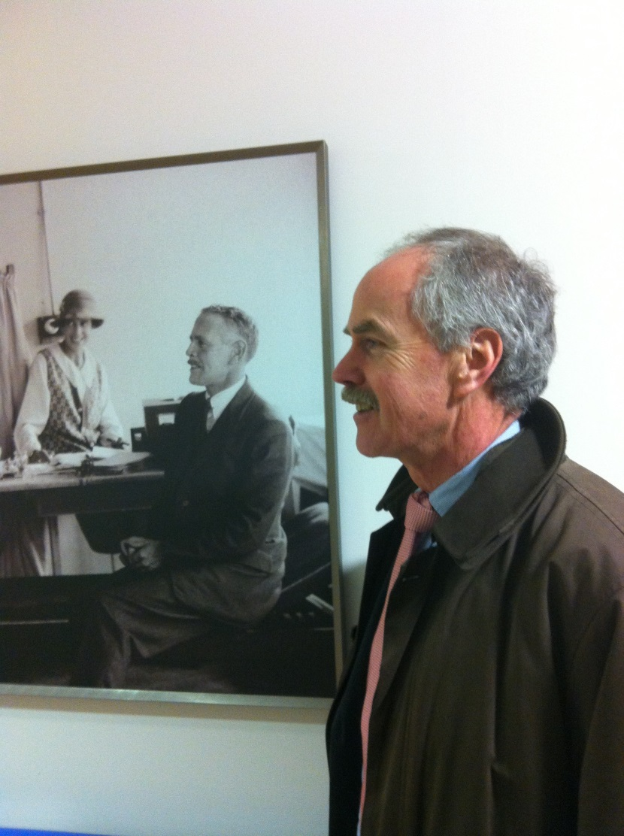
There are varying degrees of bio “similarity”……
The “parent” compound….
Similar, yet very different….
Permission to use image obtained from Peter Taylor

Slide 17
Biological product complexity:
Example: Showing a few modifications
pyro-E
O
O
pyro-E
Pyro-Glu (2)
D
D
D
D
Deamidation (3 x 2)
O
O
Methionine oxidation (2 x 2)
G
G
Glycation (2 x 2)
D
D
High mannose, G0, G1, G1, G2 (5)
Sialylation (5)
G
G
C-term Lys (2)
2 x 6 x 4 x 4 x 5 x 5 x 2 = 9,600
K
K
(9,600)² ≈ 10⁸
^{potential variants}
Adapted from: Steven Kozlowski. 2014. US FDA Perspectives on Biosimilar Biological Products. Available at: https://www.ibbr.umd.edu/sites/default/files/public_page/Kozlowski%20-%20Biomanufacturing%20Summit.pdf. Accessed 23 October 2014
Notes:
Key message: Any protein molecule has a complex structure and is subject to many post-translational modifications (i.e. many variations are possible).
Biosimilars must have the same amino acid sequence as the reference product
The relevance of major variants (e.g. basic/acidic variants, presence or absence of C-terminal Lys residues) on clinical efficacy and/or safety has to be established and reflected in the control strategy of the product
Monoclonal antibodies (reference and biosimilar) will always be micro-heterogeneous mixtures of a large number of post-translationally modified molecular species
The composition of this mixture cannot be reproduced if a completely different manufacturing process is used; therefore, comparative non-clinical and clinical data will always be necessary for biosimilar monoclonal antibodies

Slide 18
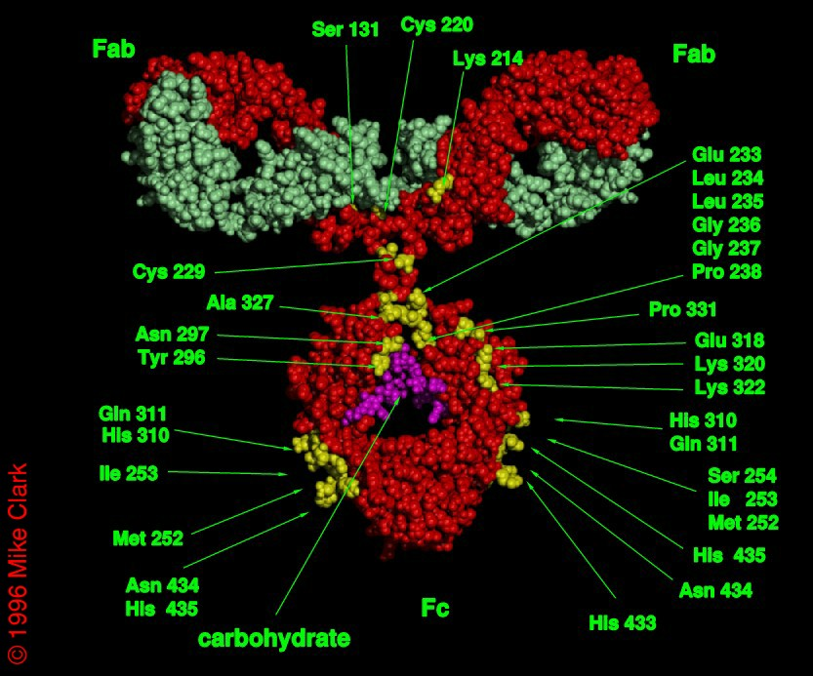
A small change can make a big difference
Example: Immune effector function of an antibody molecule
Adapted from: Clark, M (1997), Chemical Immunology;65:88-110 & Clark, M (1997) Antibody Engineering IgG Effector Mechanisms. Available at: http://www.path.cam.ac.uk/~mrc7/pdb/index.html Accessed October 2014
Notes:
The absence or presence of one single fucose molecule in the carbohydrate chain leads to a change in the overall structure of the carbohydrate, which interferes with binding of the antibody to the Fc receptors activating cytotoxicity.

Slide 19
A small change can make a big difference
Example: Immune effector function of an antibody molecule
Adapted from: Clark, M (1997), Chemical Immunology;65:88-110 & Clark, M (1997) Antibody Engineering IgG Effector Mechanisms. Available at: http://www.path.cam.ac.uk/~mrc7/pdb/index.html Accessed October 2014
Notes:
The absence or presence of one single fucose molecule in the carbohydrate chain leads to a change in the overall structure of the carbohydrate, which interferes with binding of the antibody to the Fc receptors activating cytotoxicity.

Slide 20
A small change can make a big difference
Example: Immune effector function of an antibody molecule
Adapted from: Clark, M (1997), Chemical Immunology;65:88-110 & Clark, M (1997) Antibody Engineering IgG Effector Mechanisms. Available at: http://www.path.cam.ac.uk/~mrc7/pdb/index.html Accessed October 2014
Notes:
The absence or presence of one single fucose molecule in the carbohydrate chain leads to a change in the overall structure of the carbohydrate, which interferes with binding of the antibody to the Fc receptors activating cytotoxicity.

Slide 21
A small change can make a big difference
Example: Immune effector function of an antibody molecule
Presence or absence of one sugar residue (fucose) can affect the biological activity
(killing of target cells)
Changes in immune effector function may influence potency, but also may affect the safety of the drug
Adapted from: Clark, M (1997), Chemical Immunology;65:88-110 & Clark, M (1997) Antibody Engineering IgG Effector Mechanisms. Available at: http://www.path.cam.ac.uk/~mrc7/pdb/index.html Accessed October 2014
Notes:
The absence or presence of one single fucose molecule in the carbohydrate chain leads to a change in the overall structure of the carbohydrate, which interferes with binding of the antibody to the Fc receptors activating cytotoxicity.

Slide 22

Integration of data from multiple analytical and biological tests provides complete understanding
Primary structure e.g.:
LC-MS intact mass
LC-MS subunits
Peptide mapping
Higher order structure e.g.:
NMR
CD spectroscopy
FT-IR
Impurities e.g.:
CEX, cIEF acidic/basic variants
LC glycation
Peptide mapping deamidation,
oxidation, mutation, glycation
SEC/FFF/AUC aggregation
Post translat. modif. e.g.:
NP-HPLC-(MS) N-glycans
AEX N-glycans
MALDI-TOF N-glycans
HPAEC-PAD N-glycans
MALDI-TOF O-glycans
HPAEC-PAD sialic acids
RP-HPLC sialic acids
Biological activity e.g.:
Binding assay
ADCC assay
CDC assay
Combination of attributes e.g.:
MVDA, mathematical algorithms
>100 attributes, understanding goes beyond sum of individual data

Slide 23
Anti-TNF biosimilars update: the most advanced products with published data. Many more on the way!
Originator | Biosimilar | Developed by | Status
Infliximab | CT-P13 | Celltrion (Remsima)/ Hospira (Inflectra) | Ph I (AS), Ph III (RA); marketed in EU, Korea, Japan, Turkey and filed in US
 | BOW015 | Epirus (partner: Ranbaxy Laboratories) | Infimab marketed in India; Ph III (RA) planned for EU/US
 | PF-06438179 | Pfizer | Ph III (RA)
Etanercept | SB4 | Samsung Bioepis (partner: Biogen Idec) | Ph III RA; accepted for EMA review
 | HD203 | Hanwha (partner: Merck) | Ph III RA; marketed in Korea
 | GP2015 | Sandoz | Ph III (PsO)
Adalimumab | ABP501 | Amgen | Ph III (RA & PsO)
 | GP2017 | Sandoz | Ph III (PsO)
 | Exemptia | Zydus Cadila | Ph III (RA); marketed in India

Slide 24
Novel therapies tested in inflammatory disease
IL-6¹
Sarilumab
Sirukumab
Clazakizumab
IL-17
Secukinumab²
Brodalumab³
Ixekizumab⁴
JAK⁵
Tofacitinib
Baricitinib
GLPG0634
VX-509
GM-CSF
Mavrilimumab¹¹
MOR103¹²
Namilumab¹³
Novel
Therapies
IL-12/IL-23²
Ustekinumab
Briakinumab
Vaccinations
TNFα Kinoid⁶
Rheumavax^{®7}
PDE4, B cell, T-cell costimulation,
adhesion molecules, Anti-IL20
Apremilast,⁸ vedolizumab,⁹ ofatumumab,¹⁰
1. Smolen JS et al. Ann Rheum Dis. 2014;73(3):492-509. 2. Mudigonda P et al. Derm Online J. 2012;18(10):1-10. 3. Papp KA et al. N Engl J Med. 2012;366(13):1181-1189. 4. Leonardi C et al. N Eng J Med. 2012;366(13):1190-1199. 5. Clark JD et al. [Epub ahead of print January 23, 2014]. J Med Chem. doi: 10.1021/jm401490p. 6. Vandepapelière P et al. Gastroenterol. 2011;140:S1-S192.abstract 743. 7. Ranjeny T et al. Arthritis Rheum. 2011;63(suppl 10):2430. 8. Palfreeman AC et al. Drug Design Devel Ther. 2013;7:201-210. 9. McLean LP et al. Immunotherapy. 2012;4(9):883-898. 10. Rosman Z et al. BMC Medicine. 2013;11:1-12. doi:10.2217/imt.12.85. 11. Burmester GR, et al. Ann Rheum Dis. 2013;72(9):1445-1452. 12. Behrens F et al. [Epub ahead of print February 17, 2014].Ann Rheum Dis. doi:10.1136/annrheumdis-2013-204816. 13. Takeda pipeline. 2011 Available at: http://www.takeda.com/investor-information/results/pdf/2011/qr2011_full_d10_en.pdf. Accessed May 2014

Slide 25
Targeting inflammatory pathways: IL-6 as an example
Currently (November 2014), tocilizumab is approved by the EMA and FDA for use in RA, and tofacitinib is approved by the FDA for use in RA
Target the ligand
IL-6
Target the receptor
IL-6R
gp130
Target signalling
Cell Surface
⇌
Nucleus
Transcription
Ahmed, et al. Mol Cancer Ther. 2007;6:2386-2390

Slide 26
Anti-IL-6: Review of recent data
Currently (November 2014), sirukumab is not approved for use in RA or lupus
Sirukumab
    Fully human anti-IL-6 monoclonal antibody, currently undergoing Phase III trials in RA and Phase II in Lupus
    Phase II dose ranging study in RA:
ACR50 response at Week 12
ACR50 response (%)
*
*
**
*p<0.05; **p=0.01 vs. placebo
Sirukumab was efficacious and generally well tolerated in patients with active RA despite MTX
Hsu, et al. Ann Rheum Dis. 2012;71(Suppl3):188

Slide 27
Targeting inflammatory pathways: IL-6 as an example
Currently (November 2014), tocilizumab is approved by the EMA and FDA for use in RA, and tofacitinib is approved by the FDA for use in RA
Sirukumab
Olokizumab
IL-6
Sarilumab
(& Tocilizumab)
Target the receptor
IL-6R
gp130
⇌
Tofacitinib
Baricitinib
GLPG0634
VX-509
Nucleus
Transcription
Ahmed, et al. Mol Cancer Ther. 2007;6:2386-2390

Slide 28
Anti-IL-6: Review of recent data
Currently (November 2014), sarilumab is not approved for use in RA
Sarilumab
  First fully human monoclonal antibody directed against the IL-6 receptor, currently undergoing Phase III trials in RA
  MOBILITY Part A Study
    Phase II study in patients with moderate to severe active RA
ACR20 response at Week 12
*
ACR20 response (%)
*p<0.05 vs. placebo
Sarilumab in combination with MTX significantly improved signs and symptoms of RA
Huizinga, et al. Ann Rheum Dis. 2012;71(Suppl3):60

Slide 29
Anti-IL-6 pathway: Implications for clinical practice
Increasing choice of IL-6 inhibitors targeting ligand or receptor
  Potential for differential responses and kinetics of response between agents?
  Potential for differences in safety?
  Competition for market share drives improved cost-competitiveness?

Slide 30
Targeting inflammatory pathways: IL-6 as an example
Currently (February 2013), tocilizumab is approved by the EMA and FDA for use in RA, and tofacitinib is approved by the FDA for use in RA
Target the ligand
IL-6
Target the receptor
IL-6R
gp130
Target signalling
Cell Surface
Jak inhibitors
⇌
Nucleus
Transcription
Ahmed, et al. Mol Cancer Ther. 2007;6:2386-2390

Slide 31
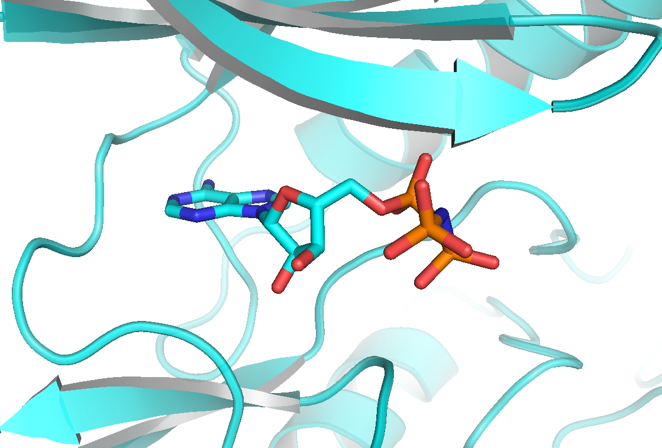
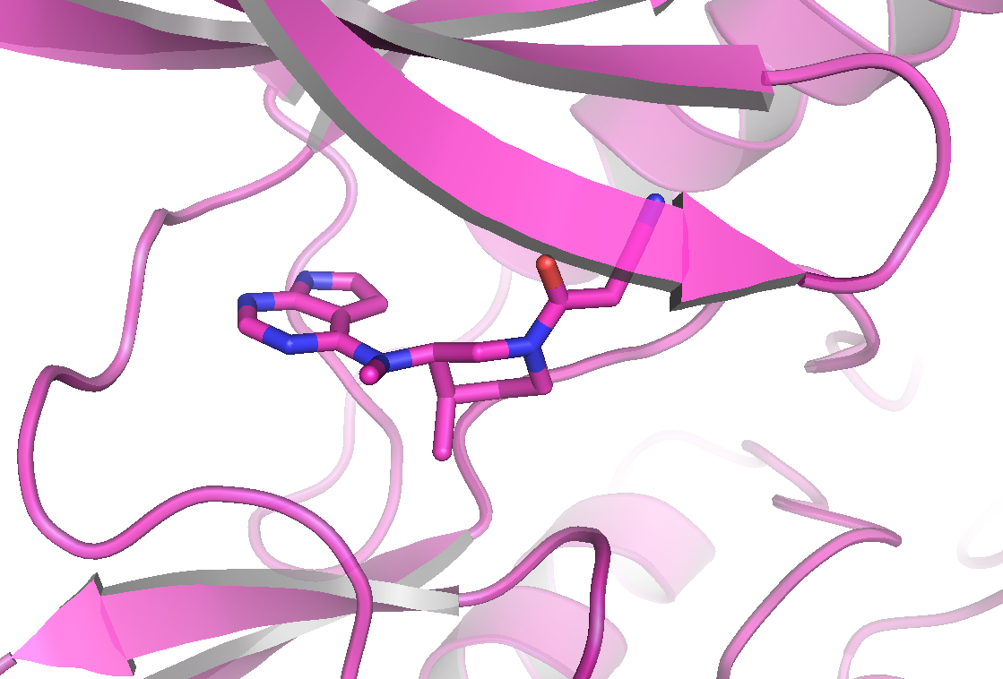
X-ray crystal structure confirms that ATP and tofacitinib bind at the ATP binding site
ATPγS bound to JAK3
Tofacitinib bound to JAK3
Chrencik, et al. J Mol Biol. 2010; 400:413-433.

Slide 32
JAK inhibitors: proposed selectivities described by manufacturers
Tofacitinib¹
Specificity for JAK1 and JAK3 over JAK2
Decernotinib ³
Specificity for JAK3
Baricitinib²
Specificity for JAK1 and JAK2
Filgotinib ⁴
Specificity for JAK1
TYK2
JAK1
TYK2
JAK1
JAK2
JAK1
JAK2
JAK2
TYK2
JAK1
JAK3
JAK2
JAK2
FUNCTION
Growth/maturation of lymphoid cells
Differentiation/ homeostasis of
T cells, NK cells
B-cell class switching
Inflammation
Antiviral
Inflammation
Antitumor
Naïve T-cell differentiation
T-cell homeostasis
Inflammation
Granulopoiesis
Antiviral
Inflammation
Anti-mycobacterial
Innate immunity
Differentiation/ proliferation of Th17 cells
Inflammation
Erythropoiesis
Myelopoiesis
Megakaryocyte/ platelet production
Growth
Mammary development
Reprinted (adapted) with permission from Clark JD et al. [Epub ahead of print January 23, 2014]. J Med Chem. doi: 10.1021/jm401490p Copyright 2014, American Chemical Society.
NK, natural killer; STAT, signal transducer and activator of transcription; TKY2, tyrosine kinase 2.
Tofacitinib is not approved by EMA.
1. Clark JD et al. [Epub ahead of print January 23, 2014]. J Med Chem. doi: 10.1021/jm401490p. 2. Smolen JS et al. Arthritis Rheum. 2012;64(suppl 10):490. 3. Hoock T et al. Arthritis Rheum.2011;63(suppl 10):1136. 4. Vanhoutte F, et al. Ann Rheum Dis. 2013; 72(suppl 3):242.

Slide 33
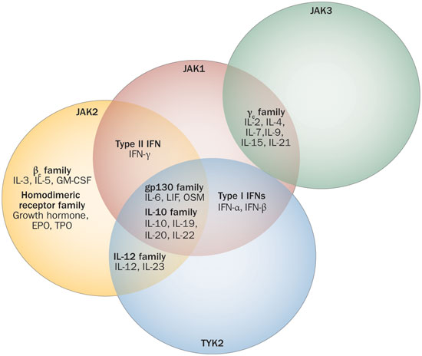
A wide range of different cytokines exert their effect via the JAK family
Adapted from O’Shea JJ, et al. Nature Reviews Rheumatology 2013; 9(3):173–182

Slide 34
Proportion of TNF-IR, DMARD-IR and MTX-naïve patients with ACR50 response
Week 12
Week 24
Week 24
Week 24
Week 12
Week 24
Adalimumab
Tofacitinib 5 mg BID
Tofacitinib 10 mg BID
PBO
Response Rates (%)
132
133
131
315
318
159
321
316
160
243
245
122
373
397
186
N=
204
201
108
204
ORAL
Step^{1,2}
ORAL
Sync^{2,3}
ORAL
Standard^{2,4}
ORAL
Scan^{2,5}
ORAL
Solo^{2,6}
ORAL
Start^{2,7}
Patient:
TNF-IR
DMARD-IR
MTX-IR
MTX-IR
DMARD-IR
MTX-naïve
Tofacitinib Regimen:
+ MTX
+ Nonbiologic DMARDs
+ MTX
+ MTX
Monotherapy
Monotherapy
*p<0.0001;ªvs baseline; †p≤0.001; §p<0.001.
Tofacitinib is not approved by EMA.
.
1. Burmester GR et al. Lancet. 2013;382(9865):451-460. 2. Pfizer Inc. 2012. Tofacitinib for Treatment of Rheumatoid Arthritis. Available at: http://www.fda.gov/downloads/AdvisoryCommittees/CommitteesMeetingMaterials/Drugs/ArthritisAdvisoryCommittee/UCM302960.pdf Accessed 23 October 2014. 3. Kremer J et al. Ann Intern Med. 2013;159(4):253-261. 4. van Vollenhoven R et al. N Engl J Med. 2012;367(6):508-519. 5. van der Heijde D et al. Arthritis Rheum. 2013;65(3):559-570. 6. Fleischmann R et al. N Engl J Med. 2012;367(6):495-507. 7. Lee EB et al. Arthritis Rheum. 2012;64(suppl 10):2486

Slide 35
Tofacitinib: rates of DAS28-4(ESR) ≤3.2 in TNF-IR, DMARD-IR and MTX-naïve RA patients
Percentage of Patients Achieving DAS28-4(ESR) ≤3.2
Week 12
Week 24
Week 24
Week 12
Week 24
Adalimumab
adalimumab
Tofacitinib 5 mg BID
Tofacitinib 10 mg BID
PBO
Patients With DAS28-4(ESR) <3.2 (%)
MTX
N=
119
125
120
204
201
108
204
316
309
156
232
229
114
373
397
186
ORAL
Step^{1,2}
ORAL
Standard²⁻⁴
ORAL
Scan^{2,5}
ORAL
Solo^{2,6}
ORAL
Start²
Patient:
TNF-IR
MTX-IR
MTX-IR
DMARD-IR
MTX-naïve
Tofacitinib
Regimen:
+ MTX
+ MTX
+ MTX
Monotherapy
Monotherapy
ESR, erythrocyte sedimentation rate.
*p<0.05; †p<0.0001; ‡p≤0.001; §p≤0.05; ‖p<0.001.
Tofacitinib is not approved by EMA. Tofacitinib 5 mg is approved in over 20 markets around the world for the treatment of moderate-to-severe RA. Tofacitinib 5 mg and 10 mg is approved in Switzerland and Russia. MTX-naïve data from ORAL Start trial was not recorded for marketing authorization.
1. Burmester GR et al. Lancet. 2013; 382(9865):451-460. 2. . Pfizer Inc. 2012. Tofacitinib for Treatment of Rheumatoid Arthritis. Available at: http://www.fda.gov/downloads/AdvisoryCommittees/CommitteesMeetingMaterials/Drugs/ArthritisAdvisoryCommittee/UCM302960.pdf Accessed 23 October 2014 3. van Vollenhoven R et al. N Engl J Med. 2012;367(6):508-519. 4. van Vollenhoven R et al. Arthritis Rheum. 2012;64(suppl 10):1297. 5. van der Heijde D et al. Arthritis Rheum. 2013;65(3):559-570. 6. Fleischmann R et al. N Engl J Med. 2012;367(6):495-507..

Slide 36
Baricitinib in MTX-IR patient with RA
ACR at Week 12
DAS28-CRP <2.6 at Week 12
Responders (%)
1 mg
(n=49)
2 mg
(n=52)
4 mg
(n=52)
2 mg
(n=52)
4 mg
(n=52)
8 mg
(n=50)
PBO
(n=98)
8 mg
(n=50)
PBO
(n=98)
1 mg
(n=49)
ACR20
ACR50
ACR70
CRP, C-reactive protein.
*p<0.05 vs placebo.
Keystone E, Taylpr PC et al. Ann Rheum Dis. 2015 Feb;74(2):333-40. .
Taylor PC et al. EULAR June 12-15, 2013; Madrid, Spain; Abstract #OP0047

Slide 37
Targeting the GM-CSF Pathway
Currently (November 2014), none of the biologics mentioned below are approved for use in RA
MOR103
Namilumab
GM-CSF
Target the ligand
Mavrilimumab
Target the receptor
GM-CSFR
Cell Surface
⇌
Nucleus
Transcription
Ahmed, et al. Mol Cancer Ther. 2007;6:2386-2390

Slide 38
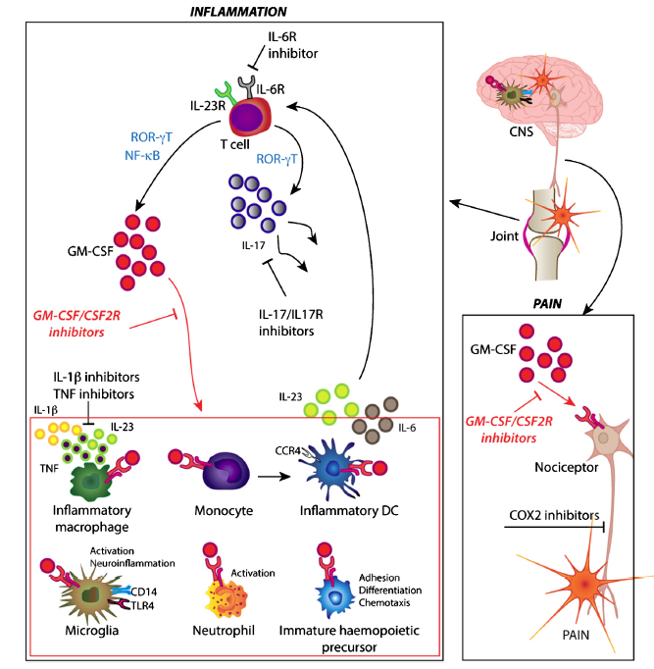
GM-CSF as a Target for Inflammation and Pain
Granulocyte macrophage colony stimulating factor (GM-CSF) as a therapeutic target for inflammation and pain.
Inhibition of GM-CSF during inflammation (joints in RA) may inhibit differentiation, adhesion, chemotaxis and activation of multiple inflammatory and immune cells (monocytes, macrophages, neutrophils, dendritic cells [DC]) and their respective precursors, and therefore reduce the production of inflammatory cytokines (IL-1β, TNF, IL-23 and IL-6). These cytokines are relevant in shaping the response of T-cells, causing differentiation and production of IL-17 and GM-CSF.
  Adapted from Van Nieuwenhuijze A et al. Mol Immunol 2013;56:675-682.

Slide 39
Mavrilimumab + MTX in Moderate to Severe RA
Phase II study, moderate-to-severe RA pts MTX IR (N=239). Of 239 patients, 6 were excluded from ITT population (ITT N=233: 75 placebo [PBO] and 158 mavrilimumab [MAV])
ACR Responses at Week 12
*
*
*
*
Response rate differences in ACR were seen from week 4 and increased during the treatment period. The 100 mg dose demonstrated significant benefit vs PBO in DAS28 remission, as well as ACR20, 50 and 70 responses
Changes in CRP were observed as early as week 2
*p<0.05
EARTH Study
  Burmester GR et al. Ann Rheum Dis 2013;72:1445-1452.

Slide 40
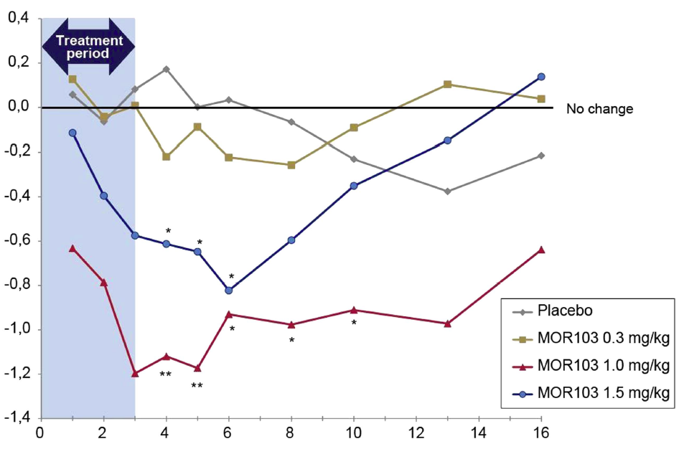
MOR103 in Moderate to Severe RA
Multicenter, randomized, double-blind, dose escalation trial of IV MOR103. Of 93 randomized and treated patients, 85 completed the trial
4 treatment groups, PBO, 0.3, 1.0 and 1.5 mg/Kg of MOR103 IV at baseline and days 8, 15 and 22. Follow-up visits at weeks 4, 5, 6, 8, 10, 13 and 16. primary outcome was safety
Mean change from BL in DAS28 score
Weeks
  Behrens F et al. Ann Rheum Dis online first published on February 17, 2014 as 10.1136/annrheumdis-2013-204816.

Slide 41
Targeting spleen tyrosine kinase
Rituximab
B Cell receptor
CD20
B Cell surface
SYK
Target signalling
BTK
PI3K
PKC
Signalling leads to activation of B cells
NFKB
Parekh, et al. Semin Cancer Biol. 2011;21(5):335-346

Slide 42
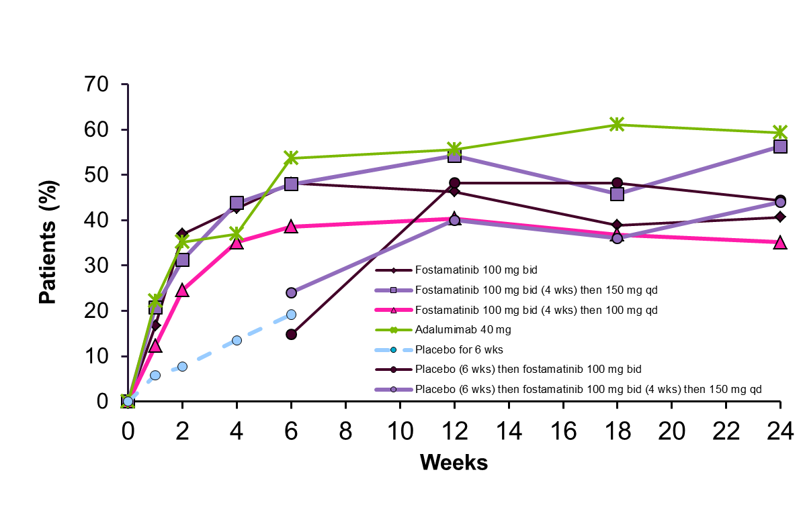
SYK inhibitor: Fostamatinib monotherapy data
OSKIRA-4: Change in proportion of patients with ACR20 response
Adalimumab 40 mg
Taylor PC et al. Ann Rheum Dis. 2014 Jul 29. [Epub ahead of print]

Slide 43
SYK inhibitor: Recent fostamatinib Phase lll data
ACR20 responder rates at Week 24 in Phase III
Fostamatinib dose | OSKIRA 1 MTX-R + Fosta | OSKIRA 2 DMARD-IR + fosta | OSKIRA 3 MTX + Fosta after one anti-TNF failure
100mg bid | 49% p<0.001 | 39.6% p<0.001 | 36.2% p=0.004
100mg bid/150mg od | 44% p=0.006 | 39.6% p<0.001 | 27.8% p=0.168
Placebo | 34% | 24.5% | 21.1%
OSKIRA-1 failed to meet co-primary endpoint of change in mTSS at Week 24*
The safety and tolerability findings were generally consistent with earlier studies^
*Rigel Pharmaceuticals Inc. 2014 Rigel will resume responsibility for Fostamatinib. Available at: http://ir.rigel.com/phoenix.zhtml?c=120936&p=irol-newsArticle&ID=1826622&highlight=
Accessed November 2014
Notes:
OSKIRA-1 (MTX add-on in MTX-IR)
OSKIRA-2 (DMARD add-on in DMARD-IR)
OSKIRA-3 (MTX add-on in TNF-α antagonist-IR)*

Slide 44
Vaccinations: The future of RA treatment?
Currently (November 2014), TNF kinoid is not approved for use in RA and Crohn’s disease
TNF-alpha Kinoid
  A vaccine targeting TNF avoids treatment resistance by eliciting a natural immune response through the production of polyclonal antibodies against multiple epitopes of TNF.
  Currently undergoing Phase II trials in RA
  Shown promising results in Phase I/II trials in Crohn’s disease:
Patients %
Semerano, et al. Expert Opin Biol Ther. 2011;11(4):1-6
Notes:
Crohn’s: The study's primary objective was to assess TNF-Kinoid's safety and its ability to induce an immune response
to tumor necrosis factor (TNF)

Slide 45
What are the unmet needs for AS patients?
Therapies that are:-
  Effective!
  Safe
  Well tolerated
  Convenient – an oral DMARD that works!
  Cost effective so that it it’s use is not restricted to the minority of sufferers with the worst disease
Something to “fill the gap” between NSAIDs and biologic anti-TNFs?
Something better than anti-TNFs?

Slide 46
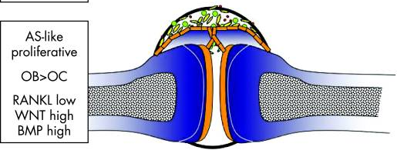
Factors contributing to AS pathophysiology
Ankylosing spondylitis is associated with genetic polymorphisms in genes involved in immunological pathways, antigen processing, T cell activation and apoptosis, and cytokines or cytokine receptors
TNF inhibition validates TNF as mediator of symptoms and signs in AS
The IL-23-Th17 axis has been implicated by data showing that patients with AS have an elevated frequency of CD4+ T cells expressing IL-17 and IL-22
In AS patients with higher greater disease activity, the percentage of T cells expressing programmed death-1 (PD-1) is significantly lower than in those with lower scores, suggesting that the defective T cell apoptosis may contribute to the spinal radiologic changes
PBMC from patients with AS are deficient in production of IL-10, an anti-inflammatory cytokine
van der Heijde et al. Ann Rheum Dis. 2010;69:949.
Notes:
This slide will be
presented

Slide 47
Longitudinal relationship between disease activity and radiographic damage (ASDAS)
 | Model with ASDAS continuous | Model with ASDAS categorical
Variable | Multivariable regression 1 Progression rate per 2-year interval ß (95% CI) (N = 183) | Multivariable regression 2 Progression rate per 2-year interval ß (95% CI) (N = 183)
Previous mSASSS (0-72) | 1.03 (1.01; 1.05) | 1.03 (1.01; 1.05)
ASDAS | 0.72 (0.41; 1.04) | §
ASDAS disease activity states
- Moderate vs inactive (≥1.3 and <2.1 vs <1.3) | § | 0.57 (-0.56; 1.69)
- High vs inactive (≥2.1 and ≤3.5 vs <1.3) | § | 0.91 (-0.17; 1.99)
- Very high vs inactive (>3.5 vs <1.3) | § | 2.31 (1.11; 3.51)
*All models are time-lagged (2 years of time lag) and auto-regressive (i.e. adjusted for mSASSS in the 2-years before). ß reflect progression in mSASSS units over 2 years. § Not included in the model
Neither HLA-B27, nor the medication (NSAIDs, NSAID score or biologics), or the presence of EAM (individually or all combined) confounded the relationship between each of the disease activity measures and mSASSS
Essers I et al, Rheumatology (Oxford). 2015 Apr;54(4):633-40.
Notes:
This slide shows that there is a longitudinal relationship between disease activity and damage progression.

Slide 48

TNF blockade has good symptomatic efficacy in SpA *
% ASAS40
Infliximab¹ Placebo
Etanercept² Placebo
Adalimumab³ Placebo
Golimumab⁴ Placebo
Certolizumab⁵ Placebo
pegol
*Different studies. No head to head comparison

Slide 49
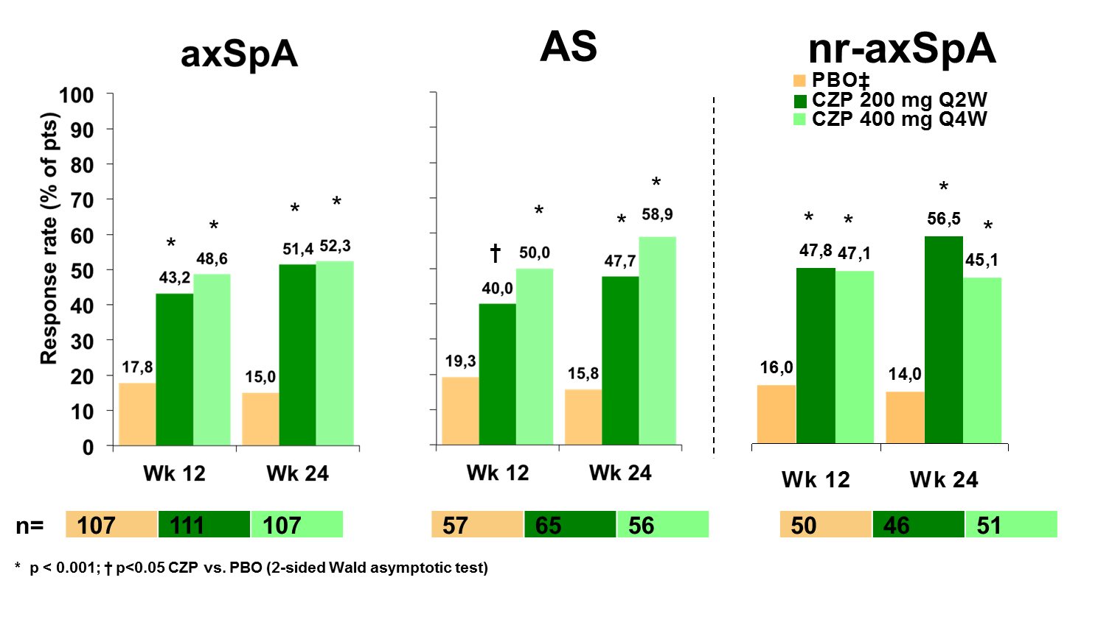
ASAS40 response after 12 and 24 weeks of Certolizumab pegol in axSpA and nr-axSpA
RAPID-axSpA Study: 200 mg Certolizumab pegol s.c. EOW vs 400 mg Certolizumab pegol s.c. every four weeks vs placebo

Slide 50
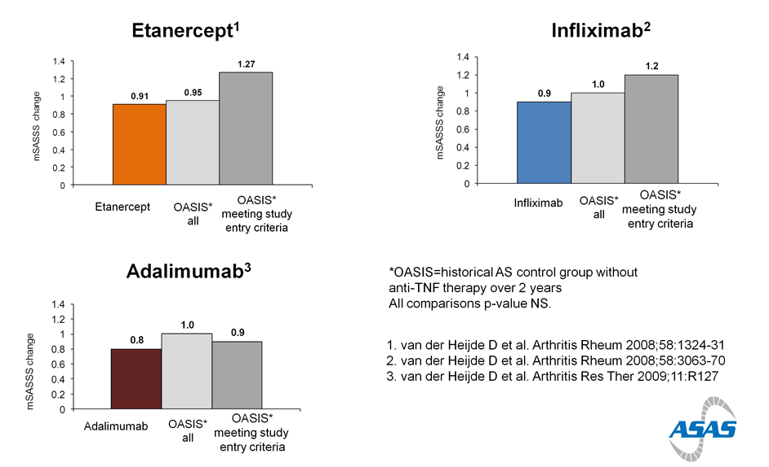
Anti-TNF over 2 years does not inhibit radiographic progression in AS

Slide 51
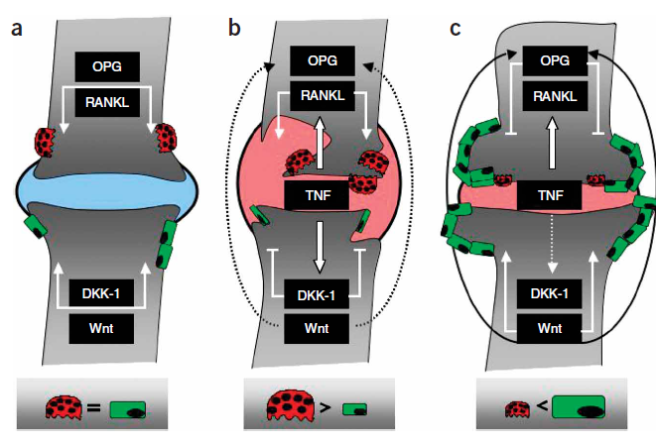
Uncoupling of inflammation and new bone formation
TNF “brake” hypothesis
  Active inflammation suppresses new bone formation by upregulating DKK-1
    DKK-1 inhibits bone formation by blocking the Wnt pathway
  TNF-inhibition downregulates DKK-I, releasing the Wnt pathway to make bone
Diarra, D et al. Nat Med. 2007. Feb;13(2):156-63.

Slide 52
Bisphosphonates Vs. Infliximab in Ankylosing Spondylitis Treatment
(Background: Pamidronate successfully used in the treatment of AS)
6-month, open-label study: 60 active AS patients, neridronate (100 mg/month IV) or infliximab (5 mg/kg) in 1:1 ratio
At six months: Significant and comparable reduction in both groups in BASDAI (NER -1.72 vs INF-1.62), and VAS axial pain
BASFI significantly reduced at 3 & 6 months in NER; and at 3, but not 6 months in INF group
Lumbar spinal BMD significantly increased in NER but not INF
ESR/CRP only reduced in infliximab group
Conclusion: High iv doses of neridronate (an amino-bisphosponate) are as effective as infliximab in reducing disease activity in AS, with additional benefits on BMD
Viapiana O. et al. Rheumatology 2014;53:90-94.
Notes:
Rheumatology (Oxford). 2014 Jan;53(1):90-4. doi: 10.1093/rheumatology/ket321. Epub 2013 Sep 24.
Bisphosphonates vs infliximab in ankylosing spondylitis treatment.
Viapiana O¹, Gatti D, Idolazzi L, Fracassi E, Adami S, Troplini S, Povino MR, Rossini M.
Author information
Abstract
OBJECTIVE:
The objective of this study was to evaluate if the anti-inflammatory properties of bisphosphonates and their effect on bone turnover could be useful in the treatment of AS.
METHODS:
Sixty patients were consecutively assigned in a 1:1 ratio in a 6-month open-label, single-centre study on active AS to receive monthly i.v. neridronate (100 mg) or standard infliximab (5 mg/kg) therapy.
RESULTS:
A significant reduction in the mean BASDAI was observed over 6 months of either neridronate (-1.72) or infliximab (-1.62) administration. The BASFI decreased significantly at 3 and 6 months in the neridronate arm, while in the infliximab group a significant reduction at 3 months but not 6 months was observed. The 10-cm visual analogue scale for axial pain decreased significantly and comparably at 3 and 6 months in both groups. No significant differences between treatment arms for all these changes were observed at both 3 months and the final assessment. The BASMI was not significantly modified in the neridronate or infliximab group. No significant variations of BMD were observed in the infliximab group, while in patients treated with neridronate a significant increase was observed at the lumbar spine.
CONCLUSION:
High i.v. doses of the amino-bisphosphonate neridronate are as effective as infliximab therapy in reducing disease activity in AS patients, with additional benefits on BMD changes. Further studies to confirm these results over a longer time frame are warranted together with the possibility to explore the long-term efficacy of a combination of lower anti-TNF doses with bisphosphonates.

Slide 53
Do TNF-blockers need to be given continuously?

Slide 54
Do TNF-blockers need to be given continuously?
Withdrawal of aTNF

Slide 55
Do TNF-blockers need to be given continuously?
Withdrawal of aTNF
Restart

Slide 56
Treat to target algorithm in SpA
Main
target
Adapt therapy
according to
disease activity
Adapt therapy
if state is lost
Active
SpA
Remission
Sustained
Remission
Use
measures
of clinical disease activity
and acute phase reactants
as needed
Use
measures
of clinical disease activity
and acute phase reactants
as needed
Low disease
activity
Sustained low
disease activity
Alternative
target
Adapt therapy
according to
disease activity
Adapt therapy
if state is lost

Slide 57
Treat to target algorithm in SpA
Main
target
Adapt therapy
according to
disease activity
Adapt therapy
if state is lost
Active
SpA
Remission
Sustained
Remission
Use
measures
of clinical disease activity
and acute phase reactants
as needed
Use
measures
of clinical disease activity
and acute phase reactants
as needed
Low disease
activity
Sustained low
disease activity
Alternative
target
Adapt therapy
according to
disease activity
Adapt therapy
if state is lost

Slide 58
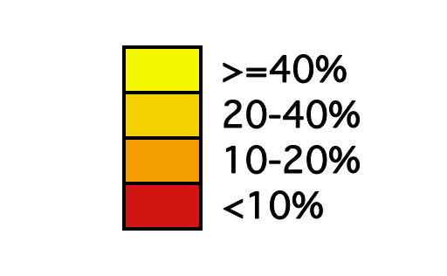
Anti-TNF treatment in axSpA: early initiation leads to better treatment outcomes
Patient 1: 24 years, CRP 0.7, HLA-B27+ve, BASFI 4.8
 |  | BASFI
 |  | >6.5 | 4.5-6.5 | ≤4.5 | >6.5 | 4.5-6.5 | ≤4.5
 | AGE ≤40 | 12% | 25% | 35% | 23% | 43% | 55% | >2.0 | CRP (mg/dL)
 |  | 8% | 17% | 25% | 16% | 32% | 43% | 0.6-2.0
 |  | 6% | 14% | 20% | 12% | 26% | 36% | ≤0.6
 | AGE >40 | 8% | 17% | 25% | 16% | 32% | 43% | >2.0
 |  | 5% | 12% | 18% | 10% | 23% | 32% | 0.6-2.0
 |  | 4% | 9% | 14% | 8% | 18% | 26% | ≤0.6
 |  | HLA-B27 neg. |  |  | HLA-B27 pos.
Probability for partial remission after 6 months

Slide 59
Anti-TNF treatment in axSpA: early initiation leads to better treatment outcomes
Patient 1: 24 years, CRP 0.7, HLA-B27+ve, BASFI 4.8
Patient 2: 42 years, CRP 2.7, HLA-B27–ve, BASFI 7.0
 |  | BASFI
 |  | >6.5 | 4.5-6.5 | ≤4.5 | >6.5 | 4.5-6.5 | ≤4.5
 | AGE ≤40 | 12% | 25% | 35% | 23% | 43% | 55% | >2.0 | CRP (mg/dL)
 |  | 8% | 17% | 25% | 16% | 32% | 43% | 0.6-2.0
 |  | 6% | 14% | 20% | 12% | 26% | 36% | ≤0.6
 | AGE >40 | 8% | 17% | 25% | 16% | 32% | 43% | >2.0
 |  | 5% | 12% | 18% | 10% | 23% | 32% | 0.6-2.0
 |  | 4% | 9% | 14% | 8% | 18% | 26% | ≤0.6
 |  | HLA-B27 neg. |  |  | HLA-B27 pos.
Probability for partial remission after 6 months

Slide 60
Anti-TNF treatment in axSpA: early response leads to better treatment outcomes
Probability at year 8
100%
Dropout
80%
BASDAI 50 Non-responder
BASDAI 50 Responder
60%
Partial Remission
40%
OR=1.27, 95% CI: 1.0–1.6, p=0.06
20%
OR=1.85, 95% CI: 1.2–6.0, p=0.002
0%
OR=2.73, 95% CI: 1.2–6.0, p=0.012
0
1
2
3
4
BASDAI at week 12

Slide 61
Duration of remission after halving Etanercept dose in AS:
A randomized, prospective, long-term, follow-up study
First phase (2005-09): n=78 open-label study, biologic-naïve active AS patients treated with ETN 50 mg/Wk
Second phase: Jan 2010: 55% were in remission (BASDAI<4, no iritis, arthritis, dactylitis, normal CRP), randomized to ETN 50 mg/wk (n=21) or 50 mg/QOW (n=22) in open label
Follow up: up to 22 months
Remission possible in 50% AS patients
Most can be maintained in remission on half dose
Cantini F. et al. Biologics. 2013;7:1–6.
Notes:
Biologics. 2013;7:1-6. doi: 10.2147/BTT.S31474. Epub 2013 Jan 4.
Duration of remission after halving of the etanercept dose in patients with ankylosing spondylitis: a randomized, prospective, long-term, follow-up study.
Cantini F¹, Niccoli L, Cassarà E, Kaloudi O, Nannini C.
Author information
Abstract
BACKGROUND:
The aim of this study was to evaluate the proportion of patients with ankylosing spondylitis maintaining clinical remission after reduction of their subcutaneous etanercept dose to 50 mg every other week compared with that in patients receiving etanercept 50 mg weekly.
METHODS:
In the first phase of this randomized, prospective, follow-up study, all biologic-naïve patients identified between January 2005 and December 2009 as satisfying the modified New York clinical criteria for ankylosing spondylitis treated with etanercept 50 mg weekly were evaluated for disease remission in January 2010. In the second phase, patients meeting the criteria for remission were randomized to receive subcutaneous etanercept as either 50 mg weekly or 50 mg every other week. The randomization allocation was 1:1. Remission was defined as Bath Ankylosing Spondylitis Disease Activity Index < 4, no extra-axial manifestations of peripheral arthritis, dactylitis, tenosynovitis, or iridocyclitis, and normal acute-phase reactants. The patients were assessed at baseline, at weeks 4 and 12, and every 12 weeks thereafter. The last visit constituted the end of the follow-up.
RESULTS:
During the first phase, 78 patients with ankylosing spondylitis (57 males and 21 females, median age 38 years, median disease duration 12 years) were recruited. In January 2010, after a mean follow-up of 25 ± 11 months, 43 (55.1%) patients achieving clinical remission were randomized to one of the two treatment arms. Twenty-two patients received etanercept 50 mg every other week (group 1) and 21 received etanercept 50 mg weekly (group 2). At the end of follow-up, 19 of 22 (86.3%) subjects in group 1 and 19 of 21 (90.4%) in group 2 were still in remission, with no significant difference between the two groups. The mean follow-up duration in group 1 and group 2 was 22 ± 1 months and 21 ± 1.6 months, respectively.
CONCLUSION:
Remission of ankylosing spondylitis is possible in at least 50% of patients treated with etanercept 50 mg weekly. After halving of the etanercept dose, remission is maintained in a high percentage of patients during long-term follow-up, with important economic implications.

Slide 62
IL-6 blockade in axSpA
Does it work?

Slide 63
Assessment of short-term efficacy of tocilizumab in AS : Results of RCT trial
BUILDER-1: DBRPCT, AS patients TNFi naïve, Part 1: TCZ 8 mg/kg or PL X 12 wks, Part 2 (beginning after part 1 enrollment ended), new pts TCZ 4 or 8 mg/kg or PL X 24 wks (Phase III)
BUILDER-2: TNFi IR AS pts, same doses of TCZ (Phase III)
102 randomized in BUILDER-1 Part 1; 99 (48 TCZ, 51 PL)
1⁰ ASAS20 at 12 weeks
BUILDER-1
Part-1
p=0.28
2⁰ & exploratory endpoints did not differ
CRP levels dropped, indicating IL-6 blockade
Other parts of the study cancelled
Sieper J, et al. Ann Rheum Dis 2014;73:95–100
Notes:
Sieper J, Porter-Brown B, Thompson L, et al. Assessment of short-term symptomatic efficacy of tocilizumab in ankylosing spondylitis: results of randomised, placebo-controlled trials. Ann Rheum Dis. 2013 Jun 13. (Original)
Placebo-controlled RCT: Tocilizumab did not improve disease activity in patients with ankylosing spondylitis naive to antitumour necrosis factor treatment.
PMID: 23765873 Free Full Text Available
OBJECTIVES: BUILDER-1 and BUILDER-2 aimed to assess the efficacy and safety of tocilizumab (TCZ) in patients with ankylosing spondylitis (AS).
METHODS: BUILDER-1 was a two part, phase II-III parallel-group trial in patients with AS naive to antitumour necrosis factor (aTNF) treatment. Patients in part 1 received TCZ 8 mg/kg or placebo for 12 weeks. In part 2 (beginning after part 1 enrolment ended), newly enrolled patients received TCZ 4 or 8 mg/kg or placebo for 24 weeks. The same treatment arms were used in BUILDER-2, a phase III study in aTNF-inadequate responders. The primary endpoint for both studies was the proportion of patients achieving 20% improvement in the Assessments in Axial SpondyloArthritis international Society (ASAS). Secondary and exploratory endpoints included ASAS40 response rates, Bath Ankylosing Spondylitis Disease Activity Index improvement, changes in joint counts, enthesitis score and C reactive protein (CRP).
RESULTS: 102 patients were randomised in BUILDER-1 part 1; 99 (48 TCZ, 51 placebo) completed 12 weeks. Week 12 ASAS20 response rates were 37.3% and 27.5% in the TCZ and placebo arms, respectively (p=0.2823). Secondary and exploratory endpoints did not differ between treatment arms. CRP levels declined with TCZ treatment, suggesting adequate IL-6 receptor blockade. As a result, BUILDER-1 part 2 and BUILDER-2 were terminated. TCZ safety results were consistent with previous observations in rheumatoid arthritis, except for a cluster of anaphylactic and hypersensitivity events at Bulgarian study sites. No apparent explanation for this clustering could be found.
CONCLUSIONS: BUILDER-1 failed to demonstrate TCZ efficacy in treating aTNF-naive patients with AS. CLINICAL TRIAL REGISTRATION NUMBERS:: NCT01209702 and NCT01209689 (www.clinicaltrials.gov).

Slide 64
Ankylosing Spondylitis: Products in Development
Product Name | Description | Organization | Stage
Secukinumab¹ | IL-17 inhibitor | Novartis/Alcon | Phase 3
Ixekizumab¹ | IL-17 inhibitor | Eli Lilly | Phase 3
Apremilast¹ | PDE4 inhibitor | Celgene | Phase 3
Tofacitinib¹ | JAK-3 inhibitor | Pfizer | Phase 2
Ustekinumab^{2,} | IL-12/23 inhibitor | Janssen | Phase 2
Actonel^{2,3} | Pyridinyl bisphosphonate | Sanofi | Phase 2
Infliximab biosimilar¹ | TNF-alpha inhibitor | Celltrion | Phase 1/2
Infliximab biosimilar¹ | TNF-alpha inhibitor | Pfizer | Phase 1
Ankylosing Spondylitis (Bekhterev’s Disease) – Pipeline Review, H2 2013 (Global Markets Direct).
Clinicaltrials.gov..
Actonel prescribing information.

Slide 65
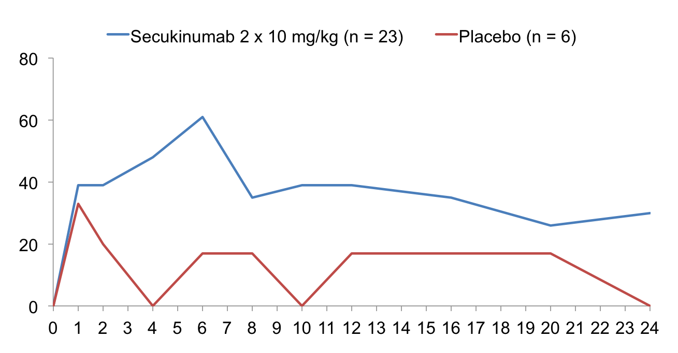
IL-17A inhibition with secukinumab in AS
% ASAS20 Responders
Weeks
Arrows indicate infusions.

Slide 66
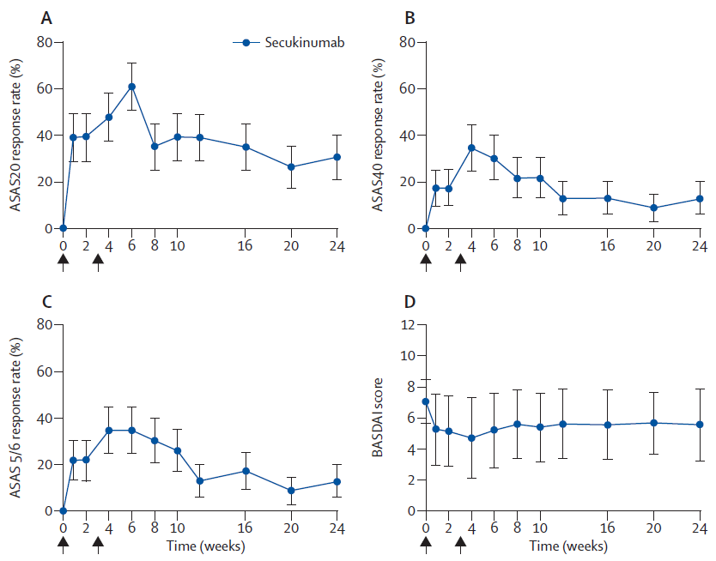
Anti-IL17A ameliorates active AS
Baeten D et al. Lancet 2013 ; 382:1705-13

Slide 67
Ustekinumab in 20 patients with active AS
Results at Week 24
Poddubnyy D, et al. Ann Rheum Dis 2014;73:817–23

Slide 68
ASAS40 with other biologics in axSpA
TNFα-inhibitor
Placebo
Anakinra
(anti-IL1)
100mg s.c
n=20
TNF-naive
Week 24
Rituximab
(anti-CD20)
each 1g i.v.
n=20
TNF-failure+
TNF-naive
Week 24
Abatacept
(T-Zell-Modulator)
10mg/kg i.v.
n=30
TNF-failure+
TNF-naive
Week 24
Tocilizumab
(anti-IL6R)
8mg/kg i.v.
n=51
TNF-naive
Week 12
Secukinumab
(anti-IL17)
2x 10mg/kg
n=24
TNF-failure +
TNF-naive
Week 6
Apremilast
(PDE-inhibitor)
30mg BID p.o.
n=17
TNF-naive
Week 12
Ustekinumab
(IL12/23-inhibitor.)
3x 90mg s.c.
(BL, W4, W16)
n=20
TNF-naive
Week 24

Slide 69
ASAS40 with other biologics in axSpA
TNFα-inhibitor
Placebo
Anakinra
(anti-IL1)
100mg s.c
n=20
TNF-naive
Week 24
Rituximab
(anti-CD20)
each 1g i.v.
n=20
TNF-failure+
TNF-naive
Week 24
Abatacept
(T-Zell-Modulator)
10mg/kg i.v.
n=30
TNF-failure+
TNF-naive
Week 24
Tocilizumab
(anti-IL6R)
8mg/kg i.v.
n=51
TNF-naive
Week 12
Secukinumab
(anti-IL17)
2x 10mg/kg
n=24
TNF-failure +
TNF-naive
Week 6
Apremilast
(PDE-inhibitor)
30mg BID p.o.
n=17
TNF-naive
Week 12
Ustekinumab
(IL12/23-inhibitor.)
3x 90mg s.c.
(BL, W4, W16)
n=20
TNF-naive
Week 24

Slide 70
Summary and conclusions
Biologic therapy has an important role in managing our RA and AS patients
Our approach to management has changed substantially since approval of the first anti-TNF
Data supporting both the long term efficacy and safety of biologics should be considered when making treatment decisions
T2T approaches are likely to improve long term outcomes
However, rapid advances in understanding the pathobiology have led to new therapeutic target identification
Clinical trials to validate these targets are underway
But the relative benefit:risk profiles and cost effectiveness remain to be seen

