Slide 1
Perspective: North American Outlook
energy
North American Natural Gas
Global Energy Forum
Vail, Colorado
January 2017
Samuel Andrus, Senior Director, North American Gas, Sam.Andrus@ihsmarkit.com

Slide 2
Key Insights
Shale Gas Reloaded:
Research found 1,400 trillion cubic feed (Tcf) of economic natural gas resource at less than $4.00/MMBtu and over 700 Tcf at sub $3.00 with major implications across the entire North American energy landscape.
Risks from concentration of production:
Creates pipeline expansion dependency and challenge of matching supply growth to demand growth.
Oil price and associated gas production not correlated to natural gas market.
Tight 2017 with higher prices and gas to coal switching.
Likely excess thereafter on completion of Appalachia pipeline expansions and capex surge to oil.
Global Gas Reset:
Shale and US LNG exports changing how global gas prices get set.
Slower Asia demand growth leading to overbuild of liquefaction capacity.
Excess global LNG liquefaction likely concurrent with surge of US production.
Variable cost pricing leaves US uncompetitive until market grows into the capacity.

Slide 3
2016 Shale Gas Reloaded update 1,400 Tcf North American supply at Henry Hub <$4
Break-even price at Henry Hub for natural gas resources
1,400 Tcf <$4/MMBtu
Demand to 2025
Demand to 2040
Source: IHS Energy
© 2016 IHS 60204-1

Slide 4
Porting shale technology from gas to oil
Notes:
As prod growth in response to environment – new approach to forecasting gas.
Now ported shale gas tech to oil…production of oil has brought along with it AG. Before a static forecast was ok
No longer we can do that. oil activity at a play level, similar to what we do for nat gas.

Slide 5
Driving rapid expansion of associated gas production

Slide 6
Concentration of production Price risk with going oily and Appalachian
Appalachia
Associated Gas
Other gas plays
Notes:
The Eagle Ford comprised about 26% of total associated gas volumes at June 2015. Looking ahead, the Eagle Ford’s share of associated gas is projected to increase to about 33% by December 2020.
The Permian Basin represented roughly 28% of associated gas volumes at June 2015, with 13% from conventional resources and 15% from unconventional. Looking ahead, conventional resources will constitute a smaller share of associated gas due to the growth in Permian Unconventionals.

Slide 7
Pipeline expansions delays owing to lengthy regulatory processes and low prices
Prior to the collapse of late 2015/early 2016, the expected pipeline expansion buildout was relatively strong for 2016–17.
Projects previously expected to enter service in 2016–17 are pushed back. At least 4.5 Bcf/d (15%) of capacity has been delayed by an average of 19 months. Further project delays are expected, pushing IHS expectations for project in-service dates as far as 2020.

Slide 8
Tight 2017 market balancing with coal/gas switching
2017 Henry Hub average price range
2016 Henry Hub average price range

Slide 9
Heading for excess global LNG liequefaction

Slide 10
A steep ramp of North American LNG liquefaction capacity

Slide 11
Global LNG: How big is the oversupply?
Unconstrained
LNG supply
Including forecast of additional supply projects
No additional
projects sanctioned
LNG demand
Notes:
Additions
Floaters – Equitorial Guinea, Delfin, Coral (Mozambique)
Small scale – Calcasieu Pass – (1mtonne blocks)
Tangguh – BP integrated
More Mozambique – ENI integrated
Oversupply peaks at 50 Bcm – 10% of total LNG supply
20 Bcm 2019-2032

Slide 12
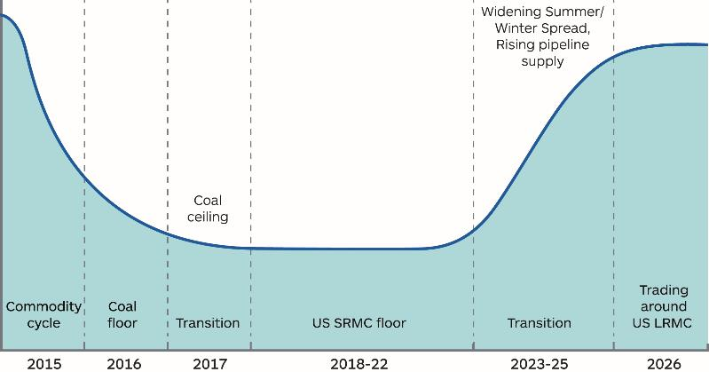
The drivers of European gas prices will change through time as market balance changes
The phases of European gas pricing
Period of heightened price risk
Source: IHS
© 2016 IHS: 61002-2
Notes:
The phases are more easy to visualise graphically. This is an intentionally simplified picture that allows us to focus on the key elements underpinning price behaviour in these phases.
2017: coal-gas switching point moved from a floor to a ceiling
2018-22: US SRMC the key price benchmark
2024-26: transition. Material volumes of LNG required to balance global market. Prices must signal recovery towards LRMC of new liquefaction to allow new investments. Key early signal will be rising winter prices in Europe

Slide 13
Excess liquefaction capacity drives lower US utilization

Slide 14
ENERGY

