Slide 1


Challenges in the Diagnosis
& Treatment of SLE
Caroline Gordon
University of Birmingham

Slide 2
Disclosures for Caroline Gordon
BMS, Lilly, Merck Serono, UCB
Aspreva, Genentech, GSK, Roche

Slide 3
Systemic Lupus Erythematosus (SLE)
Clinical features Autoantibodies Immune complexes
Skin
Kidney
Notes:
19

Slide 4
American College of Rheumatology Classification Criteria for SLE
(>4 of 11)
Neurological disorder
  seizures or psychosis
Haematologic disorder
  haemolytic anaemia
  leucopenia, lymphopenia
  thrombocytopenia
Immunological disorder
  anti-DNA, anti-Sm
  anti-phospholipid
ANA positivity
Malar rash
Discoid rash
Photosensitivity
Mucosal ulcers
Arthritis
Serositis
Renal disorder
  proteinuria > 0.5g
  cells &/or casts

Slide 5

John: Diagnosis?

Slide 6
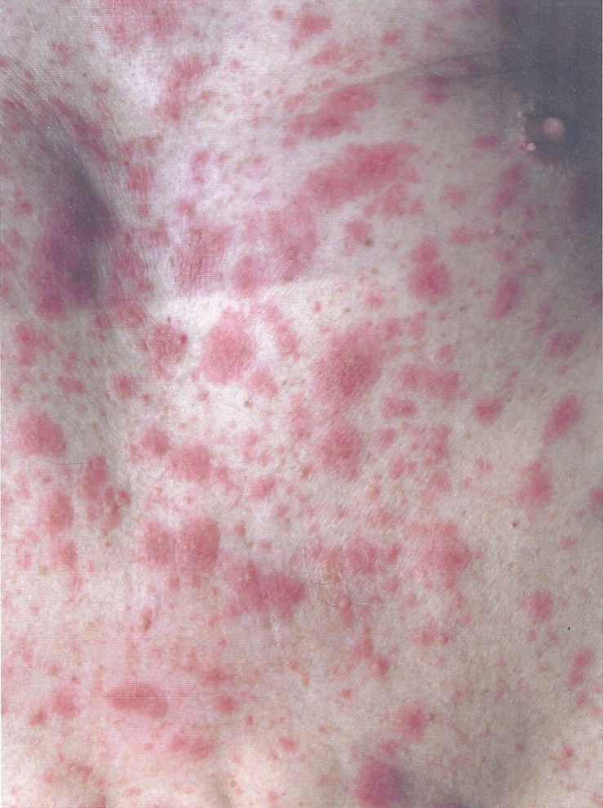
John: thrombocytopenia & autoimmune hepatitis
Subacute cutaneous lupus rash
Photosensitivity
Neutropenia
ANA 1/1600
Anti-Ro

Slide 7

John: lupus in men
Lupus is often perceived to be a disease of women…and when it occurs in men is more severe- fact or fiction?

Slide 8
Systemic Lupus International Collaborative Clinics (SLICC) classification rules
Classify patients as having SLE if either:
They satisfy 4 of the items on the expanded list of lupus manifestations
  - including at least 1 clinical and 1 immunological item
OR
2. They have biopsy proven lupus nephritis and an autoantibody (ANA or anti-dsDNA)
Petri et al A&R 2012

Slide 9
SLICC classification for lupus
Clinical Immunological
ANA
Anti-dsDNA antibodies
Anti-Sm antibody
Anti-phospholipid antibodies
Low complement
Direct Coombs’ test
  In absence if haemolytic anemia
Acute cutaneous lupus (6)
Chronic cutaneous lupus (9)
Oral or nasal ulcers (4)
Non-scarring alopecia
Inflammatory synovitis
Serositis (2)
Renal (2)
Neurologic (6)
Hemolytic anemia
10. Leukopenia / lymphopenia
11. Thrombocytopenia
Petri et al A&R 2012

Slide 10
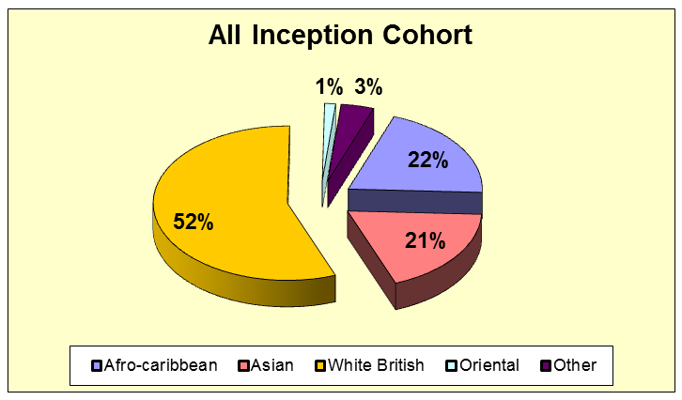
Are lupus patients at increased risk of chronic damage and premature death?
Birmingham lupus cohort
  Set up in August 1989
  Queen Elizabeth and City hospitals

Slide 11
Outcome of lupus
What is SMR for SLE patients in UK?
What age group has highest SMR?
What are main predictors for damage?
What do patients die from?

Slide 12
Predictors of damage over 21 years in Birmingham inception cohort
382 patients recruited
Caucasian 52%
Afro-Caribbean 21%
South Asian 22%
Others 3%
143 patients developed new damage (300 items)
Increased risk if:
BILAG A/B scores in Neuropsychiatric & Renal systems
Cyclophosphamide and steroid exposure
Reduced risk: hydroxychloroquine (MMF)
No difference between different ethnic groups
Yee et al 2015

Slide 13
Mortality in Birmingham 1989-2010
37 deaths in 382 patients (9.7%)
Overall SMR 2.0 (95% CI 1.5, 2.8)
Yee et al Rheumatology 2015

Slide 14
SLE patients die prematurely
(mean + sd for age at death in SLE patients and population control)

Slide 15
Challenges in improving
SLE outcomes
Identify, treat and prevent active disease
  inflammatory and/or thrombotic
Prevent adverse events in pregnancy
Prevent damage eg stroke, MI, fractures
Prevent death
Prevent infection
Maintain function
Improve quality of life
Improve adherence to therapy

Slide 16
Antiphospholipid antibody syndrome
>1specific, documented clinical events (a vascular thrombosis and/or adverse obstetric event) and confirmed anti-phospholipid antibody.
Vascular events
Venous thrombosis
  deep vein thrombosis
  pulmonary embolus
Arterial thrombosis
  heart attack (myocardial infarction)
  stroke (cerebro-vascular accident)

Slide 17
Pregnancy adverse events in APS
  1 or more unexplained deaths of a normal fetus at or beyond the 10th week of gestation
  and/or 3 or more unexplained consecutive spontaneous abortions < 10th wk of gestation
  or at least 1 premature birth of a morphologically normal neonate <34th week due to eclampsia or severe pre-eclampsia and/or placental insufficiency

Slide 18
Laboratory features of APS
Anti-cardiolipin IgG and/or IgM measured by standardized ELISA on 2 or more occasions, not less than 12 weeks apart;
and/or
Anti-β2 glycoprotein I IgG and/or IgM measured by standardized ELISA on 2 or more occasions, not less than 12 weeks apart;
and/or
Lupus anticoagulant detected on 2 occasions not less than 12 weeks apart according to the guidelines of the International Society of Thrombosis and Hemostasis.

Slide 19
First case
Recurrent thrombosis despite anticoagulation in a patient with antiphospholipid syndrome
Corinne Locke

Slide 20
Management of SLE
Advice: Education, sunscreen,
infection, fertility
For mild/moderate disease:
NSAID and COXIBs (care!)
Antimalarials (e.g. hydroxychloroquine)
Methotrexate
Corticosteroids - topical or low dose oral

Slide 21
Lupus and pregnancy
When should a woman with lupus become pregnant?
How should a patient with lupus be monitored in pregnancy?
Are any of the autoantibodies significant when considering pregnancy apart from APL?

Slide 22
Monitoring pregnant SLE patients
Maternal disease activity 4 weekly
  Clinical disease activity, urine & renal function
  Anti-dsDNA antibodies
  C3 and C4
  More often if active renal disease
In mother with anti-Ro/La
  Fetal heart rate weekly from week 16
  Fetal heart ultrasound week 20
  Fetal growth 4 weekly; well-being as needed
  ECG after birth

Slide 23
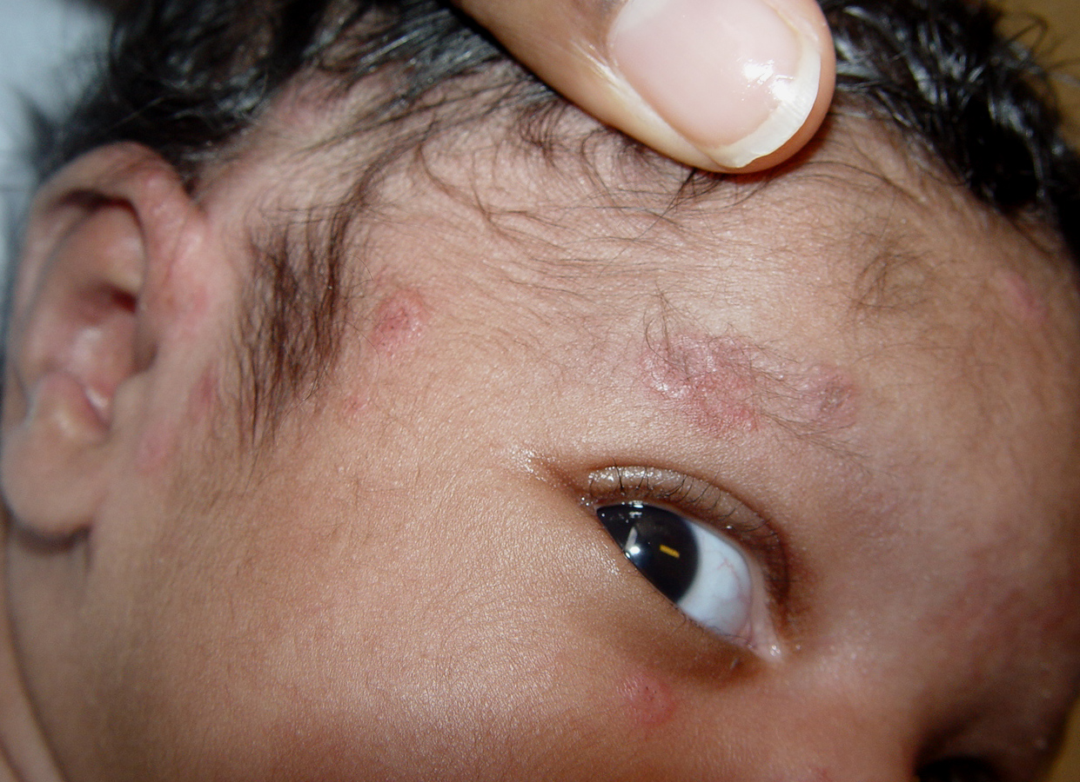
Effects of anti-Ro & -La antibodies
reactive with soluble ribonucleoproteins
48 kD SSB/La, 52 kD SSA/Ro, or 60 kD SSA/Ro
Neonatal lupus syndrome - about 5%
Congenital heart block - only 1.7 %
(complete) - recurs in 19%
- reduced by hydroxychloroquine to 10%
Brucato 2001, Askanase 2002, Izmirly 2010& 2012

Slide 24
Congenital Heart Block associated with anti-Ro/La antibodies
CCHB carries a significant mortality
  15-30%, primarily fetal and neonatal
and morbidity
  67% of surviving affected children with CCHB require permanent pacing before adulthood
  Incomplete block may progress in utero or after delivery

Slide 25
Which drugs can you use in a woman with lupus?
Who wants to conceive?
Who is pregnant?
Who is breast-feeding?

Slide 26
Drugs compatible with pregnancy
What drugs can she take for lupus before, during and after pregnancy?
  Hydroxychloroquine
  Prednisolone
  Azathioprine
  Ciclosporin/tacrolimus
What factors influence decision to treat with any other drugs in lupus?
  Risk of thrombosis
  Blood pressure but avoid ACE inhibitors/ARB
  Risk of pre-eclampsia

Slide 27
Second case
Post Partum Cerebrovascular Accident
of Rare Aetiology in SLE
Maha Azeez

Slide 28
Treatment of John
What drug (s) would you use for management of thrombocytopenia and neutropenia?

Slide 29
Current treatment of moderate and severe lupus
Corticosteroids
Methotrexate
Azathioprine
Ciclosporin A/Tacrolimus
Leflunomide
Mycophenolate mofetil
Cyclophosphamide
Rituximab
Belimumab
Oral, IM or intravenous
weekly oral/IM/subcut
oral continuous
oral continuous
oral continuous
oral continuous
IV pulse (oral)
IV intermittent
IV monthly

Slide 30
Treatment of John
What drug (s) would you use for management of autoimmune liver disease in a patient like this with lupus?

Slide 31
Current treatment of moderate and severe lupus
Corticosteroids
Methotrexate
Azathioprine
Ciclosporin A/Tacrolimus
Leflunomide
Mycophenolate mofetil
Cyclophosphamide
Rituximab
Belimumab
Oral, IM or intravenous
weekly oral/IM/subcut
oral continuous
oral continuous
oral continuous
oral continuous
IV pulse (oral)
IV intermittent
IV monthly

Slide 32
Third case
A challenging case of gastrointestinal symptoms in SLE
Fiona Pearce

Slide 33
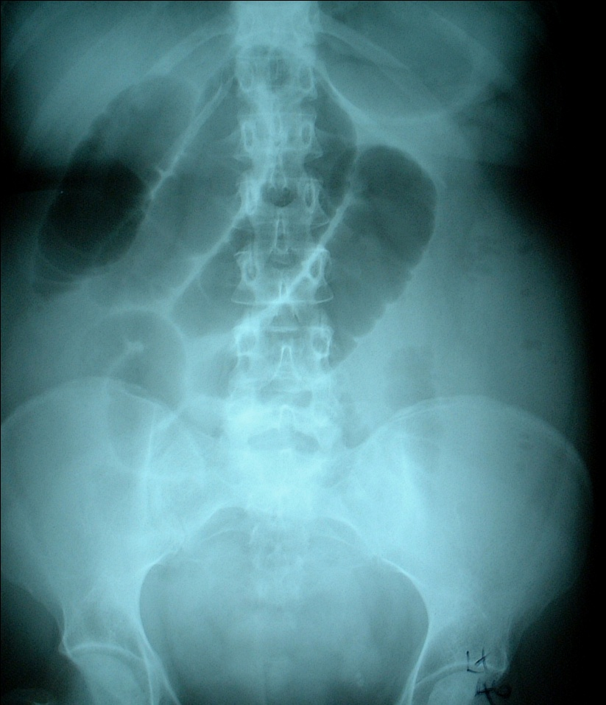
Gastro-intestinal features of SLE
Serositis
Hepatitis
Cholecystitis
Pancreatitis
Lupus enteropathy
Subacute bowel obstruction

Slide 34
Differential diagnosis of acute abdominal pain in SLE patient
Lupus-associated
  vasculitis (bowel, pancreas, gall bladder)
  thrombosis (bowel, hepatic vessels)
  (chronic protein-losing enteropathy)
  serositis
Non-lupus related
  dyspepsia/peptic ulcer- often drug-related
  irritable bowel
  co-morbid disease

Slide 35
Diagnostic work up
1. Clinical assessment
  active lupus including urinalysis
  previous thrombosis
  infection
2. Laboratory assessment
  Haematology, (ESR) , CRP
  Renal assessment, liver function, amylase, lipids
  Infection screen
  ANA, anti-dsDNA Abs, C3, C4, C3d
  Lupus anticoagulant, anti-phospholipid antibodies

Slide 36
3. Imaging
Plain abdominal X-ray
Ultrasound
Barium follow-through
CT scan (MRI) and Angiography
[Gallium/Indium labelled WC/Technicium RBC scan]
4. Surgery/Histology
Endoscopy
Paracentesis/Laparoscopy/Laparotomy
(Renal biopsy)

Slide 37
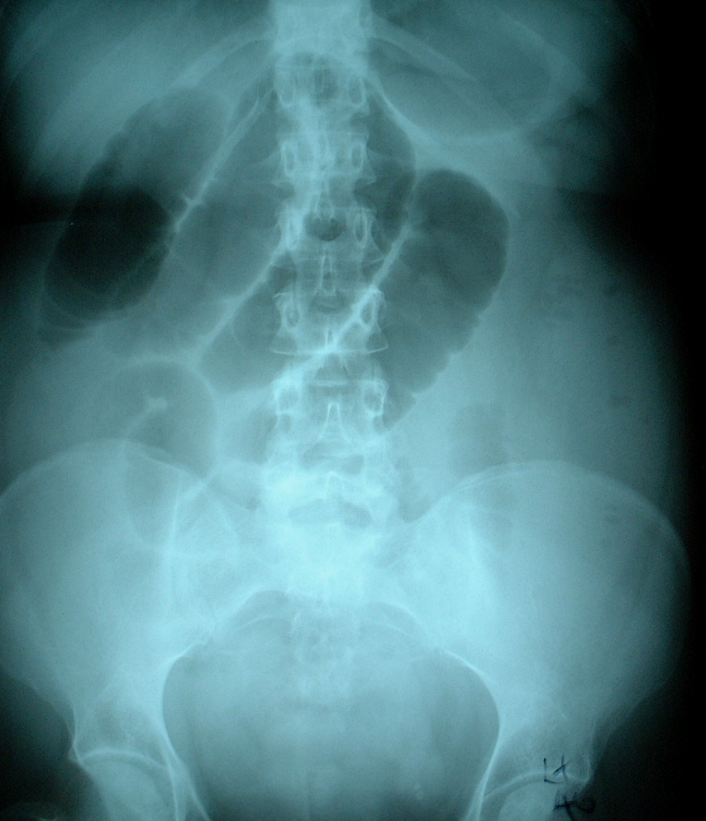
Abdominal X-ray
Distended loops of small bowel
[Look for air-fluid level : abscess]

Slide 38
Ultrasound
Abscess
Ascites
Distended loops of bowel + fluid
Gall bladder wall thickening [stones]
Pancreatitis
Ureteric dilatation/hydronephrosis [stones]
Bladder: wall thickening/contraction

Slide 39
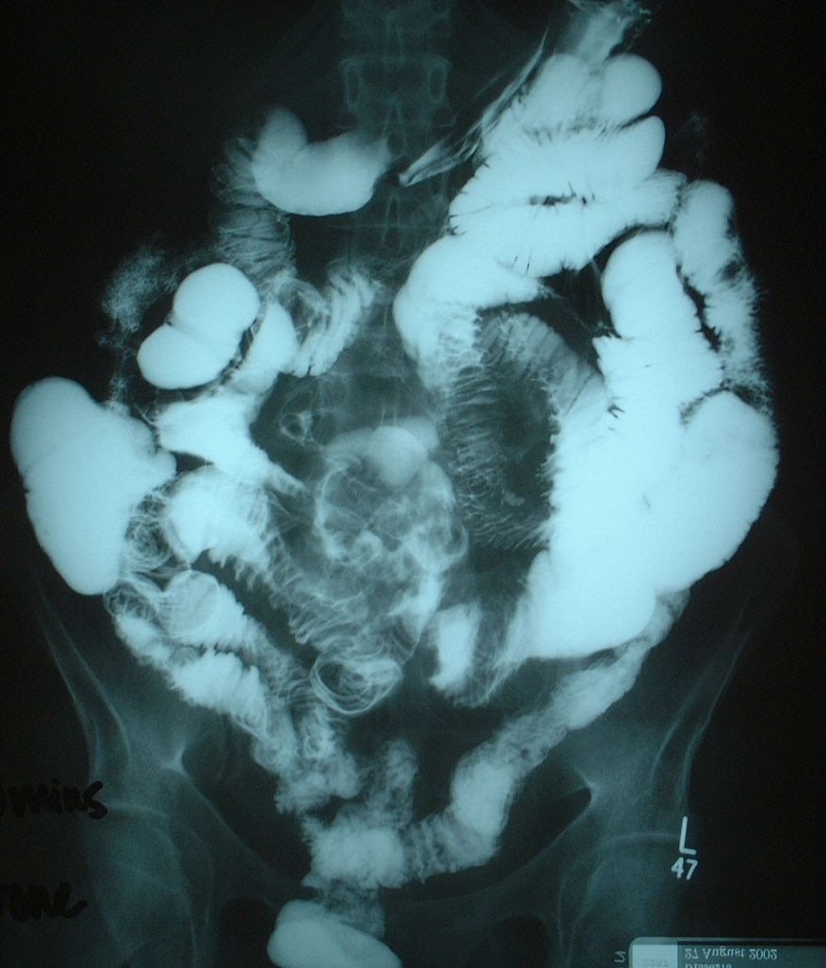
Barium follow-through studies
Luminal narrowing
Circular fold thickening-irregular with spiculation
Stacked coin sign
Thumb-printing

Slide 40
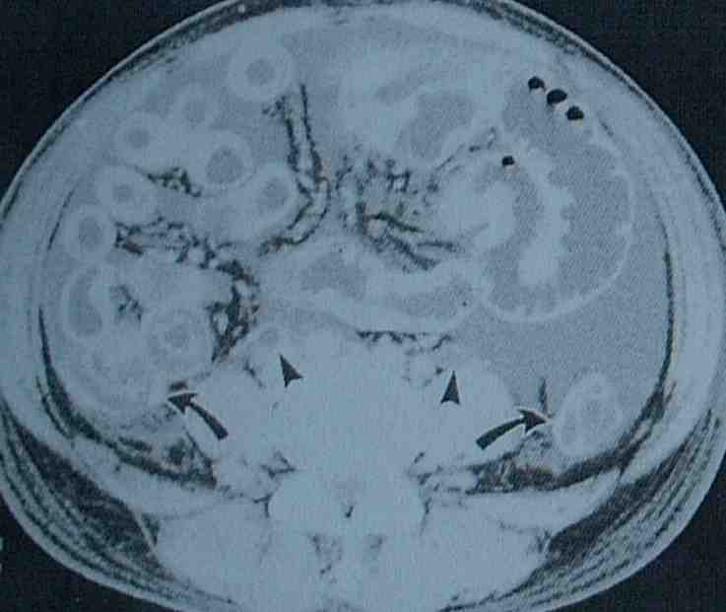
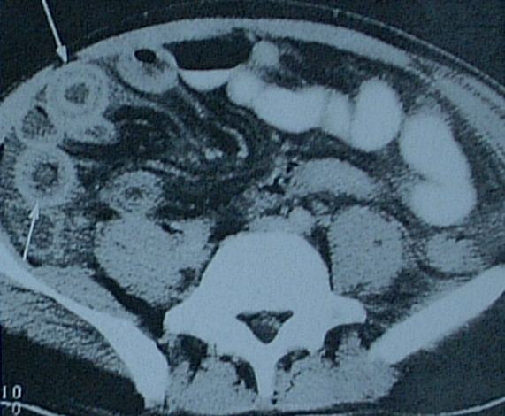
CT scan changes
Dilated bowel
Bowel wall thickening
  small bowel
  colon
  “target sign/double halo”
Ascites
Ureteral dilatation
[Abscess]
[LNs, liver, spleen]

Slide 41
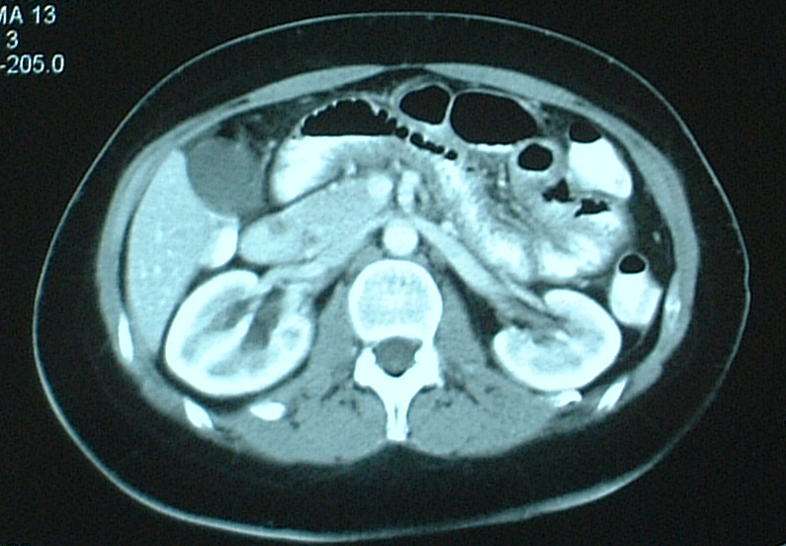
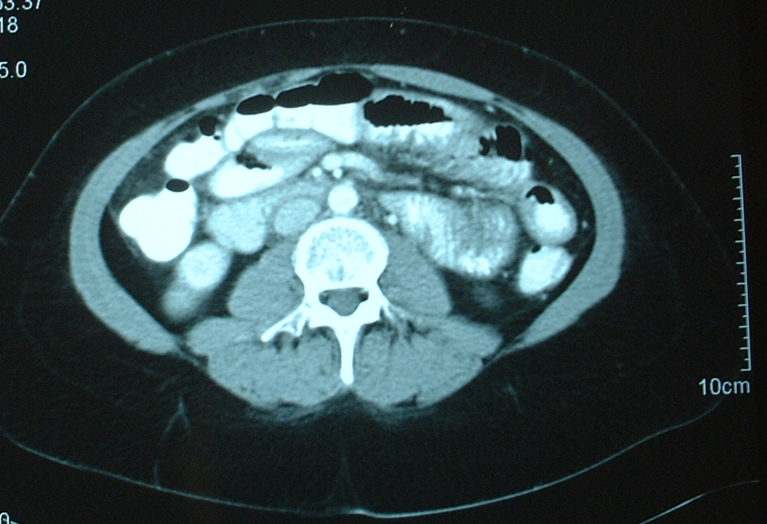
CT scan changes in small bowel
Dilation, wall thickening + abnormal enhancement
(distinguish lymphoma)

Slide 42
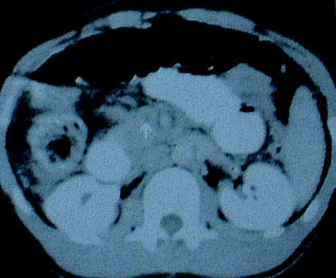
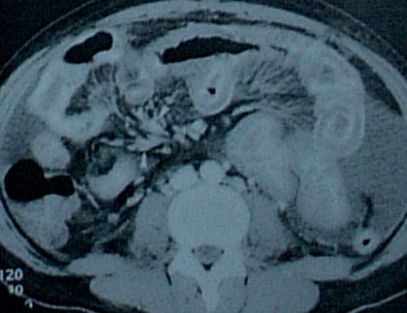
CT vascular changes
Thrombus in superior mesenteric vein
Mesenteric vascular
engorgement

Slide 43
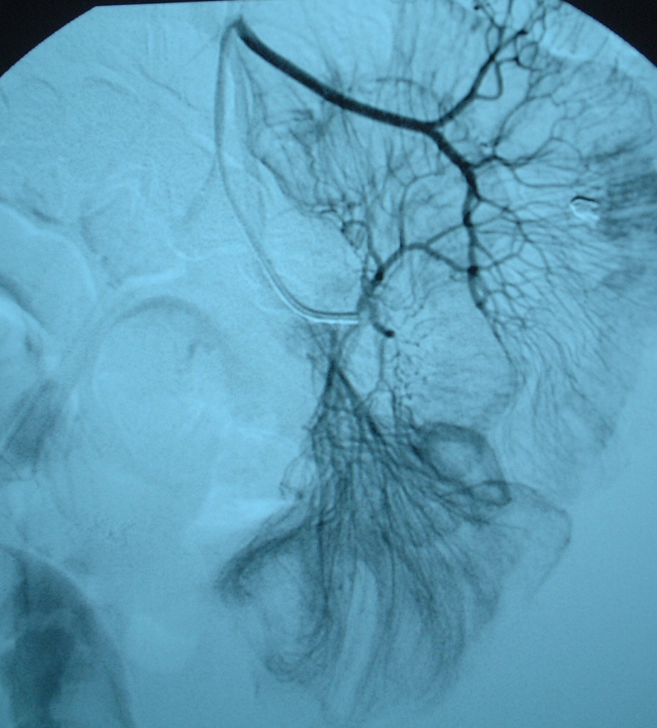
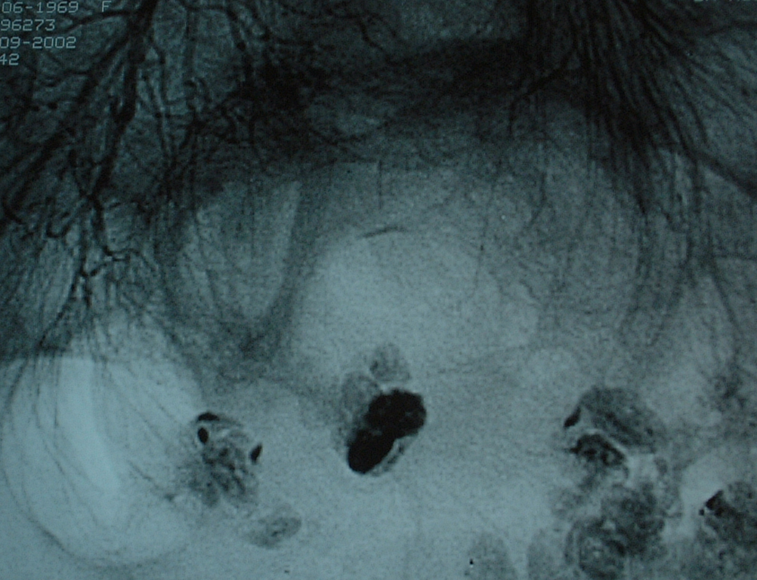
Angiography
Irregular vessels and
perfusion defects in areas of
dilated bowel [aneurysms rare]

Slide 44
Subacute small bowel obstruction
Thrombosis- acute event
AND
Inflammation- vasculitis
  arteritis &/or venulitis
  causes dysfunction of visceral smooth muscle
  chronic intestinal pseudo-obstruction

Slide 45
Management of mesenteric vascular disease
Think of it!
Cover infection if suspected
Rest bowel
High dose steroids
Cyclophosphamide
Heparin/Warfarin if possible thrombosis
Surgery if fails to improve/deteriorates

Slide 46
Complications of mesenteric vascular disease
Ileus
Intestinal ischaemia
Ulceration
Haemorrhage
Infarction
Perforation (abscess, peritonitis)
Stricture or malabsorption

Slide 47
Mesenteric vascular disease follow-up
Monitor clinically and serologically
Increase immunosuppression if disease activity not fully controlled
Repeat barium studies/CT scan if symptomatic (stricture/perforation/abscess)
Surgery if acute deterioration or electively

Slide 48
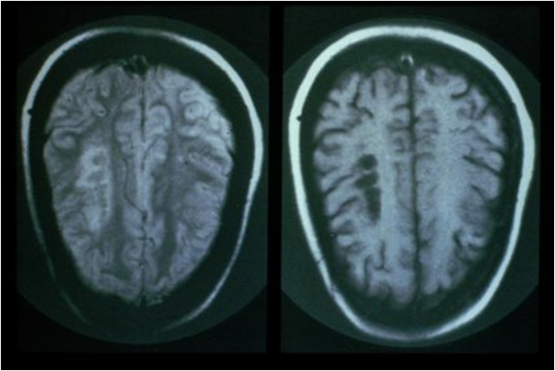
Neuropsychiatric (NP) disease in lupus patients
Central and/or peripheral nervous system
Epilepsy
Psychosis
Young stroke
Aseptic meningitis
Transverse myelitis
Peripheral or cranial neuropathies

Slide 49
When do NP events occur?
Before, at time of diagnosis or after
Most often within first year
Usually associated with generalised activity
Bertsias et al 2010

Slide 50
What is neuro-psychiatric lupus?
ACR nomenclature and case definitions for NP-SLE events irrespective of attribution
  Central nervous system 12
  Peripheral nervous system 9
Ainiala defined some as “minor NP events”
  Unlikely to be due to SLE
  Common in normal population:
  headaches, anxiety, mild depression
  mild cognitive impairment,
  polyneuropathy without electrophysiology evidence

Slide 51
Data from SLICC inception cohort
572 patients at first analysis
Enrolled within 15 months of diagnosis (dx)
NP-events at baseline & <6 months before Dx
88% female
Mean + sd: 35 + 14 years
Disease duration: 5.2 + 4.2 months
158 (28%) had 242 NP events
Hanly et al 2007

Slide 52
Baseline neuropsychiatric syndromes 1 in SLICC inception cohort (242 events)
Headaches 94
(38%)
Mood disorders 30
(12%)
Migraine 52%
Tension 32%
Cluster 3%
Ic HT 2%
Non-specific 1%
Major depression 67%
Depressive 21%
Manic 0
Mixed 12%
Hanly et al 2007

Slide 53
Baseline neuropsychiatric syndromes 2 in SLICC inception cohort (242 events)
Cerebrovascular disease
19 (8%)
Seizure disorder
19 (8%)
Stroke 62%
TIA 19%
Multifocal 9%
SAH 5%
Sinus thrombosis 5%
Generalised 76%
Partial 24%
Hanly et al 2007

Slide 54
Baseline neuropsychiatric syndromes 3 in SLICC inception cohort (242 events)
Anxiety disorder 7%
Cognitive dysfunction 5%
Acute confusional state 5%
Mononeuropathy 4%
Polyneuropathy 3%
Psychosis 2%
Cranial neuropathy 2%
Aseptic meningitis 1%
Myelopathy 0.8%
Movement disorder 0.8%
Autonomic disorder 0.4%
Guillain-Barre syndrome 0
Demyelination syndrome 0
Myasthenia Gravis 0
Plexopathy 0
Hanly et al 2007

Slide 56
Risk factors for primary NP-SLE
1. Generalised SLE disease activity
2. Previous severe NP-SLE events
- for seizures & severe cognitive dysfunction
3. Antiphospholipid antibodies
- for CVD, seizures, chorea
Bertsias et al 2010
Notes:
Category 2. strength of statement B, based on controlled non-randomised studies

Slide 57
Investigations for NP-SLE
CT scan
  To look for bleed, abscess & tumour
Lumbar puncture
  Pressure
  CSF cells, protein, Igs
  Culture
Autoantibodies
EEG
Nerve conduction studies & EMG
Cognitive function
MRI Brain Scan (+/- spine)
  Diffusion weighted imaging
  MR angiography
  MR venography
  MR Spectroscopy
  Magnetization transfer imaging
  Functional MRI
SPECT: Single photon emission computed tomography
PET: Positron emission tomography

Slide 58
Management of NP-SLE
Assess lupus disease activity
Establish NP diagnosis (lupus or not)
  Consider pathogenesis
    Inflammatory or thrombotic or atherosclerosis
    Infection or other co-morbid condition
Identify risk/aggravating factors
  Hypertension, metabolic factors, infection
Treat NP symptoms
  Anti-convulsants, anti-depressants, etc
Immunosuppression &/or anticoagulation

Slide 59
Case 4
The Girl Who Cried “Wolf”
Jeanette Trickey

Slide 60
Differential diagnosis of SLE
RA
Other autoimmune/systemic rheumatic disease
Infection
Malignancy (lymphoma)
Post-viral fatigue syndrome
Fibromyalgia
Drug-induced condition

Slide 61
Case 5
TB or not TB?
Subhra Raghuvanshi

Slide 62
Differential diagnosis of SLE
RA
Other autoimmune/systemic rheumatic disease
Infection
Malignancy (lymphoma)
Post-viral fatigue syndrome
Fibromyalgia
Drug-induced condition

Slide 63
Challenges in improving SLE outcomes
Identify, treat and prevent active disease
  inflammatory and/or thrombotic
Prevent pregnancy adverse events
Prevent damage eg stroke, MI, fractures, malignancy
Prevent death
Prevent/treat infection
Maintain function
Improve quality of life
Improve adherence to therapy

