Slide 1
Cybersecurity:
Audit Considerations
Virginia Local Government Auditors Association
May 3, 2019

Slide 2
Introductions
Anthony DiGiulian, CISA
Principal
14 years of experience
Specializing in Information Technology (IT) internal audits, consulting services, risk assessments, control reviews, systems implementations, business process analyses, third party SOC reports, and compliance audits for government and commercial organizations
Samuel Fitzgerald, ITIL, CISA, CISM
Manager
11 years of experience
Specializing in IT risk assessments, IT internal controls reviews, IT infrastructure reviews, system implementation reviews, disaster recovery and business continuity reviews, and IT security reviews for government and commercial organizations

Slide 3
Today’s Objectives
01.
02.
03.
04.
05.
Importance of Cybersecurity
Cybersecurity’s Affect on Business
Linkage to Business Process
Emerging Cybersecurity Threats
Training Goals

Slide 4
Background
What is Cybersecurity?
“Measures taken to protect a computer or computer system (as on the Internet) against unauthorized access or attack.”
-Merriam Webster
“Cybersecurity threats exploit the increased complexity and connectivity of critical infrastructure systems, placing the Nation’s security, economy, and public safety and health at risk.”
-NIST Cybersecurity Framework Version 1.1

Slide 5
Cybersecurity affect on business
Why Does a Cybersecurity Attack Occur?
Traditional cyber attacks
Data theft
Extortion
Vandalism
Denial of Service (DoS)
Cyber attackers are launching sophisticated agendas
Espionage
Disinformation
Market manipulation
Disruption of infrastructure
“Cybersecurity Ventures expects that businesses will fall victim to a ransomware attack every 11 seconds by 2021, up from every 14 seconds in 2019, and every 40 seconds in 2016.”

Slide 6
Cybersecurity affect on business
Who Does it Affect?
Big Businesses
Facebook (April 2019)
World’s biggest social network
540 million user records were in plain sight
Two 3rd party companies improperly storing data
Schools
San Diego Unified School District (January to October 2018)
Data breach that exposed 500,000 students and staff personally identifiable information (PII)
Affects students as far back as 2008-2009 school year
Unauthorized access through phishing emails
The 5 most cyber-attacked industries
over the past 5 years are:
Healthcare
Manufacturing
Financial Services
Government
Transportation

Slide 7
Cybersecurity affect on business
Who Does it Affect?
Government Entities
Federal Emergency Management Agency (March 2019)
2.5 million disaster victims had PII unprotected that was shared with contractor
Oregon Department of Human Services (March 2019)
9 employees clicked on phishing emails exposing information to 1.6 million clients
Oklahoma Department of Securities (January 2019)
Millions of government files left unprotected on an open storage server
ALMOST EVERY INDUSTRY

Slide 8
Cybersecurity affect on business
No Longer Just a Technology Issue
Attention from Senior Leadership
Cost
High profile data breaches
Reputational impact
Job loss
Business leaders forced to think about cyber risk
Cyber attacks included in Business Continuity Plan
Thwarting cyber attacks training given to non-IT employees
Operational risk and cyber risk are being aligned
Realization that cybersecurity expands beyond IT
Cybersecurity practices should be embedded across all departments

Slide 9
Linkage to business process
Six Key Dimensions of Organizational Cyber Maturity
Leadership and governance
Operations and technology
Legal and Compliance
Business continuity
Human factors
Information risk management

Slide 10
Linkage to business process
Leadership and governance
Operations and technology
Legal and Compliance
Business continuity
Human factors
Information risk management
Leadership and Governance
Tone at the top
Demonstrating due diligence
Taking ownership
Effectively managing known risk
Organizational policies and procedures
Human Factors
Cybersecurity culture
Training and knowledge
First line of defense

Slide 11
Linkage to business process
Leadership and governance
Operations and technology
Legal and Compliance
Business continuity
Human factors
Information risk management
Information Risk Management
Critical information security
Supply partners
Business Continuity
Cybersecurity events are included in Business Continuity Plan
Minimizing or preventing impact of a successful cyber attack

Slide 12
Linkage to business process
Leadership and governance
Operations and technology
Legal and Compliance
Business continuity
Human factors
Information risk management
Operations and Technology
Appropriate control measures
Addresses identified risk
Minimizes impact of compromise
Legal and Compliance
Regulatory standards
International certification standards

Slide 13
Linkage to business process
Leadership and governance
Operations and technology
Legal and Compliance
Business continuity
Human factors
Information risk management
Addressing Each Key Dimension
Minimizes risk of a successful cyber attack
Limits impact of successful cyber attack
Enables employees to know his/her responsibility when incident occurs
Reduces negative impact on reputation

Slide 14
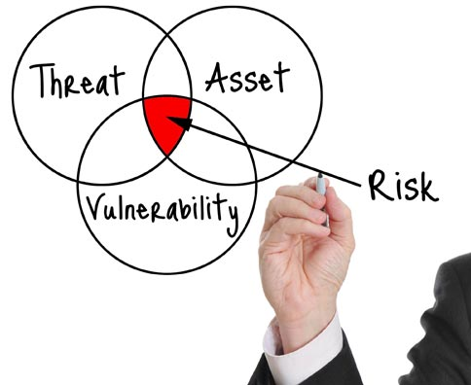
Linkage to business process
Key Questions for Business
How big is the risk and who is at risk?
Organizational attractiveness to criminals
Dependencies on service partners
Processes and/or systems that represent greatest cybersecurity asset
Acceptable level of risk for specific processes and/or systems
Partners are in agreement on risk appetite and cybersecurity measures

Slide 15
Linkage to business process
Key Questions for Business
How do culture and governance enable effective risk management?
Culture contributes or hampers good cybersecurity
Board/ senior leadership communicates importance of cybersecurity
Ready to act in the event of a cybersecurity crisis
Communication plan and who should do it
Stakeholder assurance on cybersecurity policy can be provided

Slide 16
Linkage to business process
Key Questions for Business
How large should your cybersecurity budget be?
Ranges vary depending on risk profile, 3% to 5% of total IT budget
Cybersecurity budget should address:
Solving past problems
Structural investments in improved security systems
Systems and tool investments
Awareness and culture change

Slide 17
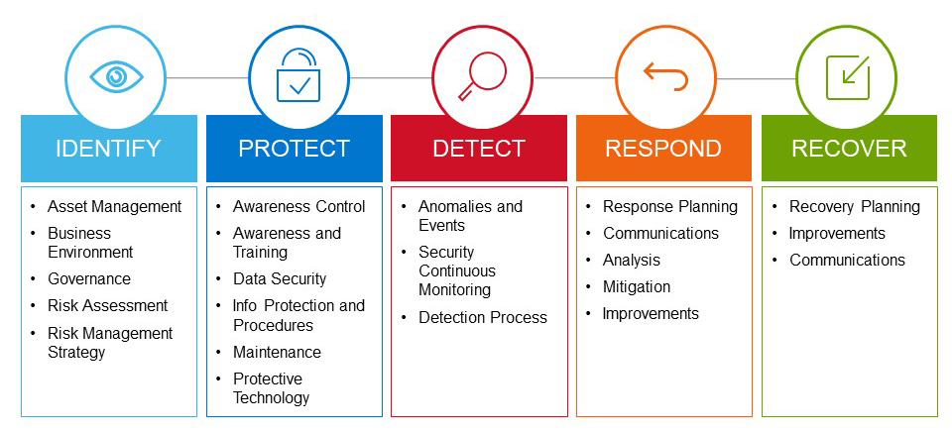
Identify, assess, and manage cyber risk
NIST Cybersecurity Framework

Slide 18
Emerging cybersecurity threats
Internet of Things (IoT)
System of computing devices and objects with unique identifiers and the ability to transfer data over networks w/o human interaction
Smart refrigerators
Webcams
SmartTVs
Thermostats
Issue: Prioritizing convenience over security
Risk: Unmanaged/ unsecured devices allowing unauthorized access
Spying through cameras or listening devices
Gateway to a secured network
Distributed denial of service attack (DDoS)

Slide 19
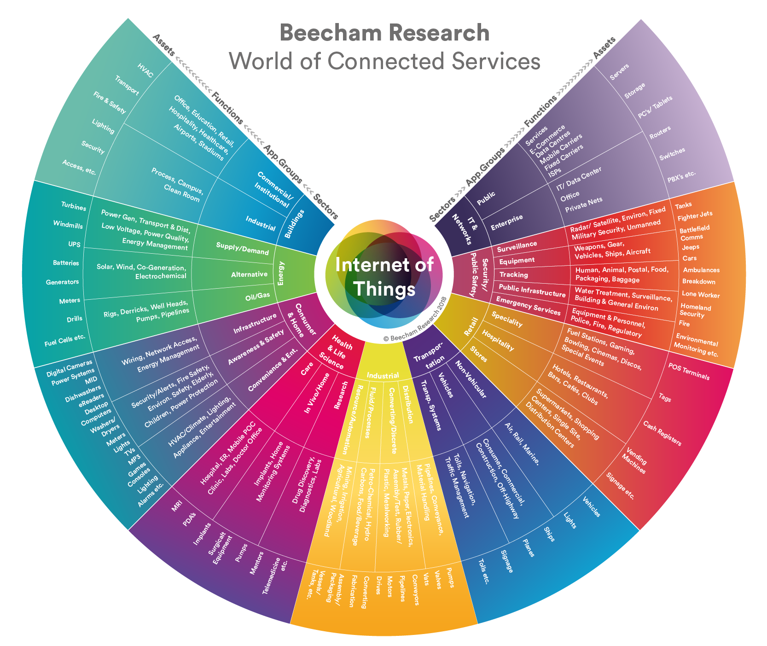
Image courtesy of Beecham Research

Slide 20
Emerging cybersecurity threats
Artificial Intelligence (AI) Systems
Machines that can learn algorithms and techniques, that mimics cognitive functions associated with humans
No sleep
Processes data faster than humans
Issue: The intent of use
Risk: AI can infiltrate an IT infrastructure but then stay on for an extended period of time, undetected, launching powerful effective and efficient attacks in:
Identity theft
Denial-of-service (DoS)
Password cracking

Slide 21
Emerging cybersecurity threats
Artificial Intelligence (AI) Systems
Current Attacks:
Automation of attacks limited
Humans must target and trigger the attacks
Virus programs can self-replicate w/o human interaction
Future Attacks:
Sophisticated spear phishing
AI can gather, organize, and process database information
Less time in database, may not be noticed by security
Timely attacking
Pulling information from several sources to identify best time to attack
Bank account attacks are launched when person is in hospital
Improved adaptation
Adapts quicker when met with resistance or weakness if fixed

Slide 22
Emerging cybersecurity threats
Call to Action
PREVENT
PROTECT
PROGRESS

Slide 23
Contact information
Anthony DiGiulian, CISA
Principal
703-852-5607
adigiulian@schgroup.com
Samuel Fitzgerald, ITIL, CISA, CISM
Manager
703-287-5985
sfitzgerald@schgroup.com

