Slide 1
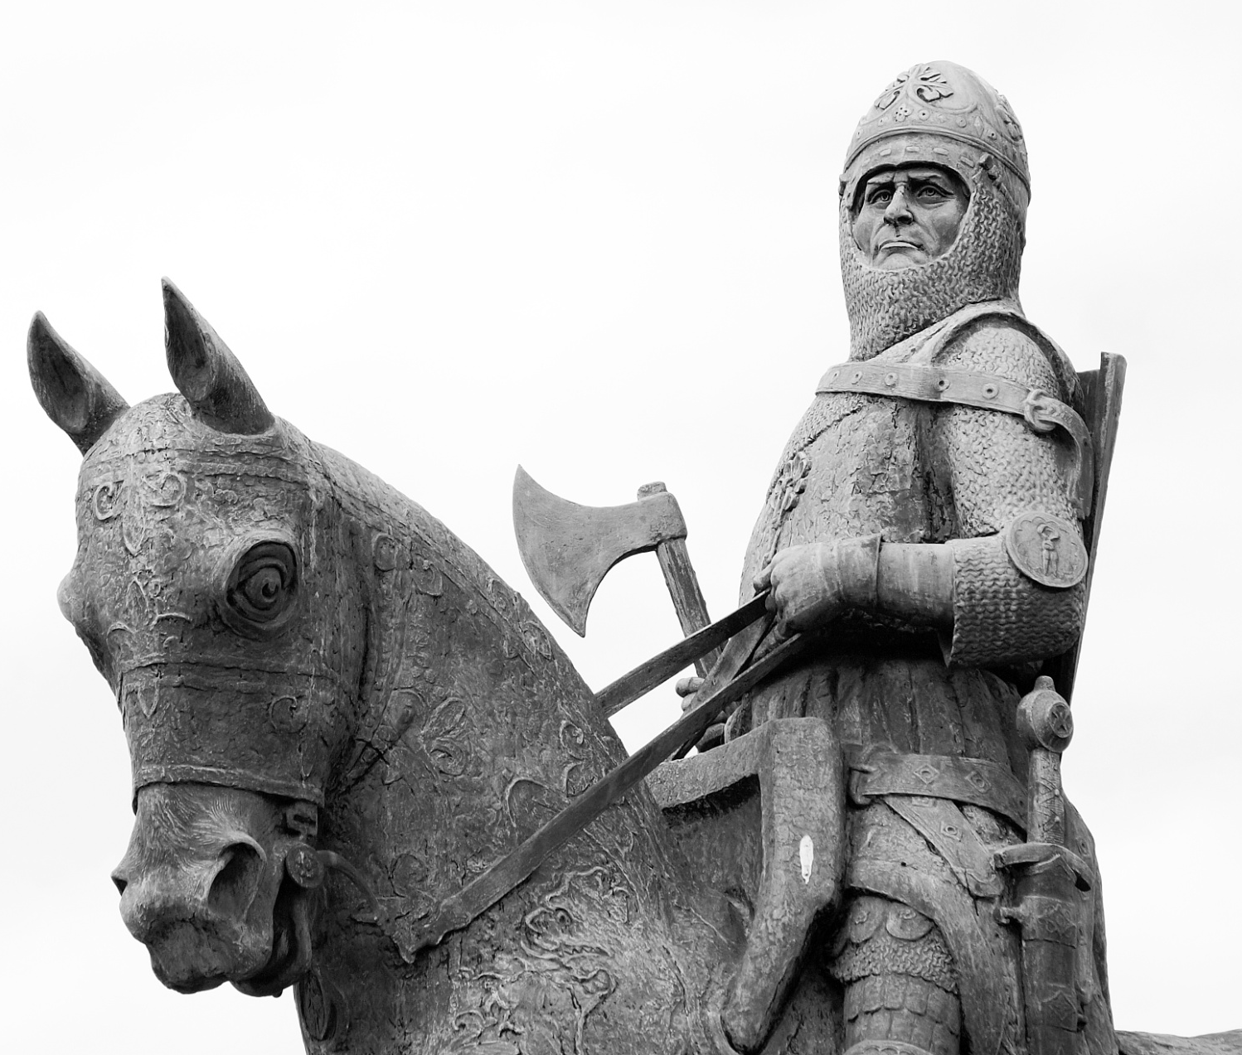
The Battle of Bannockburn
Dr Francesca Mackay
and
Dr Ross Crawford
Learning Officers, Battle of Bannockburn

Slide 2
Some of the Trust’s responsibilities encompass:
Natural and designed landscapes and all the wildlife they contain
Coastlines, which ,along with 400 islands and islets, provide habitats for over one million seabirds
Archaeological sites
Architectural wonders
190,000 acres of countryside
46 Munro mountains
394 miles of mountain footpaths
35 major gardens nurturing 13,500 plant varieties
7 national nature reserves
45 sites of special scientific interest
St Kilda, Britain's only dual World Heritage Site
Battlefields, such as Culloden and Bannockburn
Collections of fine art and more than 100,000 precious artefacts

Slide 3
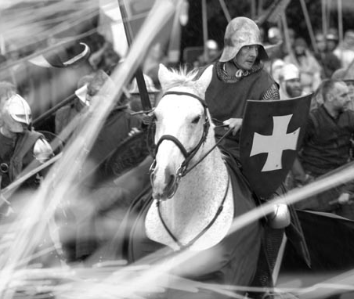
To mark a seminal moment in Scotland’s History
To revive the site and give it due respect
To make the site relevant and accessible
To help to generate tourism – nationally and locally
The Battle of Bannockburn Project: Background
Why?

Slide 5
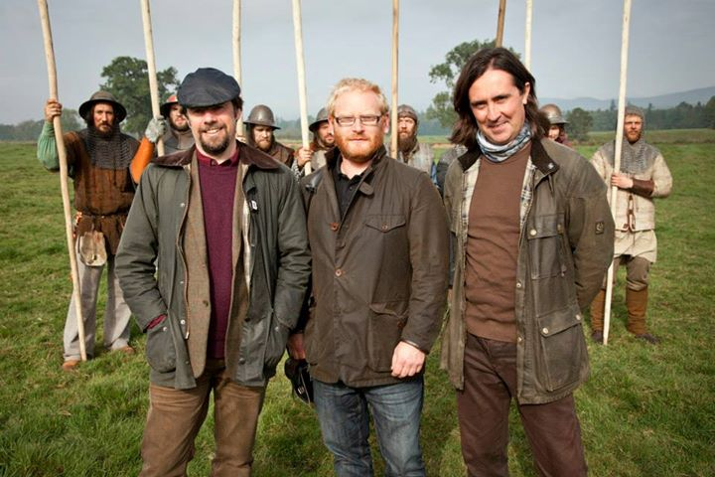

Slide 6
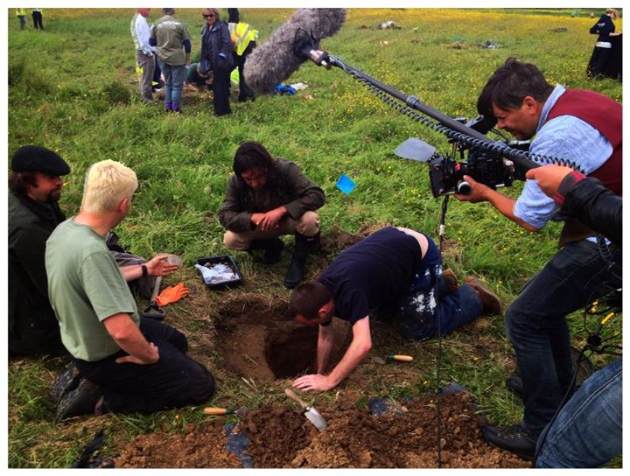
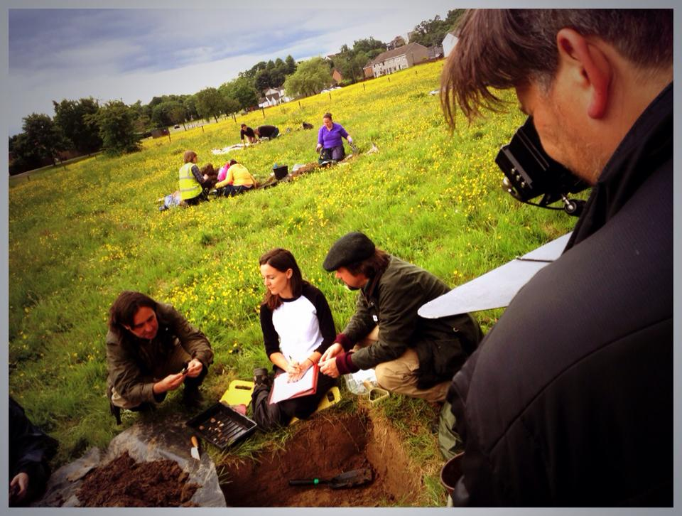

Slide 7
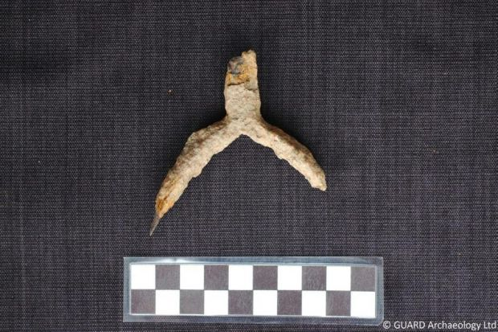
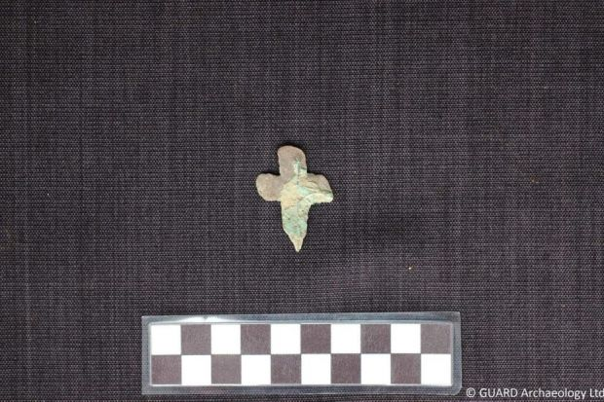
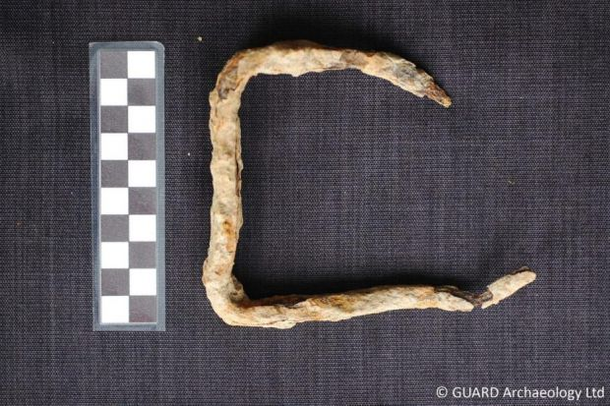

Slide 8
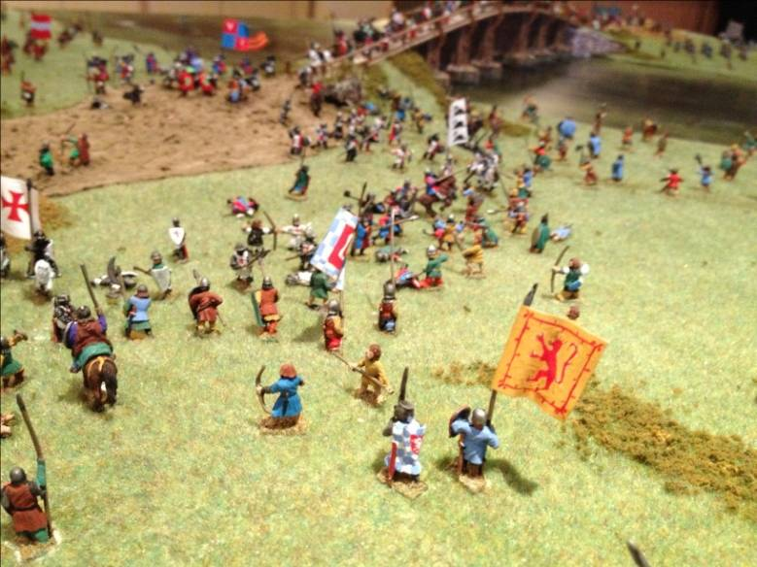
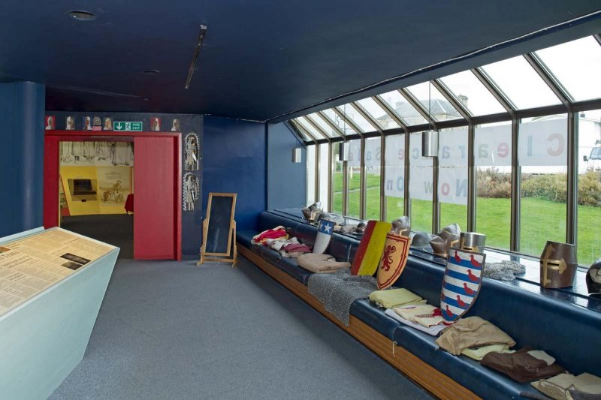
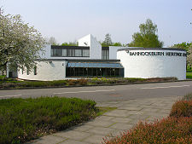
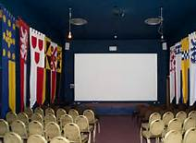
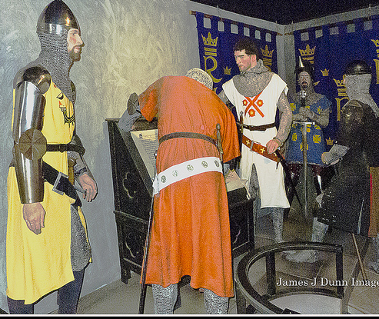
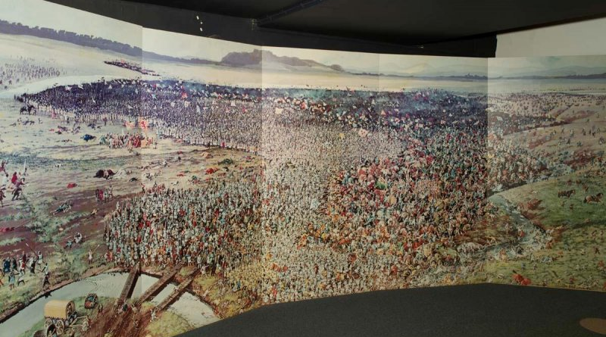

Slide 9
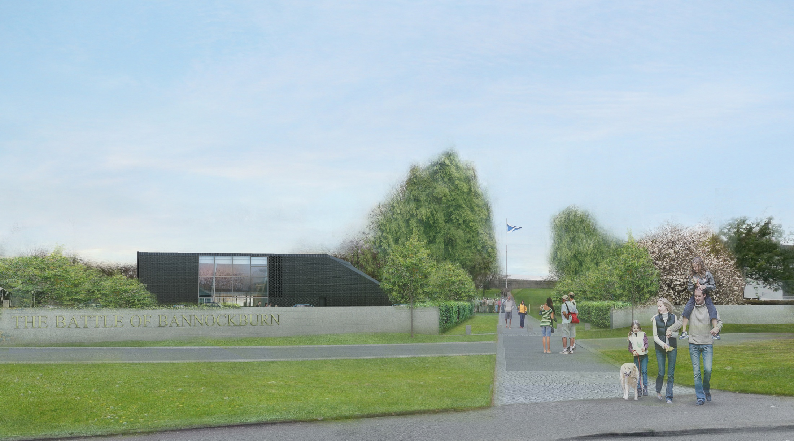

Slide 14
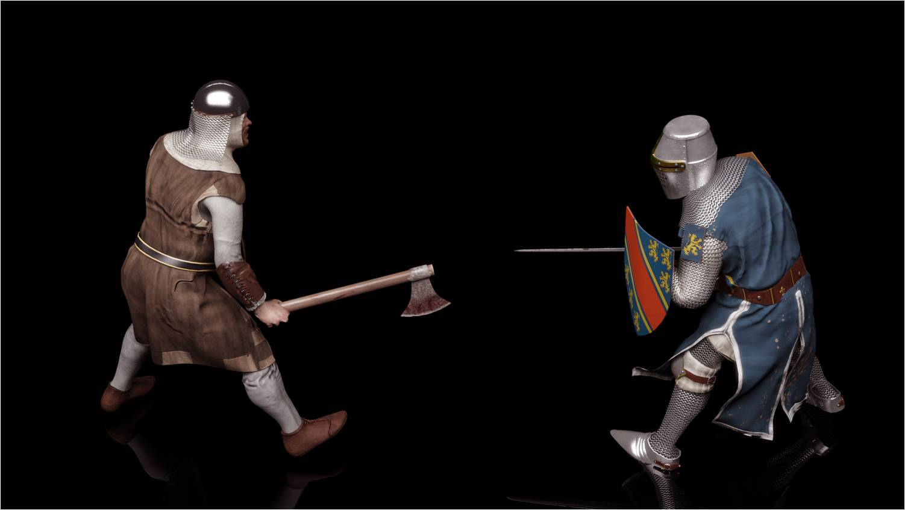

Slide 15
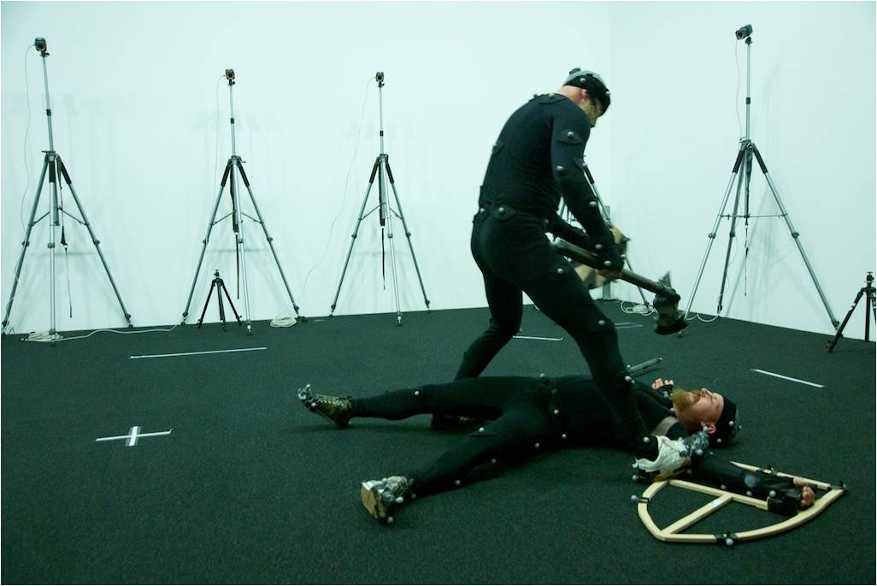
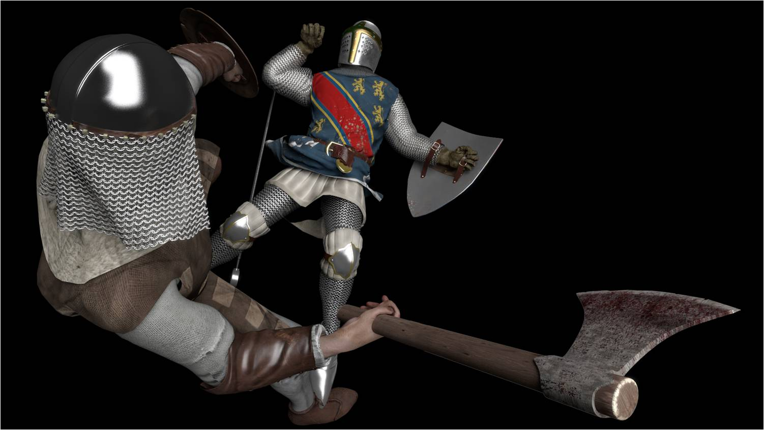

Slide 16
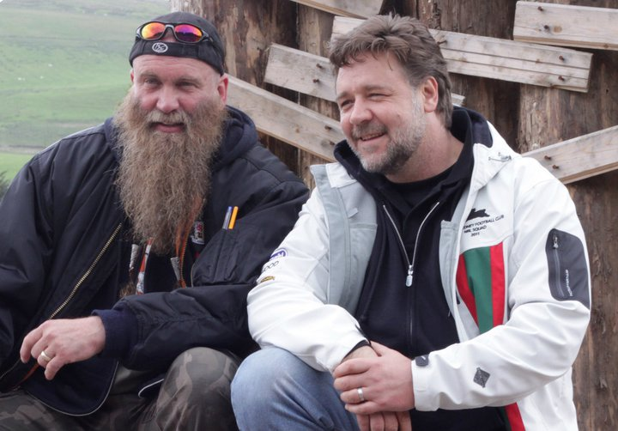
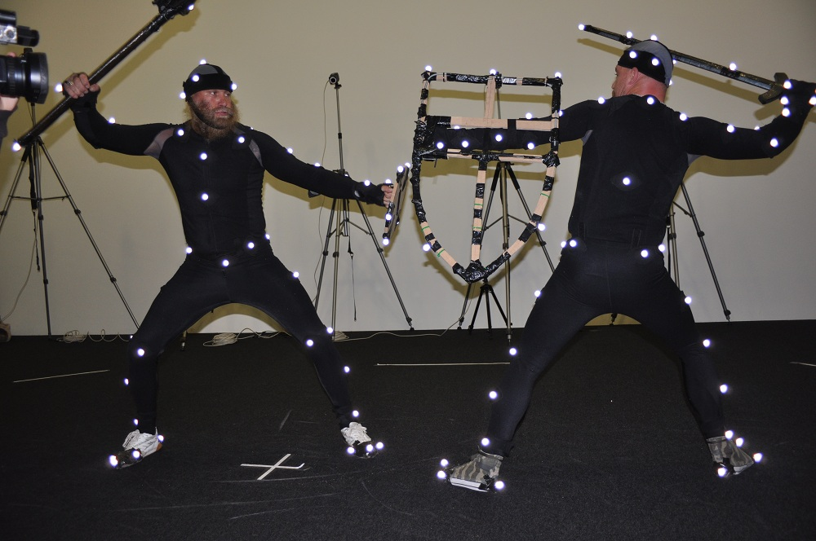

Slide 17
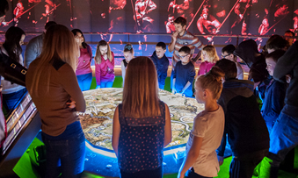

Slide 18
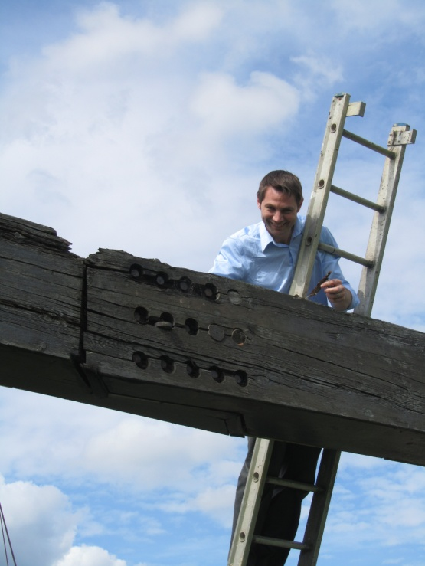
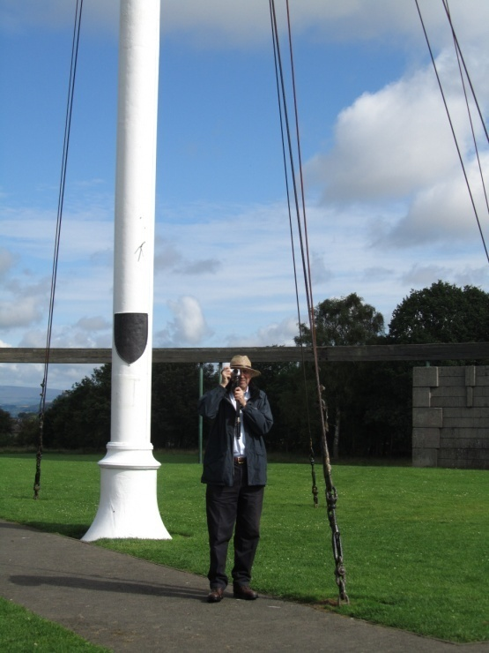
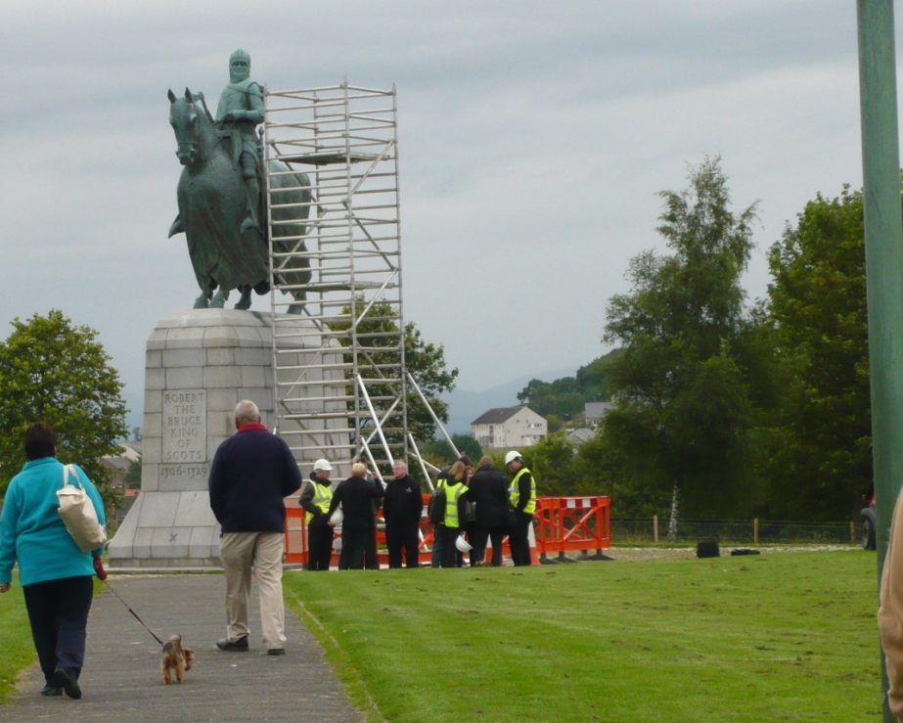
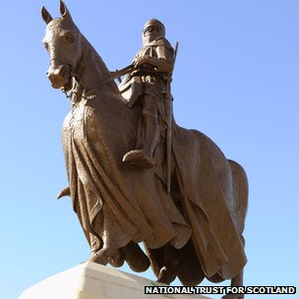

Slide 19
Education in Museums/Heritage Organisations
Current emphasis on learning in museums has been a positive development
BUT
Recent government initiatives tend to focus on FORMAL LEARNING
Museums/heritage organisations can do much more than this
museums have the opportunity to help people be inspired and enthused by what they encounter
HOLISTIC CASE for arts and culture
- Wider impact on individuals/communities

Slide 20
Education in Museums/Heritage Organisations
GEM
‘excellence in heritage learning can improve the education, health, and well-being of the general public’
Involvement with heritage is an enriching and transformational experience that provides distinctive opportunities for learning
Explore and make sense of the world
Generate curiosity
Inspire self-confidence
Provide a sense of achievement

Slide 21
Formal Learning Programme
School workshops
Wars of Independence are central to several stages of the primary and secondary school Curriculum for Excellence, along with several tertiary-level modules.
Aim to provide learning through:
Conversation/dialogue
Role play
Hands-on engagement
Outdoor learning
Map work
Tactical thinking
Teamwork
Decision making

Slide 22
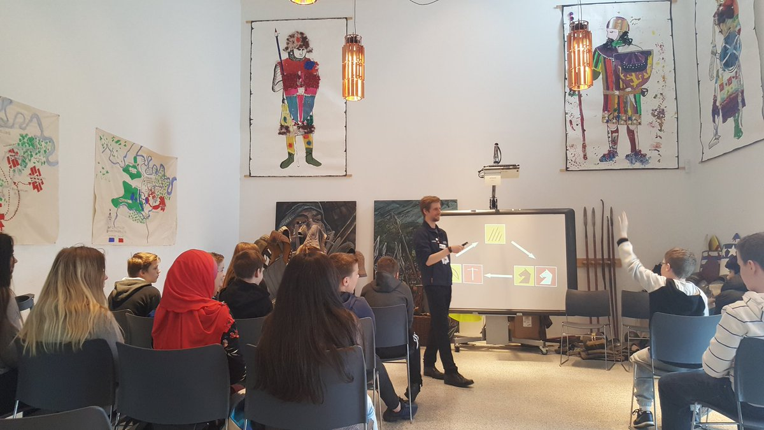
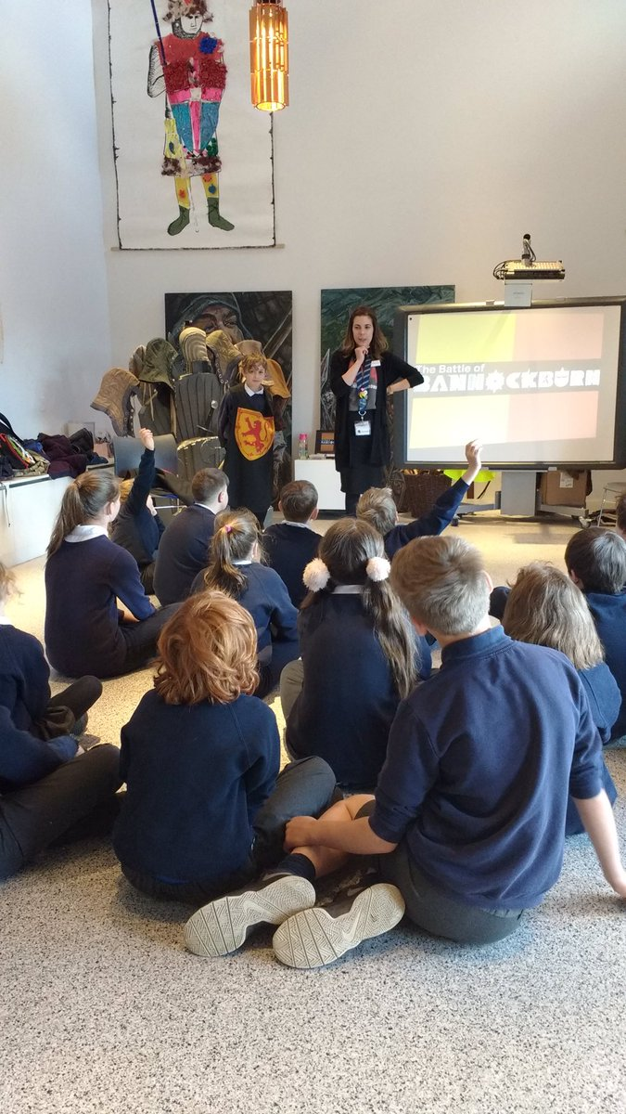
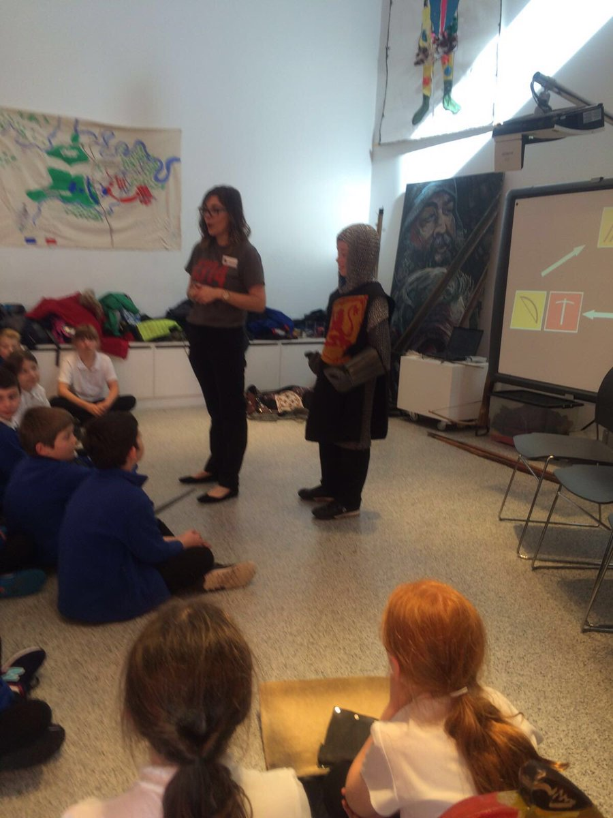
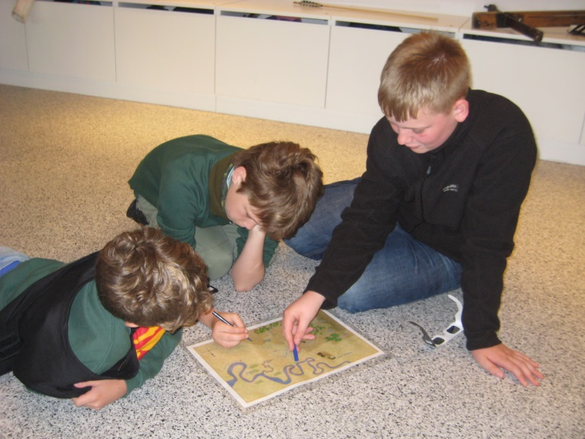

Slide 23
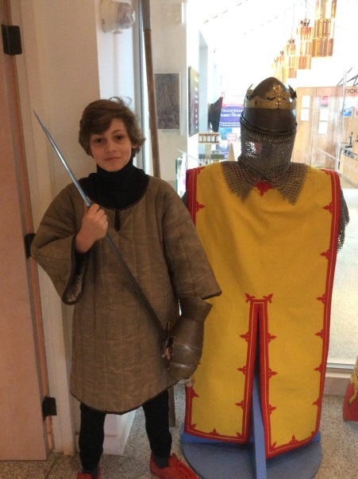
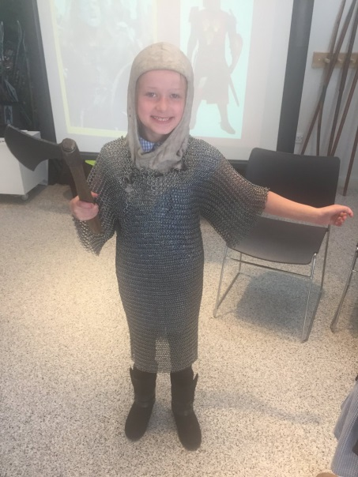
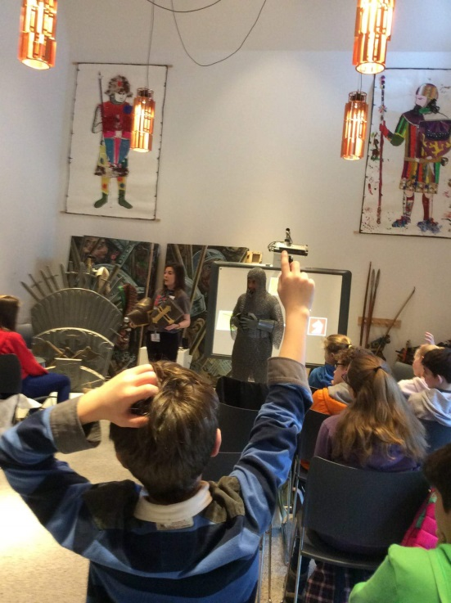
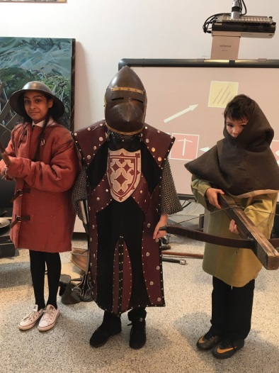
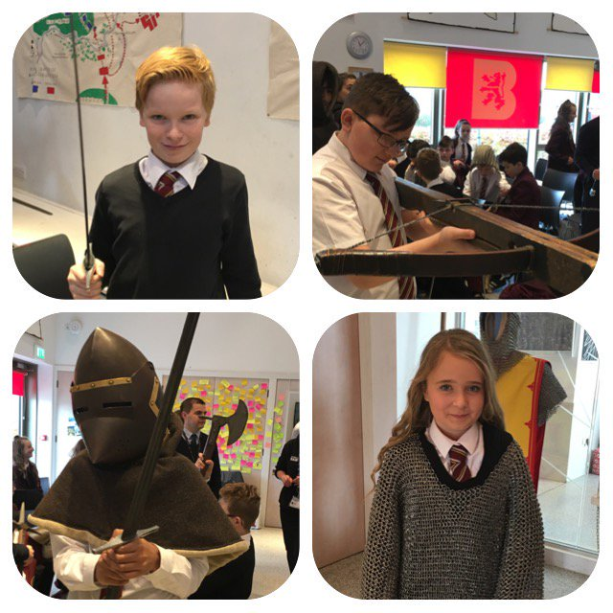
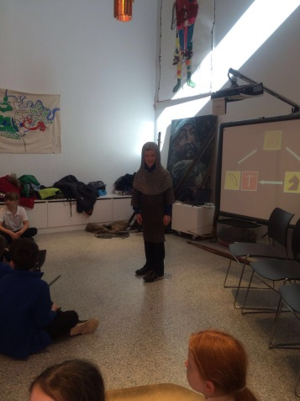
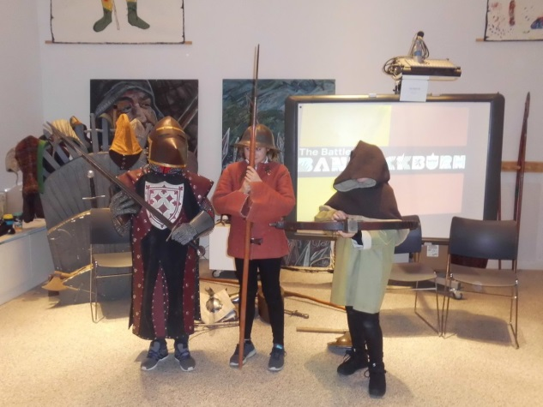
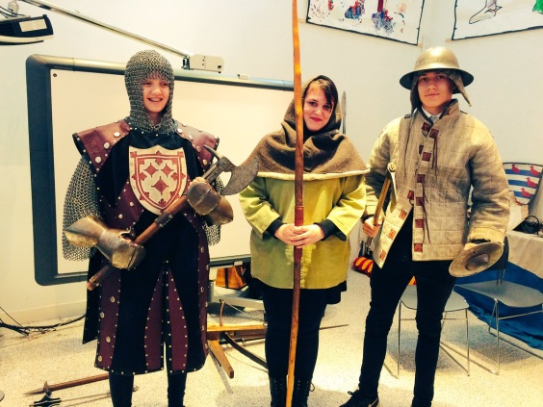
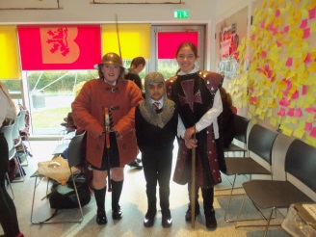
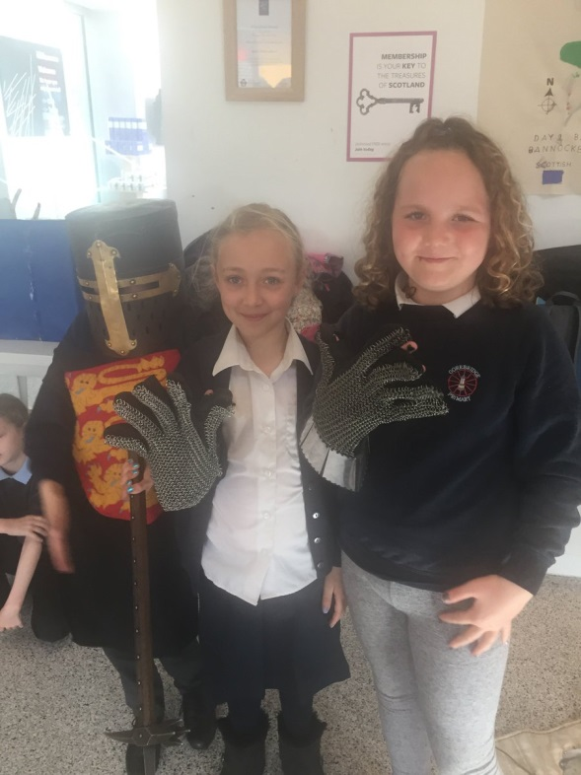
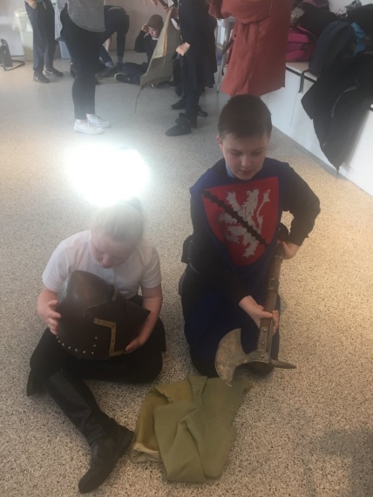
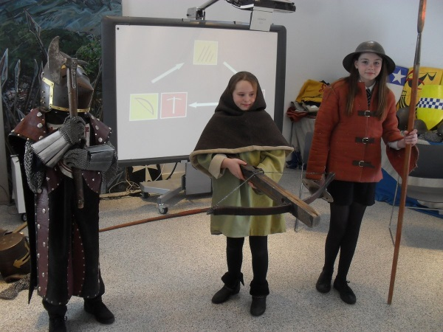
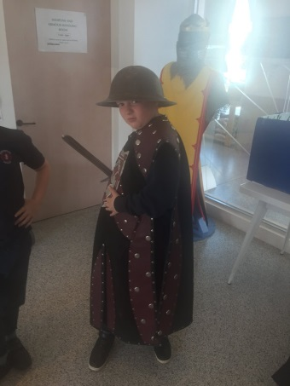
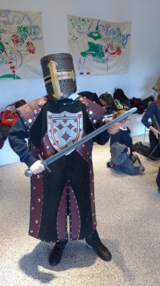
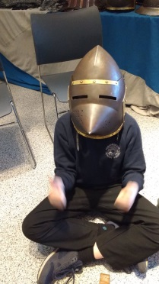

Slide 24
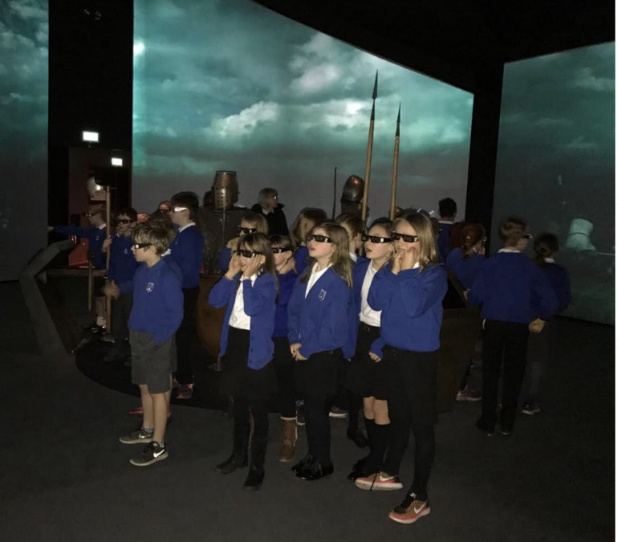
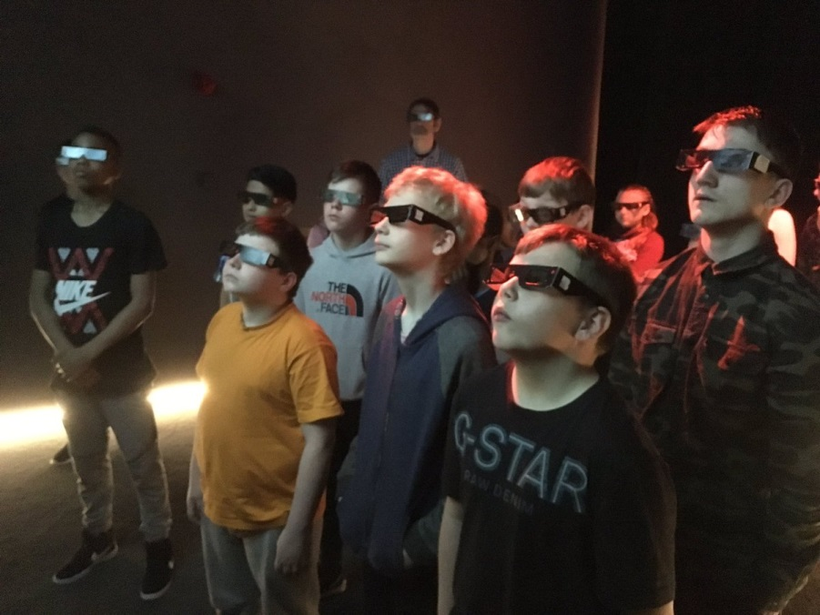
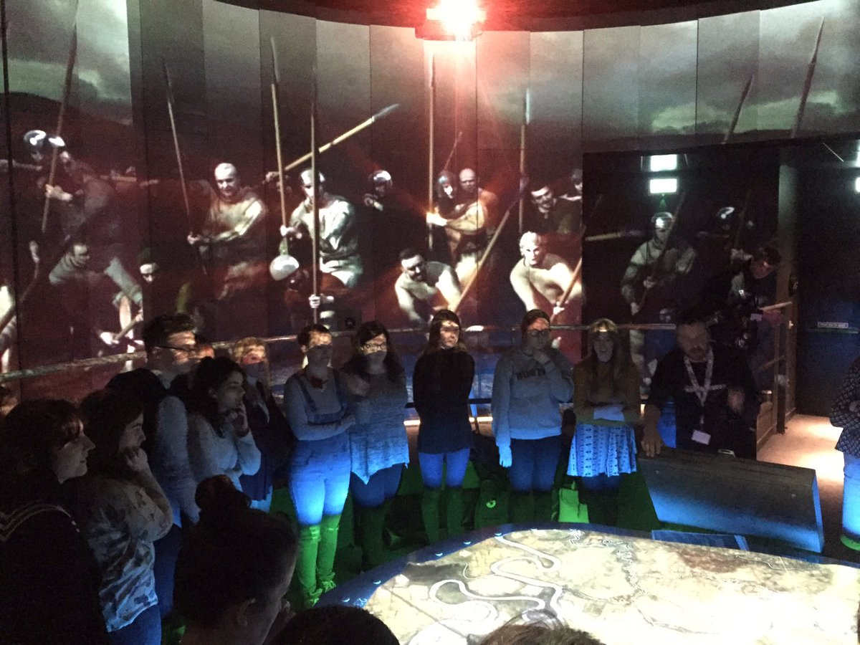
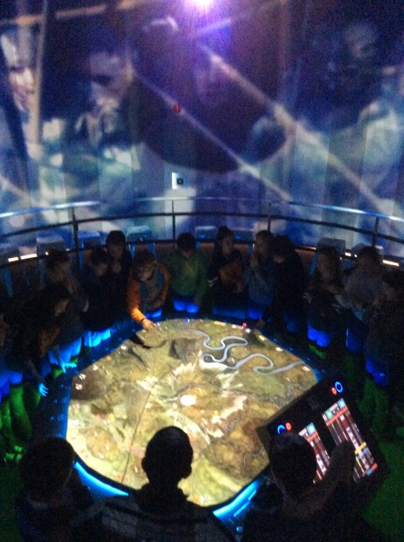
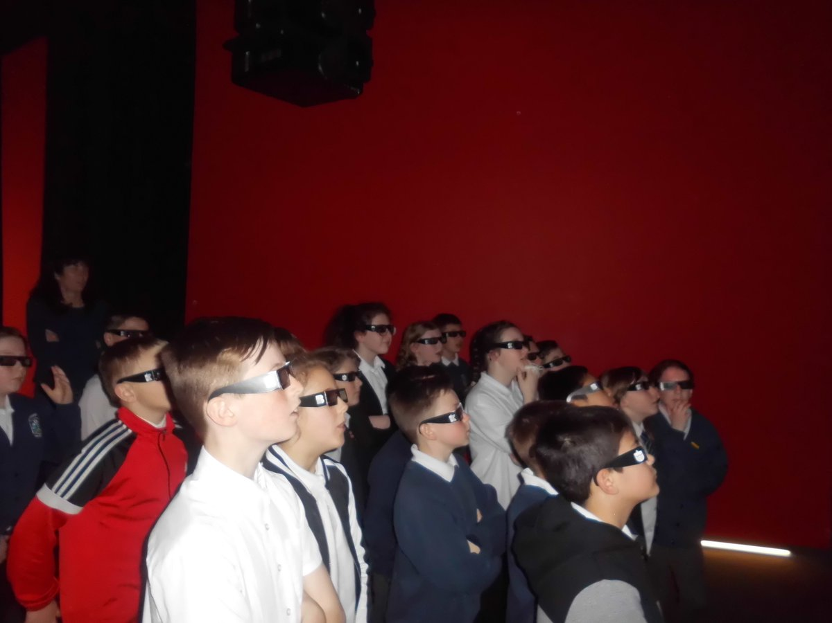
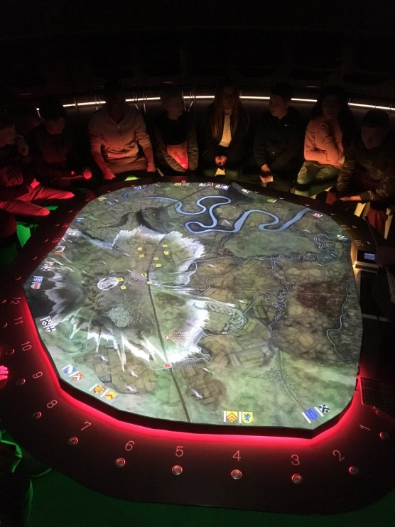

Slide 26
Links to Curriculum for Excellence
e.g. Social Studies – People, Past Events and Societies

Slide 27
Informal Learning Programme
Aiming to create:
Community building opportunities
Opportunities to engage with nature/technology/history/self-identity/community-identity
Opportunities to be creative
Opportunities to learn new skills
Opportunities to consider new perspectives
Opportunities to develop decision-making processes
Opportunities to engage with other people

Slide 29
Provide formal/informal learning programmes for:
Nursery/Pre-School Groups
E.g. Borestone Nursery – dress up/object handling
E.g. ‘Nature Nippers’ Community Ranger events.
Primary Schools (P4-P7 – visiting from as far afield as Aberdeen and the Scottish Borders)
Provided formal learning programmes to 2192 primary school pupils during the 2016-17 financial year.
Secondary Schools (S1-S6 – including specialised Higher/Advanced Higher workshops on request)
Provided formal learning programmes to 2205 secondary school pupils during the 2016-17 financial year.
Tertiary Education (specialised workshops/lectures to correspond with specific college and university courses)
E.g. Honours and PGT ‘Heritage and Cultural Informatics’ Course, University of Glasgow
E.g. HND/BA ‘Heritage and Tourism’, Forth Valley College
E.g. Honours ‘Humanities in the Classroom’, University of Glasgow
E.g. International Student Programmes – ‘Introduction to Scottish Culture’, St Andrews University and Glasgow Caledonian University.

Slide 30
Provide formal/informal learning programmes for:
Community Youth Groups
E.g. Scouts and Guides; youth clubs.
Additional Support Needs Groups
E.g. Options in Life
Camphill community groups.
Military Groups
Battlefield Study module as part of required training programme.
Adults
E.g. Academic lecture series; music and poetry sessions.

Slide 31
Please get in touch!
Battle of Bannockburn Learning Team: Francesca Mackay & Ross Crawford
learningatbannockburn@nts.org.uk

