Slide 1
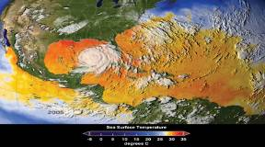
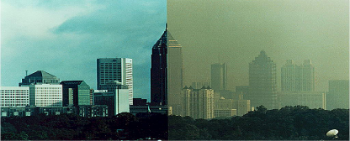
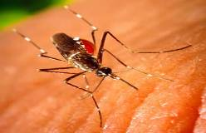
Under the Weather?
The Health Consequences
of a Changing Climate
George Luber, PhD
Centers for Disease Control and Prevention
National Center for Environmental Health
Division of Environmental Hazards and Health Effects

Slide 2
300
280
260
240
CO2 (ppmv)
CO2 Concentration
220
200
180
800,000
700,000
600,000
500,000
400,000
300,000
200,000
100,000
0
Age (years BP)
Source: National Climatic Data Center, NOAA
Notes:
ID #1379 - Can be used in noncommercial online and TV broadcasts of your presentation, but not modified.
Look at CO2 in the historical perspective – this graph goes back 800 thousand years and shows each of the Ice Ages throughout that time.
DESCRIPTION: Graph showing changes in the concentration of carbon dioxide (CO₂) over the last 800,000 years
ADDITIONAL TALKING POINTS: There is more carbon dioxide in the atmosphere now than any time in at least 800,000 years.*
REFERENCES:
*NOAA National Climatic Data Center, “Global Climate Change Indicators,” last accessed June 2013. http://www.ncdc.noaa.gov/indicators/

Slide 3
300
280
260
240
CO2 (ppmv)
CO2 Concentration
220
200
180
Temperature
800,000
700,000
600,000
500,000
400,000
300,000
200,000
100,000
0
Age (years BP)
Source: National Climatic Data Center, NOAA
Notes:
ID #1380 - Can be used in noncommercial online and TV broadcasts of your presentation, but not modified.
Carbon dioxide and temperature go up and down together. Throughout the historical record, the concentration of carbon dioxide has never gone above 300 parts per million.
DESCRIPTION: Graphs showing the relationship between carbon dioxide (CO₂) and temperature over the last 800,000 years
ADDITIONAL TALKING POINTS: It is obvious from these figures that carbon dioxide and temperature are a coupled system (i.e., positively correlated). It’s hard to ignore that when one line goes up the other line goes up, and when one line goes down the other line goes down.
ADDITIONAL BACKGROUND: The lowest temperatures on this graph correspond to periodic ice ages. The difference between the last minimum temperature before the Industrial Revolution and the current temperature is the difference between a nice day in New York City and about 2 vertical kilometers (1.2 miles) of ice.
These dramatic fluctuations over time are caused by Milankovitch cycles,* which are changes in the relationship between the Earth and the sun. There are three cycles:
- Variations in the shape of the orbit of the Earth around the sun;
- Variations in the degree of the Earth’s tilt; and
- Variations in the direction of the Earth’s axis of rotation. (To visualize this, take a coin out of your pocket, stand it vertically on a table, and give it a good spin. Note that as the coin slows down, it tilts further and further toward the table. Earth’s north-south axis periodically tilts more to the horizontal plane, changing the amount of sun received by the poles.)
You may be asked why “carbon dioxide lags temperature.” In other words, if carbon dioxide causes global warming, why has temperature sometimes preceded an increase in carbon dioxide by decades or even hundreds of years?
Tens of thousands of years ago, temperatures in the Southern Hemisphere seemed to rise before carbon dioxide concentrations. But at a global scale, it was the other way around. In these circumstances, the initial temperature rise in the Southern Hemisphere was caused by changes in Earth’s orbit around the sun. The warming led to a release of carbon from the Southern Ocean, and the increased carbon levels then contributed to further warming.** More recent research suggests that the apparent lag between carbon dioxide and Antarctic temperatures in just the last 20,000 years is due to a misinterpretation of the ice core record. In other words, in the period since the last ice age, carbon dioxide triggered Antarctic warming.***
REFERENCES:
* Jeffrey Lee and Stephen J. Reid, eds., "Milankovitch cycles," Encyclopedia of Earth, last updated August 1, 2012. http://www.eoearth.org/article/Milankovitch_cycles
** dana1981, “Shakun et al. Clarify the CO₂-Temperature Lag,” Skeptical Science (blog), April 10, 2012. http://www.skepticalscience.com/skakun-co2-temp-lag.html
*** Michael D. Lemonick, “Ice Bubbles May Solve Carbon-Temperature Paradox,” Climate Central (blog), February 28, 2013. http://www.climatecentral.org/news/antarctic-ice-bubbles-may-solve-carbon-temperature-paradox-15663

Slide 4
400
2013 CO2 Concentration: 400
380
360
340
320
300
280
260
240
CO2 (ppmv)
CO2 Concentration
220
200
180
Temperature
800,000
700,000
600,000
500,000
400,000
300,000
200,000
100,000
0
Age (years BP)
Source: National Climatic Data Center, NOAA
Notes:
ID #1417 - Can be used in noncommercial online and TV broadcasts of your presentation, but not modified.
Here’s where we are now. In 2013, we just crossed 400 parts per million.
DESCRIPTION: Graphs showing the relationship between carbon dioxide (CO₂) and temperature over the last 800,000 years
ADDITIONAL TALKING POINTS: May 2013 saw the daily average CO₂ level at Mauna Loa exceed 400 ppm.*
REFERENCES:
* NOAA National Climatic Data Center, “Trends in Atmospheric Carbon Dioxide,” last accessed June 2013. http://www.esrl.noaa.gov/gmd/ccgg/trends/mlo.html

Slide 5
600
580
560
540
520
500
480
460
440
420
400
After 40 more years at the current rate of increase
2013 CO2 Concentration: 400
380
360
340
320
300
280
260
240
CO2 (ppmv)
CO2 Concentration
220
200
180
Temperature
800,000
700,000
600,000
500,000
400,000
300,000
200,000
100,000
0
Age (years BP)
Source: National Climatic Data Center, NOAA
Notes:
ID #1418 - Can be used in noncommercial online and TV broadcasts of your presentation, but not modified.
In the next 40 years, unless we make some dramatic changes, this is where the concentration of carbon dioxide will be.
DESCRIPTION: Graphs of the current and projected concentration of carbon dioxide (CO₂)
ADDITIONAL TALKING POINTS: The average concentration of carbon dioxide at Mauna Loa in 2012 was 394 ppm.* That is well outside the normal range of variability. And if we don’t make big changes, we’re on track to exceed 600 ppm by 2050.**
PRESENTATION TIP: This sequence is complicated, but the difference between past, present, and projected carbon dioxide is so striking that these images can be very powerful.
REFERENCES:
* Thomas Conway and Pieter Tans, “Trends in Atmospheric Carbon Dioxide: Recent Mauna Loa CO₂,” NOAA/ESRL, last accessed June 2013. http://www.esrl.noaa.gov/gmd/ccgg/trends/
** Organisation for Economic Co-operation and Development, OECD Environmental Outlook 2050: The Consequences of Inaction. (OECD Publishing, 2012): 71-152. http://www.oecd.org/environment/environmentalindicatorsmodellingandoutlooks/climatechangechapteroftheoecdenvironmentaloutlookto2050theconsequencesofinaction.htm

Slide 6

Global Ocean Heat Content
1955 – 2010
Heat Content (10²² Joules)
5 year average, 0 - 2000 m depth
1960
1970
1980
1990
2000
2010
Source: NOAA/NESDIS/NODC Ocean Climate Laboratory, updated from Levitus, S., et al., “World ocean heat content and thermosteric sea level change (0-2000), 1955-2010,” Geophys. Res. Lett. 39, doi:10.1029/2012GL051106, 2012.
© 2012 American Geophysical Union. Reproduced/modified by permission of American Geophysical Union.
Notes:
ID #1441 - Can be used in noncommercial online and TV broadcasts of your presentation, but not modified.
…and the temperature of the ocean. Over the last half of the 20th century, there has been a dramatic rise in global ocean heat content. What difference does that make?
DESCRIPTION: Graph of global ocean heat content, 1955-2010
ADDITIONAL TALKING POINTS: Temperature rise can be measured in the oceans, as well as on land. As this graph indicates, the average temperature of the upper 2,000 meters (≈1.25 miles) of the ocean has increased dramatically since 1955.*
Recent studies show that our oceans have absorbed approximately 90 percent of the extra heat caused by climate change over the past 50 years. Why does this matter? Warmer oceans result in a variety of consequences like sea level rise, supercharged storms, and damage to marine ecosystems.**
REFERENCES: * S. Levitus et al., “World ocean heat content and thermosteric sea level change (0-2000 m), 1955-2010,” Geophysical Research Letters 39 (2012):
http://data.nodc.noaa.gov/woa/PUBLICATIONS/grlheat12.pdf
** National Oceanographic Data Center, “Climate Change: Ocean Heat Content,” March 5, 2011. http://www.climatewatch.noaa.gov/article/2011/climate-change-ocean-heat-content

Slide 7
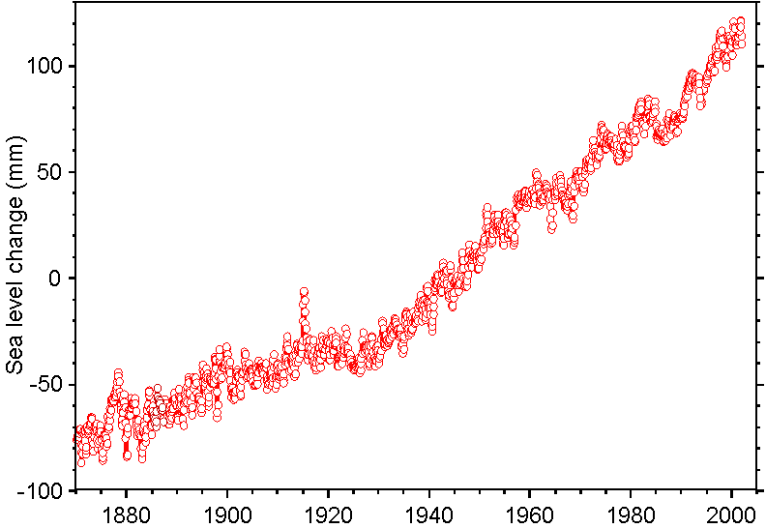
Accelerating Sea Level Rise
3.2 mm/year
2.0 mm/year
0.8 mm/year
Average Rate ~ 1.8 mm/year
Source: Church and White 2006, GRL 33:L01602
Courtesy R.S. Nerem

Slide 8

September Arctic Sea Ice Extent
1979 – 2012
September ice extent
Trend
Million Square Kilometers
New record low
1979
1982
1985
1988
1991
1994
1997
2000
2003
2006
2009
2012
Source: National Snow and Ice Data Center, October 2012
Notes:
ID #1345 - Can be used in noncommercial online and TV broadcasts of your presentation, but not modified.
Summer sea ice extent reached a record low in September of 2012.
DESCRIPTION: Graph illustrating the decrease in September Arctic sea ice extent, 1979 - 2012
ADDITIONAL TALKING POINTS: September sea ice extent is decreasing relative to the 1979-2000 average. Since the early 2000s, the melting trend has steepened with September sea ice extent levels that are consistently well below average,* culminating at an all time low in 2012.**
Many scientists predict that the Arctic will completely free of summer ice by 2030.***
REFERENCES:
* NASA Earth Observatory, “Arctic Sea Ice,” last accessed January 4, 2013. http://earthobservatory.nasa.gov/Features/WorldOfChange/sea_ice.php
** National Snow & Ice Data Center, “Arctic sea ice extent settles at record seasonal minimum,” September 19, 2012. http://nsidc.org/arcticseaicenews/2012/09/arctic-sea-ice-extent-settles-at-record-seasonal-minimum/
*** Weather Underground, “Arctic Sea Ice Decline.” last accessed June 27, 2013. http://www.wunderground.com/climate/SeaIce.asp

Slide 9
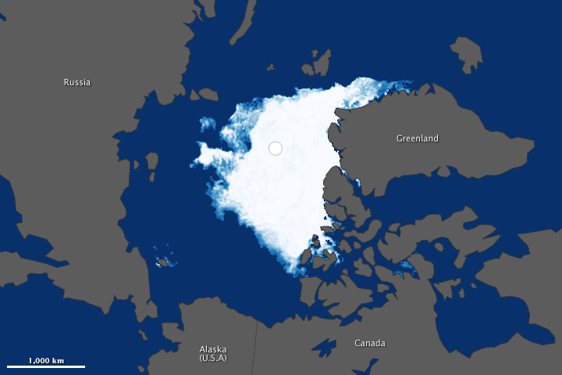
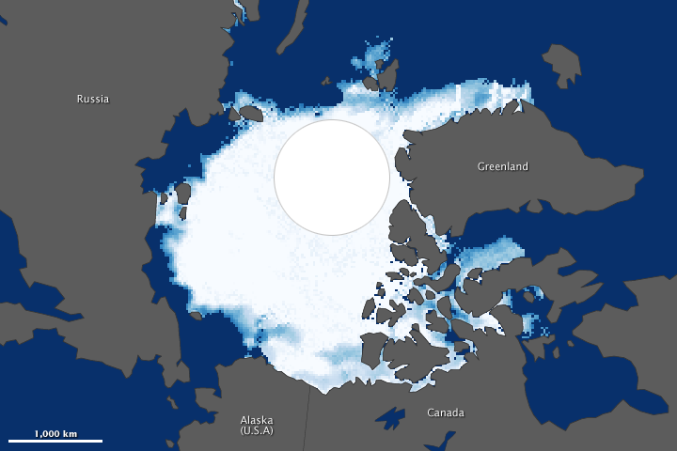
Arctic Sea Ice Extent
September 1984
September 2012
Sea Ice Concentration
0%
100%
Source: NASA Earth Observatory
Notes:
ID #1365 - Can be used in noncommercial online and TV broadcasts of your presentation, but not modified.
This satellite image compares September sea ice extent from 1984 to 2012. This has had an impact on the heat absorption in the Arctic.
DESCRIPTION: Satellite image of Arctic sea ice extent, September 1984 compared to September 2012
ADDITIONAL TALKING POINTS: On September 16, 2012 Arctic sea ice extent set a record low at 3.41 million square kilometers (more than 1.3 million square miles). The average minimum extent for 1979-2000 was 6.7 million square kilometers (nearly 2.6 square miles), roughly equal to the sea ice extent in 1984.* Between the maximum and minimum extents of the season, nearly 12 million square kilometers (4.6 million square miles) of ice were lost, the largest amount in any summer since records began.**
REFERENCES:
* Michon Scott and Mike Carlowicz, “Visualizing the 2012 Sea Ice Minimum,” NASA Earth Observatory, September 27, 2012. http://earthobservatory.nasa.gov/IOTD/view.php?id=79256
** National Snow & Ice Data Center, “Arctic sea ice extent settles at record seasonal minimum,” September 19, 2012. http://nsidc.org/arcticseaicenews/2012/09/arctic-sea-ice-extent-settles-at-record-seasonal-minimum/

Slide 10
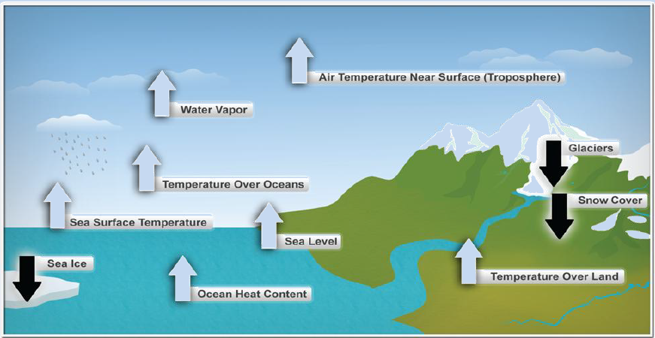
Ten Indicators of a Warming World
Source:

Slide 11
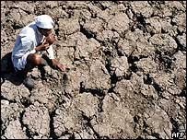

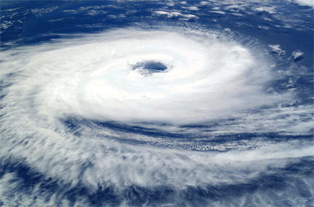
Climate Change Science:
Key Findings
Climate change is altering both the average (mean) global temperature and the global frequency of extremely hot temperatures (variance)
The impacts of climate change will vary significantly by region; some places are warming faster than others.
Notes:
(Note: Previous speaker –NOAA scientist- previews some of the evidence for climate change, in a climate “primer” discussion; he does not discuss these two points that I’m about to present)
As noted in the previous presentation, evidence for climate change is present in a number of physical and natural systems. From a public health perspective, there are two key findings that are particularly salient for our discussion:
First is the fact that while climate change alters the average (mean) global temperature, that is, the average temperature, season by season, in a given locale, it is also altering the frequency of days with extremely high temperatures, thus altering the variance of the temperature distribution.
Second is the fact that warming is not occurring evenly; some places are warming at a faster rate than other areas. I’ll present the evidence for this in the following few slides.

Slide 12
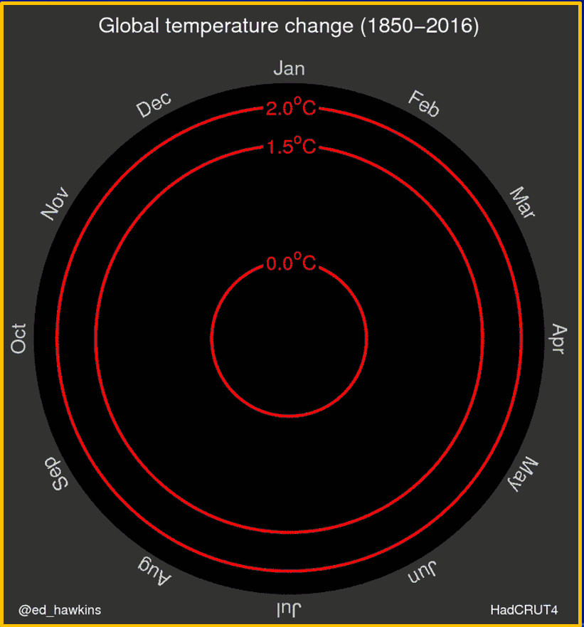
Global Average Temperatures have been increasing
Source: http://www.climate-lab-book.ac.uk/2016/spiralling-global-temperatures/

Slide 13
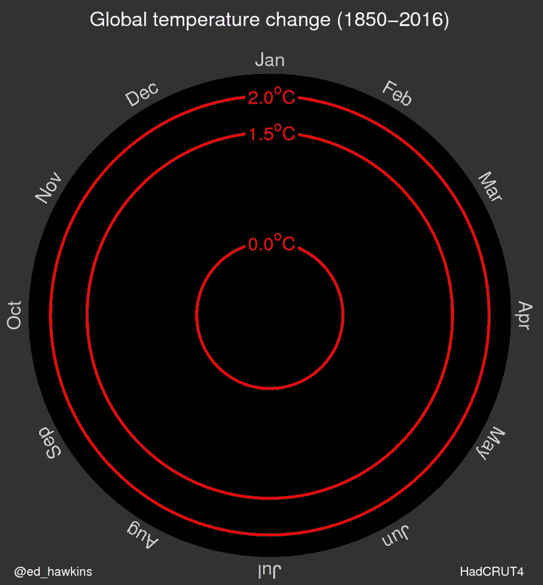
Global Average Temperatures have been increasing
Source: http://www.climate-lab-book.ac.uk/2016/spiralling-global-temperatures/

Slide 14

Summer Temperatures Have Shifted 1951 – 1980
0.5
Cooler than average
Baseline (1951 - 1980) mean
Average
0.4
Warmer than average
0.3
Frequency of Occurrence
0.2
0.1
0
-5
-4
-3
-2
-1
0
1
2
3
4
5
Deviation from Mean
Source: NASA/GISS; Hansen, et al., “Perceptions of Climate Change,” Proc. Natl. Acad. Sci. USA 10.1073, August 2012
Notes:
ID #1193 - Can be used in noncommercial online and TV broadcasts of your presentation, but not modified.
This series of graphs shows the average distribution of hot days, cold and normal days, as compared to the 1951-1980 baseline. In the mid 20th century, there were about one-third cooler than normal days and one-third normal days and one-third warmer than normal.
DESCRIPTION: Graph of the frequency of cool, average and warm summer temperatures in the Northern Hemisphere (compared to a 1951-1980 base period), 1951-1980. The horizontal axis is in units of local standard deviation.
ADDITIONAL TALKING POINTS: Dr. Hansen and his colleagues recently examined the frequency of different categories of summer temperatures.* This series of graphs show the shift over time towards more warmer than average conditions.
REFERENCES:
* J. Hansen, M. Sato, and R. Ruedy, “Perception of climate change,” Proceedings of the National Academy of Sciences (August 6, 2012). http://www.pnas.org/content/109/37/E2415.full

Slide 15
Summer Temperatures Have Shifted 1981 – 1991
0.5
Cooler than average
Baseline (1951 - 1980) mean
Average
0.4
Warmer than average
Extremely hot
0.3
Frequency of Occurrence
0.2
0.1
0
-5
-4
-3
-2
-1
0
1
2
3
4
5
Deviation from Mean
Source: NASA/GISS; Hansen, et al., “Perceptions of Climate Change,” Proc. Natl. Acad. Sci. USA 10.1073, August 2012
Notes:
ID #1194 - Can be used in noncommercial online and TV broadcasts of your presentation, but not modified.
But in the late 20th century, the whole graph started shifting towards the warm side. All of a sudden we see extremely hot events occurring.
DESCRIPTION: Graph of the frequency of cool, average and warm summer temperatures in the Northern Hemisphere, 1981-1991 (compared to a 1951-1980 base period). The horizontal axis is in units of local standard deviation.
ADDITIONAL TALKING POINTS: In the 1980s and 1990s, we see the appearance of a new category of temperature deviations: “extremely hot.”*
REFERENCES:
* J. Hansen, M. Sato, and R. Ruedy, “Perception of climate change,” Proceedings of the National Academy of Sciences (August 6, 2012). http://www.pnas.org/content/early/2012/07/30/1205276109.full.pdf+html

Slide 16
Summer Temperatures Have Shifted 1991 – 2001
0.5
Cooler than average
Baseline (1951 - 1980) mean
Average
0.4
Warmer than average
Extremely hot
0.3
Frequency of Occurrence
0.2
0.1
0
-5
-4
-3
-2
-1
0
1
2
3
4
5
Deviation from Mean
Source: NASA/GISS; Hansen, et al., “Perceptions of Climate Change,” Proc. Natl. Acad. Sci. USA 10.1073, August 2012
Notes:
ID #1195 - Can be used in noncommercial online and TV broadcasts of your presentation, but not modified.
In the 1990s, it shifts further, and we get even more extreme events.
DESCRIPTION: Graph of the frequency of cool, average and warm summer temperatures in the Northern Hemisphere, 1991-2001 (compared to a 1951-1980 base period). The horizontal axis is in units of local standard deviation.

Slide 17
Summer Temperatures Have Shifted 2001 – 2011
0.5
Cooler than average
Baseline (1951 - 1980) mean
Average
0.4
The “extreme” temperature events used to cover 0.1% of the Earth. Now they cover 10%.
Warmer than average
Extremely hot
0.3
Frequency of Occurrence
0.2
0.1
0
-5
-4
-3
-2
-1
0
1
2
3
4
5
Deviation from Mean
Source: NASA/GISS; Hansen, et al., “Perceptions of Climate Change,” Proc. Natl. Acad. Sci. USA 10.1073, August 2012
Source: NASA/GISS; Hansen, et al., “Perceptions of Climate Change,” Proc. Natl. Acad. Sci. USA 10.1073, August 2012
Notes:
ID #1196 - Can be used in noncommercial online and TV broadcasts of your presentation, but not modified.
And in the most recent decade, we see even more extreme events. All of a sudden the number of extremely hot days is larger than the number of cooler than normal days. The whole graph has spread out. There are still colder than normal days but the distribution has changed. The extreme temperature events use to cover just 0.1 percent of the Earth, now they cover 10 percent. That is a 100 fold increase, globally.
DESCRIPTION: Graph of the frequency of cool, average and warm summer temperatures in the Northern Hemisphere, 2001-2011 (compared to a 1951-1980 base period). The horizontal axis is in units of local standard deviation.
ADDITIONAL TALKING POINTS: In just the past three decades, hot summers have become much more frequent and cold summers much less frequent. If we keep polluting like normal, the “extreme” temperatures we’re experiencing now will become the norm over the next 50 years and the hottest temperatures more common.*
REFERENCES:
* J. Hansen, M. Sato and R. Ruedy, “Perception of climate change,” Proceedings of the National Academy of Sciences (August 6, 2012). http://www.pnas.org/content/109/37/E2415.full

Slide 18

Key Health Threats from Climate Change
“Disaster within a disaster”
  Extreme events increase the probability of “complex emergencies” where multiple system failures can occur which can exceed response capacity.

Slide 19
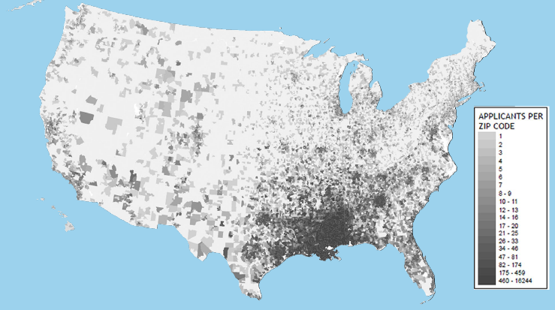
Katrina Diaspora

Slide 20

Key Health Threats from Climate Change
“Morbidity and Mortality by a thousand cuts”
  Impacts add to the cumulative stresses currently faced by vulnerable populations and in locations most vulnerable to extreme events & ongoing, persistent climate-related threats

Slide 21
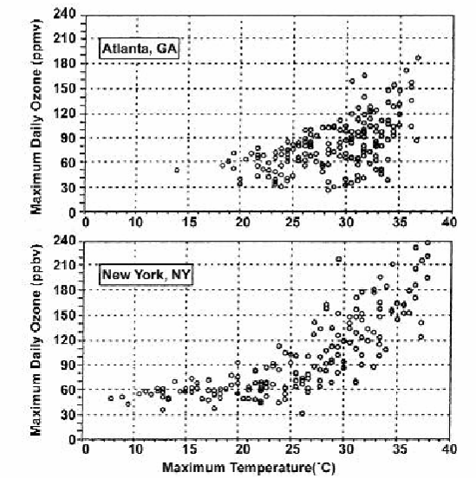
Heat Impacts on Air Pollution
Maximum Daily Ozone Concentrations vs. Maximum Daily Temperature
Atlanta
New York

Slide 22
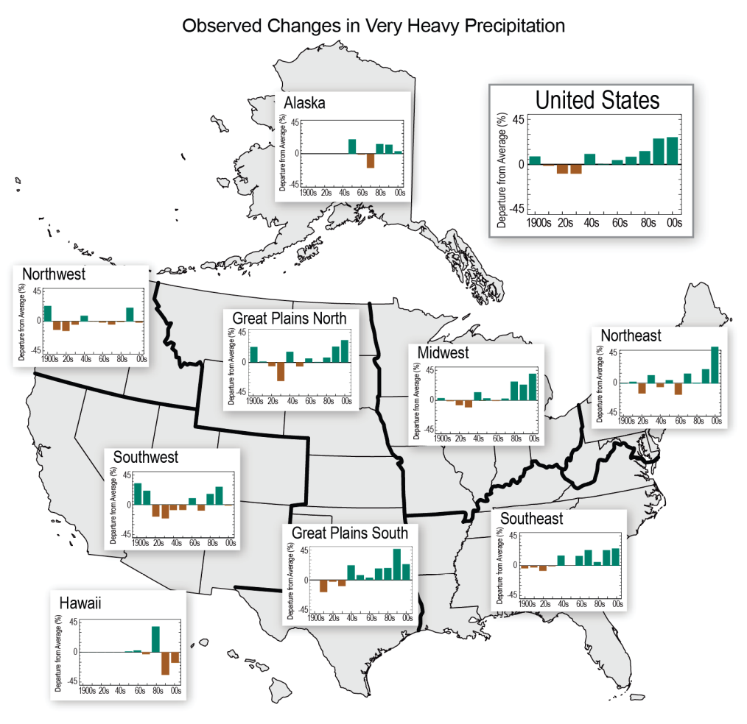
Extreme Precipitation Events Impact Human Health: Waterborne Disease
67% of waterborne disease outbreaks preceded by precipitation above 80th percentile (across 50 year climate record)
Heavy precipitation events projected to occur more frequently
Observed Increases in Very Heavy Precipitation (heaviest 1% of all events) 1901 to 2011
Curriero, Patz, et al, 2001.
Source: Walsh et al. 2013: Draft NCA Report, Chapter 2
Notes:
Unusually high rainfall events increases the likelihood of waterborne diseases by contaminating drinking water sources or recreational water use.
This slide draws information from a study that linked waterborne disease outbreaks with high precipitation events.

Slide 23
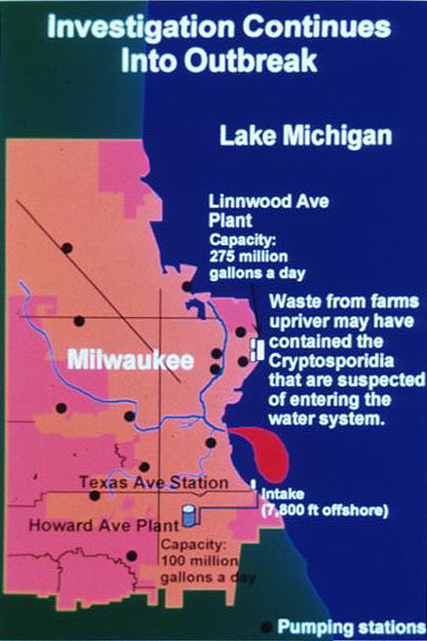
Heavy Precipitation and Water-borne Disease:
Milwaukee 1993
Cryptosporidiosis epidemic
405,000 cases, 54 deaths
Preceded by heaviest rainfall in 50 years (Curriero et al., 2001)
$31.7 million in medical costs
$64.6 million in lost productivity
(Corso et al., 2003).

Slide 24
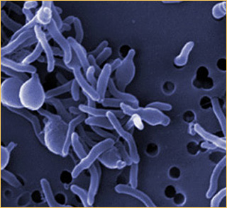
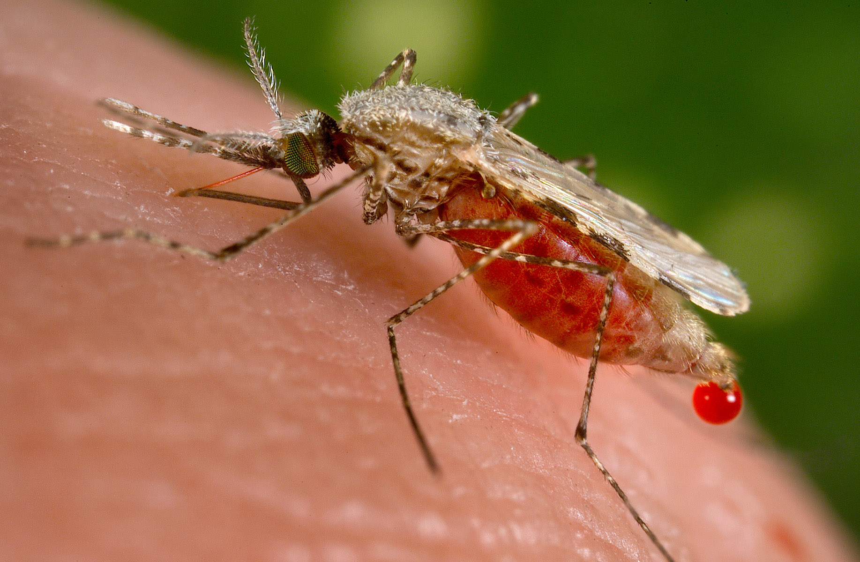
Key Health Threats from Climate Change
Novel threats emerge
  Large scale ecological perturbations facilitate disease emergence and redistribution.

Slide 25
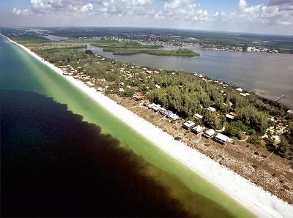
Harmful Algal Blooms (Red-tides)
Enhanced by:
Increased water temps
Nutrient runoff
Upwelling events

Slide 26


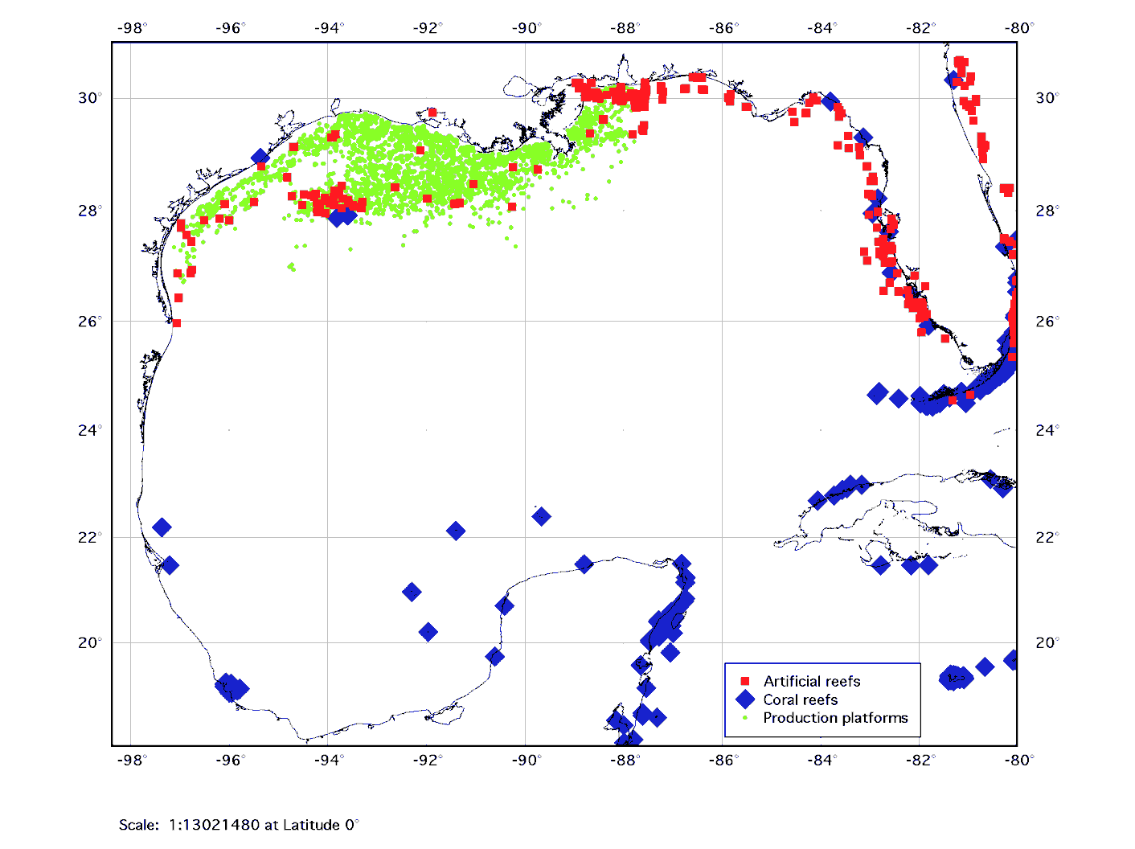
Ciguatera Fish Poisoning on Texas Coast Oil Rigs

Slide 27
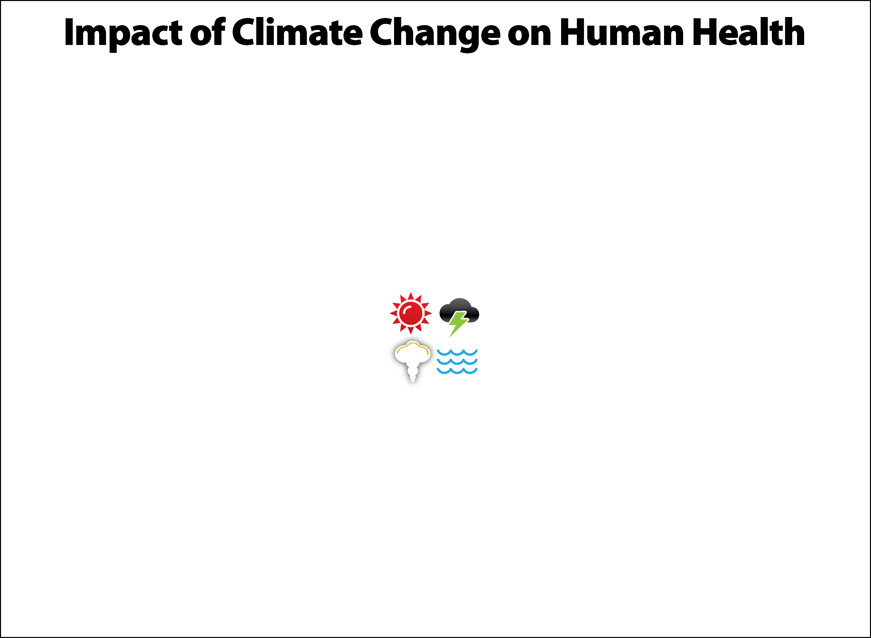
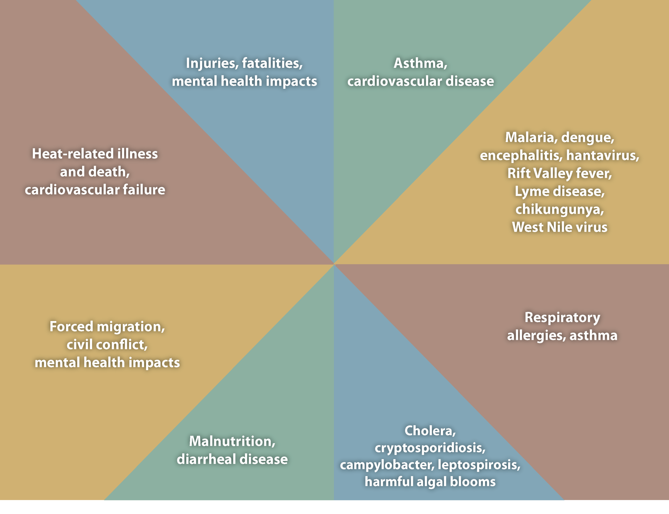
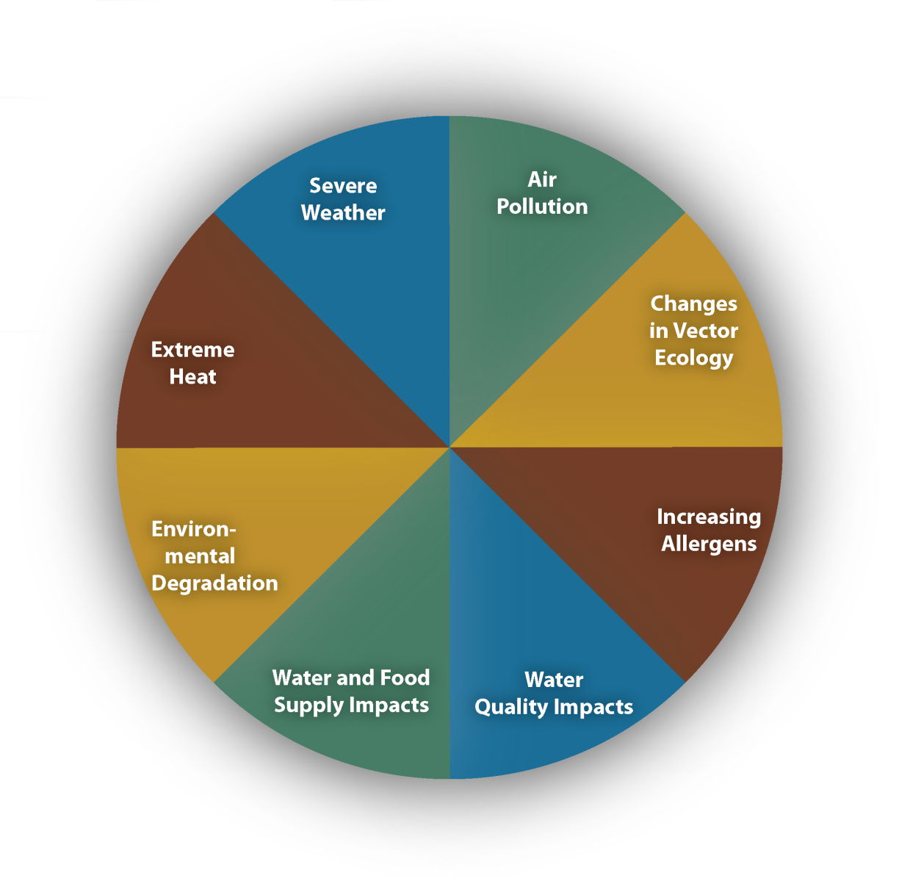
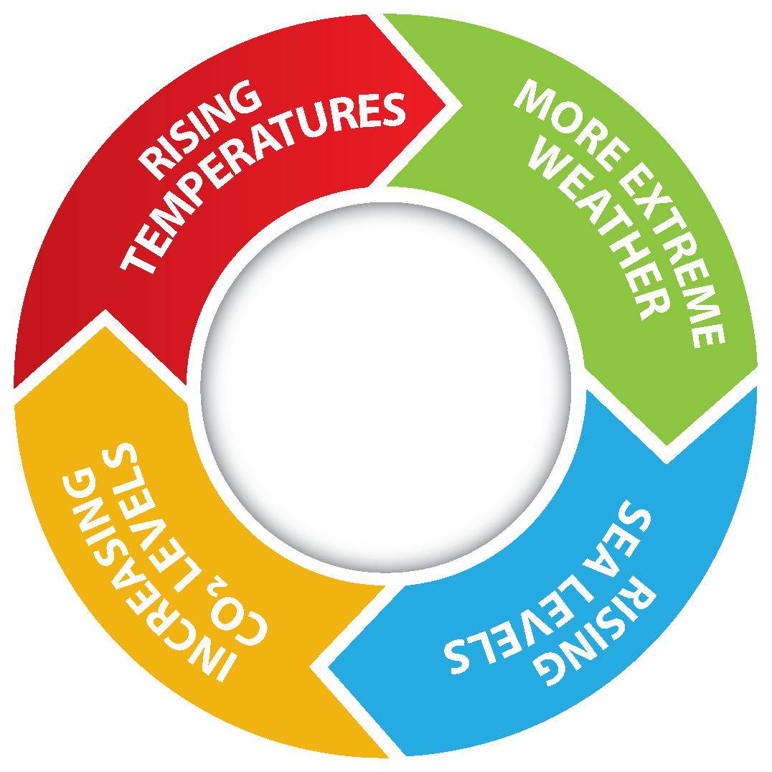

Slide 28
What is CDC doing to prepare for health effects of climate change?
CDC helps states and cities prepare for health challenges of climate change by
  Providing scientific guidance
  Developing decision support tools
  Ensuring public health concerns are considered in climate change adaptation and mitigation strategies
  Creating partnerships between public health and other sectors
CDC’s Climate and Health Program – nation’s only investment in climate change preparedness for public health sector
Notes:
CDC’s Climate and Health Program is the only Federal government investment designed to build climate change capabilities of health departments. The program aims to build the systems, skills and experience of state and local health departments to identify, plan for and respond to the near and long term health impacts of climate change. This $7 million program accomplishes this through funding provided to 16 states and two cities through the Climate Ready States and Cities Initiative (CSCRI). Funded states use the CDC developed Building Resilience Against Climate Effects (BRACE) framework. The BRACE framework enables a health department to identify likely climate impacts in their communities, potential health effects associated with these impacts, and their most at-risk populations and locations. The BRACE framework enables a health department to prepare and implement an adaptation plan that best reflects the greatest challenges within their jurisdiction and the best use of limited resources to achieve the most efficient and effective public health results.
CDC’s Climate and Health Program plays three critical roles.
Translating climate science for health departments and the public health community. For example:
Identifying regional climate trends that impact health
Identifying the health impacts of climate change and the populations most vulnerable to these impacts
Modeling future health impacts and how disease rates will change based on climate scenarios
Developing decision support tools for state and local health departments. For example:
Providing technical guidance and support for adaptation planning
Developing training and guidance for health departments to create vulnerability maps
Enhancing surveillance tools e.g. adding climate information and functionality on the CDC’s Environmental Public Health Tracking Portal.
Promoting public health engagement in the response to climate change
Ensuring public health concerns are addressed in climate change adaptation and mitigation strategies
Creating partnerships between public health and other sectors

Slide 29
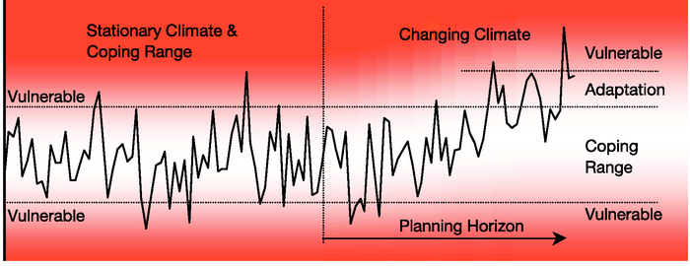
Priority Actions for Climate Change:
Shift the Coping Range

Slide 30
Climate-Ready States and Cities Initiative
CDC effort to enhance capacity of state and local health agencies to deal with health challenges associated with climate change
CDC accomplishes this by
  Funding 18 state and local health departments
  Providing framework and tools for planning, implementing, and evaluating climate adaptation strategies
    Tools to identify populations and places vulnerable to climate impacts
    Materials to help communicate climate and health issues to public health partners (e.g., extreme heat toolkit)
Notes:
Objective: To enhance the capability of state and local health agencies to deal with the challenges associated with climate change
CDC accomplishes this through:
Cooperative Agreements with State and Local HDs:
“Developing Public Health Capacity and Adaptations to Reduce Human Health Effects of Climate Change”
Developing Decision Support Tools:
Communications and Educational Tools
Vulnerability Mapping Tools

Slide 31
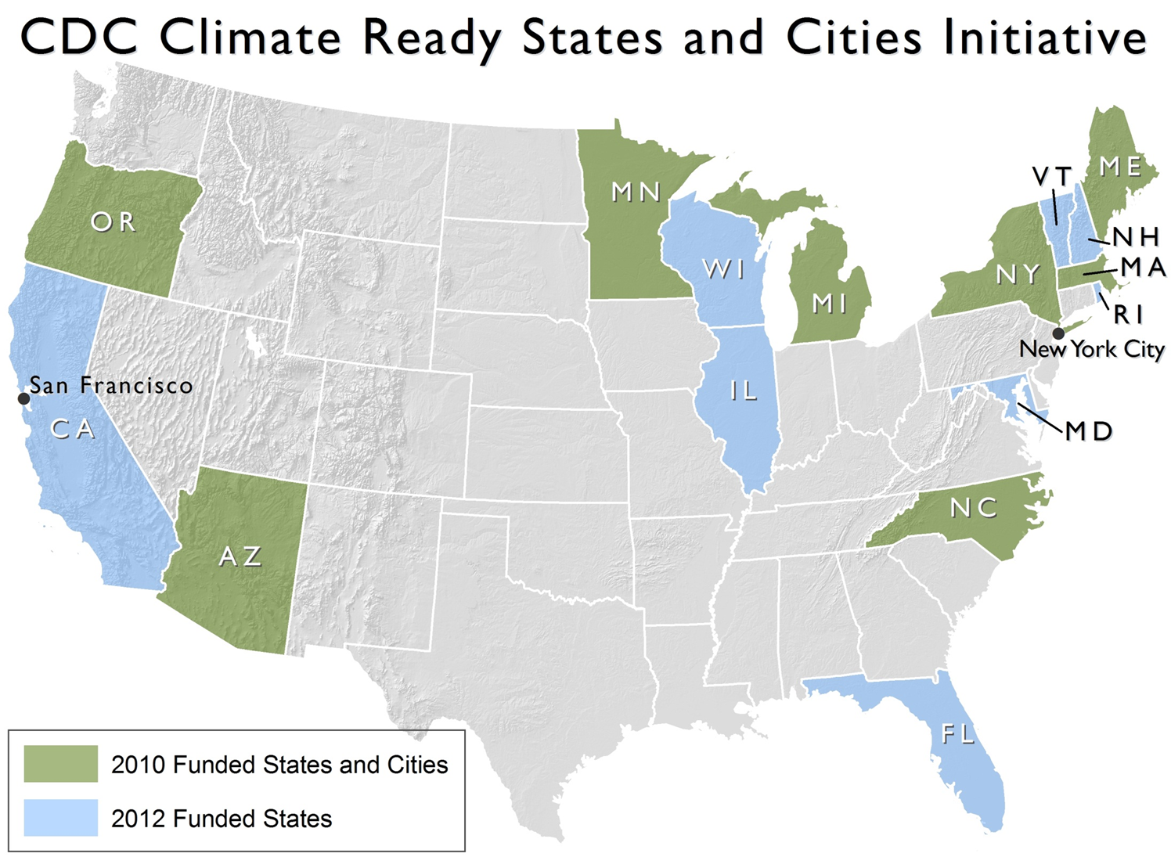
Notes:
CDC’s Climate Ready States and Cities Initiative supports the work of 16 states and 2 cities to do pioneering work to develop the methodologies for projecting and responding to climate change, that can be adopted by health departments around the country.
CDC roles in this is to provide a lot of the guidance, technical support, and tools while our state and city partners are adapting the theories and testing how it works in the real world environment that they face everyday.
The emphasis of the Climate Ready Initiative is to build and test methodologies, critique the methods employed and capture and widely disseminate the case studies and the findings.
Objective: To enhance the capacity of state and local health agencies to deal with the challenges associated with climate change
Cooperative Agreements with State and Local HDs:
“Developing Public Health Capacity and Adaptations to Reduce Human Health Effects of Climate Change”
Developing Decision Support Tools:
Communications and Educational Tools
Vulnerability Mapping Tools

Slide 32






Building Resilience Against Climate Effects
01
^{Forecasting}
^{Climate Impacts and Assessing}
^{Vulnerabilities}
^{Projecting the}
^{Disease Burden}
05
02
BRACE
^{Evaluating}
^{Impact and}
Improving Quality of Activities
Building Resilience
Against Climate Effects
^{Assessing}
^{Public Health Interventions}
04
03
^{Developing and Implementing a}
Climate and Health Adaptation Plan

Slide 33
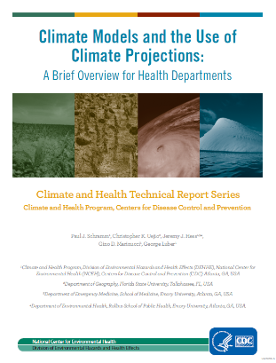
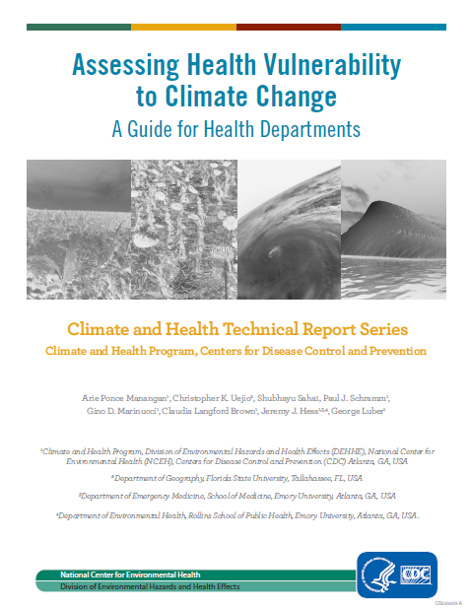
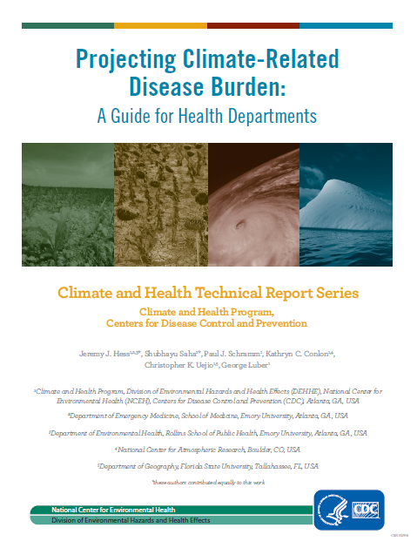
BRACE Technical Guidance

Slide 34

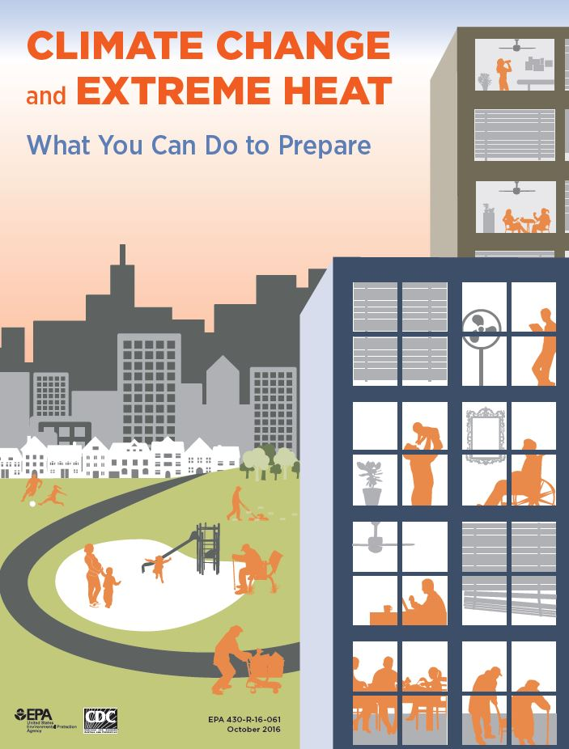
Resources: www.cdc.gov/climateandhealth

Slide 35
Summary
The effects of climate change are already evident in our communities
Climate change must be framed as a human welfare and public health issue.
Early action, through evidence-based approaches, can help to protect the public’s health
Opportunity costs of not taking action are high

Slide 36
Contact:
George Luber, PhD
Centers for Disease Control and Prevention gluber@cdc.gov
Thank You
The findings and conclusions in this report are those of the authors and do not necessarily represent the official position of the Centers for Disease Control and Prevention.

