Slide 1
Statewide training plans: The butterfly effect & sister state agencies
Title IV-E National Roundtable
Portland, Oregon
May 22, 2018
Arizona Department of Child Safety
Andrea Hightower, Grants Manager – Budget & Finance
Xheni Ndreu – Statewide Program Specialist – Title IV-E
Andrea.Hightower@azdcs.gov & Xheni.Ndreu@azdcs.gov

Slide 2
Statewide training plans: The butterfly effect & sister state agencies
Agenda:
Can "small changes" within the scope and reach of your state's annual training plan can have "larger effects" on the amount of federal Title IV-E reimbursement realized?
Finding Common Ground in seemingly Opposing Goals.
Statewide Title IV-B training plans: Who’s plan is it?
Who’s families are they really? Case management, client assessment & service referral
Sister state agencies and Certified Expenditures: Attracting greater federal reimbursement for your state
Notes:
Introductions

Slide 3
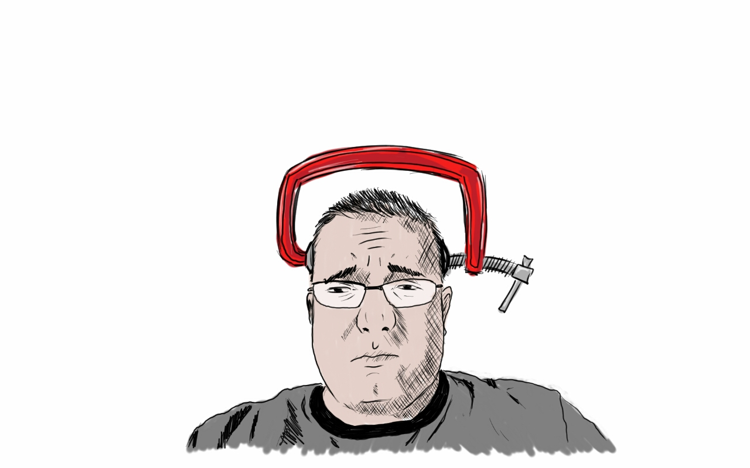
Statewide training plans: The butterfly effect & sister state agencies
Finding Common Ground in seemingly Opposing Goals :
Reduce Spending
&
Contain Costs
Increase Services to meet client needs
Finance
Program
This Photo by Unknown Author is licensed under CC BY-NC-ND
Notes:
Get to know who’s in the room & Center the Topic of Workshop in something common to all
Ask the audience to raise their hands when they can relate to goal statements
Click to show each goal thought
Often organizations assume a culture of opposition similar to this called
Click to bring in Program and Finance labels
What if there was a way to find common ground and achieve both? That’s been my passion and journey over the past couple of decades and it’s centered on Title IV-E participation/reimbursement in state funded training activities.

Slide 4
Statewide training plans: The butterfly effect & sister state agencies
Statewide Title IV-B training plans: Who’s plan is it?
Sections 235.61 through 235.66 of the Social Security Act contain:
State plan requirements for training programs, and
conditions for Federal financial participation (FFP) for training costs under the State plans.
Program
Finance
Statewide training plans have been incorporated into Child Welfare Annual Reporting against 5 year Child & Family Services Plans.
https://sites.google.com/site/2017titleiveroundtable/resources/2015-19-child-family-service-plans
Notes:
When Finance and Program staff do not view the Title IV-B state training plan as a shared responsibility, opportunities to reduce state spending are missed. Those savings could be utilized to increase services to clients.
Click to show Finance label
Click to show Program label
Raise your hand if you’ve seen or know how to access your state’s Training Plan
Click to show link to 2017 Roundtable page for Training Plans

Slide 5
Statewide training plans: The butterfly effect & sister state agencies
Statewide Title IV-B training plans: Who’s plan is it?
The Child Welfare Policy Manual Section 8.1H details the what type of activities and costs are eligible for Title IV-E reimbursement:
https://www.acf.hhs.gov/cwpm/public_html/programs/cb/laws_policies/laws/cwpm/policy_dsp.jsp?citID=116
Sister state agencies efforts are allowed to be incorporated – but require coordination with the child welfare agency who “owns the plan”:
In Arizona these currently include:
University BSW/MSW Stipend programs (ASU & NAU)
Arizona Juvenile Justice Probation Department
Court Appointed Special Advocates (CASA) program AZ Administrative Office of the Courts
Arizona State University Research Centers (development of training content or evaluation of training efforts)
Notes:
Looking at the top part of this slide, who’s plan is it?
Click to bring in image of child welfare finance manager
Okay, what about the second part of this slide? Who’s plan is it?
Click to bring in image of multiple people

Slide 6
Statewide training plans: The butterfly effect & sister state agencies
Statewide Title IV-B training plans: Who’s plan is it?
Since 2015, Arizona has focused on expanding training performed under the 2008 Fostering Connections Act through the promotion of cross-system collaboration among state agencies and providers of child welfare training.
AZ Training Plan:
The Department may engage in both the development and delivery of short-term advanced and specialized training above and beyond what is outlined above. These activities will be continuing education and professional development for DCS staff and/or audiences eligible under the 2008 Fostering Connections Act (Reference: 45 CFR 1356.60(b)).
Notes:
This does NOT commit the child welfare agency to anything but rather lays the foundation that allows for incorporation of sister state agency efforts which can be governed through Inter Governmental Agreements (IGA) which spells out:
the agreed upon activities for a particular time period
methods to report those activities to the public child welfare agency so that the eligible costs may be included in the states’ Title IV-E claim, and
How resulting federal participation (FFP) would be dispersed by the public child welfare agency.

Slide 7
Statewide training plans: The butterfly effect & sister state agencies
Statewide Title IV-B training plans: Who’s plan is it?
AZ Training Plan:
The Department recognizes the following as approved child welfare agencies for the purposes of receiving eligible title IV-E training (Reference: 45 CFR 1356.60(b)):
contracted child placement providers;
members of the staff of abuse and neglect courts, agency attorneys, attorneys representing children or parents, guardians ad litem, and other court-appointed special advocates (CASA) representing children in court proceedings; and
members of the staff of mental health, public health, academic institutions including school social workers, and private family service staff who engage with children served by the Department.
https://sites.google.com/site/2017titleiveroundtable/resources/licensed-or-approved-cw-agencies
Notes:
This does NOT commit the child welfare agency to anything but rather lays the foundation that allows for incorporation of sister state agency efforts which can be governed through Inter Governmental Agreements (IGA) which spells out:
the agreed upon activities for a particular time period
methods to report those activities to the public child welfare agency so that the eligible costs may be included in the states’ Title IV-E claim, and
How resulting federal participation (FFP) would be dispersed by the public child welfare agency.
California All County Memo handout

Slide 8
Statewide training plans: The butterfly effect & sister state agencies
Who’s families are they really?
Case management, client assessment & service referral
Put yourselves “in the shoes” of a family involved with the child welfare system.
What sister state agencies might the family might be referred to as part of their case plan?

Slide 9
Statewide training plans: The butterfly effect & sister state agencies
Who’s families are they really?
Case management, client assessment & service referral
Recognizing the involvement of non-public child welfare staff in support of Title IV-E eligible children and families is integral to improving outcomes; and
It is crucial to have increased engagement of family members in identifying individuals, groups, and agencies that are engaged at key decision points and throughout the life of the case plan; and
As part of the case plan implementation, these providers may be integrally involved in a variety of team processes such as: Team Decision Making, Family Group Decision Making, and Wraparound Teams.
Therefore, given the ongoing work of non-public child welfare groups and individuals with Title IV-E eligible children and families, it is critical that joint and cross system training occur to support consistent messaging and improved shared practice.
Notes:
California’s premise:
Consistent with the focus of the Fostering Connections to Success and Increasing Adoption Act of 2008:

Slide 10
Statewide training plans: The butterfly effect & sister state agencies
Sister state agencies and Certified Expenditures: Attracting greater federal reimbursement for your state
Code of Federal Regulations § 235.66 - Sources of State funds.
(a) Public funds. Public funds may be considered as the State's share in claiming Federal reimbursement where the funds:
Are appropriated directly to the State or local agency, or transferred from another public agency (including Indian tribes) to the State or local agency and under its administrative control, or certified by the contributing public agency as representing expenditures eligible for FFP under §§ 235.60-235.66;
Are not used to match other Federal funds; and
Are not federal funds, or are Federal funds authorized by Federal law to be used to match other Federal funds.
Notes:
We have great historical precedent in utilization of Certified Expenditures – it is widely recognized as acceptable by all federal regions in the relationships involving public child welfare and university BSW/MSW stipend programs.
Thinking about the wide variety of sister state agencies who are involved in supporting children/families involved with the public child welfare system, what other agencies might be able to certify expenditures in your state?

Slide 11
Statewide training plans: The butterfly effect & sister state agencies
Sister state agencies and Certified Expenditures: Attracting greater federal reimbursement for your state
Code of Federal Regulations § 235.66 - Sources of State funds.
(b) Private funds. Funds donated from private sources may be considered as the State's share in claiming Federal reimbursement only where the funds are:
Transferred to the State or local agency and under its administrative control;
Donated without any restriction which would require their use for the training of a particular individual or at particular facilities or institutions; and
Do not revert to the donor's facility or use.
[45 FR 29835, May 6, 1980]
Notes:
Here is what I consider the “growing potential” for all of us, both in terms of relationship building to better support our children/families/staff as well as to decrease state costs by increasing the federal participation.
There is not nearly the same amount of discussion, or written reference, to the instances where private funds have successfully been utilized as the public child welfare agencies “share” in Title IV-E activities. That does not mean we should shy away from exploration of this allowable source of funding.
Examples that I’ve been given permission to share where this is working (or has been successful in the past include):
Washington DSHS Children’s Administration – in partnership with the University of Washington’s Partners for Our Children – under the current leadership of Benjamin de Haan
Oregon DHS – under the previous leadership of Benjamin de Haan
Alaska OCFS – under the previous leadership of Tammy Cordva

Slide 12
Statewide training plans: The butterfly effect & sister state agencies
Questions & Next Steps:

