Slide 1
270 days to write your future
Prof Irene Cetin
UNIVERSITY OF MILAN
HOSPITAL LUIGI SACCO
a new scientific humanism

Slide 2
OUTLINE
PROGRAMMING in PREGNANCY
NUTRITIONAL PHENOTYPE OF PREGNANCY
PLACENTA and FETAL NUTRITION
IUGR

Slide 3

PROGRAMMING
Malnutrition and other adverse environmental exposures during development alter gene expression and programme the body’s structures and functions for life. Adverse exposures also result in slow growth and small body size.

Slide 4
Fetal Origins of Adult Diseases (FOAD)
Fetal
under/over nutrition
Other organ
malfunction,
eg, liver
Decreased
β-cell mass
Insulin
resistance
Abnormal
vascular
development
Obesity
Age
Hyperlipidemia
Type 2 diabetes
Hypertension
Metabolic syndrome
Barker DJP et al. Diabetologia 1993; Barker DJP BMJ 1995
Notes:
*Barker DJP. Acta Paediatr Suppl. 1997;422:78.
†Barker DJP. BMJ. 1995;311:171.
‡Barker DJP et al. Diabetologia. 1993;36:62.
Fetal Origins of Metabolic Syndrome
Barker observed that “Studies in humans have shown that men and women whose birth weights were at the lower end of the normal range, who were thin or short at birth, or who were small in relation to placental size have increased rates of coronary heart disease.”* He hypothesized that these rates are associated with specific patterns of disproportionate fetal growth that result from fetal undernutrition in middle to late gestation.†
The occurrence of metabolic syndrome—hyperlipidemia, type 2 diabetes, and hypertension—in adulthood has been correlated with low birth weight. The slide shows the proposed relationship between fetal undernutrition and metabolic syndrome in adult life.
In two studies, the prevalence of metabolic syndrome in both men and women progressively increased from those who had the highest birth weights to those who had the lowest birth weights.‡
Among 64-year-old men, those whose birth weights were 2950 g or less had a greater than 10-fold increase in risk of developing metabolic syndrome compared with men whose birth weights were more than 4310 g.‡
This relationship was independent of possible confounding variables, including cigarette smoking, alcohol consumption, and social class in adulthood or at birth.‡

Slide 5

270 days to write your future
2nd trimester
1st trimester
3rd trimester
implantation
neonatal viability
PUERPERIUM
0
12
20
25
28
32
34
40
LD
positive pregnancy test
fetal movements
conception
delivery

Slide 6
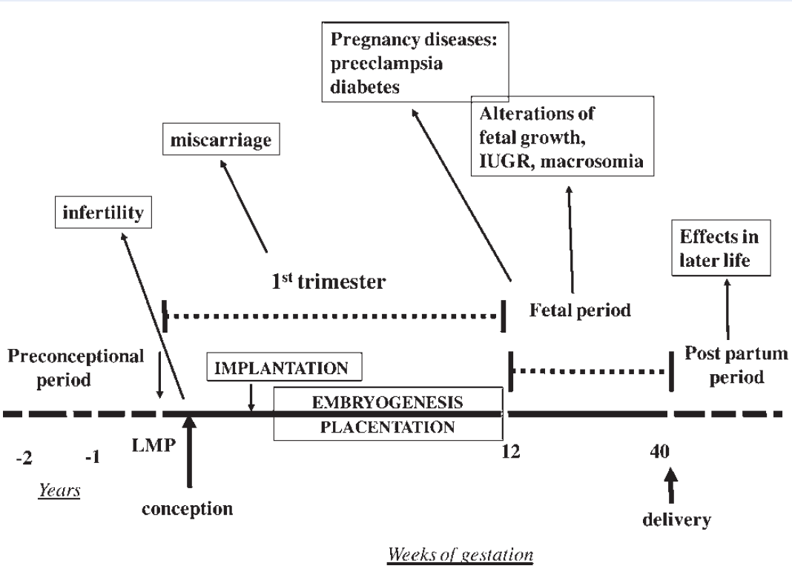
Pregnant women do not always meet their increased micronutrient requirements
HEALTH OUTCOMES
Diet = important determinant of pregnancy outcomes and infant health both in short and long-terms:
significant association between inadequate or poor nutrition and high “reproductive” risks
different impacts of the timing of nutritional insults during gestation on both the overall outcome of pregnancy and the nature of adult diseases (i.e. programming the postnatal pathophysiology [Buckley et al. (2005) Cell Tissue Res 322: 73–79]) ⇨ potential to affect cell numbers or differentiation in the developing embryo
Cetin I et al, Hum Repr Update 2010

Slide 7
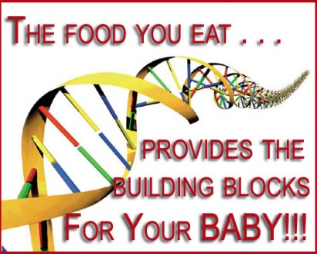
health ➔ from mother to baby
maternal diet, together with placental function, determines the umbilical nutrient composition

Slide 8
Environment - Maternal diet
Maternal diet is one of the main players in this context, as macro and micronutrients are direct regulators of DNA stability and phenotypic adaptation, by influencing the availability of methyl donors and mechanisms promoting DNA stability
Epigenetic modifications
Fetal gene expression
Placental gene expression
Fetal development
NUTRITIONAL PROGRAMMING
Cetin et al., Curr Opin Clin Nutr Metab Care, 2013

Slide 9
OUTLINE
PROGRAMMING in PREGNANCY
NUTRITIONAL PHENOTYPE OF PREGNANCY
PLACENTA and FETAL NUTRITION
IUGR

Slide 10
Nutritional phenotype of pregnancy
Dynamic state: adjustments in nutrient metabolism evolve continuously as the mother switches from an anabolic condition during early pregnancy to a catabolic state during late pregnancy
Three compartments model, i.e, mother/placenta/fetus, each of them has different metabolism - fetal growth regulated by the balance between fetal nutrient demand and maternal-placental nutrient supply
Cetin et al, Hum Reprod Update 2010

Slide 11
Nutrient needs in pregnancy
• Energy (macronutrients) needs increase only slightly during the course of pregnancy. Energy needs during the final months of pregnancy are about 10% higher than before pregnancy
• The needs for certain vitamins and minerals (micronutrients) in pregnancy show a much greater increase
Therefore, pregnant women should pay special attention to the quality of their diet

Slide 12
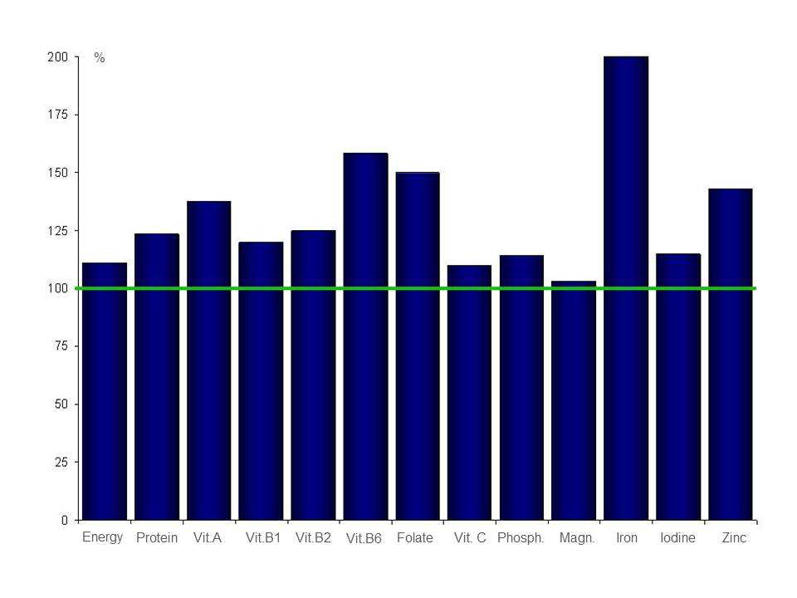
Reference nutrient intakes for pregnant women expressed as percentage of reference intake values non-pregnant women. The recommended intake for several nutrients shows a much greater increase then the recommended energy intake
iron
folate
zinc
Koletzko B et al, Ann Nutr Metab 2013, in press

Slide 13
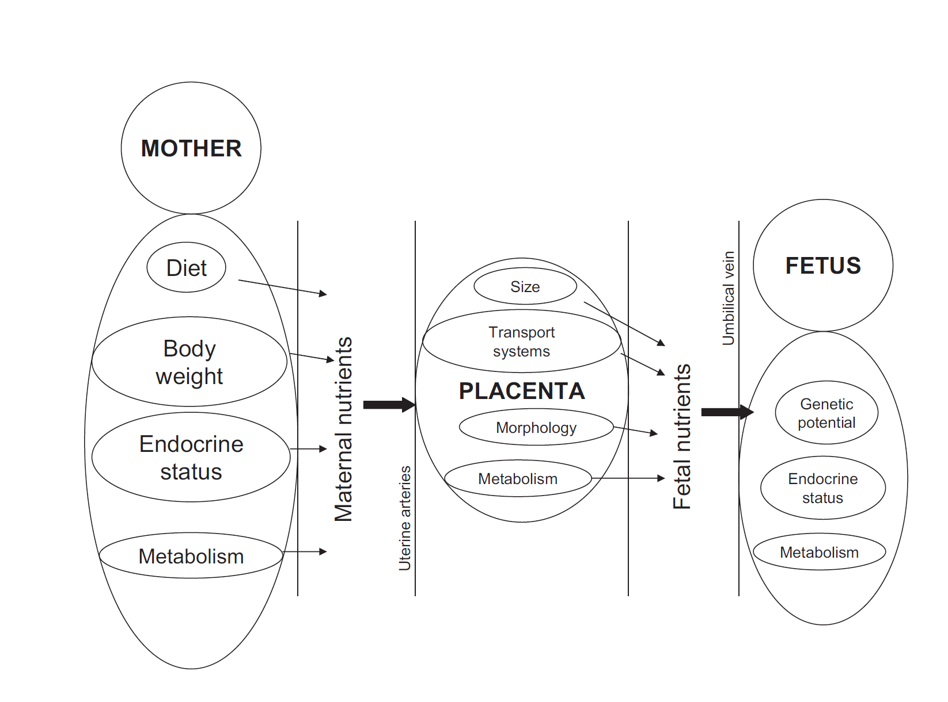
PREGNANCY = three compartment model = mother - placenta - fetus
Cetin & Cardellicchio, 2010

Slide 14
OUTLINE
PROGRAMMING in PREGNANCY
NUTRITIONAL PHENOTYPE OF PREGNANCY
PLACENTA and FETAL NUTRITION
IUGR

Slide 15
Major Determinants of Fetal Nutrition
Maternal nutrition
Maternal metabolism
Placental transport and metabolism
Umbilical Blood Flow
Fetal Blood Sampling
Stable Isotope Tracers
Umbilical uptake
Fetal metabolism
Tissue deposition (growth)
Oxydation (energy)

Slide 16
Fetal and placental weights
weight
gestational age
how does the placenta cope with increased fetal needs?

Slide 17
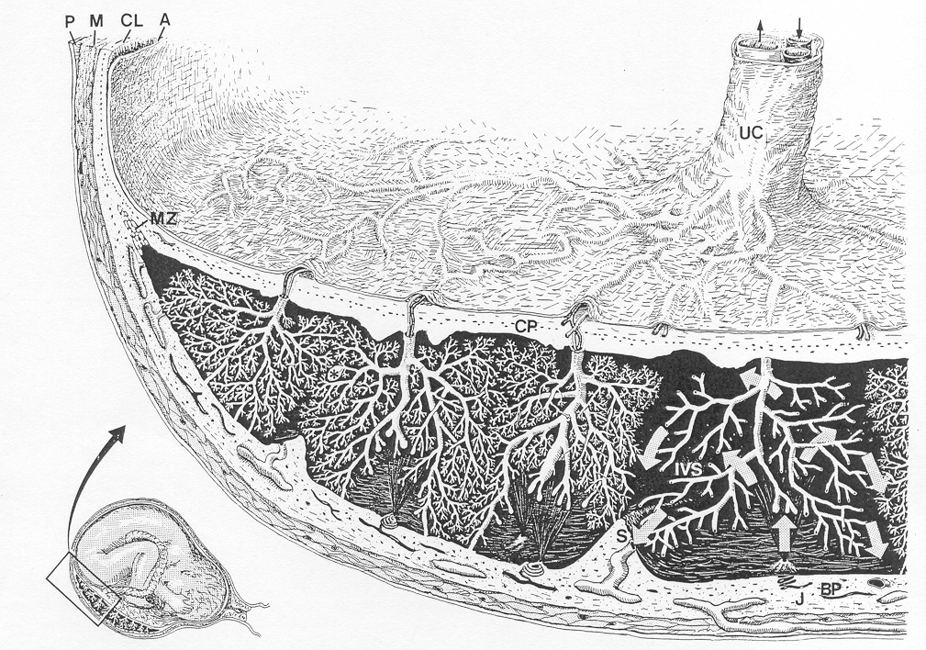
Placental structure

Slide 18
PLACENTAL TRANSPORT
(1)
(2)
GLUCOSE
ALA
(3)
(4)
Na⁺
MICROVILLOUS MEMBRANE
BASAL MEMBRANE
(1) DIFFUSION FLUX DEPENDENT (O₂, CO₂)
(2) PARACELLULAR DIFFUSION
(3) TRANSPORT PROTEINS (glucose, aminoacids, lipids?)
(4) endocytosis/exocytosis (IgG, big proteins…)

Slide 19
MATERNAL
BLOOD
UTERO
PLACENTA
FETAL
BLOOD
Amino acids
serine
glycine
NH3
urea
urea
lactate
CO₂
CO₂
Oxygen
Glucose
Fatty acids

Slide 20
mother
placenta
fetus
"trafficking" of fatty acids
Oxidation
▪ Mitochondria
▪ Peroxisomes
Biological activity
▪ Signal transduction
▪ Gene regulation
▪ Eicosanoid formation
1-3% FA
Albumin
Complex
FABPpm
Diffusion
Dissociation
~~~~~
~~~~~~
~~~~
~~~~
~~~~
~~~~
Free fatty
acid
FATP
FABP
Free fatty
acid
Free fatty
acid
~~~~
~~~~~
~~~~
~~~~
FATP
~~~~
~~~~
Free fatty
acid
FAT/CD36
Lipid
resynthesis
Lipid
hydrolysis
Hydrolysis by Lipases
?
~~~~
FAT/CD36
Diffusion
~~~~~
~~~~
Storage in Lipid
Droplets (perilipins)
Lipid
Droplets
Incorporation in Lipoproteins
97-99% FA
Lipoproteins
Lipoprotein Receptor

Slide 21
Placental transfer and fetal levels of fatty acids (FAs)
Major source of FAs in fetal circulation: free fatty acids
Total amount of FAs: M>F plasma
Fetal fatty acids correlate to maternal levels, but different FA profile in fetal compared with maternal circulation → higher proportions of LC-PUFAs to support central nervous system development: biomagnification
Placental ability to preferentially transfer DHA and then ARA, ALA and LA into fetal blood
Notes:
A different fetal blood FA profile is observed, with proportionally higher amounts of LC-PUFAs in comparisonwith those present in the maternal circulation.

Slide 22
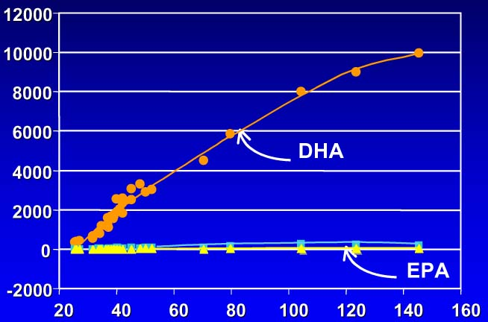
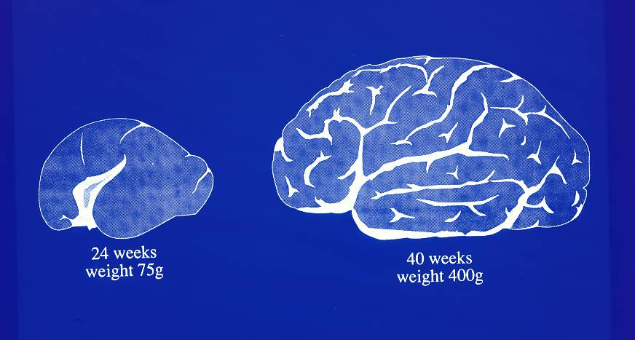
Early DHA deposition in brain
DHA
DPA
EPA
24 weeks,
≈75 g
ω-3 LCPUFA, μmol/forebrain
40 weeks,
≈400 g
Postconceptional Age
Martinez 1992

Slide 23
LC-PUFA: different FA profile in fetal compared with maternal circulation → higher proportions of LC-PUFAs to support CNS development: biomagnification
n-3
***
***
M
F
M
F
α-LN
DHA
***
***
n-6
M
M F
F
F
M F
M
LA
AA
Cetin et al, Pediatr Res, 2002

Slide 24
OUTLINE
PROGRAMMING in PREGNANCY
NUTRITIONAL PHENOTYPE OF PREGNANCY
PLACENTA and FETAL NUTRIENTS
IUGR

Slide 25
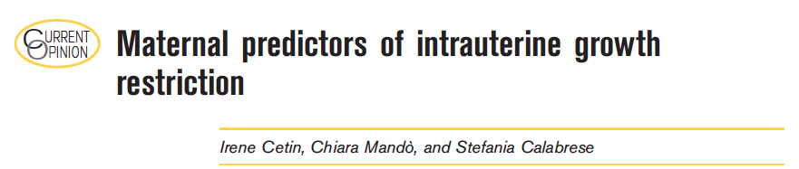
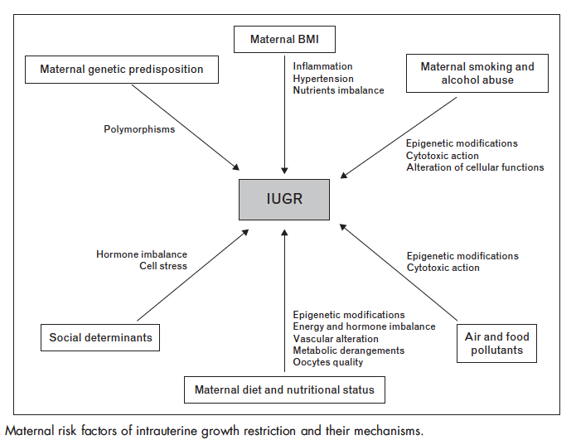
Cetin et al., Curr Opin Clin Nutr Metab Care, 2013

Slide 26
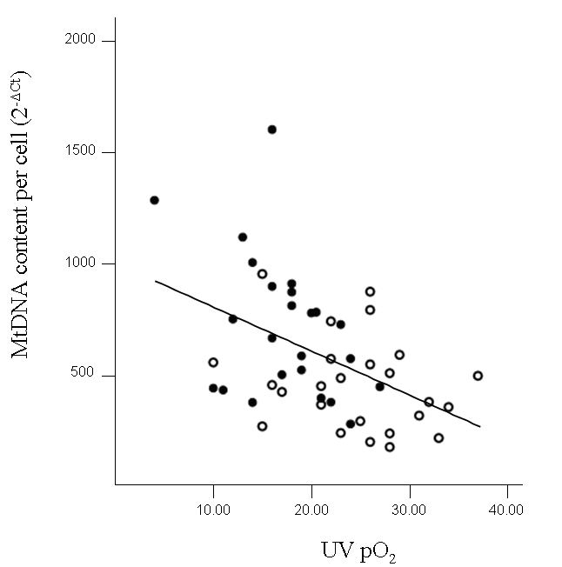
Relationship between placental mitochondrial DNA content and umbilical vein pO₂
o controls
• IUGR
Lattuada D et al, Placenta 2008

Slide 27

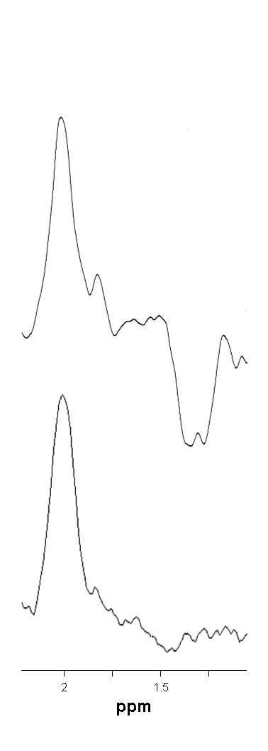
MRS study of the fetal brain
Università degli Studi
di Milano
O₂ cont LAC
at delivery
NAA
LAC
CASE # 5
(IUGR 3)
UV UA UV UA
CASE # 4
(IUGR 2)
Cetin I et al, AJOG 2011
Notes:
OSCAR
Ontogenesi dello Sviluppo del Cervello e delle ARterie nell’uomo: studio in epoca periconcezionale, fetale e neonatale

Slide 28
Analysis of MESENCHYMAL STEM CELLS
isolated from IUGR and CONTROL human placentas
1) EARLIER mesenchymal cell ENRICHMENT after 7 days of culture
both in IUGR fetal membranes and villous parenchyma vs CONTROL
FETAL MEMBRANES
VILLOUS PARENCHYMA
FOLD CHANGE
between controls and IUGR
term controls
4.1
3.1
1.8
1.6
2.2
IUGR
5.3
3.0
2.3
5.8
3.0
105+ 29+ 44+ 73+ 90+
105+ 29+ 44+ 73+ 90+
Mesenchymal markers
Mesenchymal markers
2) HIGHER ADIPOGENIC DIFFERENTIATION
in IUGR mesenchymal stem cells vs both pre-term (34^{w}) and term controls
3) LOWER ENDOTHELIAL DIFFERENTIATION
in IUGR mesenchymal stem cells vs both pre-term (34^{w}) and term controls
Mandò C et al, Stem Cells Research 2016

Slide 29
Timing of insult
Placental phenotype of IUGR changes in relation to severity from adaptation to failure
O2 =
Lactate =
Glucose =
Amino acids ↓
LCPUFA↓
Transferrin receptor ↓
O2 ↓
Lactate ↑
Glucose ↓
Amino acids ↓
LCPUFA↓
Altered
placental mitochondrial respiration
delivery should be carefully planned, also in relation to gestational age
Changes in placental transport systems precede IUGR
➔ intrauterine programming
F

Slide 30

courtesy of David Barker

Slide 31

IRON TRANSFER
ACROSS THE PLACENTA
and
ITS REGULATION
IRP
HFE
?
IRP
McArdle HJ, et al. J Neuroendocrinol. 2008 Apr;20(4):427-31. Review
Bastin J, et al. Br J Haematol. 2006 Sep;134(5):532-43
Gambling L, Lang C, McArdle HJ. Am J Clin Nutr. 2011 May 4
?
HFE
FPN1/
IREG1
?
zyklopen
IRP
?
Notes:
Il ferro nel sangue materno lega la transferrina (2 Fe ogni transferrina); la tranferrina diferrica lega il regettore della tranferrina localizzato sulla membrana microvillare che affaccia sul lato materno, e così viene internalizzato in delle vescicole che nella cellula si acidificano, provocando la dissociazione tra ferro e transferrina. Il ferro esce quindi dall’endosoma tramite DMT1, e sicuramente anche tramite pathway alternativi ancora sconosciuti (è stato dimostrato che topi KO per DMT1 comunque nascono, anche se anemici); i complessi TfR-transferrina vengono riciclati tornando sulla membrana microvillare. Il ferro che ora è nel citoplasma viene trasportato verso la membrana basale, il lato fetale della cellula, attraverso meccanismi non chiari (c’è chi dice via ferritina, ma per esempio invece Bastin non ha trovato ferritina nel trofobl, ma l’ha trovata nello stroma placentare). Comunque probabilmente ci sono dei trasportatori che legano il ferro mantenendolo in forma ridotta (Fe2+) e che lo preservano dall’essere coinvolto in reazioni chimiche nel citoplasma. Il passaggio dal trofoblasto allo stroma placentare avviene attraverso ferroportina (FPN1 o IREG1), che trasporta nello stroma Fe2+, e qui viene ossidato in Fe 3+ da zyklopen, perché solo Fe3+ può legare la ferroportina che trasporta il ferro. Da qui il ferro viene immagazzinato probabilmente legando ferritina, oppure viene trasportato nella circolazione fetale attraverso l’endotelio dei capillari fetali, con meccanismi ancora non chiari.
Tutto questo sistema viene regolato in modo complesso, e in buona parte ancora non chiarito. Sicuramente ci sono le IRP (iron regulatory protein) che in presenza di ferro lo legano e si attivano, andando a stimolare la traduzione della ferritina (che quindi lo sequestra immagazzinandolo) e invece a degradare l’mRNA del TfR1 (quindi tanto ferro = downregolazione TfR1). Anche DMT1 è regolata dalle IRP. Poi c’è l’epcidina, che regola negativamente il trasporto di ferro: sicuramente quella prodotta dal fegato fetale è molto importante, ma probabilmente partecipano anche quella placentare e quella del fegato materno. Ad esempio, si pensa che l’epcidina possa legare la ferroportina e promuoverne la degradazione (impedendo quindi il passaggio di ferro al feto). Questi aspetti della regolazione sono ben spiegati nell’ultimo lavoro di Gambling, fine pag 2 e inizio pag 3.

Slide 32
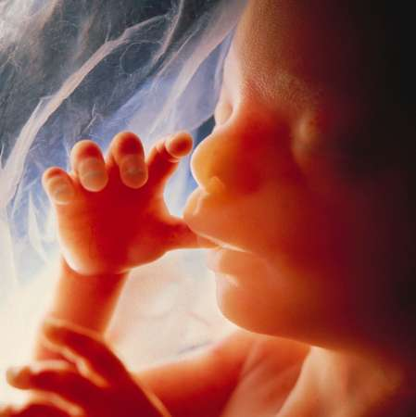
how much iron?
270 mg iron in neonates at birth!

Slide 33
Placental Transferrin Receptor (TfR1) expression
is decreased in IUGR independently of severity
associated with reported lower iron levels in SGA infants
IUGR of different severity are all significantly different from AGA
*p<0.05 vs AGA
2^{-ΔCt}
*p<0.05 vs AGA
Mandò C et al, Placenta 2010

Slide 34
Maternal anemia and adverse pregnancy outcomes
Preeclampsia
↑ Mortality
MATERNAL IDA
MOTHER
Low birth weight (LBW)
Prematurity - IUGR
Reduced iron stores
Metabolic syndrome
Schizofrenia
FETUS
OFFSPRING

Slide 35
Critical factors potentially affecting iron requirements in pregnancy
Maternal micronutrient status and intake (quality of diet, dietary patterns, micronutrient bioavailability)
Timing of micronutrient intake
Maternal age (i.e., poor obstetric outcomes ⬆ in pregnant adolescents)
Pregestational maternal BMI
Socio-economic and cultural background
Short interpregnancy interval
Berti et al, Maternal & Child Nutrition 2010

Slide 36
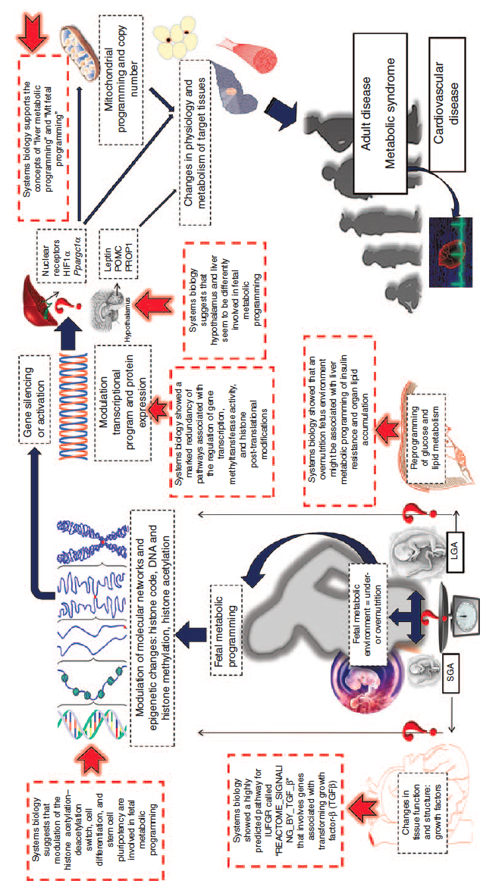
Nutritional Programming
Sookoian et al., Pediatric Resarch, 2013

Slide 37
