Slide 1
Understanding and Reaching the YA Market
Digital Book World 2014
January 14th, 2014

Slide 2
Kristen McLean
Founder & CEO, Bookigee
@BKGKristen
Marianna Ricciuto
Digital Commerce Manager, Harlequin Teen
@MariannaR80
Jean Feiwell
Publisher, Swoon Reads, Macmillan
@SwoonReads
Sean Moss
Digital Marketing Officer, Walker Books
@seanpmoss
Alvina Ling
Executive Editorial Director, LLBYR
@planetalvina

Slide 3
Teens who have not read a book for fun
A disturbing trend!

Slide 4
Teens adoption of eBooks still lags ebook units purchased by age
Notes:
Teens lag behind all other age groups in their take up of ebooks….

Slide 5
eBook Trends: Major Categories (units)
Source: Nielsen Books & Consumers US
Notes:
Turning now to what our Books and Consumers survey says, we see how Children’s books (except YA) have been lagging in terms of ebook penetration

Slide 6
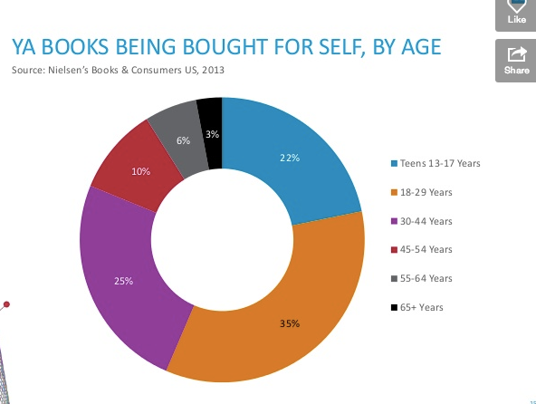

Slide 7
Kristen McLean
Founder & CEO, Bookigee
@BKGKristen
Marianna Ricciuto
Digital Commerce Manager, Harlequin Teen
@MariannaR80
Jean Feiwell
Publisher, Swoon Reads, Macmillan
@SwoonReads
Sean Moss
Digital Marketing Officer, Walker Books
@seanpmoss
Alvina Ling
Executive Editorial Director, LLBYR
@planetalvina

