Slide 1

KACT, WCO Headquarters, Brussels, Belgium, July, 3– 4, 2014
Rules of Origin
Ulrika Lyckman-Alnered
Mette Werdelin Azzam

Slide 2
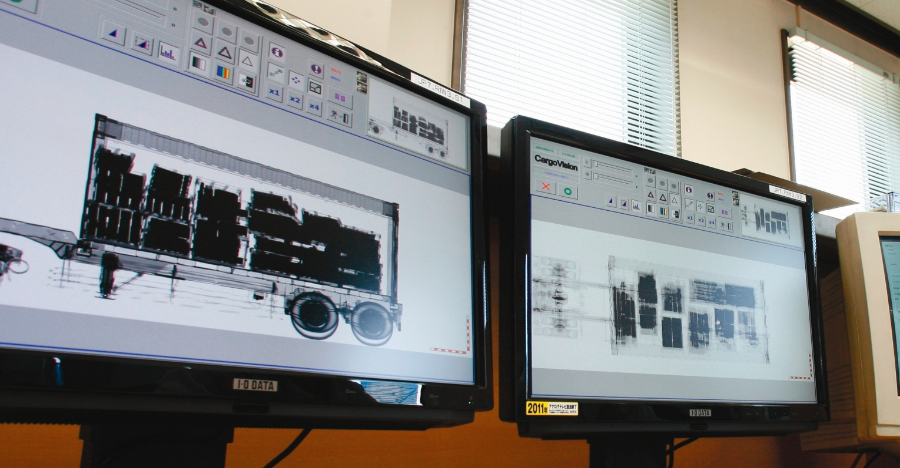
ORIGIN
Demos Group
Brussels, BE

Slide 3

Ground Rules
Be on time
No PCs or mobile phones
Respect
There is no such thing as a stupid question
Support
Team Work
Active participation
Have fun

Slide 4
Introductions
HELLO
What's my name?
Where do I work?
Why am I here?

Slide 5
Master Class in Rules of Origin
Sessions I-VIII
Day 1
I Introduction to the programme and the WCO and the Rules of Origin
II Introduction to the basic concepts of Rules of Origin
III Preferential Rules of Origin – why should they be harmonized?
Day 2
IV Benefits & Risks of preferential Rules of Origin
V Recap on the basic elements of Rules of Origin
VI Group exercise
VII Summary and closing remarks
Notes:
II: LESSON 1: Introduction
LESSON 2: General Introductory Commentary
LESSON 3: Absence of Sell
LESSON 4: Payments
LESSON 5: Questions
LESSON 6: Exercises
LESSON 7: Article 8.1, Compulsory Adjustments
LESSON 8: Article 8.1(a) (ii) & (iii)
III: LESSON 22: Valuation Risk
V: LESSON 9: Assists
LESSON 10: Royalties
LESSON 11: The Proceeds of Resale
LESSON 12: Freight Terms
VI:
LESSON 14: Article 1.2 (b), Test Value
LESSON 15: Exercises
LESSON 16: Alternate Methods
LESSON 17: Article 4
LESSON 18: Computed Value, Materials
LESSON 19: Fallback Method
LESSON 20: Definitions
LESSON 21: Associated Articles
VII

Slide 6
Objectives
By the end of this program, you will be able to understand:
concept of origin
impact of rules of origin on world trade
difference between preferential and non-preferential treatment of goods
technical concepts related to the rules of origin

Slide 7
Background
The origin of goods is referred to in a number of cases in international trade:
Preferential duty treatment; granted when the goods are ‘of origin’;
Import/export statistics are referring to the origin of goods;
The application of trade policy measures requires the determination of the origin:
  anti-dumping;
  monitoring of goods;
  quantitative restrictions; and
  import/export embargo
The incorrect determination of the origin may lead to incorrect duty application, incorrect marking, etc., with consequential delays and interruption of the trade flow.

Slide 8
Outline of the presentation
What are Rules of Origin?
- Non-preferential and preferential rules of origin
- Preferential rules of origin: purpose and problems
Basic Principles – How do we Determine Origin?
- Wholly obtained and substantial transformation
- Textiles and Originating or not?
Cumulation, tolerance and minimum operations
- Bilateral, diagonal and full cumulation
- Strenghts and weaknesses

Slide 9
Rules of origin give the nationality of a product
Why do we have rules of origin?
  Collect statistics
  To apply the correct rate of duty
  To apply certain policy measures
Is knowing the origin important?
  Affects the price of goods
  Know if a good is foreign or domestic
  Can affect the image of a country
2 sets of origin rules – non-preferential and preferential

Slide 10
Rules of origin in Free
Trade Agreements
  define the conditions under which a product is deemed as originating and therefore suitable for preferential treatment
  prevent deflection of trade and transhipment in an effort to (falsely) obtain origin and therefore preferential treatment

Slide 11
Why do we need to understand preferential rules of origin?
    RoO can be used as a development policy tool
  Traders?
    RoO need to be complied with in order to utilize trade preferences
    RoO affects the ability to source inputs
    RoO requires certain administrative steps – such as acquiring an origin certificate
  Customs officials?
    RoO discriminate between goods
    RoO determine your country’s revenue from tariffs
    RoO’s administrative requirements can distort trade
  Trade officials/negotiators?
    Defining a good’s nationality increasingly difficult with globalization
    RoO influence trade flows
    RoO can be used as a development policy tool

Slide 12
Outline of the presentation
What are Rules of Origin?
- Non-preferential and preferential rules of origin
- Preferential rules of origin: purpose and problems
Basic Principles – How do we Determine Origin?
- Wholly obtained and substantial transformation
- Textiles and Originating or not?
Cumulation, tolerance and minimum operations
- Bilateral, diagonal and full cumulation
- Strenghts and weaknesses

Slide 13

Definition
Rules that determine the “economic” nationality of goods in international trade.
This is done by dictating the sufficient level of processing that must take place in a given exporting country in order for the product to be considered as having its origin in that country.

Slide 14
There are two kinds of
Rules of Origin...
Rules of Origin
1. Non-Preferential
2. Preferential
- The focus of this training

Slide 15
Non-preferential rules of origin
Used for determining economic nationality of products subject to commercial policy measures
  anti-dumping
  tariff quotas
For statistical purposes
For government procurement
For application of ”Made in”-labelling in some countries
Notes:
Wholly obtainable and substantial transformation still applies, but here not part of a FTA

Slide 16
Preferential rules of origin
  Determine the nationality of a product subject to preferential tariff rates within an FTA/PTA
  “Except as otherwise provided in this Agreement, each Party shall eliminate its customs duties on originating goods of the other Party”
  Each FTA/PTA has their own sets of rules of origin
Notes:
The need for the RoO are clearly defined by this line from a trade agreement (dont know which one, but standard)
Every FTA has their own specific way of determining origin

Slide 17
Purpose of preferential RoO: to prevent trade deflection
Country B
Trade deflection
Free trade agreement/
Preferential access
Tariff=10%
Rest of
the world
Country C
Tariff=0%
Country A
Tariff=20%
Tariff=20%
Rest of
the world
Rest of
the world
Notes:
This is the core, the main purpose of why RoO exist
Preferential origin rules exist in order to prevent third country (C which has a 10 % tariff agreement with B) imports from taking advantage of the concessions which have been made by the parties (A and B) to the preferential agreement. There has to be rules that define what a B-country good is and an A-country good is, otherwise the FTA will be worthless.
In a FTA individual members can have different tariff rates towards third country, this problem should not arise to the same extent in a customs union where a common external tariff exist

Slide 18
What are the problems of
rules of origin?
  Two apparent problems…
    ”The spaghetti bowl” of overlapping FTAs
    Restrictive rules of origin distort trade

Slide 19
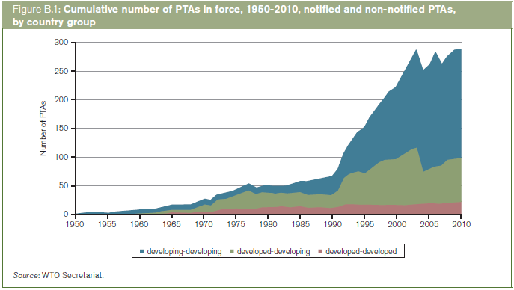
The number of trade agreements has increased rapidly
Notes:
This graph is from WTO and shows how the number of trade agreements have sky rocketed the last 20 years
The most agreements are disclosed between developing/low income parties (the blue patch in the diagramme)
What does this lead to??

Slide 20
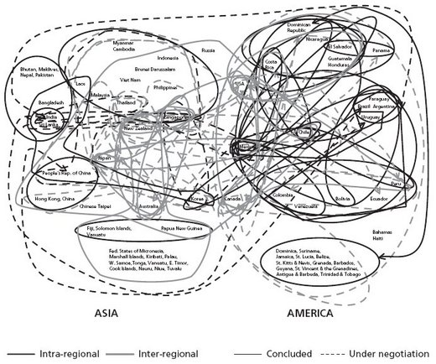
Notes:
- This is one example of the spaghetti bowl focusing on Asia and America and the respective trade agreements in these two regions.

Slide 21
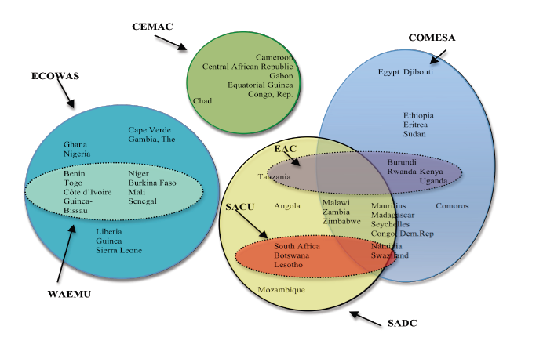
Notes:
- Heres another example from Africa and this is just african parties, add the agreements with other parts of the world and it will get messy. Not to forget the Tripartite negotiations as well..

Slide 22
How can RoO distort trade?
Sourcing from third countries fundamental in a fragmented world economy
Look at the economics: RoO are seen by exporters as a cost
    Production-related costs
    Administrative costs
      These costs have to be balanced against the benefit of fulfilling the RoO – which is tariff preference
      Strict RoO often leads to lower utilization of trade preferences
      The purpose of rules of origin – to prevent trade deflection – has to be balanced against this fact
Notes:
Fragmented world economy - companies use inputs from all over the world, production taking place all over the world and companies operate all over the world
Global value chains makes sourcing inputs from different parties necessary
Production costs: for example choosing a more expensive production input in order to comply with RoO
Administrative costs: an exporter trying to comply with different sets of RoO in order to export to different countries

Slide 23
Outline of the presentation
What are Rules of Origin?
- Non-preferential and preferential rules of origin
- Preferential rules of origin: purpose and problems
Basic Principles – How do we Determine Origin?
- Wholly obtained and substantial transformation
- Textiles and Originating or not?
Cumulation, tolerance and minimum operations
- Bilateral, diagonal and full cumulation
- Strenghts and weaknesses

Slide 24
How to determine origin?
…two main categories
Wholly obtained
  from the ground
  from the sea
  animals
Substantially transformed – 3 main methods:
  Change of tariff heading
  Value added rule
  Special Technical Requirement
(sometimes used in combination)
Notes:
Examples and further descritption will follow

Slide 25
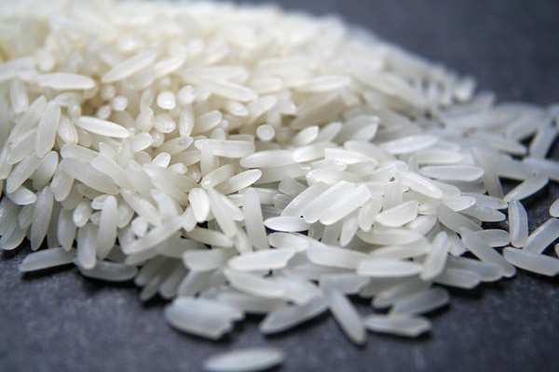
Wholly obtained – e.g EU’s
EPA Market Access
Regulation (MAR)
Source: Fotoakuten.se
1006, Rice: ” Manufacture in which all the materials of Chapter 10 used are wholly obtained”

Slide 26
Change of tariff heading
The product obtained must be classified in a heading (4-, 6
or 8-digit level) of the Harmonised System (HS)
which is different from the headings in which the non
originating materials used in its manufacture are classified.
- chapter level (2-digit)
- heading level (4-digit) – most commonly applied
- sub-heading level (6-digit)
- item level (8 or 10-digit)
Notes:
- These rules can differ in terms of strictness as well. A CTH that requires a change on a 2-digit level is harder to comply with than a 4-digit level change

Slide 27

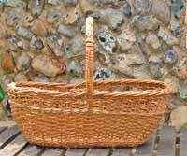
Change of tariff heading –
e.g. from EU’s MAR
Heading 1401
Heading 4602
The manufacture of a straw basket, classified under heading 4602 of the HS.
The rule for the whole of Chapter 46 is "manufacture in which all the materials used are classified within a heading other than that of the product". As the basket is classified under 4602, while the straw material was imported under 1401, the origin criterion is clearly satisfied.

Slide 28
Value added rule
The value of non-originating materials used should not exceed a given percentage of the ex-works price of a product
The value of the local content should not be lower than a given percentage of the ex-works price of a product
    Ex-works price : price paid for the final product when it leaves the last manufacturer minus any internal taxes which are repaid when the product obtained is exported (profits incl) – used e.g. by the EU
Notes:
Ex-works price is the method the EU uses in their agreements
Perhaps the easisest to apply in practise out of the three origin methods
Negatives: incurs a high administrative burden due to necessity of calculating the various cost components
Negatives: fluctuating exchange rates can alter the scene completely, a product that has origin one year can due to volatile exchange rates not have it the next year

Slide 29
Special Technical
Requirement
Prescribes for each product or product group, certain manufacturing or processing operations…
that have to be carried out on any non-originating materials in order for the product to confer origin (positive test), or
operations that do not confer origin (negative test).
In EU RoO, and many others, these requirements are compiled into a list sorted by HS chapter.
Notes:
Common in the EU RoO
Negative test example: list of insufficient operations
A product specific example on the next slide

Slide 30
Special technical requirement – e.g.EU´s MAR
Articles of Apparel
Chapter 62 of the HS, for which (most
headings) the rule is "manufacture from
fabric".
This means that you can import fabric. Sewing and possible other subsequent manufacturing stages must be carried out in the beneficiary country in order to obtain origin.
The so called ”single transformation rule”

Slide 31
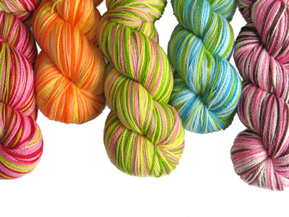
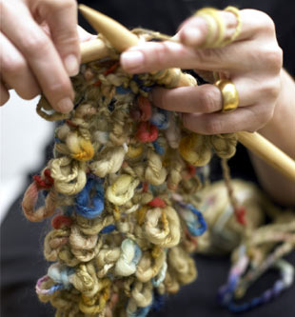
… to be compared with the previous and stricter Cotonou rules
In Cotonou, the rule for the same chapter (62) was "manufacture from
yarn"
Weaving and sewing, plus all
subsequent manufacturing stages
must be carried out in the
beneficiary country in order to
obtain origin.
The so called ”double transformation
rule”

Slide 32


Originating or not?
An electric hair curling iron (subheading 8516.32) made in EU from Japanese parts (8516.90).
Net cost: 3,65
Non-originating inputs: 1,20
Profit: 0,50
Manufacturing costs: 2,45
Transport: 0,25
Ex-works price: 4,15
FOB price: 4,40

Slide 33
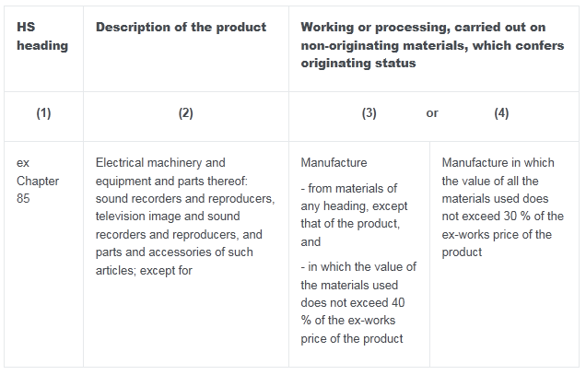
Originating or not?.....
List rule for hair curling iron (8516.32):

Slide 34
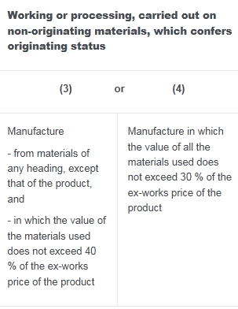
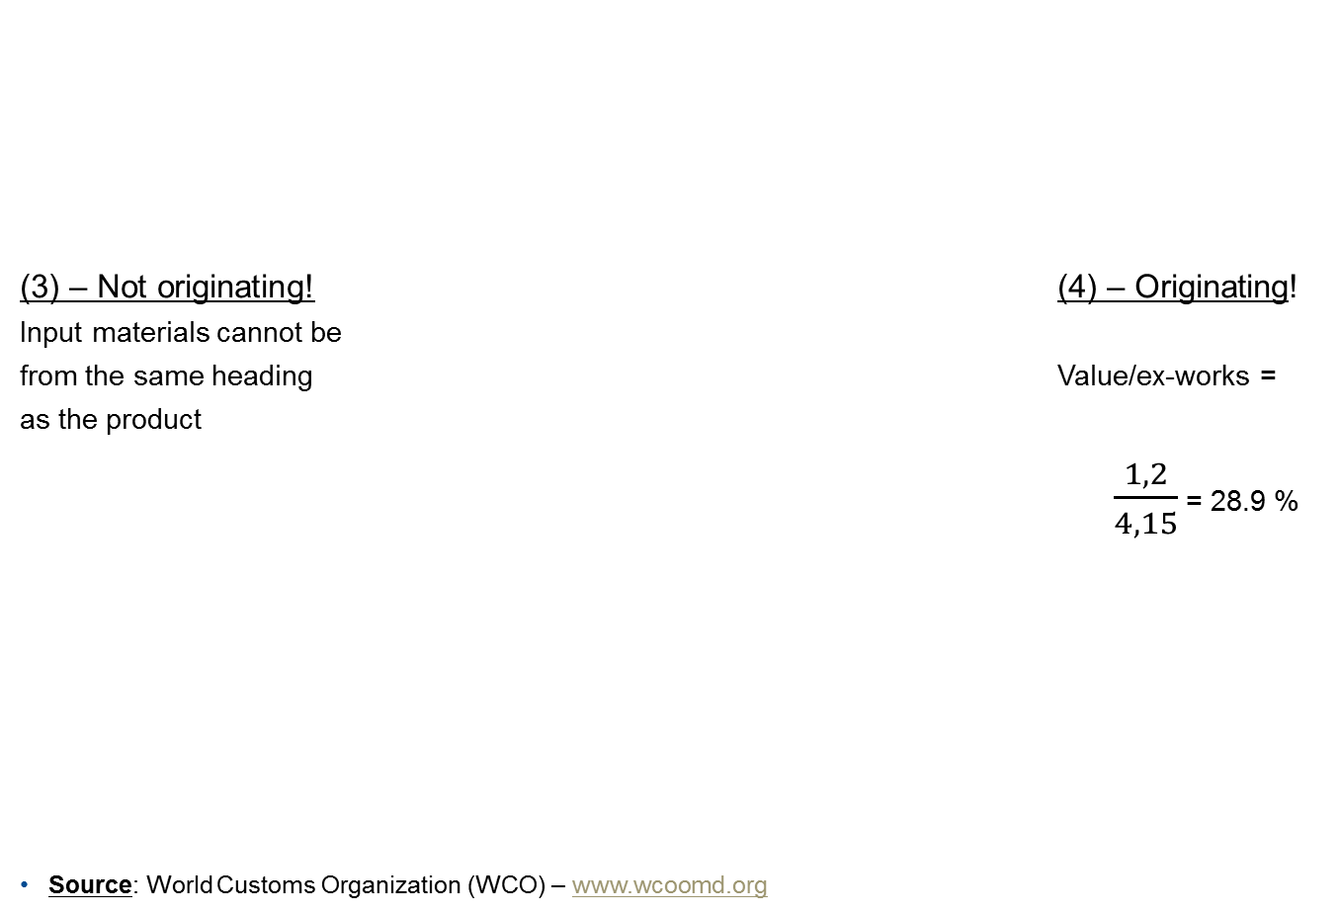
Originating or not?
(3) – Not originating! (4) – Originating!
Input materials cannot be
from the same heading Value/ex-works =
as the product
= 28.9 %
Source: World Customs Organization (WCO) – www.wcoomd.org

Slide 35
Outline of the presentation
What are Rules of Origin?
- Non-preferential and preferential rules of origin
- Preferential rules of origin: purpose and problems
Basic Principles – How do we Determine Origin?
- Wholly obtained and substantial transformation
- Textiles and Originating or not?
Cumulation, tolerance and minimum operations
- Bilateral, diagonal and full cumulation
- Strenghts and weaknesses

Slide 36
Definitions of the concept of originating products
Tolerance rule or de-minimis rule
Permits manufacturers to use non-originating materials up to a specific percentage value of the ex-works price
- Normally 10 % in EU FTAs, 15 % in the reformed GSP
Insufficient working or processing / minimal operations
Operations that are regarded as being only a minor processing operation and thus cannot count towards origin
- In EU agreements theses operations are complied into a list, examples of common minimal operations are slaughter, simple assembly and mixing
Notes:
Two general rules which apply to all products regardless of group and whats specified in the list
Some areas are often excluded from the general tolerance rule, for example textiles

Slide 37
Tolerance rule continued…
Strengths and weaknesses
The tolerance rule can lessen the burden of RoO for products with non-originating inputs,
Can be used as ‘hidden protection’ for example, among textiles and clothing, the sector specific tolerance rules are often different and less favorable than the general tolerance rules.

Slide 38
Cumulation
  Refers to the degree to which inputs from several preferential trading partners are allowed to jointly count towards satisfying the rules of origin – i.e. that transformations can be cumulated
  allows for relaxation and flexibility when product specific rules are strict
Notes:
In other words: countries are allowed to cumulate inputs from other approved parties, without risking the origin of the product
A lot of the latest research on RoO mentions the role of cumulation and how it can be an effective way to liberalise the RoO

Slide 39
…there are different types of cumulation
Bilateral cumulation
  The basic form of cumulation, operates between two countries in a PTA
  Permits them to use originating products
  from the partner country as if they were their
  own products
  Example: Shirts (HS 6205) - If the rule requires “Manufacture from yarn”, originating fabrics can be imported from Country A and used in the production of shirts in Country B and qualify for preferential access to Country A.
Country A
Fabrics
Country B
Shirt

Slide 40
…there are different types of cumulation
Diagonal/Regional cumulation
  Between three or more countries with interlinked trading agreements, provided that the agreements have identical RoO
  Countries tied by the same set of
  preferential origin rules can use products
  that originate in any part of the area as if
  they originated in the exporting
  country
Country A
Shirt
Country B
Country C
Fabrics
Notes:
- For example in the GSP there are several regional groups which are allowed for cumulation under certain circumstances. Also Norway, Switzerland and Turkey are allowed.

Slide 41
…there are different types of cumulation
Full cumulation
  All operations carried out in the participating countries are taken into account
  Goods do not need to be originating before
  being exported from one party to another
  for further working or processing
  A piece of clothing made in Swaziland
  from fabric made in Botswana (which in
  turn was made from non-originating yarn
  from Namibia) would qualify for preferential
  access to the EU under full cumulation
Country A
Shirt
Country B
Country C
Non-originating fabrics
Notes:
The most liberal alternative

Slide 42
…there are different types of cumulation
  Strengths and weaknesses
Bilateral cumulation: most restrictive and unfortunately the most common in EU and US FTAs. Creates the strongest incentives to add value within the free trade zone.
Diagonal cumulation: less restrictive, but can still be very costly for traders since inputs used have to be already originating
Full cumulation: is the most liberal of the cumulation alternatives because it allows for a more fragmented production processes. This in turn fits well with the global economic climate today and could stimulate increased economic linkages. It is also the least costly alternative if inputs can be sourced within the FTA.
Full cumulation puts a strain on the administrative systems, a sophisticated system is needed to track back on the different production processes. Administrative cooperation needed between the countries in the FTA.
Notes:
Nämna att full kumulation kommer att gälla i CETA – eller är det känslig info?
Exemplet med Paraguay och deras regionala kumulation när länder ”tar examen” från GSP
EU löser problematiken med delad bearbetning genom suppliers declarations där origin relevant information medföljer försändelsen

Slide 43
The Registered Exporter
System - REX
REX is a system of self-certification of origin that will enable exporters to make out statements of origin themselves.
  It will replace the origin certification made by the authorities. In order to make statements of origin, exporters will be required to undergo a registration process with the competent governmental authorities and similarly, EU exporters should be registered with the customs authorities in the relevant member state.
  The REX system will be operational from 2017, but beneficiary countries which are not in a position to implement REX on the 1 January 2017 will be able to continue to certify origin by issuing Form A certificates until 1 January 2020.

Slide 44
Origin
Ulrika Lyckman-Alnered
Thank you

Slide 45
Free Trade Agreements
Worldwide more than 200 FTAs
A country can belong to several different FTAs.
Each FTA can have different rules of origin
Economic operators must correctly apply different sets of rules for their products

Slide 50
Origin conferring operations
Module 4: WCO – preferential rules of origin
Wholly obtained products
Sufficiently worked or processed products:
  Change in tariff classification (CTH, CTSH, etc.)
  Value added rules

Slide 51
General rules
Module 4: WCO – preferential rules of origin
Insufficient working or processing
De minimis or tolerance rules
Cumulation
Direct transport rule
No drawback rule
Neutral elements

Slide 52
Costs and advantages for business
Module 4: WCO – preferential rules of origin
Costs:
  Issuance fee in some countries
  Internal costs (administration, staff, internal and external audits)
  Longer processing times in some countries
Advantages:
  Preferential treatment (lower duty rates)

Slide 53
Module 5
Origin modalities
Wholly obtained products
When two or more countries are involved
Change of tariff heading
Insufficient working
Added value
Minimal operations – not conferring origin
De minimis or tolerance rule
Cumulation
Direct transport rule
No drawback
Neutral elements

Slide 54
Module 5
Origin modalities
Wholly obtained products (1)
Mineral products extracted within the country
Vegetable products harvested in the country
Live animals born and raised in the country
Products derived from live animals raised in the country
Products of hunting or fishing in the country

Slide 55
Module 5
Origin modalities
Wholly obtained products (2)
Products of sea-fishing and other products taken from the sea outside a country’s territorial sea by vessels registered or recorded in the country concerned and flying the flag of that country
Goods obtained or produced on board factory ships from the products above provided that such factory ships are registered or recorded in that country and fly its flag
Products taken from the seabed or subsoil beneath the seabed outside the territorial sea provided that that country has exclusive rights to exploit that seabed or subsoil

Slide 56
Module 5
Origin modalities
Wholly obtained products (3)
Waste and scrap products obtained from manufacturing operations and used articles, if they were collected in that country and are fit only for the recovery of raw materials
Goods which are produced in a country exclusively from the goods described before

Slide 57
Module 5
Origin modalities
When two or more countries are involved
Country of origin is the country where a product underwent the last, substantial processing or working;
This processing or working should be economically justified; and
Should result in the manufacture of a new product or representing an important stage of manufacture
In many cases ‘change of tariff heading’

Slide 58
Module 5
Origin modalities
Change of tariff heading
What is ‘change of tariff heading’ (CTH)?
The product is classified in a four digit HS heading that differs from the heading where the material is classified.
Example:
Tableware of polyester (HS heading 39.24)
Obtained from polyester presented in primary form (granules) (HS heading 39.07)

Slide 59
Module 5
Origin modalities
Change of tariff heading
In some cases: change of tariff subheading (CTSH)
Product obtained classified in the same HS heading as the imported product, but in different HS subheadings;
Specific provision describing the product obtained
Example:
Sanitary towels of wadding (HS subheading 5601.10 (HS 2007))
Produced from cotton wadding (HS subheading 5601.21 (HS 2007))

Slide 60
Module 5
Origin modalities
Change of tariff heading – Insufficient (1)
‘Double’ CTH required in some cases
Imported material (HS heading # 1) should undergo process or working resulting in intermediate product
Intermediate product classified in HS heading # 2
Final product is obtained from intermediate product and classified in HS heading # 3

Slide 61
Module 5
Origin modalities
Change of tariff heading – Insufficient (2)
Example A:
Woven fabric (HS heading 52.10) from
Cotton yarn (HS heading 52.05) spun from
Imported carded cotton (HS heading 52.03)
Example B:
Rule:
  Article of apparel of synthetic textile material (staple fibres) (Chapter 62)
  Manufacture from yarn of heading 55.09
Need intermediate product: woven fabric of heading 55.12

Slide 62
Module 5
Origin modalities
Added value (1)
Non-originating material can be used to a certain percentage
The percentage refers to the ex-works price of the product
Could be combined with CTH

Slide 63
Module 5
Origin modalities
Added value (2)
Example:
Heading 84.23 (Weighing machinery (excluding balances of a sensitivity of 5 cg or better), including weight operated counting or checking machines; weighing machine weights of all kinds)
Rule:
Manufacture in which the value of all the materials used does not exceed 25 % of the ex-works price of the product

Slide 64
Module 5
Origin modalities
Minimal operations – not conferring origin (1)
Operations to ensure the preservation of goods in good condition during transport and storage (ventilation, spreading out, drying, removal of damaged parts and like operations)
Simple operations consisting of removal of dust, sifting or screening, sorting, classifying, matching (including the making-up of sets of articles), washing, cutting up
Changes of packing and breaking-up and assembly of consignments

Slide 65
Module 5
Origin modalities
Minimal operations – not conferring origin (2)
Simple placing in bags, cases, boxes, fixing on cards or boards, etc., and all other simple packing operations
The affixing of marks, labels or other like distinguishing signs on products or their packaging
Simple assembly of parts of products to constitute a complete product
A combination of two or more operations specified above
Slaughter of animals

Slide 66
Module 5
Origin modalities
De minimis or tolerance rule
Example
Non-originating materials shall be disregarded in determining the country of origin of the goods if:
(a) In the case of goods classified under any other chapter of the Harmonized System other than under any of Chapters 1 to 4, 6 to 8, 11, 12, 15, 17 and 20 the value of the non-originating materials is not more than 7% of the transactional value of the good, or 10% of the volume of the total alcoholic strength of the goods classified under Chapter 22; and
(b) in the case of goods classified under Chapters 50 to 63, the combined weight of the non-originating materials does not exceed 7% of the total weight of the goods

Slide 67
Module 5
Origin modalities
Cumulation (1)
Bilateral cumulation
Agreement between country [A] and country [B]
Materials originating in country [ A] shall be considered as materials originating in country [B] when incorporated into a product obtained in country [B]
No need for such materials to have undergone sufficient working or processing

Slide 68
Module 5
Origin modalities
Cumulation (2)
Diagonal cumulation

Slide 69
Module 5
Origin modalities
Direct transport rule
Goods should be transported directly between the countries involved in the agreement
Exceptions when the territory of another country is used:
  One single consignment
  Trans shipment or warehousing
  Under Customs surveillance
  Proof needed

Slide 70
Module 5
Origin modalities
No drawback
When non-originating materials are used in the manufacturing:
No drawback of Customs duties
No exemption of Customs duties
Also applies to:
Packaging
Accessories
Products in sets

Slide 71
Module 5
Origin modalities
Neutral elements
In order to determine whether a product originates, no need to determine the origin of the following which might be used in its manufacture:
Energy and fuel
Plant and equipment
Machines and tools
Goods which do not enter and which are not intended to enter into the final composition of the product

Slide 72
Origin of a product
Module 4: WCO – preferential rules of origin
Importer requests preferential treatment (no obligation)
  Is the product originating according to the FTA?
Necessity to attribute a country of origin (non-preferential origin)
  Where is the product originating?

Slide 73
Scope
Module 4: WCO – preferential rules of origin
Benefit from tariff preferences beyond the MFN treatment
Reduced or zero customs duties for internationally traded goods fulfilling the rules of origin contained in preferential trade arrangement
Duty reductions which are not equally granted to all other WTO members according to the MFN clause

Slide 74
Scope
Module 4: WCO – preferential rules of origin
Apply to goods covered by the respective preferential agreement
Exceptions are possible

Slide 75
Definition
Module 4: WCO – preferential rules of origin
ANNEX II of the WTO Agreement on Rules of Origin
Common Declaration with regard to preferential rules of origin
„Those laws, regulations and administrative determinations of general application applied by any Member to determine whether goods qualify for preferential treatment under contractual or autonomous trade regimes leading to granting of tariff preferences“

Slide 76
Module 2: WCO – a brief introduction
  Achieving WCO objectives:
  Promoting international instruments
  Harmonizing Customs systems and procedures
  Assisting Members to apply their legislation
  Ensuring co-operation between Members and international organizations
  Developing human resources
  Improving working methods of administrations

Slide 77
What is new and what is next?
REX
CETA and ASEAN FTAs
EU-US FTA

Slide 78
CETA and ASEAN FTAs
EU-Canada FTA (CETA)
  Clash of two RoO regimes, the EU and NAFTA
  Tough negotiations that are expected to be finalised soon, interesting to see the effects in the long run
  The ASEAN FTAs
    EU currently negotiating bilaterally with ASEAN-members with the goal of establishing an ASEAN-wide trading agreement
    A way to counter the Trans-Pacific Partnership

Slide 79

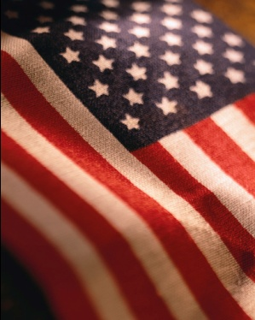
EU-US FTA
The major trade related ”happening” in the EU at the moment, National Board of Trade working extensively on the issue already
Transatlantic trade worth an estimated 500 billion euros every year, one third of world total trade
Talks to begin before the end of the year
EU and USA two integrated economies, tariffs average 3 % so Non-Tariff Barriers (NTB) expected to be key in the negotiations

Slide 80
Module 2: WCO – a brief introduction
  Achieving WCO objectives:
  Promoting international instruments
  Harmonizing Customs systems and procedures
  Assisting Members to apply their legislation
  Ensuring co-operation between Members and international organizations
  Developing human resources
  Improving working methods of administrations

Slide 81
Module 2: WCO – a brief introduction
  WCO structure
  The Customs Co-operation Council is the highest body
  Meets once a year - Directors General from all Member administrations
  The Council is assisted by a Policy Commission and a Finance Committee

Slide 82
Module 2: WCO – a brief introduction
  Guiding principles:
  Co-operation and consensus
  Bridges interests of nations at different levels of economic development
  One Member = One vote

Slide 83
Module 2: WCO – a brief introduction
  Who actually carries out the work of the WCO?
The WCO works mainly through a number of Technical Committees
These, along with the Council, Policy Commission and Finance Committee, are supported by the WCO Secretariat
The Secretariat implements the Council’s instructions

Slide 84
Module 2: WCO – a brief introduction
International forum:
Technical Committees:
  Harmonized System Committee
  Permanent Technical Committee
  Technical Committee on Rules of Origin
  Technical Committee on Customs Valuation
  Various Sub-Committees
Secretariat

Slide 85
Module 2: WCO – a brief introduction
Developed number of international Customs instruments:
  Harmonized System Convention
  Revised Kyoto Convention
Administration or development of other international agreements:
  WTO agreement on Customs valuation
  Harmonized Non-Preferential Rules of Origin

Slide 86
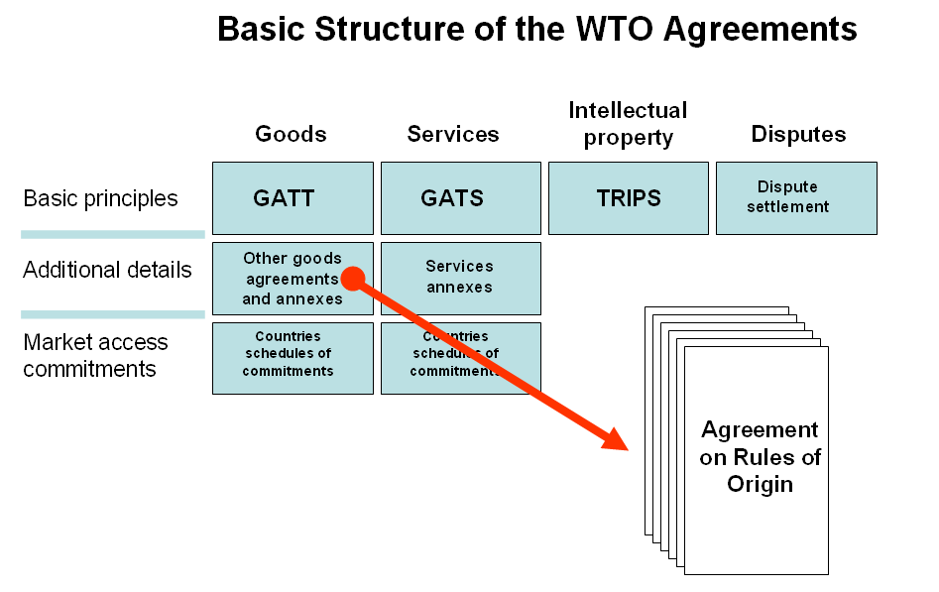

Module 3: WCO – non-preferential rules of origin
Notes:
86

Slide 87
Marrakesh Agreement Establishing the World Trade Organization (WTO)
Module 3: WCO – non-preferential rules of origin
Body part: Preamble, Article I - Article XVI
  Annex 1A: Multilateral Agreements on Trade
  in Goods
    Agreement on Rules of Origin
    Agreement on Customs Valuation
    Agreement on Pre-shipment Inspection

Slide 88
Agreement on Rules of Origin
Module 3: WCO – non-preferential rules of origin
Preamble
Part I - Definitions and Coverage
Part II - Disciplines of Application of
Rules of Origin
Part III - Notification, Review,
Consultations, Disputes
Part IV - Harmonization of Rules of Origin
Annex I - Technical Committee
Annex II - Common Declaration on Preferential Rules
[Annex III - Harmonized Non-Preferential Rules of Origin ]

Slide 89
[Annex III – Harmonized Non-Preferential Rules of Origin]
Module 3: WCO – non-preferential rules of origin
Definitions
General Rule 1 Harmonized System
General Rule 2 Determination of Origin
General Rule 3 Neutral Elements
General Rule 4 Packing and Packaging Materials and Containers
General Rule 5 Accessories and Spare Parts and Tools
General Rule 6 Minimal operations and processes

Slide 90
Appendixes to the Annex III of the Agreement
Module 3: WCO – non-preferential rules of origin
Appendix 1 Wholly obtained goods
Appendix 2 Product specific rules of origin

Slide 91
Examples of the proposed rules and subdivisions of the HS
Module 3: WCO – non-preferential rules of origin

Slide 92
State Of Play Of The Harmonization Work Program Of The Non Preferential Rules Of Origin
Module 3: WCO – non-preferential rules of origin
Started July 1995, planned to be completed within 3 years
The TCRO completed the technical examination in May 1999 (486 open issues sent to CRO)
In July 2002, 93 cores issues were sent to the General Council of the WTO
So far, 349 out of 486 issues (72 %) were approved by the CRO (137 issues to resolve) (January 2012)

Slide 93
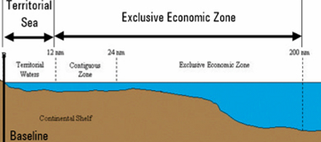
Controversial core issues and implication issues
Module 3: WCO – non-preferential rules of origin
Fishing in the Exclusive Economic Zone (EEZ)
Value added rules

Slide 94
Controversial core issues and implication issues
Module 3: WCO – non-preferential rules of origin
Slaughtering
Blending of wine or alcohol
Milk powder
Coffee roasting
Production of wine and fruit juices
Ottawa language
Dyeing or printing of yarn and fabrics
Refining of oil
Assembly of machines, vehicles and watches

Slide 95
Controversial core issues and implication issues
Module 3: WCO – non-preferential rules of origin
The General Council
  asked the CRO to resolve as much as possible within the technical issues
  decided to study the question of implications of the WTO Agreement on Rules of Origin on the other WTO Agreements
Implication issues linked to outcome of Doha round

Slide 96
IMPLICATIONS FOR ANTI-DUMPING MEASURES
Module 3: WCO – non-preferential rules of origin
Anti-dumping measure for goods coming from an exporting country different than the country of origin
Investigation in the country where the dumping was done (country of exportation)

Slide 97
IMPLICATIONS FOR LABELING
Module 3: WCO – non-preferential rules of origin
Origin marking requirements under Article IX of GATT 1994
trade names which misrepresent the true origin
regulation for origin marking
voluntary marking requirements

Slide 98
IMPLICATIONS FOR SAFEGUARDS
Module 3: WCO – non-preferential rules of origin
Article 5 of the Regulation of Safeguard Measures uses the concept of “supplying country” and not the term “country of origin”

Slide 99
IMPLICATIONS FOR SANITARY AND PHYTO-SANITARY MEASURES
Module 3: WCO – non-preferential rules of origin
No reference to Sanitary and Phyto-Sanitary measures
Sanitary and Phyto-Sanitary Agreement speaks about country of origin, part of country, multiple countries.

Slide 100
CONSOLIDATED TEXT OF NON-PREFERENTIAL RULES OF ORIGIN
Module 3: WCO – non-preferential rules of origin
WTO DOC. G/RO/W/111/REV. 6 (11 November 2010)
Outcome of the work done under the Harmonization Work Programme
Product specific rules in square brackets have not yet been adopted
General Rules, definition 2 of Appendix 1, and rules of Appendix 2 as well as product specific rules of HS Chapters 84 - 90 have not yet been endorsed

